Slide 1
Fixed Capital Charge
1
Consultation Paper Webinar
15 December 2025

Slide 2
Acknowledgement of Country
The Department of Energy and Economic Diversification acknowledges the traditional custodians throughout Western Australia and their continuing connection to the land, waters and community. We pay our respects to all members of the Aboriginal communities and their cultures, and to Elders both past a present.

Slide 3
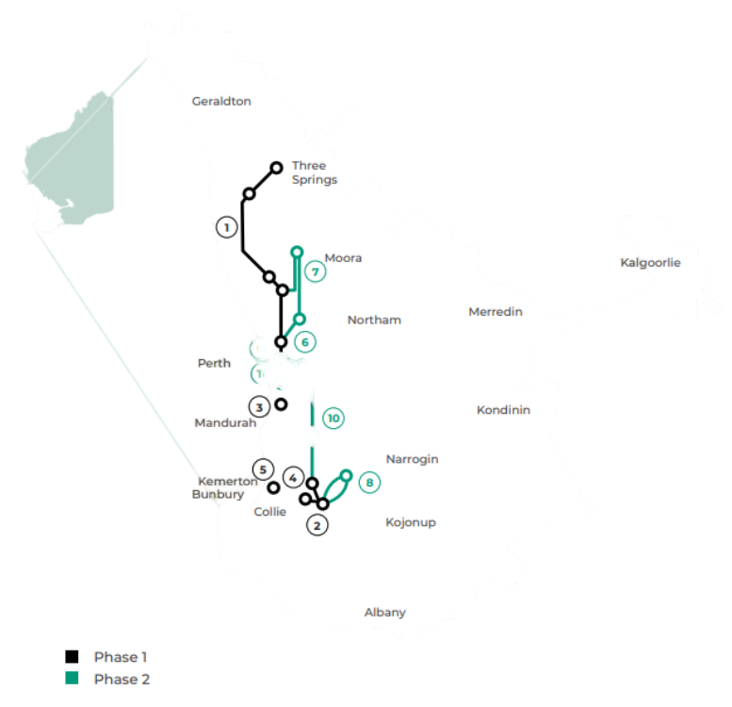
3
Significant Transmission Expansion
Major SWIS expansion needed for the energy transition
SWIS Transmission Plan outlines the significant transmission assets needed to:
facilitate the phase-out of coal generation
support the widespread electrification of existing industries
enable new load to diversify and strengthen the State economy
A new funding approach has been developed to:
reduce barriers to entry in the SWIS
support the connection of renewable energy projects
provide greater cost certainty

Slide 4

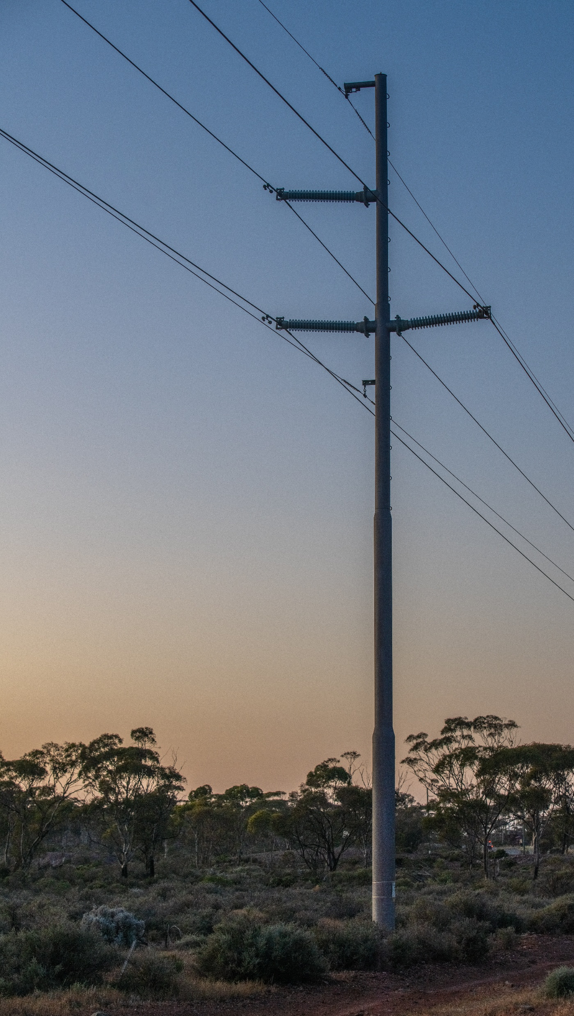
4
Fixed Capital Charge (FCC)
Providing proponents greater cost certainty
Government (as Western Power’s owner) funds the up-front costs of transmission infrastructure, which are paid back over the life of the assets
The cost of the transmission infrastructure is typically recovered through
up-front capital contributions paid by connecting generation, storage and load based on the share of other assets being utilised
over a 50-year period via network tariffs, paid by all network users
A new, simpler contributions framework has been developed to remove complexity and uncertainty associated with the current arrangement
Customers will continue to pay the cost of their direct connection assets
Fixed Capital Charge
$100,000/MW charge on all new connections
(generation, storage and load over 10MW)

Slide 5
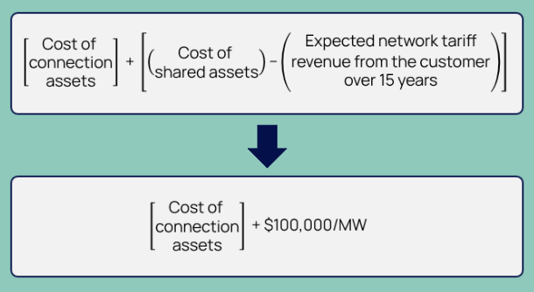
5
Simplifying the Contributions Regime
Replacing the existing ‘shared’ assets arrangement for capital contributions

Slide 6


6
Contribution Value and Tariffs
Balance cost-recovery certainty with impact on industry
The value of $100,000/MW was informed by the Registration of Interest process that tested willingness to pay
  66% willing to contribute more than $100,000/MW
  86% willing to contribute more than $80,000/MW
  The FCC is set at a level that should not materially impact the viability of projects
Costs not recovered via the FCC will be recovered via network tariffs

Slide 7
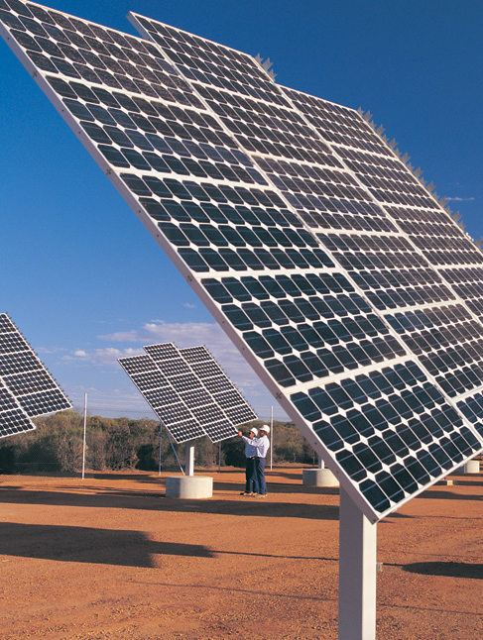
7
FCC Characteristics
Feedback is sought on the proposed structure of the new charge
New or expanded generation, storage or industrial load >10MW
Apply to connection applications that execute access offers with
Western Power on or after 1 July 2026
Transitional arrangement
  If Western Power forecasts an access offer will be executed by
  1 July 2026, but
  the applicant faces delays beyond their control, then
  the applicant would have until 30 September 2026 to choose between paying the existing ‘shared assets’ charge or the FCC
Payable at the conclusion of the Planning stage of Western Power’s connection process
Coordinator of Energy will review the FCC every five years to ensure it is meeting its policy objectives
Western Power will retain flexibility on the needs of individual developers

Slide 8
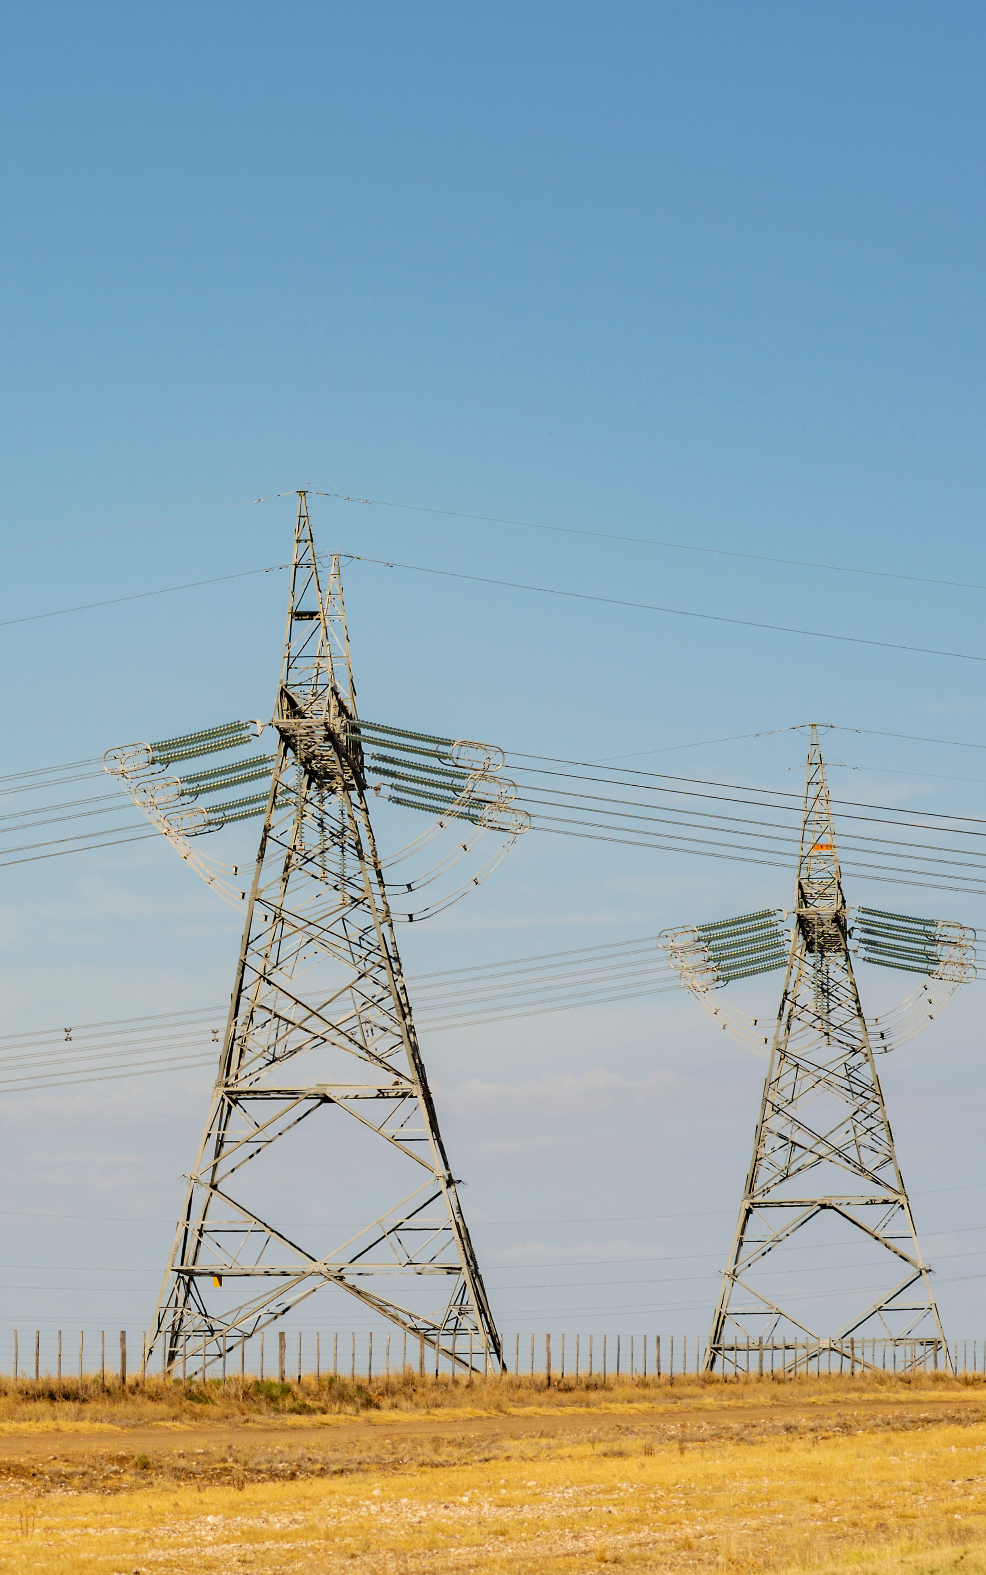
8
Capital Contribution Impact
The impact of the switch to the FCC on connection costs
The current contributions policy produces variable results for each connection and is difficult to forecast
Under the existing arrangement, a capital contribution would be
low if
  shared assets costs are low; and/or
  tariff revenue the connection customer would pay is high
high if
  the cost of the shared assets is high; and/or
  tariff revenue the connection customer would generate is low
Under the FCC arrangement, transmission augmentations (including new lines) that would typically rely on proponent activation can proceed with certainty

Slide 9

9
Consultation
Government is consulting on the Fixed Capital Charge
Changes to the EI Act and Access Code are required to give effect to the FCC
  Feedback is sought on the implementation approach and key policy details
  due 5pm (AWST) on Friday 23 January 2026
  email submissions to EPWA-info@deed.wa.gov.au
  unless marked confidential, submissions may be made publicly available
  structure and wording of the Access Code changes will be informed by responses to the Consultation Paper
  a subsequent 30-day consultation process will be undertaken on the draft Access Code changes

Slide 10



10
Q&A
Department of
Energy and Economic Diversification

