Slide 1
Privacy 101
Privacy and Responsible Information Sharing Act 2024 (WA)
for IPP entities
Publication date: 28/05/2026
Version Control: 01

Slide 2
© Copyright Information
You are free to share and use this ‘Privacy 101 – Privacy and Responsible Information Sharing Act 2024 (WA) for IPP entities’ version 01 in accordance with Creative Commons Attribution - NonCommercial - ShareAlike 4.0 International licence.
Under this licence, you are free to:
share — copy and redistribute the material in any medium or format
adapt — remix, transform, and build upon the material.
However:
you must provide appropriate attribution
you must indicate if you have made changes to the original
you may not use the material for commercial purposes.
The following materials are not covered by this licence:
images, photographs or branding, including the Government of Western Australia Coat of Arms and the Office Information Commissioner in Western Australia logo and branding;
any content provided by third parties.
Attribution: © Office of the Information Commissioner Western Australia, ‘Privacy 101 – Privacy and Responsible Information Sharing Act 2024 (WA) for IPP entities’ version 01, Office of the Information Commissioner (28 May 2026), available at https://www.wa.gov.au/organisation/office-of-the-information-commissioner.
If you have any questions about this licence or would like to use this material for commercial purposes, please contact us at info@oic.wa.gov.au.

Slide 3
Course Outline
Why is privacy important?
The Privacy and Responsible Information Sharing Act 2024 (PRIS)
  Privacy Officers
  Personal Information
  Information Privacy Principles
  Enforcement
  Notifiable Information Breach scheme
3. Questions
4. Resources
What does this mean for…
YOU
YOUR WORK
MEMBERS OF THE PUBLIC

Slide 4
Why privacy matters
Technological advances – mass data collection, retention and customisation
Fosters free and open society
Increasing number of data breaches
Facilitates trusted innovation

Slide 5
Key dates
1 July 2025
1 January 2027
New office established with new Information Commissioner, Privacy Deputy Commissioner and Information Access Deputy Commissioner.
The notifiable information breach provisions in the PRIS Act will commence.
1
2
3
1 July 2026
Most of the substantive provisions in the PRIS Act will commence. This includes most of the privacy provisions (other than notifiable information breach), responsible information sharing provisions, and consequential amendments to the FOI Act.

Slide 6
Privacy Officer
[ENTITY NAME] Privacy Officer: [Insert name and contact details of privacy officer]
Key Responsibilities
Promote compliance with the IPPs and PRIS privacy provisions.
Ensure privacy impact assessments are conducted when required.
Coordinate:
the preparation of the information breach policy and maintaining the register of notifiable information breaches.
responses to privacy complaints.
IPP entity dealings with the OIC including enquiries, privacy complaints and investigations, conciliation, monitoring or assessments conducted by the Information Commissioner.

Slide 7
What is personal information?
Information or opinion (true or not)
That relates to an individual
There is a clear connection
to an identified individual
Who is identified / reasonably identifiable
Individual may be living or dead
🚩Intentionally broad
🚩Context is important – consider the other information you hold or can connect to
Includes unique identifiers
Includes inferred information

Slide 8
[ADD/ REMOVE/ ALTER EXAMPLES AS RELEVANT TO YOUR ENTITY]
Examples of personal information
A council rates notice that includes the name and contact details of a resident
A manager’s opinion of an employee in a performance review
A person’s social media handle tagged in a social media post
An employee payslip that specifies their name, job title and salary
A student number and related information included on an academic transcript
A list of the classes an individual teaches
The pseudonym given to an individual who doesn’t want to provide their name
A staff roster that contains the name of employees and their work shifts
A log-in used to access an online portal
The signature of an individual on a contract
A prediction about the likelihood of an individual using a service inferred from their address, gender and previous engagement with other services
IP addresses collected by an agency so they know the location of people accessing their website

Slide 9
Sensitive personal information
Racial or ethnic origin, gender identity, sexual orientation or practices, political opinions or associations, religious beliefs, membership of a trade union or association, criminal records
Health information
Additional protections
Genetic or genomic information
🚩Health information is not confined to the health care setting
Biometric information

Slide 10
[ADD/ REMOVE/ ALTER EXAMPLES AS RELEVANT TO YOUR ENTITY]
Examples of sensitive personal information
Health Information
An agency collects the ethnic origin and gender of new employees as part of workforce demographic reporting
A checkbox on a form asks individuals whether they identify as Aboriginal and/or Torres Strait Islander
An employee provides medical reports and supporting documents about their condition when applying for a medical retirement
A committee maintains a conflict-of-interest register that records members’ political party affiliations
A job application form asks applicants to voluntarily disclose their sexual orientation for diversity reporting
Patient records that include diagnoses, treatment plans and prescribed medications
An employee declares their trade union membership when nominating a representative for workplace consultations
An agency collects information about an individual’s criminal history as part of a pre-employment clearance
An individual discloses a chronic health condition when requesting modified conditions for an examination

Slide 11
Information Privacy Principles (IPPs)
Apply to IPP entities:
The Information Privacy Principles (IPPs) outline how IPP entities must handle personal information.
There are 11 IPPs, including IPPs relating to de-identified information and automated decision-making.
The IPPs are set out in Schedule 1 of the PRIS Act.
WA Government departments
Statutory Authorities
Local Governments
Government Trading Enterprises
WA Police Force
Contracted Service
Providers

Slide 12
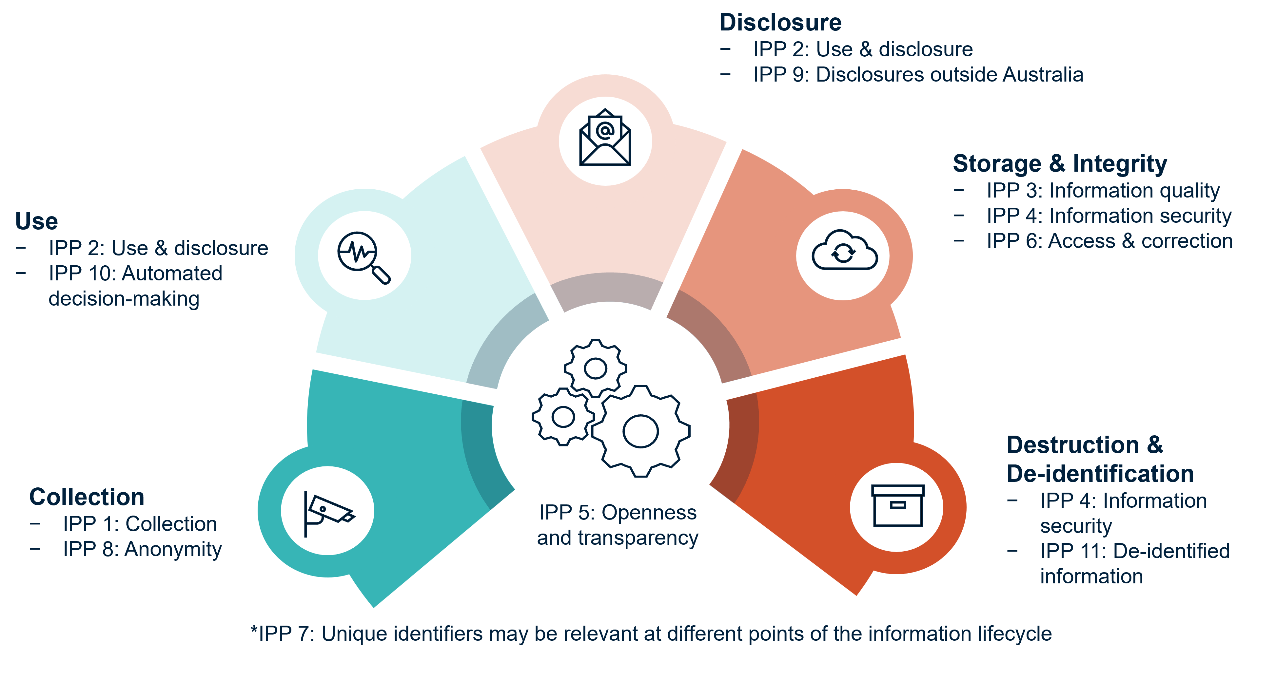
Information lifecycle
IPPs apply throughout the personal information lifecycle

Slide 13
Privacy Policy
Required by
IPP 5: Openness and transparency
What is it?
A policy that sets out the entity’s information handling practices in a broad sense
It is usually published on the IPP entity’s website
What isn’t it?
A collection notice
A consent form
Considers the audiences
Includes the last date updated
Is concise and written in plain language
Is specific to the entity
A good policy

Slide 14

Collection
IPP 1:
Data Minimisation
Only collect the minimum amount of personal information necessary to fulfil functions or activities
Collection can be:
Directly from an individual
From a third party
By observation
Inferred or generated from other information
Fair and Reasonable
Collection must be fair and reasonable irrespective of consent
Collection Notice
Manage individuals’ expectations about how their personal information will be handled
Allows individuals to exercise some control in how their personal information is managed
IPP 8: Anonymity
Individuals have the option of not identifying themselves unless required by law or it is impracticable

Slide 15
Use and disclosure
IPP 2: Personal information which was collected for a particular purpose (the primary purpose) must not be used for another purpose (a secondary purpose)
IPP 10: Automated decision-making
Conduct an impact assessment
Be transparent – notify individuals and provide sufficient information about the process
Provide an option for human intervention
1
2
Certain secondary uses and disclosures are permitted
Reasonable expectation and related purpose
3
Fair and reasonable
IPP 9: Disclosures outside Australia
Exceptions
Consent - research - prevent harm - authorised by law - law enforcement - court proceedings
An IPP entity must not send personal information overseas unless certain requirements are met

Slide 16
Storage and integrity
Information security
Ipp 4
Safe from misuse and loss and unauthorised access, modification or disclosure
IPP 6
ACCESS & CORRECTION
IPP 6 and the Freedom of Information Act 1992 (WA)
INFORMATION QUALITY
Accurate, complete and up-to-date
IPP 3

Slide 17
Destruction & De-identification
When personal information is no longer needed for the purpose it was collected:
Destruction
De-identification
Destruction in accordance with record keeping obligations
Consider all forms of information (digital and physical records)
De-identification to remove or alter information that identifies / is reasonably likely to identify
Must protect the de-identified information from loss, misuse or re-identification

Slide 18
The Information Commissioner and Privacy Deputy Commissioner
Proactive Functions
Enforcement Powers
Creating guidance materials
Determination making powers
Own motion investigations
Up to $75,000 compensation payable to complainants
Monitoring and conducting assessments
Directing privacy impact assessments to be undertaken
Commissioner may issue compliance notices for serious, flagrant or repeated interferences with privacy.
*Fine of up to $60,000 for a failure to comply with a compliance notice.
Reactive Powers
Complaints, enquiries, conciliation and investigation
Prepare and publish reports
Notifiable information breach scheme

Slide 19

Privacy complaints
A privacy complaint is about an IPP entity allegedly handling an individual’s personal information in a way that is inconsistent with the IPPs (called an interference with privacy)
[YOUR ENTITY] and privacy complaints
Presently receive and respond to privacy complaints.
From 1 July 2026:
the privacy provisions of PRIS and IPPs will apply
Privacy officer to coordinate responses to complainant and to OIC
The OIC and privacy complaints
From 1 July 2026:
Can investigate privacy complaints
Complainant should generally make their privacy complaint directly to the relevant entity before bringing it to the OIC
Act or practice that is subject of the complaint must have taken place on or after 1 July 2026

Slide 20
Notifiable Information Breach (NIB) Scheme
ESCALATE
TRIGGER
A POTENTIAL PRIVACY INCIDENT OCCURS…
ACTION
[ADD IN DETAILS OF YOUR ENTITY’S ESCALATION PROCEDURE]
CONTAIN
ASSESS
NOTIFY
ENTITY RESPONSE
Is this an information breach that is likely to result in serious harm?
Information Commissioner
Affected individuals
Contain the impact

Slide 21
[ADD/ REMOVE/ ALTER EXAMPLES AS RELEVANT TO YOUR ENTITY]
Examples of potential privacy incidents:
Depending on the circumstances these could be notifiable information breaches
Someone emails a group of external recipients and uses the CC field instead of the BCC field
Reusing an old document as a template and failing to remove or update all the existing personal information
An employee still has access to entity computer systems after their employment has ended
Outlook auto-populates an unintended recipient when an employee shares a document containing personal information via email
An entity’s computer system is hacked by an unknown person
An unauthorised person accesses the filing cabinet where personnel files are held

Slide 22

Where to from here?
Everyone has a role in developing effective privacy practice
Understand your entity’s privacy risks and mitigate
Understand your privacy obligations

Slide 23
QUESTIONS

Slide 24
Useful links
OIC - Privacy in Western Australia
www.wa.gov.au/organisation/office-of-the-information-commissioner/privacy-western-australia
State Records Office – State Information Management
www.wa.gov.au/organisation/state-records-office-of-western-australia/state-information-management
Office of Digital Government - Responsible Information Sharing (part 3 of the PRIS Act)
www.wa.gov.au/government/privacy-and-responsible-information-sharing

