Slide 1
TAC Webinar –
Mastering Assessment
Dr Russell Docking
Notes:
Before we begin, I would like to start with an Acknowledgement of Country.
Next slide: Acknowledgement of Country

Slide 2

The Training Accreditation Council acknowledges Aboriginal peoples as the first Nations of Western Australia.
The Council respects the ancestral ties and ongoing relationships with the lands, waters, communities and spiritual connections to Country.
The Council honours Elders, both past and present, and recognises the contributions of Aboriginal and Torres Strait Islander individuals within the organisation.
Together, we work in partnership towards a more inclusive and shared future for all Australians.
Notes:
Read acknowledgement
Next slide: The review of assessment tools prior to use

Slide 3

The review of assessment tools prior to use
Outcome Standard 1.3 requires that the assessment system is fit-for-purpose and consistent with the training product.
This workshop has been designed to demonstrate the process of reviewing assessment tools to ensure that they are consistent with the training product and with the principles of assessment and the rules of evidence.
Notes:
Welcome to this workshop … it’s a little unusual as I will be demonstrating the process of reviewing a suite of assessment resources. I will be taking you through a step-by-step process that you can use to review assessment plans and tools to make sure that they meet the requirements of the 2025 Standards for RTOs and enable you to be confident that you can make safe judgements of the competence, or otherwise, of your students. I will be identifying things that are compliant, and things that are not. It’s a bit like an audit, but unlike an audit I will explain why compliance matters, why things are not compliant, and what needs to be done to fix them.
The PowerPoint slides will provide the framework for the review process, and I will be reviewing assessment resources that you have been provided for this workshop.
Let’s start with what the Registration Standards 2025 or 2025 Standards for short have to say about the review of assessment tools:
Note that although the Standard refers to the assessment system it actually focusses on assessments and assessment tools. The purpose of the assessment system is to “produce consistent and valid judgements of VET student competency …” [Definition]
The workshop will demonstrate the review process, following steps that were outlined in a previous TAC webinar.
We will be using an assessment mapping and assessment tools for CHCCCS040 Support independence and wellbeing, bravely offered by an RTO to be mangled to create faults to illustrate the review process.
Next slide: The importance of high-quality assessment

Slide 4
The importance of high-quality assessment
Decisions made by VET assessors leading to VET certification are of profound significance for:
The students and their future careers
The future employers of these students
The productivity and safety of their workplaces
The quality of products for consumers and community
The reputation of the assessors and their RTOs
The credibility of the VET sector
Notes:
Draw a gentle comparison between the consequences of errors in assessment within an education context and a VET training context:
In education, assessment and certification vouch for what has been learned … it is backwards looking …
In VET, assessment and certification vouch for what now can be done … it is forwards looking …
Because VET certification makes promises about future performance the cost of mistakes in VET assessment will impact on:
The students and their future careers;
The future employers of these students;
The productivity and safety of their workplaces;
The quality of products for consumers and community;
The reputation of the assessors and their RTOs; and
The credibility of the VET sector
Next slide: … the significance of this judgement is woven into the framework within which VET assessment is conducted …

Slide 5
VET assessment
The core business of all RTOs is the certification of industry-relevant competencies of individual candidates.
This certification must be based on a judgement of competency made by a qualified assessor.
This judgement must be valid, reliable, fair and flexible.
This judgement must be based upon evidence gathered through assessment tools that are valid, sufficient, current and authentic.
The RTO and the assessor are accountable for the accuracy of these judgements … any of the above might be challenged in an appeal … and all of the above are the subject of validation.
Notes:
Step though this slide, emphasising the words in bold text, stressing that the assessor is ultimately accountable for errors in the assessment judgement.
Next slide: …. So what do we need to review to give us confidence in our assessment strategies?

Slide 6


The review process
Consistency with the training product
The assessment of knowledge
The assessment of performance
Instructions for students
Instructions for conducting assessments
Instructions for assessors (marking guides and judgement)
Notes:
This review applies to home-made assessment tools and purchased assessment tools. Also applies to RPL.
We will be looking at:
Consistency with the training product
The assessment of knowledge
The assessment of performance
Instructions for students
Instructions for conducting assessments
Instructions for assessors
Next slide: This will involve reviewing five key documents …

Slide 7
Resources to review
The assessment mapping
Knowledge assessment
Performance assessment
Assessor marking guides
The unit of competency
Notes:
The assessment mapping will be at the core of the review process. Once we have established that it faithfully reflects the requirements of the unit, we can then use it to interrogate knowledge assessment, performance assessment and assessor marking guides.
Next slide: What resources will we be using for this demonstration of a pre-use review.

Slide 8

The assessment resources
Modified assessment resources have been provided for this demonstration of the review of assessment resources prior to use:
The unit of competency CHCCCS040 Support independence and wellbeing
A mapping of assessments and learning resources
Assessment 1: Knowledge assessment
  Student assessment tool
  Assessor marking guide
Workplace Observation & Assessment Task Book
  TASK No. 20 Independence and wellbeing observation record
Notes:
In this demonstration of the review of assessment tools prior to use, we will be using the following assessment resources for CHCCCS040 Support independence and wellbeing generously and bravely volunteered by an RTO and subsequently mutilated to illustrate problems with assessment:
The unit of competency CHCCCS040 Support independence and wellbeing
A mapping of assessments and learning resources
Assessment 1: Knowledge assessment
Student assessment tool
Assessor marking guide
Workplace Observation & Assessment Task Book
TASK No. 20 Independence and wellbeing observation record
Not seen is an Assessment Policy and Procedure document, a Training and Assessment Strategy, or a Delivery and Assessment Plan for the unit.
Next slide: We will start with consistency with the training product.

Slide 9
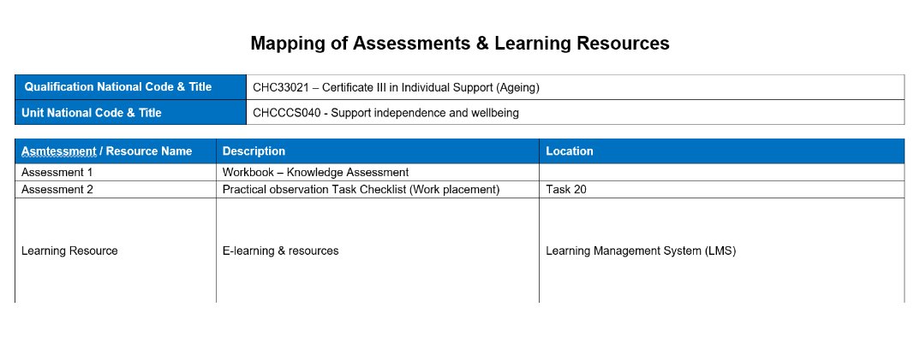
Consistency with the training product
Check the assessment mapping for:
Correct unit code and title
Consistency of assessment strategies with the TAS or QDAS and DAP
Delineation between formative and summative assessment tools
Listing of all unit requirements:
  Application
  Prerequisites
  Elements of Competency and their Performance Criteria
  Foundation Skills
  Range of Conditions
  Performance Evidence
  Knowledge Evidence
  Assessment Conditions
Notes:
Handout: CHCCCS040_Mapping_Edited
This is a specific requirement of Outcome Standard 1.4
Check the mapping document for:
Correct unit code and title [Note errors in codes and titles on page 5 of the Workplace Observation & Assessment Task Book]
Consistency with the TAS or QDAS – the suite of assessment tools reflects those listed in the TAS, QDAS and DAP
Delineation between formative and summative assessment tools – the assessment mapping should only show those evidence sources used to support the judgement of competency. It should not include assessments to provide feedback to the trainer and students on progress, such as quizzes at the end of chapters. These are a training resource rather than an assessment resource. If training resources are mapped, these quizzes could be listed under that heading.
Listing of all unit requirements (Application, Prerequisites, all Elements and their PC, all Foundation Skills, all Range of Conditions, all Performance Evidence , all Knowledge Evidence, all Assessment Conditions)
In the CHCCCS040 mapping:
The unit code and title are correct
TAS, QDAS and DAP have not been reviewed …
All assessments are summative
There are no prerequisite units prescribed for this unit
PC 1.5 is missing, so Element 1 is not assessed. It was on the next page … was it missed in the cut and paste?
Foundation Skills are explicit in the performance criteria
There is no range of conditions for this unit
Performance Evidence is listed in full
Knowledge Evidence is listed in full and each sub-item is mapped separately
The Assessment Conditions are listed in full, and reference is made to documentation reporting the credentials of assessors.
Application tells us that the unit will enable a person providing individualised services to do so in a way that supports independence as well as physical and emotional wellbeing. The unit is not about the services being delivered … this is addressed in CHCCCS031, but about the way they are delivered. We will need to check that the assessments are not distracted by the service and focus on the way the service is delivered. The unit applies to those delivering an established individualised plan. Compliance with the plan is not being assessed, the way the delivery of the plan promotes independence and wellbeing is the focus.
Next slide: What the mapping tells us about the assessment of knowledge

Slide 10
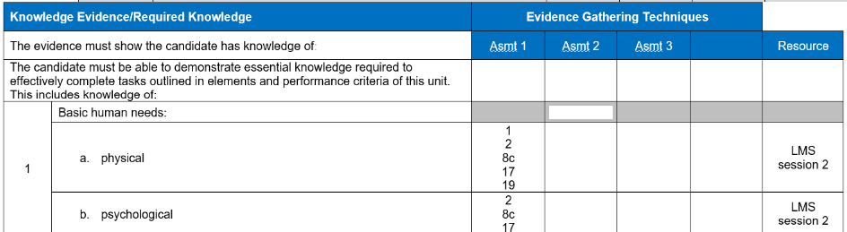
The assessment of knowledge
Look at the assessment mapping to confirm structural requirements
All Knowledge Evidence requirements are addressed by one or more questions
If more than one knowledge question … what is required?
Knowledge Evidence requirements are not assessed through observation
Every knowledge question in the assessment tool is mapped to a Knowledge Evidence requirement
More ….
Notes:
Check the CHCCCS040 mapping document to confirm structural requirements:
All Knowledge Evidence requirements are addressed by one or more questions. No evidence source has been mapped for Knowledge Evidence item 8 f. This could be a typographical error or a failure to assess. The use of observation 14 does not address the documentation requirements for restrictive practice.
Many Knowledge Evidence items are mapped to multiple evidence sources. This is not an issue, but it introduces a complication … do all have to be demonstrated … are these all needed to address different aspects of the knowledge item … is this over-assessment … ? Is this explained in the marking guide? Could be a reliability non-compliance.
Knowledge Evidence requirements are not assessed through observation. Obs 11, 12 & 14 have been mapped to KE 4, KE 9 & KE 10 items. These are not indicators of knowledge. Observations are restricted to time and place, but knowledge questions can transcend time and place … they can reflect the wide range of contexts and conditions.
Every knowledge question is mapped to a Knowledge Evidence requirement (check all question numbers appear in the mapping, Q25 is not mapped, Should be mapped to KE 8a … not a non-compliance as Q25 does map to a KE item. However, there may be other questions that do not match the content of the KE items, and these would be non-compliant (next slide)
Next slide: More knowledge assessment checks …

Slide 11
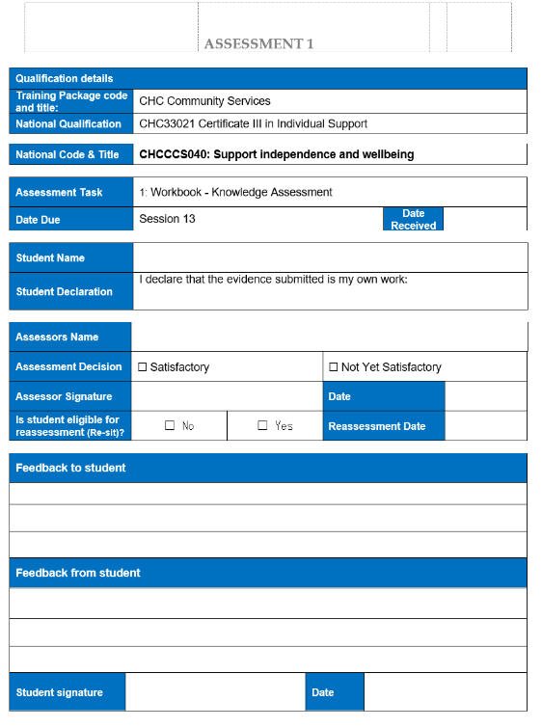
The assessment of knowledge
Look at the knowledge assessment tools to confirm mode and content requirements
The assessment strategy reflects the industry use of knowledge (open or closed book, multiple-choice or short answer, etc.)
The knowledge questions truly relate to the Knowledge Evidence items
The knowledge questions reflect current industry practices
The knowledge questions reflect national industry practices
The knowledge questions are at the appropriate nominal level
No extra conditions imposed (essay, referencing, presentation, etc.)
Notes:
Look at the CHCCCS040 knowledge assessment tools to confirm mode and content requirements.
This requires the reviewer to have current industry skills and knowledge. ASK QUESTIONS OF THESE EXPERTS
The assessment strategy reflects the industry use of knowledge (open or closed book, multiple-choice or short answer) The assessment is open book. At AQF level III* the student is expected to be able to use knowledge autonomously to complete the tasks set in the elements and performance criteria. This would appear to exclude open-book assessment.
The knowledge questions truly relate to the Knowledge Evidence items and address all aspects of that knowledge. Q1 – 11 relate to a scenario or case study that asks the student to describe what action they would take … these are assessing skills (elements and performance criteria) rather than knowledge*. When we remove Q1 – 11 none of the items in KE4, KE5, KE10 or KE18 are assessed. Also Q2 relates to the Charter of Human Rights which is not knowledge required by the unit of competency and there are no questions relating to support resources and networks (KE 17). Further, Q22 does not ask about human development across the lifespan and the focus of the questions appear to relate only to aged care, but this is a core unit for ageing and disability, and covers “people who may require support due to ageing, disability or some other reason” (Qualification description).
The knowledge questions reflect current industry practices. This can only be judged by a person with current industry skills … ask for examples …
The knowledge questions reflect national industry practices This can only be judged by a person with current industry skills … ask for examples …
The knowledge questions are at the appropriate nominal level (relevant to the AQF/qualification**) Another question to ask of an expert.
No extra conditions imposed (essay, referencing, presentation, etc.) Not an uncommon practice … don’t introduce extra challenges …
* Note that Q 1 – 11 could be used as a formative assessment. This could be a self-assessment activity.
** Note that most units do not have an assigned AQF level, but it is important to ask questions that require a level of thinking appropriate to a “nominal AQF level”, usually inferred from the qualifications that incorporate that unit (this can be found through finding the unit in training.gov, selecting the “qualifications” tab and noting the lowest AQF level qualification commonly using the unit, in this case Cert III)
Next slide: The assessment of performance …

Slide 12
The assessment of performance
Look at the assessment mapping to confirm structural requirements
All Performance Criteria are evidenced by one or more observations
All Performance Criteria in each element are observed together
All Foundation Skills are evidenced by one or more observations
All Performance Evidence items are mapped to observations
The number and variety of observations meet Performance Evidence requirements
All Range of Conditions items are mapped to observations
Performance Criteria or Foundation Skills are not mapped to knowledge questions
Every observation is mapped to a Performance Criterion, Foundation Skill, Performance Evidence or a Range of Conditions item
Notes:
Check the CHCCCS040 mapping document to confirm structural requirements:
All Performance Criteria are evidenced by one or more observations. PC 1.3 is not mapped, and is not demonstrated by answering Q17.
All Performance Criteria in each element are observed together. The PCs define the element and are not isolated skills. All items in Task 20 must be observed for each patient. The elements of competency are not mentioned in the observation tool, and there is some disjointedness. For example Obs 6 is linked to 2.5 and 3.1 … these are different elements, and the Observation has two parts but only one response. Likewise, Obs 8 assesses 6 PC across element 3 and element 4, but these are different and the observation has three parts and only one response. Think of each element as a cake, and each performance criterion as its ingredients. If any ingredient is missing, it’s not a cake, and you can’t make up for it by pointing out that the ingredient was included in another cake! You are not assessing performance criteria … you are assessing elements by looking for instances where you see all their performance criteria happening together.
All Foundation Skills are evidenced by one or more observations. N/A
All Performance Evidence items are mapped to observations. Yes, but the time sheet is where the 120 hours work placement requirement is signed off.
The number and variety of observations meet Performance Evidence requirements. Yes
All Range of Conditions items are mapped to observations N/A
Performance criteria or foundation skills are not mapped to knowledge questions. There are instances where performance criteria have been mapped to knowledge questions. These are not indicators of performance (e.g. PC 1.3, 4.7 & 4.8) Note: PC 4.8 might be difficult to observe, so you might have to resort to a “what if” question. Q12 could serve that purpose
Every observation is mapped to a Performance Criterion, Foundation Skill, Performance Evidence item or a Range of Conditions item Yes, but many map to more than one element.
Next slide: More assessment of performance checks:

Slide 13
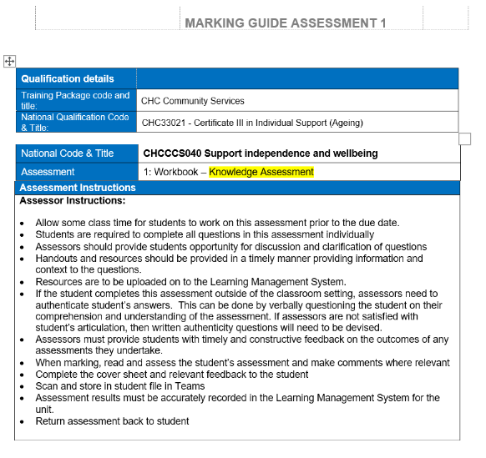
The assessment of performance
Look at the observation tool to confirm mode and content requirements
The observation checklist is not just a recitation of the unit requirement, but includes a description of typical tasks and products
The observation checklist items truly relate to the unit performance requirements
The facilities, resources and equipment are consistent with the Assessment Conditions
The observers and assessors meet the credential requirements of the Assessment Conditions
The assessment tasks reflect current industry practice and standards
Simulations fully reflect workplace conditions
Notes:
Look at the CHCCCS040 performance assessment tools to confirm mode and content requirements.
This requires the reviewer to have current industry skills and knowledge. ASK QUESTIONS OF THESE EXPERTS
The observation checklist is not just a recitation of the unit requirement, but includes a description of typical tasks and products. The observations paraphrase the PC and do not add meaning or clarity to the requirement. Obs 2 makes little sense, and “Did you …” invites the answer “No”
The observation checklist items truly relate to the unit performance requirements. Obs 8 is linked to 6 PC, each relates to a different aspect.
The facilities, resources and equipment are consistent with the Assessment Conditions. Yes
The observers and assessors meet the credential requirements of the Assessment Conditions. Observer unspecified, RTO assessor yes. There is no indication in the Workbook Observation & Assessment Task Book of the qualifications and experience requirements of the observers (workplace signatories) or workplace supervisor, yet the RTO Workplace Assessor relies upon their observations to make the judgement. There is no indication of how these observers are briefed, managed and validated.
The assessment tasks reflect current industry practice and standards. Yes as the assessment is conducted in an operating workplace.
Simulations fully reflect workplace conditions. N/A (Note: Q1-11 in the Knowledge Assessment is not a simulation)
Next slide: Now let’s look at the instructions for students. Do they provide accurate, complete and clear guidance?

Slide 14
Clarity of instructions for students
Unit(s) to be assessed
Description of assessment task(s)
Modes of response
Timing of assessment
Multiple assessments
Performance standards
Facilities, resources and equipment provided by RTO
Resources and equipment provided by the student
Prohibited resources and equipment
Supervised or unsupervised
Open-book or closed book
Authentication processes and penalties
Role of observers and assessors
Regulatory and safety conditions
Recording evidence
Feedback
Reassessment
Appeals
Opportunities for practice
Notes:
Review the assessment tools for the unit CHCCCS040 for the clarity of student instructions. There are some issues here, and some of them may be addressed in a Delivery and Assessment Plan for the unit.
Unit(s) to be assessed Yes
Description of assessment task(s.) Yes, but not in colloquial workplace language
Modes of response. Yes, although “Y” “N” is not as meaningful as “S” and “NS” for the observations.
Timing of assessment. Yes, although Task 20 would be best assessed late in the 120 hours when service delivery had been mastered.
Multiple assessments Yes, but the observation would be improved if 3 different clients were chosen. A space to record how they were different would be helpful. AT2 Page 2 requires observation “on at least two different days”.
Performance standards. No, there is no statement that all questions and all observation items must be successfully demonstrated (hinted on page 10 of handout).
Facilities, resources and equipment provided by RTO. Yes … access to Learning Management System and access to a workplace.
Resources and equipment provided by the student. Yes
Prohibited resources and equipment. N/A
Supervised or unsupervised. Yes, unsupervised for the Knowledge Assessment
Open-book or closed book. Yes, open book for the Knowledge Assessment but consider if this is appropriate
Authentication processes and penalties. No … authentication is mentioned (Knowledge Test p 2) but not explained, nor are penalties indicated. “My own work” declaration inadequate.
Role of observers and assessors. Yes, on page 2 of Workplace Observation & Assessment task Book
Regulatory and safety conditions. Yes
Recording evidence. Yes
Feedback. Yes
Reassessment. No, although implied by assessor response.
Appeals. No
Opportunities for practice. Yes
Next slide: Now let’s look at the instructions for those conducting the assessments. Do they provide accurate, complete and clear guidance?

Slide 15
Instructions for conducting assessments
Unit(s) to be assessed
Description of assessment task(s)
Modes of response
Timing of assessment
Multiple assessments
Performance standards
Facilities, resources and equipment provided by RTO
Resources and equipment provided by the student
Prohibited resources and equipment
Supervised or unsupervised
Open-book or closed book
Authentication processes and penalties
Role of observers and assessors
Credentials of observers
Regulatory and safety conditions
Recording evidence
Feedback
Flexibility and contextualisation
Guidance
Questions or checklists
Notes:
Includes assessors, evidence gatherers, facilities, resources and equipment.
Review the assessment tools for the unit CHCCCS040 for the clarity of administration instructions. There are some issues here, and some of them may be addressed in an Assessment Policy and Process document, or in a Delivery and Assessment Plan for the unit.
Many of these have been addressed in the previous slide …
Unit(s) to be assessed. Yes
Description of assessment task(s). Yes, but not in colloquial language
Modes of response. Yes, although “Y” “N” is not as meaningful as “S” and “NS” for the observations.
Timing of assessment. Yes, although Task 20 would be best assessed late in the 120 hours when service delivery had been mastered.
Multiple assessments. Yes, but the observation would be improved if 3 different clients were chosen. A space to record how they were different would be helpful. AT2 Page 2 requires observation “on at least two different days”.
Performance standards. No, there is no statement that all questions and all observation items must be successfully demonstrated (hint on page 10 of the handout).
Facilities, resources and equipment provided by RTO. Yes … access to Learning Management System and access to workplace.
Resources and equipment provided by the student. Yes
Prohibited resources and equipment. N/A
Supervised or unsupervised. Yes
Open-book or closed book. Yes
Authentication processes and penalties. No … authentication is mentioned (Knowledge Assessment p 2) but not well explained, nor are penalties indicated. “My own work” declaration inadequate. Nowhere to record authenticity outcome.
Role of observers and assessors. Yes, on page 2, but unclear on page 77 … three observers (Client 1, 2 & 3), one observer comment (should be three columns).
Credentials of observers. No credentials specified for workplace signatories (Workplace Observer) or Workplace Assessor (Lecturer/Workplace Assessor)
Regulatory and safety conditions. Yes
Recording evidence. Yes, but advised to return assessment to the student. This does not comply with Compliance Requirement 10 (c) to retain assessments.
Feedback. Yes
Flexibility and contextualisation. No indication of allowed and disallowed adjustments
Guidance. Minimal indication of support that can be offered during assessment or observation.
Questions or checklists. Yes
Other comments: There is reference in the assessment resources to: work placement tutor, work placement coordinator, workplace signatories, observers, workplace assessor, assessor, workplace supervisor, workplace observer, Lecturer/Workplace assessor, and Workplace Manager.
Next slide: Now let’s look at the instructions for those making the assessment judgements. Do they provide accurate, complete and clear guidance?

Slide 16
Instructions for assessors
Unit(s) to be assessed
Description of assessment task(s)
Reasonable adjustment (2.4)
Marking guides
Authentication processes and penalties (1.4)
Selection and management of observers
Compiling knowledge and performance evidence for each unit of competency
Making the assessment judgement with regard to all unit requirements including prerequisite units, authentication
Reassessment
Appeals (2.8)
Gap training and supplementary assessment
Retaining assessments
Notes:
Interpreting evidence with marking guides and making the assessment judgement
Review the information provided for assessors for the assessment judgements for the unit CHCCCS040. There are many issues here, and some of them may be addressed in an Assessment Policy and Process document, or in a Delivery and Assessment Plan for the unit.
Unit(s) to be assessed. Yes
Description of assessment task(s). Yes, but not in workplace terminology with examples of practices and outcomes.
Reasonable adjustment. No indication of adjustments that could be applied for disability
Marking guides No guidance provided where there are multiple measures of a PC or a KE item or multiple responses to a KE item, or partial outcomes for an observation. “Answers can include the following but are not limited to …”
Authentication processes and penalties. No … authentication is mentioned (AT1 p 2) but not explained, nor are penalties indicated. “My own work” declaration inadequate. Nowhere to record authenticity outcome.
Management of observers. No credentials or conditions set for workplace observers
Compiling knowledge and performance evidence. No process to combine outcomes of AT1 and AT2 for judgement. No provision for alternative evidence.
Making the assessment judgement with regard to all unit requirements including prerequisite units, authentication. No mapping back to the elements, no mapping back to unit requirements, no record of authenticity to determine outcome.
Reassessment. No indication of where reassessment would be appropriate
Appeals. No statement that the assessment judgement can be appealed
Gap training and supplementary assessment. No advice about remedies for unsuccessful outcomes
Retaining assessments. Observers are advised to return assessment to the student. This does not comply with Compliance Requirement 10 (c) to retain assessments.
Next slide: What about RPL assessments?

Slide 17
Recognition of Prior Learning
The assessment mapping is a planning tool and a validation tool for home-made and purchased assessment tools These tools can be used to conduct RPL assessments.
Alternatively, the mapping tool can be used to map evidence provided by the student against the requirements of the unit of competency.
Apply the rules of evidence to each item of evidence and map evidence that is demonstrably current, genuinely authentic, and unambiguously valid to each relevant unit requirement
Then review each requirement to determine if there is sufficient evidence to make a decision.
Supplementary assessment involving observation and questioning should be used to: verify authenticity; demonstrate currency; confirm validity; provide sufficiency; and address any evidence gaps.
(Outcome Standard 1.6)
Notes:
RPL assessments are required to meet the same standards as other assessments of the training product.
This could be met by:
Using the same assessment tools that have been created or purchased for non-RPL students; or
An assessment strategy could be created (or purchased) specifically for RPL candidates … often in the form of an RPL Kit.
The mapping tool can be used to map evidence requested in the RPL Kit and provided by the student against the requirements of the unit of competency.
Apply the rules of evidence to each item of evidence and map evidence that is demonstrably current, genuinely authentic, and unambiguously valid to each relevant unit requirement (and discard the other evidence), then review each requirement determine if there is sufficient evidence to make a decision. If there is insufficient credible evidence you may request additional evidence or require the candidate to participate in direct assessment activities.
Supplementary direct assessment activities should be used to: verify authenticity; demonstrate currency; confirm validity; provide sufficiency; and address any evidence gaps.
Next slide: We have seen how the mapping facilitates the review of assessment tools before we use them … but the mapping can add more value …

Slide 18
Bonus Offer! Added value for mapping …
Targeting supplementary learning and assessment
Incorporating serendipitous evidence (fairness and flexibility)
Incorporating evidence gathered through work placements
Enabling a unit-based assessment judgement for each unit assessed in a cluster (validity, fairness, flexibility, reliability)
Meeting assessment record requirements
Assisting with assessment appeals
Mapping learning resources
Mapping evidence gathered for RPL
Making valid changes for reasonable adjustments
Mapping evidence for trainer/assessor equivalence
Notes:
The mapping document can also be used for a number of additional purposes, including some bright ideas, such as:
(NOTE: performance criteria are not specifically referred to in an audit)
Targeting supplementary learning and assessment Outcome Standard 1.1(c);
Incorporating serendipitous evidence (Fairness and flexibility) Outcome Standard 1.4a
Incorporating evidence gathered through work placements Outcome Standard 1.1(e);
Enabling a unit-based assessment judgement for each units assessed in a cluster (Validity, fairness, flexibility, reliability) Outcome Standard 1.4a
Meeting assessment record requirements Compliance Requirement 10(c);
Assisting with assessment appeals Outcome Standard 2.8;
Mapping learning resources (ito meet Outcome Standard 1.1);
Mapping evidence gathered for RPL Outcome Standard 1.6(b)(c);
Making valid changes for Reasonable Adjustments Outcome Standard 2.4; and
Mapping evidence for trainer/assessor equivalence (to meet Outcome Standard 3.3(a)i)
This page is off-script, but it illustrates how a mapping of unit, assessment tools, student performance and judgement provides a basis for many other RTO responsibilities … not always on its own, but as a significant contributor to compliance.
Next slide: TAC resources

Slide 19

Resources
TAC Fact Sheets
Assessment in the workplace
Assessment and assessment judgement
Assessment validation
Recognition of prior learning
TAC Podcasts / TAC Talks
Retaining assessment records (Ep 11)
TAC Webinars
Making an assessment decision
Assessing in the workplace
Assessment validation
Notes:
Resources are available to view and download from the TAC website which can be accessed using the QR code on the handout
TAC Fact Sheets:
Assessment in the workplace
Assessment and assessment judgement
Assessment validation
Recognition of prior learning
TAC Podcasts / TAC Talks
Retaining assessment records (Ep 11)
TAC Webinars
Making an assessment decision
Assessing in the workplace
Assessment validation
Next slide… Time for questions, answers and feedback … and farewell …

Slide 20


Questions and Feedback
Thank you for your participation.
Please complete the TAC Education Program - Webinar - Mastering Assessment
Survey:
Notes:
Respond to questions … or direct to TAC if no time.
Feedback Survey can be accessed through the QR Code.
Thank participants for their participation, and encourage them to apply the ideas in their own RTOs.
Final slide.

