Slide 1
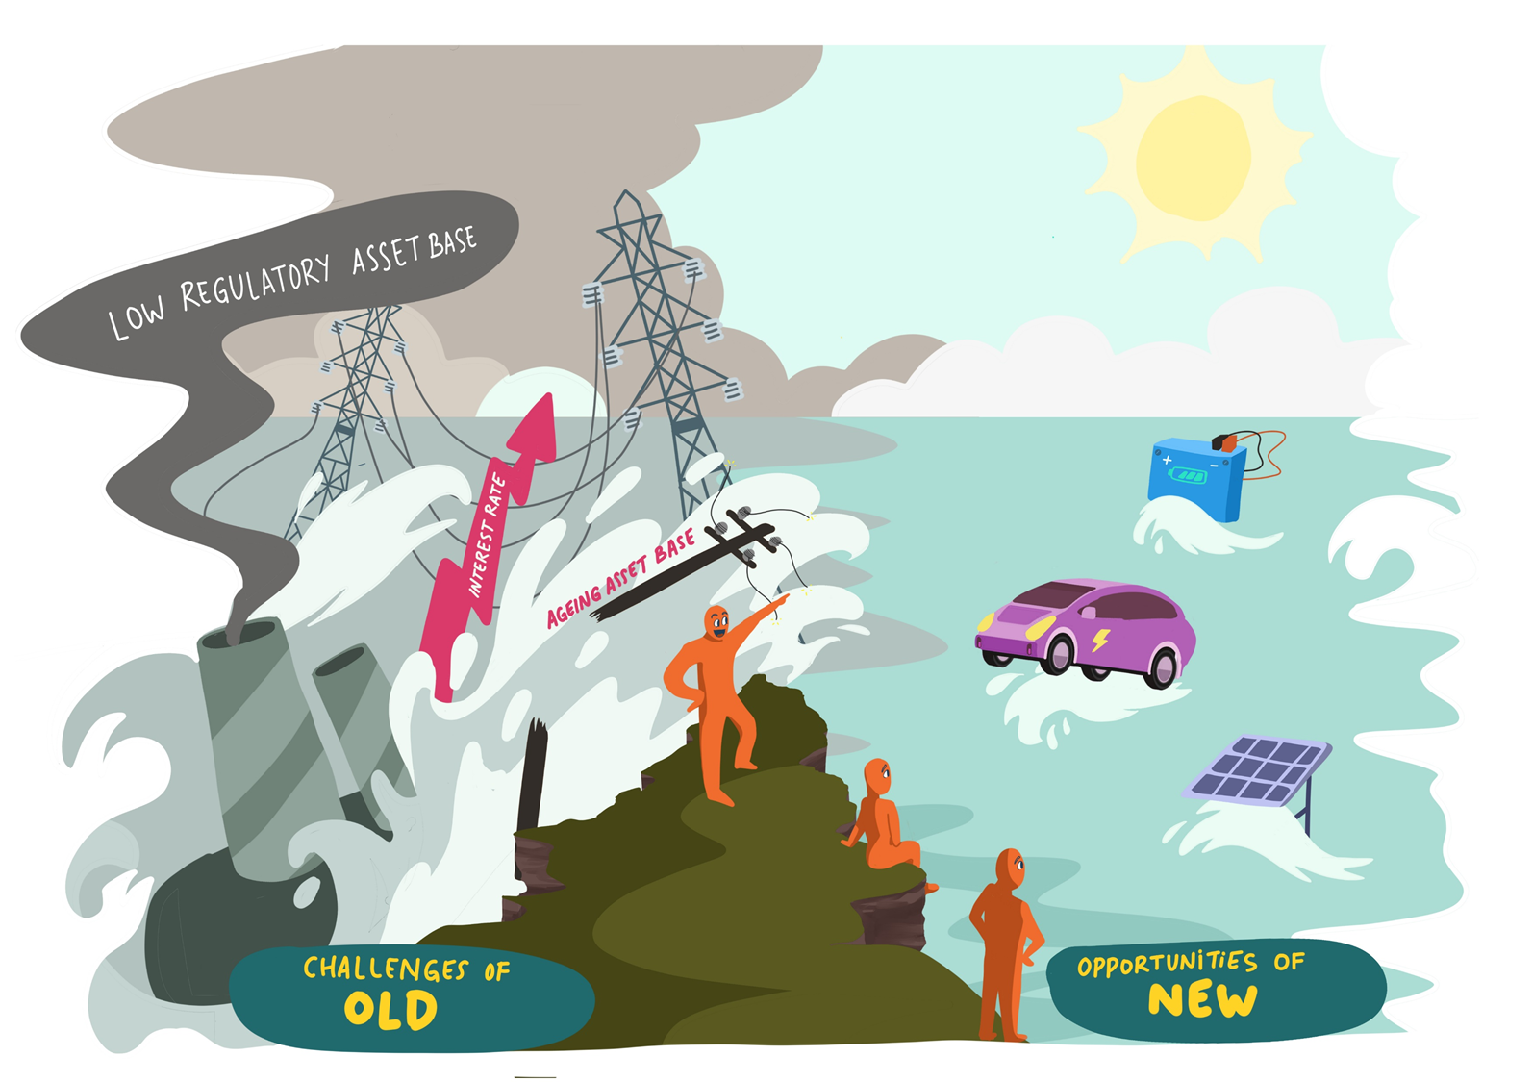
  Strategic assessment
  Review of Western Power’s proposed access arrangement for 2022-27
  Dynamic Analysis
  22 April 2022
Contents
Summary
Strategy and engagement
Building blocks and tariffs
Dynamic Analysis

Slide 2
Purpose and scope of this review
Our review provides a strategic assessment of whether Western Power’s proposed access arrangement is in the best long term interests of WA customers. We identify areas that require further scrutiny by the independent regulator.
Purpose - The purpose of the review is to help inform the Expert Consumer Panel’s review of Western Power’s proposed access arrangement for 2022 to 2027.
Funding - This project was funded by the Government of Western Australia (Energy Policy WA) as part of its grants process for consumer advocacy projects and research projects for the benefit of consumers of electricity and gas. The views expressed in this document do not necessarily reflect the views of the Government of Western Australia, Energy Policy WA or the Expert Consumer Panel.
Who we are - Dynamic Analysis has considerable experience in developing and assessing regulatory proposals in the National Electricity Market. We have provided regulatory advice to 8 networks, and have provided technical advice to the Energy Consumers Australia (ECA) on regulatory proposals of 3 other networks. We have specialist experience in developing expenditure proposals and engagement processes.
Scope - Our review is limited to a strategic (high level) assessment of key public documents submitted by Western Power to the Economic Regulation Authority (ERA). Our lens is to identify whether the access arrangement is broadly in the long term interests of WA customers. We identify both the strengths of the access arrangement, and the areas requiring further scrutiny by the ERA.

Slide 3
1. Summary

Slide 4
Key findings
We consider the strategies underpinning Western Power’s proposed access arrangement are innovative and sound. However, we consider that aspects of the expenditure proposals require scrutiny, and that there may be opportunities to reduce costs. We also consider that the proposed tariff design requires further explanation, and more analysis on the bill impacts to customer segments.
Strategy - We consider that Western Power has deeply considered the evolving energy landscape, and has developed a well justified strategy to transition the network to deliver customers with low cost and reliable electricity. We consider Western Power’s proposal to be at the forefront of networks in Australia in its vision and commitment to the transition.
Customer engagement – Western Power has shown a genuine commitment to engage with customers, with a diversified and extensive engagement program. However, we consider that the program lacks sufficient deliberative engagement and this has not provided a baseline knowledge for customers to inform the technical choices presented such as undergrounding. We would encourage Western Power to adopt deeper deliberative engagement processes such as a People Panel.
Expenditure proposals – The expenditure proposals require further scrutiny by the ERA. We have not seen demonstration of risk quantification, prioritisation or business case tools that could reduce the 30% expected uplift in capital expenditure. We have also not seen a plan to improve operational efficiency. We note that price stability has largely been a product of falling interest rates, and that locking in higher expenditure levels could lead to long term affordability concerns when interest rates rise.
Returns on investment – We consider the ERA should examine whether the change in WACC methodology is reasonable. We note that the changed method would increase prices in the short term, but that customers may benefit from lower returns on investment in the future. In our view, we consider the approach should align with Western Power’s actual debt structuring.
Tariff proposals – There is insufficient information to understand how Western Power’s proposed tariff changes will apply in practice. While there are innovative aspects such as lower rates in the day, we are concerned that some customers will face significant bill shock if fixed prices increase. We would encourage Western Power to provide more ‘bill impact’ analysis beyond the first year.

Slide 5
Improvements to the regulatory framework
There is limited benchmarking comparison put forward in the proposal compared to networks in the NEM. We see that this relates to a data gap where Western Power is not subject to the same level of reporting requirements as NEM networks. Crucial data such as asset ages, populations, utilisation, unit costs, and category costs would be useful to compare Western Power to other Australian networks.
Improve data availability– In the NEM, the distribution and transmission networks are required to submit audited information on costs, asset performance, asset age and utilization. While we would argue that some of this information is an unnecessary regulatory burden, there are elements of the reporting regime that could be adopted by the ERA to assist its review, and to assist consumer bodies such as the ECP. We note this would increase regulatory costs and that Western Power would need to be compensated.
Incorporate more benchmark analysis – We caution against using high level econometric benchmarking in regulatory decisions. The operating and environmental factors in WA are exceptionally difficult to normalise, and such an approach will not yield improvement but just cost cutting. However, there are many aspects of category benchmarking that can help improve performance such as unit cost assessment, maintenance cycle comparisons, age before an asset type is replaced, and planning and rating standards.
Customer language – We would encourage both Western Power and the ERA to use ‘customer friendly’ tools such as plain English overviews, infographics, animations, and videos to entice more involvement from customers.
Customer negotiation – While we are cautious about models that solely rely on customer negotiation, we see significant merit in formally recognising deliberative engagement processes that identify the values, vision and priorities of customers. We note the AER’s process allows for a short tracked assessment process if networks have demonstrated a genuine commitment to negotiating with customers.

Slide 6
2. Strategy and engagement

Slide 7
Long term strategy
A clear strength of Western Power’s proposed access arrangement is a commitment to re-engineering the grid to meet changes in the energy landscape. There is a sound plan to unlock small scale renewables and use stand alone power systems in remote areas that suits Western Power’s unique geography and circumstances. We would encourage Western Power to go even further, including quantitative modelling of customer impact from upcoming changes such as replacement of ageing assets and uptake of electric vehicles.
Strengths
Overall, we consider that Western Power is leading edge with its ambition to re-design the grid to meet the changing energy landscape, and its innovation and ambition should be commended.
We consider that Western Power has a well articulated strategy to evolve the network to efficiently facilitate the uptake of renewables.
We agree with the reasoning that unlocking small scale solar can lead to cost savings for customers, particularly if innovative automated solutions are employed.
We also consider that stand alone power systems could lead to lower costs and improved reliability, and given WA’s geography, this is a sensible approach moving forward if the timing is correct.
Possible improvements
We consider that the strategy may have been expanded to include other upcoming challenges and opportunities.
For example, we consider that Western Power may face replacement challenges in the medium term, and this may lead to the possibility of sharp price rises given the relatively low value of the regulatory asset base.
We also consider that more analysis could be put forward on the impact of electric vehicle charging on peak demand (and future growth capex) in the future. This is a key influencer on pace of tariff reform, and on aggregation/control of DER.
Finally, we consider that Western Power has not provided a vision of how it transforms its business from the inside to better deliver services cost effectively.

Slide 8
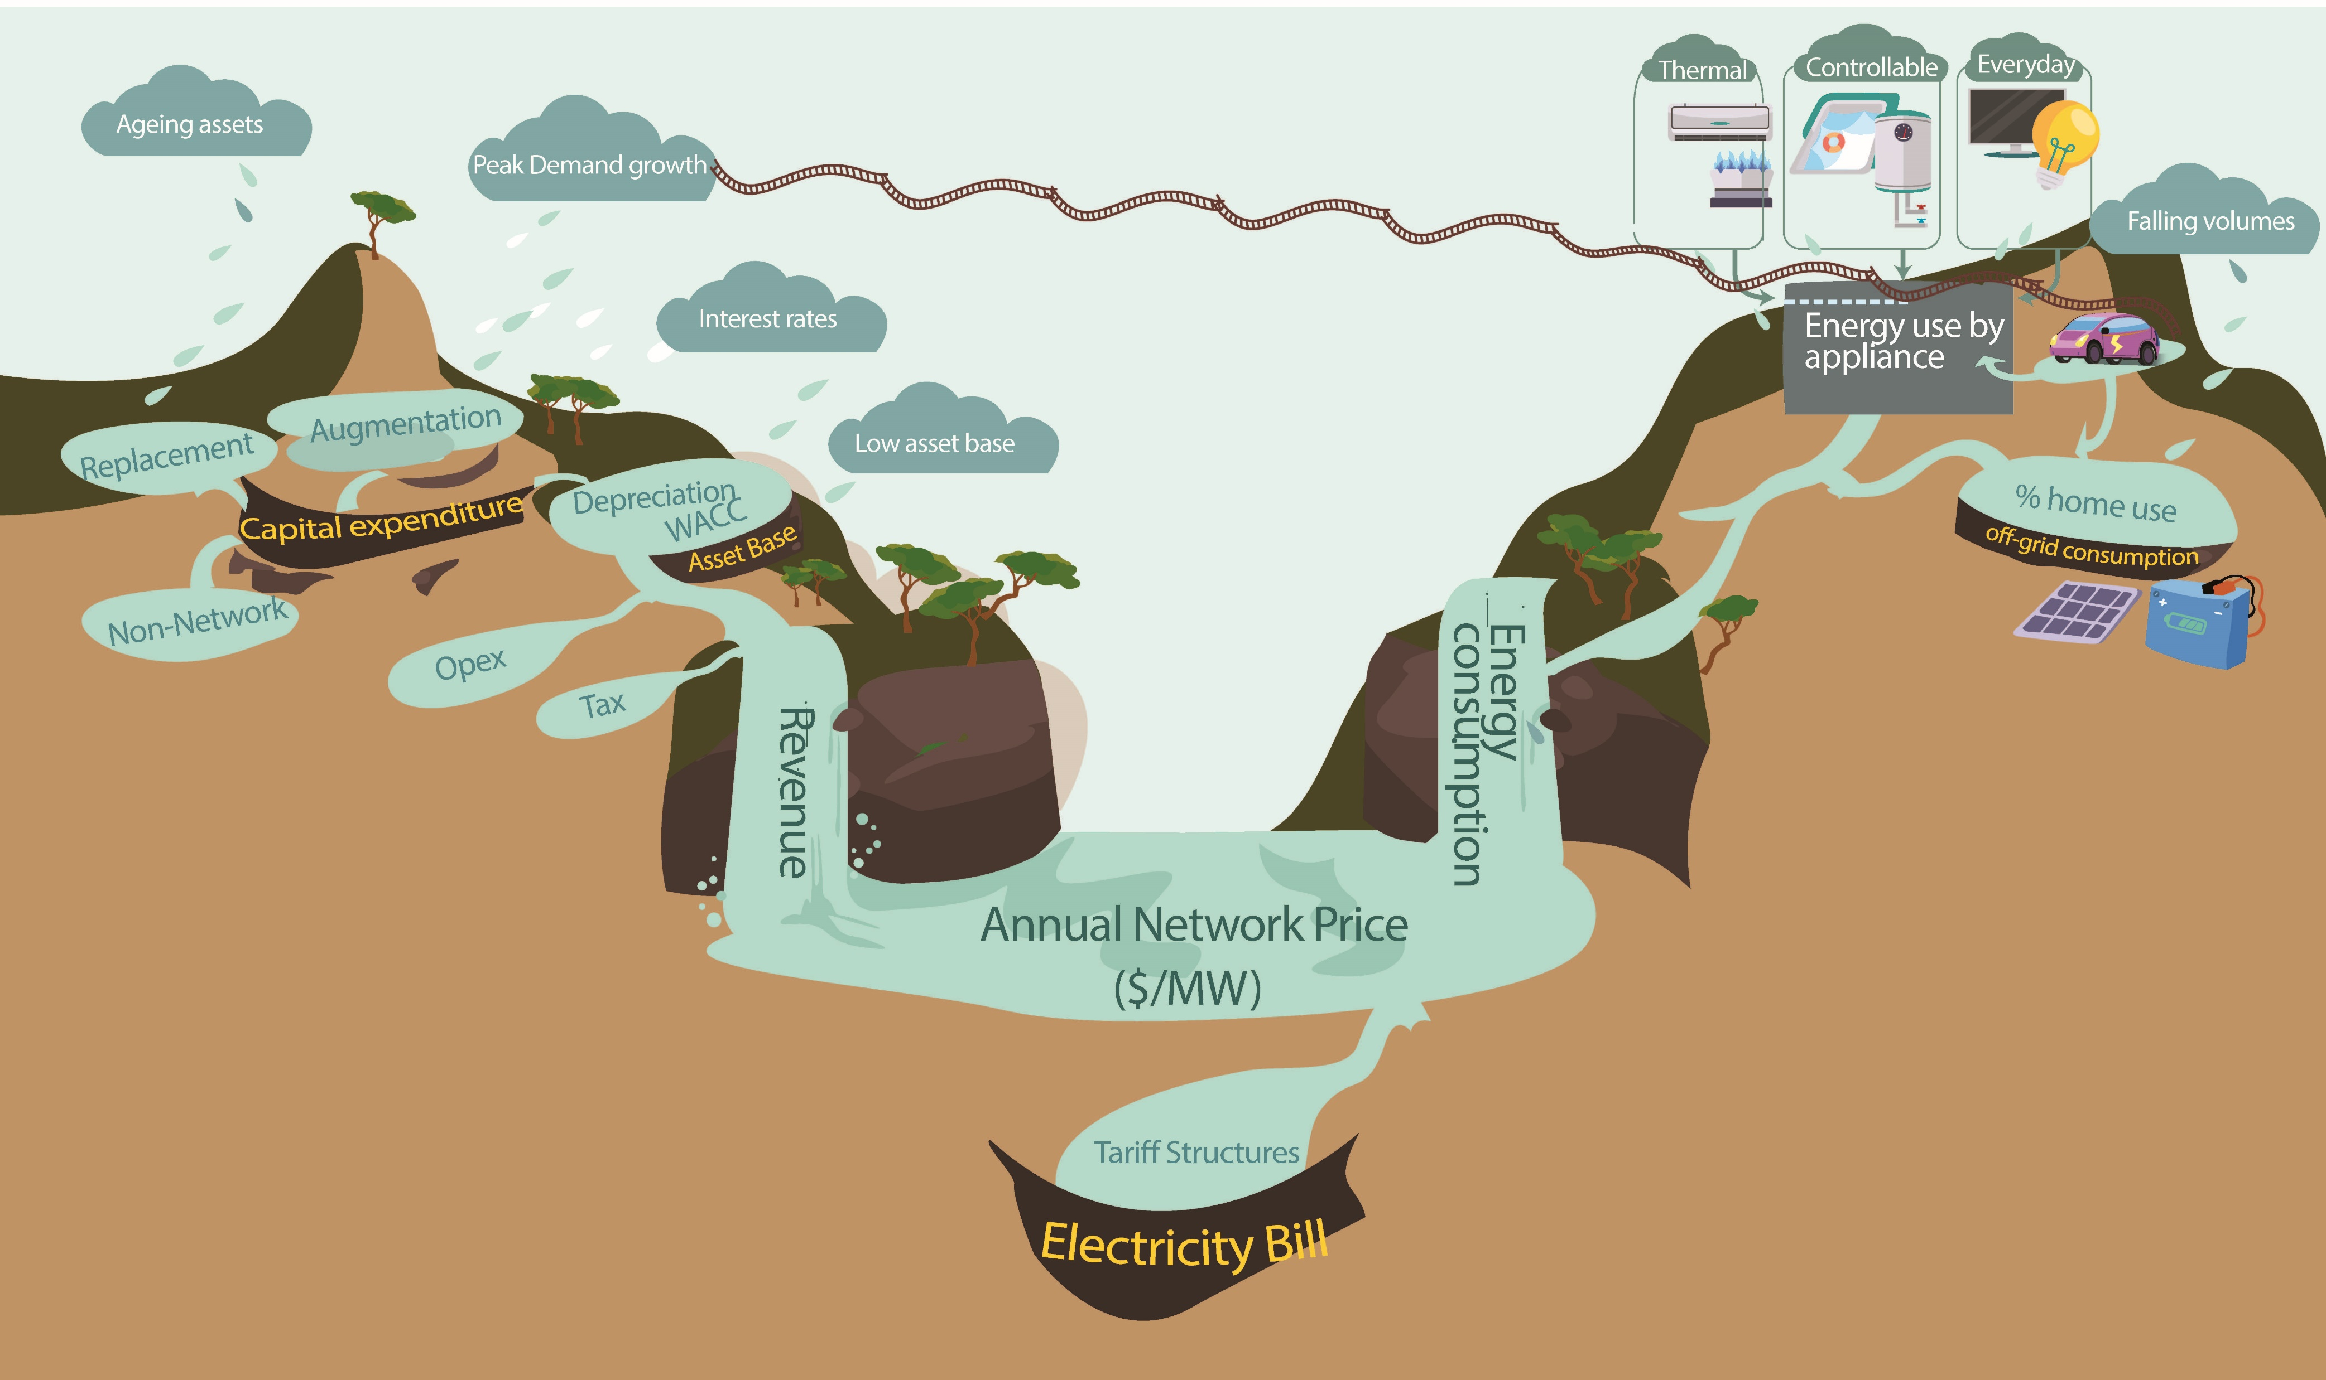
Strategic challenges that may impact affordability
Western Power faces many strategic challenges that impact long term affordability for customers. The visual below shows the affordability clouds hanging over Western Power including ageing assets, higher interest rates, prospects of a return to higher peak demand. A relatively low regulatory asset base may amplify potential upward pressure on prices.

Slide 9
Customer engagement
Western Power has devoted considerable time and effort to seeking customer feedback on its current performance and future plans. This includes a diverse and extensive engagement program. There was also a genuine effort to understand the preferences of its customers on key expenditure options. However, we consider that customers may not have been provided with enough baseline information to inform their choices, and that Western Power may wish to consider options such as intensive People Panel models to meet the gap.
Strengths
Western Power’s staff have clearly committed to seeking feedback from customers on current performance and future plans.
It appears that all customer segments have been considered, and that regions have been involved.
Engagement has been genuine, with a clear scientific method in how choices for customers have been constructed.
Concerns to raise with ERA
From the available evidence it is not clear that customers have been provided with sufficient ‘baseline’ knowledge to make informed choices on the options provided. For this reason, we consider some caution should be applied when customers have supported expenditure decisions of Western Power such as undergrounding. For instance, customers were provided with impact on short term prices, but this may not hold if interest rates rise in the long term.
Our experience is that customers require successive sessions of deliberative engagement to understand the consequences of the decisions they are making.
Possible improvements
We consider Western Power could consider ‘best practice’ deliberative engagement processes, even through the current process.
In the NEM, most networks are moving toward a People Panel – a group of household representative customers. The sessions are intensive and ongoing.
Our view is that they provide a good base-line understanding of impacts of expenditure decisions on short and long term prices.

Slide 10
3. Building blocks and tariffs

Slide 11
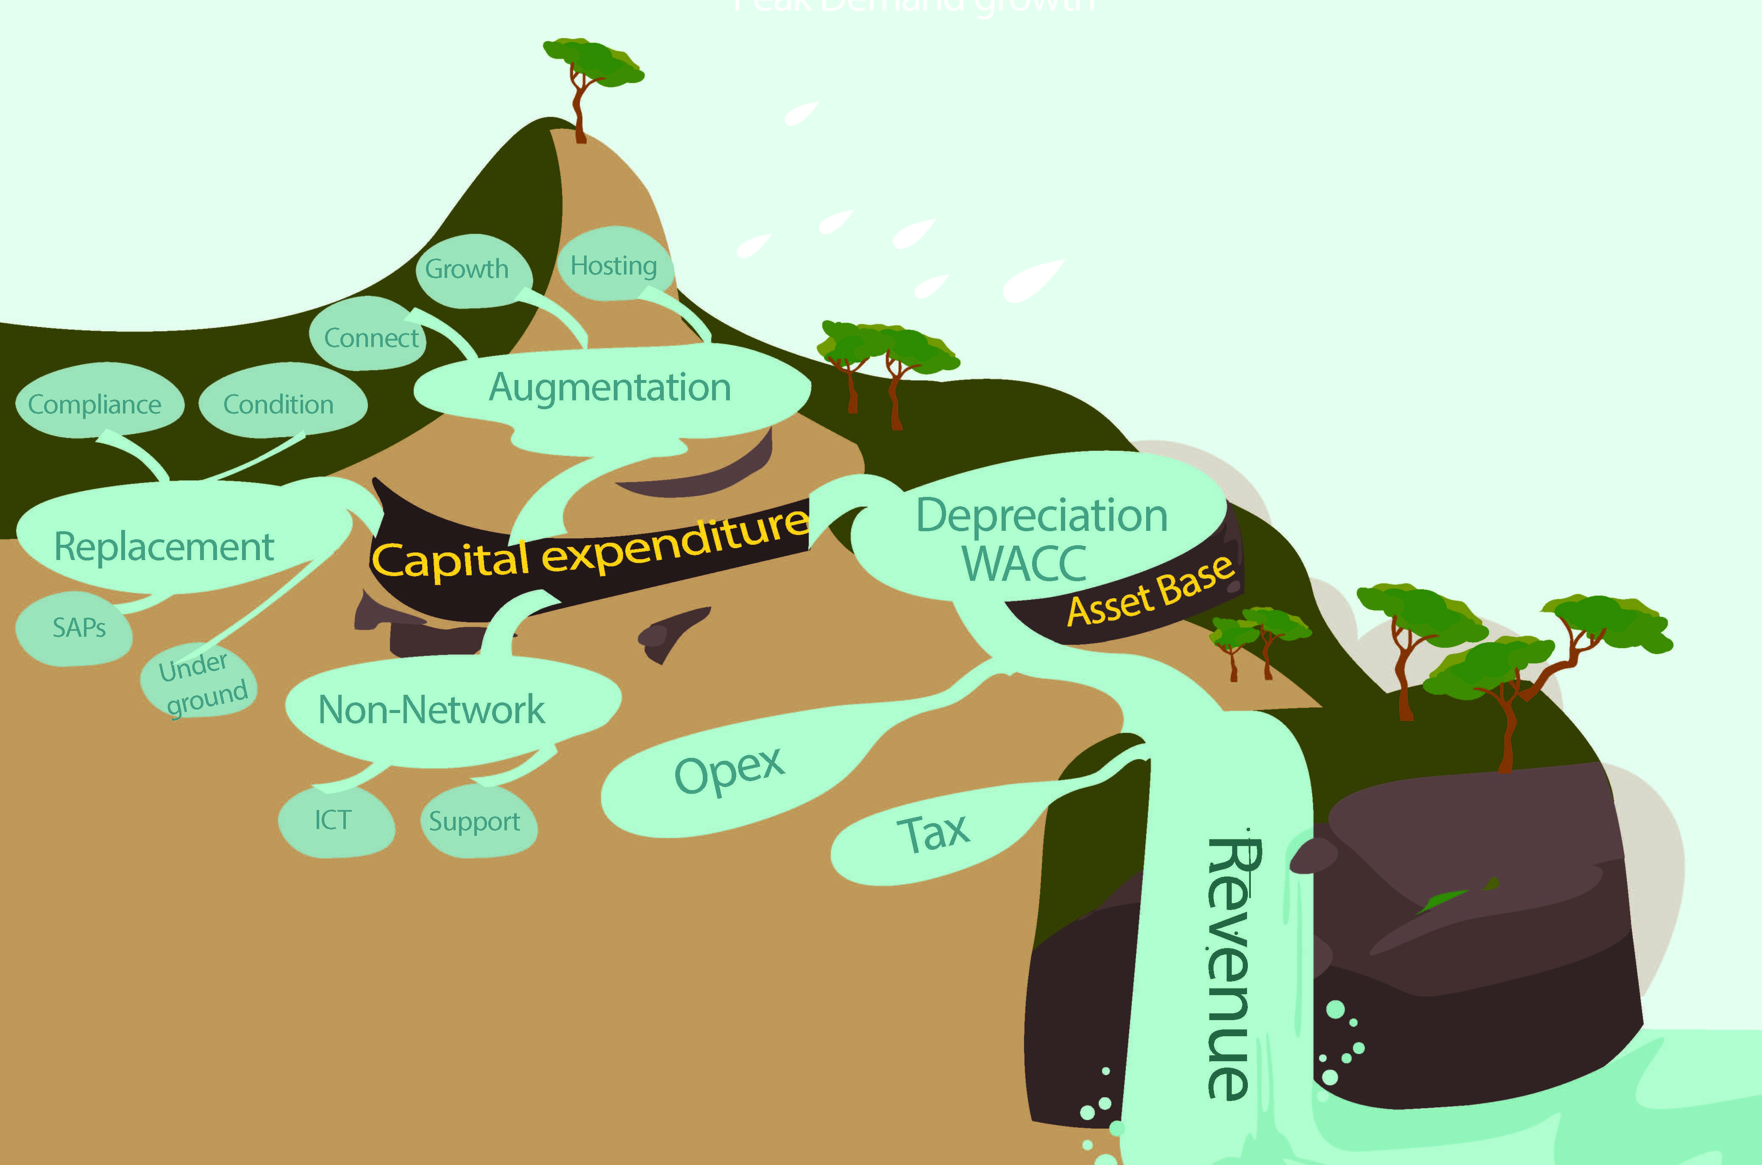


Identifying key areas for review by the ERA
Our review of supporting documents suggest there are many areas requiring further review by the ERA before the proposed access arrangement is accepted. Our view is that there may be opportunities to reduce expenditure and returns, and that this will help with long term affordability for WA customers. Key areas of concern are replacement, corporate capital expenditure, and efficiency of operating expenditure. We consider further technical analysis of the proposed rate of return method is required.
Requiring further review
Strong concerns

Slide 12
Capital expenditure
We consider a 30 per cent increase in capital expenditure will lock in higher prices for customers in the long term, and exposes customers to greater bill shock if interest rates rise in the future. While we understand that Western Power are in the middle of a significant transition, more effort should be placed on prioritising the best value projects rather than doing everything at once. We have not seen detailed business cases or risk quantification tools applied to derive the forecast.
Strengths
Western Power are implementing the key elements of the Grid strategy such as SAPs and improving hosting capacity for household solar.
We recognise that Western Power need to address ageing of assets, and that significantly deferring programs will increase the risks of price spikes in the future.
We also recognise that investment in ICT is required in a digital world where cyber-security is increasingly important.
Unlike networks in the NEM, Western Power appear to have a sound delivery record and this suggests they can deliver uplifts if required.
Concerns to raise with ERA
Total increases in capital expenditure will lock in higher prices for customers.
Replacement levels: The level of replacement expenditure increase is very high for distribution assets, and the replacement rate appears to be higher than networks in the NEM. We have not seen evidence of prioritisation based on risk quantification. There may be opportunities to ‘sweat assets’ which have low consequences of failure.
SAPs: While we strongly agree with the strategy of a modular grid over time, we consider that the business cases should be assessed in detail to ascertain whether a time delay would result in more optimal outcomes. For example, the ERA should consider if the overhead lines connecting the SAP need to be replaced today or in ten years time, as this is critical for justifying the business case.
Undergrounding: Our experience is that undergrounding costs can be 5 to 10 times higher than overhead construction. While the costs are being shared with councils, we are concerned that WA citizens may be paying too high a price for undergrounding.
ICT levels: ICT has the greatest impact on short term prices. We consider that only projects with maximum value should be approved.

Slide 13
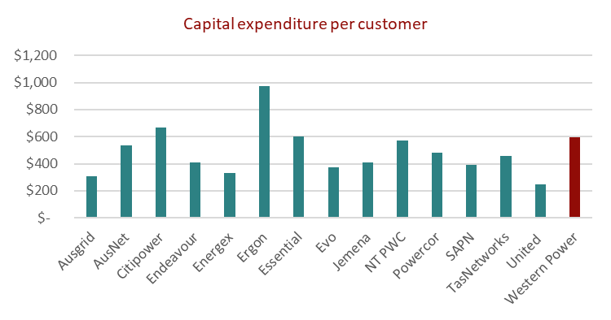
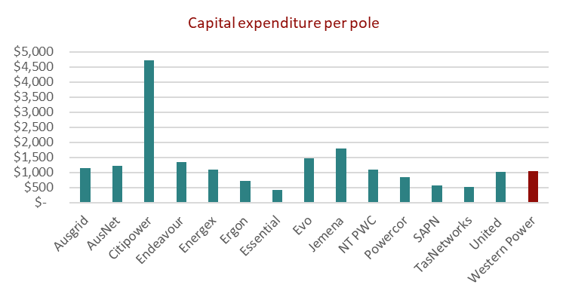
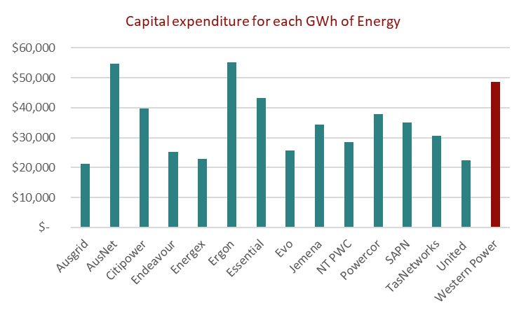
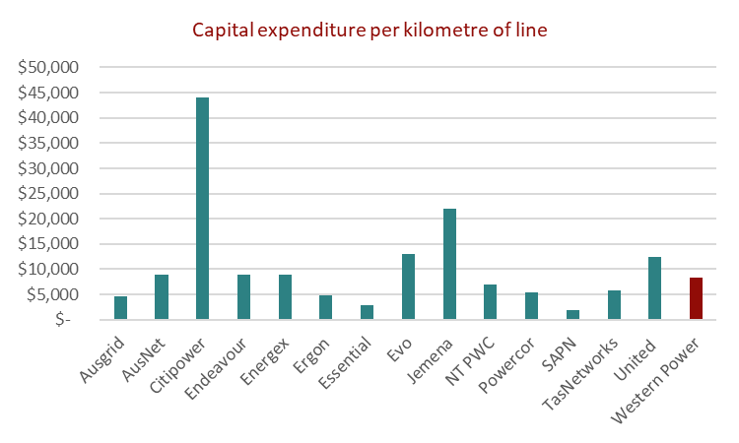
Capital expenditure metrics
We consider that capital expenditure metrics should not be relied on to form views of efficiency. Western Power seem to have proposed high capex when measured by customer numbers or energy consumption basis but are in the mid-range when considering the size of the network infrastructure. We consider that category analysis and tools such as the AER’s repex model could be used for benchmarks.

Slide 14
Operating expenditure
While Western Power are not proposing material increases to operating expenditure, we consider ERA should undertake category level benchmarking to assess if any activities could be delivered more efficiently. We also consider the ERA should carefully assess the real cost escalators and the opportunity for efficiencies going forward based on past IT projects.
Issues to raise with ERA
We caution against econometric benchmarking to form a view on efficiency, but we also note that Western Power do not seem to be an outlier compared to other networks in the NEM based on top down metrics (see next slide).
We would recommend examining if there are relevant benchmarks for categories of expenditure, such as maintenance cycles and office costs per employee.
We consider the ERA should carefully assess if any efficiency benefits from ICT programs have been incorporated into the efficiency trend forecast, noting that $14 million appears to be a low level of target efficiency given a total opex of $2300 million.
Greater economic assessment should be applied to the real cost escalators. We consider that escalators may be considered as an annual revenue adjustment (similar to cost of debt) to avoid ‘locking in’ pessimistic scenarios of material and labour cost rises.

Slide 15
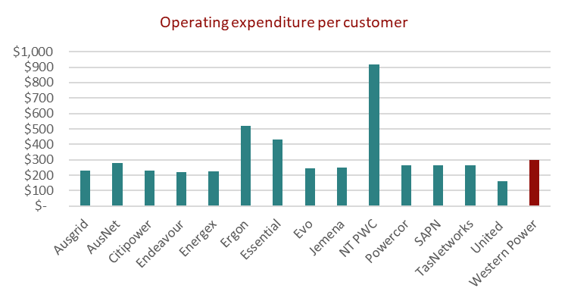
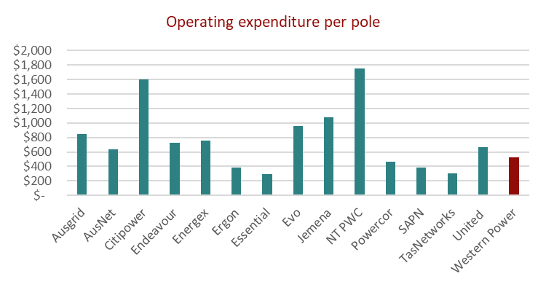
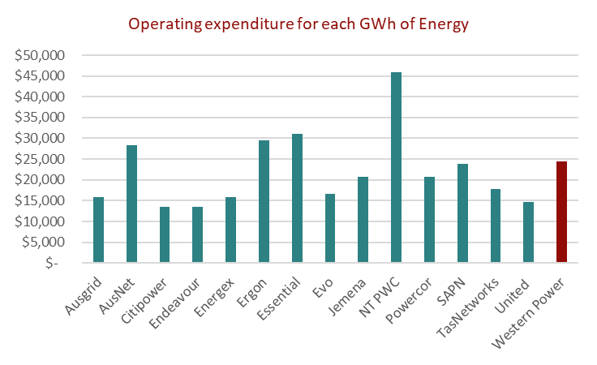
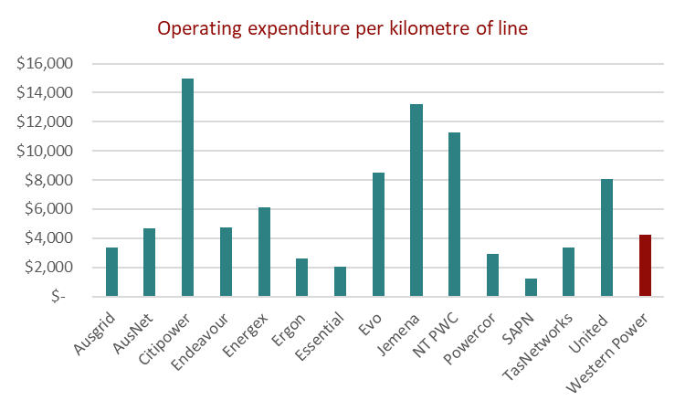
Operating expenditure metrics
Western Power has a unique mix of geography and scale that make it difficult to benchmark from a top down perspective. Our experience is also that accounting treatment of overheads has a bearing on results. Regardless, there is no evidence to suggest that the costs are very high compared to networks in the NEM on a wide array of top down benchmarks.

Slide 16
Rate of return
Western Power proposed a new method to calculate the rate of return, and this leads to a higher rate in the short term. This should be examined in detail by the ERA to ensure there are no windfall gains made by Western Power. However, we note that the method may be more consistent with the actual debt structuring of Western Power, and that the impact of higher rates today could result in lower rates in the future.
Issues to raise with the ERA
We have limited technical expertise to provide a view on whether the change in methodology proposed by Western Power is appropriate and in the long-term interests of customers.
We consider that the ERA should examine whether moving to a calculation that more closely mirrors the debt structuring of Western Power, and whether a ten year trailing average would better serve the long-term interests of consumers.
While there are concerns that the method results in a higher rate of return today, the ERA should consider whether this method will ‘lock in’ the most recent period of low interest rates as we move forward.
In any case, we consider this area requires a technical opinion to ensure that customers do not inadvertently pay more for electricity services.

Slide 17
Tariff reform
The documentation on proposed tariffs is highly technical. In particular, we could not locate clear analysis on the potential bill impact on customers if they do not change their energy consumption habits. While we support a move to lower energy rates in the day (solar sponge), we are concerned that fixed costs are going to increase significantly.
Strengths
The concept of cheaper electricity rates to coincide with low-cost solar generation is sound, and is consistent with the direction of the NEM.
We also consider a more expensive peak period is desirable for all customers, particularly before the advent of mass electric vehicles.
We consider that incremental pace of tariff reform is in the long term interests of customers, who have time to adapt to changes in tariffs without the risk of facing bill shock.
Weaknesses
We would like more information on the expected increase in fixed rates beyond the first year. Our concern is that fixed rates are likely to result in bill shock for customers who consume low amounts of energy from the grid. Further, low income households may be disproportionately impacted in terms of bill shock.
We question whether the long run marginal cost calculation has given enough consideration to the possibility of systemic demand growth in the network if electric vehicles charge in the evening. We consider that more revenue could be collected from peak charges rather than fixed charges.
3. We consider that tariff reform should be complemented with communications. We have not seen a communication plan.

