Slide 1
Sector Information Session
Commissioning of Earlier Intervention and Family Support (EIFS) Services
January 2024

Slide 2

Acknowledgement of Country
The Department of Communities proudly acknowledges Traditional Custodians throughout Western Australia and recognise their continuing connection to their lands, families and communities.
We pay our respects to Aboriginal and Torres Strait Islander people and cultures, and to Elders past, present and emerging.
Notes:
Facilitator Notes:
We would like to acknowledge the Traditional Owners of the land we are meeting on today, the Whadjuk people of the Noongar nation.
We recognise and respect their continuing connection and contribution to the land, waters and culture of this region.
We pay our respects to the Elders, past, present and future and to all Aboriginal people we have joining us today.
We recognise the long history of Aboriginal and Torres Strait Islander peoples on this land and acknowledge that the past is not just the past.
The past, the present and the future are, as they always are part of each other – bound together.

Slide 3
What we will cover in this session
EIFS Strategy and current services
Services to be commissioned
Procurement approaches
Key activities and timelines
Getting prepared for the Tenders
Notes:
Current Transcript – Slide and Recording is accurate
So the purpose of this session is to provide an overview of the upcoming Earlier Intervention and Family Support services commissioning activities that are coming up. The timelines and also our procurement approaches which will commence in early 2024. So in this session, we will cover the EIFS Strategy and also the current services that are being provided, the services that are being recommissioned, our procurement approaches, key activities and timelines and getting prepared for the tenders

Slide 4
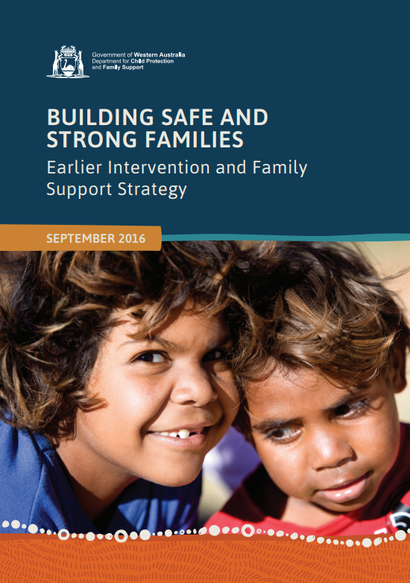
EIFS Strategy and Key Focus Areas
Delivering shared outcomes through collective effort
A culturally competent
service system
Diverting families from the child protection system
Preventing children
entering care
Please click here for the EIFS Strategy.
Notes:
Current Transcript – Slide and Recording is accurate
The Earlier Intervention and Family Support services that are being recommissioned come out of the EIFS Strategy that was released in 2016. The EIFS Strategy provides a framework for the alignment of the service system to meet the needs of the families that are most vulnerable in Western Australia. As you can see, the EIFS Strategy has four key focus areas. Number one, delivering shared outcomes through collective effort. Number two, developing and implementing a culturally competent service system. Number three, diverting families away from the child protection system. And number four, preventing children entering care.

Slide 5




EIFS Suite of Services
Aboriginal In-home Support Service
ACCO led culturally safe and intensive in-home support to Aboriginal families where children are at imminent risk of entering care or to safely reunify
Service streams include:
Keeping Children Safe at Home (Communities referrals)
Reunification (Communities or self-referrals by families)
Operates across metropolitan area including Peel
Intensive Family Support Service
Provides intensive in-home support to families where their children are at imminent risk of entering care or to safely reunify children home
Two service streams:
Keeping Children Safe at Home (Communities referrals)
Reunification (Communities or self-referrals by families)
Operates in 14 locations across the metropolitan and selected regional areas
Family Support Network
Provides diversionary and co-ordination support to families needing to navigate the service system
Two service streams:
Assessment & Coordination (open referrals)
Intensive Case Management (Communities referrals)
Operates in four metropolitan corridors
Regional Service Model
Provides a continuum of support services in certain regional and remote locations
Three service streams:
Early Diversionary Support Network (open referrals)
Community Intensive (Communities referrals)
Statutory Intensive (Communities and self-referrals for reunification)
Operates in three regional locations
Notes:
Current Transcript – Slide and Recording is accurate
Currently, the Department of Communities commissions a range of Early Intervention and Family Support services. They're on the screen now. The Aboriginal In-home Support Service, the Intensive Family Support Service, the Family Support Network, which comprises the assessment and coordination stream and the intensive case management stream, and also, the Regional Service Model, which brings early intervention and family support services to regional areas.

Slide 6
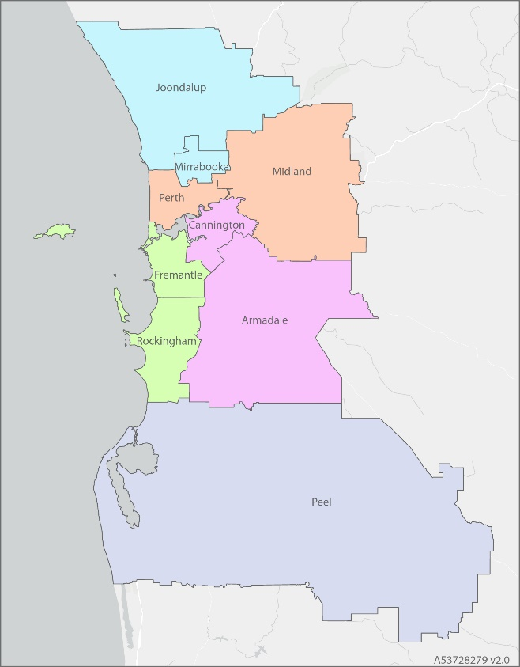
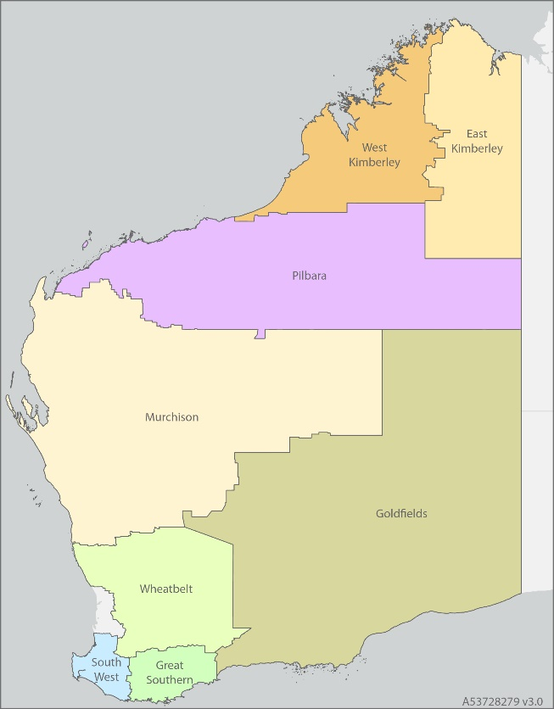
EIFS Service Locations
Family Support Network (FSN)
Aboriginal In-home Support Service (AISS)
Intensive Family Support Service (IFSS)
Regional Service Model (RSM)
Department of Communities
Notes:
Current Transcript – Slide and Recording is accurate
This slide provides an overview of where the EIFS service system currently operates across the metro and regional areas. The EIFS services have been designed to complement each other and deliver to families across the full spectrum of family support needs within a particular geographic area. It is intended that EIFS services work together as part of a wider service system, building connections and client pathways between each other and one another to deliver long-term, sustainable, and positive outcomes for individuals and families. As you can see on the screen the Aboriginal In-home Support Services, Intensive Family Support Services, and Family Support Networks are delivered and currently operate in the metropolitan area. In regional and remote locations, the Intensive Family Support Services and the Regional Service Model currently operate. The Regional Service Model operates in the South West, Pilbara, and East Kimberley only.

Slide 7
EIFS Milestones and Achievements
Ongoing funding for AISS, IFSS, FSN and the RSM South West has been secured
Expansion and enhancement of EIFS services in three regional locations in 2023 (East Kimberley, Pilbara and South West)
87.5% of children referred to AISS remained at home with their family after 12 months (2021-22)
82.4% of children referred to IFSS remained at home with their family after 12 months (2021-22)
Family Support Networks supported 8,011 clients in 2022-23
Notes:
Current Transcript – Slide and Recording is accurate
EIFS has achieved a lot since 2016. I'd like to talk you through a number of the milestones and achievements. EIFS has secured ongoing funding for the Aboriginal In-home Support Services, Intensive Family Support Services and Family Support Network, as well as the South West Regional Support Model. Likewise in 2023, the Department of Communities and partners implemented the EIFS services in the three regional areas: East Kimberley, Pilbara, and the South West. EIFS is proving to be very effective and successful in diverting children from the Child Protection System and preventing children from entering care. In the 2021-2022 financial year, 87.5% of children referred to the Aboriginal In-home Support Services remained at home with their family after 12 months, which is an incredible achievement. In the same period of time, 82.4% of children referred to the Intensive Family Support Services remained at home with their family after 12 months. To give you an idea of the volume in the 2022-2023 financial year, Family Support Networks across the metropolitan area supported 8,011 clients.

Slide 8
Community Consultation and Sector Engagement
Information Sessions were held from October 2022 to March 2023 to discuss upcoming commissioning - 138 people attended the sessions.
In 2022, Indigenous Professional Services (IPS) conducted extensive community consultations - 73 stakeholders participated with a further 80 providing online feedback.
An ACCO Sector Strengthening Session held on 12 June 2023 was attended by 34 individuals representing 32 ACCOs from across WA.
Notes:
Current Transcript – Slide and Recording is accurate
We know that expertise in supporting families to keep their children at home exists throughout the entire state and not just in one sector. As a result, the Department of Communities has undertaken significant consultation and engagement across all areas of the state with all types of people in preparation for this tender. Between October 2022 and March 2023, the Department of Communities held information sessions, resulting in nearly 140 people attending these sessions. In 2022, Indigenous Professional Services conducted extensive community consultation involving 73 stakeholders with a further 80 providing feedback. In June 2023, a further ACCO Sector Strengthening Session was attended by a number of 34 individuals representing 32 ACCOs from across WA.

Slide 9
Alignment of Service Names
The following name changes will come into effect with new contracts (2025):
Regional Service Model will be renamed Regional Family Support Hub (The Hub). The service streams will be renamed as follows:
  Early Diversionary Support Network will be renamed to Support Network
  Community Intensive In-home Support will be renamed to Community Intensive Case Management
  Statutory Intensive In-home Support will be renamed to Regional Intensive Support
Notes:
Current Transcript – Change slide and Recording (6.22 – 6.57) Ben Whitehouse
As a result of this consultation, some of the service names have been changed. Going forward for this tender, the Intensive Family Support Services will be renamed Keeping Children Safe. The Regional Service Model will also be renamed to become the Regional Family Support Hub or known as The Hub. The service streams that will exist within The Hub will be renamed as follows. The Early Divisionary Support Network will now become the Support Network. The Community Intensive In-home Support will now become the Community Intensive Case Management, and the Statutory Intensive In-home Support will also be renamed Regional Intensive Support. Keeping Children Safe.

Slide 10
EIFS Services Commissioning: 2024/2025
Services to be Commissioned
Services not being Commissioned
Family Support Network
Aboriginal In-home Support Service
Intensive Family Support Service
Regional Family Support Hub – East Kimberley and Pilbara
Regional Family Support Hub (formerly RSM) - South West
These contracts will be extended
Notes:
Current Transcript – Change slide and Recording (7.05 – 7.13) Ben Whitehouse
So now, moving to what is going to be commissioned in 2024 and 2025, the following services will be commissioned: the Family Support Networks in the metropolitan area, Keeping Children Safe Intensive Family Support Service in the metropolitan and regional areas, as well as the Regional Family Support Hub in the South West area. Services that won't be commissioned are: the Aboriginal In-home Support Service and the Regional Family Support Hub in the East Kimberley and the Pilbara. These contracts will be extended.

Slide 11
Locations of Programs to be commissioned
Family Support Network - Metropolitan
Four Corridors
Armadale/Cannington
Midland/Perth
Mirrabooka Joondalup
Fremantle/Rockingham
Intensive Family Support Service – Metropolitan
Nine Locations
Armadale
Cannington
Fremantle
Joondalup
Mirrabooka
Midland
Peel
Perth
Rockingham
Intensive Family Support Service – Regional
Five Locations
Goldfields
Great Southern
Murchison
West Kimberley
Wheatbelt
Regional Family Support Hub
One Location
South West
Includes Outreach
Notes:
Current Transcript – Change slide and Recording (7.35-8.40) Ben Whitehouse
Here are the locations of the services that will be commissioned. The Family Support Network metropolitan will be commissioned in four corridors: the Armadale/Cannington corridor, the Midland/Perth corridor, the Mirrabooka/Joondalup corridor, and the Fremantle/Rockingham corridor. The Intensive Family Support Service Keeping Children Safe service in the metropolitan area will be commissioned in nine separate locations: Armadale, Cannington, Fremantle, Joondalup, Mirrabooka, Midland, Peel, Perth, and Rockingham. The Intensive Family Support Service Keeping Children Safe program in regional areas will be commissioned in the Goldfields, Great Southern, Murchison, West Kimberley, and Wheatbelt. The Family Support Hub regional will be commissioned in one location which is the South West. The Intensive Family Support Service Keeping Children Safe regional and the Regional Family Support Hub regional will include outreach to other areas. Now, I'm going to hand over to Jacqui who's going to talk a little bit further about the procurement approach.

Slide 12
Commissioning Approach
Communities will be undertaking different procurement approaches depending on the location:
Metropolitan Locations:
Family Support Network
Intensive Family Support Service
Regional Locations:
Intensive Family Support Service
Regional Family Support Hub
Notes:
Current Transcript – Change slide – Recording is accurate (8.41 – 9.23) Jacqui Herring
Thanks, Ben. So the next couple of slides, we'll actually go through the commissioning approach and a procurement approach for the EIFS services. Communities will be undertaking a different commissioning approach for EIFS services in metropolitan and regional locations. We are undertaking this process as we recognise that families supported by EIFS services in regional locations are predominantly Aboriginal families. In some locations, such as the West Kimberley and Goldfields, Aboriginal families make up approximately 90% of the clientele being supported within EIFS. As such, it is important that the procurement approach supports locally based ACCOs and Aboriginal businesses to tender for these services as a priority. In the next two slides we'll run through these approaches in more detail.

Slide 13
Metropolitan Procurement Approach
FSN and IFSS
Draft Request for Tender (RFT)
Open Advertisement and competitive RFT
Respondents to provide a written and interview response to qualitative requirements
Panel Evaluation Assessment
Respondents will be required to partner with an ACCO to deliver the service.
Notes:
Current Transcript – Change slide and Recording (9.24 – 9.57) Jacqui Herring
The procurement process in the metropolitan region for the Family Support Network and Intensive Family Support Service Keeping Children Safe will involve a Draft Request being published on Tender's WA for feedback and comment. It will also involve an open advertisement and competitive request for Tender, and respondents will firstly provide a written response to qualitative criteria, then attend an interview to provide further information. Please note, non-ACCO respondents will need to partner with an ACCO to deliver the service and develop a genuine Partnership Plan with their ACCO partner.

Slide 14
Regional Procurement Approach
IFSS & The Hub
Draft Request for Tender (RFT)
Registration of Interest (ROI)
ACCO Restricted RFT
ACCO Respondents to provide a written and interview response to qualitative requirements
Panel Evaluation Assessment
If no suitable Respondents - Open Advertisement and competitive RFT
Department of Communities
Notes:
Current Transcript – Change slide –Recording is accurate (9.58 – 10.40) Jacqui Herring
Procurement method for regional locations will also involve a Draft Request to enable people to provide feedback. This will be followed by a Registration of Interest that is restricted to ACCOs on Tenders WA. ACCOs who register their interest as lead agencies for service will be invited to submit an ACCO restricted Request for Tender. ACCO Respondents will firstly provide a written response to qualitative requirements, then attend an interview to provide further information. In the event that there are no suitable ACCO respondents, there will be an Open Advertisement and competitive Request for Tender. It should be noted that non-ACCO Respondents will need to demonstrate a genuine partnership with an ACCO to deliver the service and develop a Partnership Plan with their ACCO partner.

Slide 15
Supporting the Sector
Early release of draft Request for Tender (RFT)
ROI and restricted Tender for regional areas
Staggered release of RFTs
Consistent Qualitative Criteria across all programs
Interview component in the evaluation assessment
Six-week timeframe for Request for Tender
Notes:
Current Transcript – slide and recording is accurate.
ACCOs and Aboriginal businesses have provided feedback previously which clearly indicates that current commissioning practices are difficult to navigate and can be a deterrent to ACCOs and Aboriginal businesses, particularly those that are smaller place-based organisations. To support the sector, particularly the ACCO sector as smaller place-based ACCOs, Communities has built in several commissioning components. These components include an early release of the Draft tender, Request for Tender to allow respondents the opportunity to provide feedback. This will enable interested parties to provide feedback regarding the clarity of the requirements within the request document. This also supports Respondents having additional time to prepare for the RFT opening period. Staggered release of the Request for Tender for the different services to allow Respondents time to apply for multiple programs. The use of consistent qualitative criteria across all of the programs will reduce the burden on Respondents, particularly if they're applying for multiple services. We've also included both a written and interview assessment to support a greater participation in the tender process. The interview component supports a more flexible and culturally appropriate approach for the sector, particularly ACCOs to enable them to provide information to support their response to the written Request for Tender. We've also extended the Request for Tender period from a standard four to six weeks to allow more time for Respondents to complete.

Slide 16
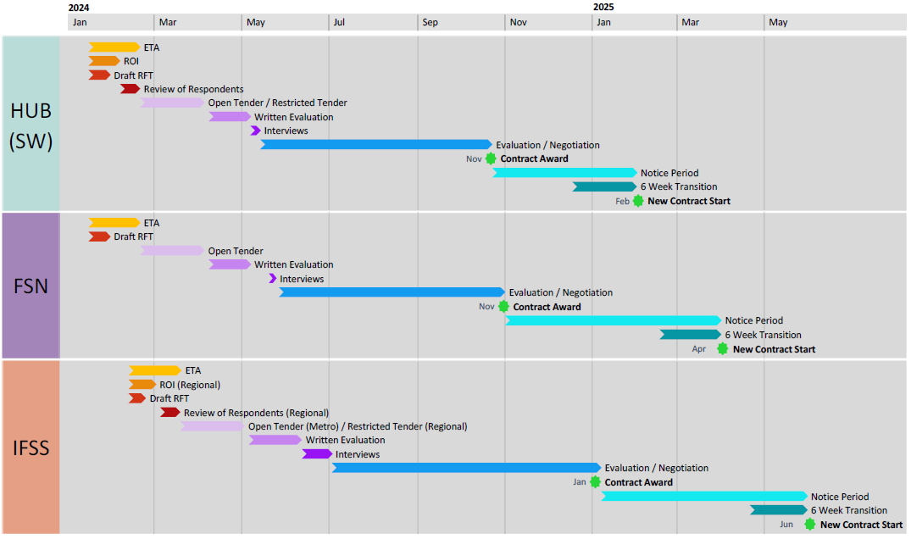

Activities and Key Dates
Notes:
Current Transcript – slide to be replaced - recording is accurate (12.08 – 12.40) Jacqui Herring
This slide gives an overview of the proposed commissioning process. It might be a little bit difficult to see and it will be included in our pack that we send out at the end of this session, including and it includes timelines, key activities, and dates for each of the programs being commissioned. A slide outlining each program including key dates will follow in the next couple of slides. Please do note though that these activities and dates are anticipated, and we are awaiting Delegated Authority approval. So whilst we don't anticipate them changing, they may, and we will obviously advise you via your registered email address.

Slide 17
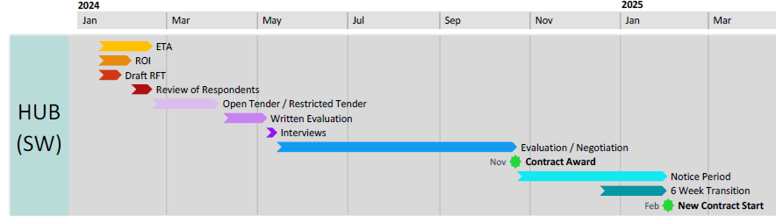
The Hub (SW) Commissioning Activities Timeline
Activity | Completion Date (Financial Quarter) | Anticipated Month
Draft RFT and ROI Release Date | 2024, First Quarter | January
Restricted Tender Release Date | 2024, First Quarter | February / March
Service Agreement Awarded | 2024, Fourth Quarter | November
New Contracts Commence | 2025, First Quarter | February
Notes:
Current Transcript – change slide and recording (12.41 – 13.23) Jacqui Herring
This slide outlines the proposed timeline dates for The Hub South West Commissioning activities. The key dates for these activities include the Draft Request for Tender release, and Registration of Interest is in January. on the 15th of January. The Restricted Tender release date will be between February and March 2024. the 20th of February 2024. Interviews will commence in May 2024. on the 7th of May 2024. Negotiations and consultations with providers are due to commence in August 2024 on the 15th of August 2024 with the aim of having service agreements awarded in November 2024 by the 21st of October 2024 and new contracts commencing in from the 1st of February in 2025.

Slide 18
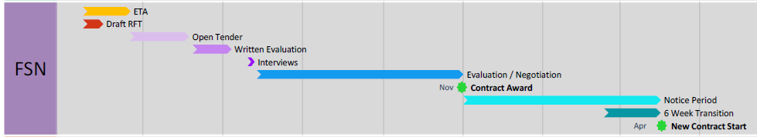
FSN Commissioning Activities Timeline
Activity | Completion Date (Financial Quarter) | Anticipated Month
Draft RFT Release Date | 2024, First Quarter | January
Tender Release Date | 2024, First Quarter | February / March
Service Agreement Awarded | 2024, Fourth Quarter | November
New Contracts Commence | 2025, Second Quarter | April
Notes:
Current Transcript – change slide and recording (13.24 – 13.55) Jacqui Herring
The proposed dates for the FSN Commissioning activities include the Draft Request for Tender being released in January 2024. on the 15th of January 2024. The Tender release date between being 20th of February and March 2024. Interviews commencing in on the 20th of May 2024. Negotiations and consultations with providers commencing in August. Service agreements being awarded in November on the 30th of October, and new contracts commencing in from the 1st of April 2025. So lots of dates there for your diaries.

Slide 19
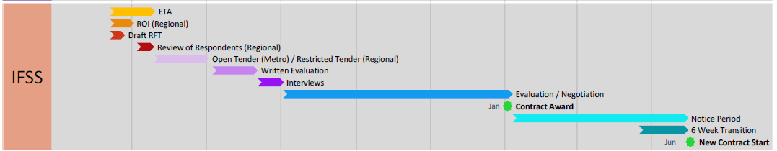
IFSS Commissioning Activities Timeline
Metropolitan Locations | Completion Date | Anticipated Month
Draft RFT and Release Date | 2024, First Quarter | February
Tender Release Date | 2024, First Quarter | March
Service Agreement Awarded | 2025, First Quarter | January
New Contracts Commence | 2025, Second Quarter | June
Regional Locations | Completion Date | Anticipated Month
Draft RFT and ROI Release Date | 2024, First Quarter | February
Restricted Tender Release Date | 2024, First Quarter | March
Service Agreement Awarded | 2025, First Quarter | January
New Contracts Commence | 2025, Second Quarter | June
Notes:
Current Transcript – change slide and recording (13.56 – 15.07) Jacqui Herring
The anticipated dates for the Intensive Family Support Service Keeping Children Safe commissioning activities, and they include the Draft Request for Tender being released in March 2024.on the 12th of February 2024. The Tender release date is in March 2024. for this tender is the 19th of March 2024. Interviews commence in June 2024. from the 26th of June 2024. Negotiations and consultations with providers will be due to commence in October. from the 9th of October. Service agreement award will happen in on the 2nd of January 2025 and new contracts are due to commence from the 1st of June 2025. The regional service locations for Intensive Family Support Service Keeping Children Safe will include a Draft Request for Tender and Registration of Interest release date in being the 12th of February 2024. The Restricted Tender release date will be in the 19th of March 2024. Interviews commencing in from the 12th of June 2024, and negotiations of consultations with providers commencing in from the 9th of October with service agreement awards occurring in on the 2nd of January 2025 and new contracts commencing in from the 1st of June 2025.

Slide 20
What can I do now to prepare?
All providers are encouraged to register on Tenders WA prior to the tender release date. The link to register is Tenders WA | Register New Business.
If you are registered on Tenders WA, please ensure your contact details are up to date and correct.
ACCOs, please ensure you are registered with Supply Nation (Supply Nation) and/or the Aboriginal Business Directory WA (Aboriginal Business Directory WA).
Notes:
Current Transcript – Slide and Recording is accurate Jacqui Herring
So there are a number of things that organisations can do to become prepared for the release of these Tenders, which are all due to start in early 2024. So it is important that you are prepared for this process. Please ensure that your organisation's details and nominated contact are up to date on Tenders WA. There have been many instances where the details listed on Tenders WA are out of date and organisations have missed out on applying. So it is really important that you get your details up to date on Tenders WA. Please also check for incorrect email addresses and names including spelling mistakes, as these also will mean that you don't receive the information that you need to. To ensure you are made aware of the Tender as soon as it is live, please also check this information is correct as soon as possible. For the Registration of Interest and Direct Negotiation, Communities Procurement processes recognise and source from Supply Nation and the Aboriginal Business Directory of WA. Please note the Office of Registrar of Indigenous Corporations, ORIC, is not a recognised source.

Slide 21
Summary
Commissioning for FSN, IFSS and the Hub (SW) will be commencing shortly with a draft request for tender being released over January/February 2024 and release of tender over February/March 2024.
Regional services will be procured using an ROI and restricted tender request.
All existing service contracts will be extended to align to the procurement timelines.
AISS and the Hub East Kimberley and Pilbara will not be part of this commissioning process.
Notes:
Current Transcript – Slide and Recording needs changing (16.15 – 17.10) Ben Whitehouse
Alright, we're nearly there. So let's just recap. Commissioning for the Family Support Network, Intensive Family Support Service Keeping Children Safe, and The Hub in the South West will be commencing shortly, with a Draft Request for Tender being released over January or February 2024 and our Release of Tender intended to be for February or March 2024. Regional services will be procured using a Registration of Interest and Restricted Tender Request. All existing service contracts will be extended to align to the procurement timelines. The Aboriginal In-home Support Service and The Hub in the East Kimberley and Pilbara will not be part of this commissioning process. Please note, we have outlined our proposed commissioning approach and timelines. We are currently finalising and getting Delegated Authority approval for this work. We don't anticipate any changes. However, if there are, we will endeavor to contact you to outline these changes.

Slide 22
Frequently Asked Questions
Please refer to EIFS Website Earlier Intervention and Family Support (www.wa.gov.au) to view FAQ Sheet
For any further queries:
Please contact the EIFS Project Team with any questions on EarlierInterventionandFamilySupport@communities.wa.gov.au
For queries regarding contracts, please contact Samantha.Hilhorst@communities.wa.gov.au
Department of Communities
Notes:
Current Transcript – Slide and Recording is accurate - Ben Whitehouse
So further to this info session, if you have any questions or require clarifications, please contact the EIFS Project Team on the email address provided. Communities will also release a more detailed Frequently Asked Questions fact sheet that will be made available on the EIFS website.
FAQ:
Communities came out to the sector to talk about the commissioning in May 2023. Why has this taken until now to hold the session? Communities chose to extend the timeframe to finalise the procurement process to make sure that we got the approach right, both for the sector and the families who need and use these services. We wanted to ensure that the approach best reflected our commitment to priority initiative’s including the ACCO Strategy and the National Agreement on Closing the Gap. It was also a consideration that we did not overlap with the finalisation of the Out of Home Care commissioning process. We do acknowledge that this has taken time and apologise for any confusion or inconvenience that this delay may have caused.
Will my organisation be able to Tender for the AISS and the Family Support Hubs in the Pilbara and East Kimberley regions? The answer to this question is no as these programs are not a part of the commissioning process. It is Communities intention to extend these contracts and current service providers have been notified.
How are ACCO’s, including smaller ACCO’s, being supported to participate in this commissioning? Communities is committed to supporting ACCO led service delivery and strengthened partnership arrangements between ACCOs and Non ACCOs. In the commissioning of the regional services ACCO led service delivery is supported by the ROI process. This approach will also support smaller place-based organisations. More generally, there will be an extended Tender release timeframe, consistent qualitative criteria will be applied across all programs, and there will be an interview evaluation component rather than a written only process. It is requirement that Non ACCO Respondents partner with an ACCO and develop an agreed partnership plan; outlining roles, responsibilities and expectations which will reviewed across the lifetime of the contract.
When should the contracts begin for each of the programs? It is anticipated that the programs will commence as follows: Family Support Hub - South West on 1 February 2025, Family Support Network on 1 April 2025 and Keeping Children Safe on 1 June 2025.
How will we be notified about when the Tenders have been released, including if the regional ROI has not resulted in any successful respondents and an open Tender process will be commencing? Notifications about the Tenders, details of their release, and any other relevant details, will be advertised on Tenders WA. Please ensure that the right person is listed on Tenders WA so that you will see the notifications.

Slide 23
Please note that Communities has outlined a proposed commissioning process including the approach and timelines. Communities is currently finalising this work and seeking approval by our delegated authority.
Communities does not anticipate any changes, however if there are any changes, we will contact you via your registered email address.

