Slide 1
TEMPLATE 3: DCE CHOICE SCENARIOS
This template provides an example of how you can present the choice scenarios that you have generated from “Template 2: DCE experimental design”.
Step 1: In the image on the next slide, replace the images, edit the text describing the payment and hazard impact timeframes, and the levels shown for the status quo (Option 3) and current situation (‘What you get now’)replace the images as appropriate.
Step 2: Replicate the slide to make 25 copies.
- You will need 25 choice scenarios plus 1 extra for your example scenario question.
- Note that the photo images and the text box at the top are not grouped with the table so you must copy & paste the entire slide each time, not just the scenario image.
Step 3: copy across your levels from Template 2 into Options 1 and 2 for each of the choice scenarios.
Step 4: Use your mouse to drag and select all components on each slides, then use the Format tab to Group, and save each scenario as an image.
- This can be inserted into an online software program, and a ‘hotspot’ function can be used where respondents click on an option to select it, or radio buttons can be provided below the image asking respondents if they would select ‘Option 1’, ‘Option 2’, or ‘Option 3’.
- If you are using a paper-based version, you may wish to add an extra row to the bottom of the table image, stating “Which of these options would you choose?” with a selection box provided at the bottom of the 3 options.

Slide 2

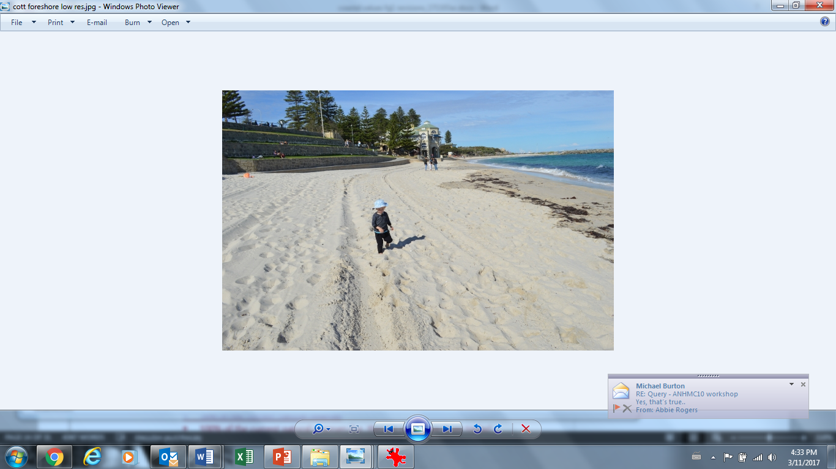

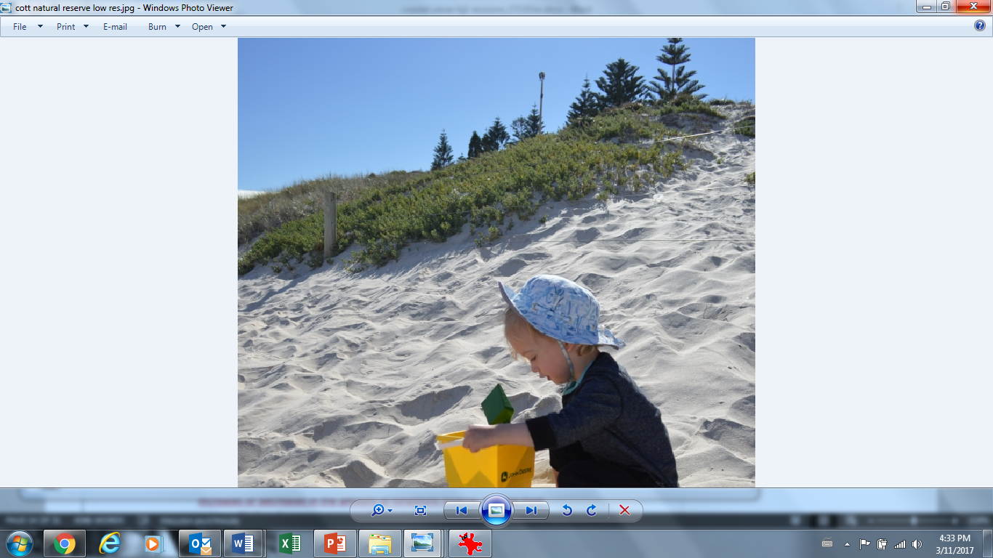
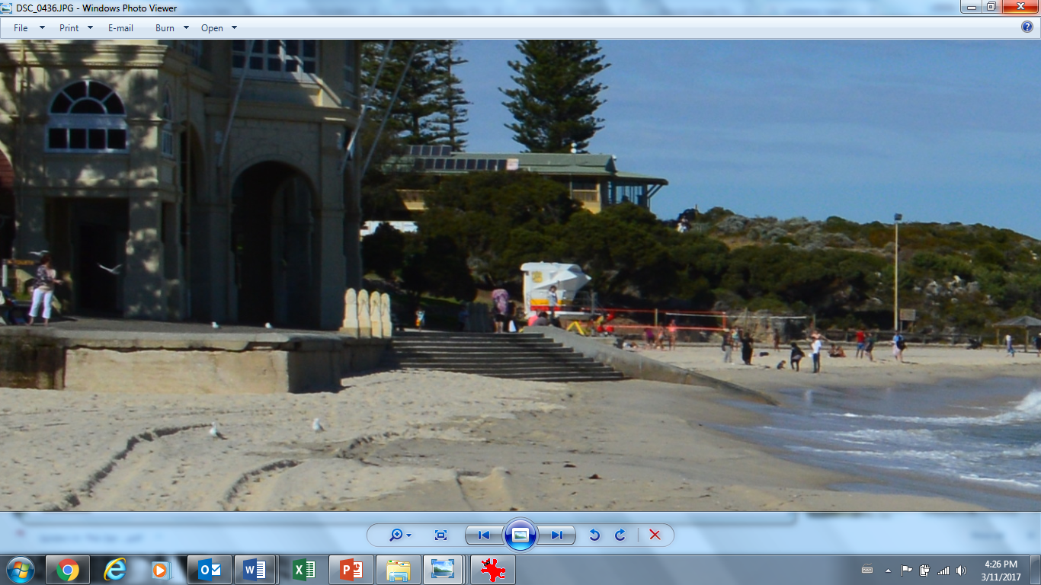
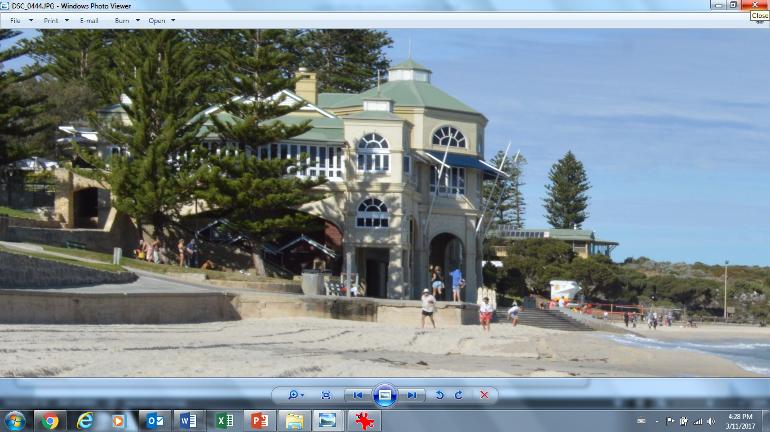
Management scenario 1: Assuming these three options are the only ones available to you, which one would you choose? Remember to be mindful of your budget constraint.
What you will get in 10 years time: |  | Option 1 | Option 2 | Option 3 Situation in 10 years time with no management change |  | What you get at the moment:
 | Sandy beach | 50% | 50% | 50% |  | 100%
 | Foreshore reserve | 25% | 75% | 50% |  | 100%
 | Natural reserve | 50% | 25% | 25% |  | 100%
 | Beach access | Average | Good | Average |  | Good
 | Retail, dining & club facilities | Absent | Absent | Absent |  | Present
Cost to you each year, for 10 years |  | $400 | $50 | $0

