Slide 1
Co-design Phase 1
Aboriginal Cultural Heritage Act 2021

Slide 2
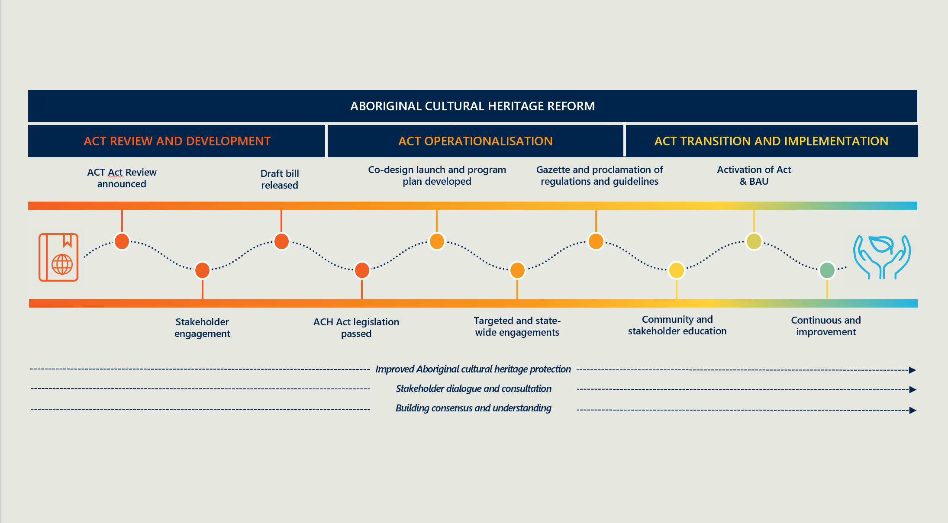
Aboriginal Cultural Heritage Reform

Slide 3
Work Program 2022
Key Tasks
  Co-design of Key Regulations and Guidelines
  Ongoing Community Engagement
  Drafting Regulations with PCO
  Establishing the ACH Council
  Development of new ACH Directory and ICT System
  Developing a model for the Distribution of LACHS $10M Capacity Building
  Rectifying validity and management issues with existing Protected Areas
  Commence education program

Slide 4
Key Features of the Act
Aboriginal people determine what is Aboriginal Cultural Heritage that is protected rather than a Government committee as currently occurs with the ACMC
Broader definition of Aboriginal cultural heritage
Formal roles for Aboriginal people and organisations
Decentralising decision making by establishing Local Aboriginal Cultural Heritage Services (LACHS)
Focus on engagement and agreement making between Aboriginal parties and proponents
Inclusion of tools and processes to better protect Aboriginal cultural heritage
Improved Compliance

Slide 5
Key Features of the Act relevant to Co-design
Mandates consultation and notification of Aboriginal parties and requires proponents and Aboriginal parties to enter negotiations.
Replaces section 18 process with a tiered approach to land use applications.
Provides certainty by:
- specifying the activities will require an approval.
- timeframes associated with an approval process.
- Aboriginal persons to be consulted or notified.
Requires proponents to undertake a Due Diligence Assessment prior to undertaking activities
Includes reference to key guideline documents

Slide 6
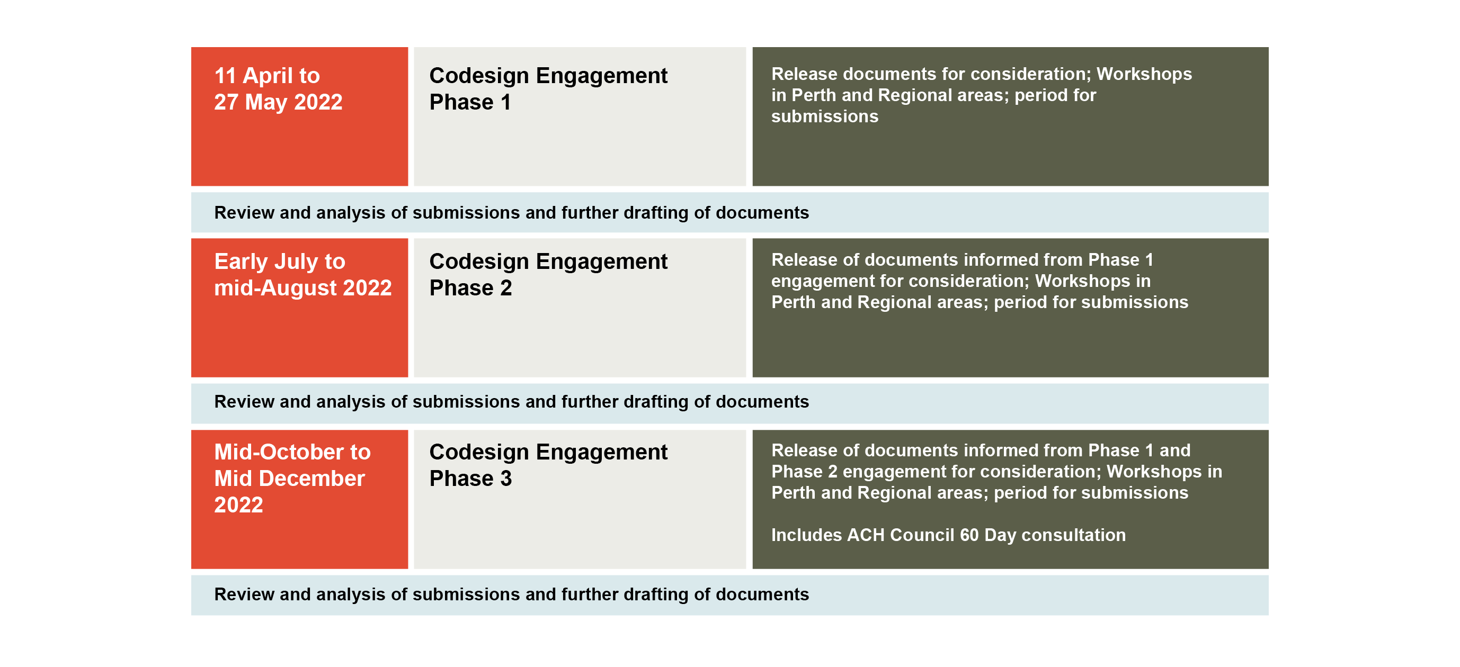
2022 Co-design Schedule

Slide 7
Objects and Principles of the Act relevant to Co-design
8. Objects of this Act …
(b) to recognise, protect, conserve and preserve Aboriginal cultural heritage;
(c) to manage activities that may harm Aboriginal cultural heritage in a manner that provides —
(i) clarity, confidence and certainty; and
(ii) balanced and beneficial outcomes for Aboriginal people and the wider Western Australian community;
9. Principles relating to Aboriginal cultural heritage ..
(b) Aboriginal people should, as far as practicable, be involved in —
(i) the recognition, protection, conservation and preservation of Aboriginal cultural heritage; and
(ii) the management of activities that may harm Aboriginal cultural heritage;
10. Principles relating to management of activities that may harm Aboriginal cultural heritage …
(d) as far as practicable, in order to utilise land for the optimum benefit of the people of Western Australia, the values held by Aboriginal people in relation to Aboriginal cultural heritage should be prioritised when managing activities that may harm Aboriginal cultural heritage.

Slide 8
Co-design Themes
n
Management Plans

Slide 9
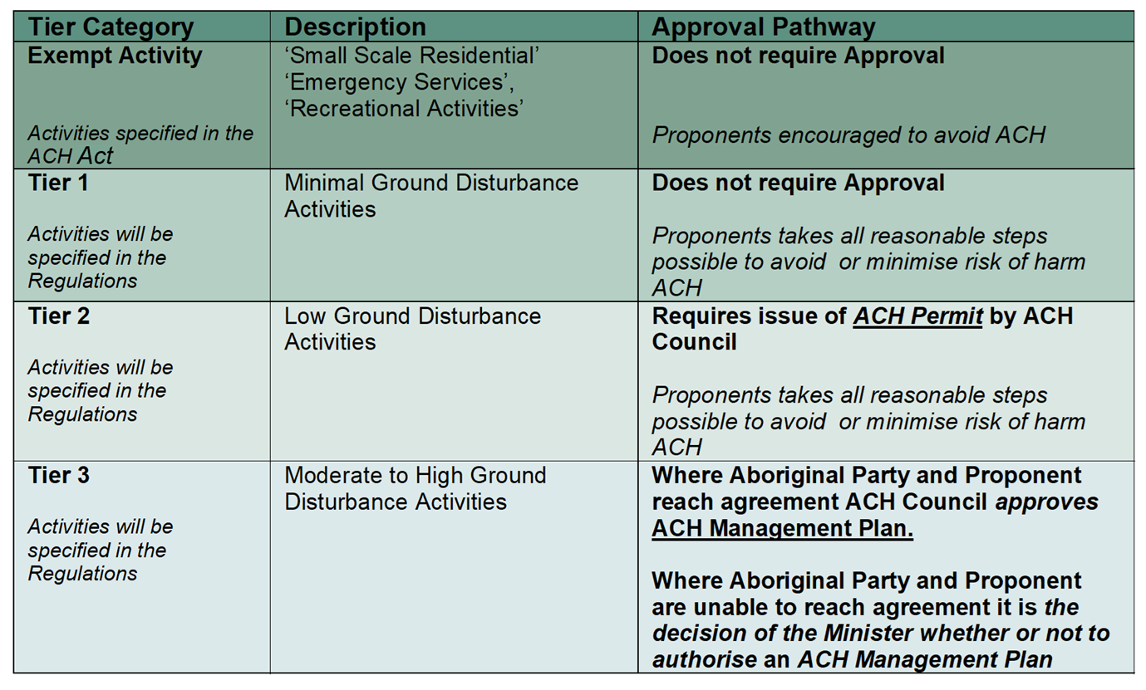
1. Activity Categories

Slide 10
1. Activity Categories
Co-design questions
Having regard to Attachment.1, which activities (if any) do you consider belong in a different category and why?
What activities other than those in Attachment 1 should be included in the Activity Categories list?
Within which category should additional activities be placed?
What other factors, such as frequency of activity and repetition of a proposed activity, need to be considered for the Activity Categories?

Slide 11
2. ACH Management Code
Proponents of activities will need to complete a due diligence assessment in accordance with the Aboriginal Cultural Heritage (ACH) Management Code prior to conducting their activities.

Slide 12
2. ACH Management Code
Co-design questions
What are reasonable, and practicable steps which proponents need to undertake to be informed whether ACH is present within the proposed activity area?
  Should these steps vary depending on e.g. the size of the area to be impacted, the type of activity (minimal, low, medium-high)?
  In what circumstances should an ACH survey be required/not be required?
What factors should be considered when determining if a proposed activity will harm ACH?
What information will assist to avoid and / or minimise harm to ACH e.g. type of ACH, geographical boundary, whether standalone or part of a large group?
How should a proponent be able to demonstrate that it has appropriately undertaken due diligence to ensure that any ACH, and the risk of harm to that ACH, has been appropriately identified?

Slide 13
3. Consultation Guidelines
Consultation Guidelines will provide the standards that will need to be adhered to in circumstances where consultation is required with Aboriginal people under the Act.

Slide 14
3. Consultation Guidelines
Co-design questions
Other than the matters listed in section 101of the Act, what other factors, if any, should the Consultation Guidelines address?
With reference to the requirements set out in s101 of the Act:
What do you consider to be a genuine attempt to contact and consult?
How much time should be allowed for that consultation to be carried out (also referenced in s139)?
What is ‘sufficient information’ that a proponent should provide to Aboriginal people and how could that best be provided?
How should Aboriginal people be able state and explain their position e.g. does it need to be in writing or can it be verbally? If verbally, how should this be captured?
What information should the proponent and the Aboriginal people be able to reasonably ask of each other e.g. having regard to commercial or cultural sensitivities?
What are the reasonable steps that a proponent needs to take in order to follow up if they haven’t had a response? Should these be different to the original steps taken to contact and consult and, if so, how?
3. Which are the most effective forms of consultation and why?
What is considered sufficient or enough consultation?
Are there any other factors that would assist with successful consultation?

Slide 15
4. Knowledge Holder Guidelines
Knowledge Holder Guidelines are required under section 294 of the Act.
The knowledge holder guidelines are concerned with the steps required for a proponent and the ACH Council to identify knowledge holders rather than determine who is or isn’t a knowledge holder.

Slide 16
4. Knowledge Holder Guidelines
Co-design questions
What reasonable steps should be undertaken by a proponent / ACH Council to identify a knowledge holder for ACH or an area?
What are the responsibilities / expectations of persons required to engage knowledge holders once they have been identified?
What are the responsibilities of knowledge holders, including to ensure that :
  i. Their status as a knowledge holder is known by others, in particular the State Government (via the Department of Planning, Lands and Heritage)?
  ii. They can be contacted to ensure they can be consulted when required?

Slide 17
5. ACH Management Plan Template Guidelines
Develop an ACH management plan template that is in accordance with the requirement under the Act.
Once finalised all ACH Management Plans submitted to the ACH Council will need to be in accordance with the ACH Management Plan template.

Slide 18
5. ACH Management Plan Template Guidelines
Co-design questions
What needs to be considered and included when developing the ACH impact statement?
In addition to the items set out in section 137(2), listed on page 2 of this document as well as Appendix 1, is there anything else that could usefully be included in the ACH management plan template?
Should there be more than one ACH management plan template to account for variations in size/complexity of propose activities or just one template that accommodates the different levels of information required for proposed activities?
If there is more than one ACH management plan template, how should these variations be accommodated and should additional information be required?
If only the level of information should change, how would you suggest determining what information is sufficient to take into account the size/complexity of the proposed activity?

Slide 19
6. Time Frames Guidelines
The purpose of this codesign is to establish prescribed timeframes associated with ACH Permits and ACH Management Plans. Once finalised the prescribed timeframes will be included in the regulations and will need to be adhered to by the ACH Council, proponents of activities and Aboriginal parties.

Slide 20
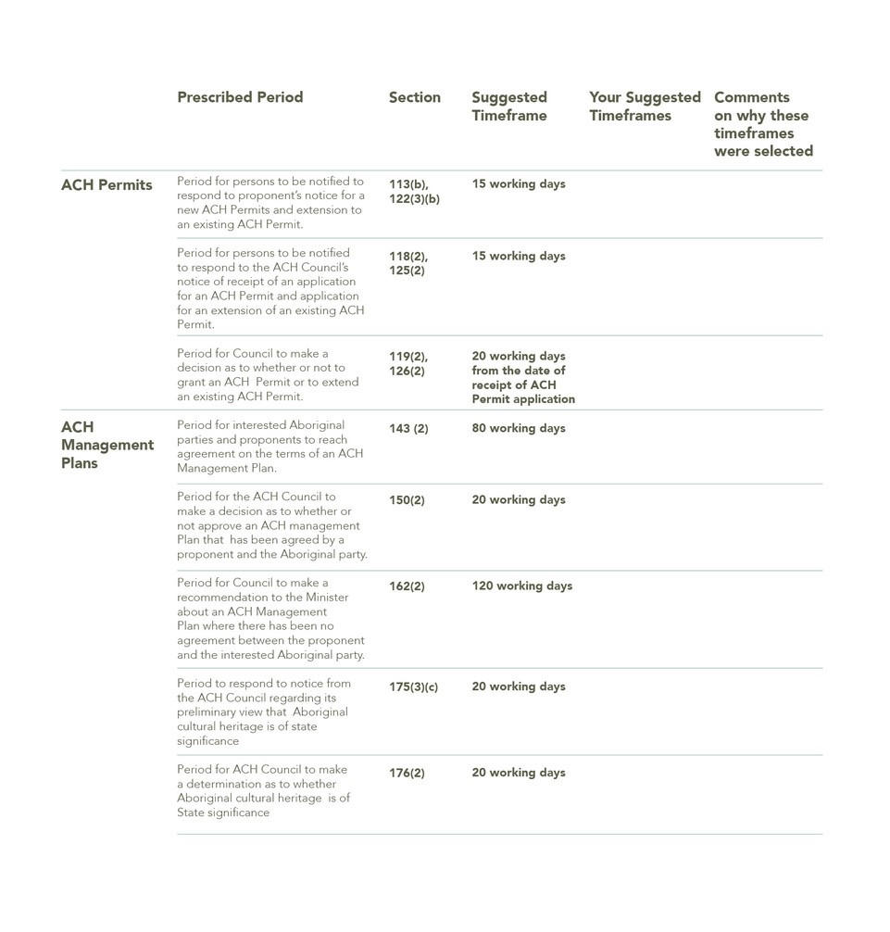
6. Time Frames Guidelines
Co-design questions
1. What prescribed timeframes are subject of codesign?

Slide 21
7. LACHS Fee Guidelines
Develop the local ACH service (fees) guidelines (LACHS Fees Guidelines) as required under section 294 of the Act.
Once appointed a LACHS will be able to charge fees for services to proponents to recoup costs associated with undertaking its statutory role. The fee for service the LACHS is able to charge needs to be in accordance with a schedule that needs to be endorsed by the ACH Council (the Council). The fee schedule that is endorsed by the ACH Council needs to comply with the Council’s own fee guidelines.

Slide 22







7. LACHS Fee Guidelines
NT Party, PBC, CATSI Act or Corporations Act Corporation
Proponent
LACHS
Local Knowledge Holder
ACH Council

Slide 23
7. LACHS Fee Guidelines
Co-design questions
What types of services should LACHS be able to charge a fee?
Should there be different fee structures for different scenarios e.g. different types/sizes of developments and/or impacts to ACH, should there be different fee structures for different types of proponents?
What factors should be considered when determining if fees are reasonable?
How should geographic differences be factored into the LACHS Fees guidelines?

Slide 24
8. State Significance Guidelines
Protecting Aboriginal Cultural Heritage of State significance.
State Significance Guidelines will include factors to determine whether ACH is of State significance.

Slide 25
8. State Significance Guidelines
Co-design questions
How can the existing heritage conventions as defined in the Burra Charter be used to define ACH of State significance?
How can they be used to differentiate from ACH that is not of State significance?
Are there any other factors that should be considered in determining State significance?
What evidence is required to determine State significance? How should the Council take different forms of evidence into consideration?

Slide 26
9. Protected Area Order Guidelines
Protected Area Order Guidelines are to include the factors to be considered in determining whether Aboriginal cultural heritage is of outstanding significance.
Under the Act it is a requirement that the Aboriginal cultural heritage in question be of outstanding significance in order for the application to be considered.

Slide 27
9. Protected Area Order Guidelines
Co-design questions
What factors make ACH of outstanding significance? How does this differ compared to other important ACH?
What are the key factors that knowledge holder(s) need to consider in applying to have ACH declared a protected area?
What sort of evidence will demonstrate that the ACH is of outstanding significance? What form should that evidence take?
Does ACH need to be of outstanding significance to more than one knowledge holders to qualify?

Slide 28
10. Substantially Commenced
Definition of ‘substantially commenced’ as it relates to historical section 18 consents that were previously granted under the Aboriginal Heritage Act 1972.

Slide 29
10. Substantially Commenced
Co-design questions
What factors should be considered in determining whether the purpose of a section 18 consent has ‘substantially commenced’?
What kind of evidence can/should be provided for these factors in order to satisfy this requirement?
Is it only the proponent who can demonstrate whether the project has substantially commenced or can/should other parties also be able to have a view? If so, what kind of evidence should they be able/expected to provide.

Slide 30


Next steps
You can make a submission via the Department of Planning, Lands and Heritage's consultation hub.
You may respond to all of the questions or only those that are of interest to you.
Please take the facts sheet package which will assist you with your submission.
Submissions will be made public.
Additional information will be shared as soon as possible
Contacts: achimplementation@dplh.wa.gov.au or
cesar.rodriguez@dplh.wa.gov.au
0428 641 785
bojana.degaris@dplh.wa.gov.au
0434 960 261

