Slide 1
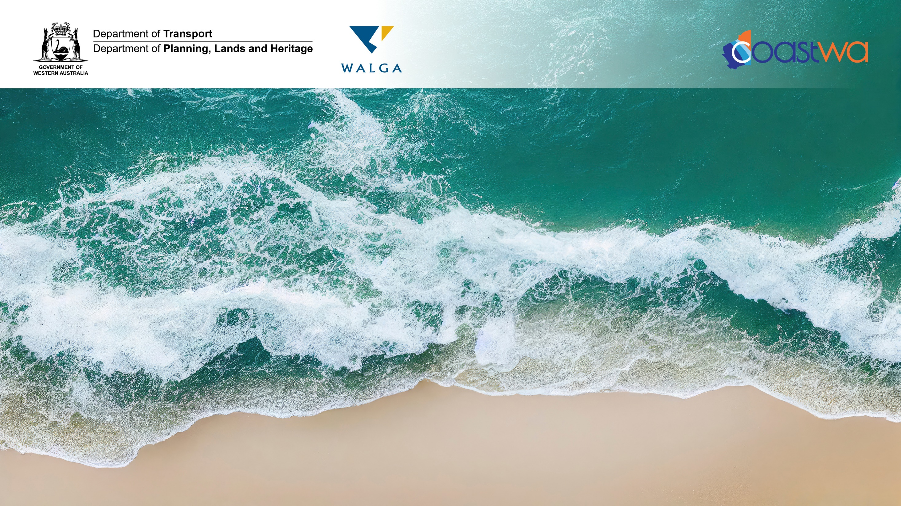
CoastWA Training
Coastal Protection Works
Presented by
Trent Hunt - M P Rogers & Associates

Slide 2
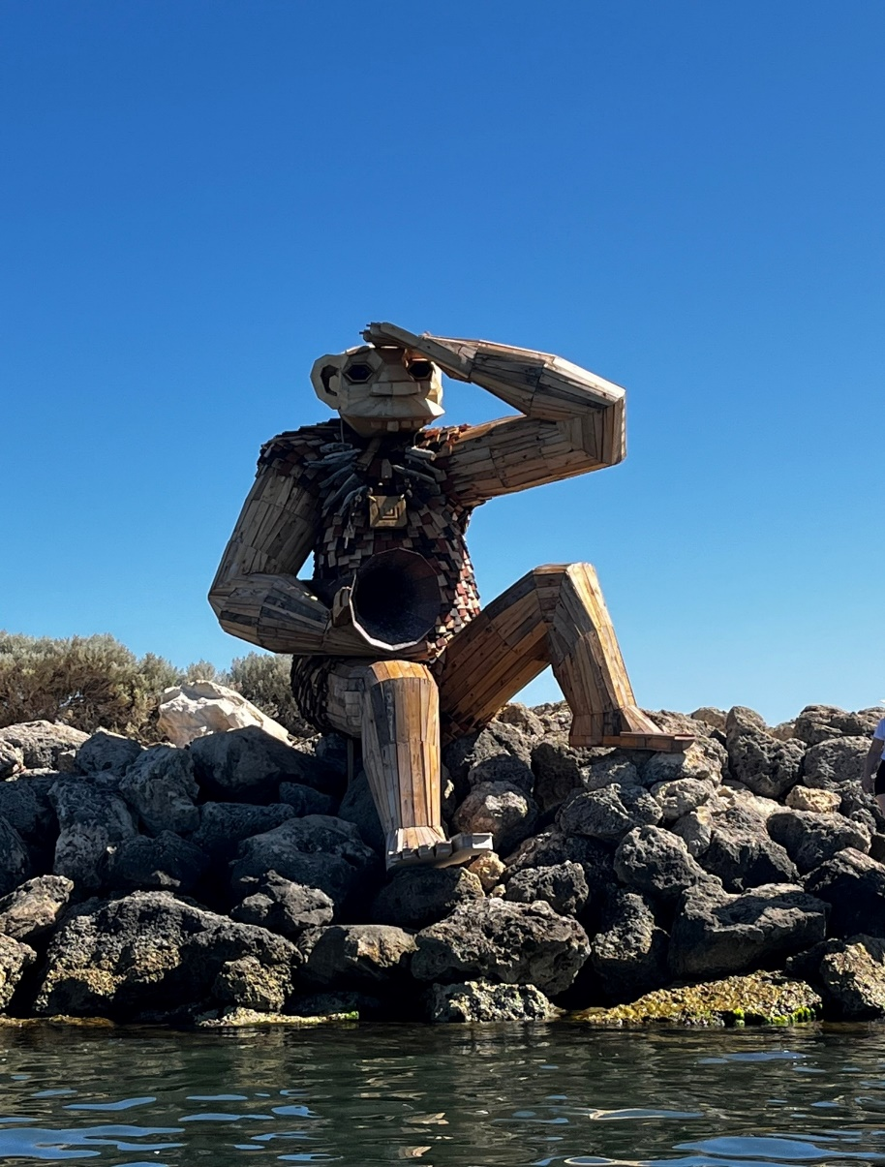
Session Schedule
Introduction What is Coastal Protection When to Protect Types of Coastal Protection | 50 mins
Break | 10 mins
Types of Coastal Protection (cont) Which Protection Type Funding & Approvals Design Considerations | 50 mins
Break | 10 mins
Case Examples | 20 mins
Further Questions | 10 mins

Slide 3
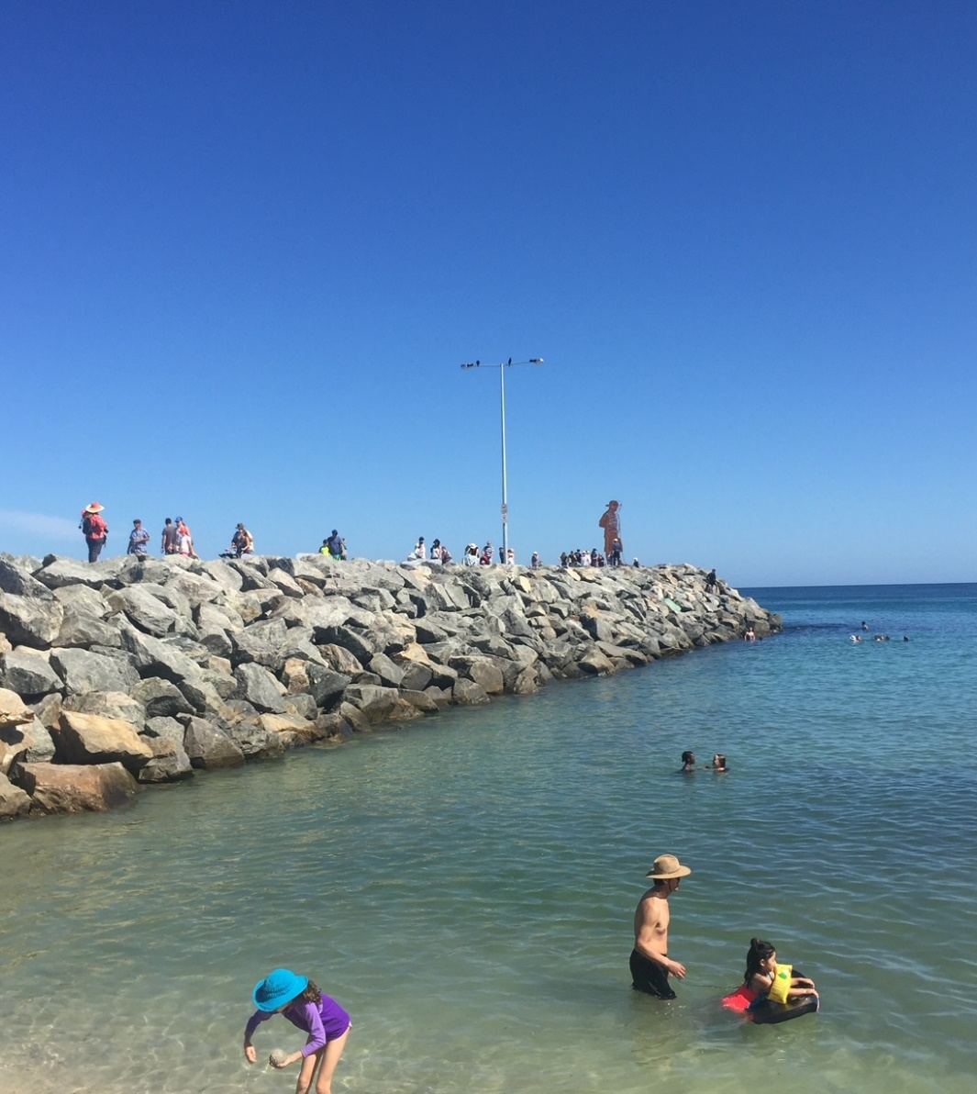
Overview
What is coastal protection?
When is coastal protection appropriate?
What are key types of coastal protection?
When should you consider different forms of
coastal protection?
What needs to be considered in selection
and design?
What impacts should be considered?
Funding and approvals
Examples and case studies

Slide 4
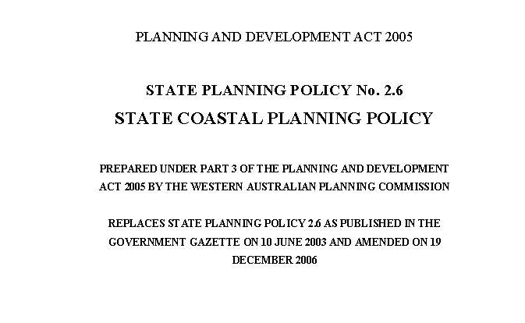
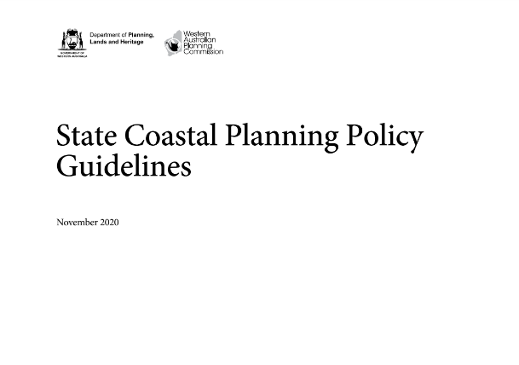
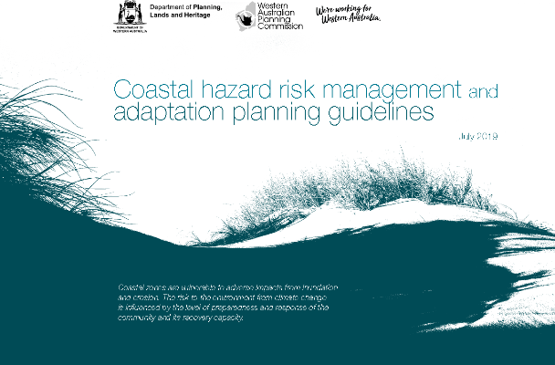
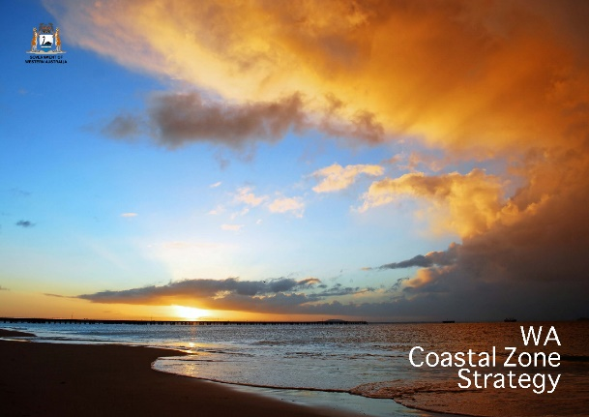
References & Documents
WA Coastal Zone Strategy
SPP2.6 State Coastal Planning Policy
SPP2.6 State Coastal Planning Policy Guidelines
Coastal hazard risk management and adaptation planning guidelines

Slide 5
What is Coastal Protection?

Slide 6
What is Coastal Protection
Under SPP2.6 coastal protection works are:
  “any permanent or periodic work undertaken primarily to alter physical coastal processes and/or manage the effects of coastal hazards.”
Coastal protection works typically protect infrastructure or assets from the action of the ocean - coastal hazards
Most frequently installed in response to coastal hazards

Slide 7
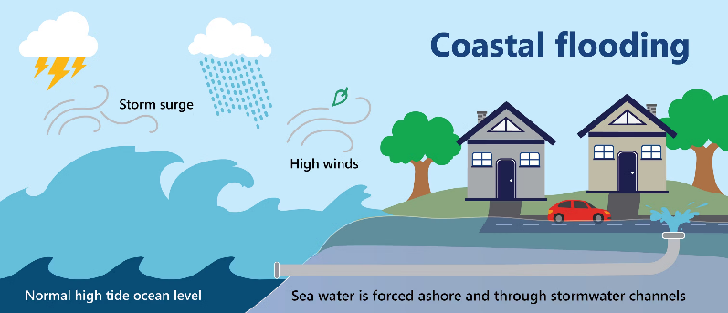
Coastal Hazards
Defined under SPP2.6 as:
  “the consequence of coastal processes that affect the environment and safety of people.”
Can include:
  Erosion
  Accretion
  Inundation (flooding)
Coastal protection works typically aim to protect from erosion and/or inundation

Slide 8
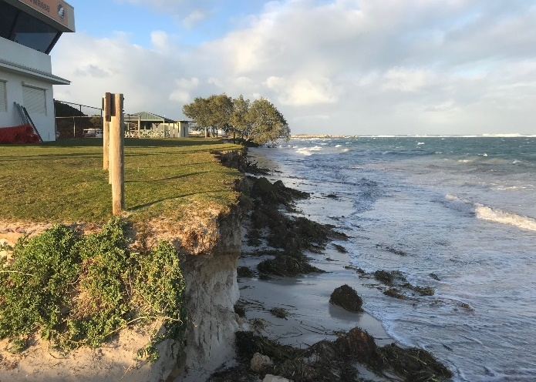
Coastal Erosion
Immediate Threat
Fear
Public outcry

Slide 9
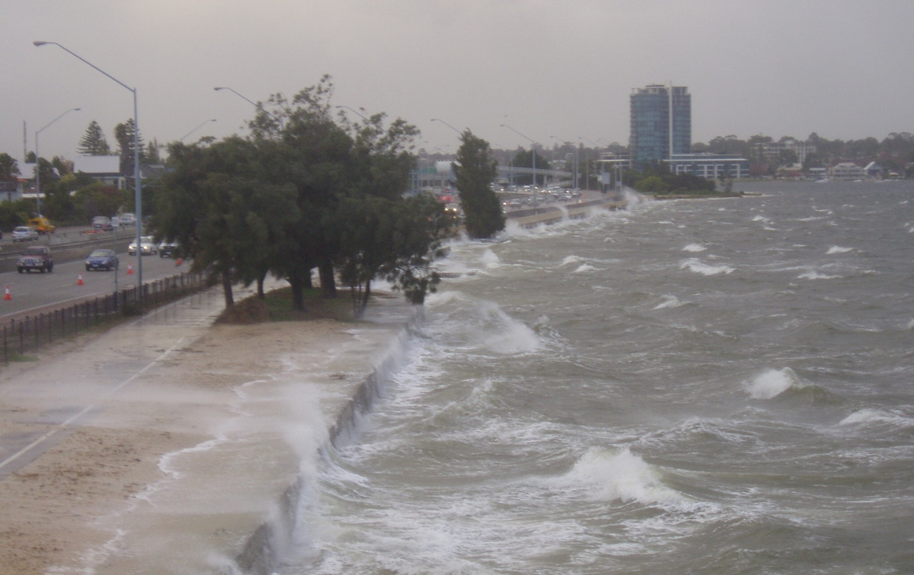
Coastal Inundation
Often in response to experienced floods
Address wave overtopping
SWAN RIVER, COMO

Slide 10
Coastal Protection Works
Protection of assets from the action of the ocean
Long history of coastal protection – not new
Records of coastal protection from 7,000 years ago
Often functional seawalls – last line of defence
Typically earth bunds, clay and stone

Slide 11
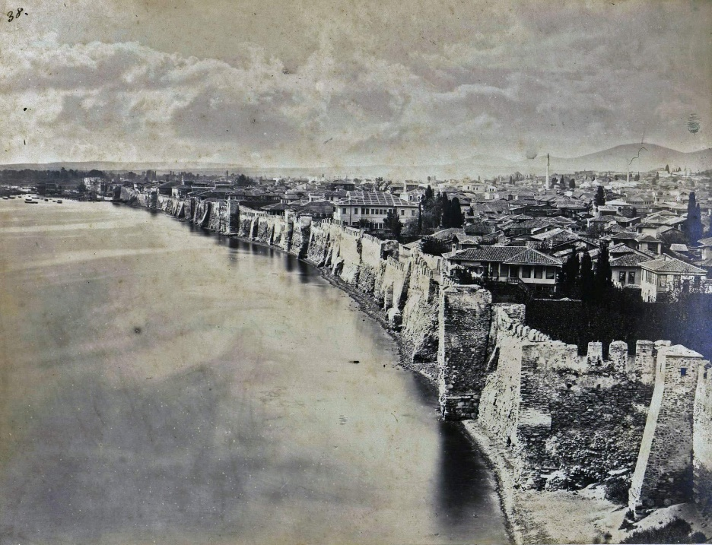
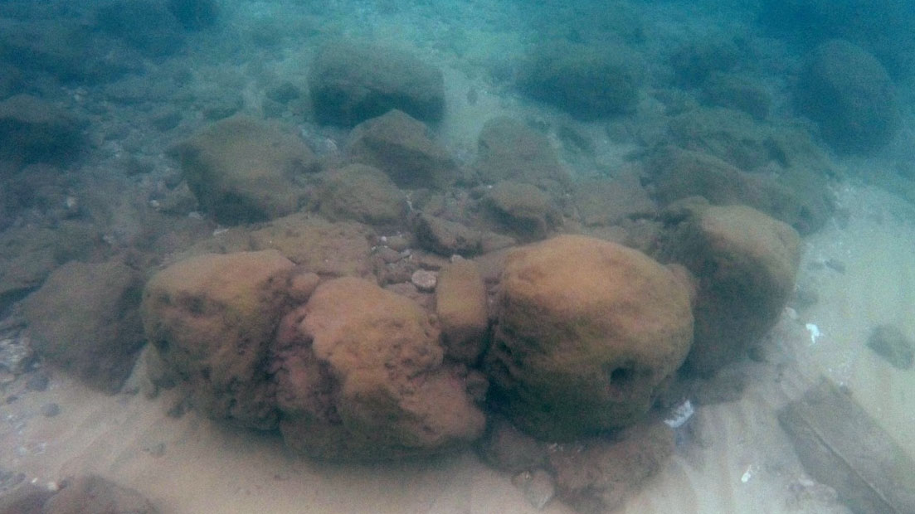
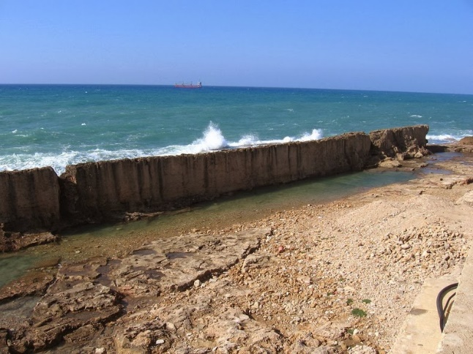
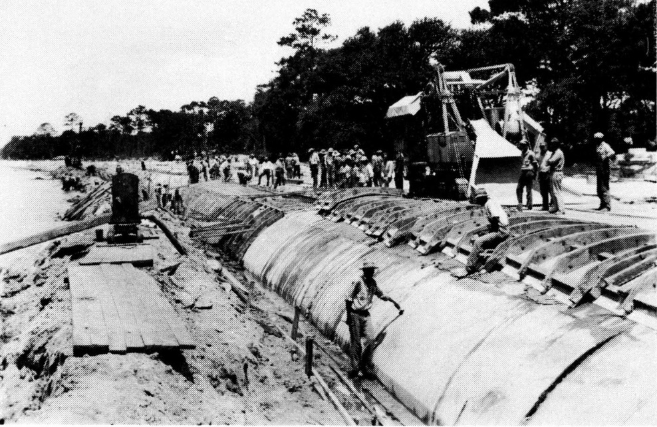
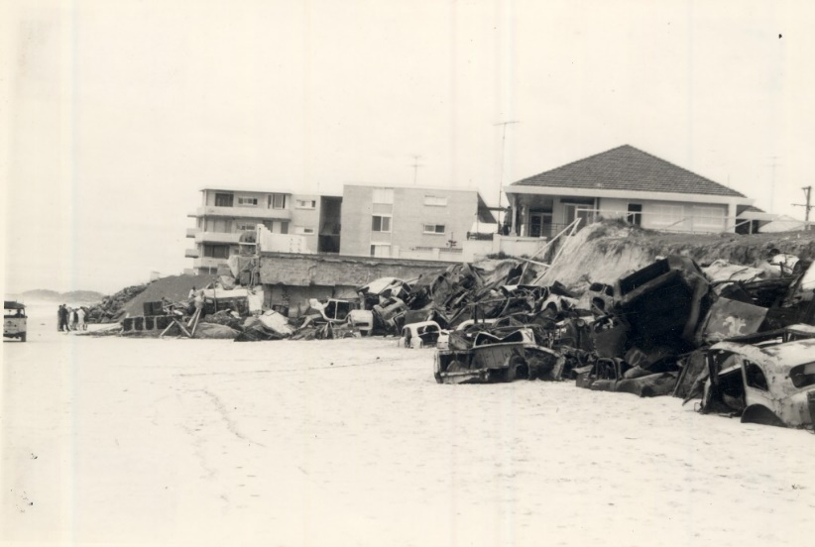
History of Coastal Protection
THESSALONICA 1860s
ISRAEL
BATROUN ~100 BC
Source: Flickr holymoor
Source: Griffith University, 2015
Source: Abdullah Freres
PASCAGOULA BEACH 1929
GOLD COAST 1967
Source: Tumblr
Source: Griffith University, 2015
Source: Wixon Collection

Slide 12
When to Protect?
Current Context

Slide 13
When to Protect?
SPP2.6 states that Coastal Protection Works:
  Are only considered after all other options for avoiding and adapting to coastal hazards have been explored.
  Should only be supported where it is demonstrated there are no significant negative impacts on the adjacent environment within the sediment cell.
  Should only be supported in conjunction with appropriate funding arrangements for construction and maintenance.

Slide 14
When to Protect?
WA Coastal Zone Strategy identifies a range of items to be addressed prior to coastal protection works being implemented. These include:
  Consistent with a CHRMAP
  Primary purpose is for public benefit
  Impacts can be sustainably managed
  Foreshore is in a vested reserve
  Coastal manager accepts ownership and responsibility
  Designed to minimise ongoing management costs
  A financial plan is in place
  Funding arrangements are based on a user pays principle
  A CBA demonstrates public benefit and a positive return
  The quantity, source and availability of sand nourishment is determined
  Works are appropriately designed by qualified engineers
  Protection measures are reviewed on an ongoing basis
  Temporary measures should be considered if there is an imminent threat
  Temporary measures should not inhibit the range of future options

Slide 15
When to Protect?
Coastal Hazard Assessment identifies coastal risks
Coastal Hazard Risk Management Adaptation Planning process has been completed
Adaptation options have been considered:
  Retreat is not possible / feasible
  Risks can not be tolerated or accommodated
Under SPP2.6, protection is a last resort
If coastal protection identified as appropriate,
the primary purpose needs to be public benefit
(WA Coastal Zone Strategy)

Slide 16
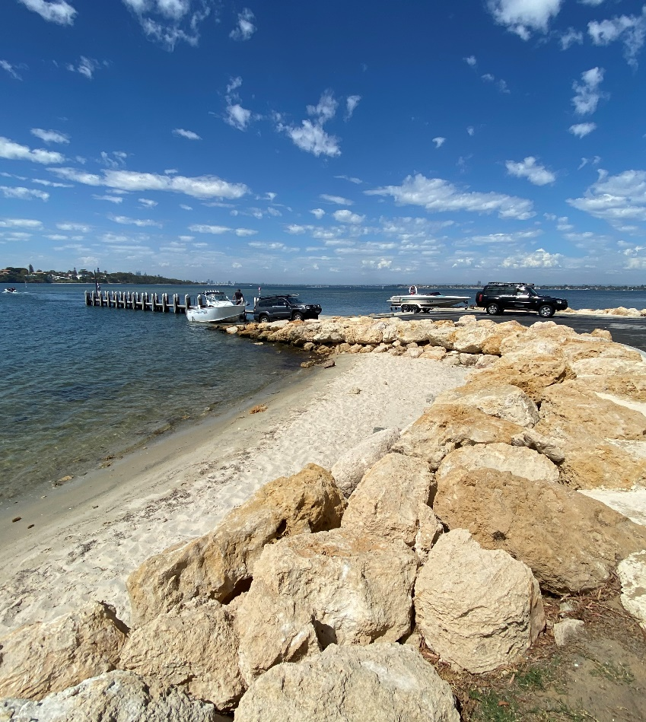
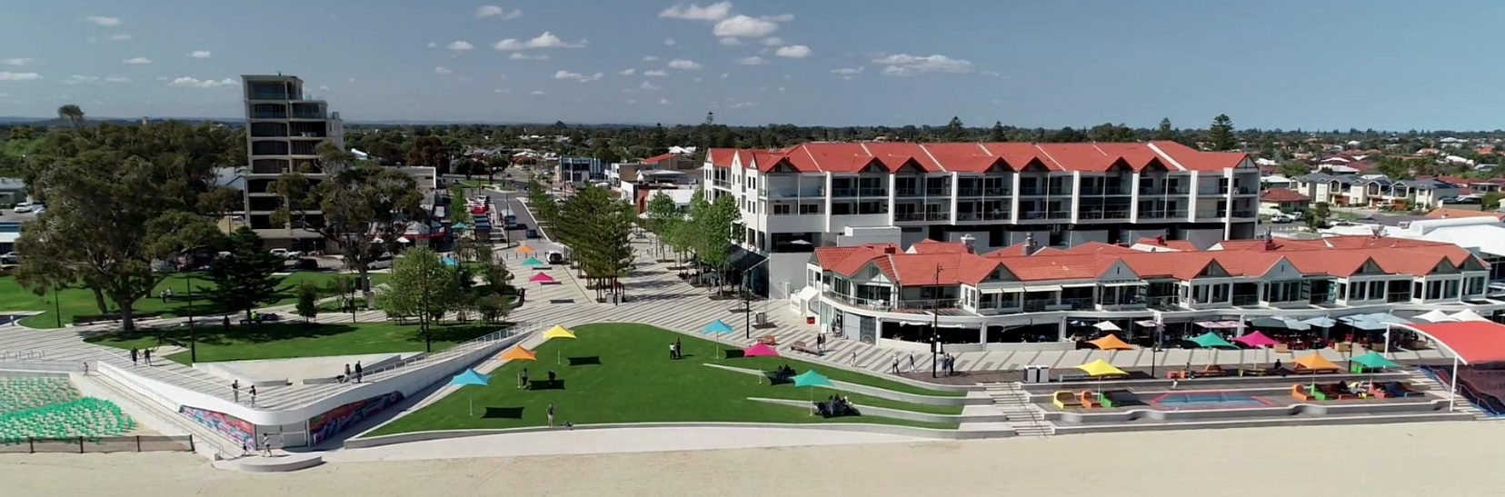
When to Protect?
Can be for coastally dependent infrastructure; eg
  Marinas
  Boat Launching facilities
Where retreat is not an option; eg
  High value coastal nodes of significant community value
  High value infrastructure

Slide 17
Types of Coastal Protection

Slide 18
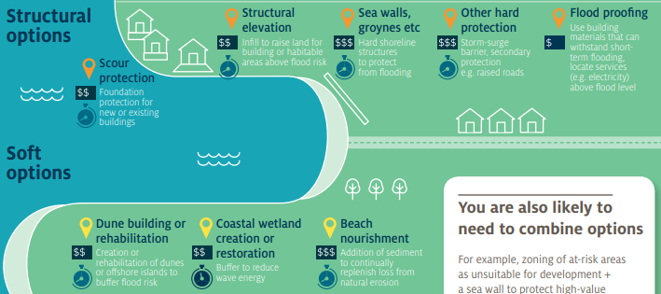
Types of Coastal Protection
Typically, “soft” and “hard” protection options
Soft protection options include:
  Nature based solutions
  Sand nourishment
Hard protection options include:
  Seawalls
  Groynes
  Offshore breakwaters / headlands
Options can be combined to complement each other
Source: CoastAdapt

Slide 19
Types of Coastal Protection
Extremely site and project dependent
Not one size fits all
All require a strong understanding of the coastal processes
Require careful consideration of design criteria and objectives, eg:
  Protection from erosion or inundation
  Design life
  Acceptable level of maintenance
  Additional complementary works required

Slide 20
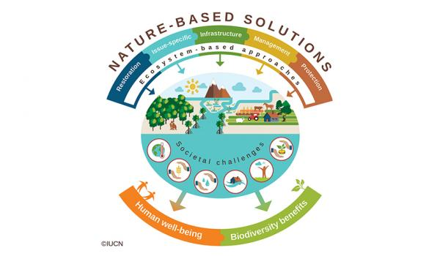
Nature Based Protection Options
Natural ecosystems can provide protection against coastal erosion and inundation
Include items such as:
  Beach and dune systems
  Revegetation
  Salt marshes
  Mangroves
  Seagrass
  Shellfish and coral reefs
Attracting increased attention,
research and effort
Source: IUCN

Slide 21
Nature Based Protection Options
Sand Nourishment and artificial reefs are nature based options but discussed separately
Other Nature Based options often more appropriate for lower energy environments (eg estuaries)
On the Swan River, DBCA and others putting considerable effort into nature based and bioengineering treatments
Often require space
On open coast, often require hybrid treatments – combination with harder protection options

Slide 22
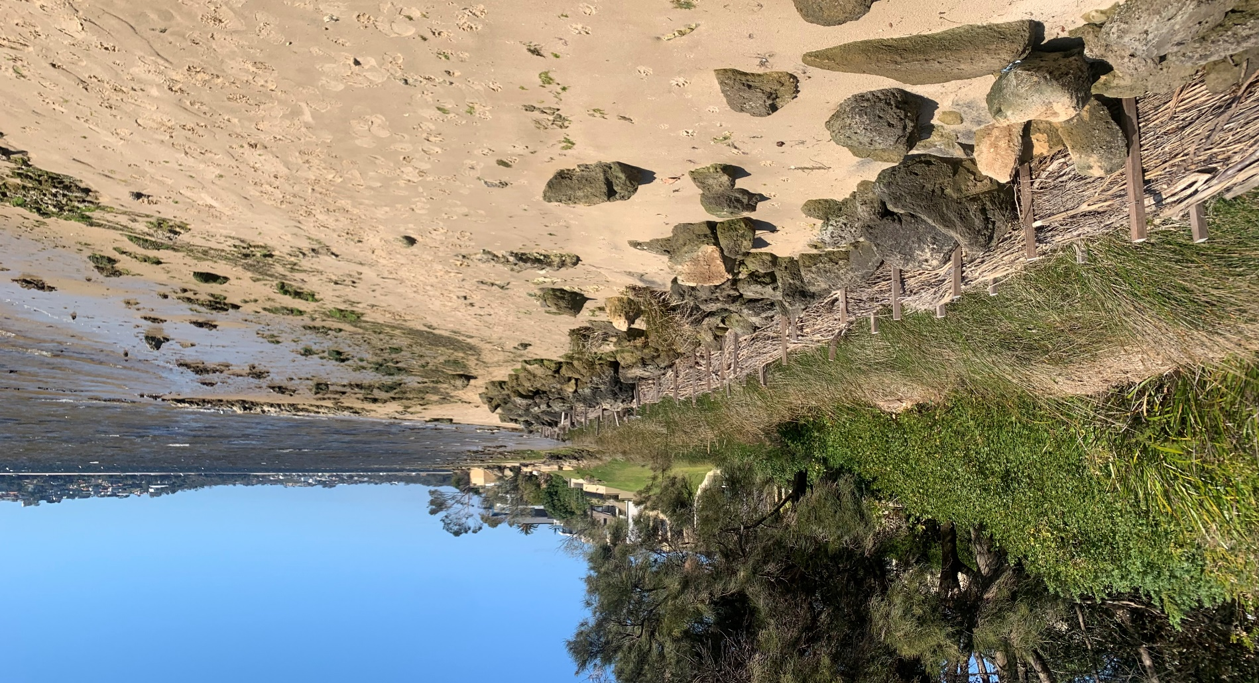
Nature Based Protection
BRUSH WALLS, NEDLANDS

Slide 23
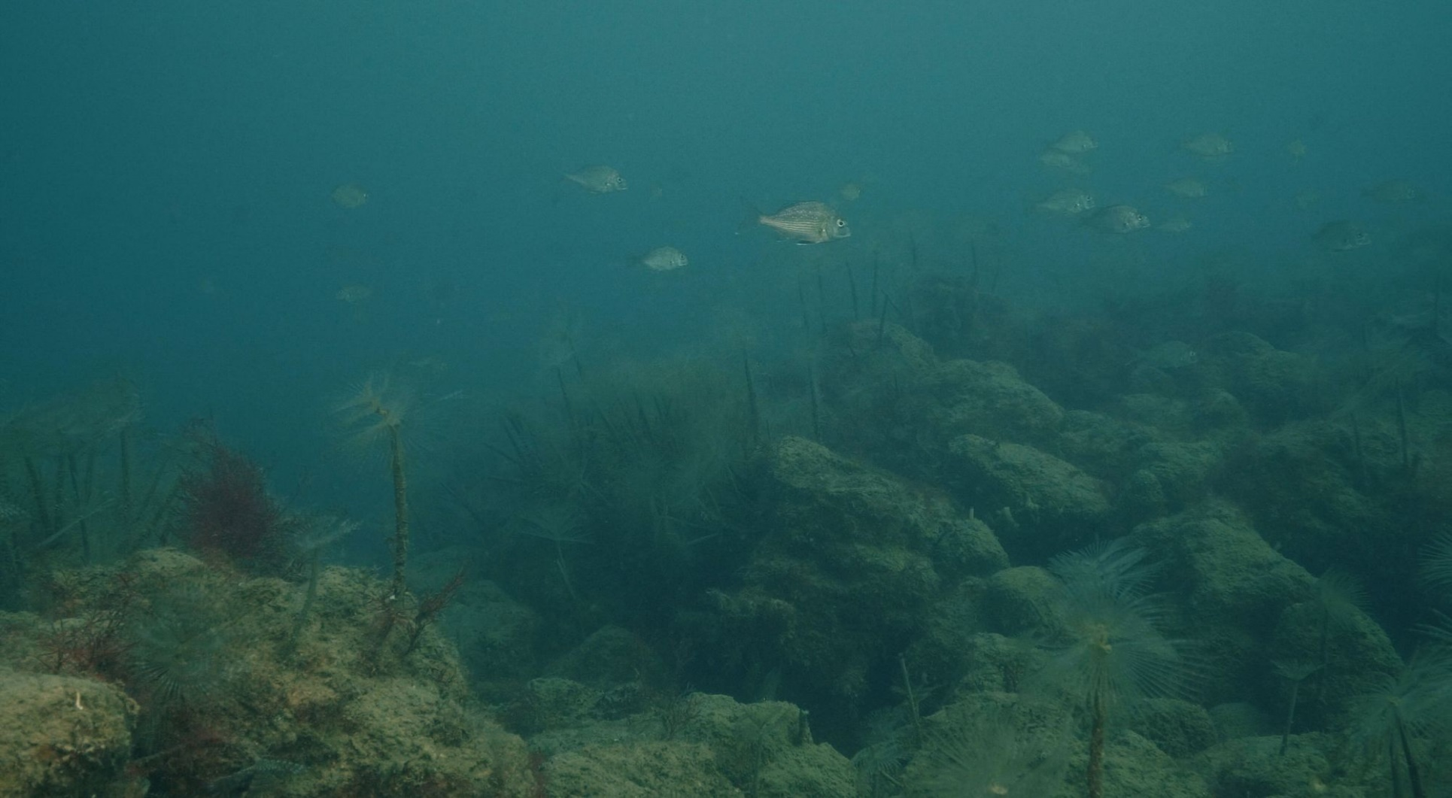
Nature Based Protection
MUSSELL REEF
Source: Nature Conservancy

Slide 24
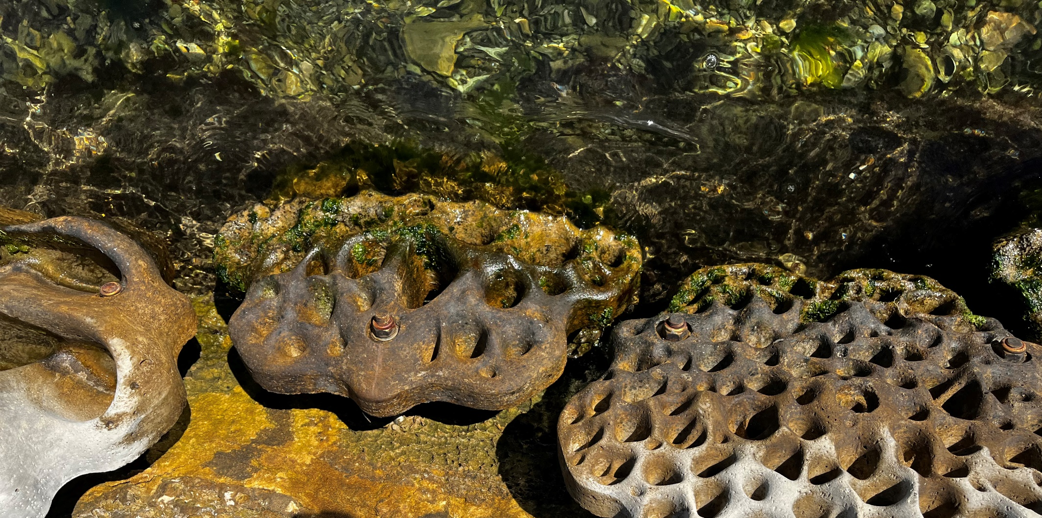
Nature Based Protection
LIVING SEAWALL, EAST FREMANTLE

Slide 25
Nature Based Options – pros and cons
Advantages | Disadvantages
Provides ecological benefit | Less certainty of protection
More sustainable and potentially self healing | Generally appropriate for lower energy environments eg estuaries and mangroves
Provide flexibility in terms of future adaptation | On open coast typically require combination with other protection works
If technically effective, are cost efficient options
Research and knowledge increasing

Slide 26
Sand Nourishment
Involves placing sand on the beach, nearshore or dunes to offset the erosion risk
Can re-establish the beach or dunes, or provide a sediment supply
Can provide a direct buffer to coastal erosion
Can be associated with hard structures, or require frequent or ongoing episodic placement
Various sources (other coastal areas, terrestrial, offshore)
Various methods of placement

Slide 27
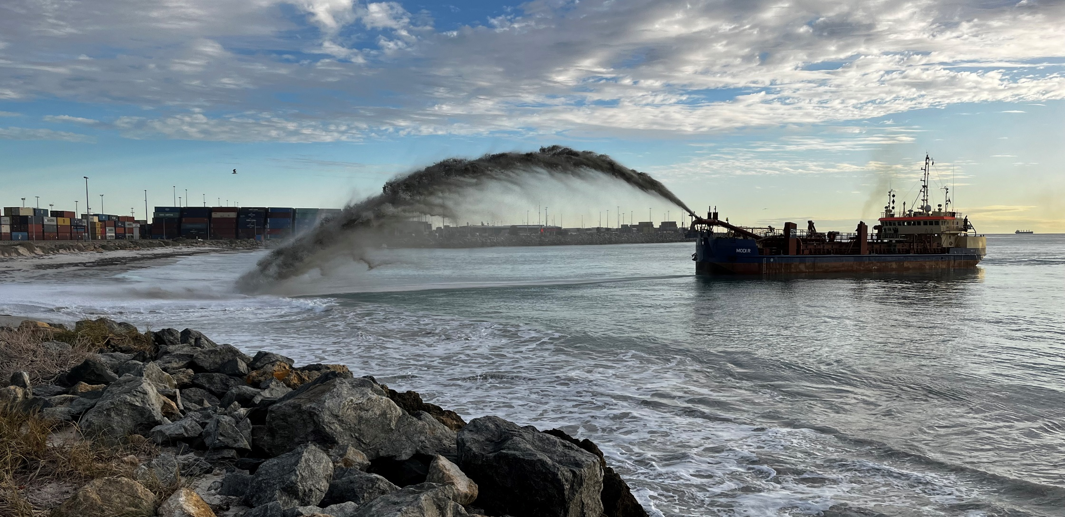
Sand Nourishment via Dredge
PORT BEACH

Slide 28
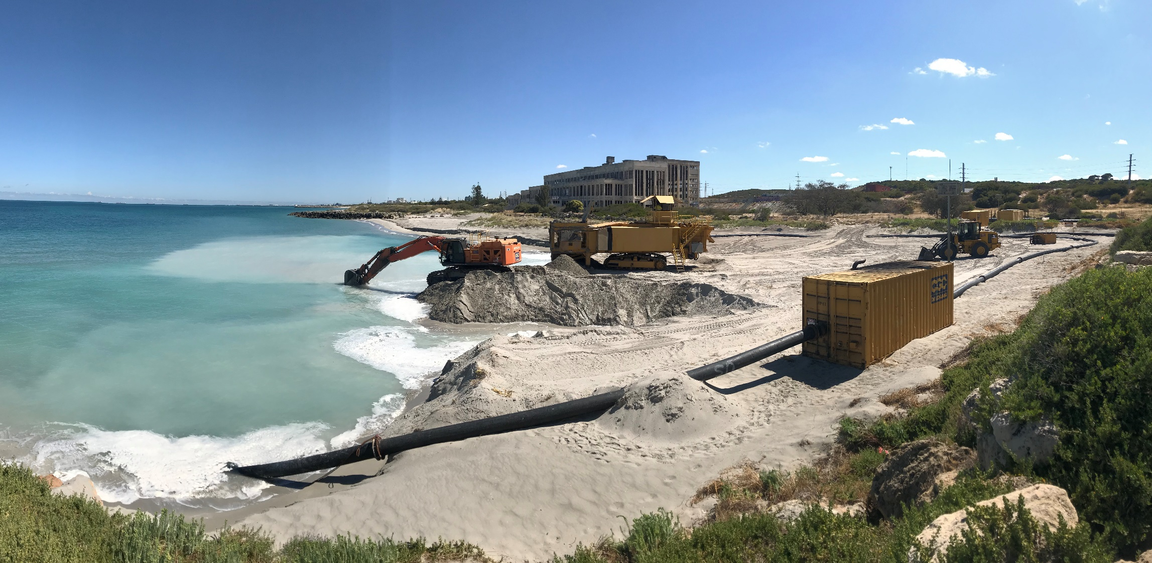
Sand Nourishment / Bypassing via Pumping
PORT COOGEE

Slide 29
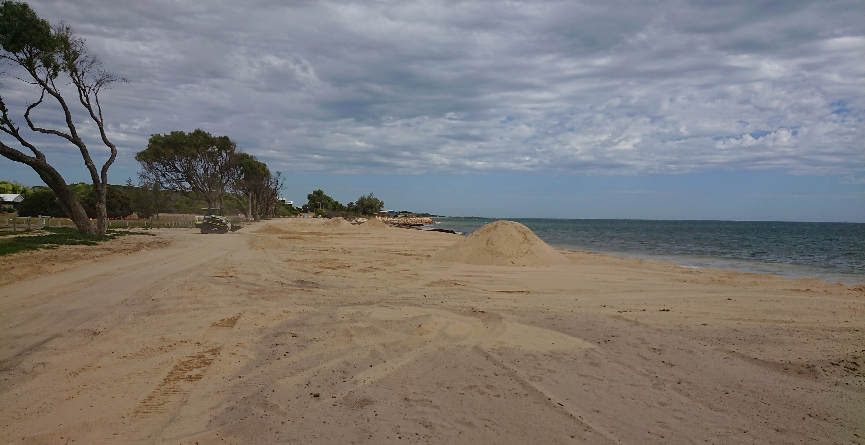
Sand Nourishment via Truck
WHITEHILL RD, GERALDTON

Slide 30
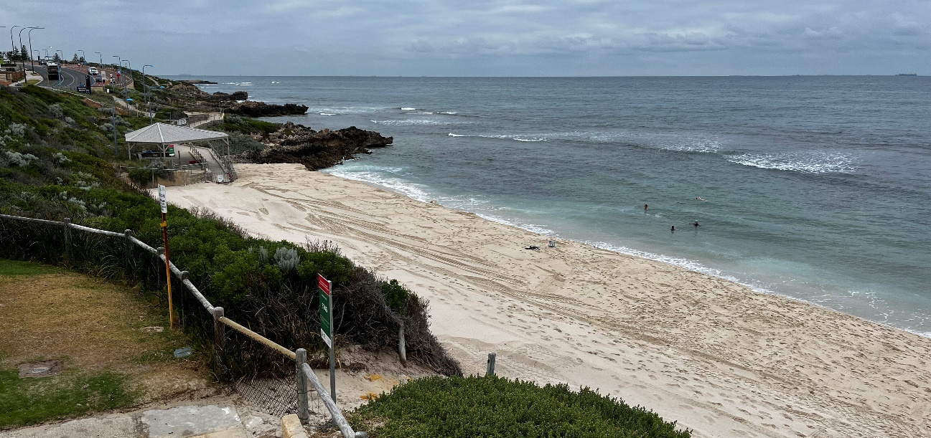
Sand Nourishment – considerations
Requires a strong understanding of coastal processes
  Dictates volumes of sand placed, where, when and how often
Placed sand will often move at an increased rate
Not always visible and may move quickly – public perceptions can vary
  “throwing money into the water”

Slide 31
Sand Nourishment – pros and cons
Advantages | Disadvantages
Provides a buffer to acute storm erosion, proportional to the amount of nourishment | Placed beach nourishment can be lost at quicker rates during storm events or under typical longshore transport conditions
Provides sediment feed to downdrift beaches | Doesn’t provide guaranteed protection to any landward infrastructure
Generally maintains beach amenity | Requires maintenance in the form of additional and ongoing beach nourishment
Provides the greatest flexibility in terms of future adaptation | Very expensive – high ongoing cost
Typically viewed as soft, low impact option

Slide 32
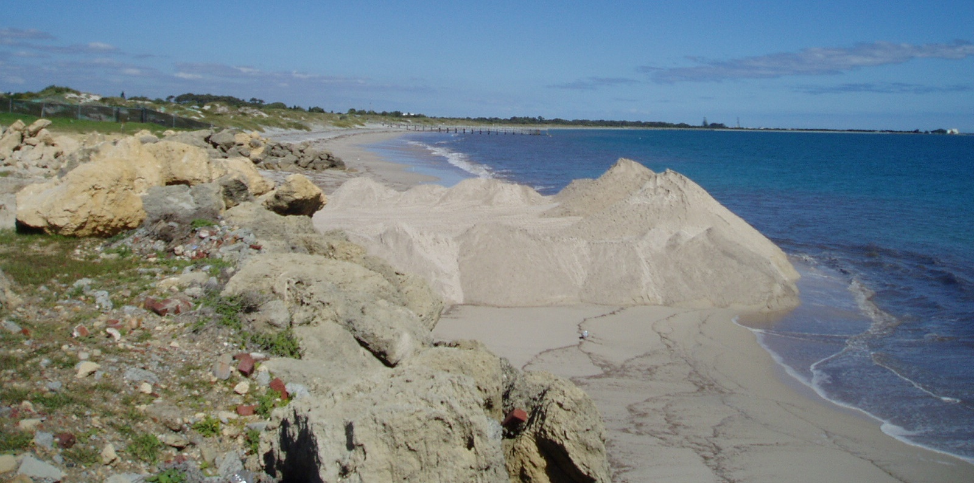
Sand Nourishment – potential impacts
Turbid plumes
Can affect seagrass and other benthic habitat

Slide 33
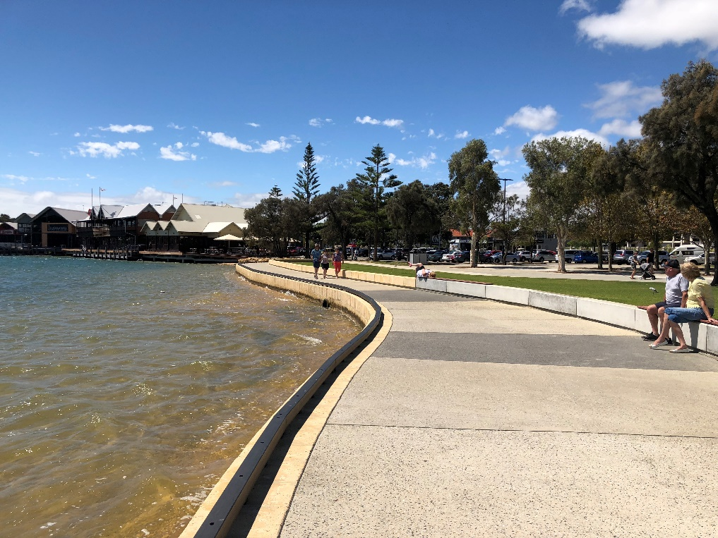
Seawalls
Typically linear structures constructed to retain and protect land, assets and infrastructure behind them
Can protect from coastal erosion and inundation risks
Wide range of forms:
  Revetments
  Vertical walls
Wide range of materials:
  Rock
  Blocks
  Concrete
  GSC

Slide 34
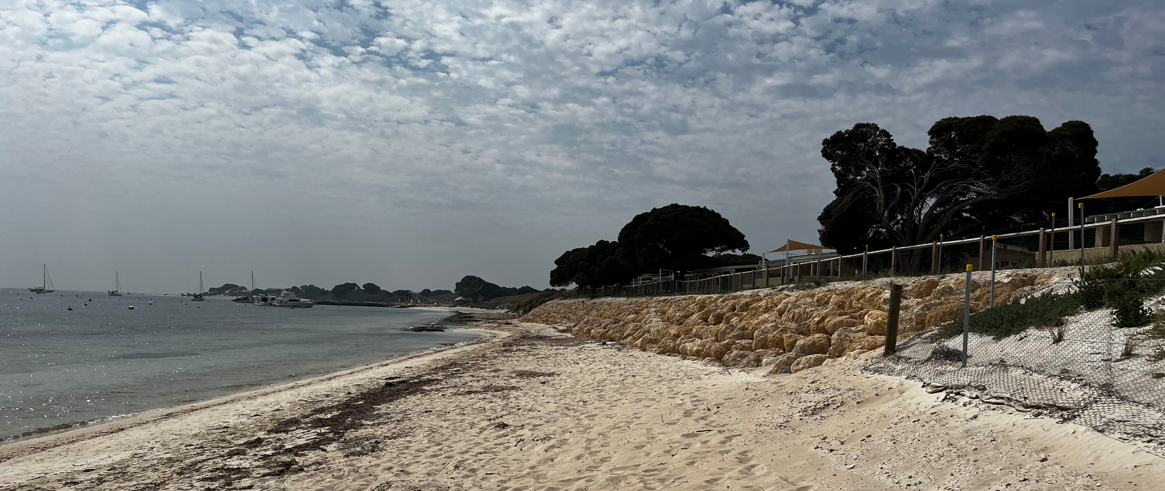
Seawalls – Rock Revetment
SOUTH THOMSON BAY, ROTTNEST

Slide 35
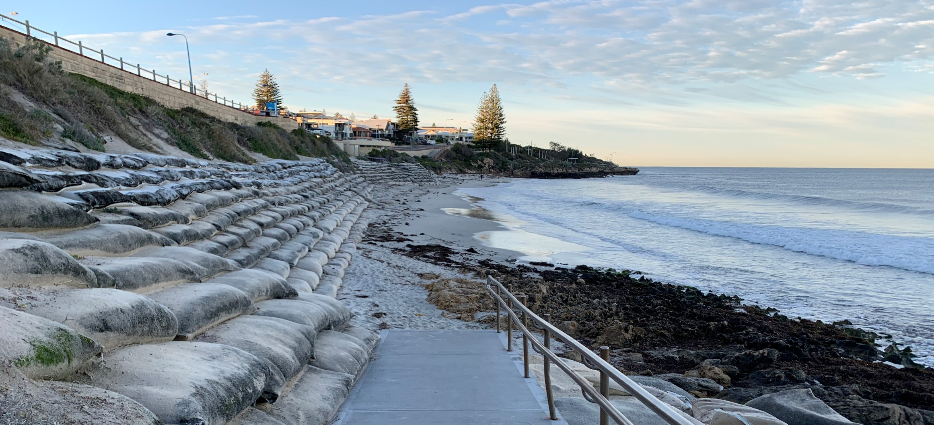
Seawalls – GSC (short term)
WATERMANS BAY

Slide 36
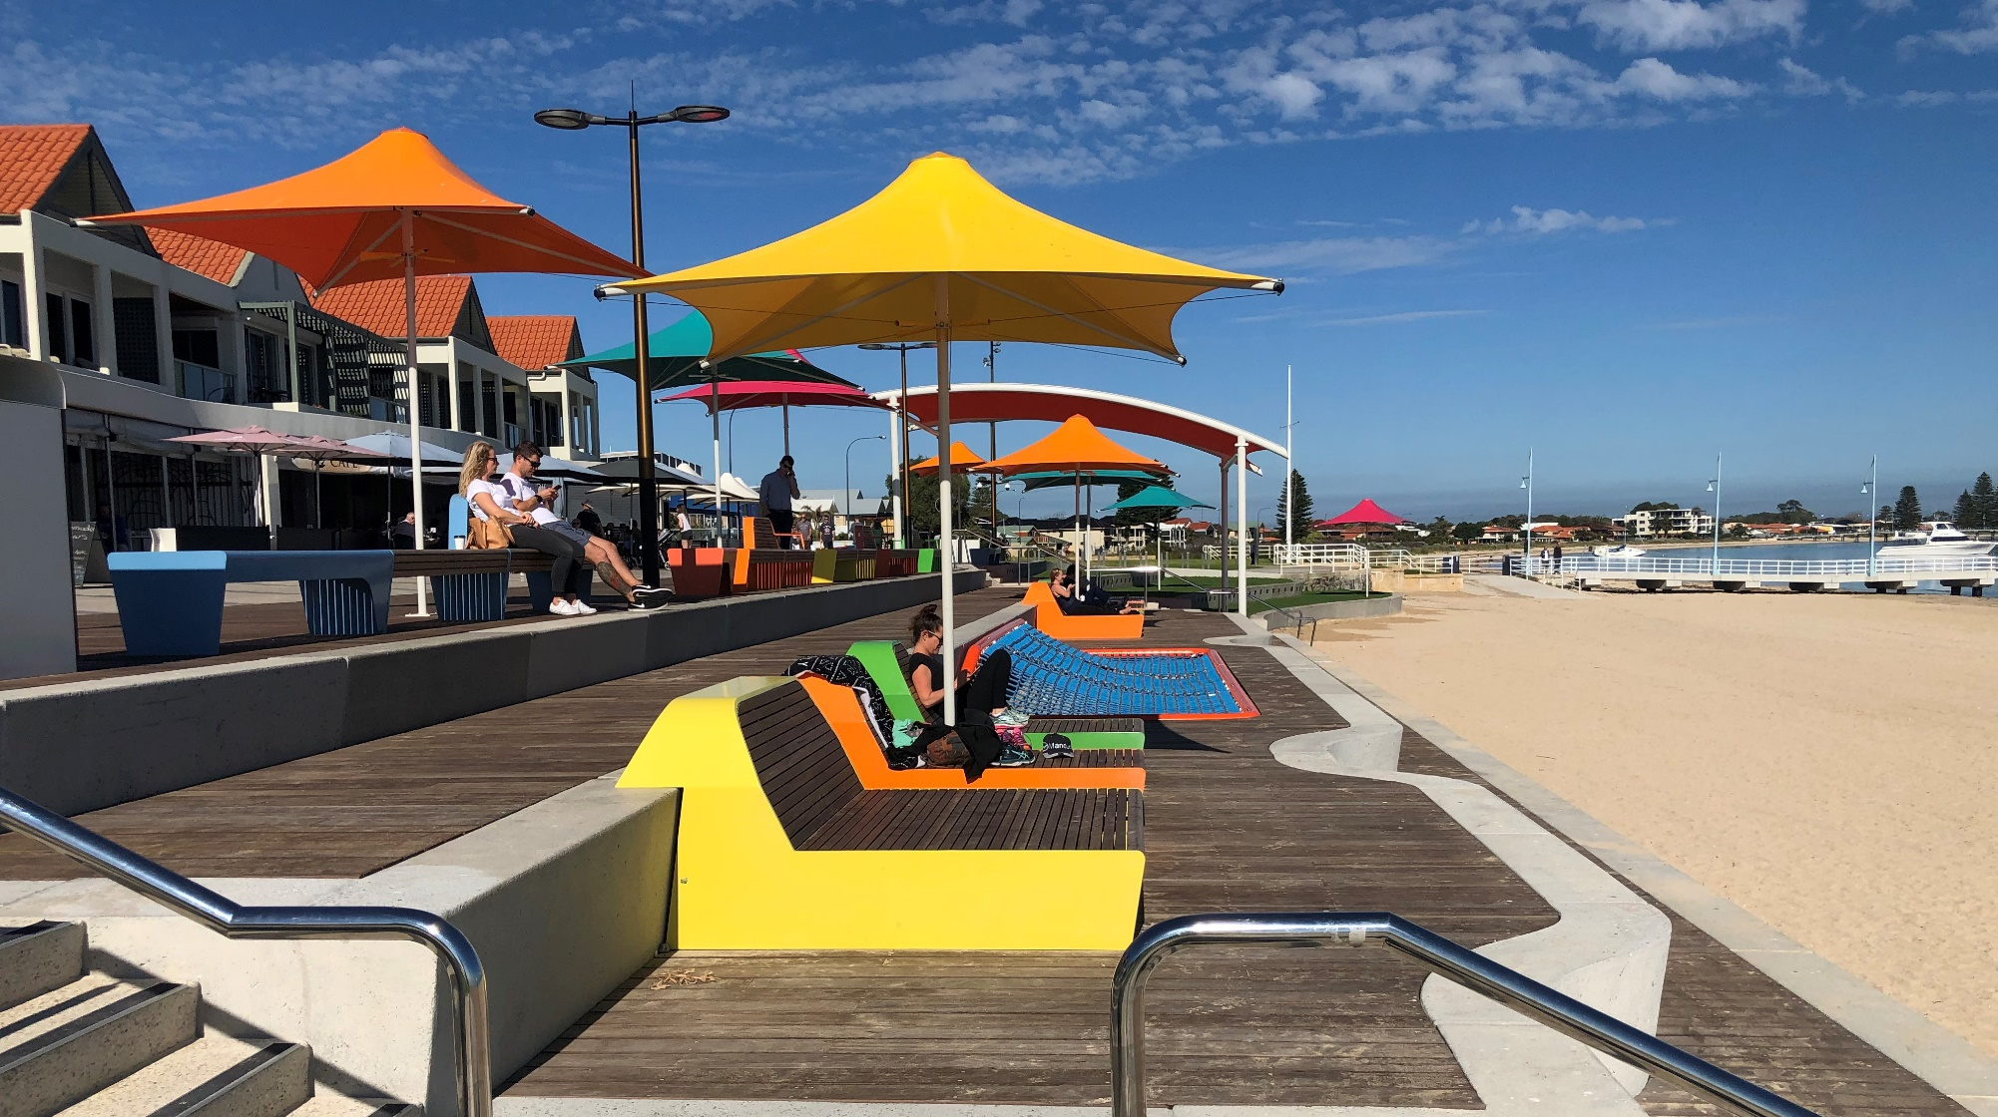
Seawalls – Vertical & Functional
ROCKINGHAM

Slide 37
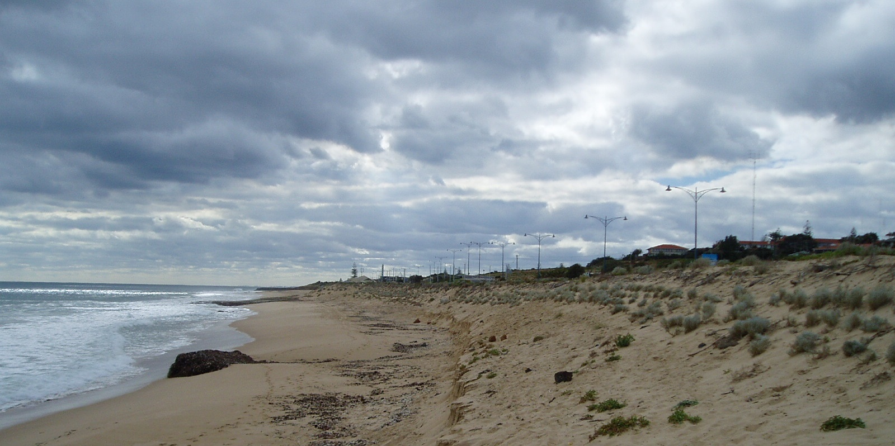
Seawalls - Buried
BUNBURY BACK BEACH

Slide 38
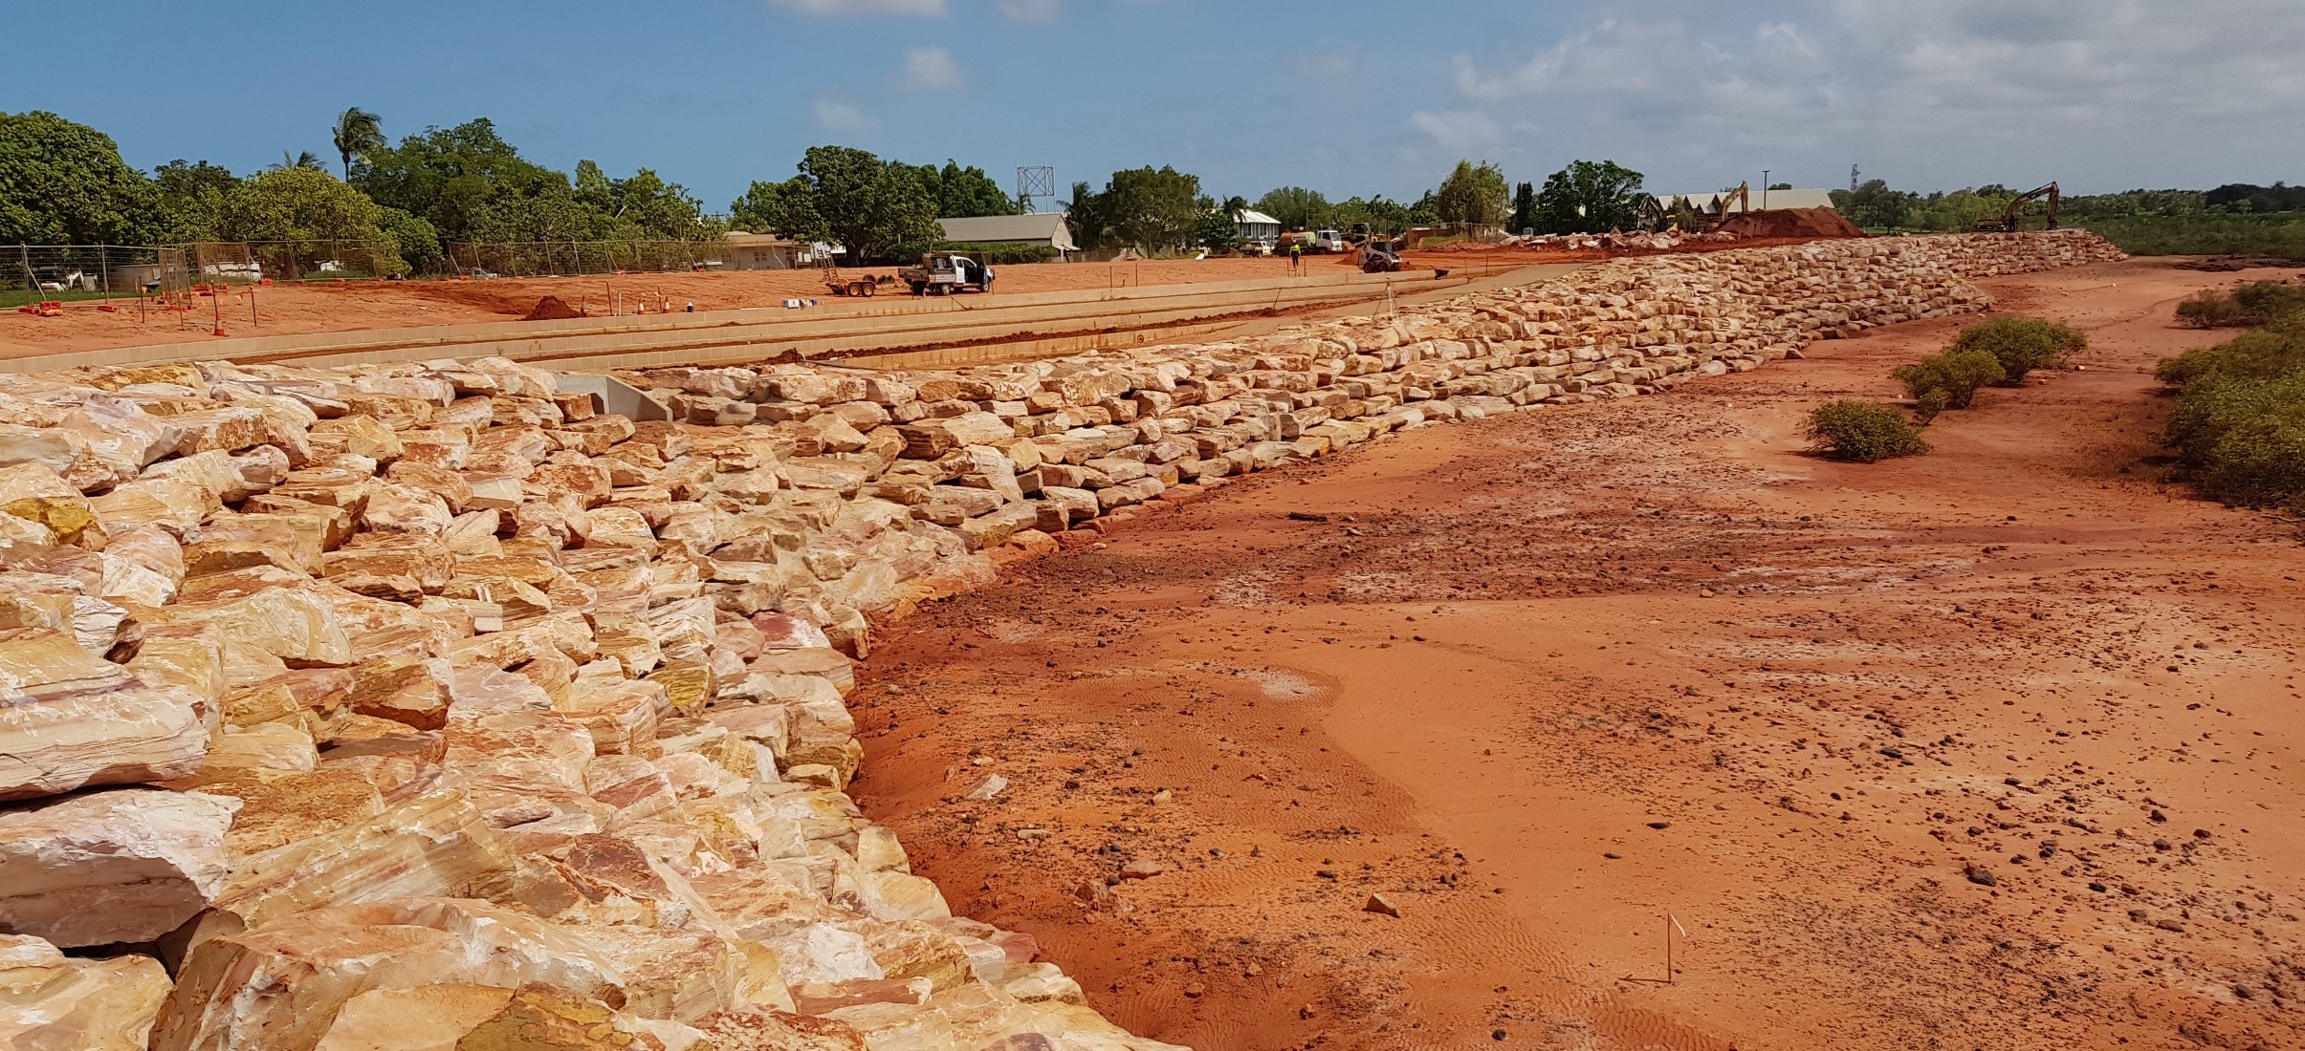
Seawalls – Local Materials
BROOME TOWN BEACH

Slide 39
Seawalls - considerations
Provide direct and effective protection
Can result in loss of sandy beach in front of wall – they protect the land behind not the beach in front
Can be imposing and change the appearance of the coast
Require maintenance and ultimately replacement

Slide 40
Seawalls – pros and cons
Advantages | Disadvantages
Effectively protects landward infrastructure and assets | Can be exposed during storm conditions or due to sustained erosion with increasing frequency/extent over the longer term
Impacts and design are well understood | Can lead to narrower or lost beaches from storm or sustained erosion with increasing frequency/extent over the longer term
Can be buried or vegetated (depending on location) to minimise visual impact | High capital cost
 | Reduce access to the water

Slide 41
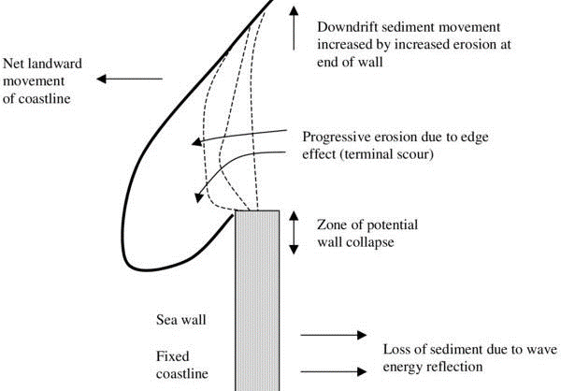
Seawalls – Potential Impacts
Downdrift and flanking erosion
Often lose beach in front of structure
Source: Boateng & Gray, 2014

Slide 42
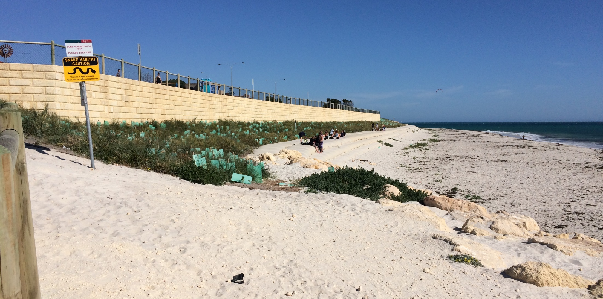
Seawalls – typical impacts
Height provides protection of assets from overtopping
QUINNS BEACH
Limestone Block Wall
GSC Revetment
Beach requires nourishment
Low level protection allows creation of vegetated dune
Rock revetment

Slide 43
Groynes
Shore perpendicular structures which stop or restrict the movement of sand
Provide protection to assets behind the beach/foreshore
Primarily effective where there is longshore sand supply
Provide beaches, but can segment the coast
Typically constructed from rock in WA, but can include timber, GSCs, concrete, sheet piles
Often completed in conjunction with sand nourishment

Slide 44
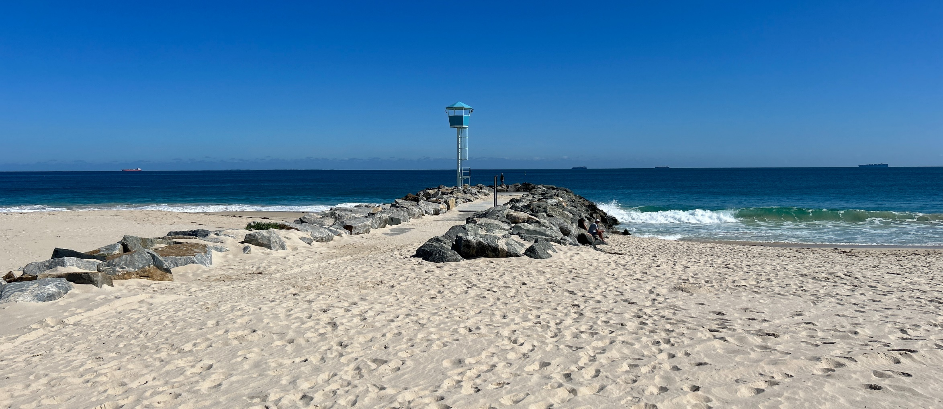
Groynes - Rock
CITY BEACH

Slide 45
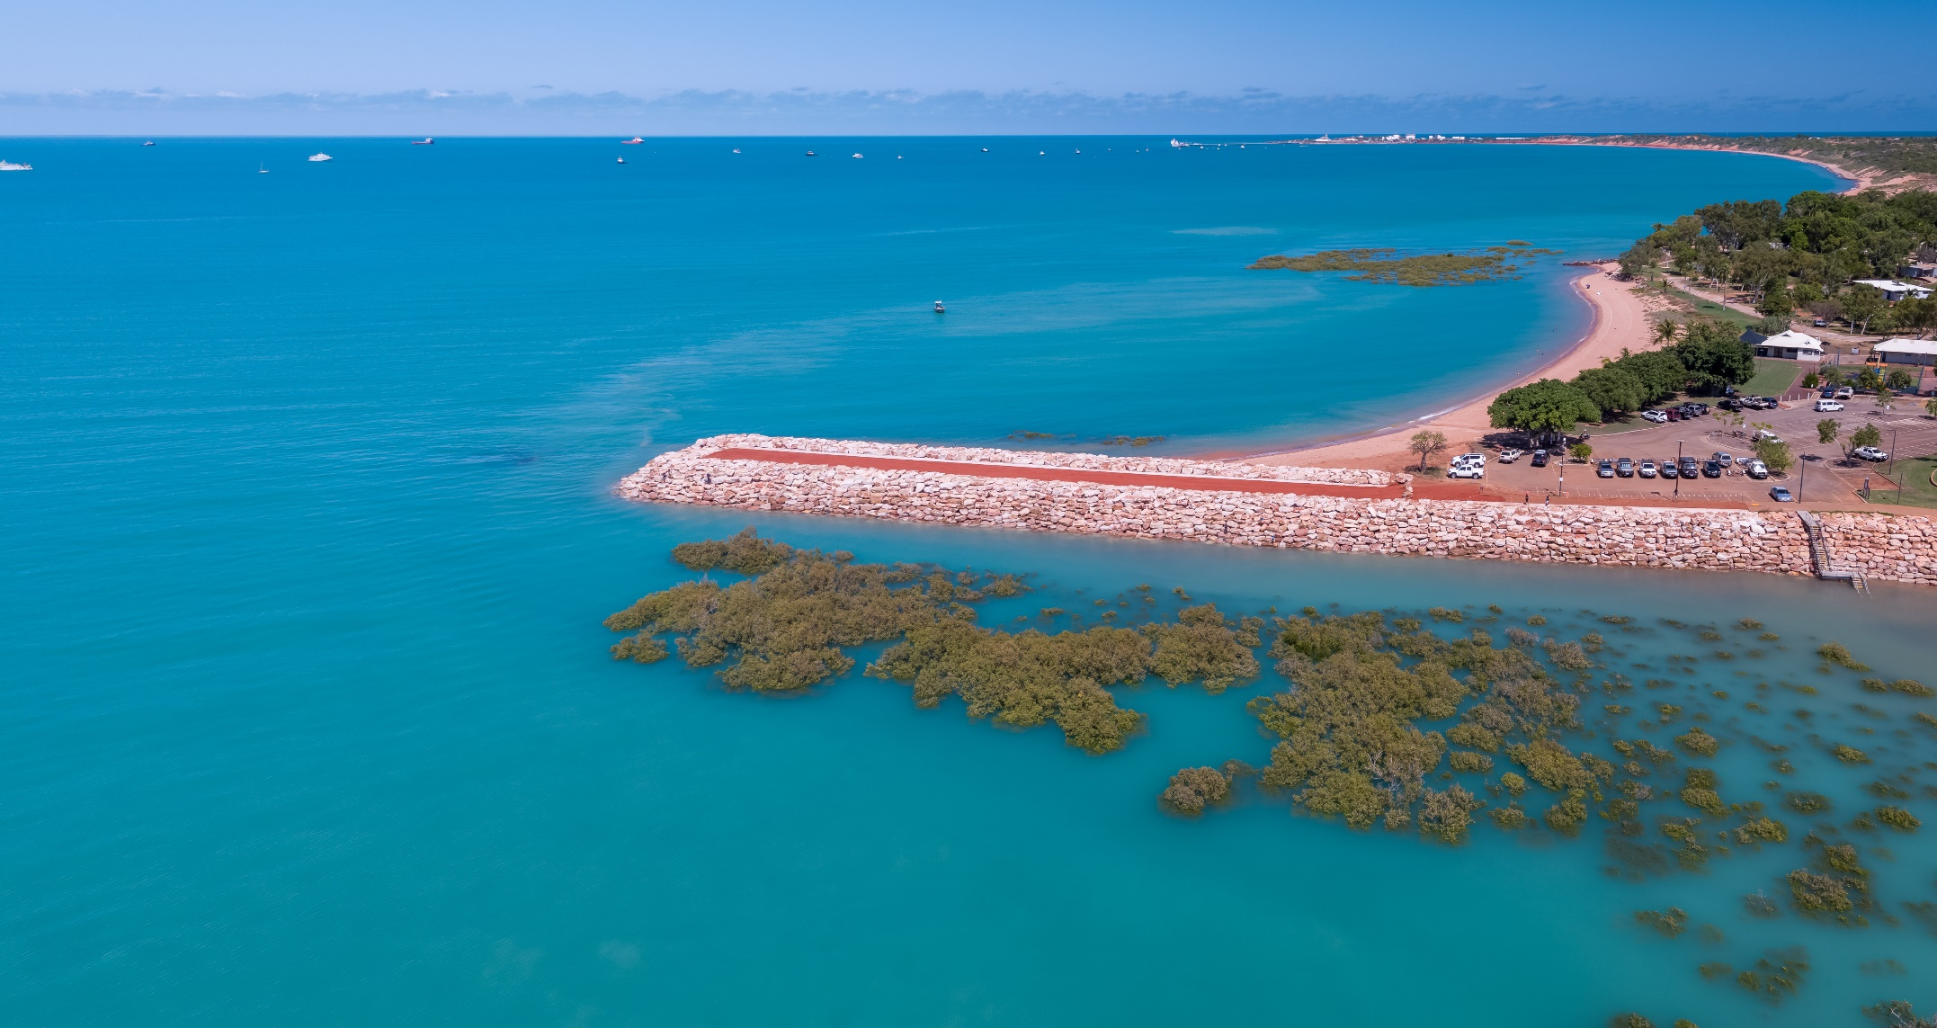
Groynes
BROOME TOWN BEACH
Source: Shire of Broome

Slide 46
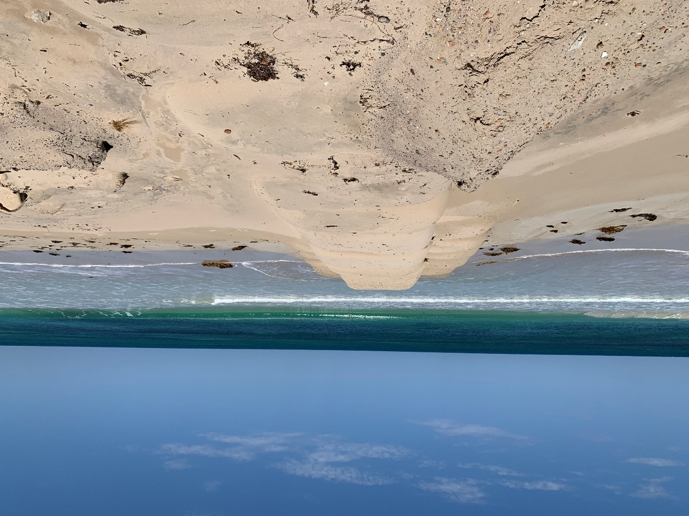
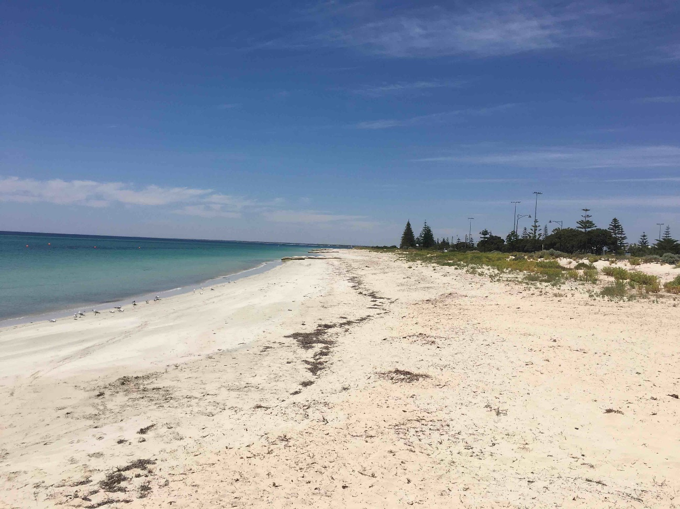
Groynes – GSC (short term)
SUNSET BEACH, GERALDTON
BUSSELTON

Slide 47
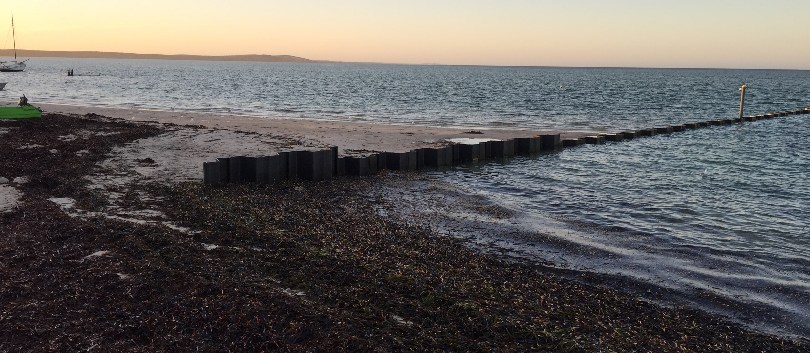
Groynes – Sheet Pile
DENHAM

Slide 48
Groynes - considerations
Requires a strong understanding of coastal processes
  Dictates length, height, spacing and number of groynes
Wave conditions dictate armour size
Groynes aim to interrupt sediment transport – will cause down drift erosion
Can be offset with sand nourishment – may require ongoing placement

Slide 49
Groynes – pros and cons
Advantages | Disadvantages
Create beach compartments that maintain beach amenity adjacent to the groynes | Doesn’t provide direct protection to the landward infrastructure along the entire extent
Can be strategically located to provide some protection to more critical infrastructure | Likely requires some level of maintenance in the form of beach nourishment
Impacts are generally well understood | Transfer erosive pressures to adjacent shorelines
Relatively lower maintenance costs | Segment and compartmentalise the shoreline
 | Has the potential to trap seagrass wrack
 | High capital cost

Slide 50
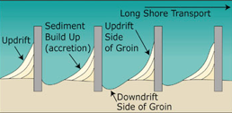
Groynes – Impact

Slide 51
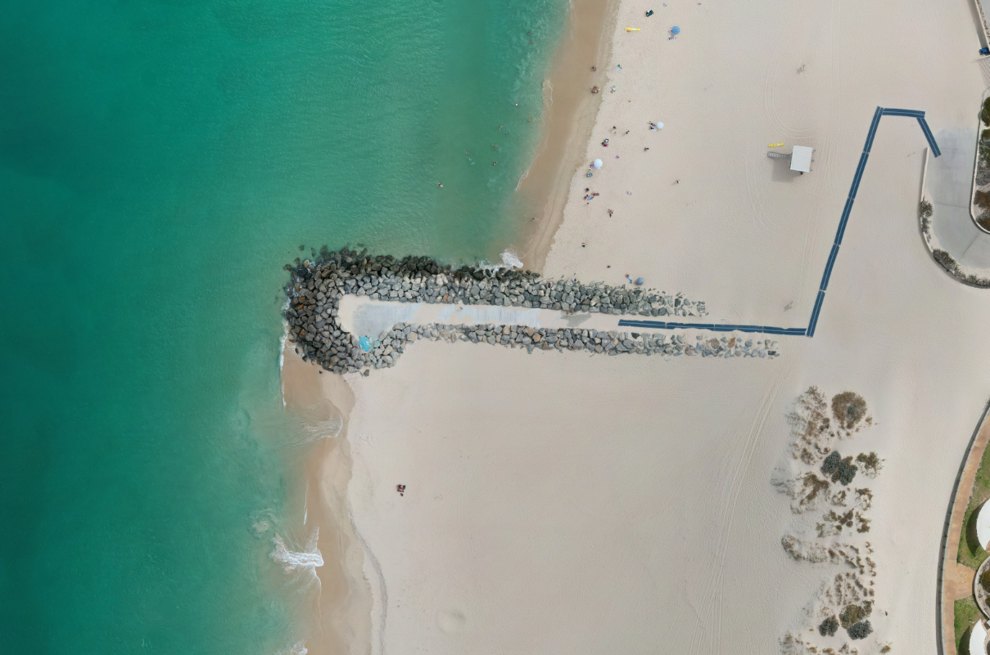
Groynes – typical impact
CITY BEACH
Net longshore transport direction
Erosion – narrow beach
Accretion – wide beach

Slide 52
Break

Slide 53
Breakwaters / Headlands
Offshore breakwaters or headlands are emergent (above water) barriers
They effectively block wave energy and create a lower wave energy section of beach behind
This area is characterised by a salient where sand accretes in
They are most suited to embayed coastlines where low or negligible net alongshore sediment transport reduces down drift impacts

Slide 54
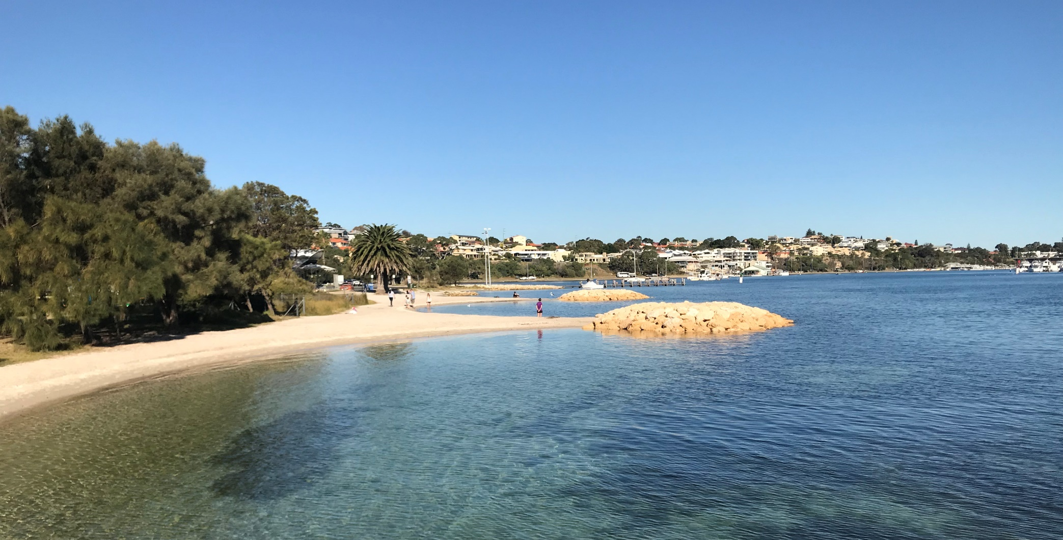
Breakwaters
EAST FREMANTLE

Slide 55
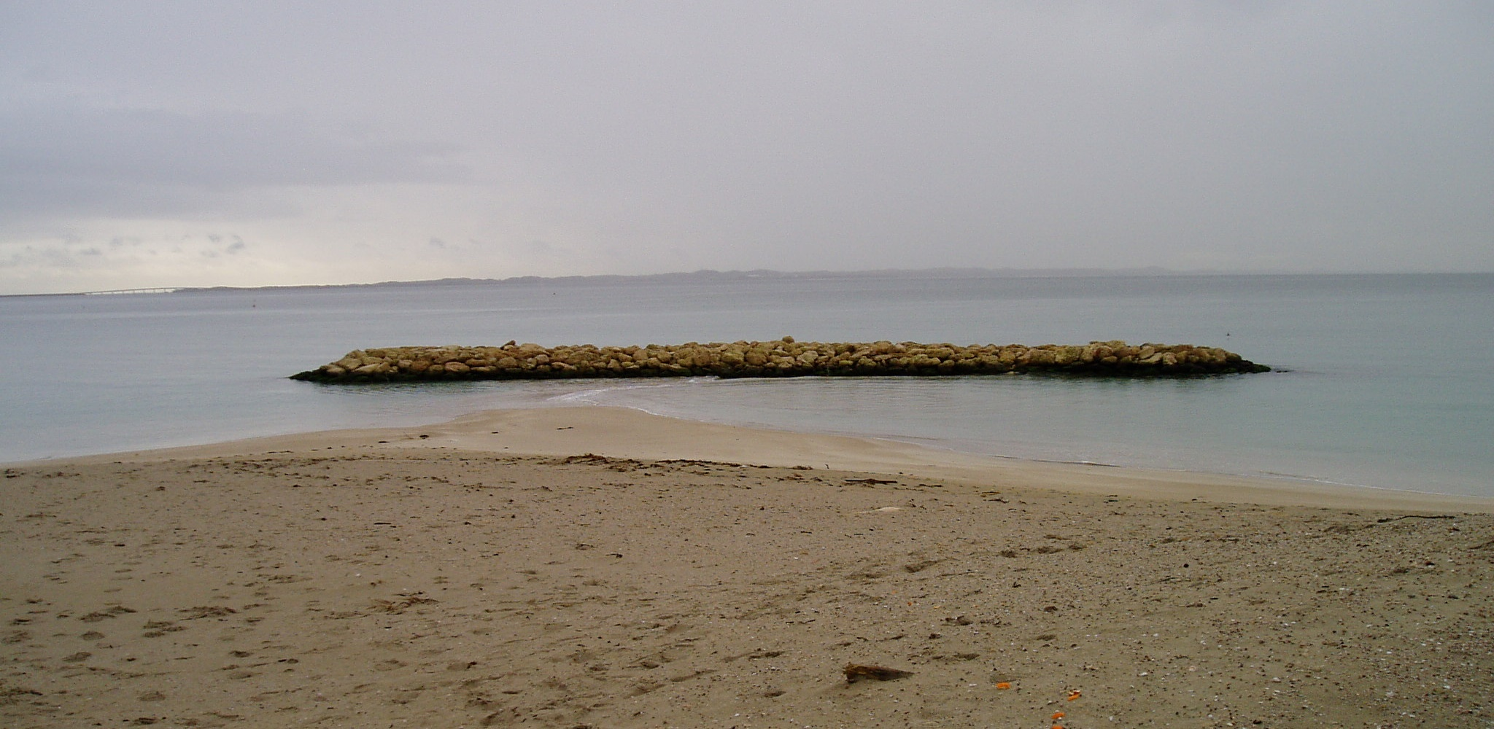
Breakwaters
KWINANA BEACH

Slide 56
Breakwaters – Shore Connected
EAST FREMANTLE

Slide 57
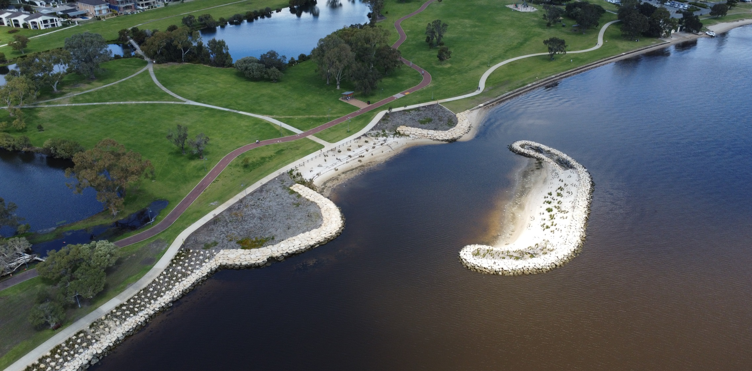
Breakwaters - Offshore
SOUTH PERTH SWAN HABITAT

Slide 58
Breakwaters - considerations
Require a strong understanding of coastal processes
  Dictates length, height, spacing and number of headlands
Wave conditions dictate armour size
Headlands aim to interrupt sediment transport – will cause down drift erosion
Can be offset with sand nourishment – may require ongoing placement

Slide 59
Breakwaters / Headlands – pros and cons
Advantages | Disadvantages
Create beach compartments that maintain beach amenity adjacent to the groynes | Doesn’t provide direct protection to the landward infrastructure along the entire extent
Can be strategically located to provide some protection to more critical infrastructure | Likely requires some level of maintenance in the form of beach nourishment
Can allow continuous beach access | Transfer erosive pressures to adjacent shorelines
Impacts are generally well understood | Compartmentalise the shoreline
 | Has the potential to trap seagrass wrack
 | High capital cost and relatively higher maintenance costs due to in water works

Slide 60
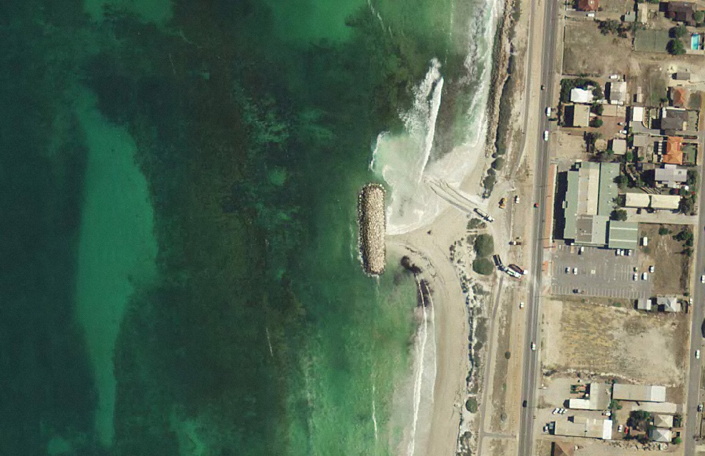
Headlands – typical impact
GERALDTON
Erosion – narrow beach
Sand nourishment to offset erosion
Net longshore transport direction
TOMBOLO
Accretion – wider beach

Slide 61
Artificial Reefs
Submerged artificial reefs are constructed off the shoreline, to reduce wave energy impacting the coast
They do not block waves – no direct protection
During storm events with high water levels, their effectiveness in protecting the beach is reduced
Can offer the opportunity for other objectives such as creating marine habitat and surfing breaks
Most suited to embayed coastlines where low longshore sediment transport reduces down drift impacts
Various materials including rock, GSC, concrete and others

Slide 62
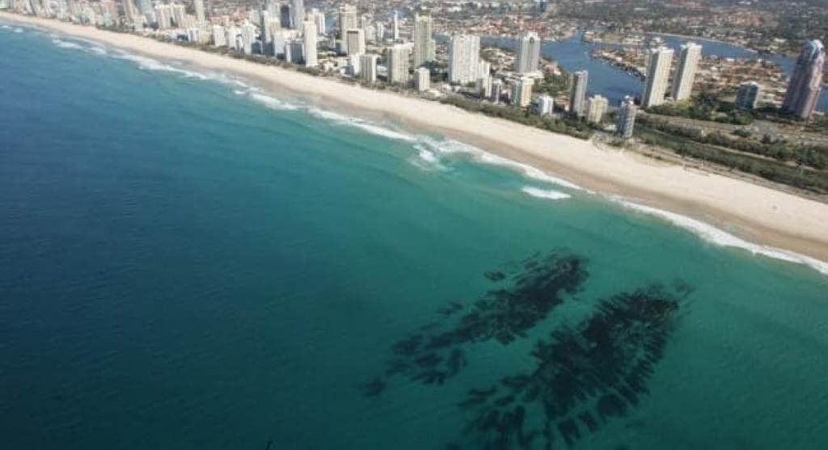
Artificial Reefs
NARROWNECK, GOLD COAST
Source: DHI
Source: Raised Water Research

Slide 63
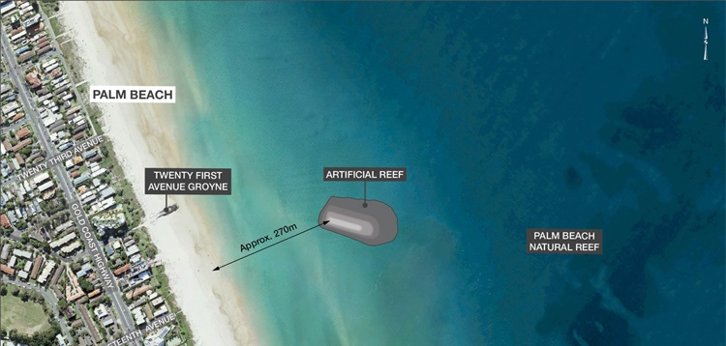
Artificial Reefs
PALM BEACH, GOLD COAST
Source: DHI

Slide 64
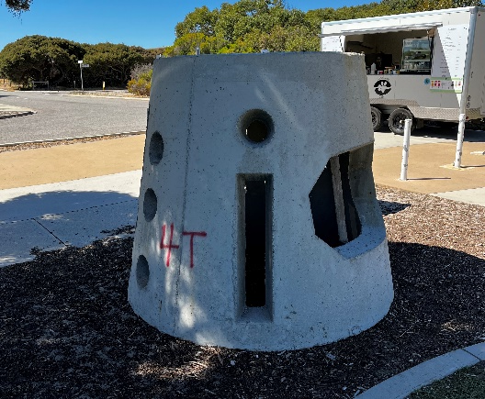
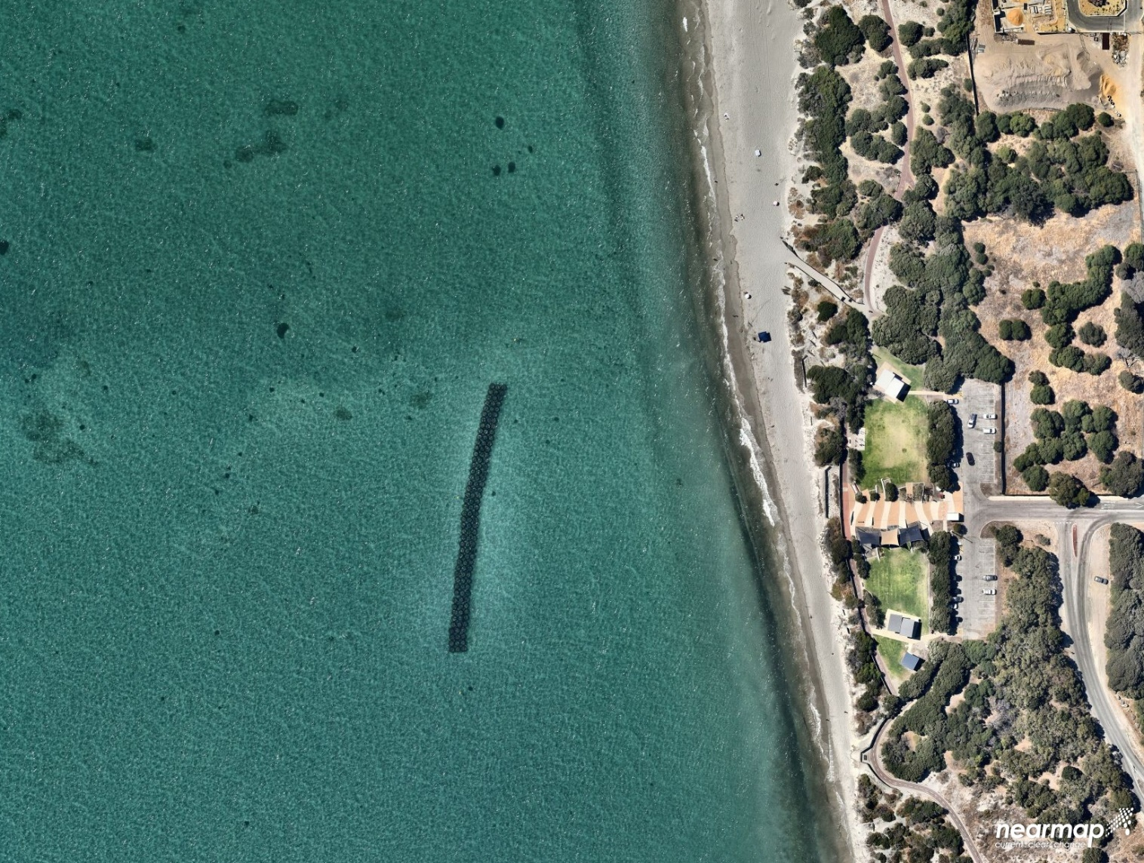
Artificial Reefs
C Y O’CONNOR BEACH

Slide 65
Artificial Reefs - considerations
Clear objectives required – coastal protection or other (eg) surfing, habitat?
Often multi-purpose applications compromise effectiveness of each objective
Require a strong understanding of coastal processes
Can impact the marine habitat, positively and negatively

Slide 66
Artificial Reefs – pros and cons
Advantages | Disadvantages
Lower visual impact than other protection | No direct protection to the shoreline behind
Provides habitat | Lose effectiveness in storm conditions
May provide additional complementary benefits eg surfing, snorkelling | Lose effectiveness with sea level rise
 | Likely requires some level of maintenance in the form of beach nourishment
 | High capital cost
 | Relatively higher maintenance costs
 | Transfer erosive pressures to adjacent shorelines

Slide 67

Artificial Reefs – Typical Impacts
Source: Ranasinghe et al 2010

Slide 68
Which Coastal Protection Type is
Suitable?

Slide 69
Which Coastal Protection Type
Not one size fits all, and project dependent
Depends strongly on:
  Project objectives
  Community values and sentiments
  Site conditions
  Timeframes
  Potential impacts
ALL have impacts, pros and cons
Typically assessed using Multi Criteria Analysis (MCA) and Cost Benefit Analysis (CBA)

Slide 70

Hybrid & Combined Options
Hybrid or combination options can incorporate nature based or bioinspired solutions into “harder” protection options
Could include:
  Nature based inspirations (eg rock pools in rock structures)
  Temporary harder options (through establishment)
  Combined nature based and hard options
Hybrid approaches can offer significant advantages in sustainability and habitat

Slide 71
Typical Selection & Design Process
Coastal processes and hazards
Develop concept options
Multi criteria analysis
Comprehensive concept development of appropriate options
Cost Benefit Analysis
Confirm or determine project objectives
Develop preliminary design of appropriate options
Multi criteria analysis
Detailed design of selected option
Construction / Implementation
Monitoring and maintenance
Community consultation through each stage

Slide 72
Multi Criteria Analysis
An MCA is a framework for assessing and selecting appropriate options
Requires consideration of success criteria
  Technical, environmental, social, economic and cultural
Selection of appropriate criteria, weighting and scoring system is critical
Ranks various protection options

Slide 73
Multi Criteria Analysis (example)
Aims to initially narrow options – identify potential options and those which are inappropriate
Option | Technical |  |  | Social |  | Environment | Economic
Option | Effectiveness | Adaptability | Constructability | Provide beach for recreation | Provide foreshore facilities | Preserve beach / dunes | Capital cost | Ongoing / maintenance cost
Sand Nourishment
Seawall
Groynes
Headlands
Artificial Reef
Indicative example only

Slide 74
Multi Criteria Analysis
Selection and understanding of criteria is critical
Different criteria will have different rankings, within the same general theme
For example, a seawall will have negative environmental benefit on the beach in front of the wall, but a positive environmental benefit for a foreshore behind the wall

Slide 75
Cost Benefit Analysis
CBA process assists in refining appropriate range of options and prioritising options
Identifies costs associated with each option along with benefits
These include economic (capital or maintenance cost) along with social and environment (loss of foreshore or provision of beach)
Considered over the planning timeframe or life of the projects
Require accurate estimate of costs – need concepts

Slide 76
Costs
Whole of life costs need to be considered
Capital and maintenance
Construction costs vary widely with design, method of construction, location and individual Contractor
Maintenance:
  Typical marine structure maintenance 1% of capital cost pa
  Episodic maintenance typically most cost effective
  Typically carried out at intervals of around 10 years

Slide 77
Costs
Appropriate concepts critical for accurate cost estimates
Costs vary based on items such as:
  Depth of water
  Materials and availability
  Exposure
  Geotechnical conditions

Slide 78
Relative Costs
Protection Works | Capital Costs | Maintenance Costs | Comments
Nature Based (eg reveg) | Low | Moderate | Low cost, more labour intensive
Sand Nourishment | Moderate | High | Higher ongoing costs
Seawall | High | Moderate | Higher capital costs
Groyne | High | Moderate | Higher capital costs
Breakwater | High | High | Higher relative capital and maintenance costs due to in water works
Artificial Reef | High | High | Likely also require other protection works, increasing total project costs
Direct costs only – does not consider loss of opportunity costs

Slide 79
Approvals & Funding

Slide 80
Approvals
Approval requirements will vary depending on the scale of works, location, structure and potential for impacts
Typical key approval authorities may include:
  Department of Planning, Lands & Heritage (planning approvals)
  Department of Planning, Lands & Heritage (heritage approvals)
  Environmental Protection Authority (Public Environmental Review)
  Department of Transport (jetty licence)
  Department of Biodiversity, Conservation & Attractions (approvals in marine parks, Swan River)
  Local government (planning & building approvals)
Processes and approvals will vary for each project

Slide 81
Approvals
Along with formal approval, comment and consultation will be required with key stakeholders
  Local community
  Reference groups
  DPLH
  DoT
  Port Authorities
Other approvals or advice may be required for aspects of construction, based on impacts:
  Department of Water & Environmental Regulation (ASS, contamination, dewatering)

Slide 82
Funding of Coastal Protection Works
Funding of coastal works the responsibility of the proponent
User / beneficiary pays principle applies
SPP2.6 requires the proponent to demonstrate funding as part of the CHRMAP process
Benefit Distribution Analysis will be specifically covered in a future module
Funding of capital and maintenance costs critical to be considered prior to selection and implementation
Number of funding opportunities
  Planning
  Design
  Implementation
  Maintenance and asset management

Slide 83
Sources of Funding
In addition to municipal funds:
  Coastal Adaptation & Protection grants (DoT)
    Design, monitoring, data collection & construction
  Hotspot Coastal Adaptation & Protection grants (DoT)
    For relevant identified coastal hotspots
  Coastal Management Plan Assistance Program (DPLH)
    Planning related projects, including options assessment – not construction
  Disaster Ready Fund (NEMA)
  Coastwest Grants (DPLH)
    Can fund softer works, but not capital construction

Slide 84
Sources of Funding
  Lotterywest Grants (Lotterywest)
  Royalties for Regions (DPIRD)
    Regional WA
  State Natural Resource Management Grants (NRM)
  Riverbank Grants Scheme (DBCA)
    For works on the Swan & Canning Estuary
  Growing Regions Program (formerly Building Better Regions Fund)
    For works in regional and rural areas
  Recreational Boating Facilities Scheme (DoT)
    Solely for boating facilities
WALGA can also assist local governments with facilitating funding applications

Slide 85
Design Considerations

Slide 86
Design of Coastal Protection Works
Design of all coastal protection works requires key inputs and criteria
Functional inputs
  Objectives
  Accessibility
  Safety
Environmental inputs
  Physical conditions (waves, water levels)
  Site conditions (surveys, depths of water)
Coastal processes
  Sediment transport and impacts

Slide 87

Functional Design Input
Considers the general objectives, such as:
  What is being protected?
  General standard – ie high value or low cost
  Are the works accessible?
Are the works safe?
Use of ultimate protection works
Materials
Cultural or heritage inputs

Slide 88
Design Criteria
Design life
Design conditions and events
  Dependent on design life and value
Maintenance requirements
Loading (where relevant)
Requires consideration of appropriate Standards

Slide 89
Design Life
Design life
  Temporary or short term ~5 years
  Typical design life - 50 years
  High value design life - 100 years
Affects design event – two are linked
May affect level of maintenance required
May affect MCA or CBA
  eg, 5 year design life may make alternative protection options more beneficial

Slide 90

Physical Inputs
Metocean conditions
  Waves
  Water Levels
  Winds
  Currents
Discussed in the coastal processes module
Need site specific conditions
Ideally, would have measurements at the proposed site
  May depend on size of project

Slide 91

Physical Inputs
Regional measurements available from DoT Coastal Data Centre

Slide 92
Physical Inputs
Typically, may use available extreme analysis of available measurements, combined with numerical modelling
Ensure modelling is calibrated and validated
Design conditions critical to be determined for the project site

Slide 93

Site Conditions
Survey – bathymetry and topography
  Offshore and onshore important
Geotechnical conditions
Contamination
Connection to assets

Slide 94

Crest Levels & Overtopping
For structures, the crest level is important to limit inundation and damage from wave overtopping
Wave overtopping can damage assets behind or pose a hazard to pedestrians or other users
Needs consideration during
design conditions

Slide 95
Coastal Processes & Potential Impacts
Existing coastal processes need to be understood
  Directions and scales of sediment transport
Coastal protection structures largely prevent loss of sediment
  They will therefore impact sediment feed to adjacent beaches
What are the likely impacts?
  There will be impacts
  Changes to sediment transport patterns and local dynamics
  Potential down drift or adjacent erosion
Can be done through conceptual models or
detailed numerical modelling

Slide 96
Other Potential Impacts
Environmental impacts on items such as vegetation, benthic habitat and water quality
Social impacts on items such as recreation, amenity, surfing
Cultural impacts on heritage or other important sites

Slide 97

Other Design Considerations
Constructability
  May be in unsuitable conditions
  Materials may be difficult to source
  Local materials
  Limited marine Contractors
Monitoring and maintenance
  Acceptable levels of maintenance
  Regular monitoring required
  Access for maintenance required

Slide 98
Case Studies

Slide 99

Case Studies
Seawall – South Thomson
  Design process for Coastal Protection Works
Lessons – Success & “Failure”
Integrated Coastal Protection
Works

Slide 100
South Thomson Seawall

Slide 101


South Thomson Seawall
Site identified as a coastal hotspot
Ongoing erosion
Limited buffer to holiday chalets
CHRMAP assessment completed
Protect via seawall selected as option
Step through detailed design process

Slide 102
South Thomson Seawall
Functional considerations determined
  Protect apartments for the long term (50 years)
  Provide as much useable beach as possible (seasonal)
  Minimise impact on existing trees
  Allow restoration of dune veg landward of the seawall
  Retain beach access to the south
The design was based on these considerations

Slide 103

South Thomson Seawall – Site Conditions
Survey was completed to allow design
Geotechnical assessment was completed
TREES FOR RETENTION
BEDROCK

Slide 104
South Thomson Seawall – Metocean Conditions
Waves and water levels critical metocean conditions
Assessment of design conditions completed
Considered waves in 200 year ARI
Considered combined water levels
Included allowances for SLR

Slide 105

South Thomson Seawall – Metocean Conditions
Metocean conditions used to determine:
  Appropriate crest height
  Potential wave overtopping
  Potential scour and toe levels
  Required rock armour size
Determined via established
calculations and criteria

Slide 106

South Thomson Seawall – Section
Key components of design
  Crest height
  Toe level
  Materials
  Rock armour size
  Filter layer
  Geotextile
  Slope

Slide 107
South Thomson Seawall – Impacts
Impacts of the seawall considered:
  Likely edge effects – downdrift erosion
  Likely loss of beach – seasonal initially and long term
Source: Boateng & Gray, 2014

Slide 108

South Thomson Seawall

Slide 109
Lessons - Success & Failures

Slide 110
Lessons
Success and failure often not as obvious as they seem
Completely dependent on their design criteria and objectives
  eg a structure that was designed as a temporary structure, and fails after 10 years is a success, not failure
  Performed exactly as intended
Often failure is due to unintended consequences
Can be from poor design, undue consideration of impacts, lack of maintenance, overloading or other reasons

Slide 111

Lessons – Guerin St Groyne
Installed to protect property
Effective at that aim
Also trapped seagrass
Impacts unforeseen
Impacted residents

Slide 112

Lessons – Kwinana Bulk Terminal
Seawall installed as temporary
works in 2013 to protect critical
port assets
Installed with 3-5 year design life
to allow long term plan
Damaged in 2020 and required
replacement
Works “failed,” but met their
objective and performed as
expected

Slide 113

Lessons – Port Hedland Seawalls
Various structures and seawalls
around the Town
Performing reasonably in
typical conditions
TC Veronica (2019) caused
widespread erosion and damage
Structures “failed” due to
exceedance of design conditions
Design conditions need to be
carefully considered and risk
of exceedance understood

Slide 114
Integrated Coastal Protection Works

Slide 115


Rockingham Foreshore
Required protection
Incorporates seawalls into landscape
Landscape design and
community input

Slide 116

Barangaroo, Sydney Harbour
Required protection
Used local materials
Considerable landscape design

Slide 117

Sanur, Bali
Incorporates many structures
Groynes, breakwaters
Provides useable beach
Planned with forshore devt

Slide 118
Questions / Discussion?

Slide 119
Additional

Slide 120
Catherine Point

Slide 121

Catherine Point History
South Fremantle Power Station
constructed in 1940s
Relied on seawater intake
Protective seawalls built to
protect intake from filling with sand
1953

Slide 122
Catherine Point History
Around 1960s dredged channels constructed through Parmelia and Success Banks
Dredged material “sidecast”
Provided an artificial slug of sand to feed onshore
Large accretion on shore around Catherine Point
Led to increased transport to the Power Station:
  Issues with seawater intake
Catherine Point groyne constructed in 1960s to control sediment transport to the Power Station

Slide 123

Catherine Point History
Onshore feed continued
Quickly filled with sand
Realised additional works were
required
Groyne was extended
Eventually, accretion became so
much of an issue that Power Station
was shut down
1961

Slide 124


Catherine Point History

Slide 125

Catherine Point History 1984 - 2022
From the 1990’s,
onshore feed stopped
Area north of Catherine
Point eroding
Threatening assets

Slide 126

Catherine Point
2012 Catherine Point Groyne refurbished
Structure improved to contemporary conditions
Was not extended due to concerns with impacts
Continued erosion require further
coastal adaptation works

Slide 127
C Y O’Connor Engineered Reef Trial

Slide 128
C Y O’Connor Engineered Reef Trial
Ongoing erosion required further coastal adaptation
City received CAP grant funding to trial an “engineered” artificial reef
Artificial reef installed offshore to attenuate wave energy from reaching the shore
Additional benefits of habitat creation and recreation

Slide 129
C Y O’Connor Engineered Reef Trial

Slide 130
C Y O’Connor Engineered Reef Trial

Slide 131
C Y O’Connor Engineered Reef Trial
Modelling estimated attenuation
Reduced with increased WL
“Potential” for accretion behind
Relies on sediment feed

Slide 132


C Y O’Connor Engineered Reef Trial

