Slide 1

CoastWA Training
Benefit Distribution Analysis
Presented by
Sarah Leck Aither

Slide 2
What is the purpose of this training?
Why, when and how we use it
Some of the challenges and key terminology and concepts
Better understand benefit distribution analysis
What information BDA does and does not provide and what it can be used for
How BDA can inform funding for adaptation measures
Notes:
Sarah

Slide 3
Introduction to benefit distribution analysis

Slide 4

What is benefit distribution analysis?
Who benefits
How much they benefit
When they benefit and for how long
Further guidance can be found in Section 4.5.1 of the SPP2.6 Guidelines (Nov 2020)
Notes:
Sarah

Slide 5
Beneficiary pays principle (BPP)
One form of cost recovery, other forms include polluter pays, equal payment, or income-based
Basic principle: those who benefit from adaptation actions should pay for them
Example: BDA shows that property owners are expected to receive 80% of the benefits of a seawall therefore property owners should pay for 80% of the cost
Further guidance can be found in 4.5 of the SPP2.6 Guidelines (Nov 2020); CHRMAP Guidelines (July 2019); and WA Coastal Zone Strategy (Aug 2017)
Notes:
Sarah

Slide 6




Why use BDA?
Identify which groups are receiving the most benefits from adaptation actions
Identify the magnitude of overall benefits resulting from adaptation actions
Useful for ensuring equitable cost recovery
Inform funding and financing models for adaptation actions
Notes:
Sarah

Slide 7
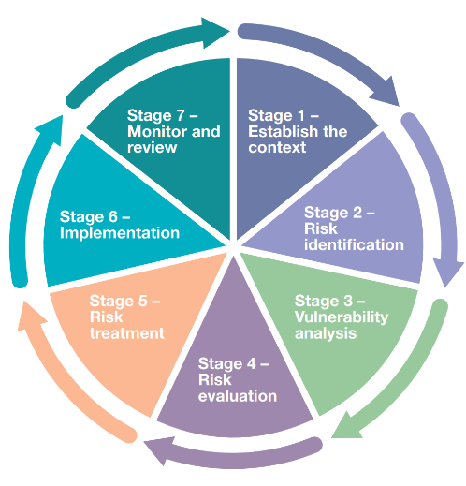
When does it make sense to undertake BDA?
CHRMAP requirement to consider funding implementation
BDA can also be undertaken after a CHRMAP has been completed to update and reassess proposed funding mechanisms
CHRMAP Process
Window for BDA
Notes:
Josh

Slide 8
When does it make sense to undertake BDA?
Less specific, more flexible
More specific, less flexible
CHRMAP Process
Start of stage 5
Adaptation actions / pathways not clearly defined
Partway through stage 5
Shortlist of adaptation pathways identified at a high-level
Start of stage 6
Preferred adaptation pathway identified
End of stage 6
Preferred adaptation pathway clearly detailed (including funding model)
Best approach: build it up
Notes:
Josh
Undertaking BDA at the end of Stage 6 can result in a number of risks:
A project may be very costly meaning it is difficult to gain community buy-in. This is bad if you’ve already chosen a pathway – may need to delay significantly or go back to the drawing board
Can do a BDA earlier, but if it’s too early will also run into issues – won’t have well-defined pathways and actions which means BDA will be imperfect – can’t define benefits well if actions aren’t defined well
Best option is to use BDA as one of the inputs to decision-making over the course of stage 5 – allows funding feasibility to be an input to the decision on a preferred pathway whilst also having relatively well-defined options.
BDA is most efficient when paired with a CBA – similar processes, doing both at the same time
Doesn’t stop you from refining the BDA in Stage 6 to develop a more detailed funding model for the preferred pathway

Slide 9
Planning and managing BDA
Confirm BDA objectives and scope
Define the base case and adaptation options
Identify outcomes, benefits and beneficiaries of adaptation options
Identify information
Notes:
Josh
In the next set of slides we’ll cover some key steps and concepts to support planning and management of BDA
Good to understand

Slide 10











Defining scope
Elements of a clear scope
Important to consider
Objective
Adaptation actions
Stage of planning
Information and knowledge base
Location
Project outputs
Remit
Budget and capacity
Hazards
Partners and stakeholders
Community values
Notes:
Josh
If these points are well considered then it should be straight forward to develop a clear scope
Stage of planning: as I discussed a few slides ago, the timing of BDA will determine how specific it can be, what it can consider (e.g. is it considering a small set of well defined options? A single preferred pathway? Actions which are not yet defined?)
Information and knowledge: Will go into typical information requirements in a bit
Remit: shouldn’t pursue actions or focus on areas which are outside of their remit. This is particularly relevant for adaptation actions which require trade-offs to be made, such as managed retreat
Budget and capacity: requirements will differ based on scope – may need to reduce scope if BDA needs to fit into a set budget

Slide 11
Base cases and project cases
Establishing a clear "base case" scenario is critical for economic analysis.
The base case should not necessarily be a "do nothing" scenario.
The base case should include any already committed investments or priorities but not include the new investments being proposed.
The key consideration is the difference between the base case scenario and the adaptation scenario in the future, rather than the change from the present day
Notes:
Josh

Slide 12
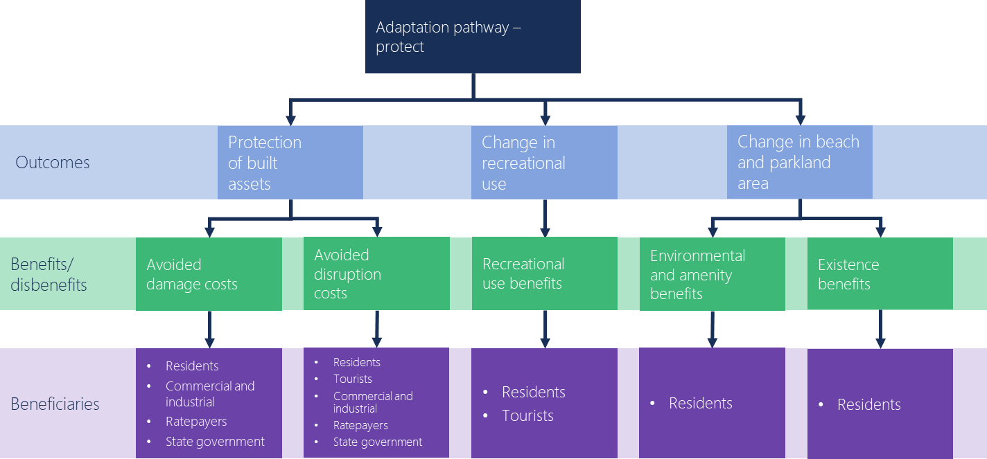
Identifying outcomes, benefits and beneficiaries
Notes:
Josh
Another key concept to understand is the difference between actions, outcomes, benefits and beneficiaries
Actions – the direct outputs from a pathway
Outcomes – direct and indirect outcomes from the actions – can be physical/social/economic/environmental/other
Benefits – distinct from outcomes – describe the ultimate benefit received due to outcomes.

Slide 13
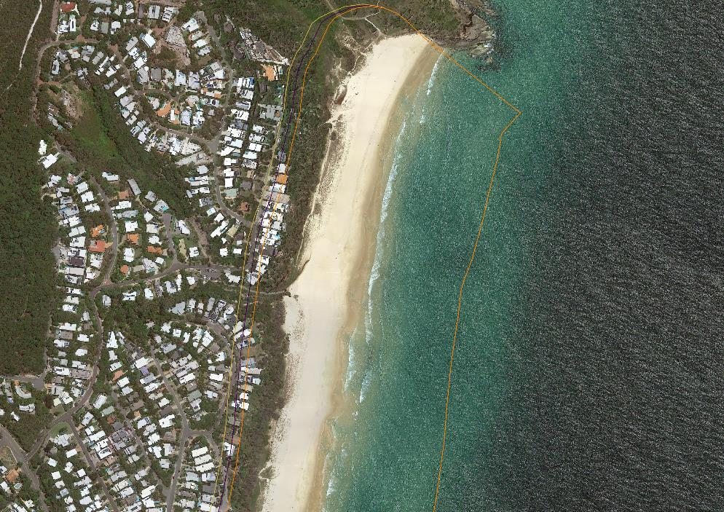
Example – Noosa: Eastern Beaches
Notes:
Sarah

Slide 14
Example – Noosa: Eastern Beaches
Location | Option 1 | Option 2 | Option 3 | Option 4 | Option 5
Management action undertaken | No action | Dune management undertaken from 2020 to 2100 | Dune management undertaken from 2020 to 2100, dune augmentation undertaken from 2030 to 2100 | Seawall built in 2040 | Properties acquired in 2020 and turned into parks
Peregian Beach - outcomes
Residential area | Assets affected from 2070 | Assets affected from 2100 (30 year delay) | Assets not affected until after 2100 | Assets not affected until after 2100 | Remaining assets affected from 2070
Peregian Park | Assets affected from 2070 | Assets affected from 2100 (30 year delay) | Assets not affected until after 2100 | Assets not affected until after 2100 | Remaining assets affected from 2070
Osprey Ave & Peregian Beach Park Car Park | Road affected by 2070, other assets affected 2100 | Road affected by 2070, other assets affected 2100 (no delay) | Assets not affected until after 2100 | Assets not affected until after 2100 | Road affected by 2070, other assets affected 2100
Marcus and Castaway Beaches - outcomes
David Low Way | Road affected by 2070 | Road affected by 2070 (no delay) | Assets not affected until after 2100 | Assets not affected until after 2100 | Road affected by 2070
Sunrise Beach - outcomes
David Low Way | Road affected by 2040 | Road affected by 2040 (no delay) | Assets not affected until after 2100 | Assets not affected until after 2100 | Road affected by 2040
Residential area | Assets affected from 2070 | Assets affected from 2100 (30 year delay) | Assets not affected until after 2100 | Assets not affected until after 2100 | Remaining assets affected from 2070
Notes:
Sarah

Slide 15
Example – Noosa: Eastern Beaches
Parameter | Value | Unit | Source | Description | Confidence
length | 12858 | metre | BMT (unpublished) - Mapped coastal erosion extent for Noosa | Length of beach under consideration | High
households | 295349 | no | ABS 2016 - Census household data | Number of households in local region | Medium
Beach use | 5530980 | no/year | Noosa Surf Lifesaving Club (unpublished) - June 2013 survey | Annual beach use when beach is in excellent condition | Medium
Beach use value | 10 | $/visit | Raybould et al. 2011 - A travel cost model of local resident’s beach recreation values | Local recreational value per visit | Low
Rec value threshold | 3.5 | metres | Parsons et al. 2013 - Valuing Beach Width for Recreational use | Threshold at which recreational value per visit declines | Low
Reduction in recreational value | 0.14 | decimal | Parsons et al. 2013 - Valuing Beach Width for Recreational use | Proportional decline in recreational value at threshold | Low
number of tourist days | 1160000 | days | Tourism Research Australia 2018 - Local Government Area profiles | Annual number of days spent in region by tourist day trip visitors | High
daily expenditure | 94 | $/day | Tourism Research Australia 2018 - Local Government Area profiles | Daily expenditure by tourist day trip visitors | Medium
Reduction tourism days | 0.18 | decimal | Tourism Research Australia 2018 - Local Government Area profiles | Proportional decline in the number of tourist days without beach | Low
Net profit | 0.17 | $ | Dwyer et. al. 2005 - The economic impacts and benefits of tourism in Australia | Local benefit per dollar of expenditure | Low
Existence value | 1.8 | $/ha/household | Pascoe et al. 2017 - What’s my beach worth | Non-use value of beach | Low
Park value | 1156121 | $/ha/yr | Ambrey and Fleming 2014 - Public greenspace and life satisfaction | Value of public open space | Low
Notes:
Sarah

Slide 16
Common challenges
Some adaptation actions can have disbenefits
Sometimes it can be challenging to identify beneficiaries
Future land use changes can make outcomes and benefits uncertain
Sometimes benefits can accidentally be included twice in analysis
Using different geographical boundaries for the analysis can lead to different results
Notes:
Sarah

Slide 17




Information and data
Identify gaps and collect new information to fill gaps (where it makes sense)
Identify likely information requirements for a BDA
A benefit distribution analysis is reliant on a range of data and information is likely to come from multiple different sources.
If information isn’t available gaps can be addressed through use of assumptions, and further information can be gathered in future.
Identify existing information held by your organisation and others
Notes:
Sarah

Slide 18






Information and data - examples
Hazard information
Adaptation measures
Coastal and estuarine erosion and inundation mapping
Timing and risk profile
Extent or effects
Frequency
Impact of proposed adaptation measures, e.g. beach width or access, frequency or risk of erosion or flood events
Costs of proposed adaptation measures
Built Asset location and value
Public and private building locations
Road network, state and local
Other built assets e.g. car parks, toilet blocks, signs
Financial value, maintenance costs
Environmental and heritage data
Information and data needed
Location of environmental assets and heritage assets
Any studies on values or use
Expected risks as a result of coastal hazard
Beach, park and recreational use data
Future planning information
Number of beach visitors, local and from other areas
Number of people using parks or recreational facilities
Changes in use as a result of flooding or erosion
Future growth, new building developments
Proposed planning controls
Population growth rates
Changes in infrastructure, access or use
Notes:
Sarah

Slide 19
Summary - planning and managing BDA
Planning and supporting BDA | Checklist | Timing
Confirm BDA objectives and scope | Has a clear scope been defined including; objectives, location, hazards, adaptation actions, project outputs, partners, and stakeholders? Is the scope feasible and appropriate given the remit, information and knowledge base, current stage of planning, community values, and resources? | This should be undertaken prior to engaging a consultant
Identify and define the base case and adaptation options | Do you have a clear understanding of the base case? What investment in coastal protection has occurred to date What investments are already funded or in planning stages Have you identified the adaptation options to be included in the assessment? Are the options clearly defined? Have costs and engineering designs been completed? If not, the analysis will be less detailed and will need to be refined once the options are further developed | The base case and adaptation options can be developed together with the consultant, but understanding the base case and adaptation options before starting the project will help set up for success
Identify outcomes, benefits and beneficiaries | Are all key outcomes, benefits and beneficiaries being considered? Is there a causal link between all outcomes, benefits and beneficiaries? | The consultant should work closely with you to help identify the outcomes, benefits and beneficiaries however they will need your local knowledge and understanding to do this effectively
Identify information and data availability | Have you identified relevant information and data, which may include: previous risk assessments spatial data for hazards and assets information on proposed adaptation options financial and cost data for council-owned assets | Identify what information you have prior to engaging with the consultant, they can then help you to address gaps or provide guidance on the level of analysis that can be undertaken given data constraints
Notes:
Sarah

Slide 20
Interpreting BDA results
Understanding non-market valuation methods
Discounting
Accounting for uncertainty
Reporting
Notes:
Josh

Slide 21
Example beneficiaries and benefits
Beneficiary | Description of benefits
Property owners | Avoided loss of property Avoided loss of critical services (property access, water and electricity)
Recreational users of beach and parklands | Avoided loss of recreational benefits from beach and parkland visitation
Local government (ratepayers) | Avoided loss of council assets
State government | Avoided loss of state government assets
Commercial/industrial | Avoided loss of capital and income
Notes:
Josh

Slide 22
Example results table
Beneficiary | Total discounted benefit ($) | Proportion of total discounted benefit (%)
Property owners | $20m | 43%
Recreational users | $12m | 26%
Local government (ratepayers) | $4m | 9%
State government | $2m | 4%
Commercial/industrial | $8m | 17%
Total | $46m | 100%
Notes:
Josh
Here are some example results from a BDA – what is ‘discounted benefit’, how do we measure it? Why is it expressed in dollars (and how)?

Slide 23
Key BDA concepts - Economic valuation
Example study
How do groynes benefit two key groups:
recreational users of a popular beach
property owners close to the beach
Analysis suggests that the groynes would:
Prevent loss of 10,000 recreational visits to the beach each year
Prevent loss of 10 properties close to the beach
How do we compare these outcomes?
Notes:
Josh
To answer the last question we can go to another example…

Slide 24
Economic valuation - monetisation
Solution - monetisation
Allows for like-for-comparison
Example study
Avoided loss of 10 properties would lead to $8 million in benefits to property owners ($800,000 per property based on market value of properties)
Avoided loss of 10,000 beach visits per year would lead to $7.5 million in benefits to recreational users over 50 years (based on a value for beach use estimated at $15 per visit)
Notes:
Josh
Allows for like-for-like comparison – putting benefits on a common unit of measurement. The just use dollars is because it’s the most convenient and intuitive measure to use

Slide 25
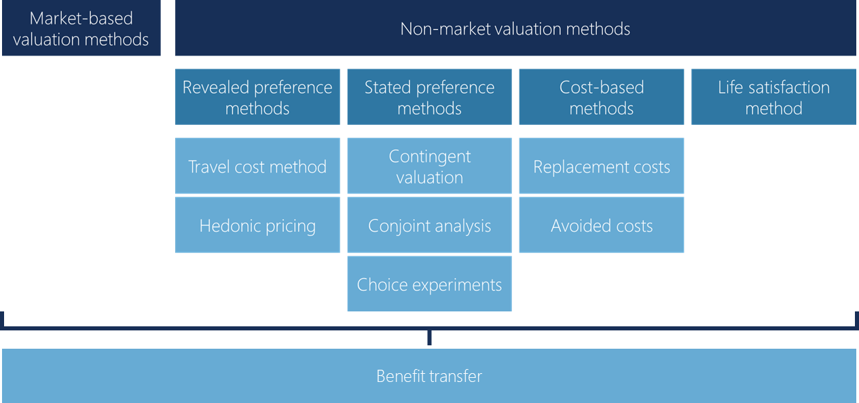
Valuation methods
Further guidance can be found in Appendix 5 of CHRMAP Guidelines (July 2019)
Notes:
Sarah

Slide 26
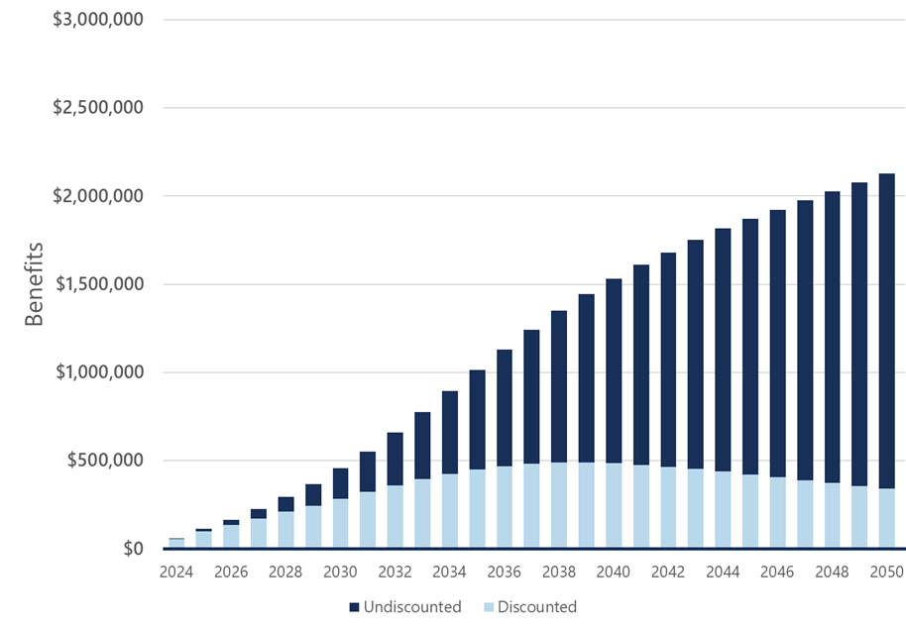
Discounted vs undiscounted benefits
Discounting is used to account for the time value of money and compare costs and benefits at different points in time.
Discounting recognises that a dollar received today is generally more valuable than the same dollar received in the future due to factors like inflation, opportunity costs, and risk
Discounting also accounts for intergenerational equity effects
Standard guidance is to use a 7% discount rate however the rate can be varied depending on the circumstance and should be tested through sensitivity analysis
Notes:
Sarah

Slide 27
Sensitivity analysis
BDA often depends on assumptions which are uncertain
Sensitivity analysis tests how alternative assumptions affect BDA results
Can identify opportunities for further work
Scenario | Beneficiary
Scenario | Property owners | Recreational users | Local government | State government | Commercial / industrial | All
Central scenario | $20m (43%) | $12m (26%) | $4m (9%) | $2m (4%) | $8m (17%) | $46m
Low discount rate (3%) | $32m (36%) | $35m (40%) | $7m (8%) | $3m (3%) | $11m (13%) | $88m
Low recreational use | $20m (48%) | $8m (19%) | $4m (10%) | $2m (5%) | $8m (19%) | $42m
Notes:
Josh
Uncertain assumptions – include discount rate, assumptions relating to outcomes (e.g. how beach use is affected by beach width), the unit value placed on social and environmental outcomes (e.g. dollar value of a beach visit)
Very important to do, particularly if analysis hinges on a few key variables with a high or moderate degree of uncertainty. Results may be significantly different than the central case when moving these variables
Example below…
Lower discount rate changes discounted benefit to rec users significantly

Slide 28
Reporting results
Outputs and reporting should align with BDA objectives and the priorities of the intended audience
Reporting should:
be clear, concise and easily understood by a non-technical audience
include an executive summary for decision-makers
include technical appendices with detailed information about methodology and assumptions
Notes:
Josh

Slide 29
Summary – interpreting BDA results
Reporting considerations | Checklist
Documenting methods and data used | Have the values used to estimate benefits been clearly documented, and the methods explained? Have any assumptions or data limitations been outlined? Has the discount rate been documented?
Sensitivity analysis | Have all key assumptions been sensitivity tested? Did the sensitivity analysis change the findings of the BDA? If an assumption is material (makes a big difference to the results) and uncertain (could be a wide range of different values) then this should be documented and addressed through future analysis
Communicating findings | Does the content and structure of the final report align with the intended audience and purpose? Is the report clear, concise and easily understood by a non-technical audience? Does it include an executive summary for decision-makers? Does it include technical appendices with detailed information about methodology and assumptions?
Notes:
Josh

Slide 30
Applying BDA results to planning decisions
The beneficiary pays principle
Other principles to consider
Example application
Building knowledge over time
Notes:
Sarah

Slide 31
Recap: the beneficiary pays principle
Focuses on equity – those who benefit from an investment should pay for it
Key purpose of benefit distribution analysis – identify beneficiaries to understand appropriate funding for action
Beneficiary pays principle by itself doesn’t consider:
Ability to pay
Boundary issues
Perverse incentives / unintended consequences
Administrative costs
Notes:
Sarah

Slide 32
Other principles to consider
Equity (beneficiary pays principle) – the funding mechanism should be funded proportional to the benefits received
Simplicity – the funding mechanism should be simple to reduce administrative burden and transaction costs, and to ensure the approach is robust to future changes in hazards
Efficiency – the funding mechanism should be efficient and not cause distortions or perverse incentives such as changing behaviour to avoid paying
Transparency – the split of funding should be transparent and clearly communicated to those paying for the adaptation measures
Adequacy – the funding mechanism should raise sufficient funds for the required adaptation measures, and there should be confidence in the funding amount raised each year
Notes:
Sarah

Slide 33
Examples/case studies
Benefit distribution analysis shows that for a program of beach nourishment and dune rebuilding:
50% of the benefits are received by property owners along the beachfront
Challenge: How do you charge the beach users?
Flat charge on all ratepayers?
Parking charge for parking at the beach?
10% of the benefits are received by the state from avoided damage to a state-road
30% of the benefits are received by people using the beach (a mix of local residents and visitors)
BPP: each beneficiary would contribute a proportion of the funding based on the proportion of the benefits they receive
10% of the benefits are received by local government from avoided damage to council-owned assets
Notes:
Sarah

Slide 34
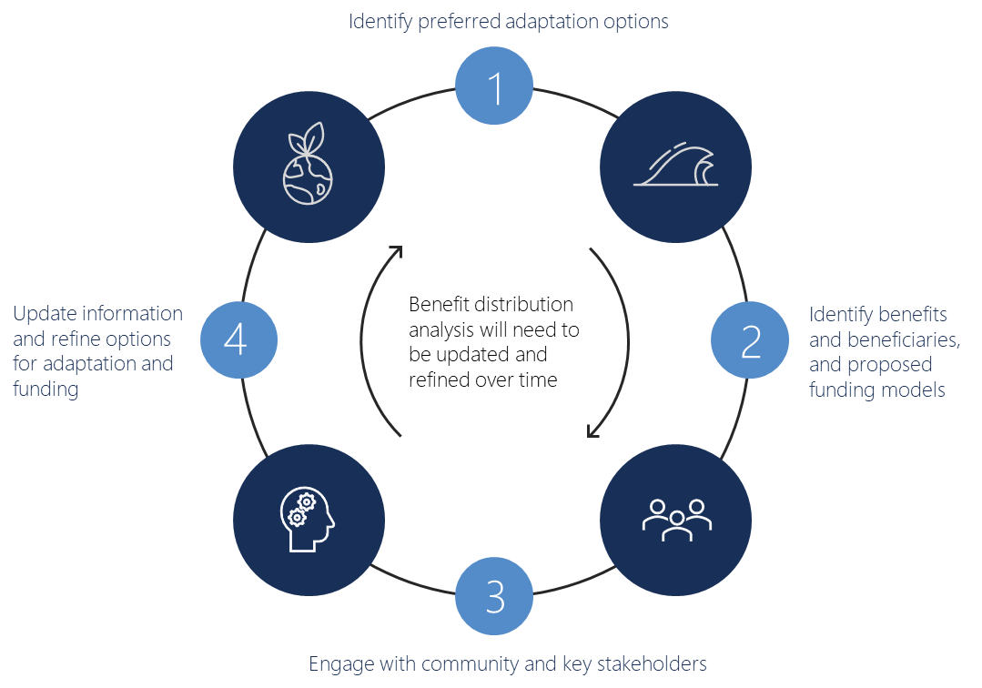
Building knowledge over time
Notes:
Sarah

Slide 35
Key takeaways
BDA is useful for informing decisions on funding models for adaptation measures
Standard economic analysis techniques can be used to develop BDA, some common issues and terminology has been provided in the accompanying factsheets
BDA can be challenging to implement and will not always produce simple answers for funding
There should be a focus on transparent analysis that draws on as much local information and knowledge as possible to complete the assessment
Identifying key trade-offs and challenges can help to prepare for the need to communicate and engage
Identify key stakeholders and information owners earlier and bring them on the journey
Ensure the benefits of action are clearly communicated and can be understood by community and decision makers
Notes:
Sarah

