Slide 1
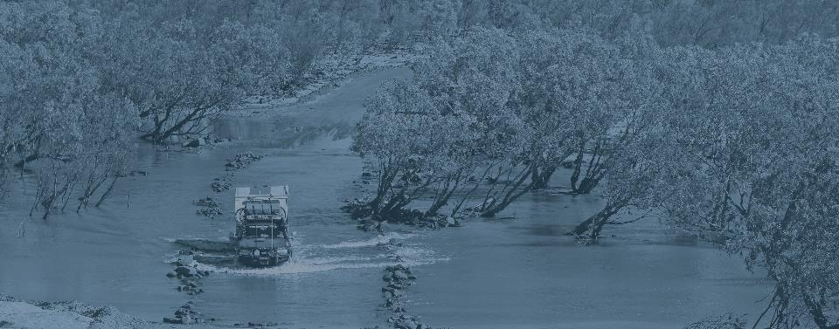
Hazard Risk Assessment
<inset date>
Shire of <name>
Notes:
Throughout this PowerPoint, for each slide text in italics are actions that you will need to undertake. Text in bold is advice for speech.
All text on the slides in grey will require updating.
Update all grey fields – the hazard you are assessing, the date, and your LGA name.
Display this slide as your title slide as people are coming in.
“Hello everyone and thank you so much for coming. Today we will be conducting a risk assessment for the XX hazard for our Shire/City. The risk assessment will inform our emergency risk management plans and will use criteria that is compliant with the National standard. What we will do today is consider a specific scenario and go through a series of risk statements, determining a consequence and likelihood level for each statement. I will explain this process a bit later on”.

Slide 2
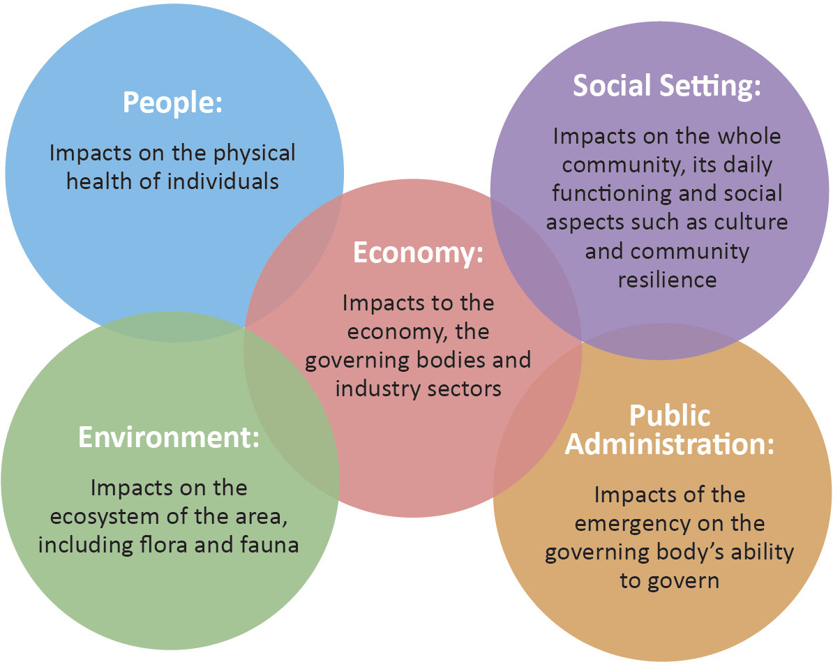
Core Objectives
The assessment will consider the possible impacts on:
Notes:
“You’ll see that the statements and the criteria that we’ll be using today is divided into FIVE different categories: People, Social Setting, Economy, Environment and Public Administration.
We’ll be looking at the degree of impact on each of these areas.”

Slide 3
Earthquake Video
Notes:
If you are playing a hazard video, update this slide to reflect the hazard that you will be assessing.
If there is no video currently available, you will need to insert ‘establish the context’ slides of your own to describe the hazard you will be looking at.
“Firstly, in order to ensure we are all on the same page and everyone understands the hazard we are looking at today and its context, we are going to play a short video (or have a presentation) which describes the hazard and its potential impacts across WA”.

Slide 4
VULNERABILITIES & IMPACTS
The Shire of Brilliant
Notes:
Update the fields in grey.
“Now that we have established the context of the hazard, we will look at the potential impacts of the hazard in our LGA and what may be vulnerable.”

Slide 5
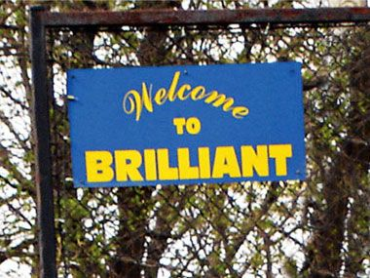
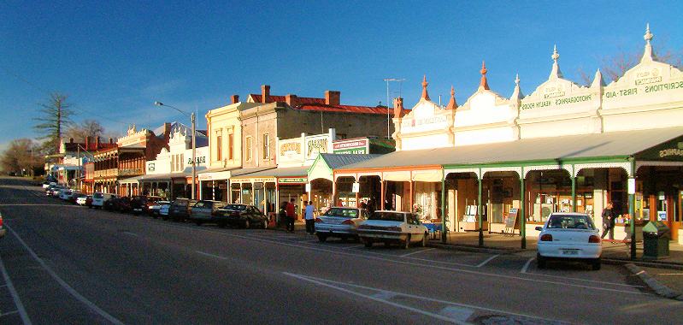
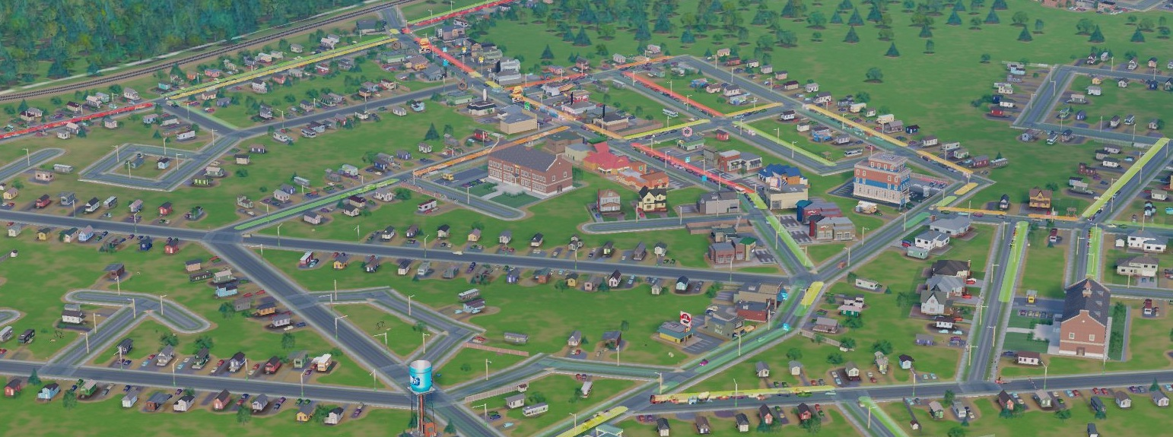
Notes:
- Add in some images of your LGA to break up the text.

Slide 6
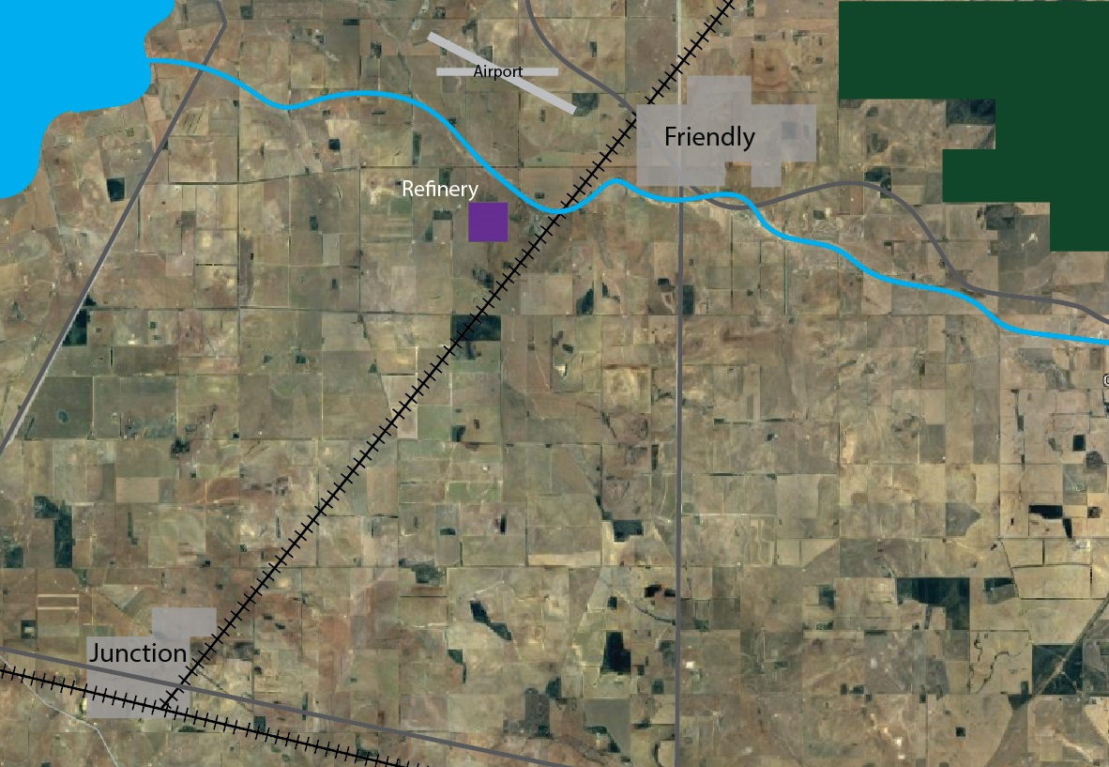
Notes:
Include a map of your LG that illustrates the social and natural environment. It could highlight important and/or vulnerable aspects of the community. For example: transport routes, major infrastructure, health campuses, schools, rivers, coastlines, lakes etc.
“This is the area that we’ll be focusing on for our risk assessment today” – Briefly describe the area.

Slide 7
People
Population: 14,613
Median age: 40 yrs
70% were born in Australia
60% are over 15yrs old and in the workforce
13% are over 65 yrs old
Earthquake Impacts:
  Deaths
  Injuries
  Further deaths and injuries due to delay receiving medical attention
Notes:
Update fields in grey.
1. Provide interesting points about the population of the LGA. This may highlight the demographic, or you may live in an area that has a highly transient or seasonal population. What percentage of the population are over 65? What percentage have English as a second language? Etc.
2. Update the hazard you will be assessing.
Describe each dot point on the slide and where necessary, explain its relevance.
Describe potential impacts to ‘people’

Slide 8
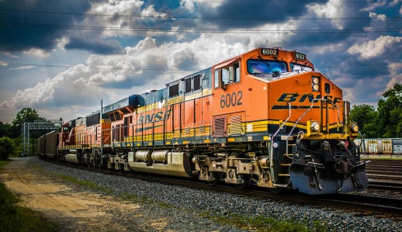
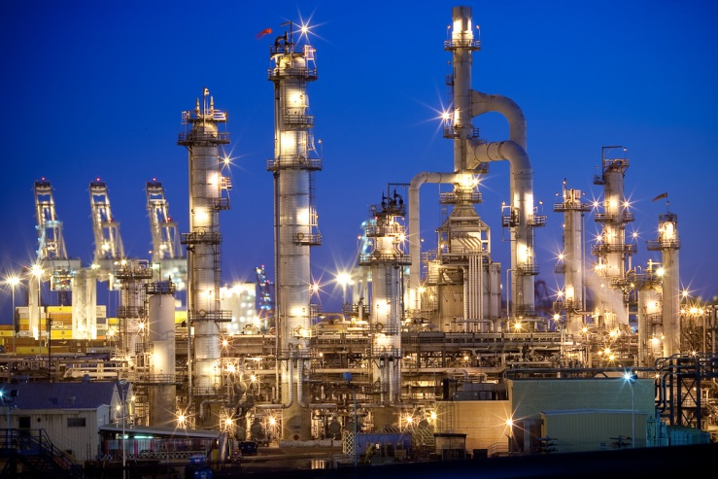
Economy
Gross area product: 2.86 billion
Significant industries: manufacturing, refinery and mining support industries (~40% of gross area product)
Extensive cropping industry (~50% of gross area product)
Tourist destination (native forest and lake)
bring in people from the state and interstate
Commercial hub for the district
Botanic industry and fair
Earthquake Impacts:
  Loss of industry operations for a time
  Loss of income or incurred expenses
  Recovery costs of infrastructure
  Indirect financial losses
Notes:
Update fields in grey and images if necessary.
1. Provide interesting points about the economy of the LGA. This may highlight significant or prominent industries within the LGA and their % attributed to the gross area product. You may also want to talk about tourism in the area, or seasonal industries.
2. Update the hazard you will be assessing.
Describe each dot point on the slide and where necessary, explain its relevance.
Describe potential impacts to ‘economy’

Slide 9
Economy cont.
Built Infrastructure
  Water and waste water treatment facilities (in Friendly)
  Regional airport with 2 flights per day
  Main roads connecting the two towns
  Railway lines for industry (mining and agriculture)
  Crop storage facilities
  8,000 houses (50% built pre 1950s)
Earthquake Impacts:
  Building damage – private and commercial
  Bridges and roads
  Essential services disruption
Notes:
Update fields in grey.
1. Provide information about the infrastructure in the LGA.
2. Update the hazard you will be assessing.
Describe each dot point on the slide and where necessary, explain its relevance.
Describe potential impacts to ‘infrastructure’

Slide 10
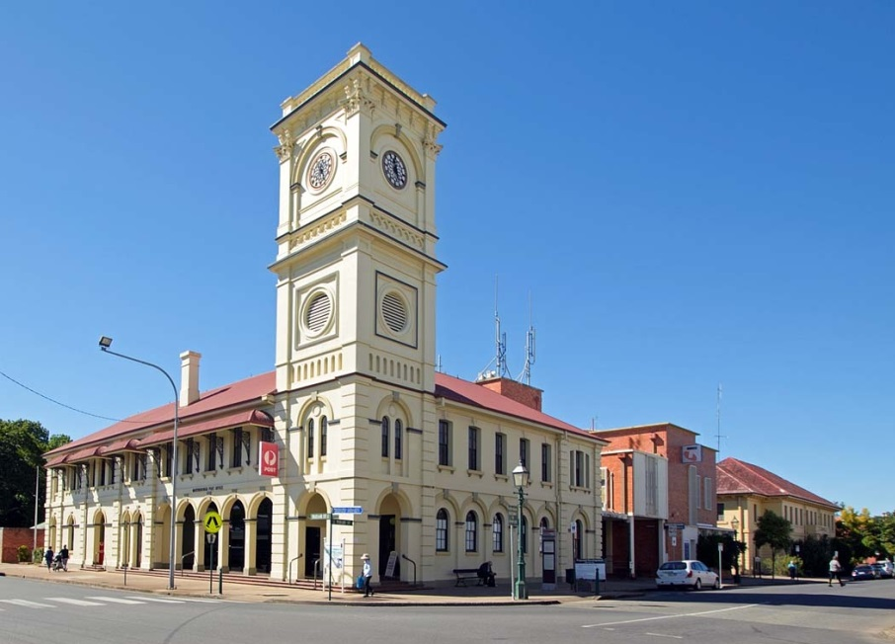
Social Setting
5 primary schools and 1 high school
2 nursing homes
Heritage town centre and clock tower built in 1875
Historic pub
Botanic gardens with native plants only found in Brilliant
Oval
Earthquake Impacts
  Displacement
  Culturally important objects
  Culturally important events
  Loss of morale
  Loss of community services
  Impacts of losing loved ones
  Damage to businesses causing loss
  of employment
Notes:
Update fields in grey and image.
1. Provide interesting points about the community. This may include aspects that make the community what it is, e.g. important places, events, heritage buildings, sporting, conservation areas etc.
2. Update the hazard you will be assessing.
Describe each dot point on the slide and where necessary, explain its relevance.
Describe potential impacts to ‘social setting’

Slide 11
Public Administration
All normal LG/government services
1 police and 1 fire station
5 bushfire brigades
Hospital
2 GP clinics
Ambulance Services
Earthquake Impacts
  Impacts to the provision of public services including
    Local government
    Essential services
  Loss of staff
  Damage to buried infrastructure
  Loss of power and communications
    State departments
    NGOs
Notes:
Update fields in grey.
1. Provide information about the services in your area, this should include government and non-government services as well as utilities.
2. Update the hazard you will be assessing.
Describe each dot point on the slide and where necessary, explain its relevance.
Describe potential impacts to ‘public administration’

Slide 12
Environment
Botanic gardens with native plants only found in Brilliant
Native forest used for tourism and conservation
Earthquake Impacts
  Discharge of debris into waterways
  Contamination e.g. asbestos, pollutants
  Dumping of building waste
  Increase sediment load in rivers
Notes:
Update fields in grey.
1. Describe the LGA’s natural environment This may include water bodies, parks, national parks, conservation areas, significant wildlife populations, endangered or vulnerable species and ecosystems.
2. Update the hazard you will be assessing.
Describe each dot point on the slide and where necessary, explain its relevance.
Describe potential impacts to ‘environment’

Slide 13
Earthquake Scenario
Shire of Brilliant
Notes:
Update fields in grey.

Slide 14
Earthquake
At 2:56 PM on a Tuesday in early June
Very shallow 5.7M earthquake occurs from fault movement 10km east of Friendly town centre
Epicentre depth: 5.0km
Friendly experience shaking of 7-8 on the MMI scale
Junction experiences shaking of MMI 6
EXAMPLE
Notes:
- Insert your scenario slides. These should describe the scenario, similar to a timeline events. Maps and images are always very useful. This slide, and the following 2 slides are example scenario slides only – please update.

Slide 15
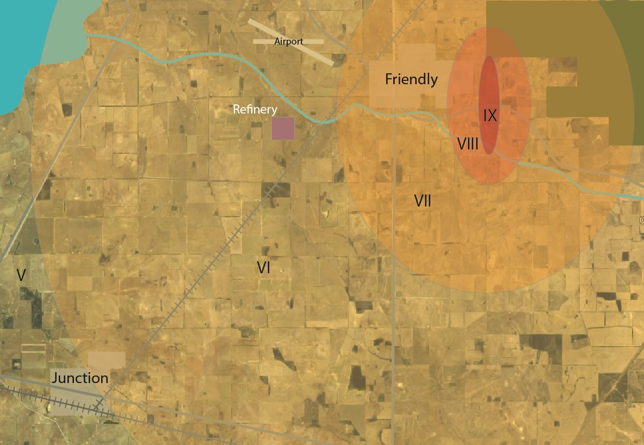
EXAMPLE
Notes:
- Please update as necessary

Slide 16
Expected damage
MMI | Example event | Expected impact
V | Kalgoorlie CBD, 20 April, 2010 | Cracking of vulnerable masonry (e.g. parapets & chimneys) with minor falls. Minor cracking to masonry houses.
VI | Boulder CBD, 20 April, 2010 | Collapse of vulnerable masonry and severe cracking to other masonry structures.
VII | Newcastle, 27 December, 1989 | Severe damage to URM buildings, some damage to housing, damage to low ductility framed buildings, particularly irregular buildings with some collapses.
VIII | Christchurch, Feb 22, 2011 | Severe to complete damage to URM buildings, severe damage to low ductility buildings.
IX | Meckering, 14 October, 1968 | Destruction of URM and low ductility framed buildings, damage to all other types.
EXAMPLE
Notes:
- Please update as necessary

Slide 17
RISK ASSESSMENT PROCESS
Shire of Brilliant
Notes:
-Update grey fields.
“I will now describe the risk assessment process and what we will be doing in the workshop today.”

Slide 18
Steps of During the Workshop
For our purposes imagine the event IS taking place
For each Risk Statement:
  Group Decision, Majority rule
Step 1.
Assess maximum possible Consequence
Step 2.
Assess the Likelihood of that Consequence
Step 3.
Assess Confidence of the decisions
Step 4.
Plot on to appropriate matrix (automatic)
Notes:
“There are 3 steps we will do together and the 4th is done by the computer.
First we assess the maximum possible consequence, next the likelihood of that level of consequence occurring, and then we assess the confidence of the decision.
Two things to remember
1. for the purpose of this assessment, we are imagining that the event is taking place. So we don’t need to figure out the chances of it happening, for our purpose, it is happening.
2. The other is that it is a group decision and majority rules if it comes to a vote. “

Slide 19
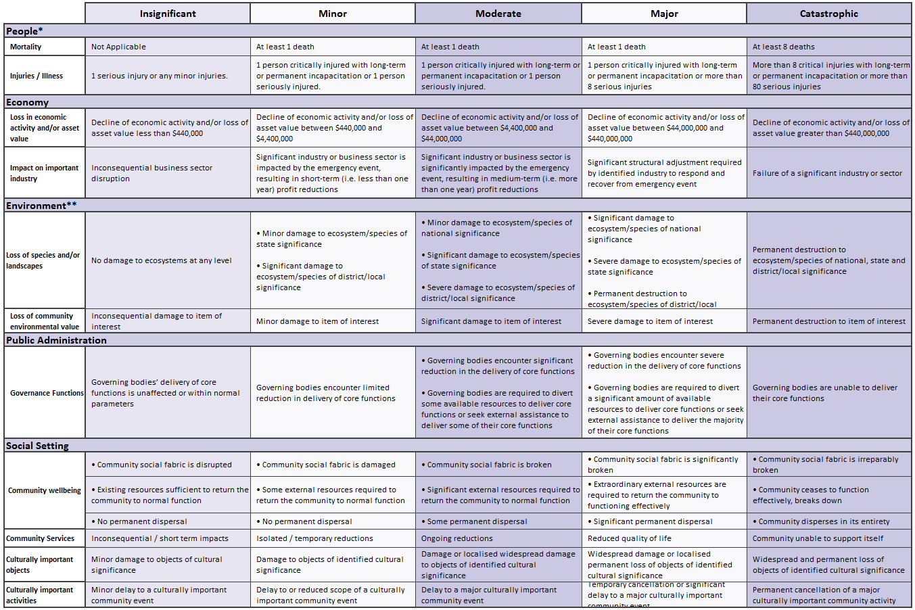
Step 1: Assess the maximal consequence
Move right to left
The risk statement only needs to fulfil one of the consequence criteria points of a level, not all, for it to be assigned that consequence level.
Yes
No
No
Notes:
“So for Step 1 – assessing the consequence. You want to always start as far right as you think is possible.
It’s possible that you could have a minor consequence with 100% likelihood or a moderate one with 50% likelihood.
We’re after the highest possible consequence, so you’d choose the moderate consequence and the assess its likelihood.”

Slide 20
Step 2: Likelihood
Likelihood =
AEP
(event probability)
X
%
(risk statement probability)
i.e. probability or event happening at all
- Predetermined by comparison and research
What we will assess today: Probability of risk statement occurring, given the event is happening.
Notes:
“Now that we’ve established the consequence level, we move to likelihood.
Likelihood is made up of two parts – the probability of the event taking place and the probability of the statement occurring given the event is happening.
The AEP, which is the annual exceedence probability, measures the percentage chance that an event of that size would occur in any given year. This number is determined by science experts or statistical analysis. This figure was determined during the hazard scenario planning and has already been put into the computer.
What we are concerned with today is the probability of the statement occurring.”

Slide 21
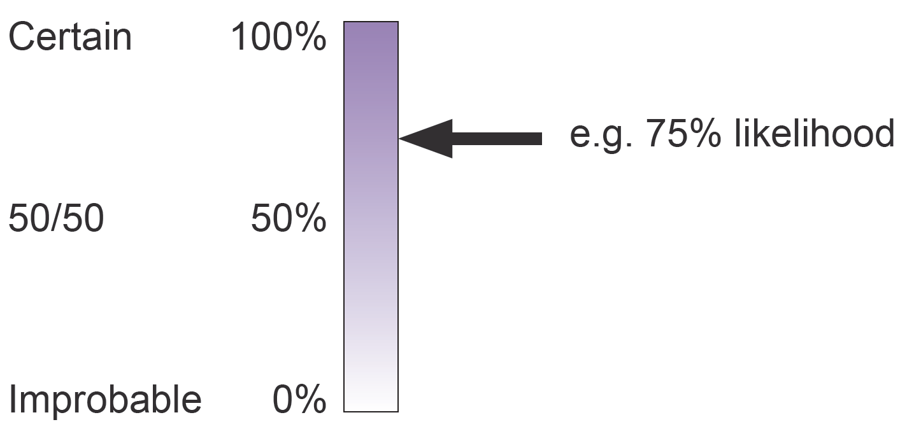
Step 2: Assess the likelihood of that consequence
Chance the statement will occur:
Likelihood = (Event Likelihood) x (X %)
Notes:
“The probability of the statement occurring is done by determining a percentage between 1 and 100%.
It’s the percentage chance of the level of consequence we have chosen. If a major consequence is chosen, the percent chance of a major consequence occurring.
For example, if there is a flood, what is percentage chance that the school will sustain major damage in the flood? So it’s a group decision of 1-100%”

Slide 22
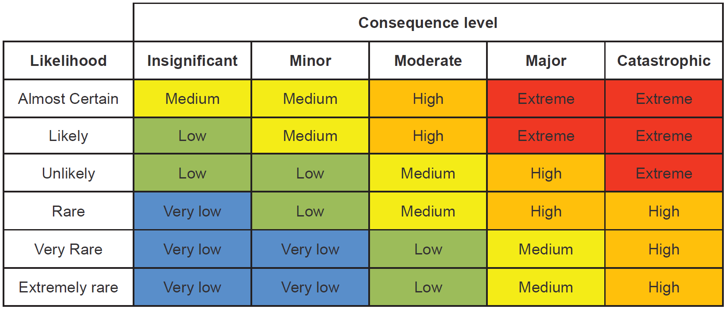
Risk Matrix
Notes:
After choosing the consequence and likelihood, the calculation of risk is done automatically in the WA risk register tool.
As we go through, XXX will be recording our assessments and taking notes to add context to the assessment on the computer.”

Slide 23
Step 3: Assess the confidence in assessment
Assess the CONFIDENCE in the assessment:
  Lowest, low, moderate, high, highest
  Depending on level of knowledge, level of data, level of agreement
  Default to moderate (time saving)
Priority List will be generated for later treatment review
Notes:
“The final step is to determine the confidence of the decision. If you turn the consequence table over, you’ll find the confidence table.
You can collectively decide whether it’s Lowest, low, moderate, high, lowest or highest, using the three descriptors:
supporting evidence – is your decision this based on a previous similar event and the impacts it had, a model, or it is a total guess?
The expertise in the room is also an factor - If we’re making a decision about health care and there is not a single health professional in the room, our confidence ought to be low.
And the last descriptor is if there is agreement between participants. If we end up with a half-half spilt, we can break the stalemate by selecting a low confidence in the decision.
We’ll use moderate as default.
It can be a bit hard to get your head around at first but once we start working our way through risk statements, it will start to become clearer.
Questions?”

Slide 24
Hazard Risk Assessment
Notes:
Update all grey fields
*Begin your risk assessment

