Slide 1
Title slide (Arial 24pt)
Subtitle (Arial 18pt)

Slide 2
Title and content slide
Example text (Arial 20pt left aligned):
Example text (Arial 20pt left aligned)
Tips:
  Write in plain English, no jargon (be concise)
  This is an example of a well-designed presentation.

Slide 3
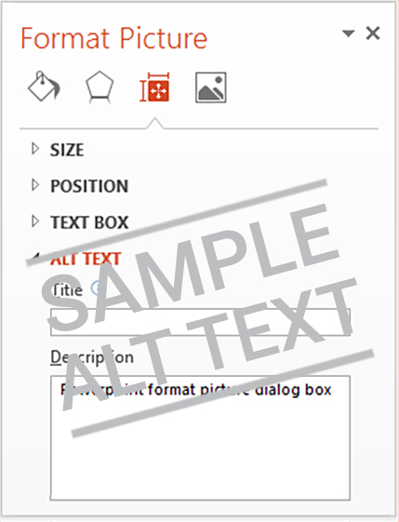
Two content slide
Example text (Arial 20pt left aligned)
Tips:
  Write in plain English,
  no jargon (be concise)
  This is an example of a well-designed presentation.

Slide 4
Section slide
(Arial 42pt)
Subtitle (Arial 20pt)

Slide 5
Comparison slide
Subheading
(Arial bold 20pt)
Subheading
(Arial bold 20pt)
Example text (Arial 20pt left aligned)
Write in plain English, no jargon
This is an example of a well-designed presentation.
Example text (Arial 20pt left aligned)
Write in plain English, no jargon
This is an example of a well-designed presentation.

Slide 6
Table example
Table header (20pt Arial Bold) | Table header | Table header
Table text (Arial 20pt Arial) | [Insert text] | [Insert text]
[Insert text] | [Insert text] | [Insert text]
[Insert text] | [Insert text] | [Insert text]

