Slide 1




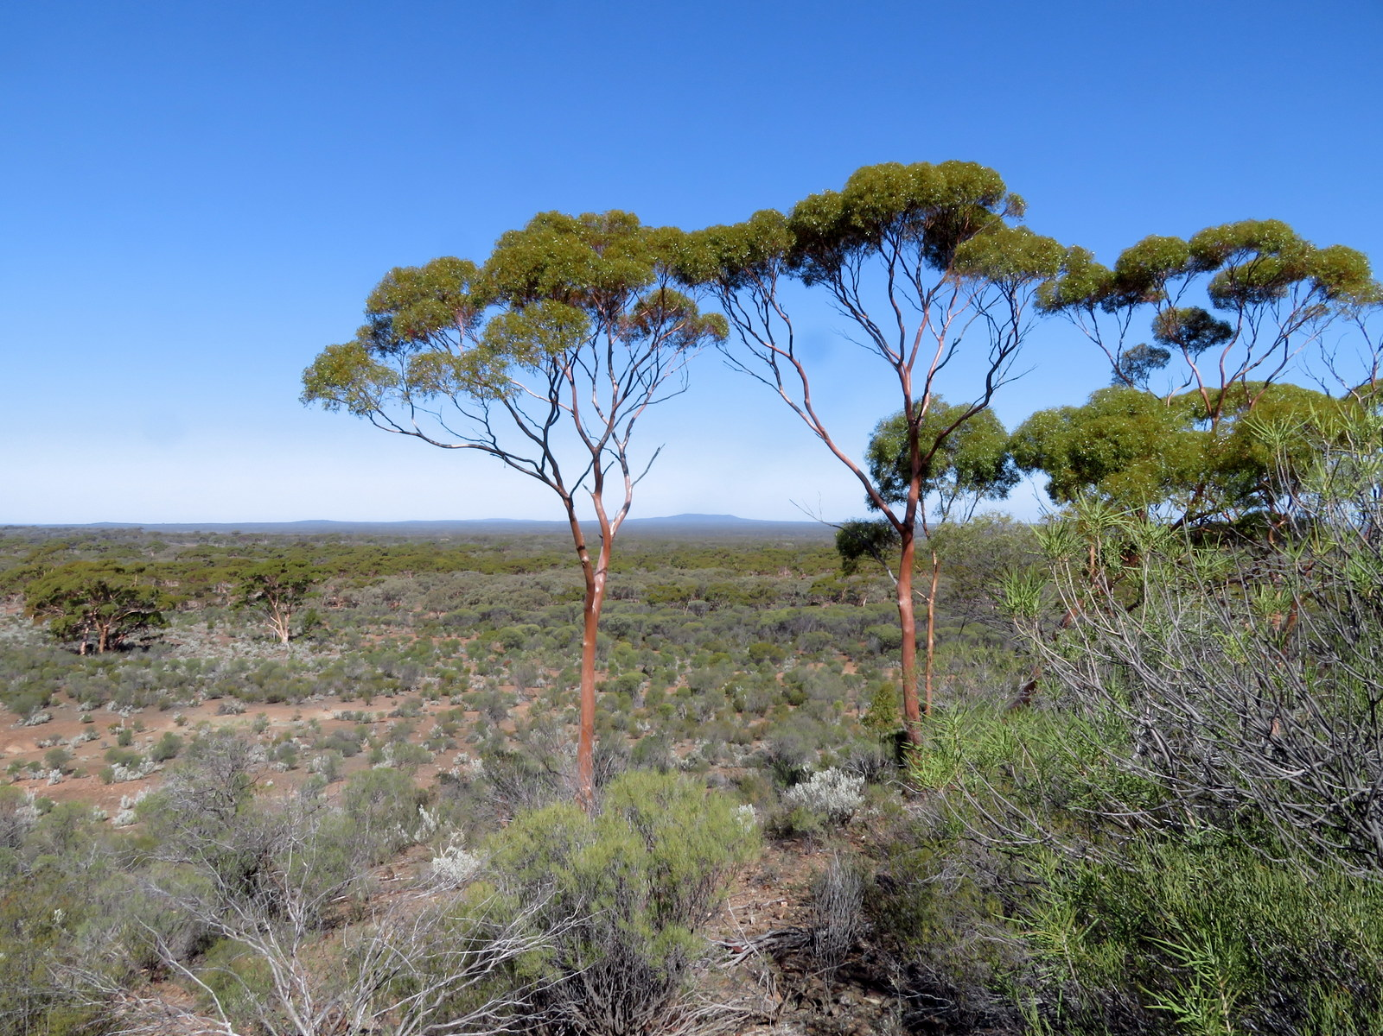
The Eastern Goldfields High Resolution Seismic Survey:
preliminary interpretation and tectonic implications
Ivan Zibra
Klaus Gessner, Jyotindra Sapkota, Matt De Paoli, Roberto Weinberg, Mike Dentith, Ruth Murdie, Renfei Tian, Huaiyu Yuan

Slide 2
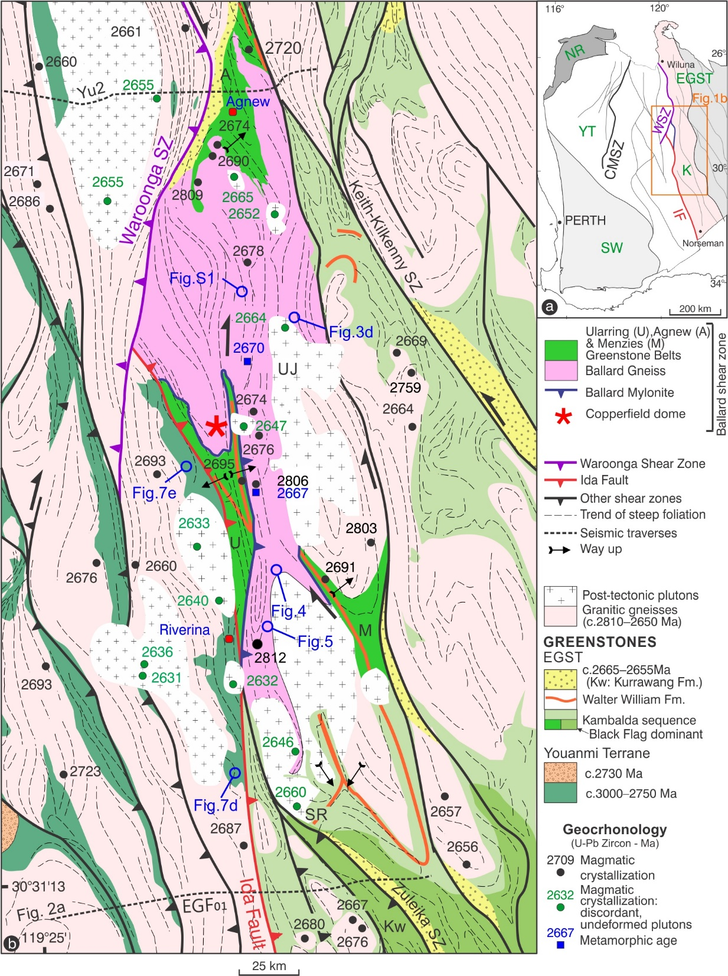
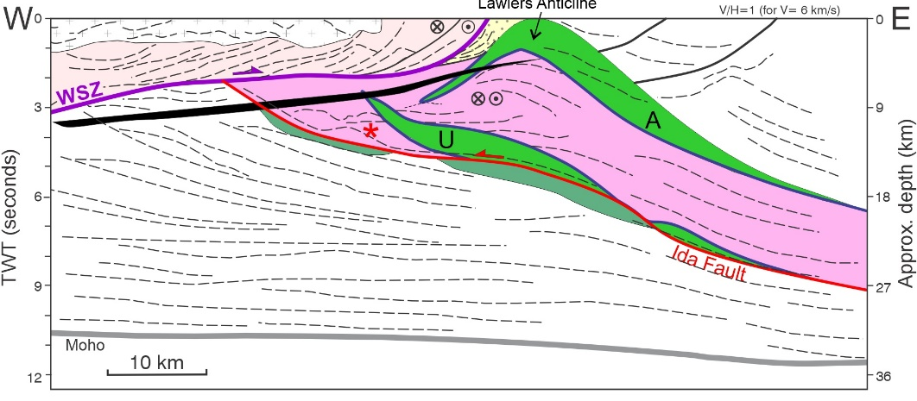
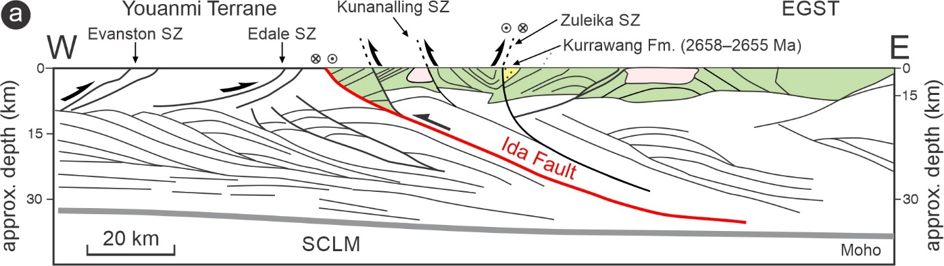
Kalgoorlie Terrane shaped by:
Transpressional Ballard shear zone
(≥200 km along strike. Zibra et al., 2020 -Tectonics)
Active in c. 2680-65 Ma
2 Structural Elements
HT Gneiss
Mylonite
Notes:
BSZ responsible for bulk of structural architecture in the kal terrane

Slide 3
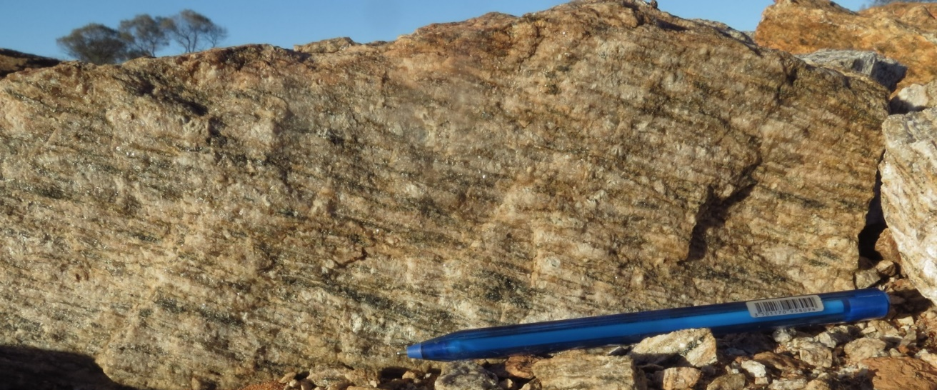
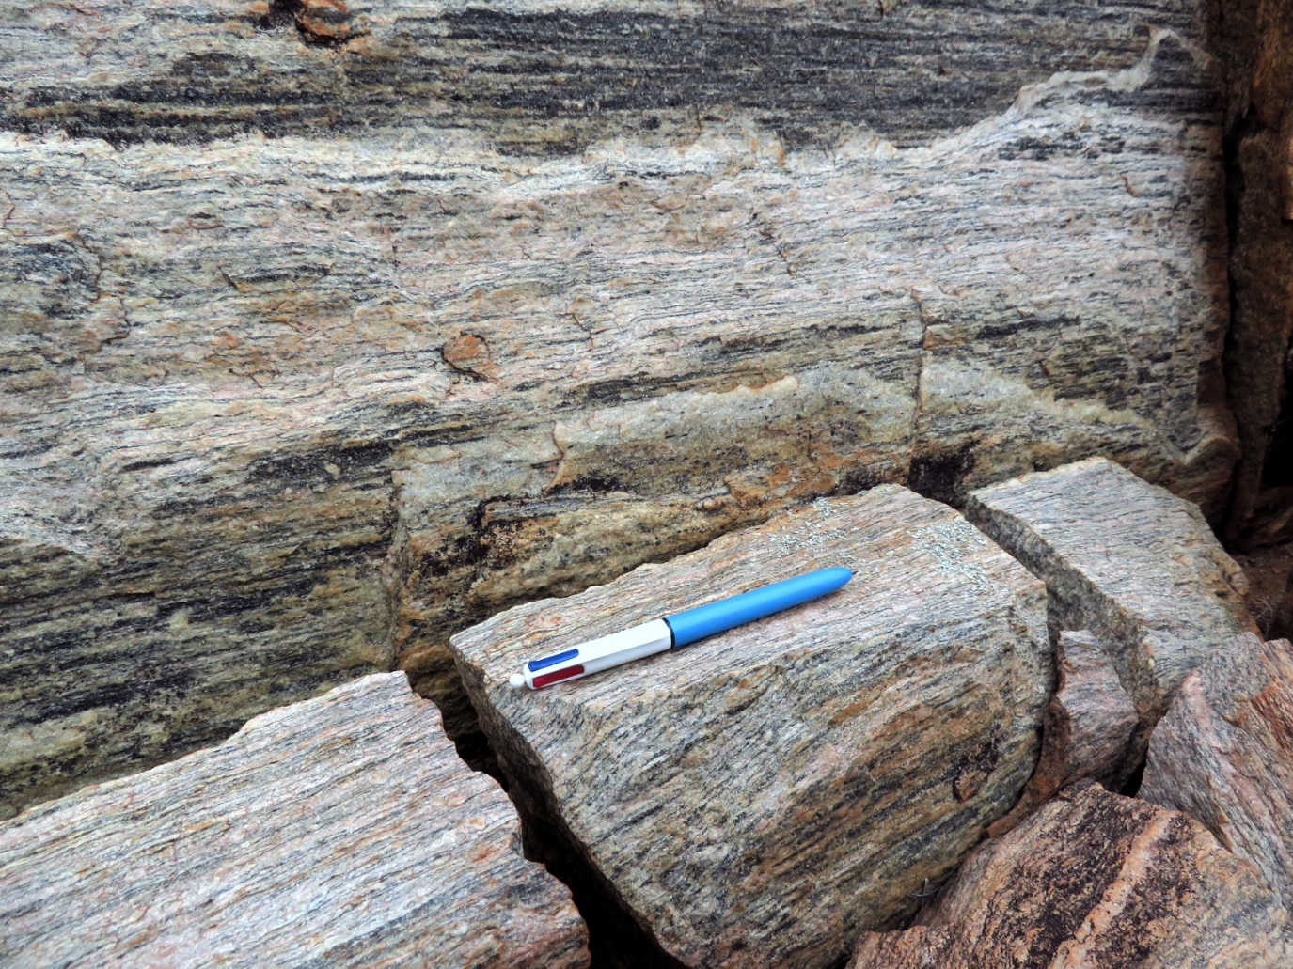
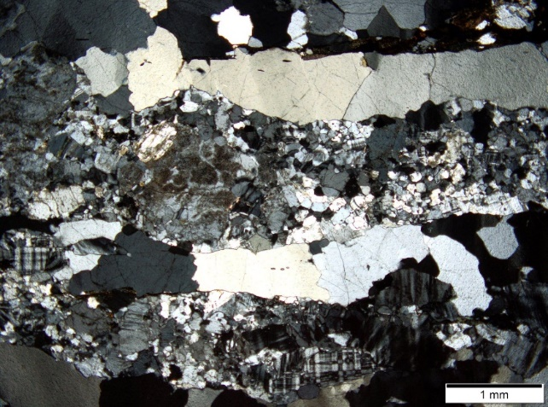
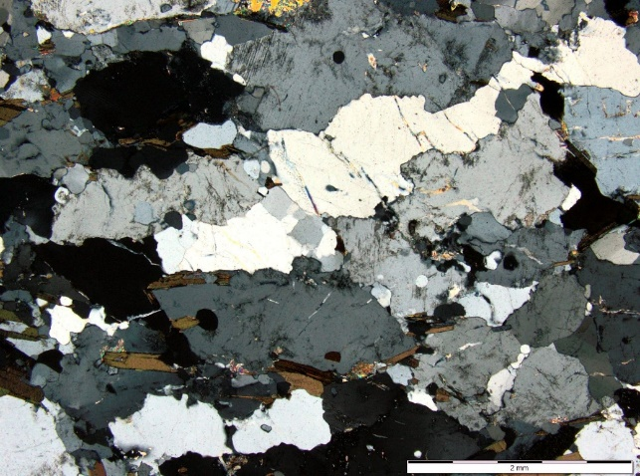
(1) Granitic gneiss: HT fabric
(2) Mylonitic domain
Most of granitic domain
Melt-present deformation
1–2 km thick SL tectonite
Grain size reduction
high strain
low strain
Notes:
This is a pervasive, HT fabric homogeneously developed across 10-30 km-wide shear zones. Typical high-strain and low-strain microstructure. Red arrow points to synmagmatic microfracture

Slide 4
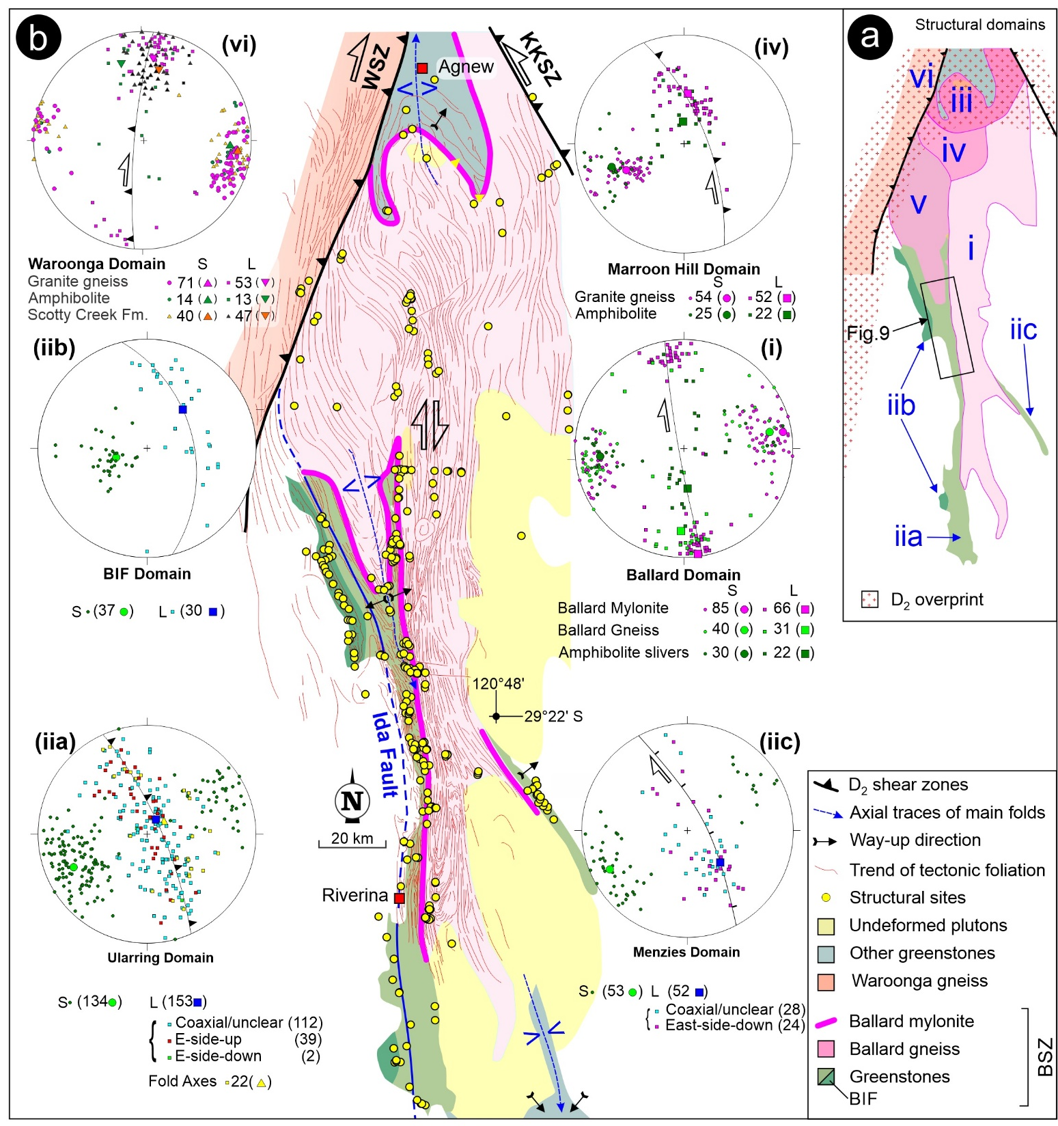
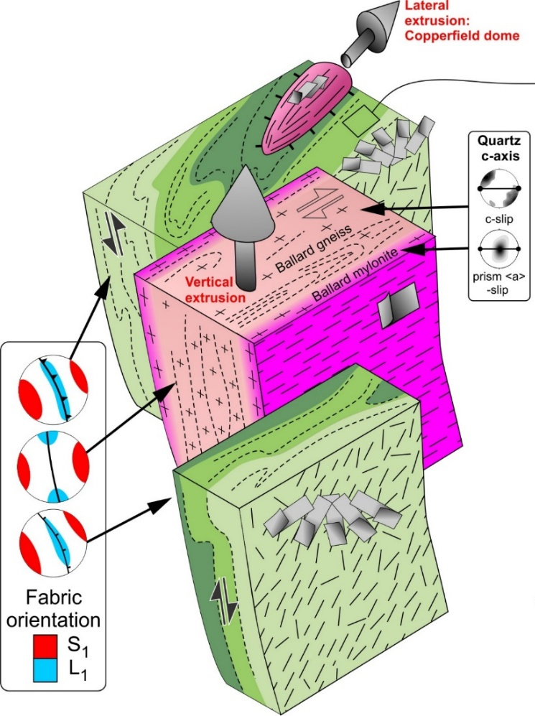
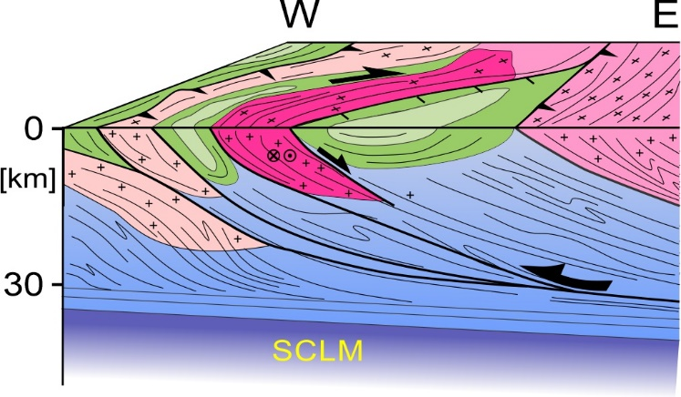
Large-scale
Strain partitioning
Crustal extrusion
Local normal SZ
In bulk shortening
Zibra et al.
(2020 - Tectonics)
Notes:
The extrusion model, in a few words, which derives from kinematic partitioning between cold greenstone and hot sheets of crystallizing granite

Slide 5
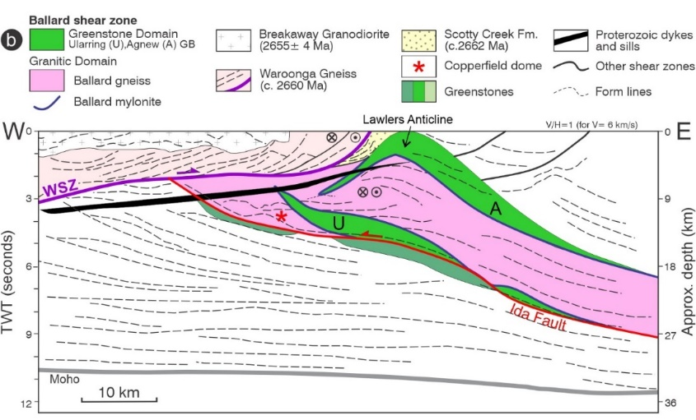

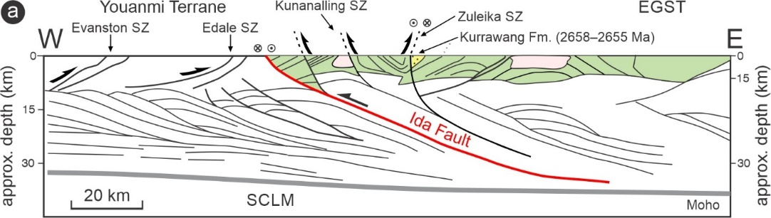
Kalgoorlie Terrane:
First-order (large-scale) tectonic scheme
Two
cross sections
Two regional-scale
tectonic events
Two regional transpressional events during bulk E-W shortening
Sedimentary response to crustal thickening
Crosscutting, undeformed granites
Notes:
Waroonga is similar story but different geometry (W dipping) but still reflecting E-W shortening. So, at the temporal resolution that we have now, the area seems to have recorded shortening for c. 20 Myr. Reality is likely that there were pulses during injection of granite sheets, alternating with periods of tectonic quiescence

Slide 6
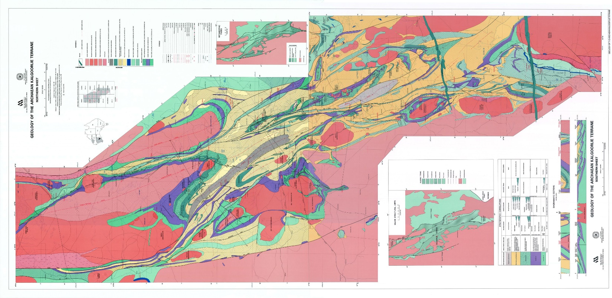
Kalgoorlie area:
Zuleika sz: Southern continuation (reactivation) of Ballard sz
(ii) Structural basin (➔ shallow crustal level)
V
V
V
V
V
V
V
V
V
V
Swager et al. (1990)
Notes:
Important for seismic interp: Kalgoorlie area is structural basin (convergence of north- and south-plunging folds), higher structural level thank Ballard sz in the north. The BSZ is therefore visible in the lower portions of our new seismic profiles.
Zuleika is a D2 structure (see time sketch at slide #13), likely reactivating the lower portion of the Ballard SZ, at higher structural levels (so more localized and exploiting lithological boundaries in greenstones; as opposed to hotter, broader & pervasive fabric along the Ballard)

Slide 7
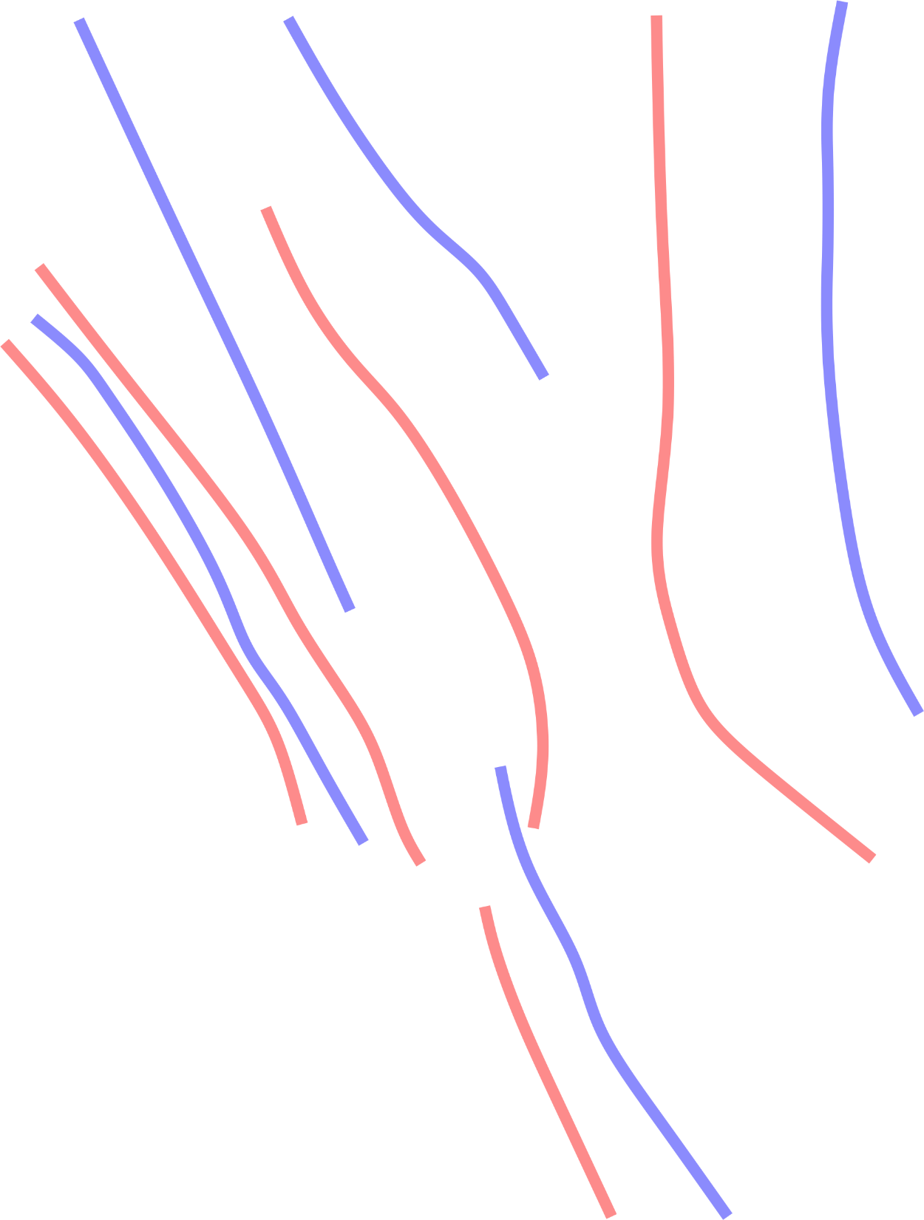
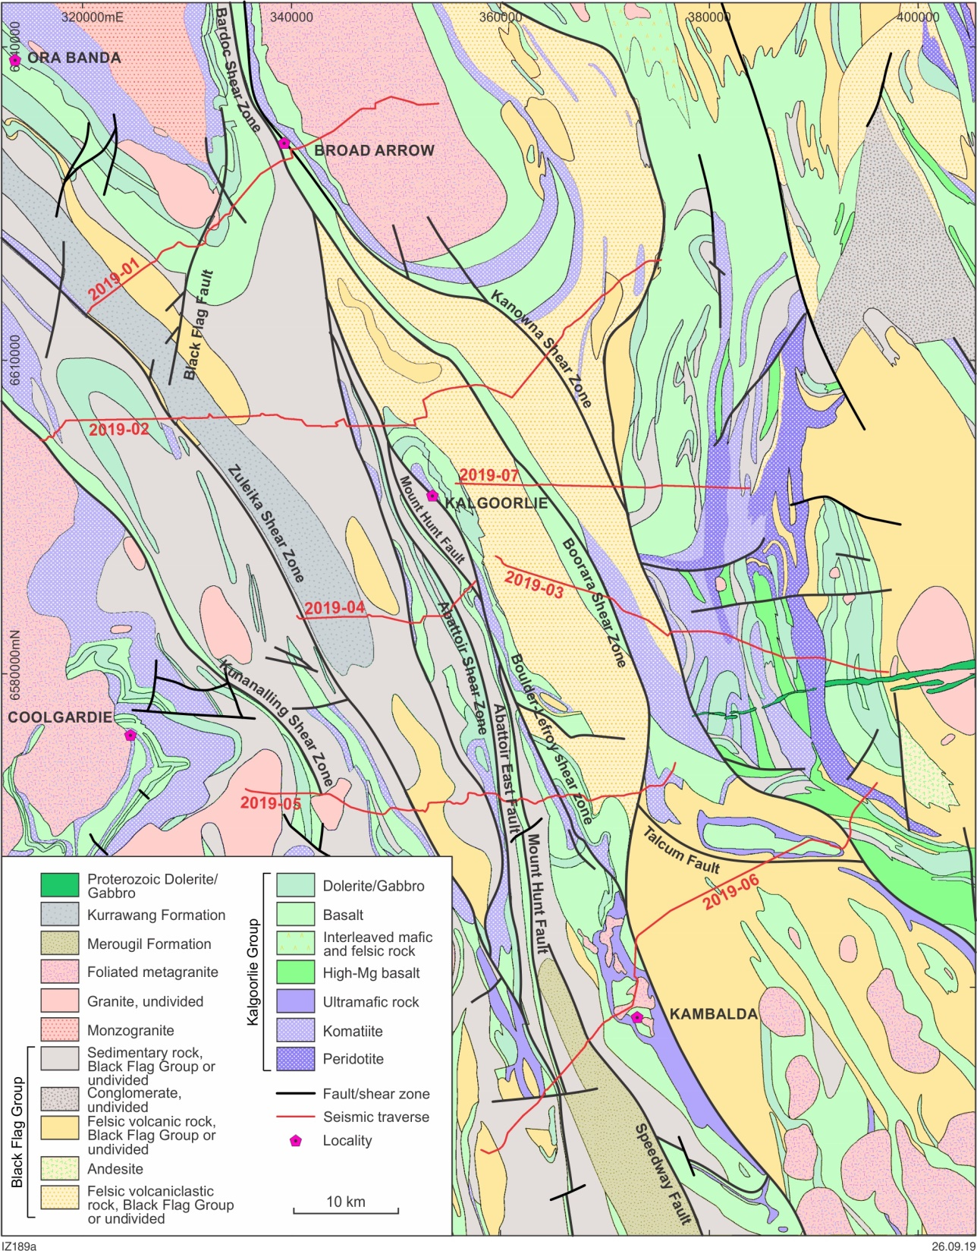
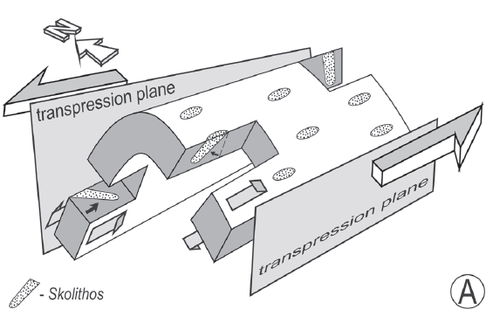
Kalgoorlie area - Structural style:
Shear zone nucleation along steep fold limbs
Broad zones of contraction (strong layers: mafic-U.mafic)
Narrow zones of simple shear (weak layers: BFG)
FACTORS PROMOTING SHEAR LOCALIZATION:
Higher structural level than Ballard sz area
(up to 10 km shallower?)
No synmagmatic shearing
Dias et al. 2008
Notes:
The Ballard+ waroonga SZ evolution teaches us that strain partitioning must have played a key role in the Kalgoorlie area. But it is very difficult to see, as zones of simple shear may have been knife-sharp and might be exposed in some pits only

Slide 8
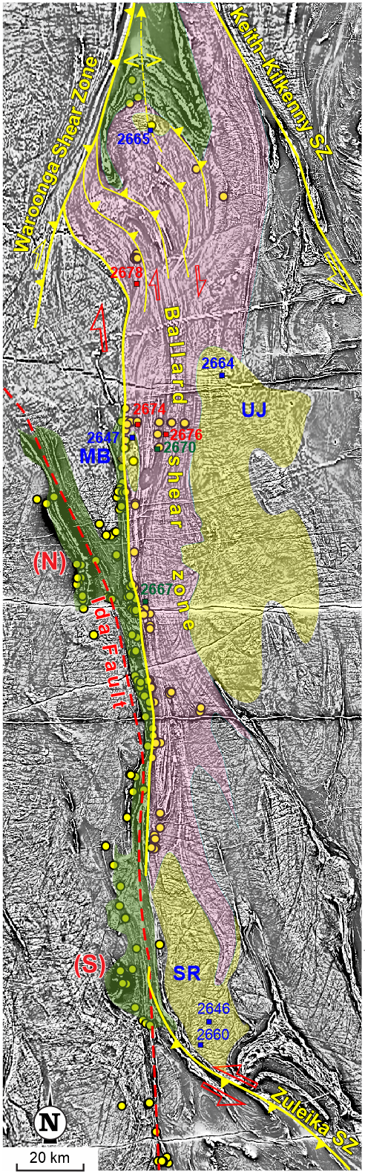
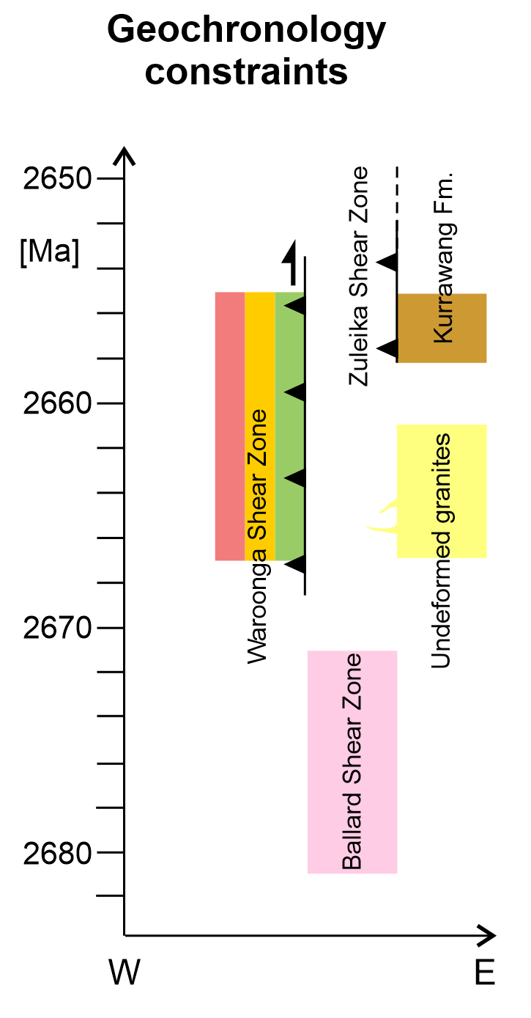
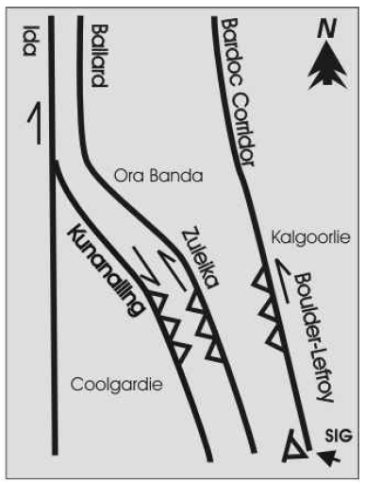
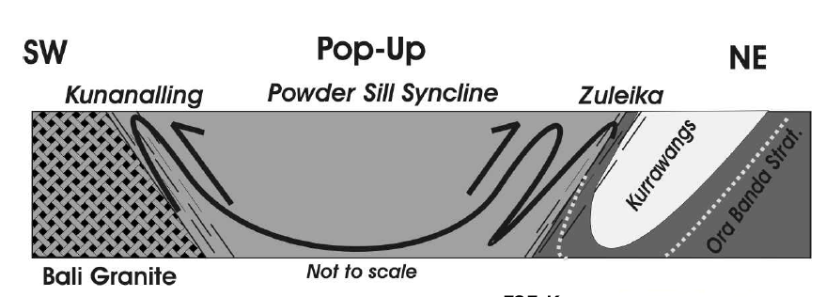
Younger reactivation
Low-grade
Thrust-sinistral
Network of ~10m-thick SZs exploiting infra-greenstones
lithological boundaries
- No overprint in Ballard gneisses
Weinberg et al., 2002
Notes:
Fundamental point for backbone concept: the ballard fabric gets reused later at lower-T, note that Zuleika is highly mineralized. So far the 2 structures are considered coeval, but clearly they are not (see time constraints at left)

Slide 9

Hi-Res Reflection Survey
Timeframe:
Early 2019:
Acquisition, processing (Velseis)
July–August 2019:
Preliminary Interpretation and report compilation
(Velseis with GSWA support)
September 2019: data released to public
2020–2021:
Structural-geophysical investigations (GSWA)
7 lines = 305 km
Depth: 5 s Two-way time (~12 km, for v=5 km/s)
Notes:
Just a few words, also as a ‘disclaimer’ as we do not have our interpr for now

Slide 10
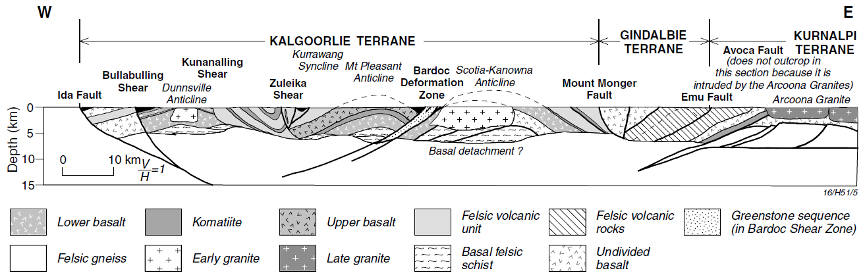


Kalgoorlie area – crustal architecture
East-dipping fabric
Local west-dipping,
upper crustal structures
Drummond et al. (2000)
Notes:
Broadly speaking, we have a series of contractional pop ups, with main east dipping sz (Ida, Ballard-Zuleika) and a series of shallower, west-dipping ones, which in map view form a series of anastomosing splays

Slide 11
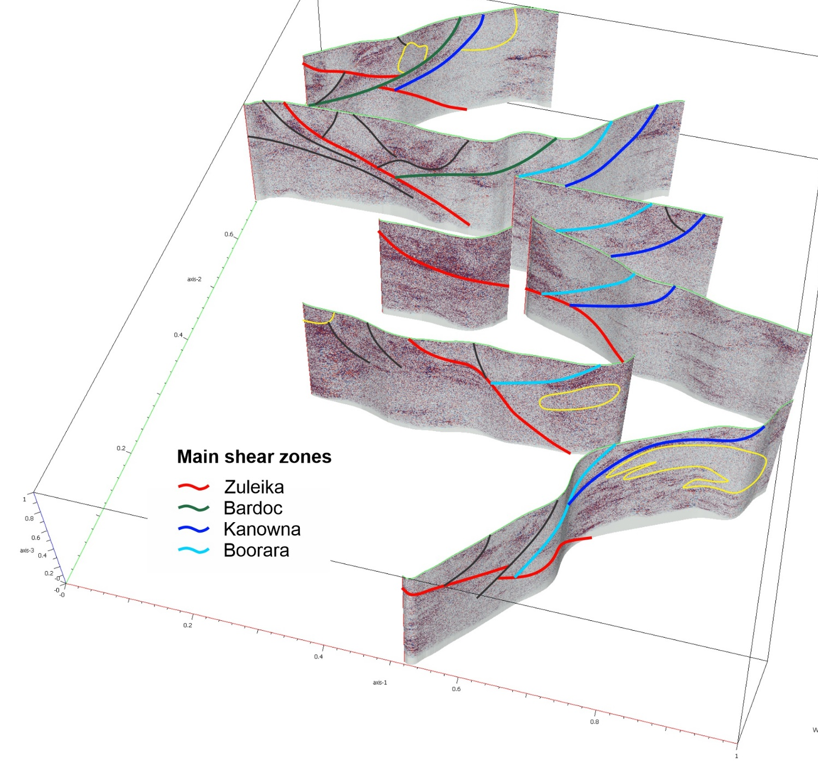
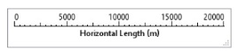

2D Seismic survey - Synthetic view
Main structures can be traced across several lines ➔ rough 3D geometry
Notes:
Just a very preliminary attempt to correlate structures across profiles. Result is encouraging, as we can follow main shear zones quite well

Slide 12
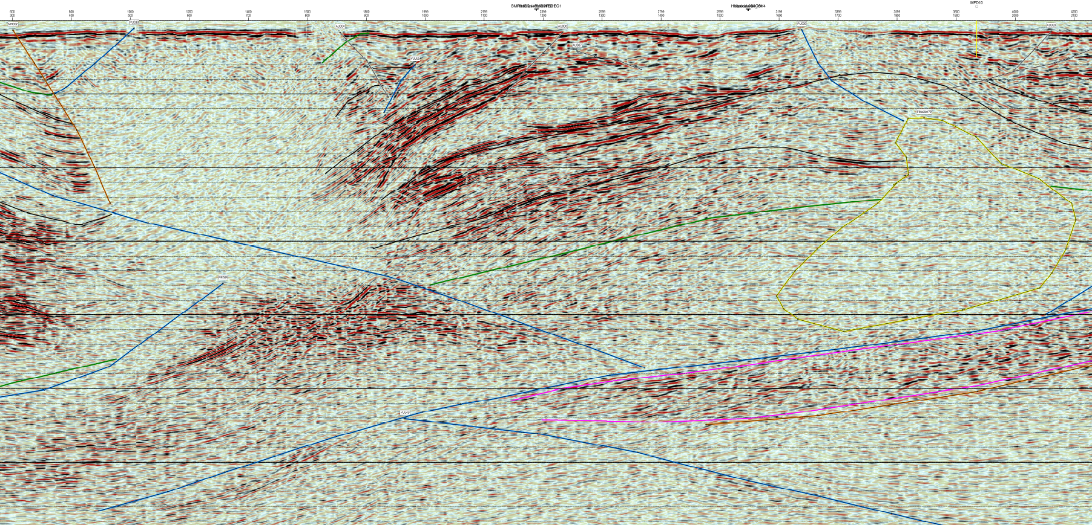
2019 seismic survey: key features
Main lithotectonic elements:
Kalgoorlie Group: strong reflectors
Upper (felsic) succession: transparent
Granites & Gneisses: reflective to transparent
Proterozoic dykes: reflective to transparent
Zones of alteration (?)
0.5 s
(~1250 m)
Notes:
Arrows indicate:
1- Kalgoorlie group
2- metasediments/felsic volc
3-granite
4- granite gneiss
(Prot dykes not visible here)
5- alteration (?) zones
➔shear zones mainly identified by spotting offsets in the strong markers of the Kalgoorlie group

Slide 13

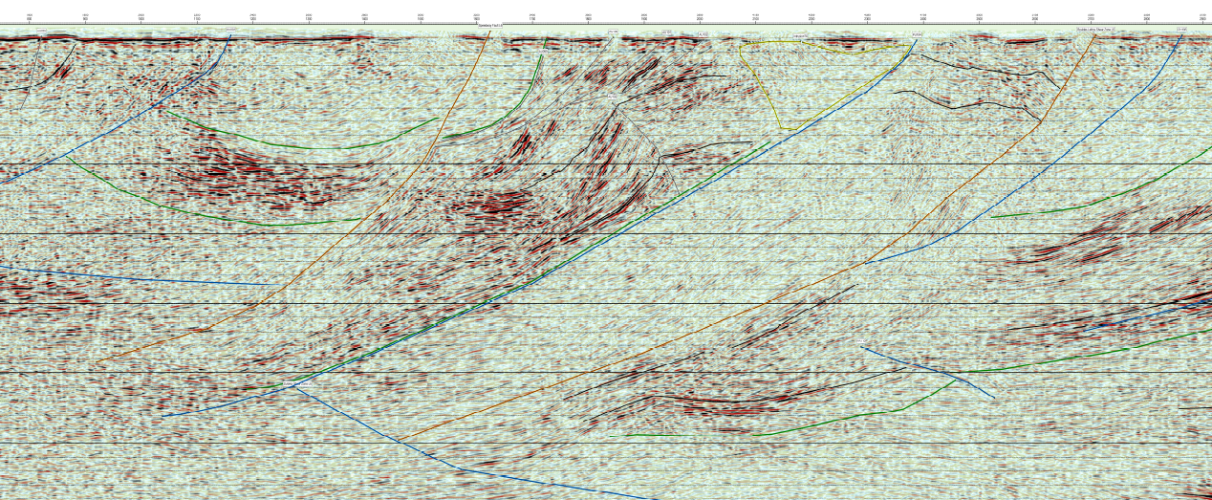
2019 seismic survey: key features
Open, parallel folds
Overall listric structures
0.5 s
(~1250 m)
Notes:
Open, parallel and kink folds, as expected at upper crustal levels.
Shear zones with overall listric geometry, replicating what’s visible in crustal-scale profiles

Slide 14
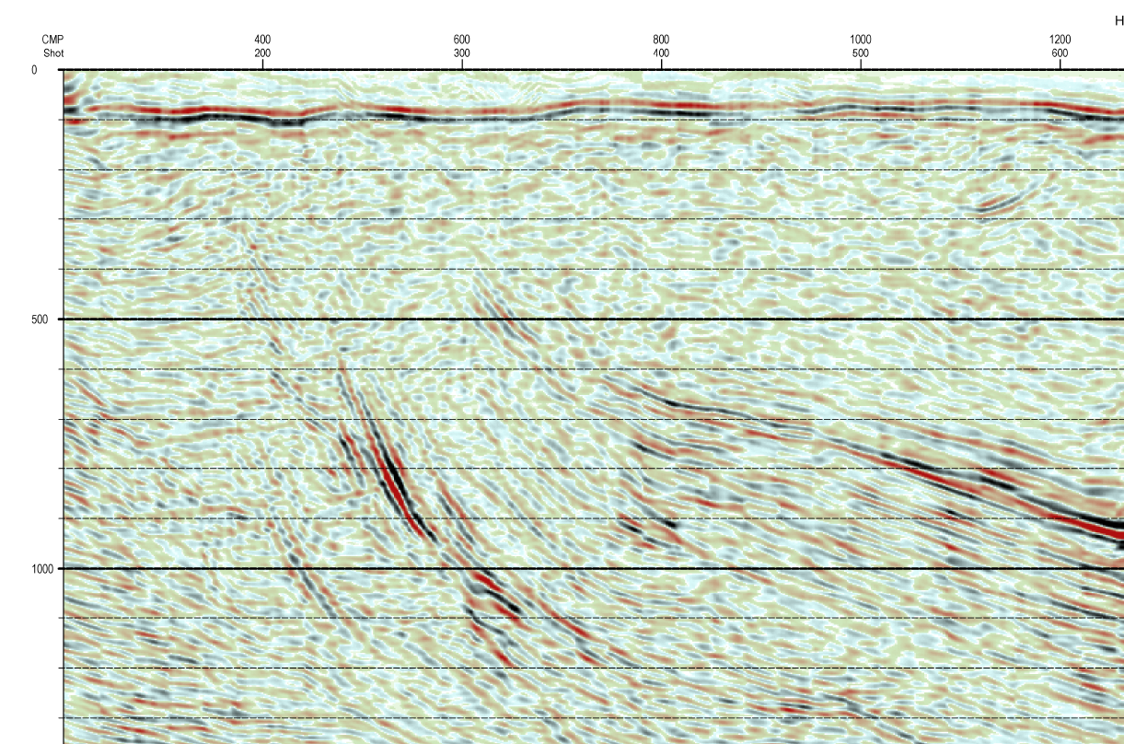

High-resolution
data
0.5 s
(~1250 m)
(W end of line 4)
Notes:
Overall, when you zoom in there is a lot of detail in the data, so there is a lot of room for anyone to play and provide your own interpr.

Slide 15
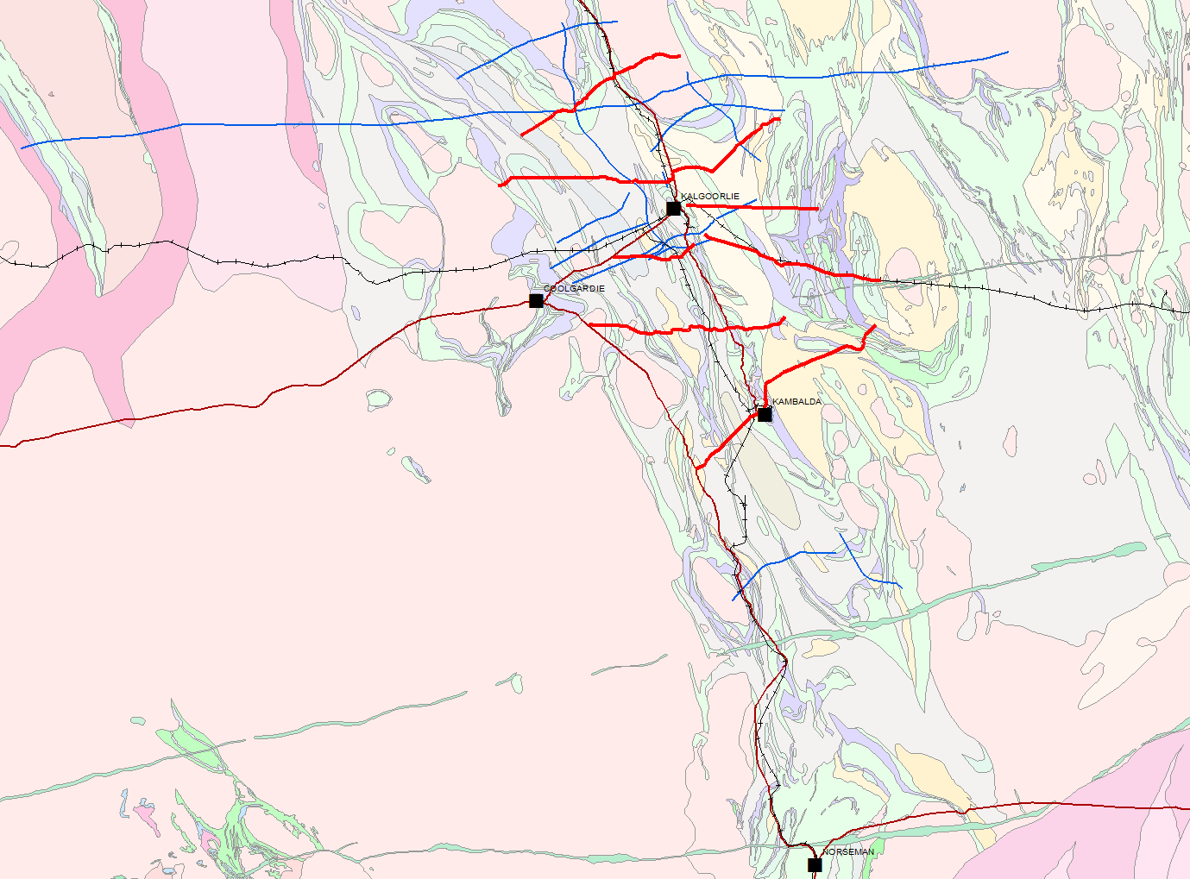
EGF Geophysical Project
Led by Prof Mike Dentith, UWA
EIS-funded by GSWA
Passive seismic survey along EGF01 deep reflection line
Kanowna Belle, Paddington
60 station long period MT survey (as far west as Southern Cross)
Broad band MT survey planned
Pa
KB
EGF01
EGF1
Kalgoorlie
Coolgardie
Norseman
Passive Seismic MT (Blue = new data)

Slide 16
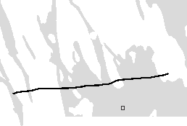
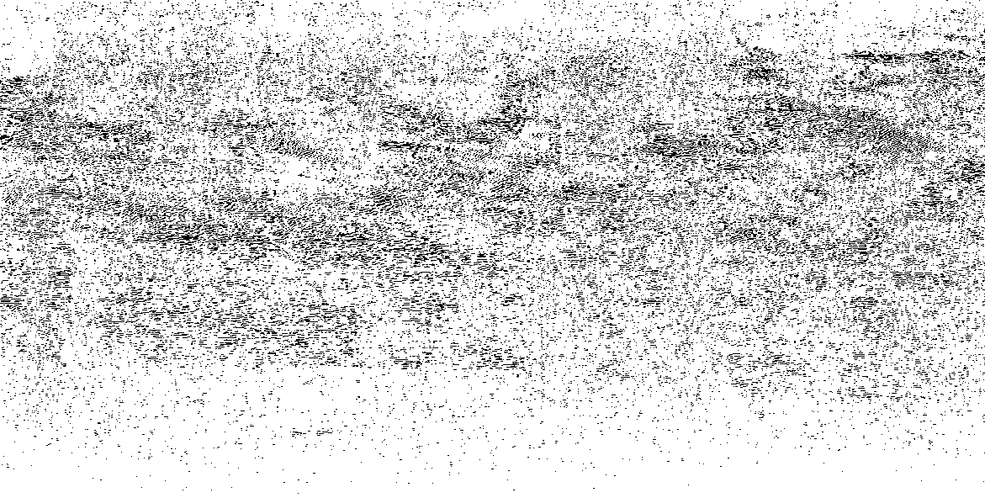
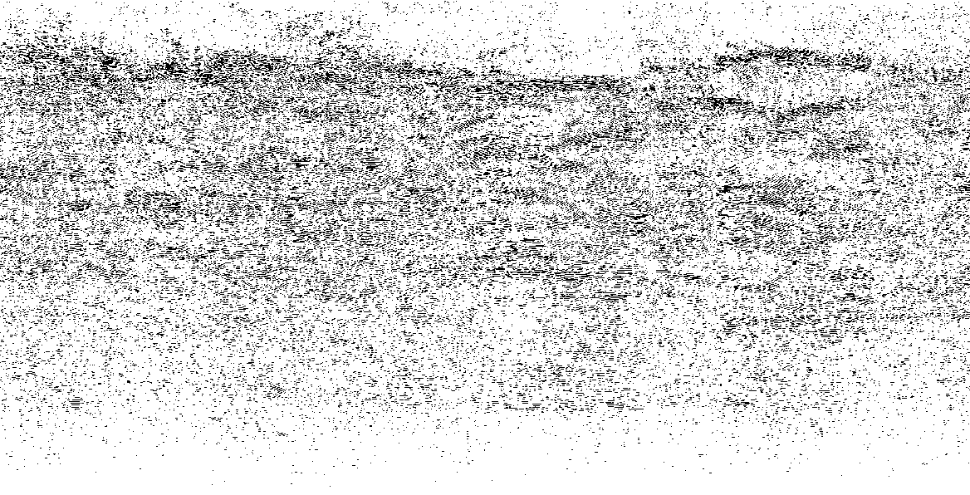
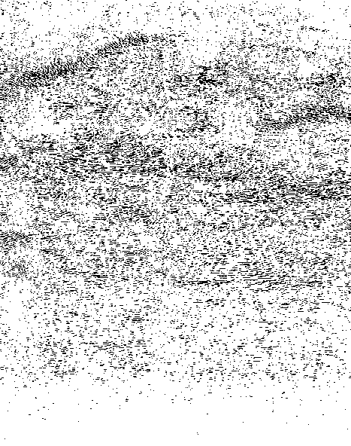
EGF01 deep reflection profile
‘Detached’ greenstone sequence
Complex lower crust
Reduced reflectivity in the Kalgoorlie terrane
Reflection Data
Source: Local explosion/
vibration
Moho
W
E
KALGOORLIE
TERRANE
KURNALPI
K
urr
TERRANE
a
w
K
unanalling
ang
Syncline
Mt
Pleasant
Bar
doc
Scotia-Kano
Bullab
ulling
Shear
Zuleika
Anticline
Def
ormation
wna
Ida
F
ault
Shear
Dunnsville
Shear
Zone
Anticline
Mount
Mong
er
F
ault
Em
)
0
Anticline
u
F
ault
Arcoona
Gr
anite
m
k
EGF1
(
5
h
t
p
Basal
detachment
?
Kalgoorlie
e
10
0
10
km
D
15
F
elsic
v
olcanic
F
elsic
v
Lo
w
er
basalt
K
omatiite
Upper
basalt
unit
roc
ks
olcanic
Greenstone
sequence
(in
Bardoc
Shear
Zone)
Basal
f
F
elsic
Undivided
elsic
gneiss
Ear
ly
g
r
anite
Late
g
r
anite
schist
basalt
4000
5000
6000
7000
8000
9000
CMP
0
Greenstones
0
5
Imbricate Thrusting
15
Two-way Time (s)
Less Coherent
Reflectivity
Imbricate Thrusting
Approx’ Depth (km)
10
30
20 km
Moho
15
45

Slide 17
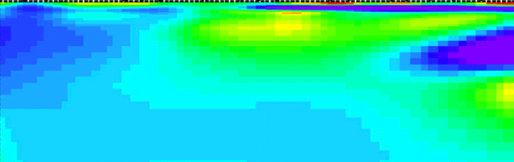
Magnetotellurics
Natural EM
energy
Long period MT data
Graham Heinson, Univ’ of Adelaide
Short term deployment of 18 stations using experimental equipment
Kalgoorlie terrane anomalously conductive
Especially conductive at base of greenstones near the Bardoc SZ
Lateral changes in upper mantle conductivity
Moho
4000
5000
6000
7000
8000
9000
CMP
0
Greenstones
0
Resistivity
(Ω.m)
10
5
Imbricate
Thrusting
15
Two-way Time (s)
Less Coherent
Reflectivity
Imbricate Thrusting
Approx’ Depth (km)
100
10
30
1000
20 km
Moho
15
45

Slide 18
Teleseismic Data
From Distant
Earthquakes
H-k analysis (crustal thickness and Vp/Vs)
Moho 35-40 km
Increase in Vp/Vs in Eastern Goldfields Superterrane (~1.72 to ~1.75)
Moho
1.76
Vp/Vs
1.72
Greenstones at surface
1.68
4000
5000
6000
7000
8000
9000
CMP
0
Greenstones
0
5
Imbricate Thrusting
15
Two-way Time (s)
Less Coherent
Reflectivity
Approx’ Depth (km)
Imbricate Thrusting
10
30
20 km
Moho
15
45

Slide 19
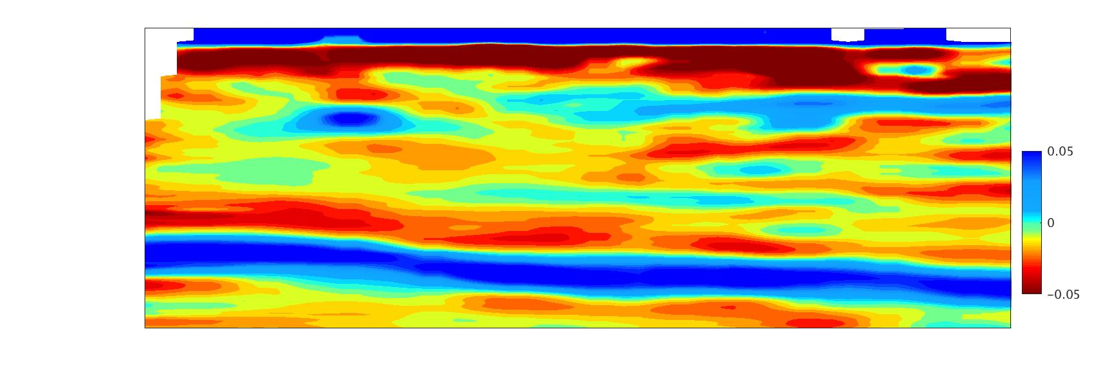

Common conversion point stacked section
Stack receiver functions according to zone where encounter crust and are converted
Excellent correlation with reflection section
Strong Moho response
Positive velocity contrast below base of the greenstones
Teleseismic Data
Moho
From Distant
Earthquakes
1.76
Vp/Vs
1.72
1.68
4000
5000
6000
7000
8000
9000
CMP
0
Greenstones
0
5
Imbricate Thrusting
15
Two-way Time (s)
Less Coherent
Reflectivity
Imbricate Thrusting
Approx’ Depth (km)
10
30
20 km
Moho
15
45

Slide 20

Ambient Noise Data
From Distant
Micro Seismic
Events
Ambient noise tomography
Crustal thickness consistent with other estimates
Excellent correlation with reflection section
High (~4.0 km/s) over low (~3 km/s) over high (~4.3 km/s) Vs anomalies under greenstones in Kalgoorlie Terrane
Fault controlled?
Moho
1.68
Vs
4000
5000
6000
7000
8000
9000
CMP
0
Greenstones
0
5
Imbricate Thrusting
15
Two-way Time (s)
Less Coherent
Reflectivity
Imbricate Thrusting
Approx’ Depth (km)
10
30
20 km
Moho
15
45
Note reverse spectrum display

Slide 21

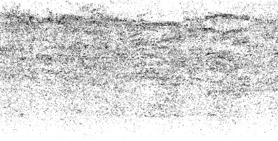
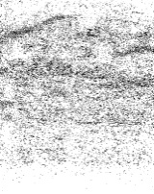

Kalg’ Terrane at Surface
EGF Geophysical Project
Vp/Vs
Summary – central Kalgoorlie Terrane
Zone of reduced reflectivity (reflection)
Increased conductivity (MT
Layered structure at base of greenstones (teleseismic)
Increase in Vp/Vs (teleseismic)
High-low-high structure beneath greenstones in shear-wave velocity (ambient noise)
Structurally controlled
Reflection Coherence
Reflection Coherence
Conductivity
Velocity Contrast
Vs

Slide 22
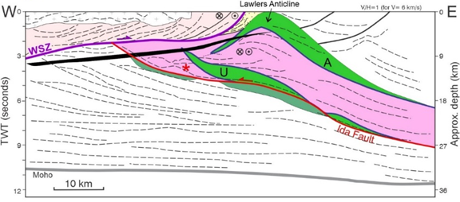
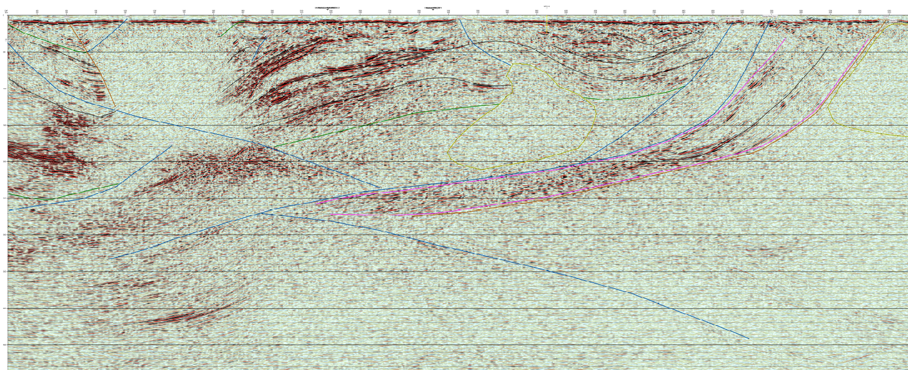
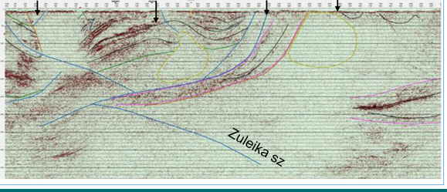
SUMMARY: work in progress, watch this space …
Mapping and geochronology established a tectonic model with the ~2680–50 Ma Ballard shear zone as a ‘Yilgarn Backbone’ accommodating E–W shortening, crustal thickening, and a coeval sedimentary response.
2019 Kalgoorlie seismic survey – preliminary assessment: key features consistent with local and Yilgarn-wide data
Passive seismic and MT project produces further constraints to the EGF crustal architecture, tectonic evolution and mineralization.
Notes:
Emphasizing that the idea is to use observations from well exposed regional structures (Ballard, Waroonga, but also the ones in the west) to picture the broad tectonic style.
A brief conclusion on the new data is that, although we are in very early days with interpr, the new data seem to fit well with the existing ones.
➔ You can also mention what we discussed in the meeting, future outlooks from gswa side (integrating geochem, 3D modelling, etc)

