Slide 1
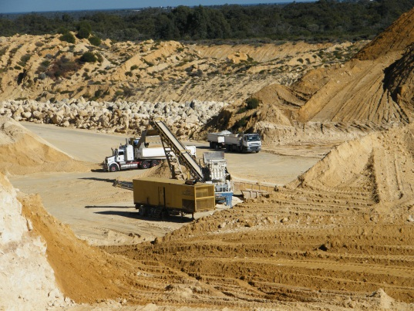
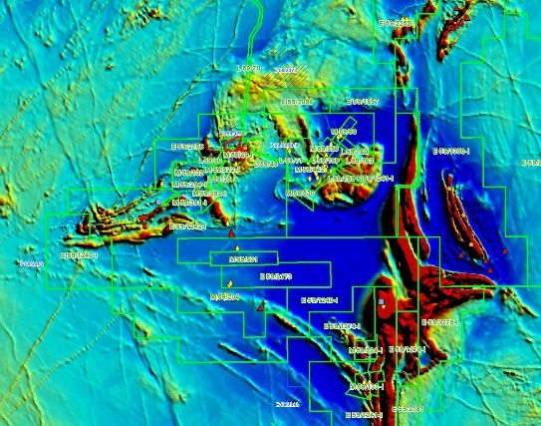
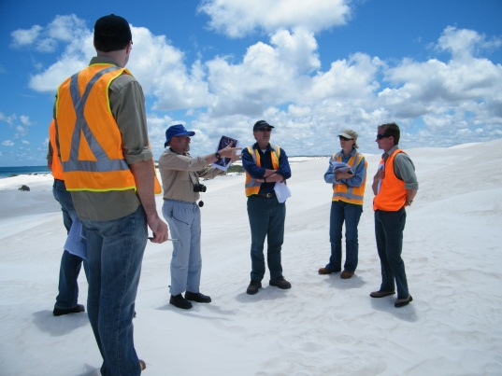
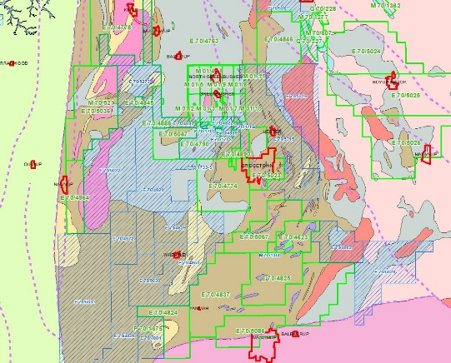
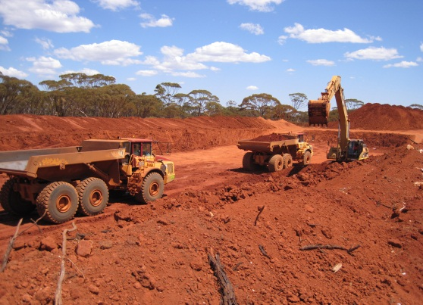
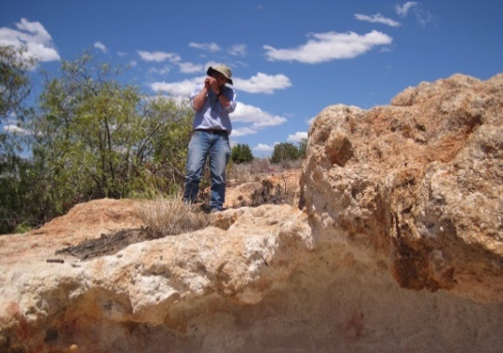
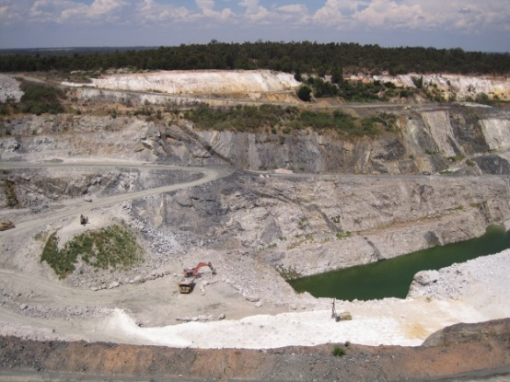
Land Use Planning
Warren Ormsby

Slide 2
Outline
What we do
How we do it
Emerging land use issues
Summary
Notes:
I will first look at what we do for you in general
Then most of the talk will be on how we go about doing it
I will then finish with some emerging land use issues and a brief summary

Slide 3

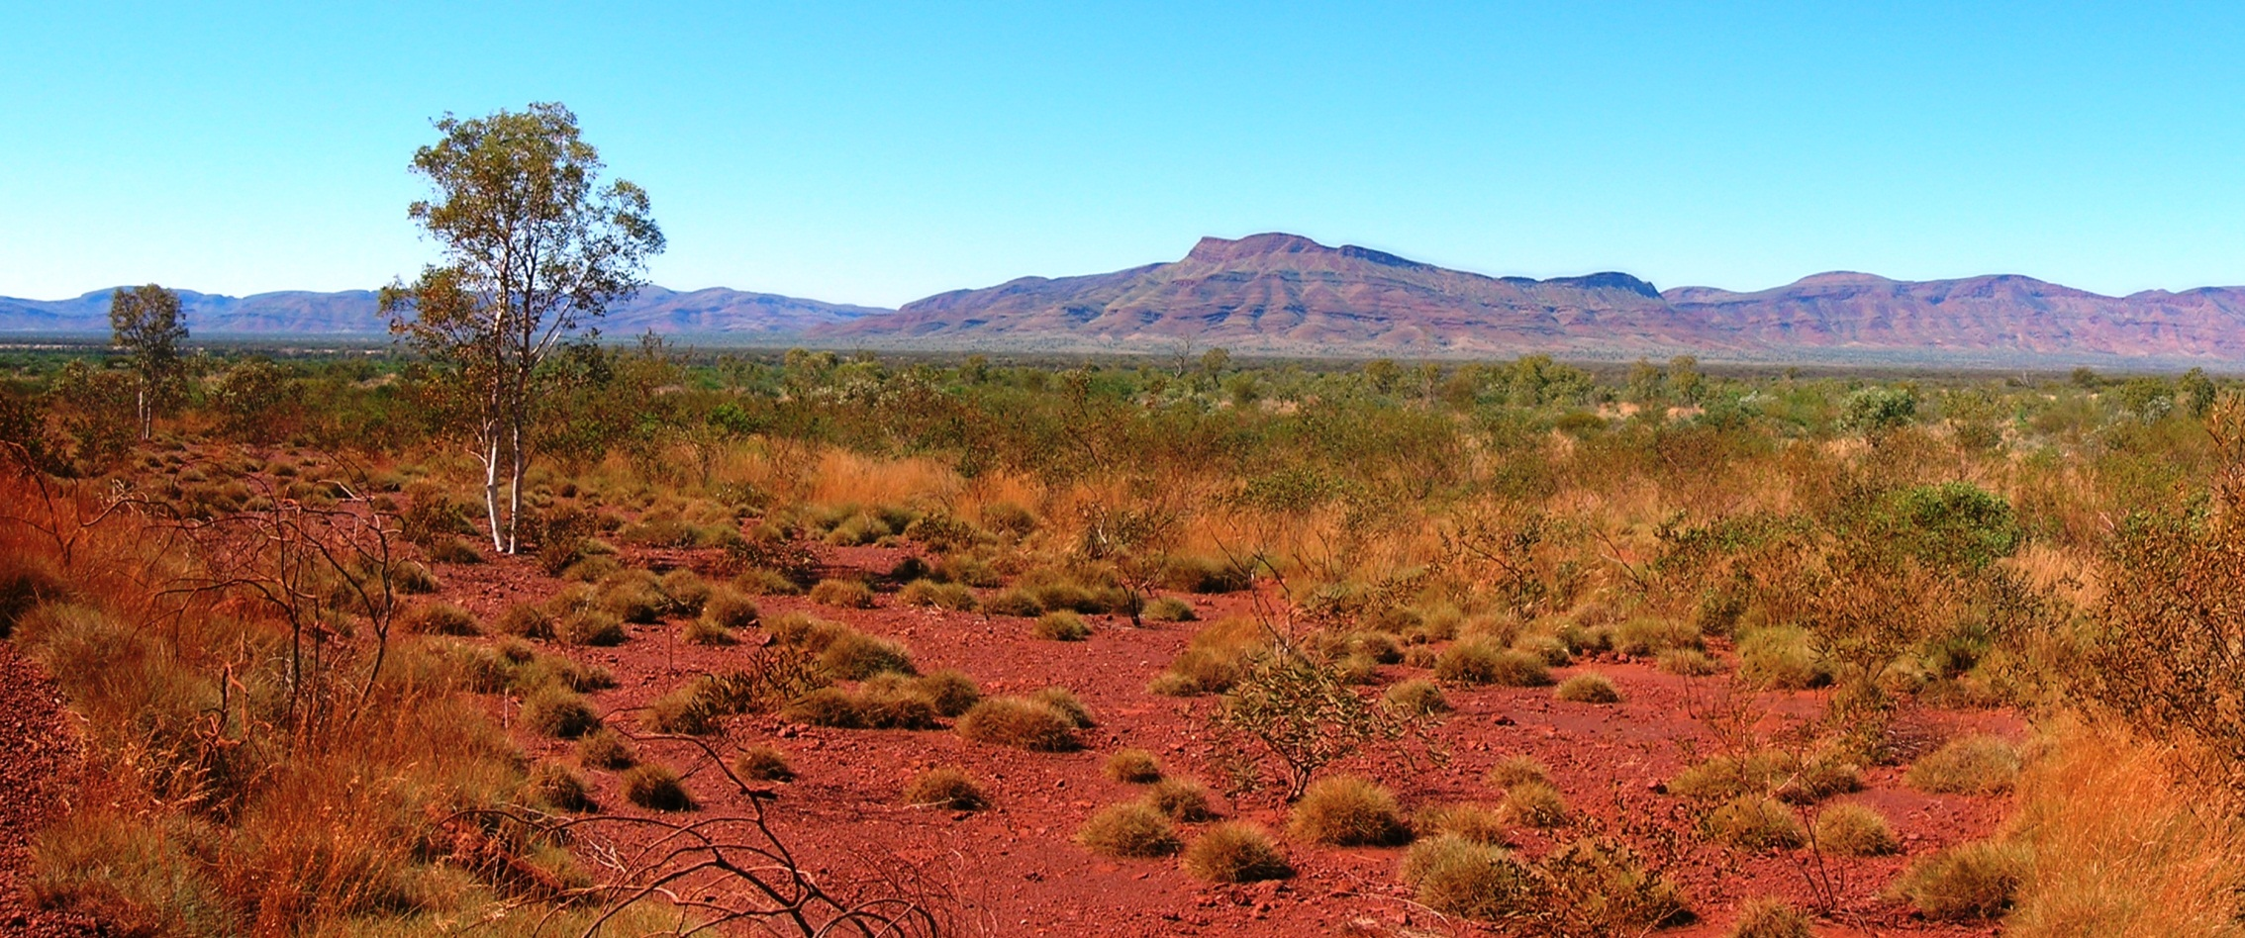
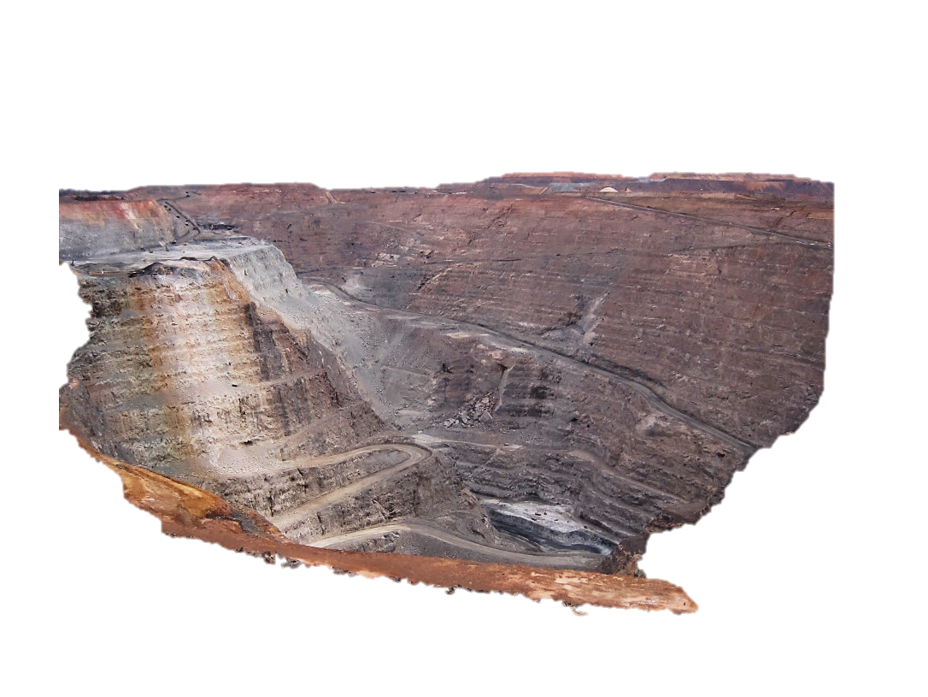
What Land Use Planning does
Contribute to the sustainability of the resource industry by wherever possible maintaining access for exploration and development
Notes:
We contribute to the future of your industry by helping to maintain access for exploration and mining of all types of resources
For example, if someone has plans for a 50 megawatt solar farm next to your planned open cut, we are the people in government whose job it is to identify the issue and to do something about it.

Slide 4
What Land Use Planning does
Advice and recommendations to assist government decision making on the most appropriate use of land
Provide certain land-related approvals under delegation from the Minister for Mines
Notes:
Therefore, we provide advice and recommendations to assist government decision making related to the most appropriate use of land
We were previously known as LUG because we are mostly geologists, but he Land Use Planning group from the former MTD joined us a couple of years ago – hence the name change
With these people in the group we now have delegated authority from the Minister for Mines for some land-related approvals.

Slide 5
How we do it — we RIP!
Reactive – respond to specific proposals
Interactive – other government agencies, and you
Proactive – resource mapping
Notes:
We use the RIP model
Our core activity is Responding to land use proposals or referrals from other parts of government – we receive hundreds of these each year
Increasingly We have been Interacting with other government agencies on whole-of government project work and play an important role in consultation with industry.
And we are Proactive in providing resource mapping tailored to land use planning for both government and the public

Slide 6
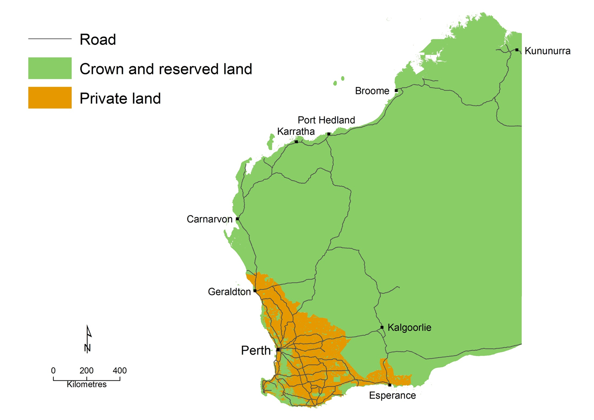
Notes:
To understand how we deal with proposals for land use changes it is important to appreciate that there are two main types of land ownership in Western Australia
– State-owned land called Crown and reserved land, and privately owned land

Slide 7
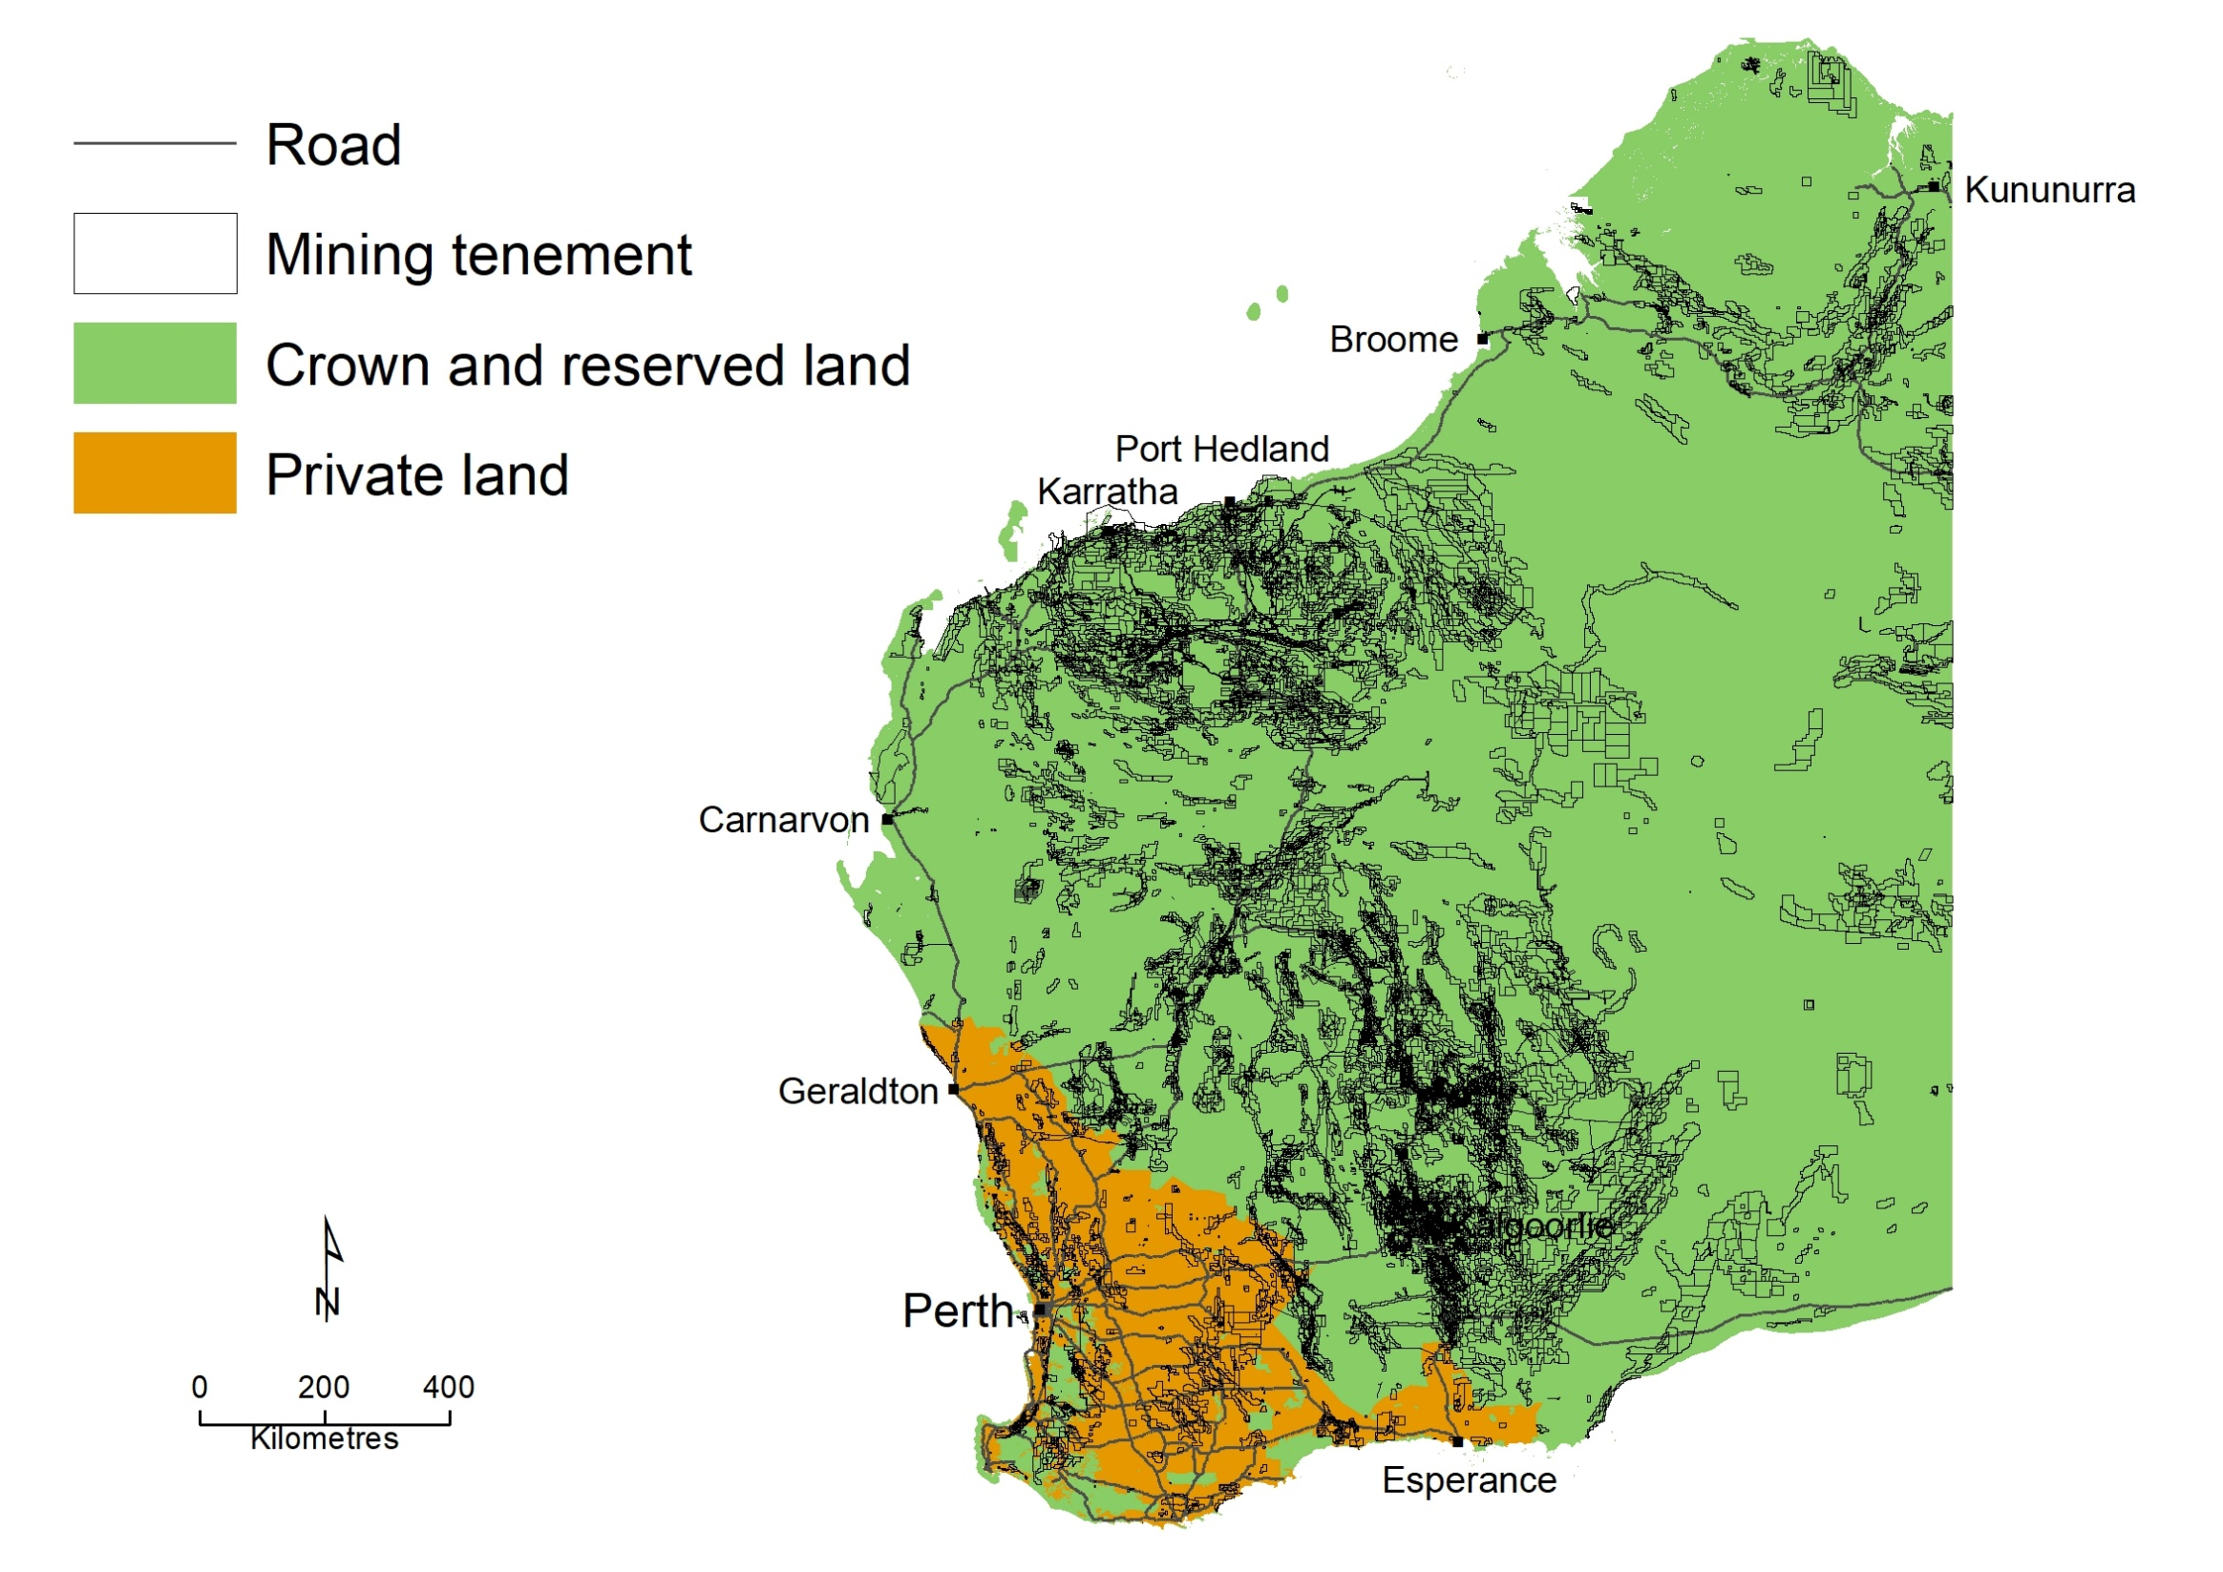
Notes:
When we overlay mining tenements it is clear that most mining activity occurs on Crown or reserved land
Because the mining act is very prescriptive on access provisions for different types of land, any changes to the underlying land tenure can have serious consequences for exploration or mining
This is particularly so for changing Crown land to private land because it may mean that the written consent of the landowner will be required for access for exploration and mining

Slide 8
Section 16(3) Mining Act 1978
“16(3) No Crown land that is in a mineral field shall be leased, transferred in fee simple, or otherwise disposed of under the provisions of the Land Administration Act 1997, without the approval of the Minister.”
Notes:
In recognition of this, a section of the mining act requires the approval of the Minister for Mines before private land can be created
Note that strictly this does not apply to reserved land such as national parks
However, in it has been longstanding practice for most land tenure changes on Crown and reserved land to be referred to us for what we call “Section 16(3) clearance”

Slide 9
Access restrictions on Crown and reserved land
Lowest restrictions
Unallocated Crown land & pastoral leases
Reserves (not class A)
Reserves class A outside SW
State forest or timber reserve outside SW
Conservation parks
Nature reserve not class A
State forest or timber reserve within SW
Reserves class A within SW
National park class A
Nature reserve class A
Open for mining
Recommendation of
responsible Minister
and management authority
Recommendation of Minister
for Environment
Approval of Minister for
Environment
Approval of Minister for Environment and Parliament
Highest restrictions
Notes:
Aside from private land there are many other land changes on Crown and reserved land that can affect your access to varying degrees
There is a spectrum of restrictions in the mining act from land that is open to exploration and mining such as ucl and pastoral leases, ranging through to highly restrictive provisions for access to class A nature reserves and national parks
These require the approval of both the Ministers for Environment and the Minister for Mines and both houses of parliament before a mining lease can be granted
It is important to understand that from the moment any new reserve is created new approvals are required for exploration and mining

Slide 10
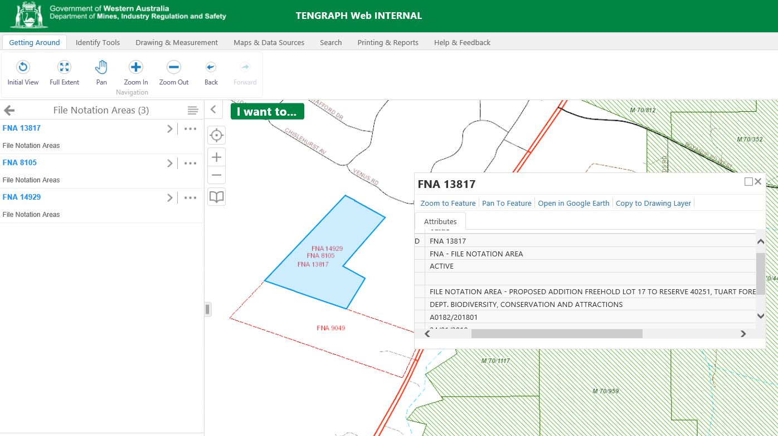
Notes:
These proposals are the main source of what we call File Notation Areas – or FNAs that you may have seen in Tengraph Web or in Geoview
FNAs are a way of alerting current and prospective mining tenement holders of proposals that may affect their access

Slide 11
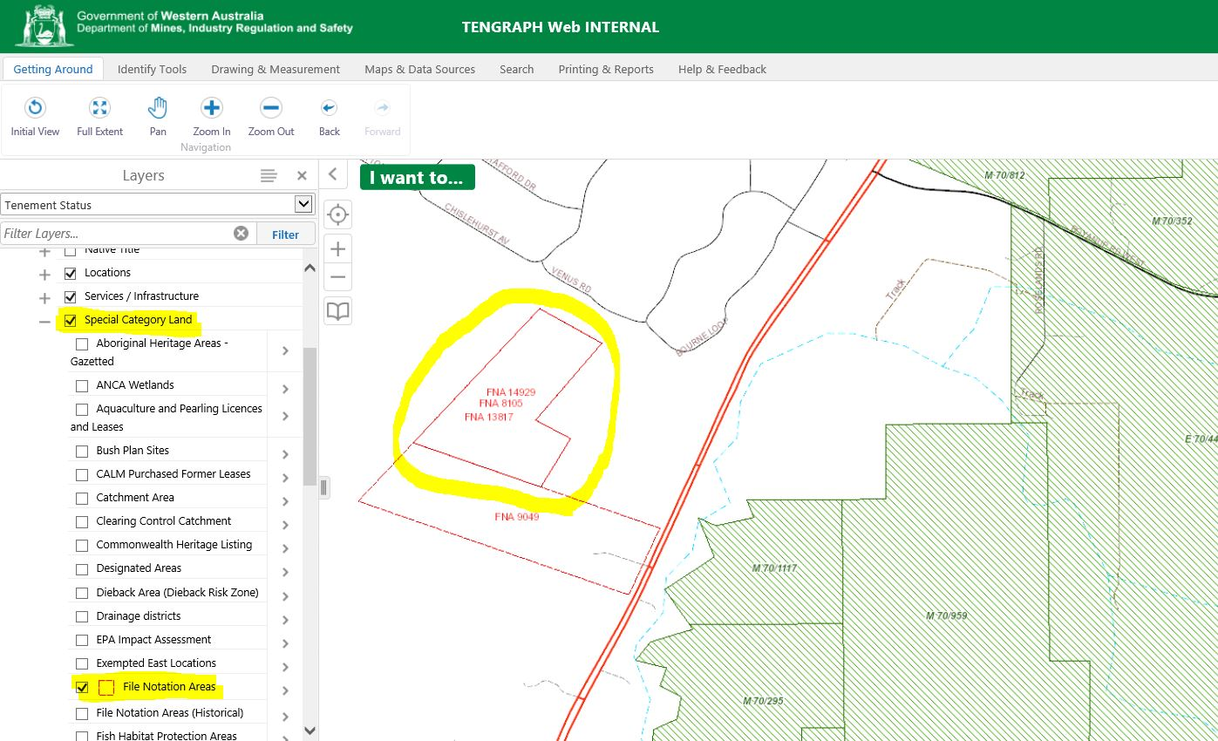
Notes:
To find FNAs in Tengraph Web, look under Special Category Land

Slide 12
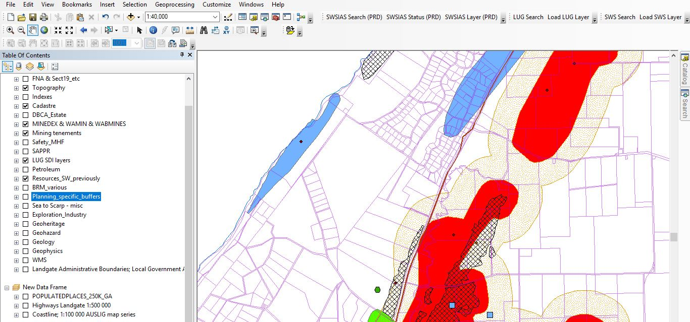
Geological assessment
Notes:
Geologists in my group assess the prospectivity of each proposal area and how the proposal may affect access for current and future tenement holders using a comprehensive GIS
As you may expect, we have access to a great deal of information including digital geology and geophysical images, the most recent aerial photography and all reports from the GSWA and mineral exploration reports and of course ready access to our in-house experts

Slide 13
Approach for S16(3) ‘clearances’
Consult with affected mining tenement holders
Recommend for or against “clearance”
Commonly recommend against proposals that hinder access to resources or areas of high prospectivity
Approve non-contentious proposals
Notes:
We consult with affected tenement holders on any proposal that may significantly affect their rights of access
This is to determine whether they have any concerns about the proposal and to identify whether there are any other geological considerations to take into account in our assessment – prospectivity, targets and known resources are particularly important
We then make a recommendation either for or against “clearance”
We commonly recommend against those proposals that hinder access to resources or areas of high prospectivity
We have delegated authority from the Minister to approve non-contentious proposals e.g. a small lot for a comms tower in low prospectivity with no mining tenements

Slide 14
Workload
Notes:
Over the last year around three quarters of our work has been related to large scale projects involving Crown and Reserved land.
These are the Plan for Our Parks project and Special Agreements (ILUAs)

Slide 15
Major projects
Plan for Our Parks
Notes:
Of these, our largest project has been the Plan for Our Parks project

Slide 16


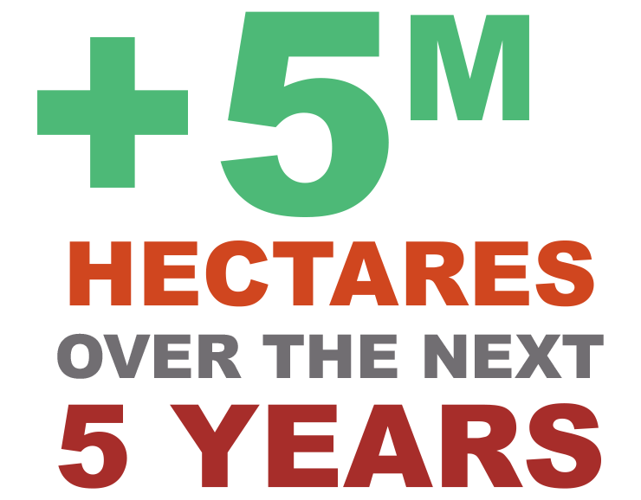
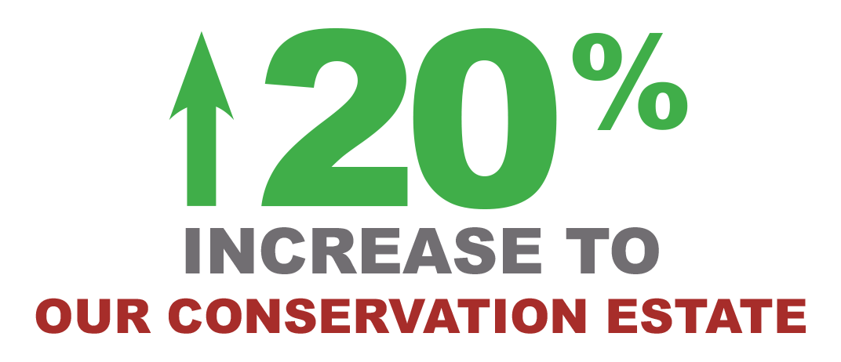

Contributes to the National Reserve System – Comprehensive, Adequate and Representative.
Aligned with previous assessments for CAR e.g. Gascoyne-Murchison Strategy (2015) and An Extraordinary Natural Legacy (Douglass et. al. 2019).
Notes:
This involves the single largest increase in conservation reservation in this State – ever
Note that there now remains only 4 years in which to reach the 5 million ha target.
We have a map showing these proposals in the poster area.

Slide 17
Access restrictions on Crown and reserved land
Lowest restrictions
Unallocated Crown land & pastoral leases
Reserves (not class A)
Reserves class A outside SW
State forest or timber reserve outside SW
Conservation parks
Nature reserve not class A
State forest or timber reserve within SW
Reserves class A within SW
National park class A
Nature reserve class A
Open for mining
Recommendation of
responsible Minister
and management authority
Recommendation of Minister
for Environment
Approval of Minister for
Environment
Approval of Minister for Environment and Parliament
Highest restrictions
Notes:
Most of these park proposals are for Class A National Parks and as shown here, the grant of a mining lease would require the approval of the Minister for Environment and both Houses of Parliament

Slide 18
Access restrictions on Crown and reserved land
Lowest restrictions
Unallocated Crown land & pastoral leases
Reserves (not class A)
Reserves class A outside SW
State forest or timber reserve outside SW
Conservation parks
Nature reserve not class A
State forest or timber reserve within SW
Reserves class A within SW
National park class A
Nature reserve class A
Open for mining
Recommendation of
responsible Minister
and management authority
Recommendation of Minister
for Environment
Approval of Minister for
Environment
Approval of Minister for Environment and Parliament
Highest restrictions
Notes:
However, some will be a lower class of conservation reserve such as an Unclassified Conservation Park, requiring fewer restrictions on access
As the red arrow shows, mining within these will require the recommendation of the Minister for Environment and it would also need the recommendation of the management body
Final decision lies with the Minister for Mines

Slide 19
Plan for Our Parks
Governance framework
Interdepartmental Working Group
Director’s General Steering Committee
Ministerial Council
Consult with affected tenement holders,
Prospectivity report
Working Group discussions, advise DMIRS and Minister
Notes:
The Plan for Our Parks project works within a governance framework. We are of course members of the IWG
Our DG is on the Steering Committee and the Minister for Mines is one of three members of the Ministerial Council
In terms of process, it is essentially our standard S16(3) approach, including consultation with affected tenement holders
We compile a prospectivity report and have of course been actively involved in the IWG and we advise both the Department and the Minister

Slide 20
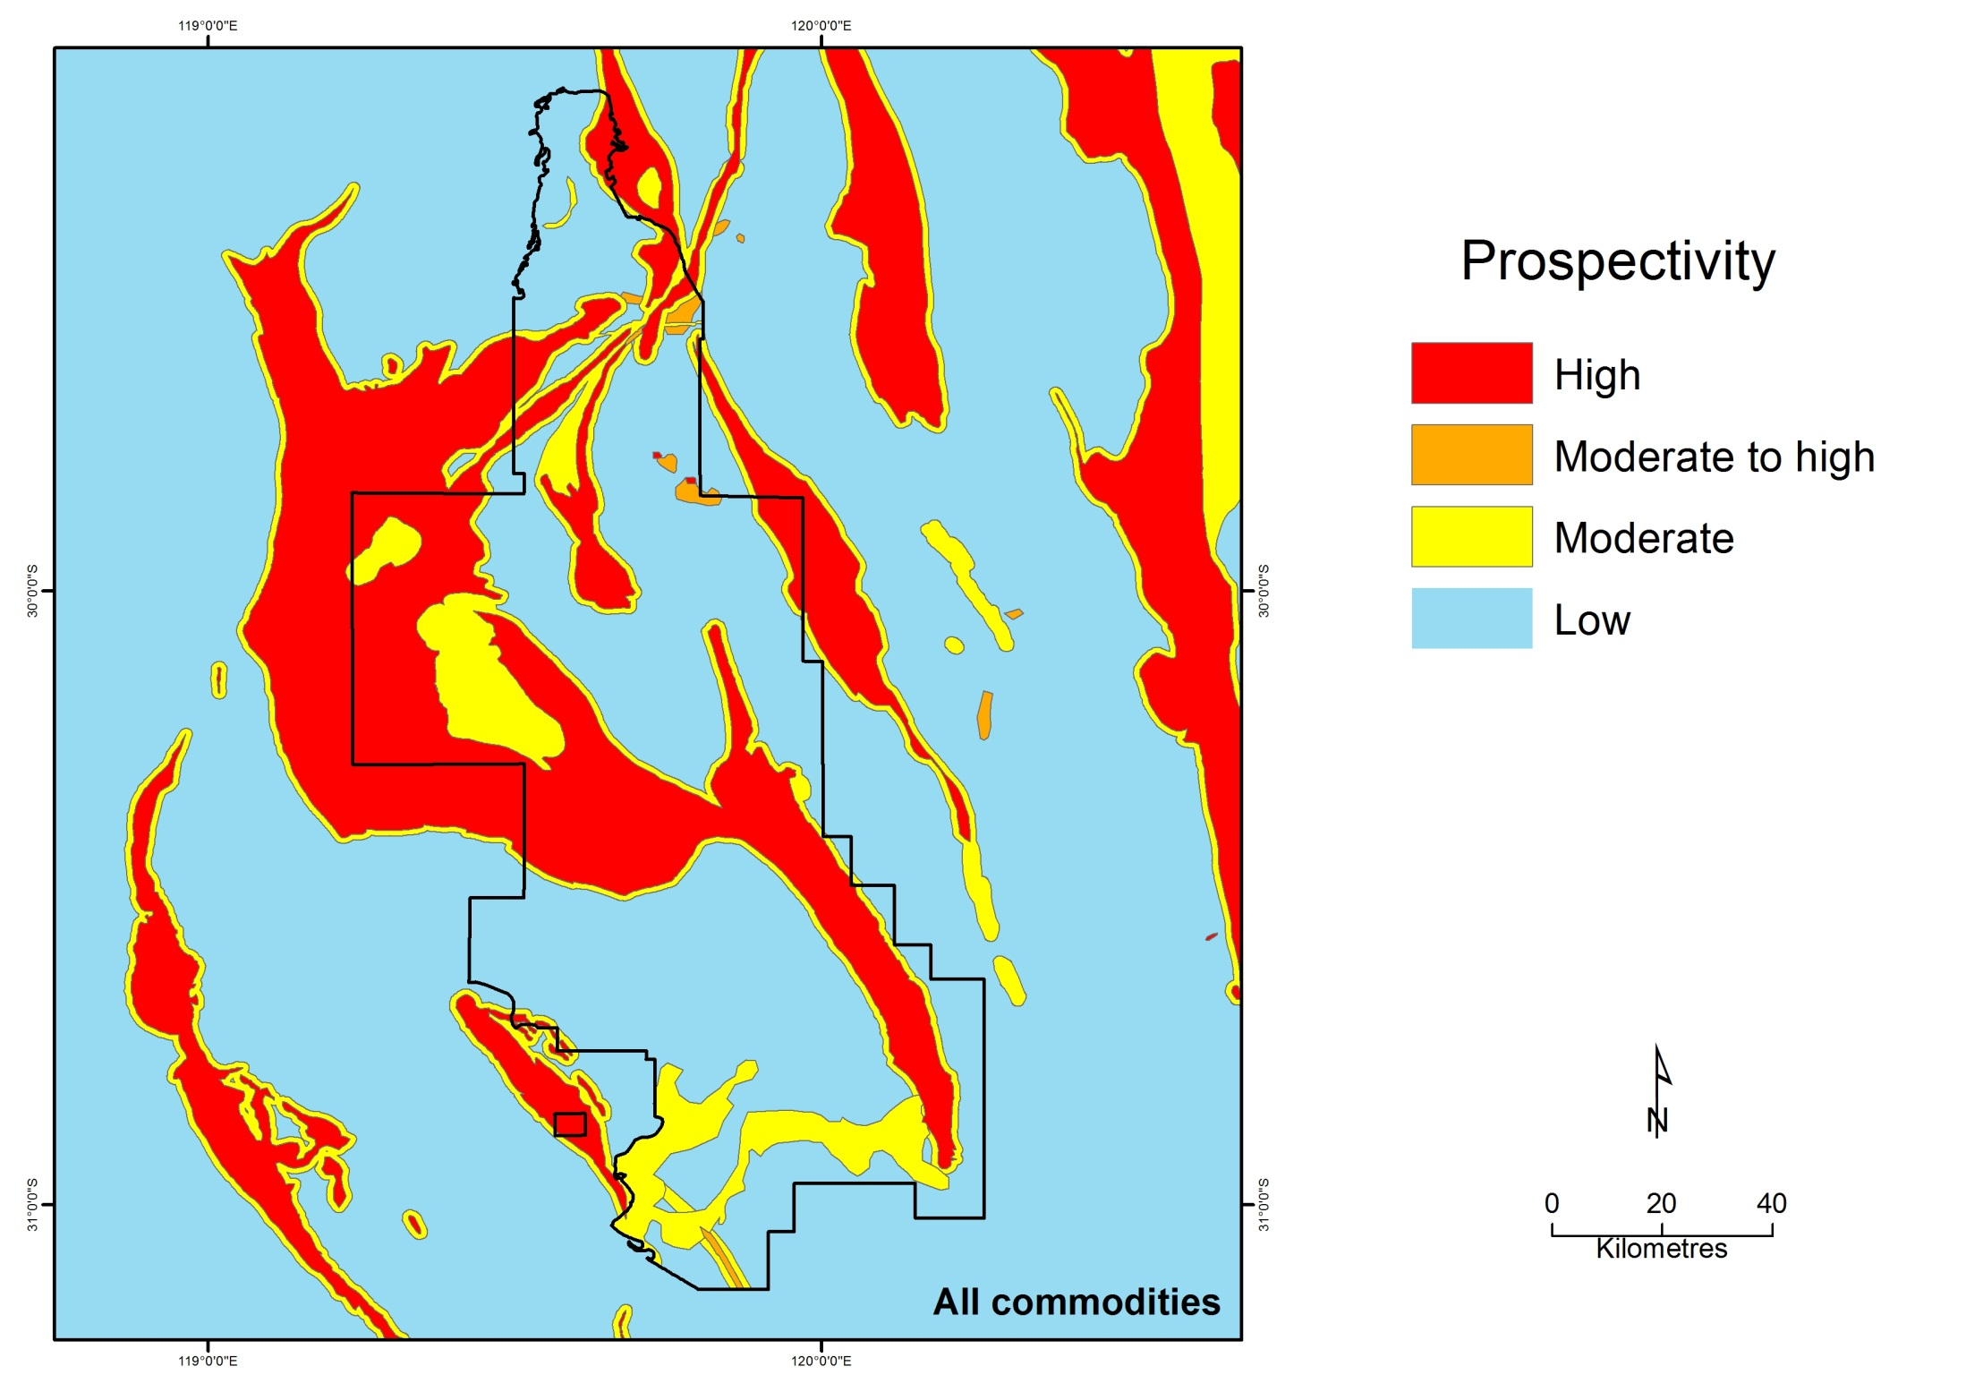
Notes:
The prospectivity reports include generalised mapping and associated mining tenement information
They also include a summary of responses and provide supporting information on expenditure, commodities and of course any relevant confidential information provided by the tenement holder

Slide 21
Major projects
Special agreements
Yamatji Nation Southern Regional Agreement (GASA)
South West Native Title Agreement
Notes:
Our second largest project involves special Indigenous Land Use Agreements
In the last year alone we carried out over 2600 assessments – mainly associated with the Yamatji Nation Southern Regional Agreement

Slide 22
State Indigenous Land Use Agreements
SWNTS
YNSRA
Notes:
Both of these agreements cover large parts of the State
They involve the surrender of native title
And part of the compensation for the surrender of these rights includes a significant land component

Slide 23

Access restrictions on Crown and reserved land
Lowest restrictions
Unallocated Crown land & pastoral leases
Reserves (not class A)
Reserves class A outside SW
State forest or timber reserve outside SW
Conservation parks
Nature reserve not class A
State forest or timber reserve within SW
Reserves class A within SW
National park class A
Nature reserve class A
Open for mining
Recommendation of
responsible Minister
and management authority
Recommendation of Minister
for Environment
Approval of Minister for
Environment
Approval of Minister for Environment and Parliament
Highest restrictions
Notes:
Most of the land component involves new reserves for the economic, social and cultural benefit of the traditional owners
My group has been, and will continue to be, closely involved in the assembly of these land packages, but I must emphasis that as for Plan for Our Parks, this is very much a whole of Government approach – with the lead agency being DPC
If your mining tenements are affected, we will contact you and of course are happy to discuss

Slide 24
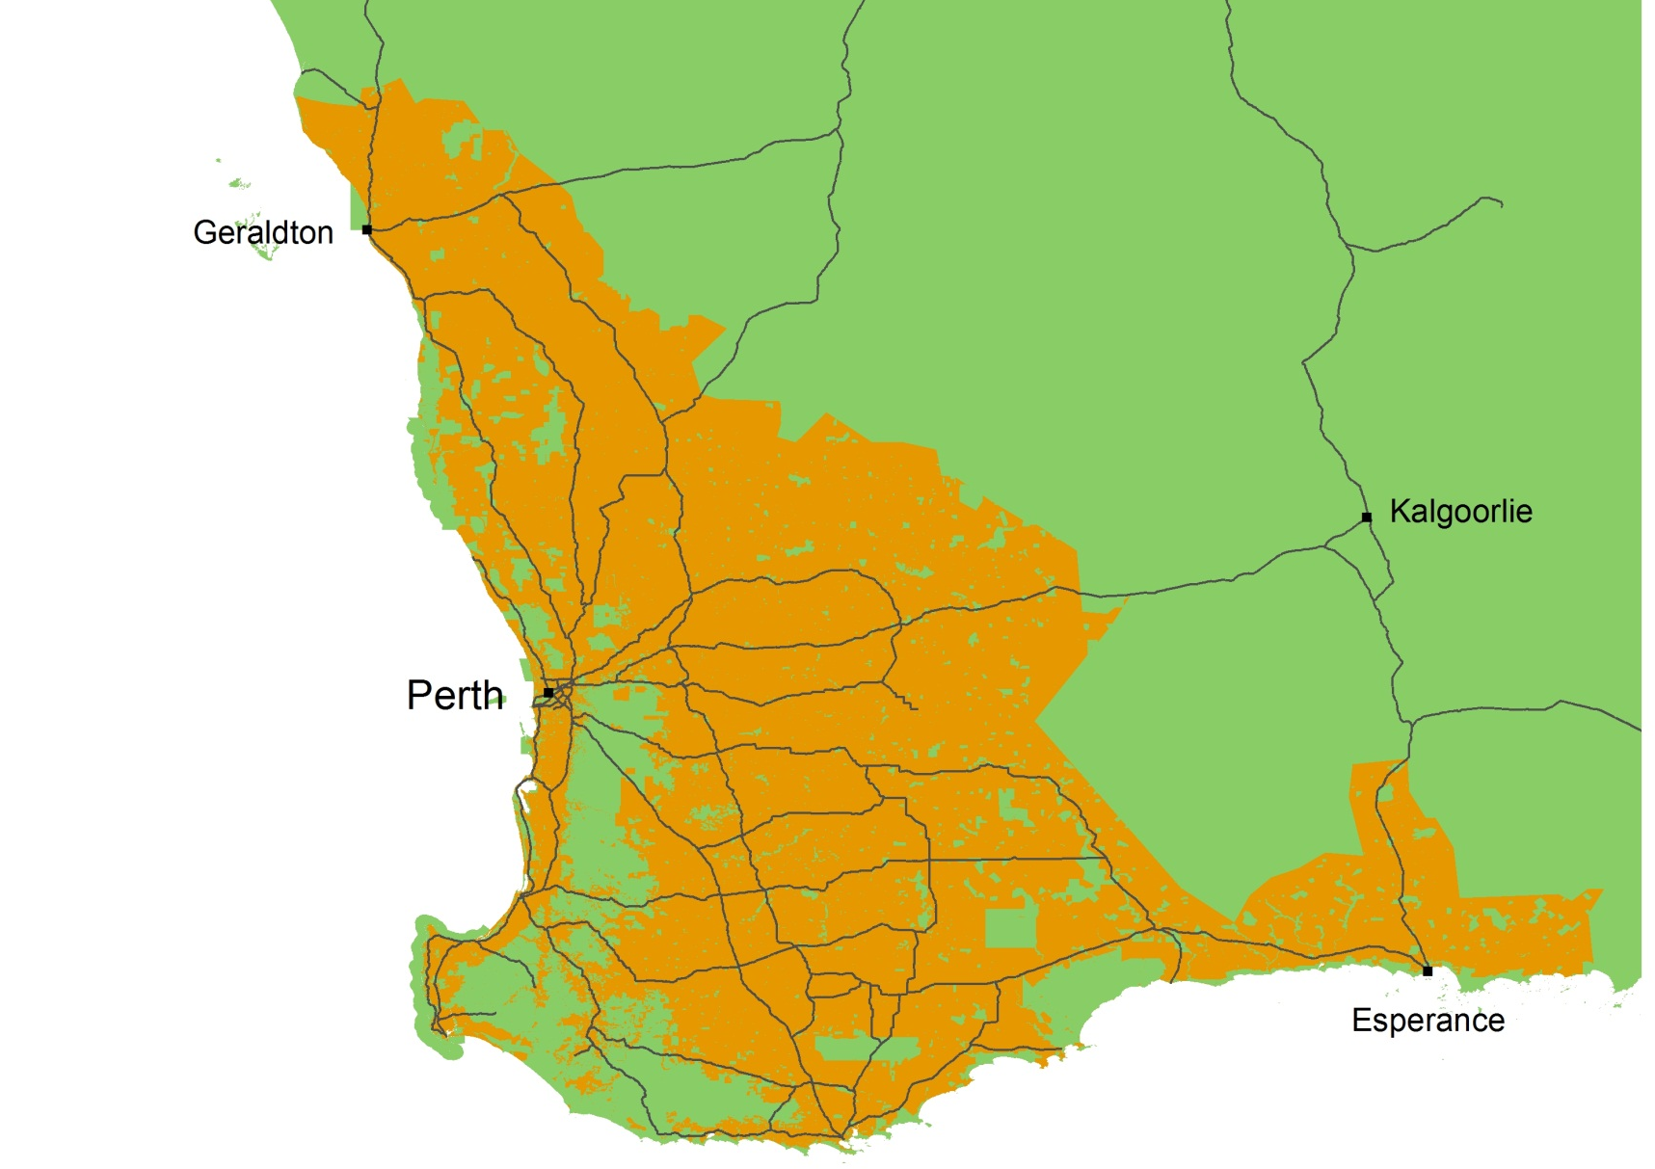
Private land
Notes:
Now we will look at how we deal with proposed land use changes on private land
Most of this land is in the SW and south of the State

Slide 25
Memorandum of Understanding
Requires subdivisions, planning schemes and relevant policies be referred to DMIRS for assessment
Recognition of importance of
protecting strategic mineral
resources
Integrating land use planning
and resource development
Department of Mines, Industry Regulation and Safety
Western Australian Planning Commission
Department of Planning, Lands and Heritage
Notes:
We have an MoU with the Western Australian Planning Commission and Dept of Planning Lands and Heritage
It requires, planning schemes, subdivisions and relevant policies be referred to us for assessment for specified areas
It recognises the importance of protecting strategic mineral resources, and integrating land-use planning and mineral resource development.
The Planning Commission is not obliged to adopt our recommendations, but in most cases it’s decisions do reflect our position

Slide 26
Private land subdivisions
Increasing distance from mining
Proposal type | Overlying the resource | Partly overlying the resource | < 500 m from the resource | > 500 m from the resource
Rural
Intensive agriculture
Industrial
Rural residential
Residential
Conditional
OK
Increasing
impact on
mining
Unacceptable
Notes:
Our recommendations depend upon the subdivision or rezoning type and its proximity to the resource
The potential impact of development on mining increases down the chart, but decreases across the chart with increasing distance from mining
Details will depend upon the type of resource and mining method. This e.g. applies to mineral sands and larger sand and limestone quarries
For example, we, would oppose a residential development that overlies or is adjacent to a resource because it would effectively sterilize it
For other situations we may request conditions such as Notifications on the titles to inform prospective purchasers of the possibility of mining nearby

Slide 27
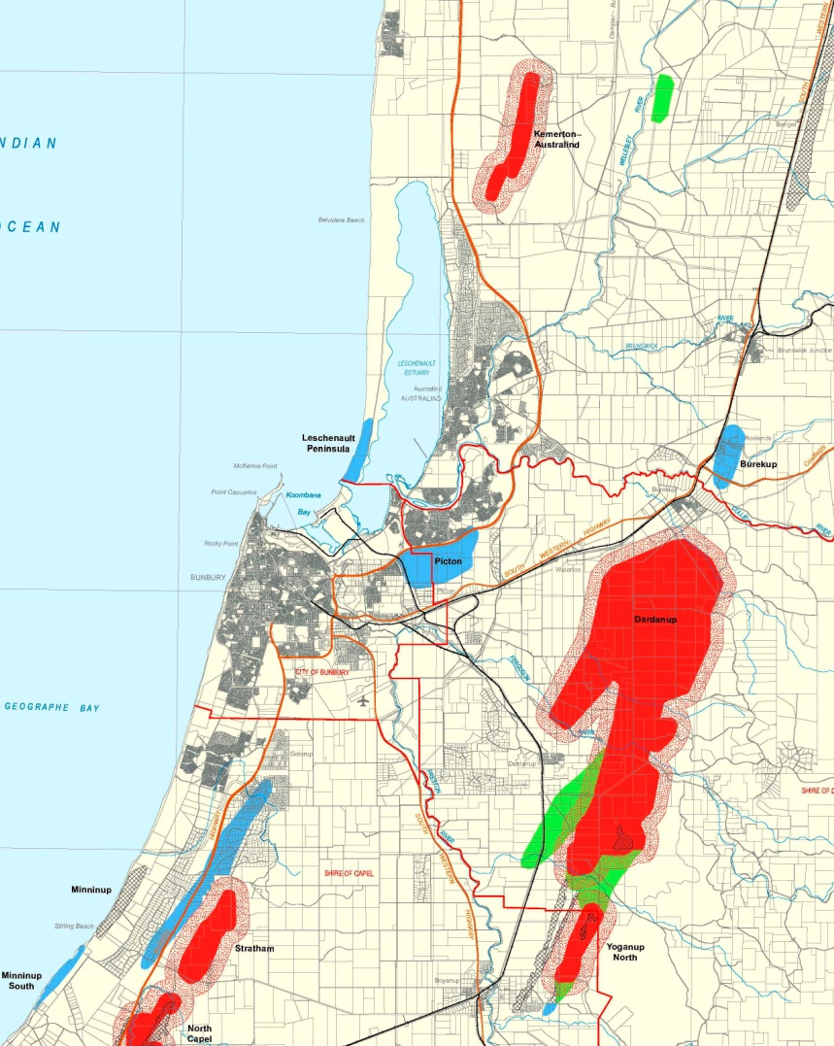
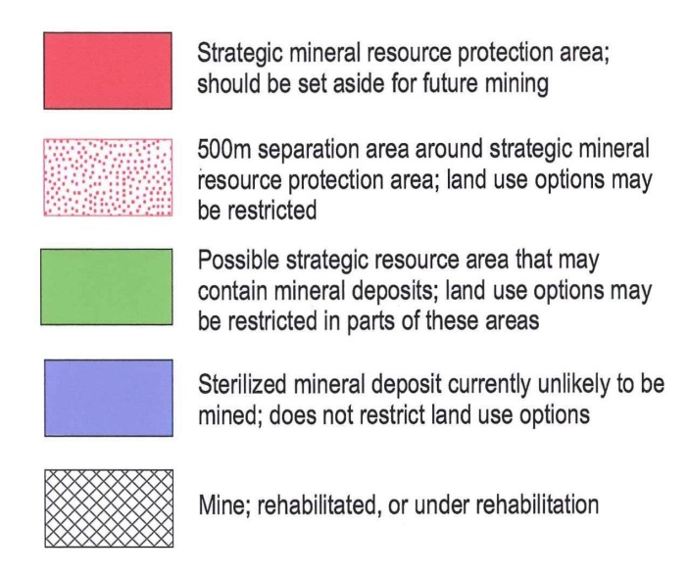
BUNBURY Sheet
Notes:
Of course to apply these guidelines, we need mapping. This is an example of the mapping we publish and use for mineral sands

Slide 28
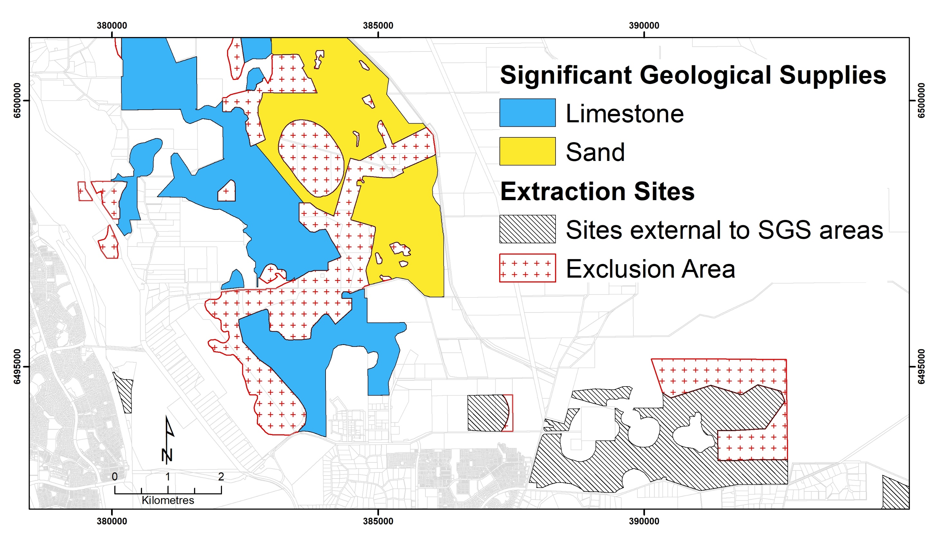
Notes:
We have similar mapping for basic raw materials such as sand, limestone, clay and hard rock quarries
This example is part of a digital dataset that accompanies the new draft State Planning Policy 2.4 on Basic Raw Materials

Slide 29
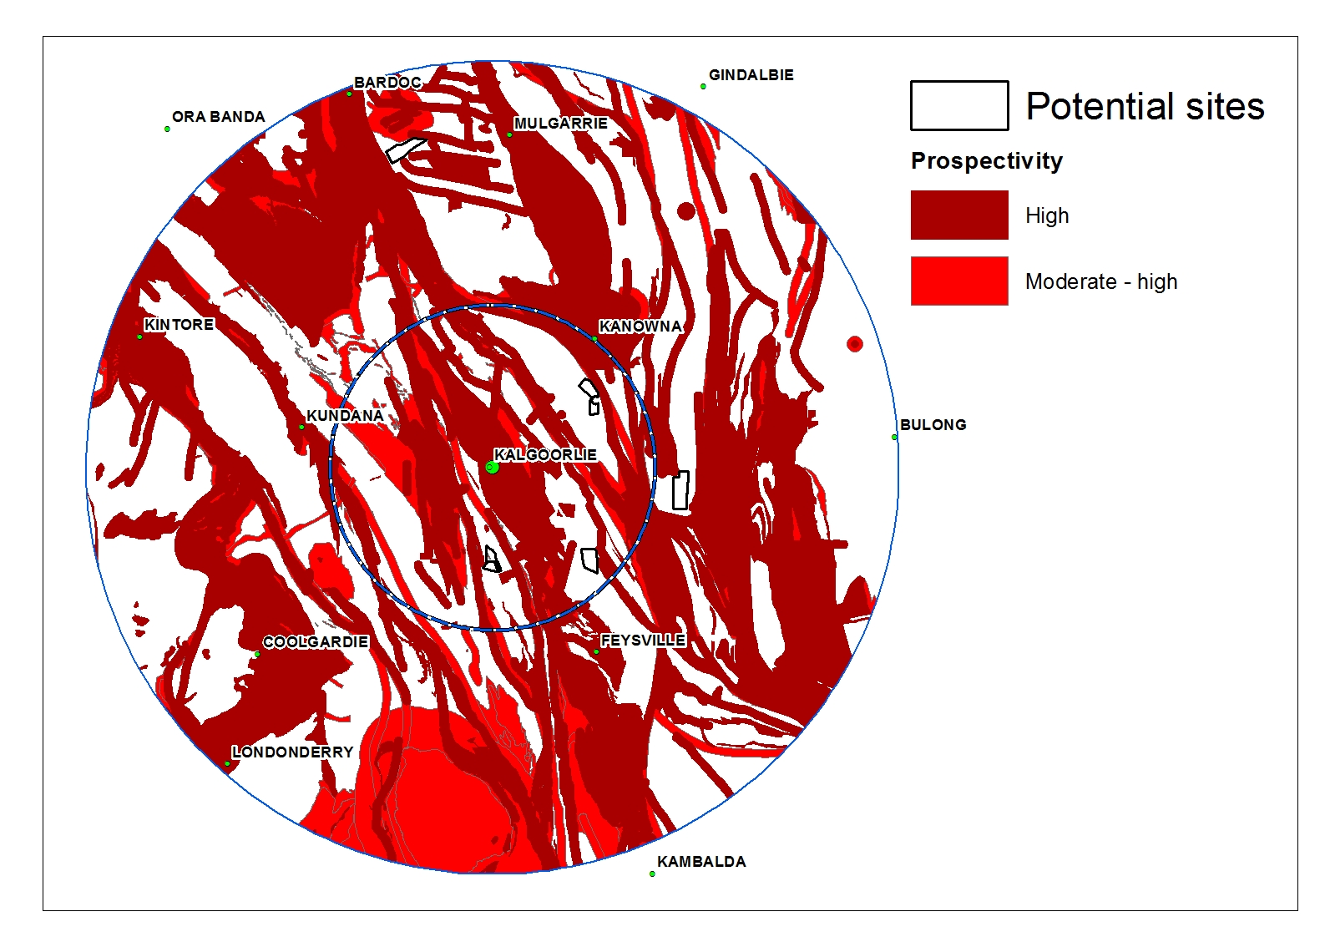
20 km
50 km
Notes:
Where necessary we also provide direct assistance to local governments
This is an example of prospectivity mapping we used to assist the City of Kalgoorlie Boulder with selecting suitable sites for future industrial development. The idea is to wherever possible avoid the highest prospectivity areas.

Slide 30
Emerging issues 2013
Calls from non-government organisations and other community groups for more formal and private conservation areas
Conservation estate set aside as environmental offsets under both Commonwealth and State legislation
Joint management conservation areas resulting from Indigenous Land Use Agreements
Notes:
The last time that I gave this talk these were the emerging issues
All have played out significantly over the last 7 years and will continue to do so

Slide 31
Emerging issues 2020
Increased land demand for:
carbon sequestration – driven by carbon offsets
large-scale renewable energy projects and ‘new energy’ projects
non-pastoral uses of the ‘rangelands’ e.g. private conservation, carbon offsets
Large-scale Indigenous Land Use Agreements and divestment of Aboriginal Lands Trust areas
Notes:
Now we are seeing increasing demand for land for…..

Slide 32
Summary
Land Use Planning plays an important role in informing government on resource access matters
Contribute to the sustainability of the resource industry by wherever possible maintaining access for exploration and development

Slide 33
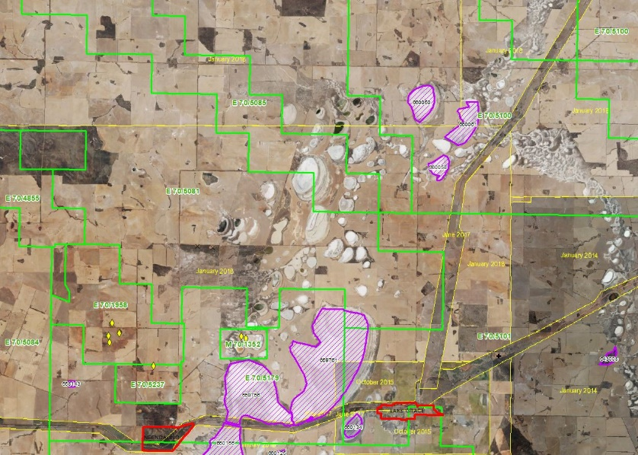


Land Use Planning Branch
Samantha Carter, Mike Critch, Steven Batty, Mark Fleming, Jordana Gardiner-Haukohl, David Hamdorf, Shane Kenworthy, Lisa Kirby, Kevin Ridge

