Slide 1
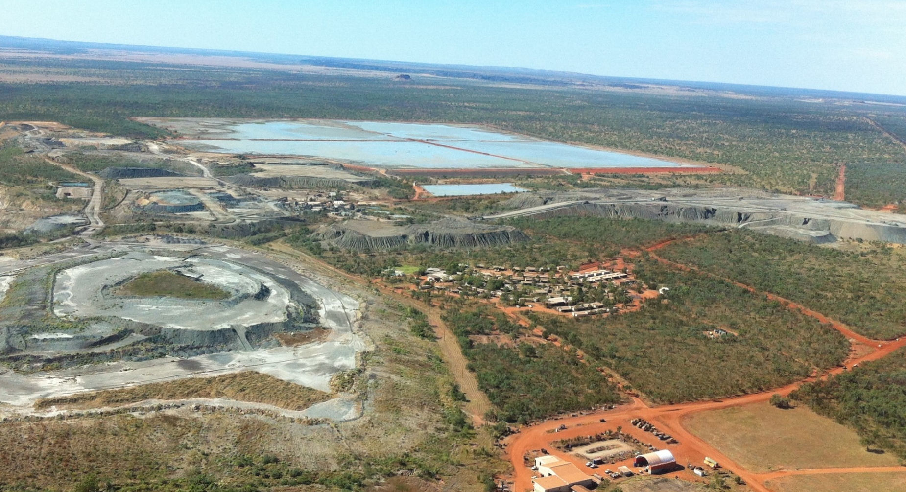
Managing an abandoned mine as a future resource
Ellendale Diamond Mine
Tara Read

Slide 2
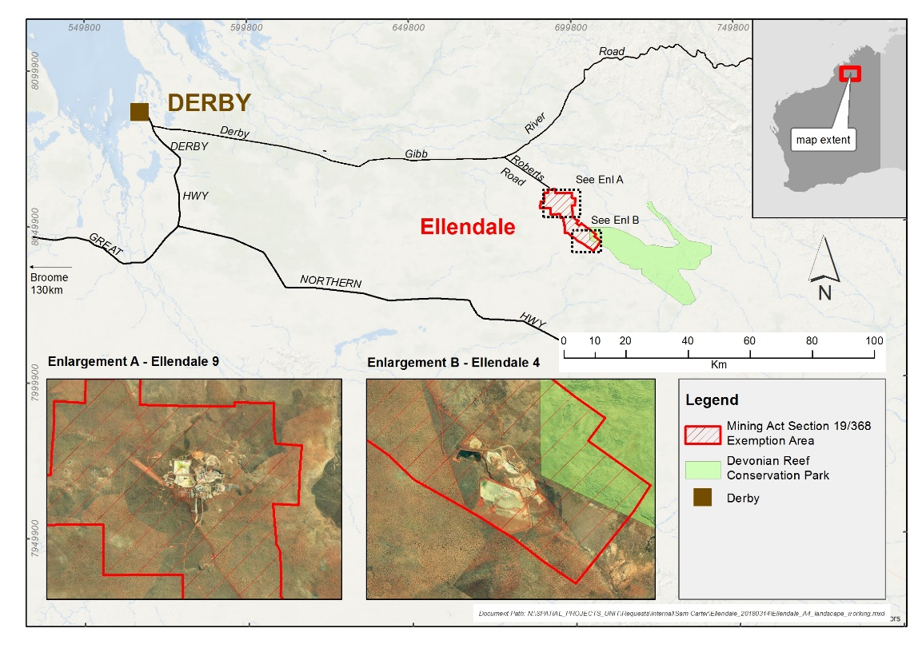
Ellendale Diamond Mine
120 km ESE of Derby
Two mine site areas (E4 and E9)
E4 located adjacent the Devonian Reef Conservation Park
Notes:
Ellendale is located on the Lennard Shelf in the northeastern portion of the Canning Basin. The geology is dominated by the Devonian marine sediments (siltstones, shales, limestones) of the Fairfield Group which are unconformably overlain by Permian-age fluvial sandstones (Grant Group). During the Tertiary Period, the Canning Basin was intruded by lamproitic plugs and subsequent eruptions have filled the volcanic vent with lamproite pyroclastic tuffs

Slide 3
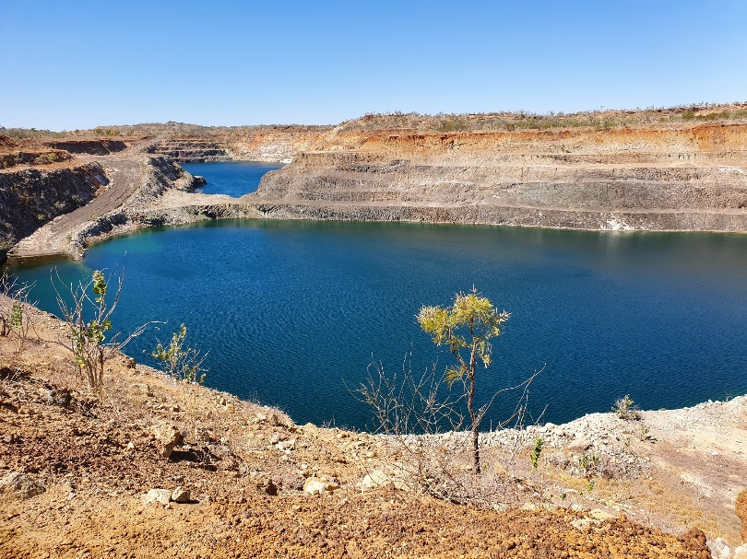
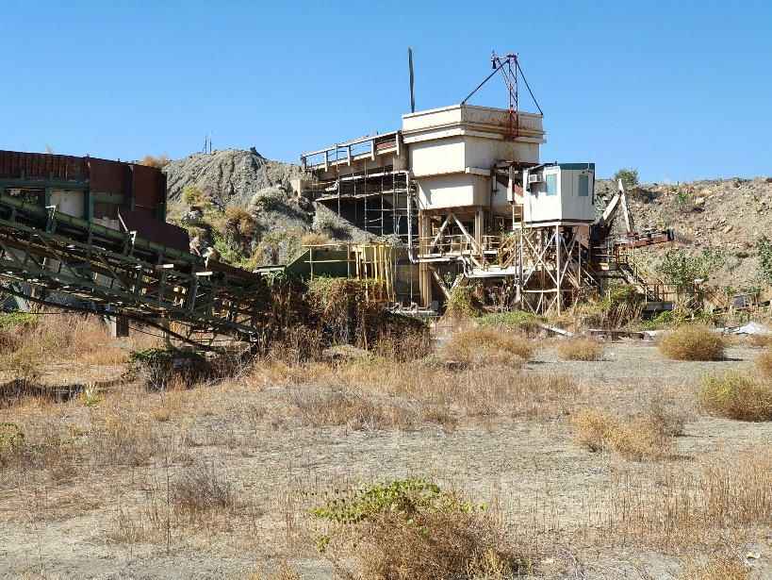
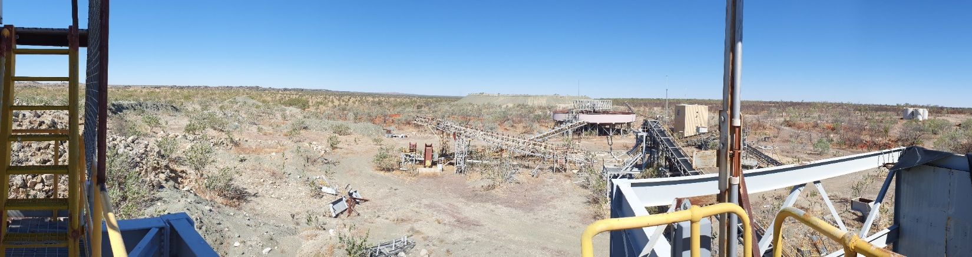
Ellendale site
Two open pits
Two processing plants
Laydown and workshop areas
Two bore fields
Camp

Slide 4
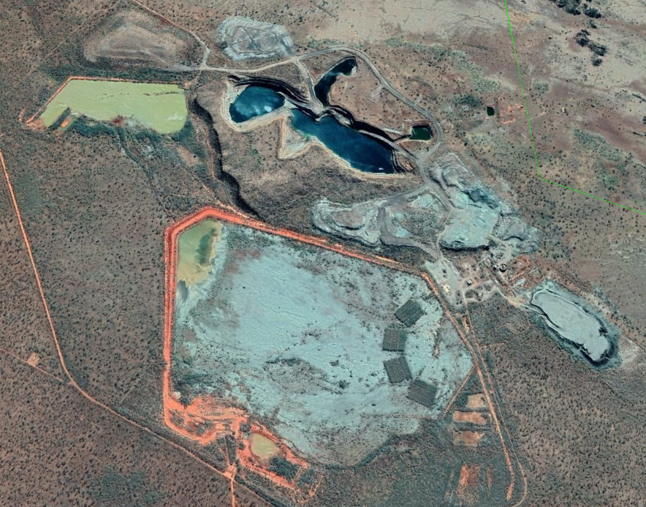
Ellendale site
A number of constructed landforms including
  Tailings storage facilities
  Waste rock landforms
  Stockpiles
  Water storage facilities
Notes:
Landform stability – ensuring these structures are safe stable and non-polluting while new tenement holders develop their plans for the site

Slide 5
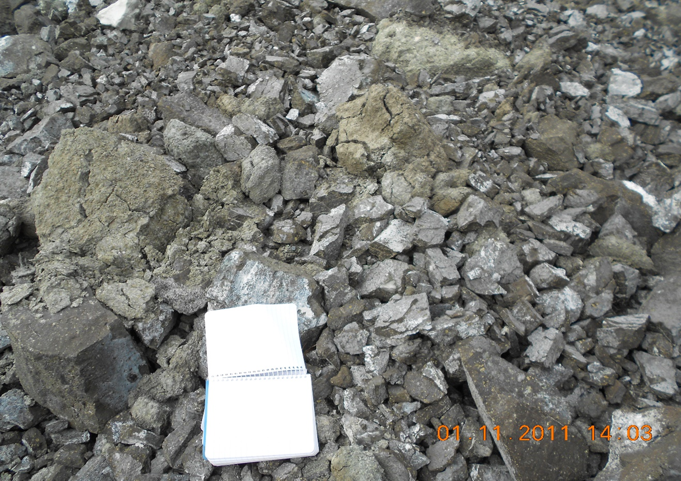
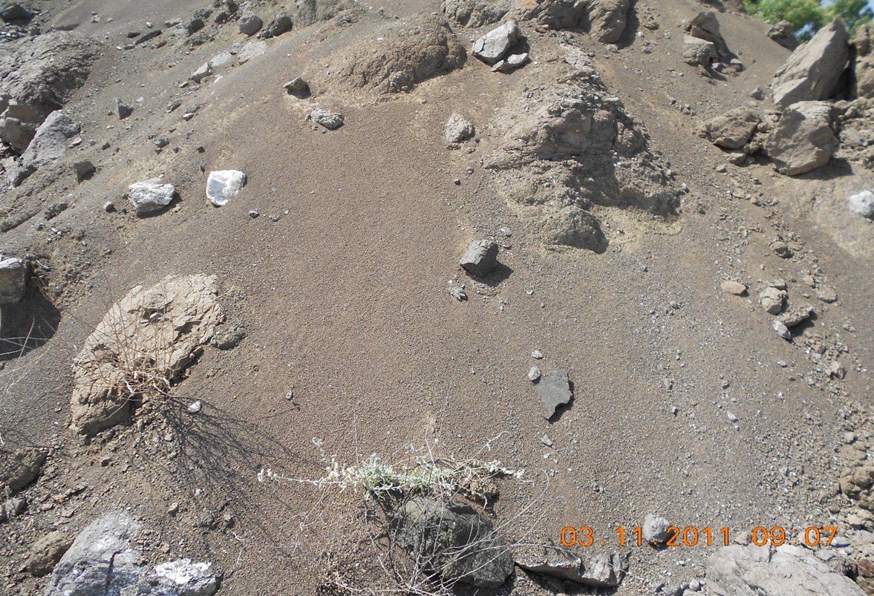
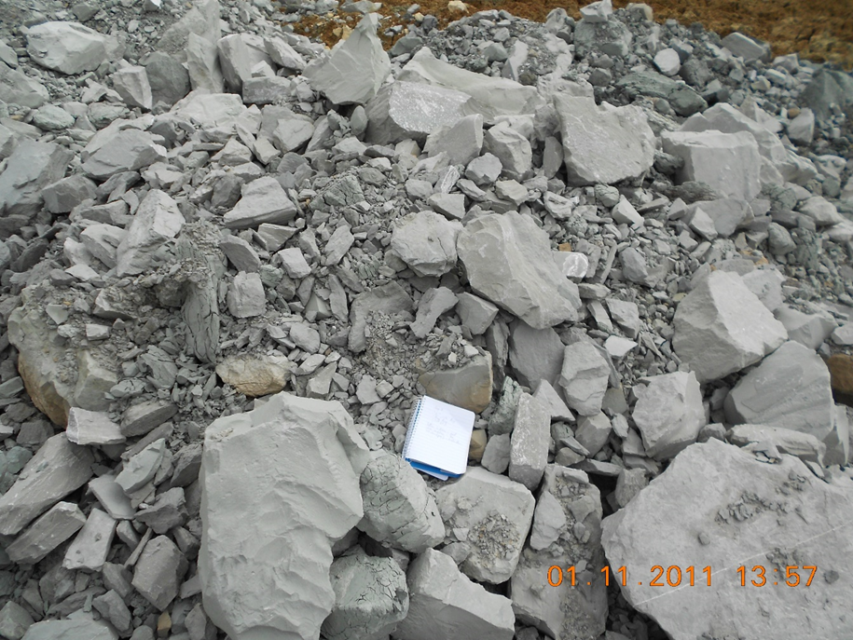
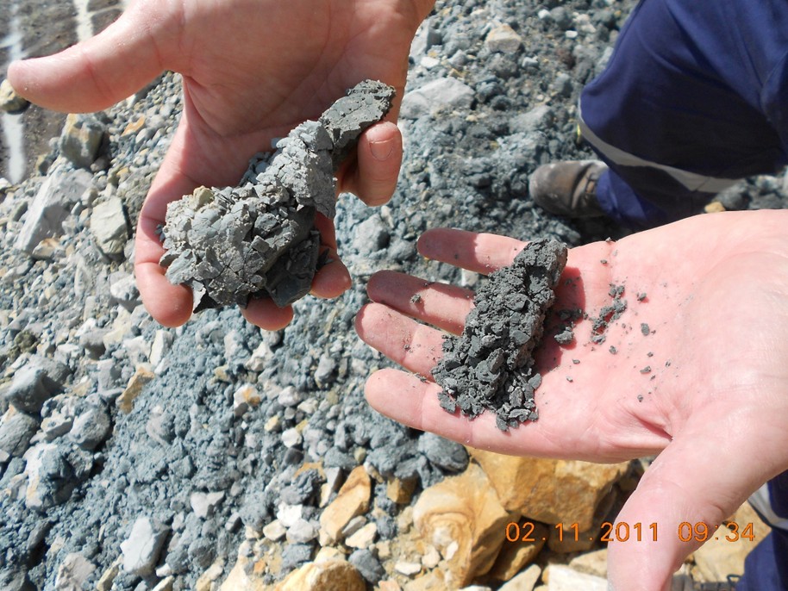
When rocks ain’t rocks
Blocky magmatics (a variety of tuffs and lamprolite) waste rock weathering in a five year period into fines
Fresh siltstone (Fairfield Group) breaking down into incompetent materials also through weathering
Notes:
Main waste rock types include:
- Magmatics, a variety of tuffs and lamprolite
- Grant Group sandstone
- Fairfield Group siltstones
Factors contributing to significant erosion:
- Waste rock types are prone to chemical and mechanical weathering
- Weathered materials becoming highly erosive, likely exacerbated by the current landform design
- Landforms with inadequate constructed surface water control features including poorly constructed or absent crest and berm bunds, and berms inadequate to contain surface run-off
These waste materials have been used to construct landforms and tailings storage facilities. The significant level of erosion on some of these features has the potential to lead to wall instability if no remedial action is taken

Slide 6
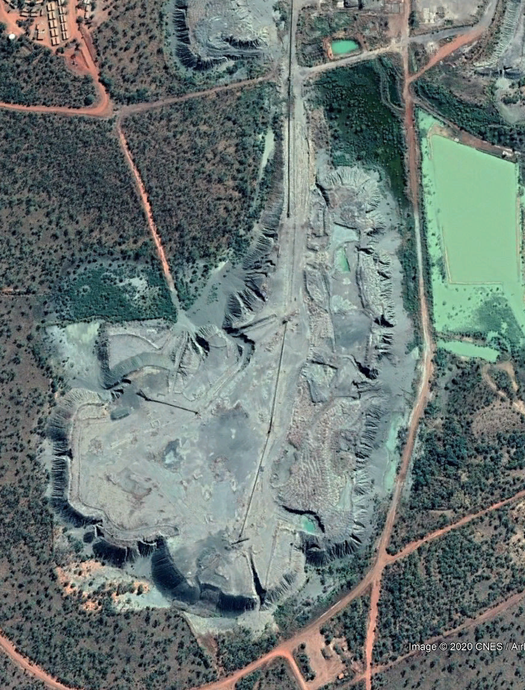
When rocks ain’t rocks
Notes:
Lights stockpile at E9
Factors contributing to significant erosion:
- Waste rock types are prone to chemical and mechanical weathering
- Weathered materials becoming highly erosive, likely exacerbated by the current landform design
- Landforms with inadequate constructed surface water control features including poorly constructed or absent crest and berm bunds, and berms inadequate to contain surface run-off
These waste materials have been used to construct landforms and tailings storage facilities. The significant level of erosion on some of these features has the potential to lead to wall instability if no remedial action is taken

Slide 7
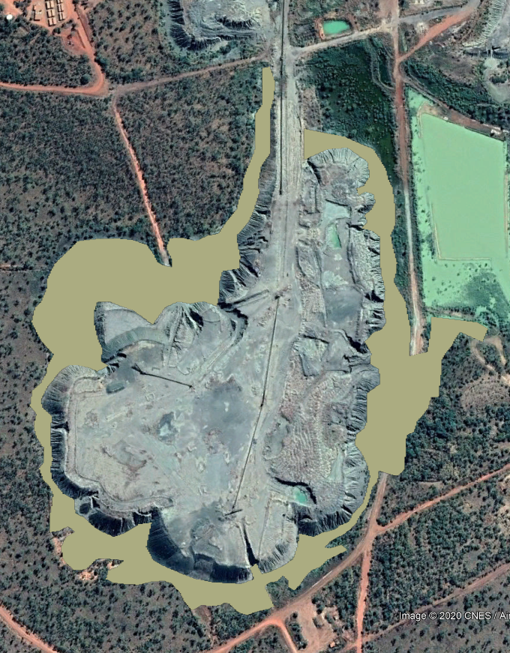
When rocks ain’t rocks
Notes:
Lights stockpile at E9
Factors contributing to significant erosion:
- Waste rock types are prone to chemical and mechanical weathering
- Weathered materials becoming highly erosive, likely exacerbated by the current landform design
- Landforms with inadequate constructed surface water control features including poorly constructed or absent crest and berm bunds, and berms inadequate to contain surface run-off
These waste materials have been used to construct landforms and tailings storage facilities. The significant level of erosion on some of these features has the potential to lead to wall instability if no remedial action is taken

Slide 8
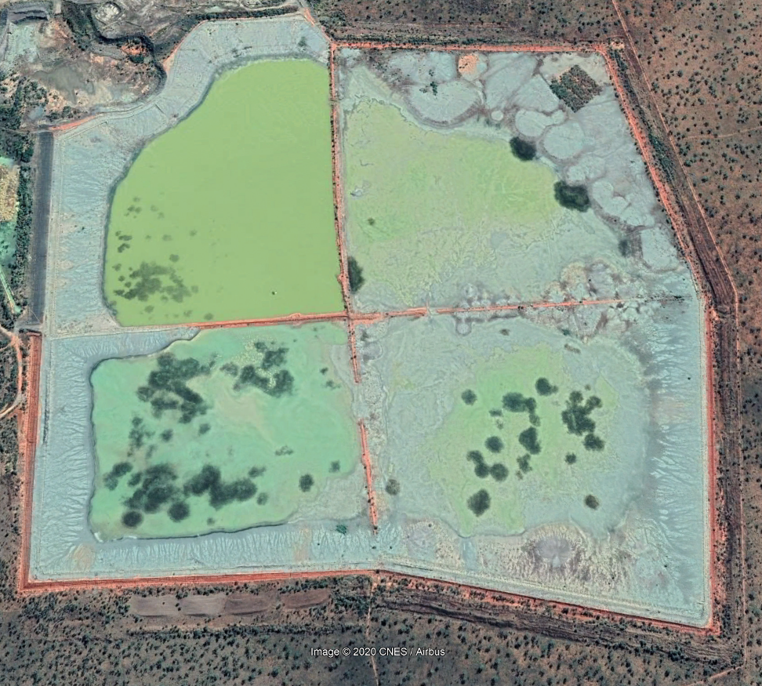
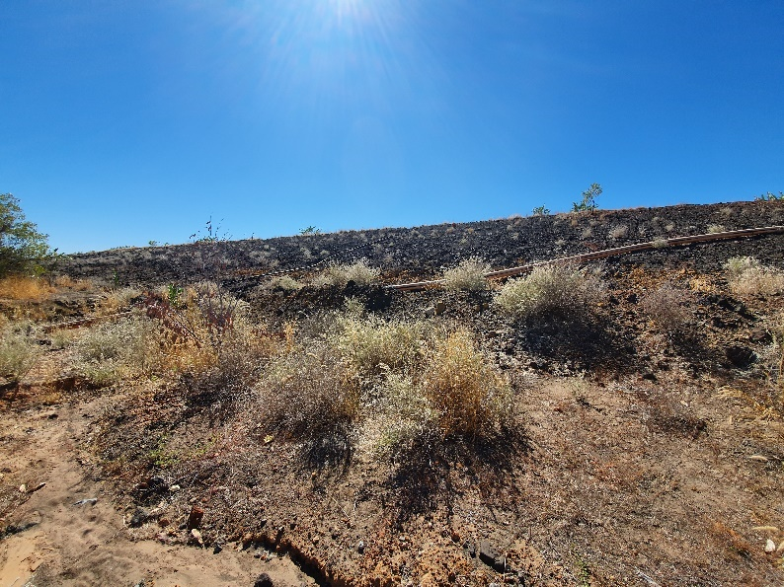
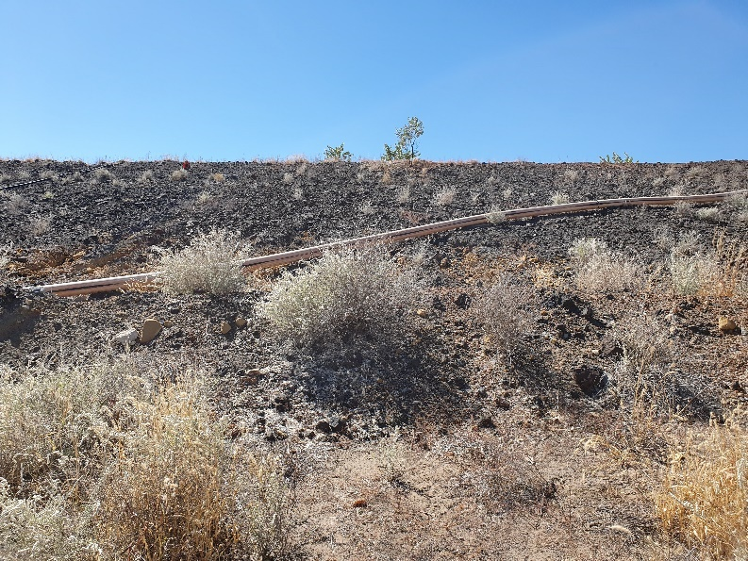
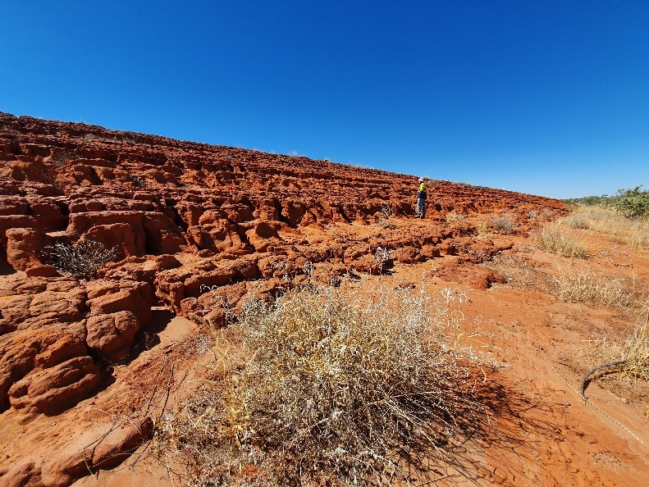
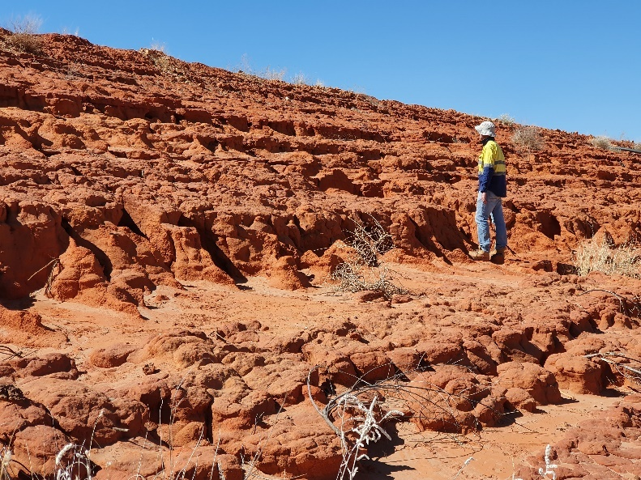
Rock armouring
Notes:
Grant Group Sandstone
E9 TSF Cell 3 and 4 western wall

Slide 9
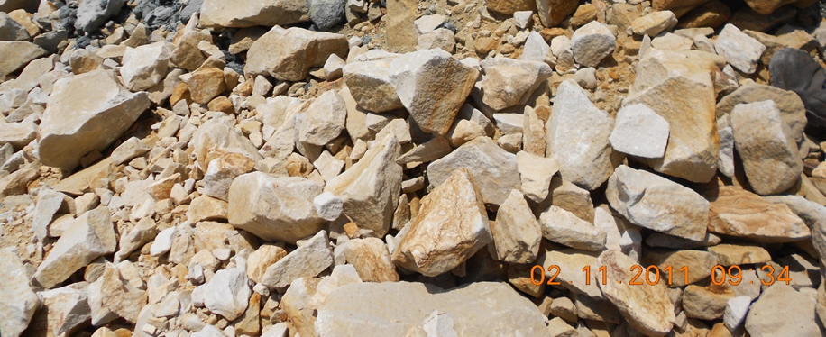

Rock armouring
Of the highly variable waste rock materials at Ellendale the Grant Group Sandstone represents the lowest risk for use in the stabilisation of constructed landforms.
It is a blocky competent material that when used within specific design criteria has been shown to be erosionally stable.
Notes:
It is a blocky competent material that is erosionally stable within specific design constraints (25m high 12 degree angle) while the siltstone, magmatic and pindan sands have been demonstrated to be erosionally unstable.
Landform remediation will incorporate appropriate rock armouring and modifications to the current batter design to enable long-term surface stability.

