Slide 1

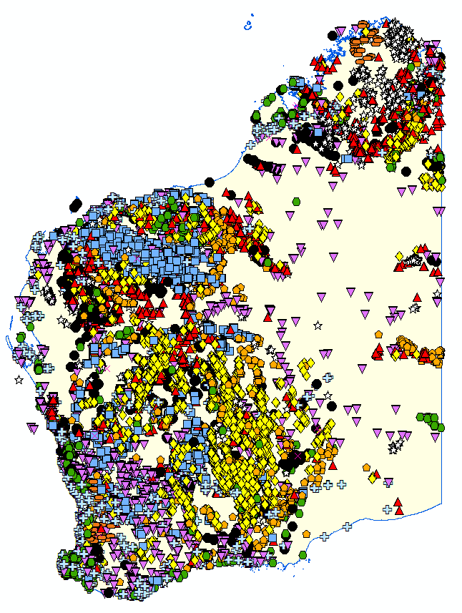

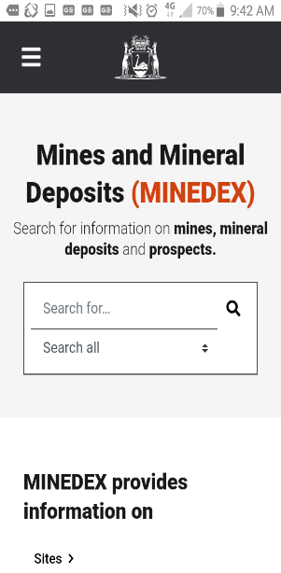
MINEDEX:
Western Australia’s database of
mines and mineral deposits
https://minedex.dmirs.wa.gov.au
Notes:
Mines and mineral deposits in Western Australia,
Reflects how the companies report their projects
Contains both current and historical data
Not as strongly linked to tenements are WAMEX

Slide 2
MINEDEX training outline
Introductions
MINEDEX primary functions
New MINEDEX User Interface
User demonstration
SEARCH
Project
Sites
Ownership
Environmental Registrations
EXPORTING
Reports
Data extracts
Questions and comments

Slide 3
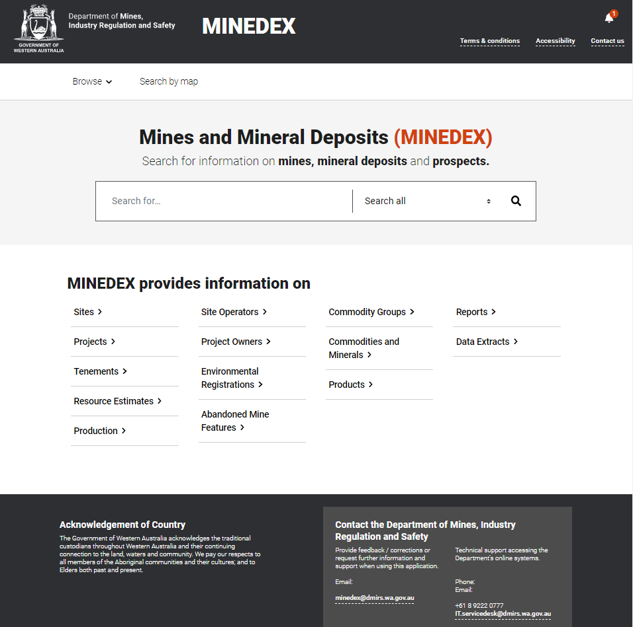
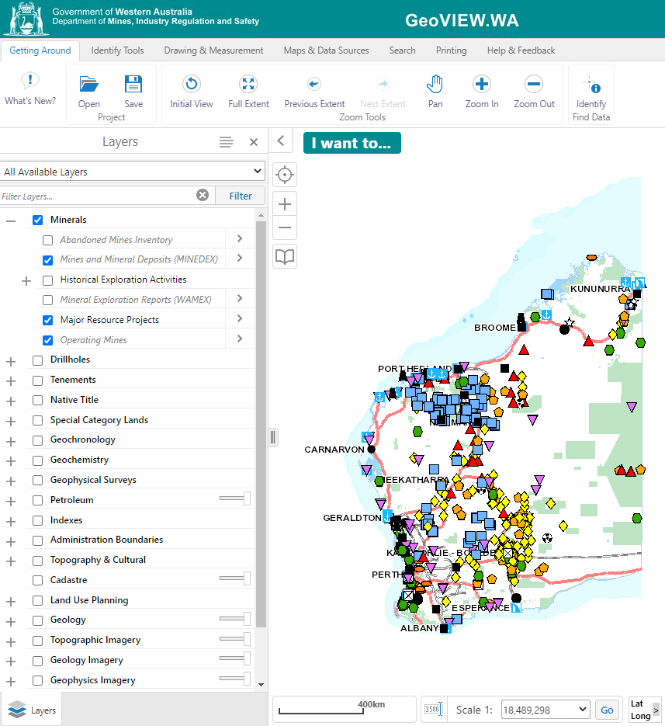
MINEDEX is…
A textual and spatial database of
WA exploration projects
Discoveries
Drillholes intersecting mineralisation
Prospects, Deposits
WA mines
Operating, shut, C & M
Includes mining infrastructure sites
Provides information on:
Location of activity
Project Owners, structure and status
Mineral Resource estimates
Information source links – Mining Proposals (Environmental Registrations)
Historical Production
TEXT Database
SPATIAL Database
Notes:
Over the years, the way information has been captured in Minedex has changed. Some historical features captured included drill targets, but now these are not captured until the ground has been broken, and then only if mineralisation is intercepted. Every individual drillhole from a drill program is not captured, unless only a single drillhole was drilled, and then only if mineralisation is intercepted. If a drill program is undertaken and significant intercepts occur in those drillholes for a single commodity e.g. gold, then a single site will be created to represent that mineralisation occurrence across all drillholes.

Slide 4
MINEDEX primary functions:
CAPTURE
SEARCH
EXPORT
1. Data capture
MANUAL
Significant drilling, mineral resource estimates, prospects
Project ownership, status and development stage
AUTOMATED
Internal DMIRS systems e.g.: Royalties, Resources Safety, Environment and Tenement Status.
2. Search engine - NEW user interface (at beginning of 2020).
Simple search
Advanced search
3. Exporting data
Advanced search (for <1000 results)
Reports (mineral resource estimates)
Data Extracts
Notes:
Manual Capture from both Public and Confidential sources including ASX Releases, Tenure Applications and Reporting to DMIRS.

Slide 5
MINEDEX Structure
Simple database structure:
PROJECT (J0001)
OWNER and COMMODITY
SITE
SITE
Location
Resource estimates
Production
S000001
SITE
S000003
S000002
Notes:
The sites are the Unique Identifiers in this database.
The Site is the unique identifier of each record related to the spatial distribution of commodities in WA. A project is a collective grouping created according to owners and commodities.
The Owner can link a group of Projects to a single owner / company, but owners do not have a spatial allocation.
There is a J code for each project.
Then for each project we have a number of sites underneath which capture specific activities associated with that project.
Eg. Early exploration project, mineral occurrences, drillholes
Eg 2 for a mining operation we capture both the mining activities, and associated infrastructure such as processing plants, waste rock dumps, magazines which are important to know from a safety and environmental side.
Sites are where the location data is attributed.
Both Projects and sites change with time; they change status, ownership, get sold to other projects. So a time factor is also captured as to whether a site is historical or current, whether it has been end-dated under one project and moved to another.

Slide 6
MINEDEX Database Structure
PROJECT OWNER and COMMODITY/COMMODITY GROUPS
Projects are a collection of sites grouped by a Target Commodity Group and by the same Ownership such as:
Gold
Base Metals
Tin-Tantalum-Lithium
REE
Other
The Project Owner links a group of Projects to a single owner / company, but owners do not have a spatial allocation.
Relationships between Project Owners allows tracking of Subsidiary companies and changes in company names

Slide 7
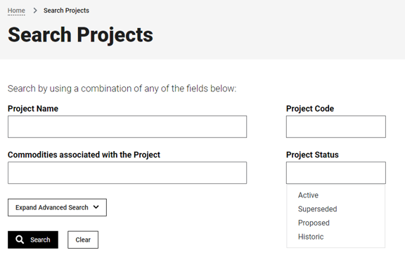
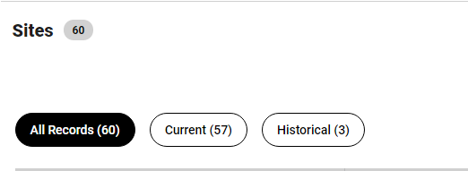
Projects and Sites
The structure of Projects and Sites to the best of our ability is to reflect how companies report their projects
Database is about 20 years old
Contains both current and historical data*
Search Sites
Notes:
* The database contains production data from the late 1800’s

Slide 8
Skip next two slides in training.

Slide 9
MINEDEX Database Structure
MINEDEX SITES
The Sites are the unique identifier of each record related to the spatial distribution of commodities in WA. Have a unique S-number.
The following information is allocated to sites:
Spatial coordinates
Tenements
Resource Estimates
Production
PROJECTS
A project is a collective grouping of Sites created according to owners and commodities.
Each project can have a number of sites which capture specific activities by Site Type, associated with that project.
Eg. Mines, Deposits, Prospects, Mineral occurrences, Drillholes
PROJECT (J0001)
SITE
SITE
S000001
S000003
SITE
S000002
Notes:
The sites are the Unique Identifiers in this database.
The Site is the unique identifier of each record related to the spatial distribution of commodities in WA. A project is a collective grouping created according to owners and commodities.
The Owner can link a group of Projects to a single owner / company, but owners do not have a spatial allocation.
There is a J code for each project.
Then for each project we have a number of sites underneath which capture specific activities associated with that project.
Eg. Early exploration project, mineral occurrences, drillholes
Eg 2 for a mining operation we capture both the mining activities, and associated infrastructure such as processing plants, waste rock dumps, magazines which are important to know from a safety and environmental side.
Sites are where the location data is attributed.

Slide 10
MINEDEX Database Structure
Both Projects and sites change with time; a time factor is also captured as to whether a site is historical or current, whether it has been end-dated under one project and moved to another. Changes are documented in Notes at both the site and project page level.
For example:
Sites can change type and status as they are developed (prospect to deposit to mine, and under dev to operating)
Change tenement status (e.g. E to M tenure, or surrendered, get sold to other Owners and change projects).
Projects can be sold in their entirety to new owners or broken up, normally by tenement, but also Commodity rights are sold.

Slide 11

How to get data out of MINEDEX
OR…
Exporting data from the database
Advanced search (for <1000 results)
Reports (mineral resource estimates)
Data Extracts
Notes:
Geoview is the most popular access point into Minedex Data however there is a lot more data to be found through the database itself.
And now that our new improved user interface has been launched – it makes searching, filtering and exporting the >60,000 data sites much easier.

Slide 12
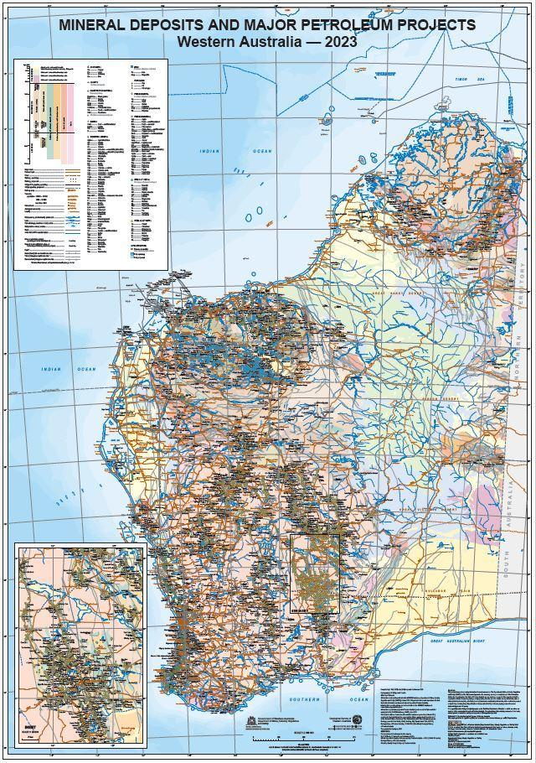
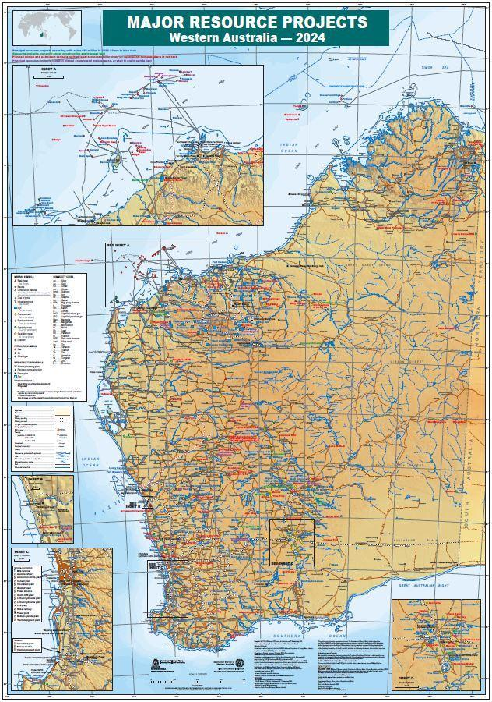
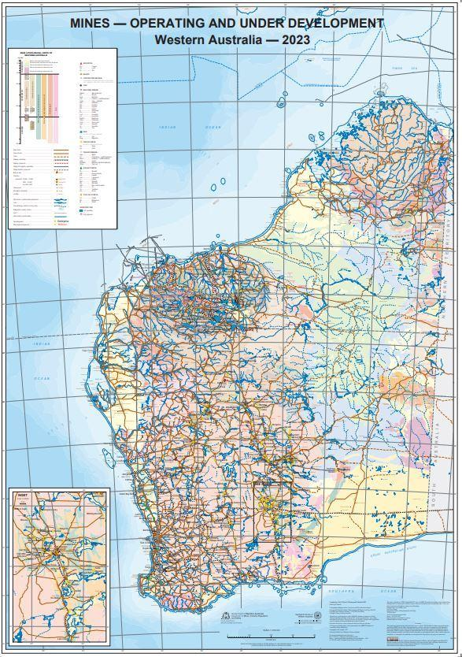
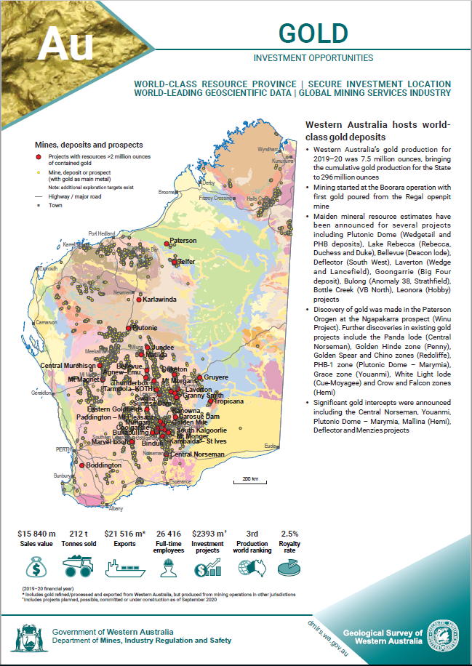
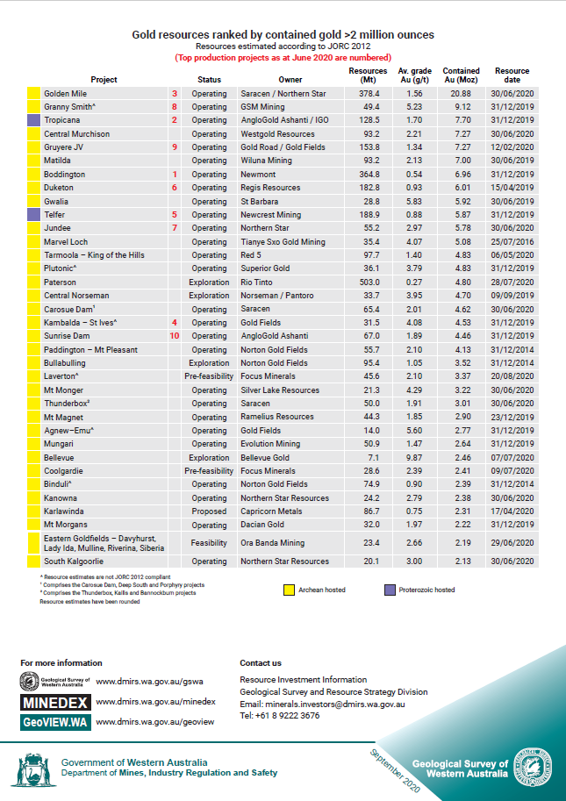
DMIRS products using MINEDEX data
Data Extracts and Reports are the basis for State Maps and Commodity Flyers:
Maps available - https://dmpbookshop.eruditetechnologies.com.au/category/state-maps-60.do
Data available through Minedex – Data Extracts link https://minedeximirs.wa.gov.au/Web/data-extracts
Flyers available - https://www.dmp.wa.gov.au/Investors/WA-commodity-flyers-16526.aspx
Data available through Minedex – Reports link: https://minedex.dmirs.wa.gov.au/Web/reports
Notes:
Minedex data is also the basis for our most popular products - State Maps
Also Minedex Reports are our custom queries that add up mineral resource estimates which are on the back page of commodity flyers

Slide 13
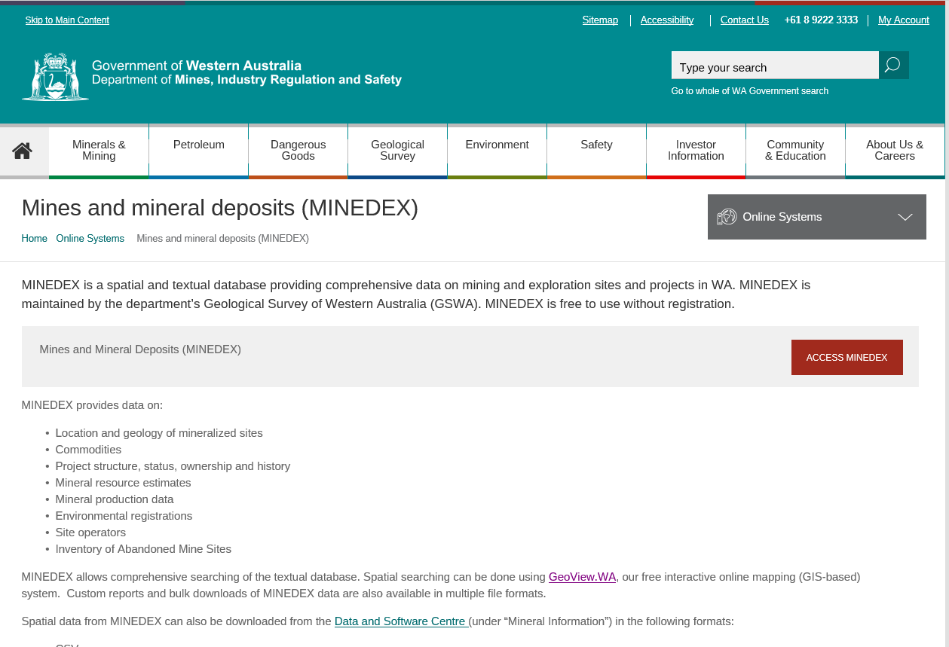
Getting started with MINEDEX Online
http://www.dmp.wa.gov.au/Mines-and-mineral-deposits-1502.aspx
Or search for GSWA Minedex
Or under Online systems on the DMIRS website (remember to press the view more button).
Or via Google Search for MINEDEX

Slide 14
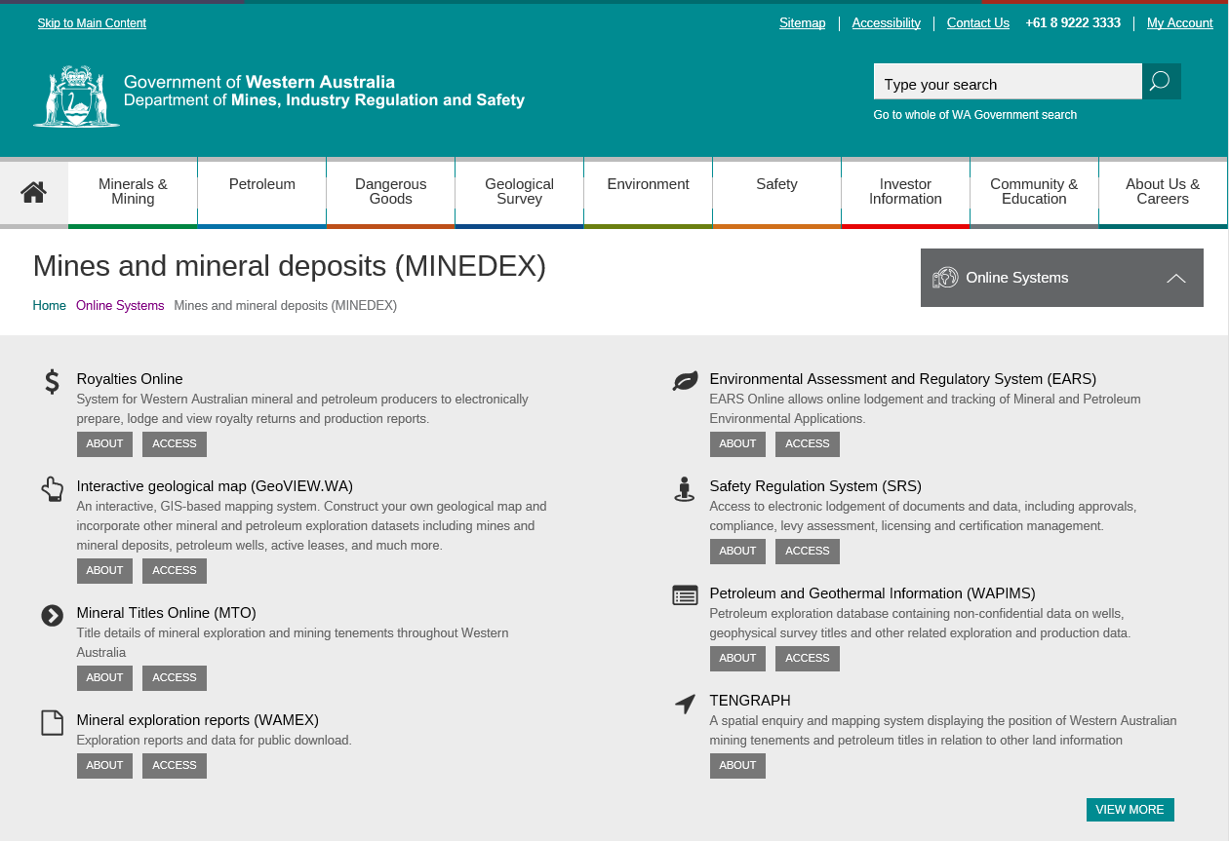
Getting started with MINEDEX Online
http://www.dmp.wa.gov.au/Mines-and-mineral-deposits-1502.aspx
Or search for GSWA Minedex
Or under Online systems on the DMIRS website (remember to press the view more button).

Slide 15
MINEDEX user interface
Launched November 2019
All publically visible notifications
Takes you to DMIRS Home Page
Click to get information on accessibility, how to contact us
Takes you to Minedex Home Page
We recommend using one of the following:
Microsoft Edge
Mozilla Firefox- latest version
Google Chrome – latest version
Email details for feedback, corrections, request for further information, or technical support
Notes:
A new MINEDEX user interface was released in November 2019, offering:
Improved search functions
Improved performance on tablets and mobile phones
Improved accessibility for users with disabilities

Slide 16
New MINEDEX user interface
Search by map
Browse menu searching
Simple text searching (unconstrained)
Advanced searching
Data exports
Notes:
A new MINEDEX user interface was released in November 2019, offering:
Improved search functions
Improved performance on tablets and mobile phones
Improved accessibility for users with disabilities

Slide 17
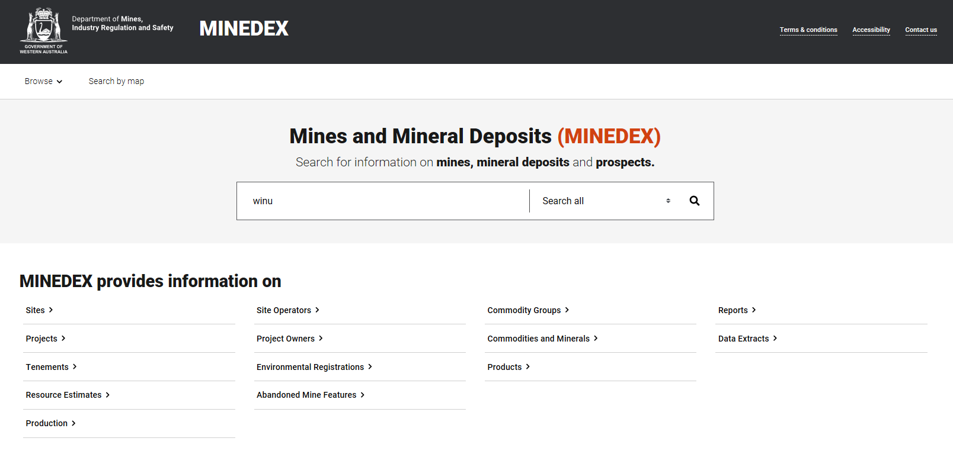
SIMPLE SEARCHING
Notes:
A new MINEDEX user interface was released in November 2019, offering:
Improved search functions
Improved performance on tablets and mobile phones
Improved accessibility for users with disabilities

Slide 18
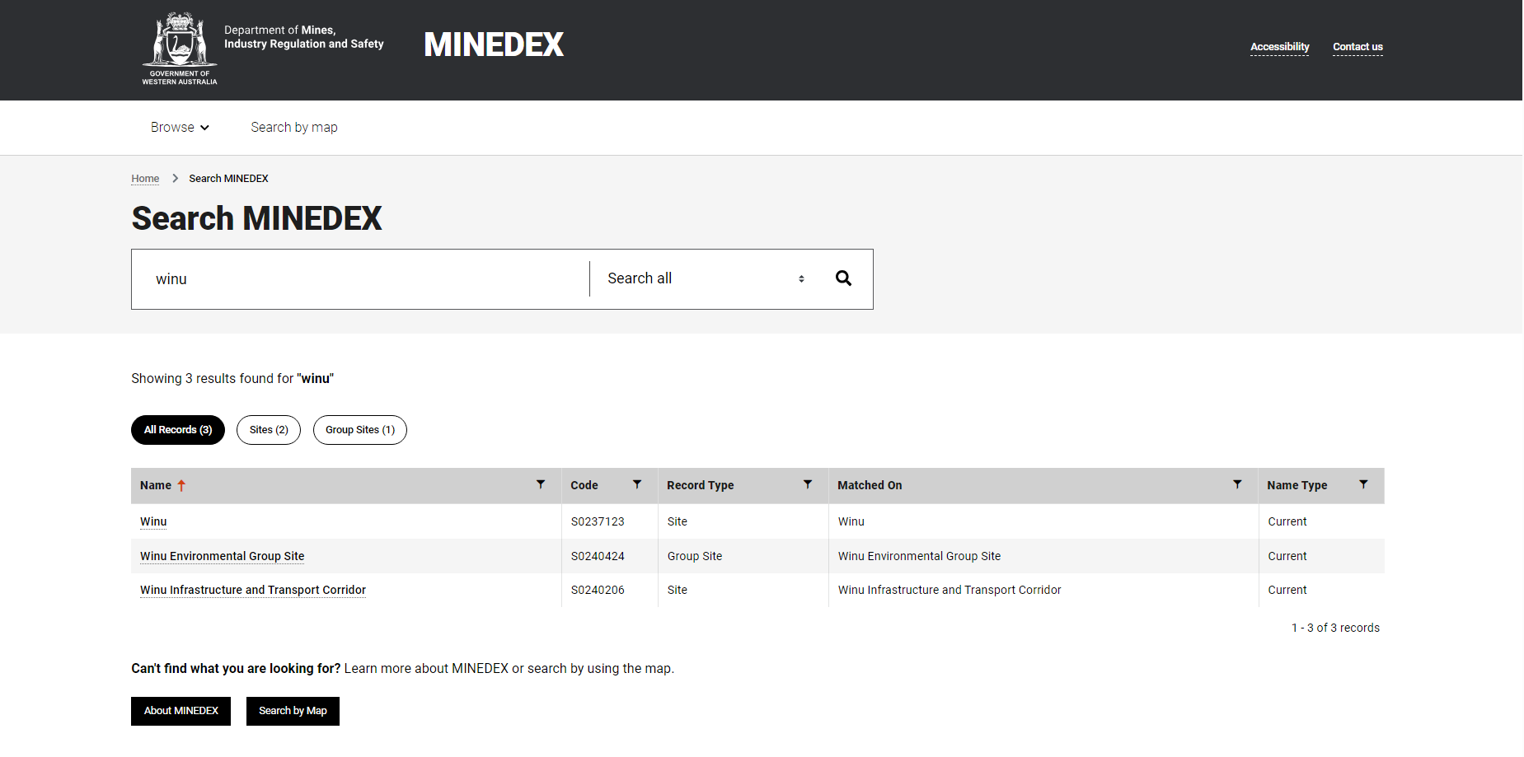
Reference codes for compliance systems
Any text underlined is a link, can right click on mouse to open in new window or tab
SIMPLE SEARCHING

Slide 19
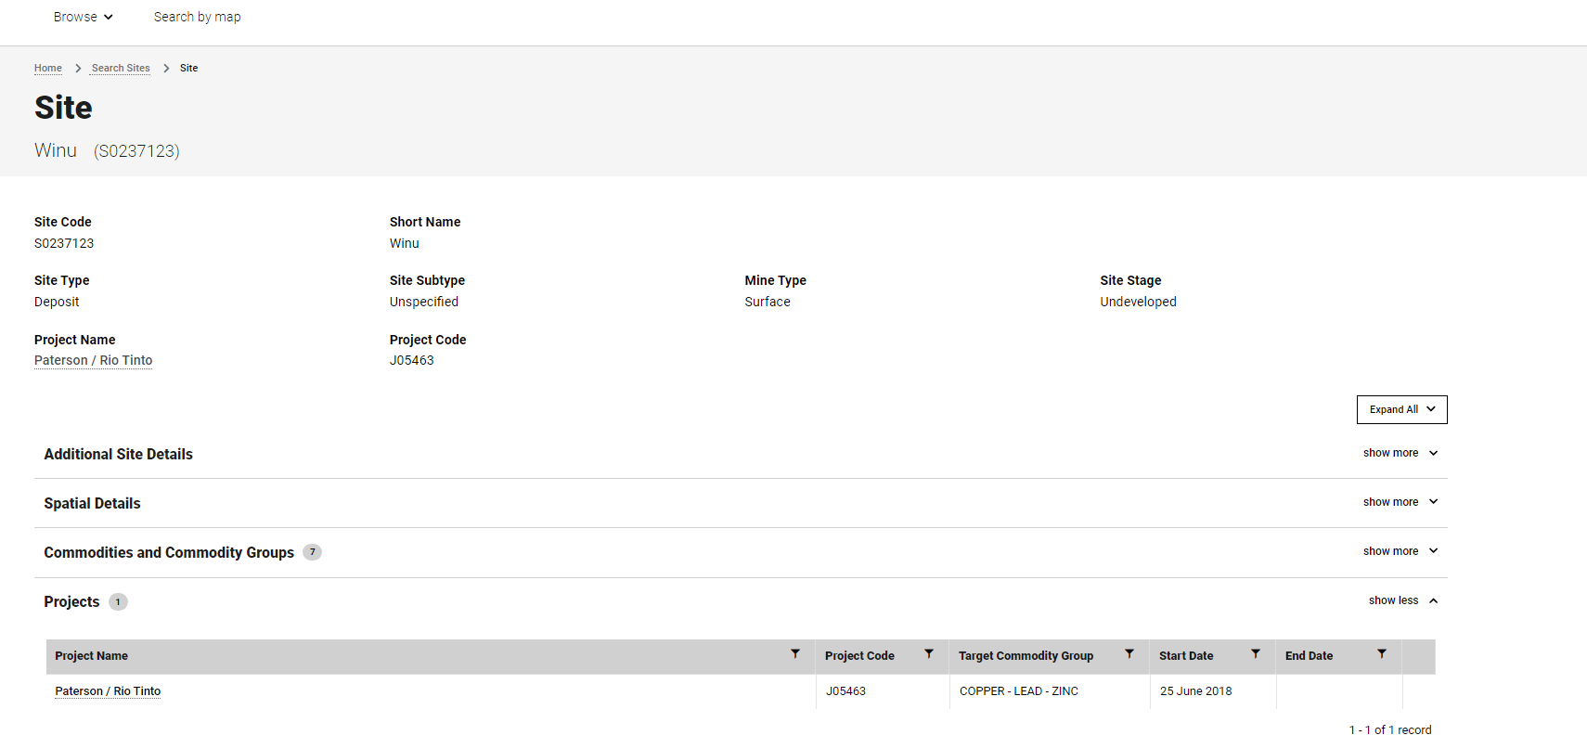
Represents the number of records present under this heading
SIMPLE SEARCHING

Slide 20
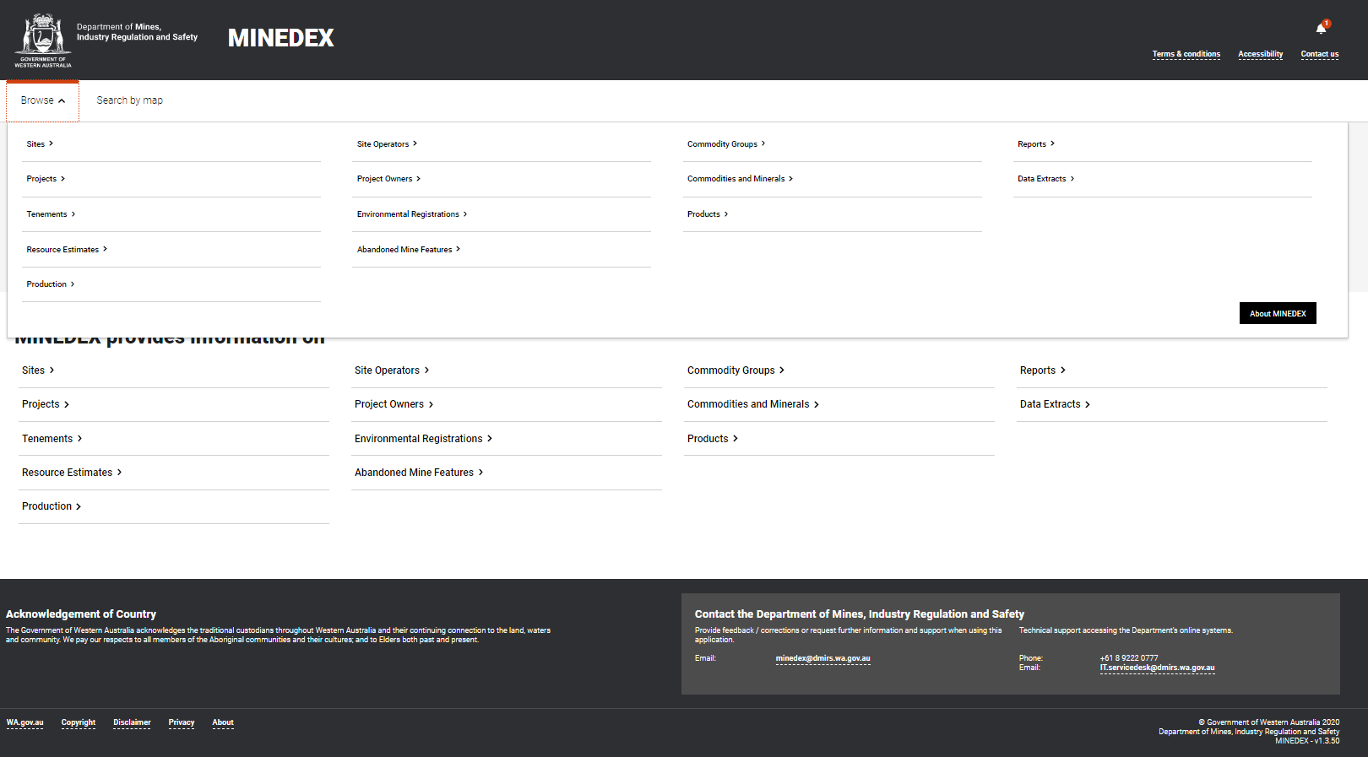
BROWSE SEARCHING

Slide 21
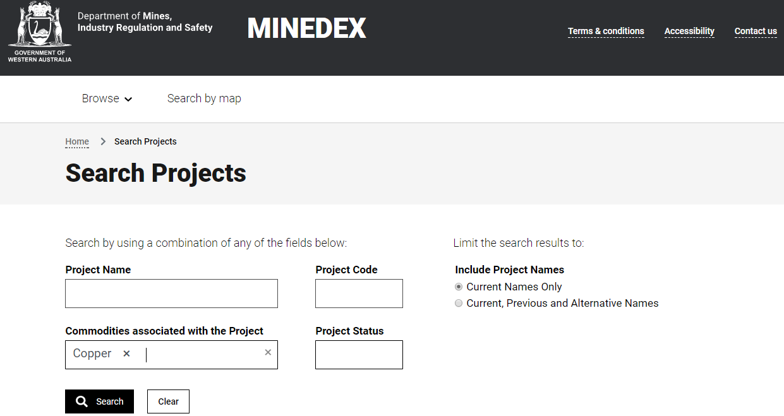
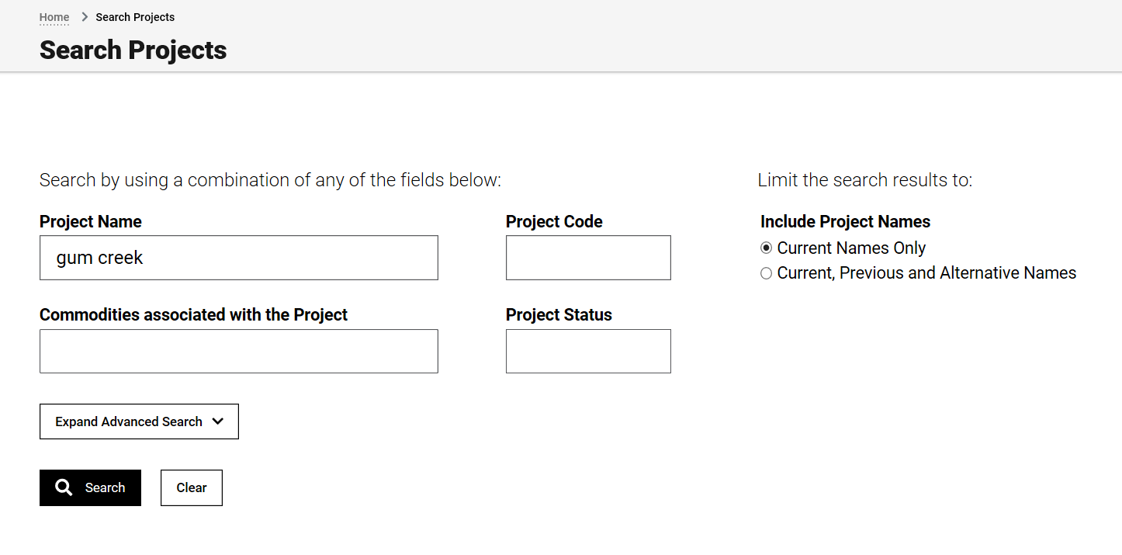
Project Screen
Unique codes for each project
Projects are grouped according to the companies that own them
Extend search by also using previous and alternative names
Can use advanced searching
ADVANCED SEARCHING

Slide 22
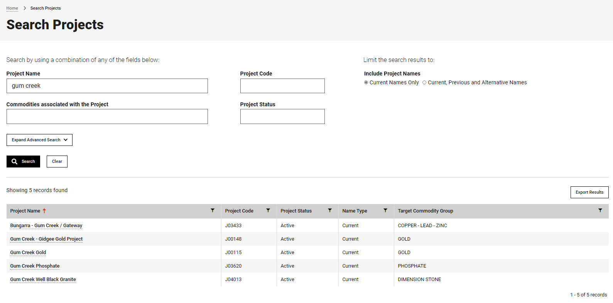
Export results to excel. NB: will never export more than 1000 results – must go into data extracts for this
To use Advanced Search, click on the button, comes up with Criteria that can be used
Filter results
Right click on mouse to open in new tab or window
ADVANCED SEARCHING

Slide 23
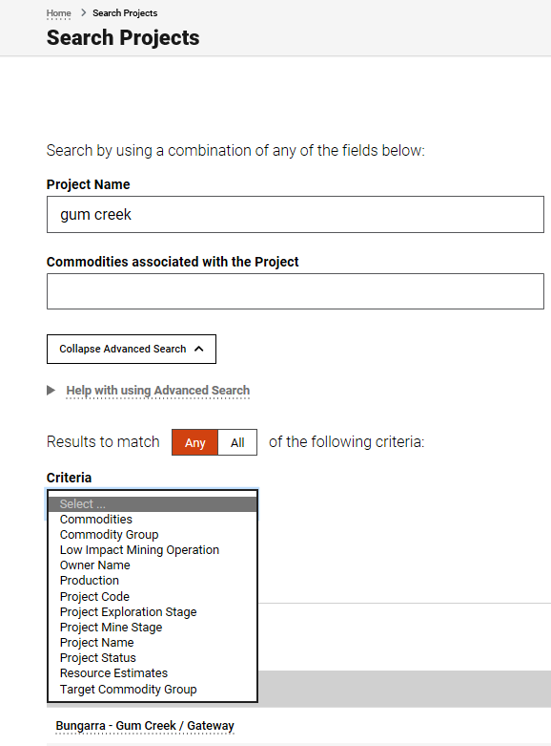
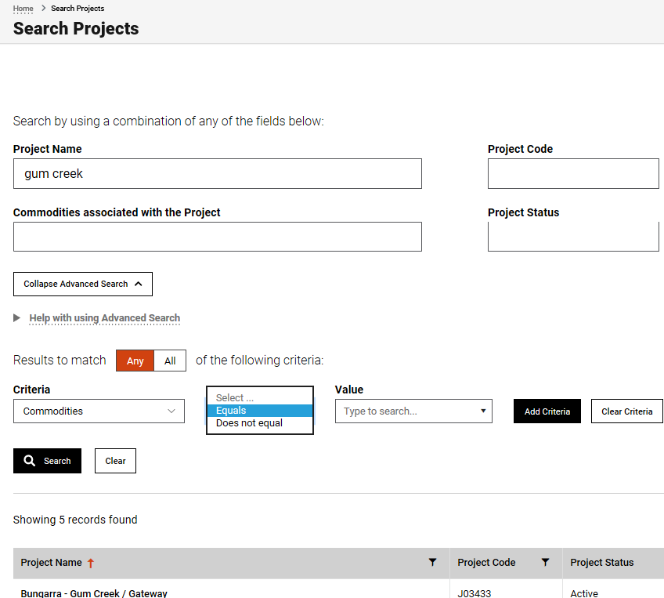
1
2
Once clicked, it looks like this
Drop down list for options to use
Drop down list for criteria
ADVANCED OPTIONS

Slide 24
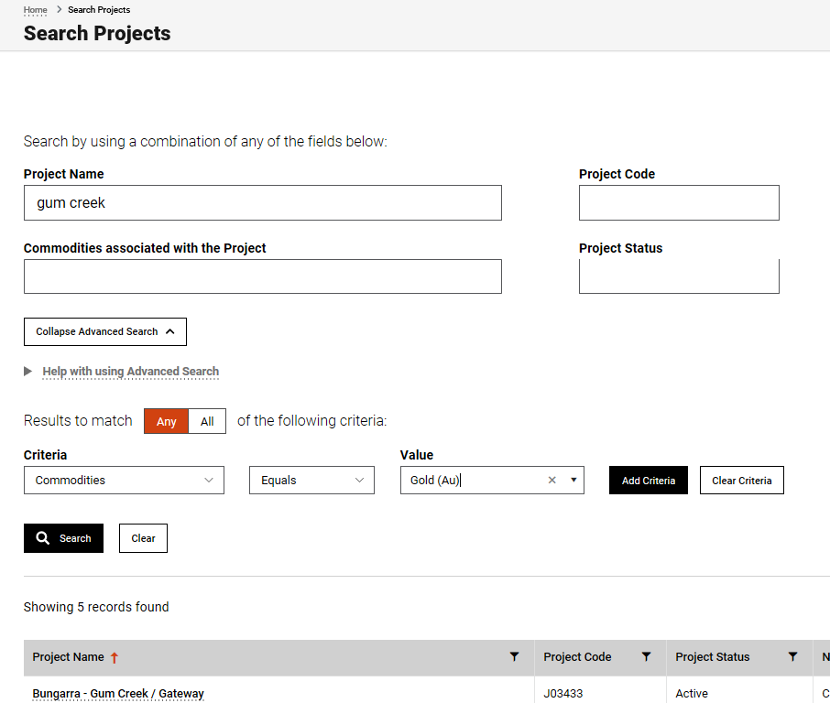
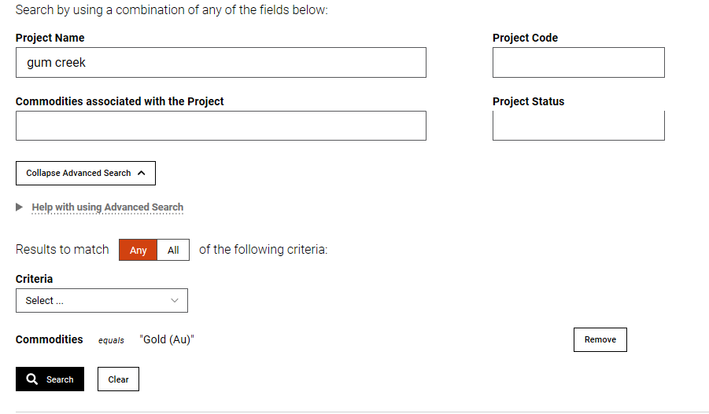
3
4
Click to use all the criteria you choose or any of them
Add the information required – with have a drop down list once the first 3 letters have been entered
Once done, then search. Can remove criteria and add others as you require
Must click on Add Criteria for it to work
ADVANCED OPTIONS

Slide 25
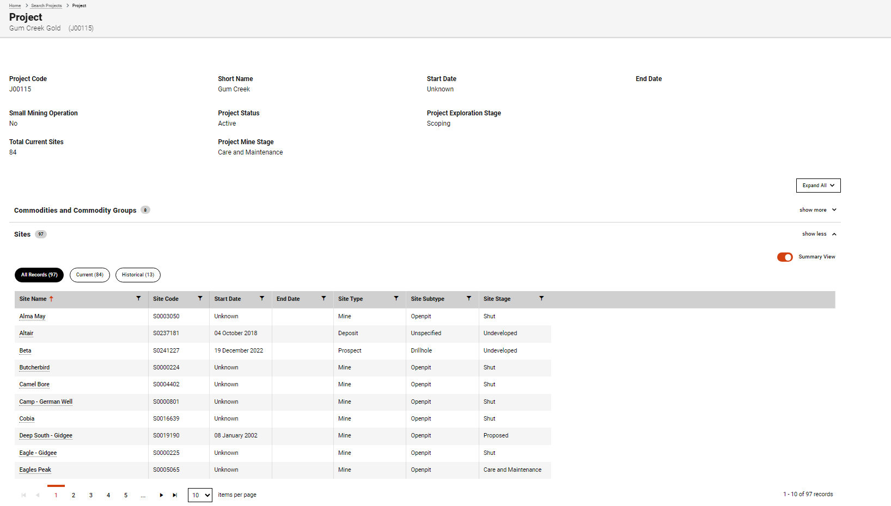
Any heading that is bold with a number after it can be expanded
Represents all sites present in the project. Can be clicked on to only represent current sites or historical sites (end dated from project)
Filter results
Click on to expand the view of the sites present in the project
ADVANCED SEARCHING
Move to pages with other sites on them

Slide 26
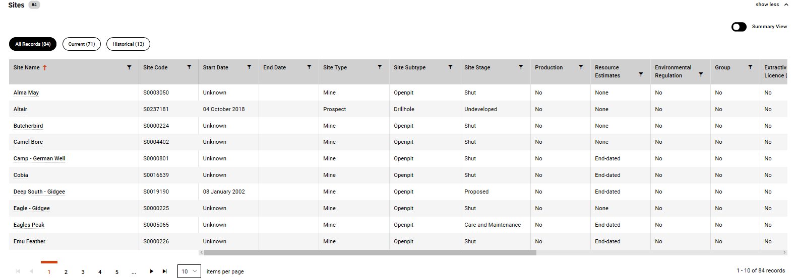
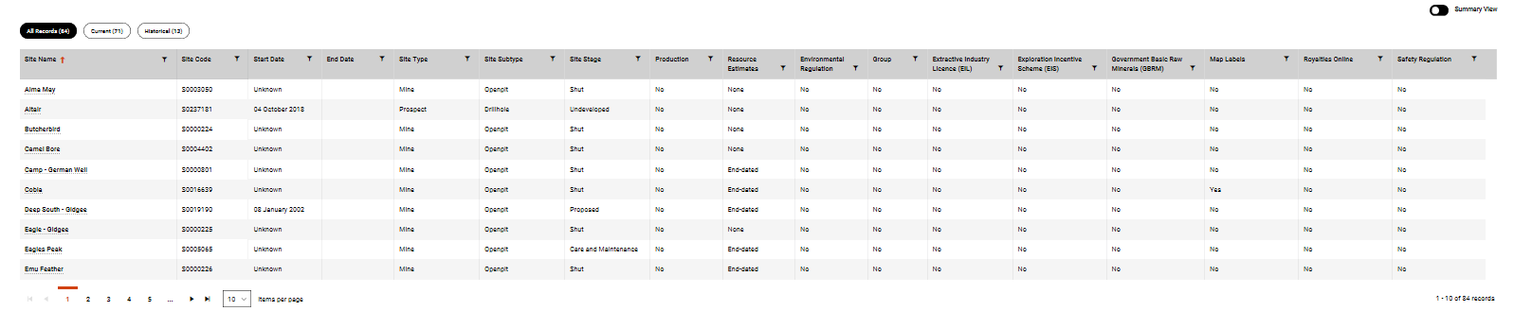
Turned black to indicate expanded view
Full list of what is available

Slide 27
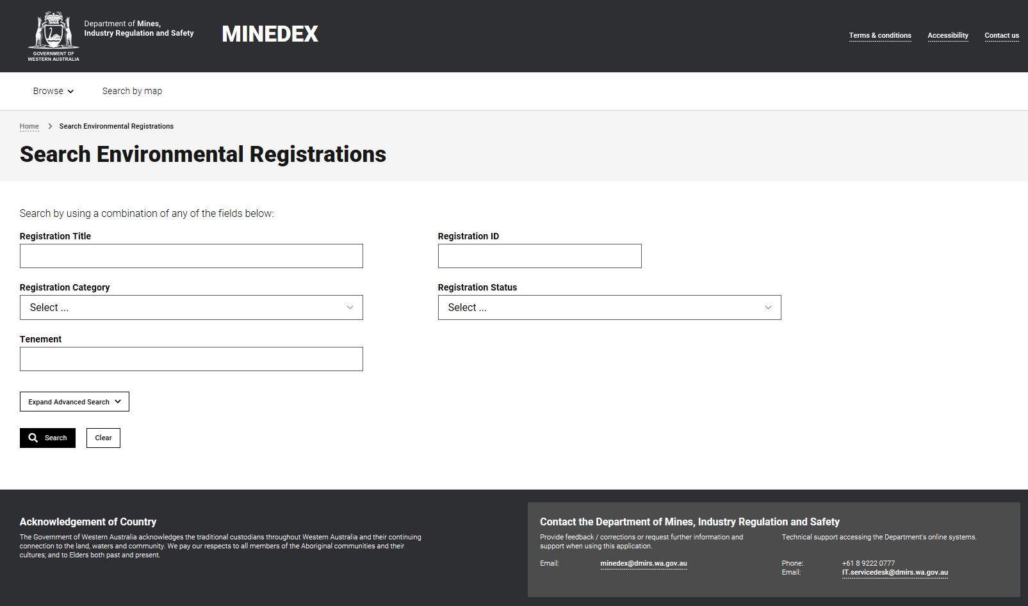
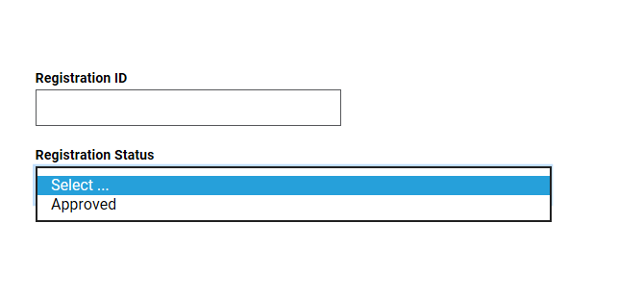
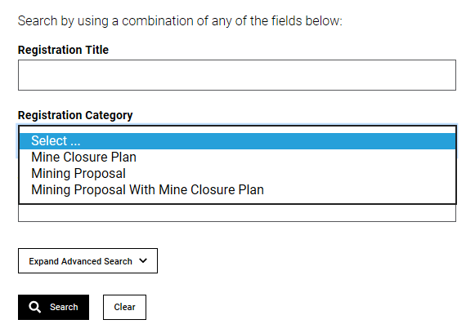
Environmental Registrations Screen

Slide 28
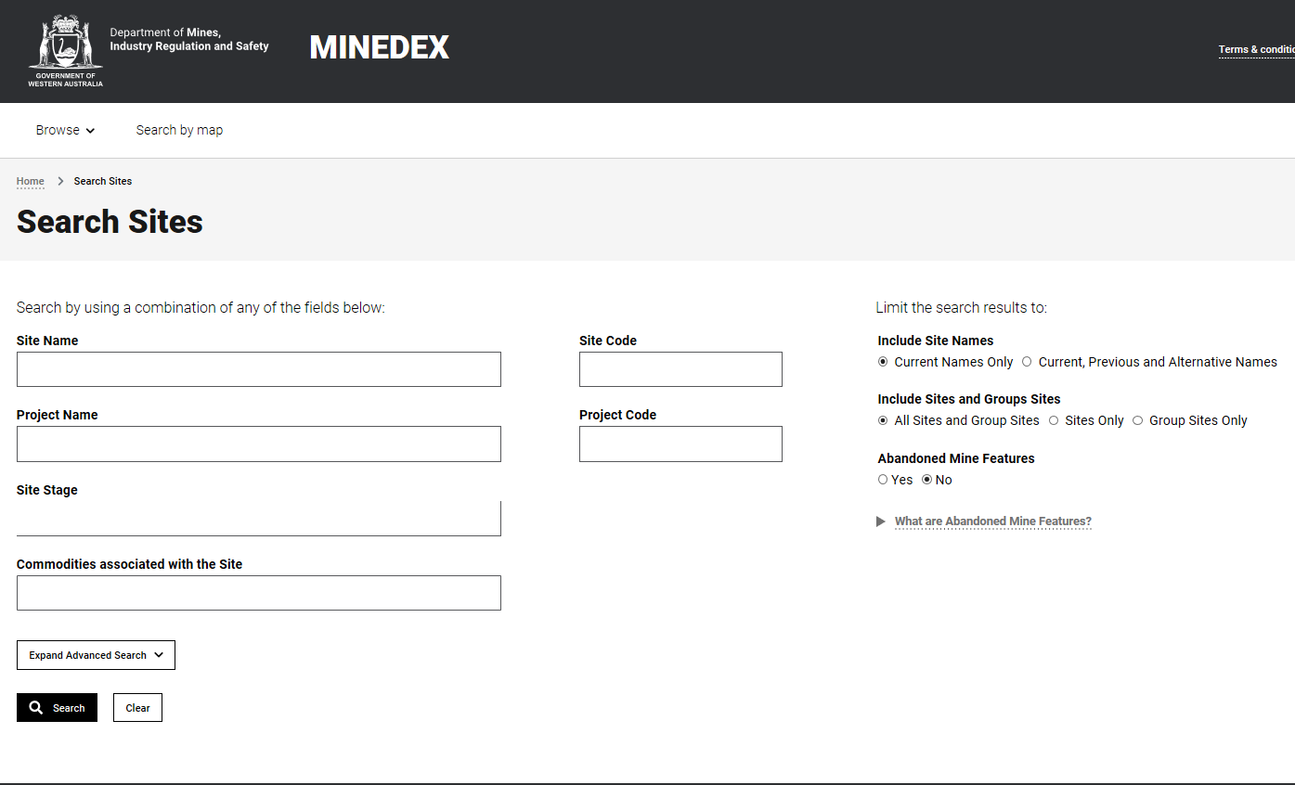
Sites Screen
Change search by also using various options

Slide 29
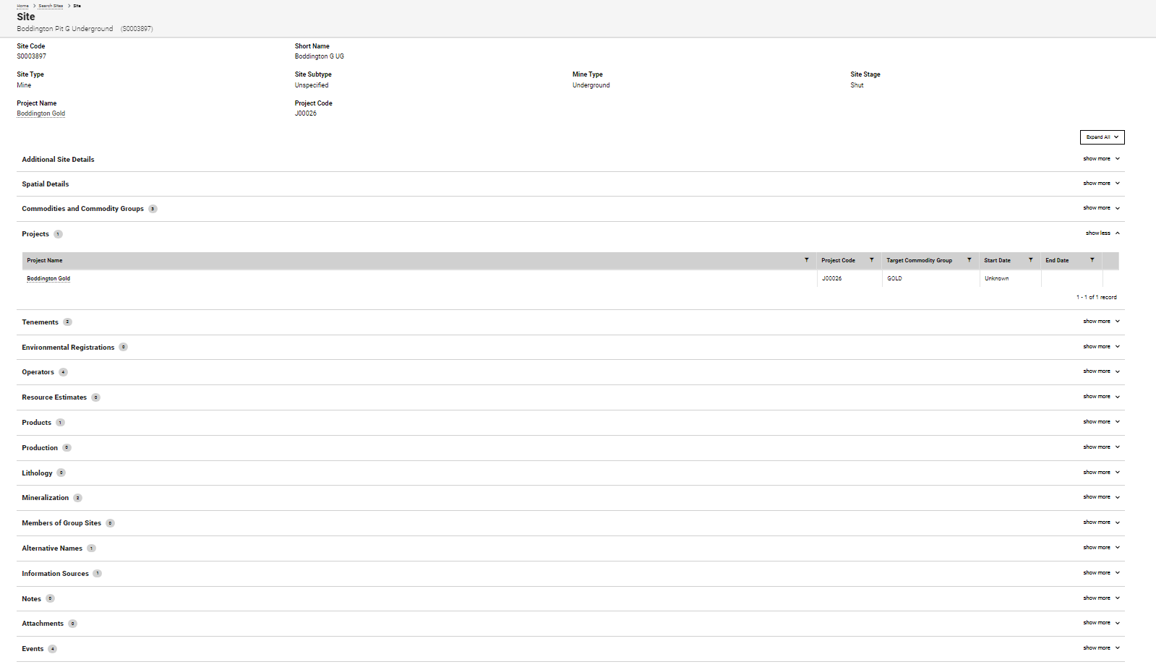
Sites Screen
All of these categories can be expanded to view information

Slide 30
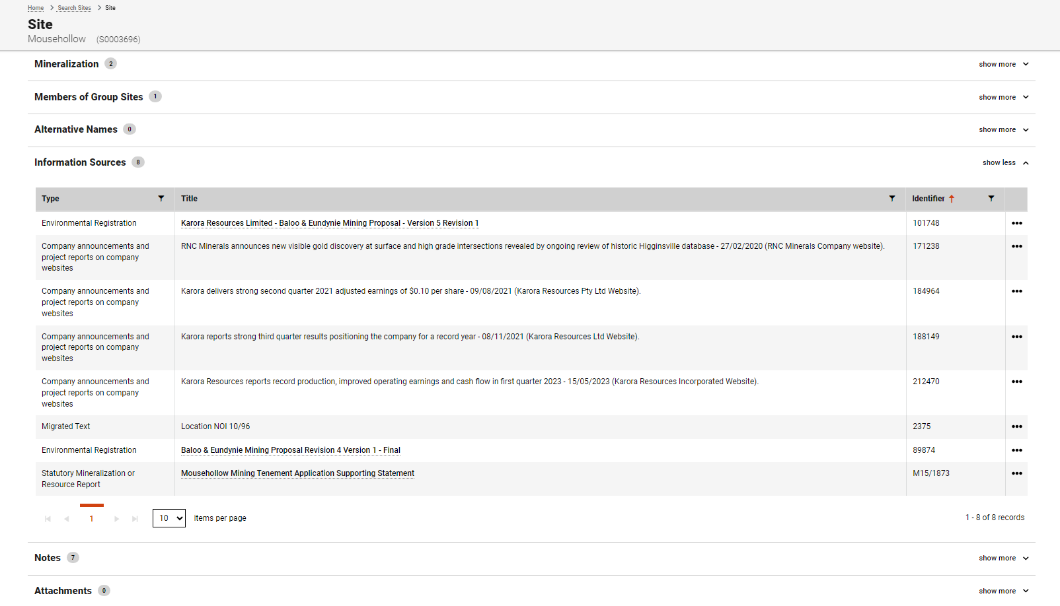
Sites Screen
Expanded
Mineralisation Report – can be clicked on and viewed in GeoDocs

Slide 31
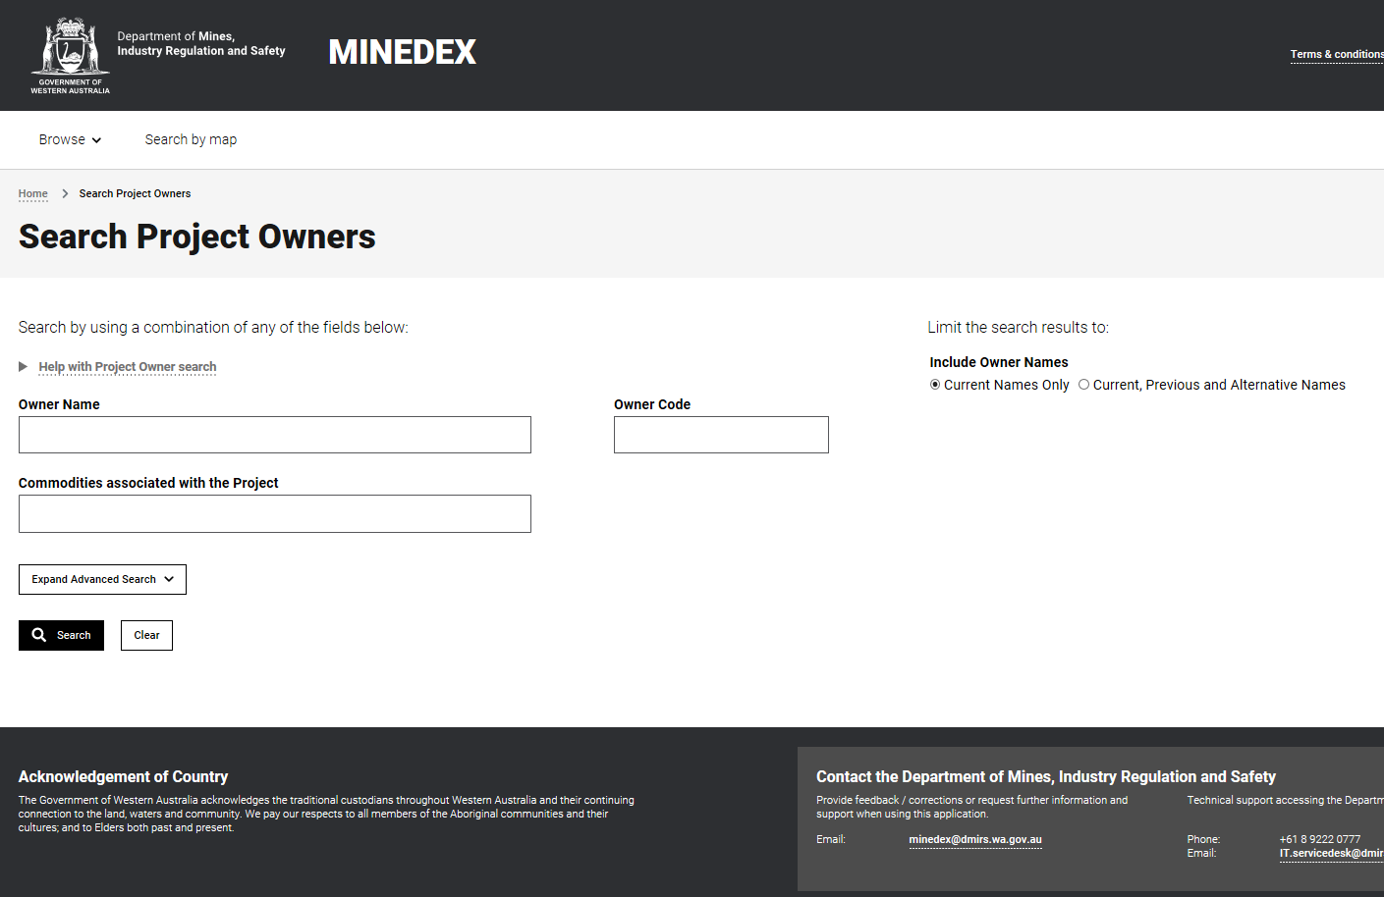
Project Owners Screen

Slide 32
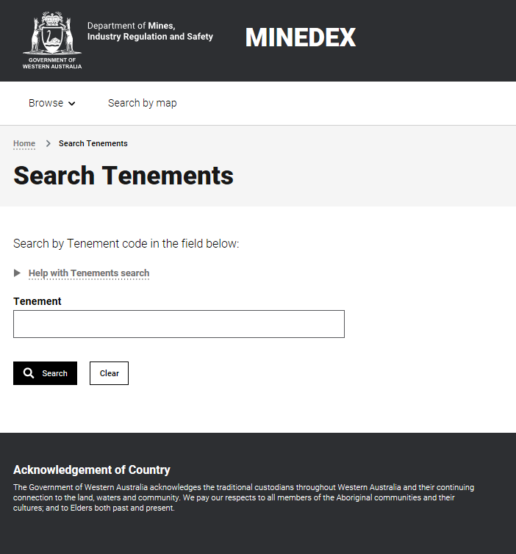
Tenement Screen
Notes:
Not all tenements occur in Minedex.

Slide 33
Geoview and MINEDEX – use double screens

Slide 34
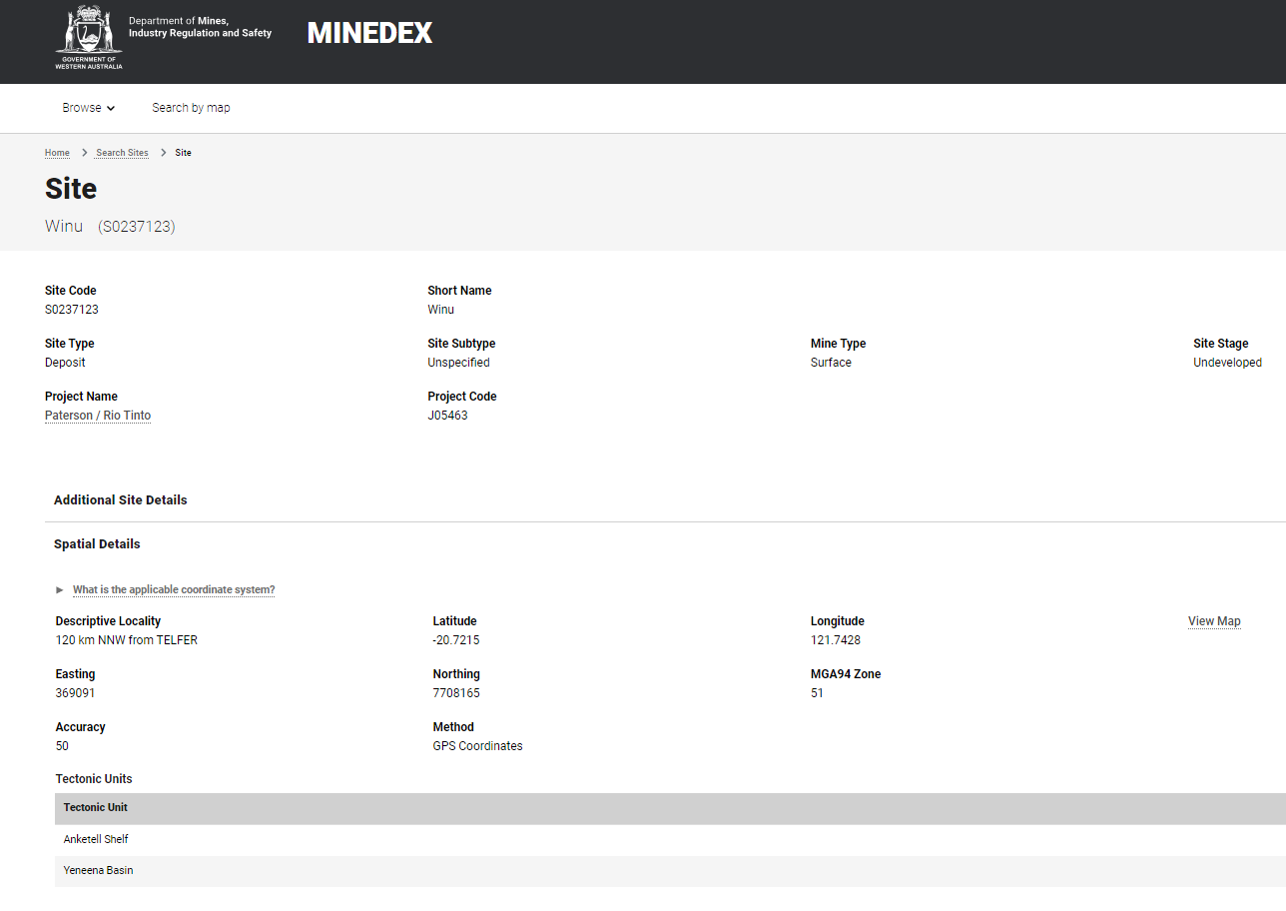
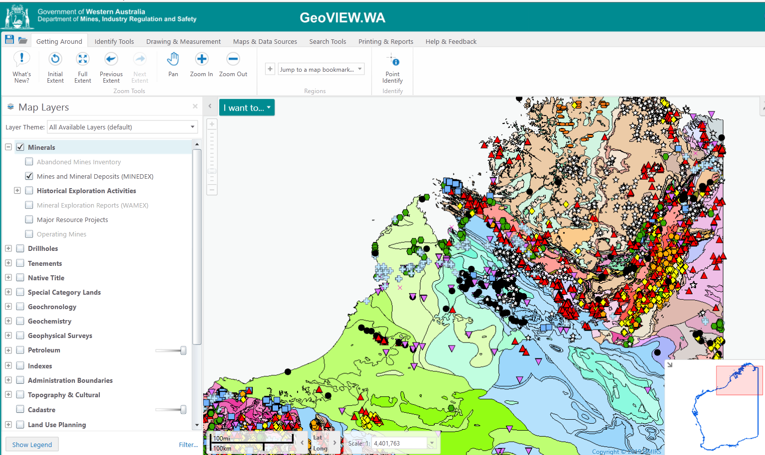
Link to Geoview from MINEDEX

Slide 35
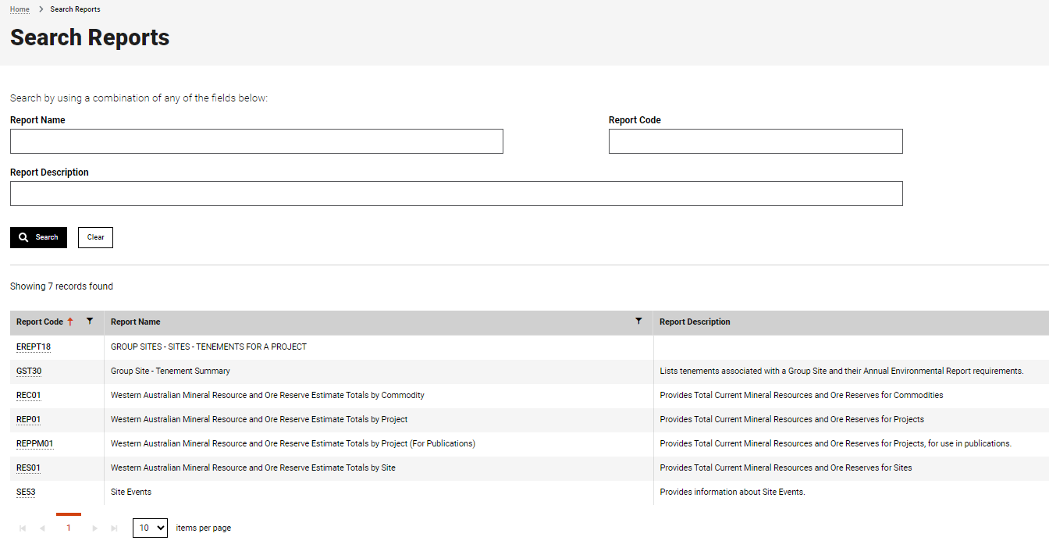
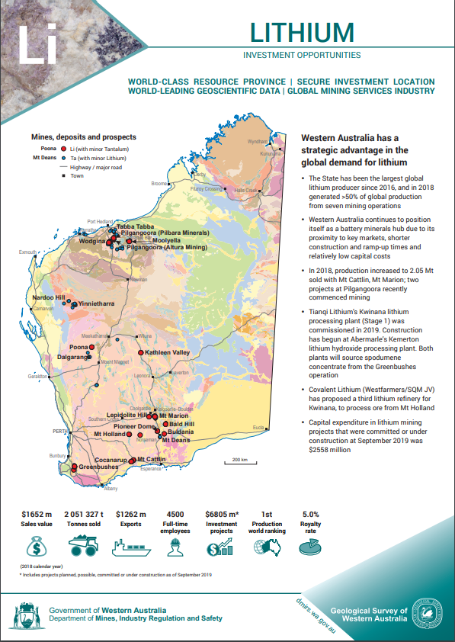
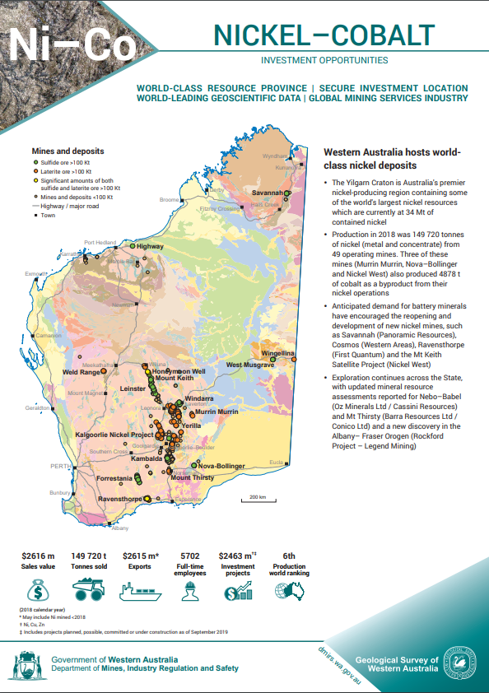
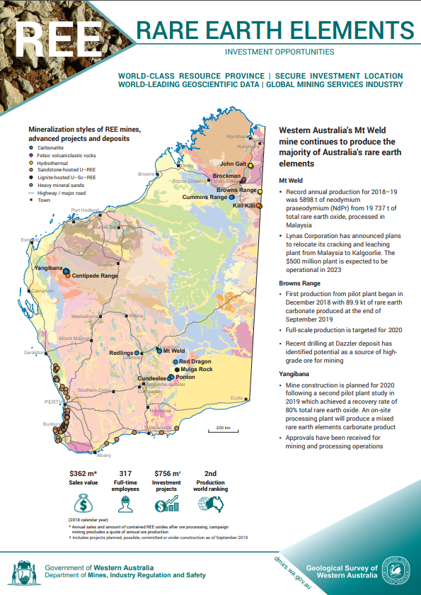
Getting data out – Reports
TIP –
If unsure of what report is called, place cursor in the box and press search – then a list of all available reports comes up below.
Commodity flyers - https://www.dmp.wa.gov.au/Investors/WA-commodity-flyers-16526.aspx

Slide 36
Resource Estimates - Additional functionality added in 2022 and 2023
Improved data extracts
Updated Table reports for common queries
Mineral resource estimates spatially located in Geoview
How?
Process mapping
Resource data audit
Notes:
So far on Resource Estimates by Project and Resource Estimates by Project for Gold have been added as spatial layers in GeoView. Later in 2023 additional Resource Layers will be added for Lithium, Nickel, Copper and Silver with additional layers planned for the 2024.

Slide 37
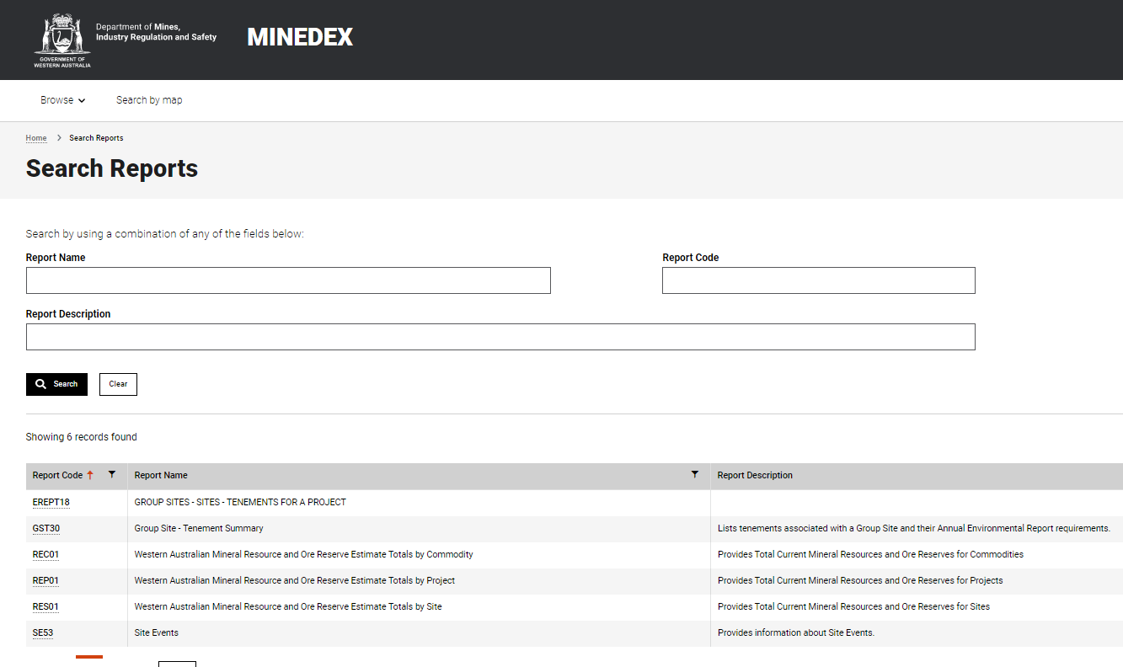
Resource Estimates - Additional functionality added in 2022 and 2023
Updated Reports for Mineral Resource and Ore Reserve Estimate data reports compliant with industry reporting standards:
by Commodity (REC01),
by Project (REP01), and
by Site (RES01)

Slide 38
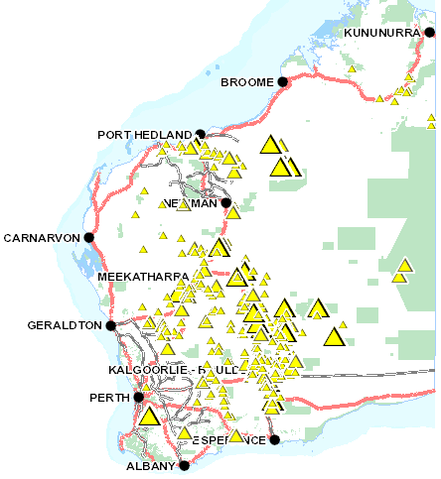
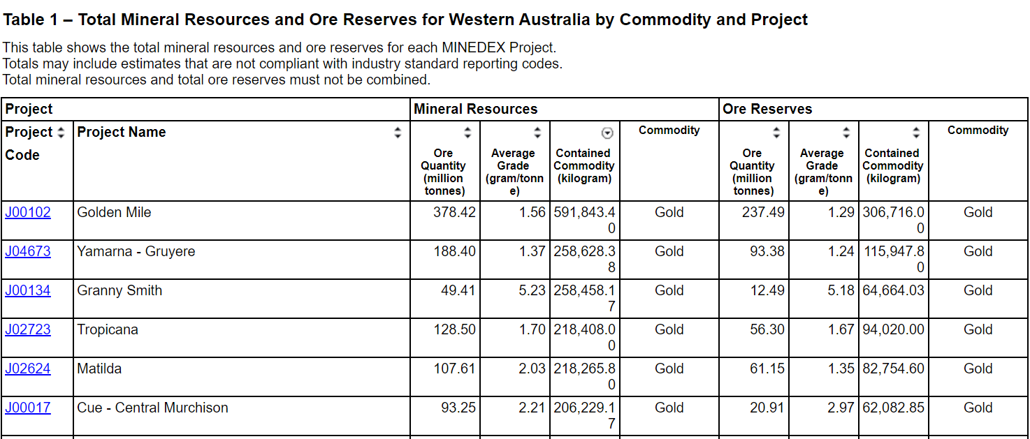
Resource Estimates - Additional functionality added in 2022 and 2023
NEW DATA LAYERS:
translating resource estimates data into easy to view and automated GIS layers
Gold resource estimates layer is now available through GeoVIEW.WA
More commodity resource estimates GIS layers to follow
Notes:
So far only Resource Estimates by Project and Resource Estimates by Project for Gold have been added as spatial layers in GeoView. Later in 2023 additional Resource Layers will be added for Lithium, Nickel, Copper and Silver with additional layers planned for the 2024.

Slide 39
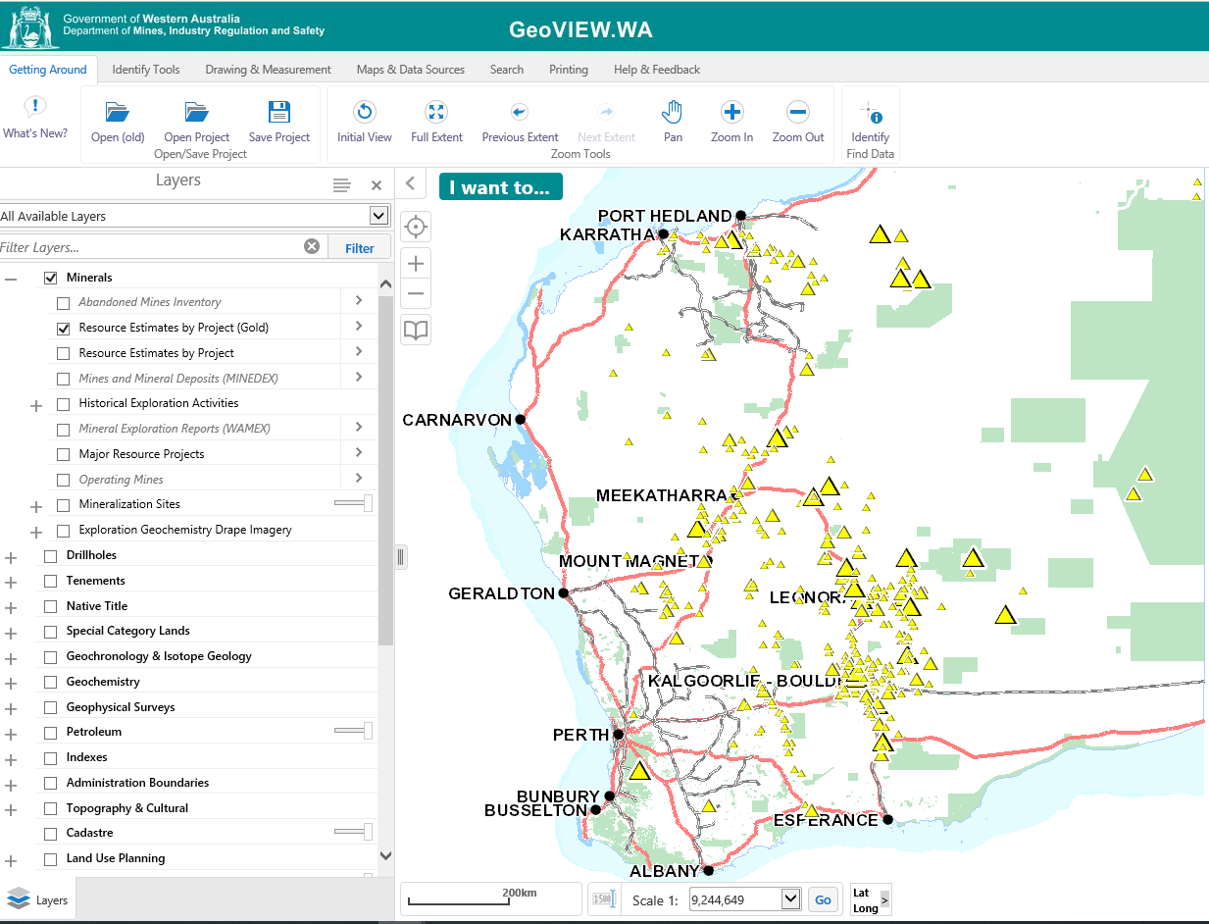
Resource Estimates - Additional functionality added in 2022 and 2023
NEW DATA LAYERS:
translating resource estimates data into easy to view and automated GIS layers
Gold resource estimates layer is now available through GeoVIEW.WA
The layers can be selected from the Minerals dropdown menu in GeoVIEW.WA
More commodity resource estimates GIS layers to follow IN 2023
Notes:
So far only Resource Estimates by Project and Resource Estimates by Project for Gold have been added as spatial layers in GeoView. Later in 2023 additional Resource Layers will be added for Lithium, Nickel, Copper and Silver with additional layers planned for the 2024.

Slide 40
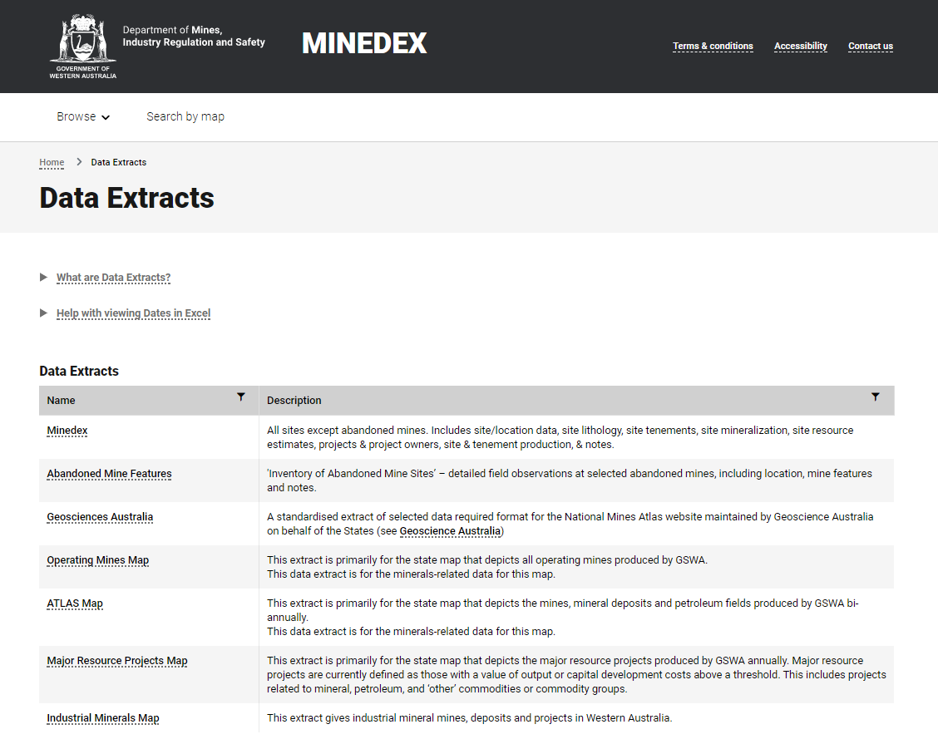
Getting data out – Data extracts

Slide 41
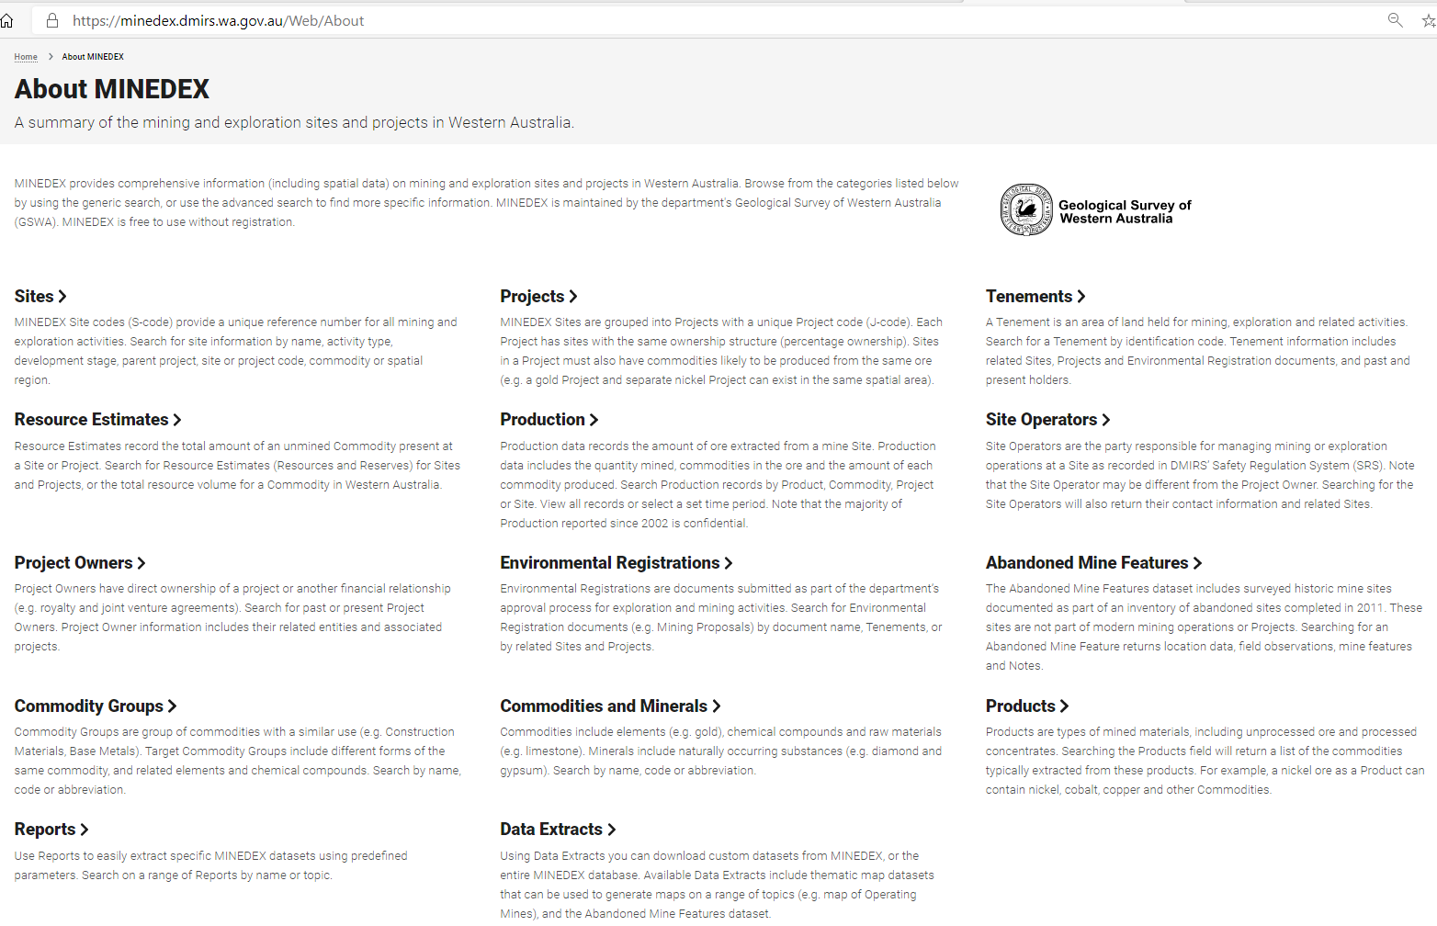
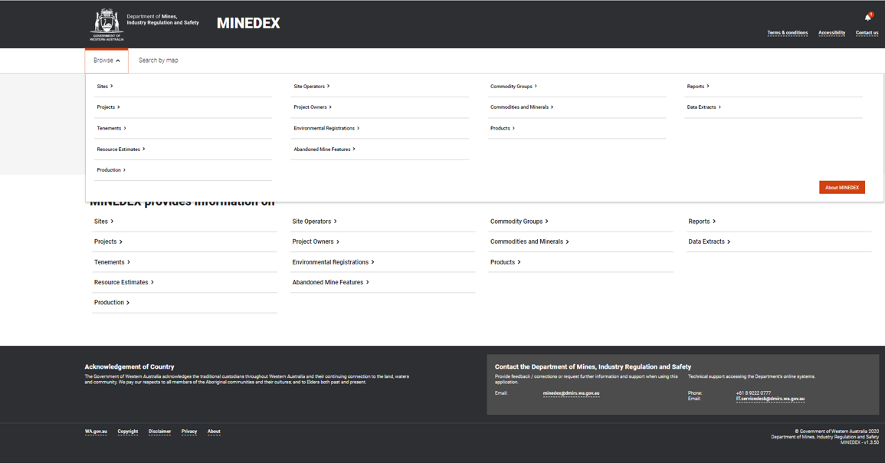
Need more explanation?

Slide 42
Or contact us
Contact the MINEDEX Database Team at minedex@dmirs.wa.gov.au
www.minedex.dmirs.wa.gov.au

Slide 43
Questions?

