Slide 1
The next generation of outcrop: MinEx CRC and the National Drilling Initiative in Western Australia
Richard Chopping

Slide 2
The next generation of outcrop: MinEx CRC and the National Drilling Initiative in Western Australia
Note: this presentation is modified from that given at GSWA Open Day 2020 with notes provided on every second slide to provide the reader some context of the images presented.

Slide 3
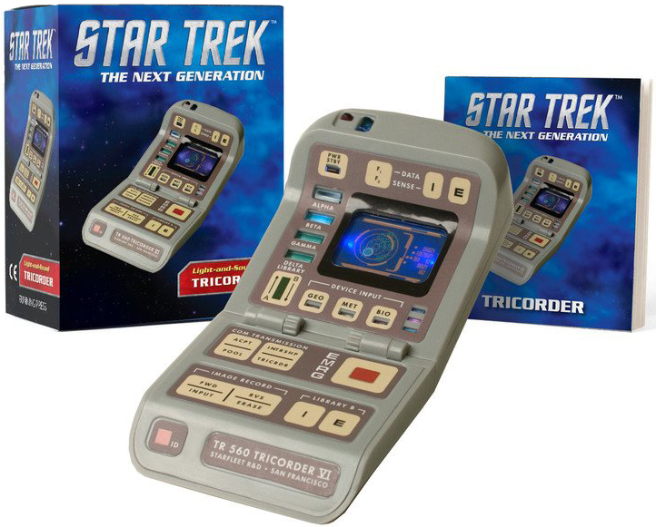
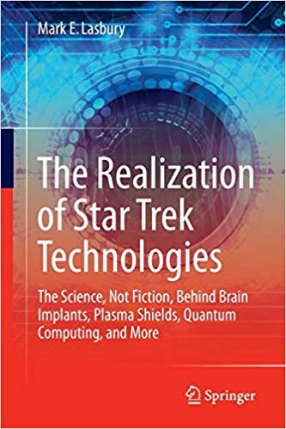
The next generation of outcrop

Slide 4
The next generation of outcrop
Star Trek tricorder ‘provides a comprehensive picture of the local environment, from the physical layout to the materials found there. Of all the functions, detailed mapping of the area is probably the most important because it gives a framework on which to hang much of the other data’ (The Realization of Technologies from Star Trek)
GSWA involvement in the MinEx CRC is aimed to build this framework of geology beneath the covered regions of Western Australia

Slide 5
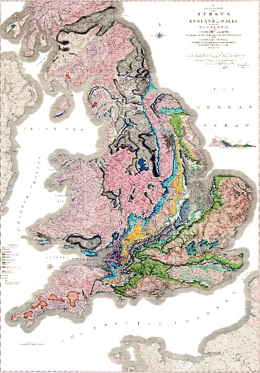
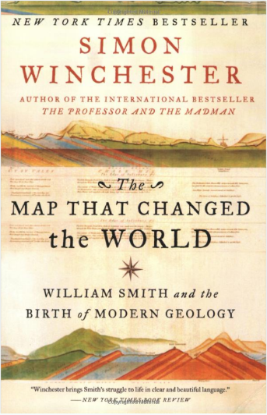
How do we map?
A delineation of the strata of England and Wales with part of Scotland: The collieries and mines, the marshes and fen lands originally overflowed by the sea, and the varieties of soils according to the variations of the substrata. Illustrated by the most descriptive names

Slide 6
How do we map?
Smith’s map: not just geology, also resources/physiography/regolith
Maps are predictions that place ‘mappable’ geology in its spatial context

Slide 7
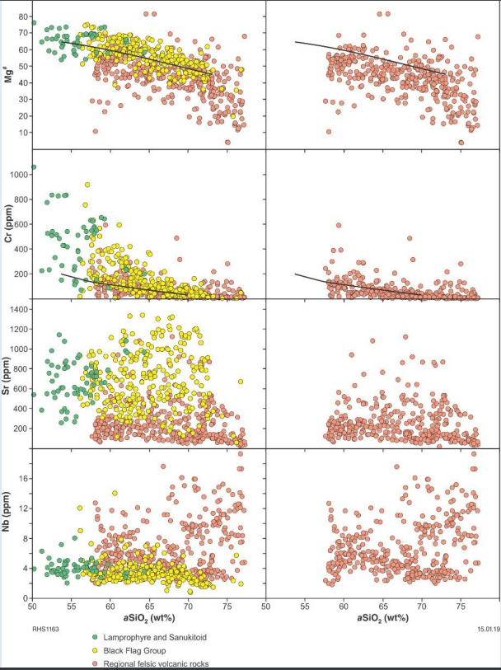
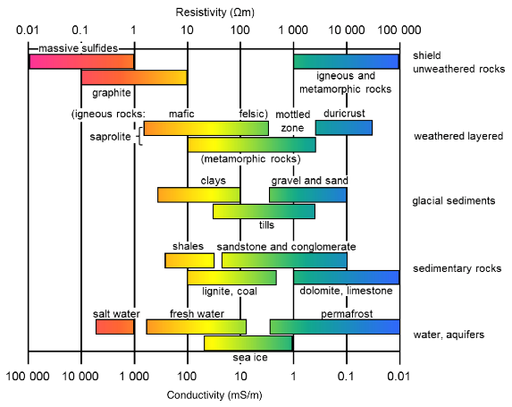
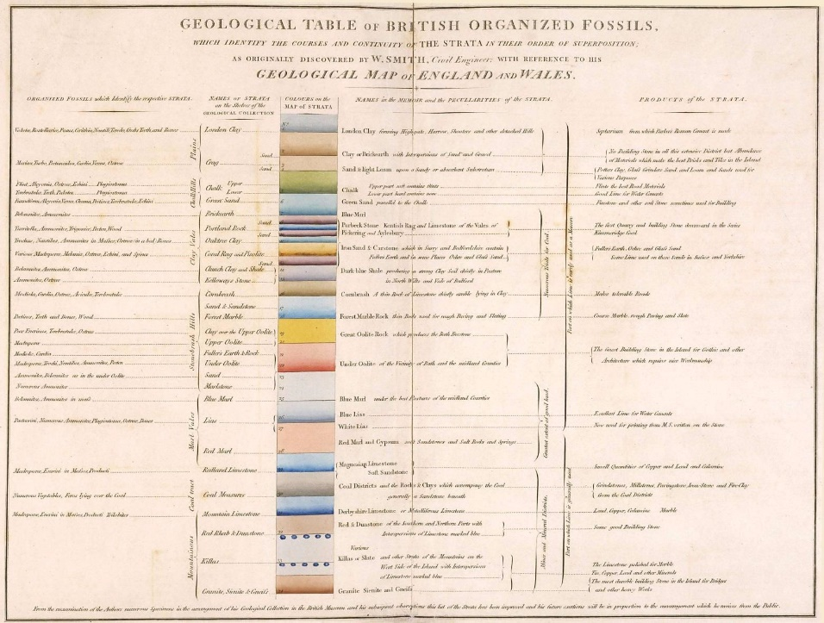
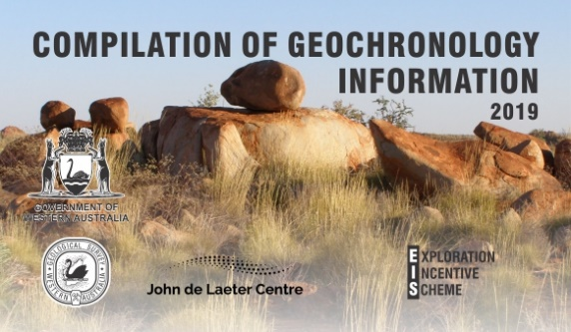
…Spatial correlations of geological materials

Slide 8
…Spatial correlations of geological materials
The definition of mappable unit (/strata) is the key
Smith’s map: spatial distribution of fossils and lithologies
We now map using properties for correlation such as
geochronology (replacing or adding to fossils)
geochemistry
…even physical properties such as conductivity shown on previous slide
Our next generation of maps need us to think of all of the criteria we use to define strata

Slide 9
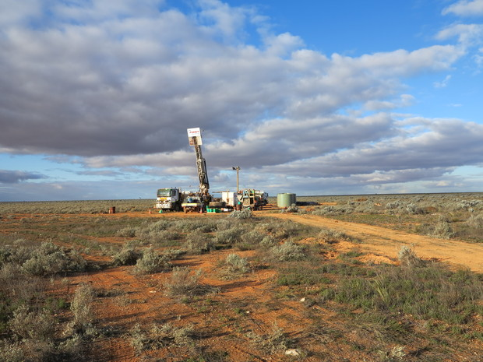
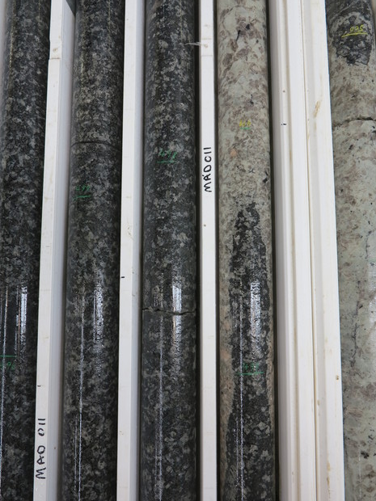
Mapping using drilling as outcrop

Slide 10
Mapping using drilling as outcrop
Nullarbor drilling program illustrates how one can use smart geology, aided by the maximum information extracted from drilling, and can stimulate interest in a region
How do we make such programs routine?

Slide 11
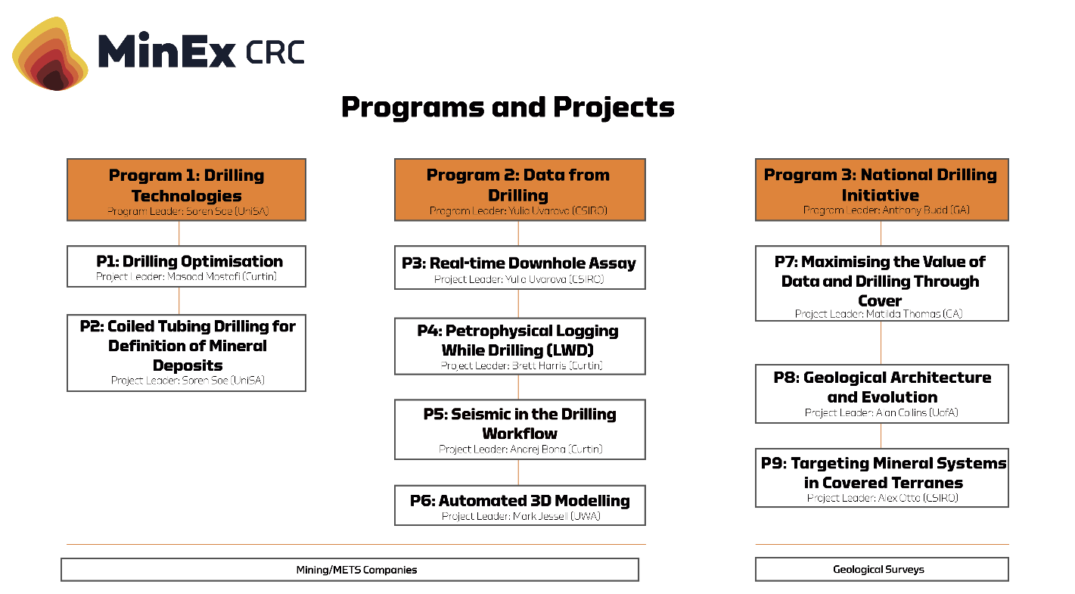
MinEx CRC structure

Slide 12
MinEx CRC structure
The MinEx CRC is the world’s largest combined geoscience research initiative. Research is conducted in three programs:
Program 1 drilling technologies
Program 2 data from drilling
Program 3 the National Drilling Initiative
These complementary programs bring together industry, research and government to tackle the challenge of successfully exploring undercover

Slide 13
Progress and CRC timeline
Q2 2028
Q3 2018
Q1 2019
Today
Phase 3
Phase 1
Q1 2025
Phase 2
Q1 2022
GSWA drilling tranche 1

Slide 14
Progress and CRC timeline
CRC has a 10-year lifespan, commenced in mid 2018
After an initial start-up phase, projects commenced at the beginning of 2019
These projects, however, represent only phase 1 of the CRC. Two more research phases are envisaged and the research conducted will adapt as required based on the results in earlier phases
Presently, GSWA is scheduled to undertake the first tranche of drilling in 2022

Slide 15
GSWA involvement in MinEx CRC

Slide 16
GSWA involvement in MinEx CRC
GSWA is a sponsor of project 6, developing automated 3D modelling methods with the Centre for Exploration Targeting at The University of Western Australia
GSWA also invests in Program 3, the National Drilling Initiative
Program 3 is the public program of the CRC, with industry participants involved in projects in Programs 1 and 2 only
Of note, MRIWA also supports projects in Programs 1 and 2, primarily developing tools for advanced drilling and sensing technologies

Slide 17
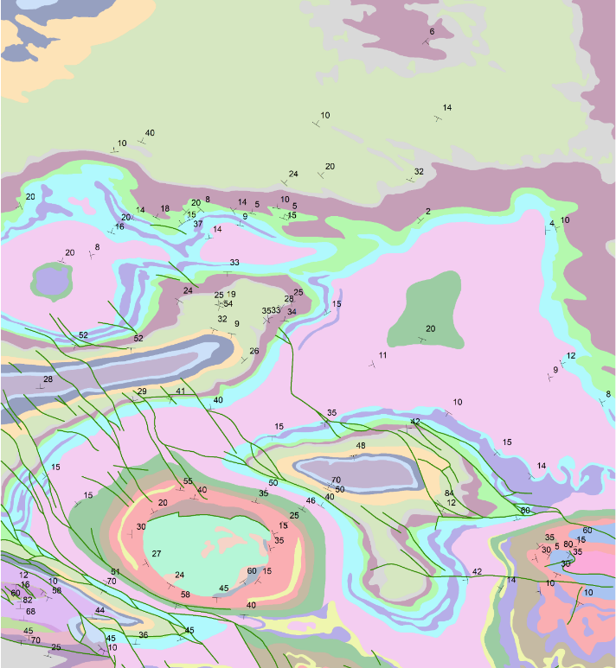
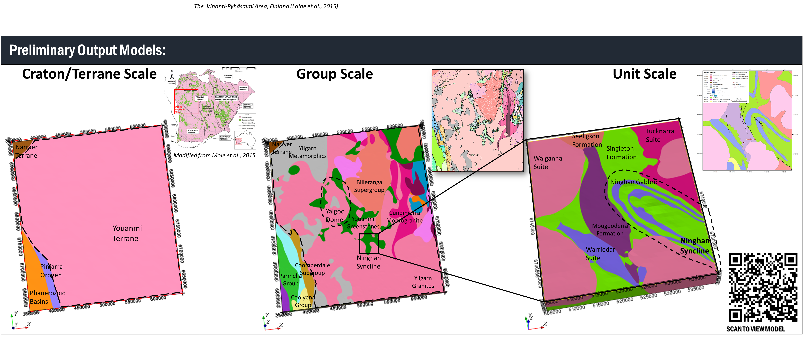
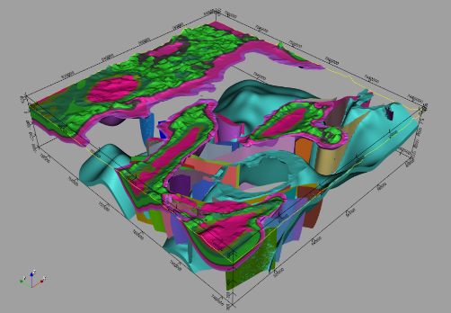
Project 6 automated 3D modelling

Slide 18
Project 6 automated 3D modelling
GSWA supports Project 6 as it is developing technologies to assist in the challenge of mapping geology in 3D
(See update from Mark Jessell for related developments for this project)

Slide 19
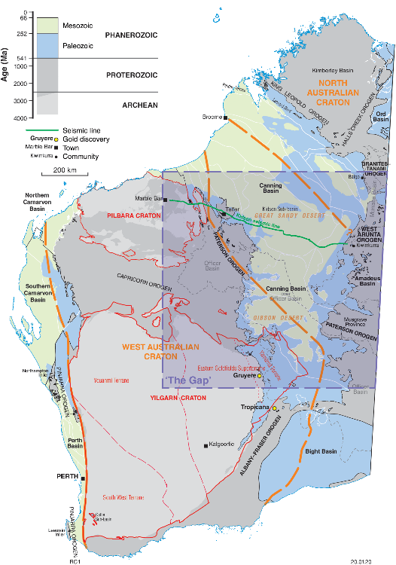
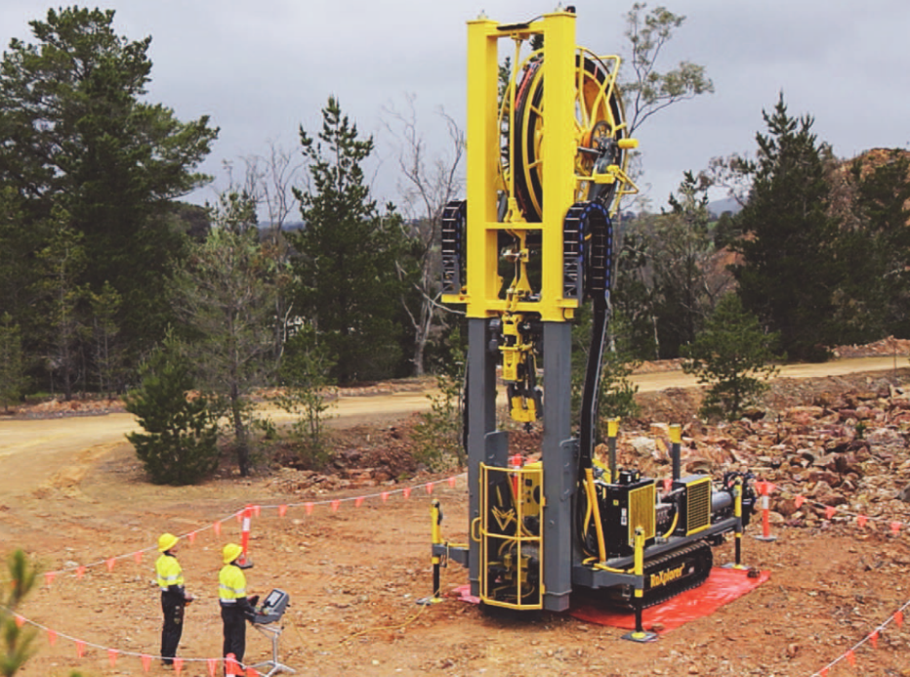
Program 3 the National Drilling Initiative

Slide 20
Program 3 the National Drilling Initiative
The National Drilling Initiative (NDI) aims to drill multiple holes in regions to map the regional geology and architecture and define the potential for mineral systems in 3D
The NDI will take advantage of new low-cost Coiled Tubing (CT) drilling technology and associated sensing, in order to maximize the number of drillholes and the volume of data collected
The Western Australia area of interest is the remote desert country of central eastern Western Australia. This area is Australia’s crossroads geologically and is where the three major cratons of the West Australian, South Australian and North Australian Cratons meet
Although some areas are obscured by deep basin cover, many areas are relatively shallow basement and remain underexplored. The NDI will provide us the tools to map these areas under cover

Slide 21
GSWA in the NDI

Slide 22
GSWA in the NDI
Initial area of interest for the NDI is the northern area proximal to the Kidson seismic line

Slide 23
GSWA in the NDI
Rudall/Paterson
WEST
EAST
0
West Arunta
60 km
WEST AUSTRALIAN CRATON
UNKNOWN TECTONIC AFFINITY
NORTH AUSTRALIAN CRATON
Gradual deepening of Canning Basin
Kidson sub-basin
Pilbara
Rudall/Paterson
Two layer crust (what affinity?) beneath Canning
Multiple faults slightly offset Moho
Thickest crust beneath Paterson
Moho
Apparent dip Central Australian Suture

Slide 24
GSWA in the NDI
The Kidson seismic line produced a significantly new picture on the architecture of this region
Crucially, it gives us a first-pass picture of the connections between the North Australian and West Australian Cratons

Slide 25
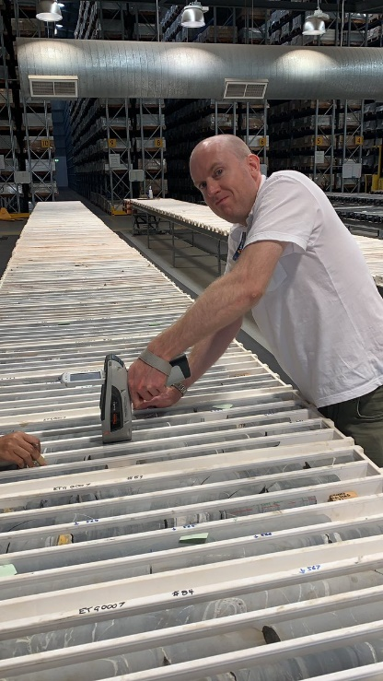
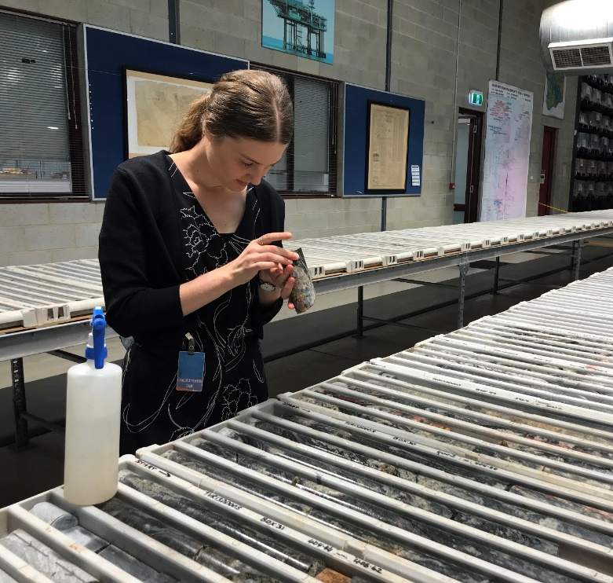
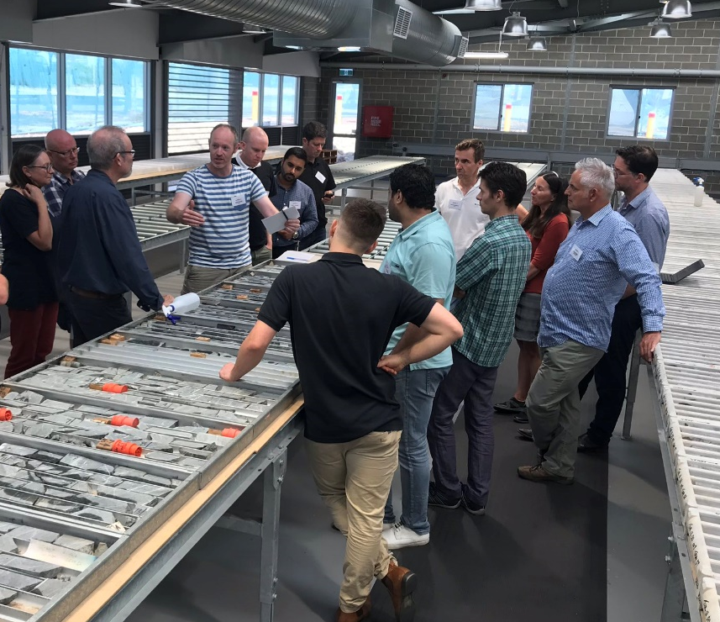
Current focus: Paterson and West Arunta
Paterson sampling
West Arunta sampling
Automating structural analysis in drillcore workshop

Slide 26
Current focus: Paterson and West Arunta
The initial NDI work will focus on the basement regions at either end of the Kidson seismic line; the Paterson region and the western Arunta
We are currently sampling Paterson stratigraphy in conjunction with researchers in the MRIWA M521 project to understand new ways to use Curtin University research on stratigraphic correlations
In the middle is our UniSA embedded researcher Dr Emily Finch, examining some of the only core available from the West Arunta. These cores were obtained through Exploration Incentive Scheme (EIS) co-funded drilling and provide an important insight into the geology under cover
The image on the right is the other part of our work: guiding research, using EIS drillcore as exemplars. A workshop conducted in December at the Perth Core Library helped define what might be expected of the next generation of tools to map structures down drillcore using machine-learning techniques. Involvement in the CRC gives us exposure to world-leading researchers in this field, and gives these researchers exposure to the fascinating rocks of Western Australia

Slide 27
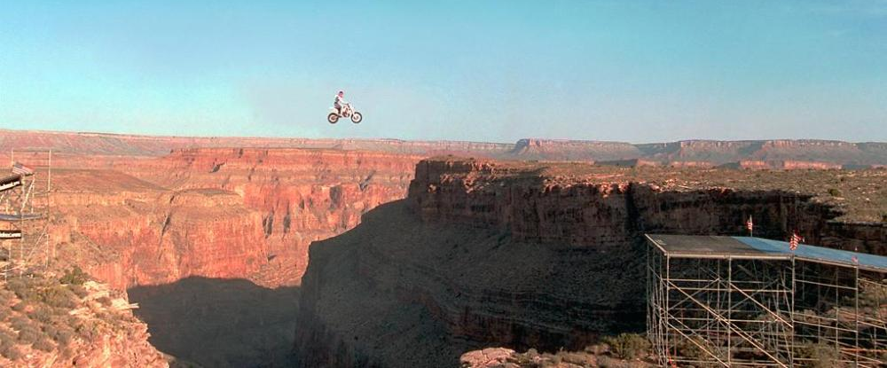
NDI and its role assisting exploration
Explorers
Deposit
Camp Scale Canyon
Ramps provided by the NDI
Regional

Slide 28
NDI and its role assisting exploration
Ultimately, the vision of the NDI is to assist explorers in taking the leap from the regional scale, across the cavern of the camp scale, and towards the deposit scale
We do this through enabling integrated science that helps put exploration drilling into its true geological context, but also through understanding the prospectivity implications of regional-scale geological mapping

Slide 29
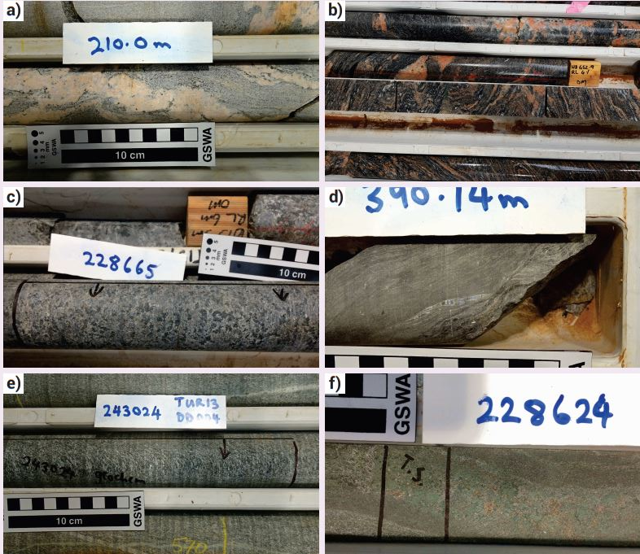
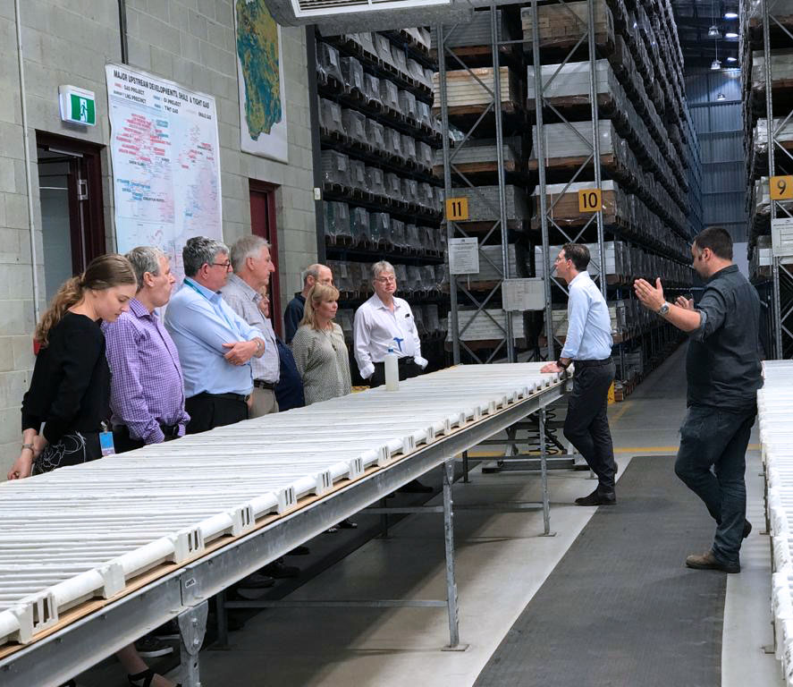
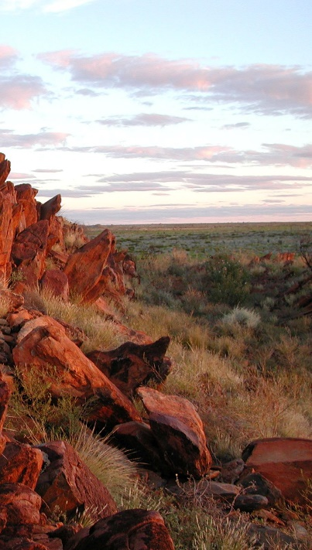
The coming years

Slide 30
The coming years
In some of the greenfields areas, we have ‘outcrop’ equivalent to a couple of kilometres. The NDI will deliver an order of magnitude more data allowing us to extract far more understanding of the subsurface
This will involve significantly more sampling, much automated, and tailored towards reconnaissance-scale techniques

Slide 31
The coming years
The NDI

Slide 32
The coming years
The NDI’s overall aim is exactly that of the introductory slide: it will provide the framework to place the understanding from the results we get from our subsurface sensing
We will be adding to these technologies with the ground mapping programs in key greenfields regions to place our NDI data in context

