Slide 1
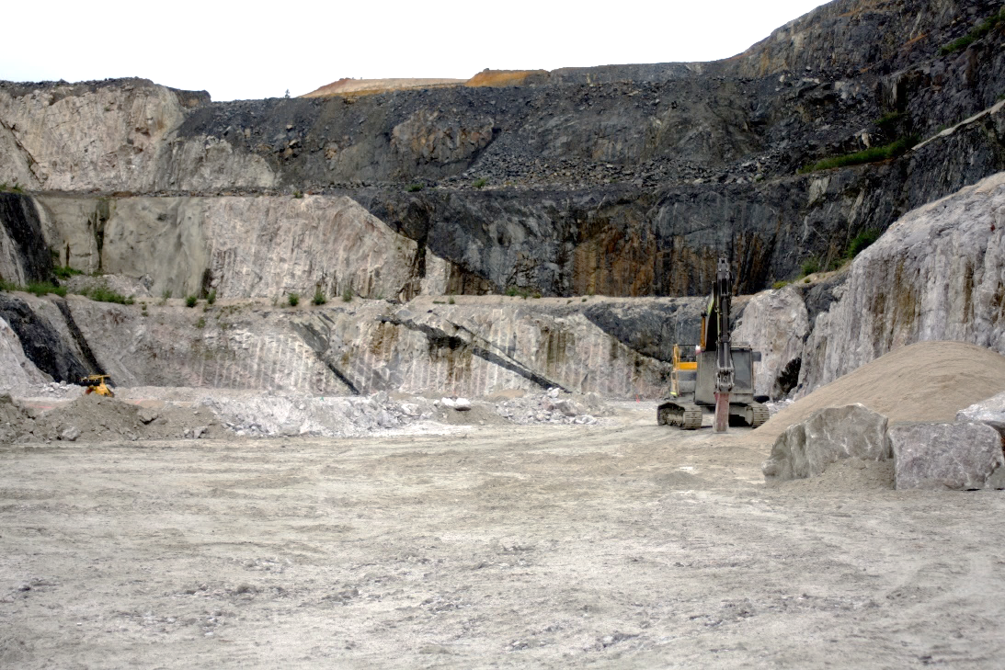

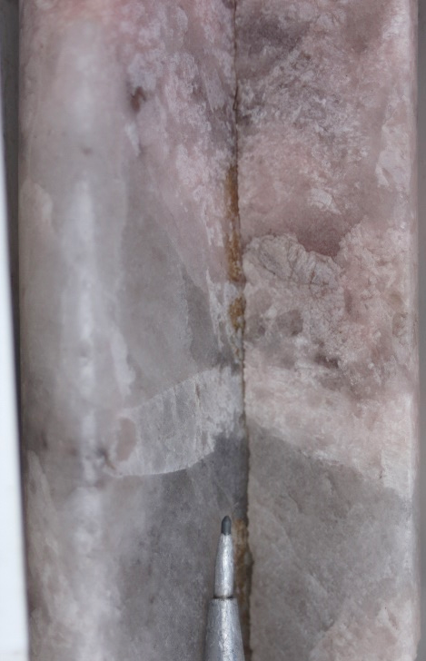
Rare-element pegmatites in the Mineral Systems Atlas
Paul Duuring, Trevor Beardsmore, Lauren Burley, Joshua Guilliamse, Sidy Morin-Ka

Slide 2
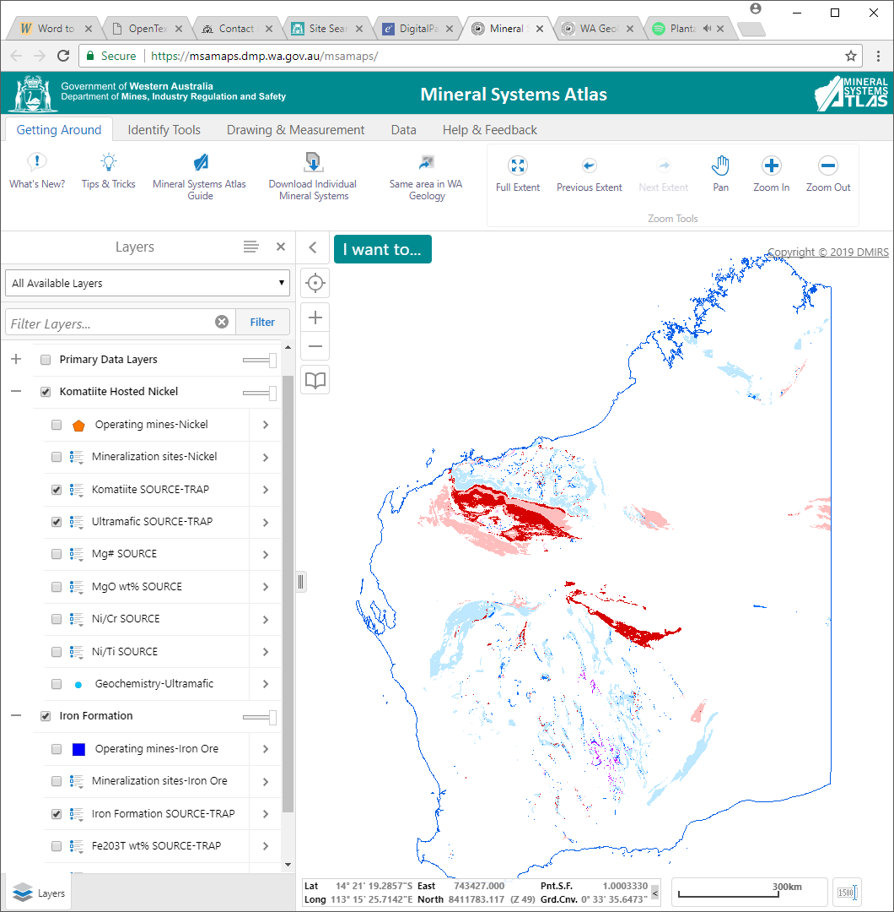
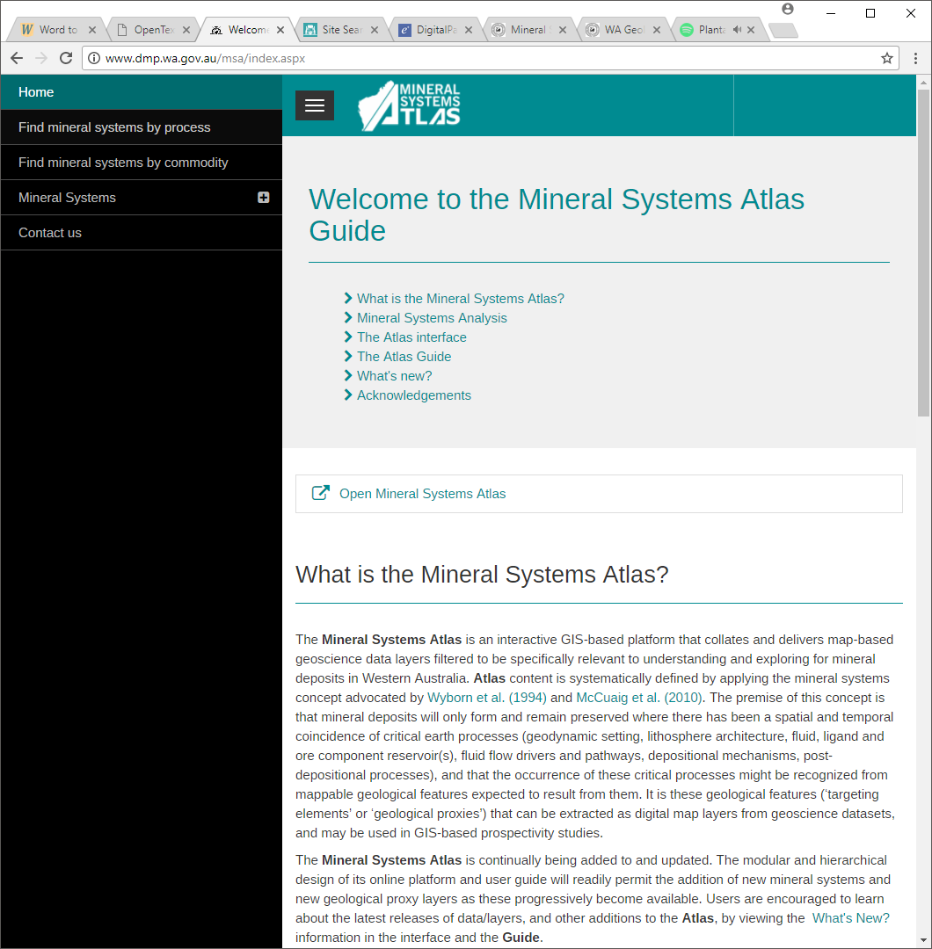
The Mineral Systems Atlas
Online interactive GIS platform
data layers relevant to mineral deposits
Mineral Systems Atlas Guide
Record of all the information related to MSA

Slide 3
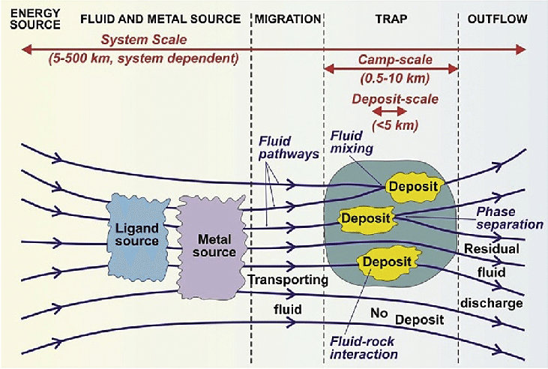
Mineral Systems approach
– all geological factors that control the generation and preservation of a mineral deposit
(after Wyborn et al., 1994; McCuaig et al., 2010)
Critical ingredients
SOURCE
PATHWAY
TRAP
PRESERVATION
Mineral Systems flow diagram (Knox-Robinson and Wyborn, 1997)

Slide 4
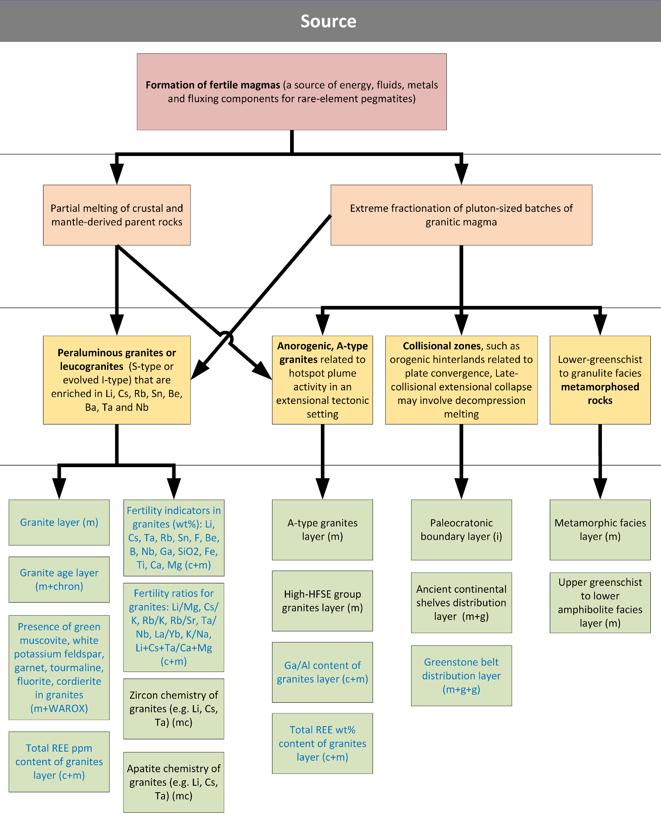
Knowledge driven
Formation of fertile granites
Critical Process
Partial melting of parent rocks
Constituent Process
Peraluminous granites or leucogranites
Targeting
Fertility indicators in granites
(e.g. geochemical tracers)
Mappable Proxies
Mineral System Tree

Slide 5
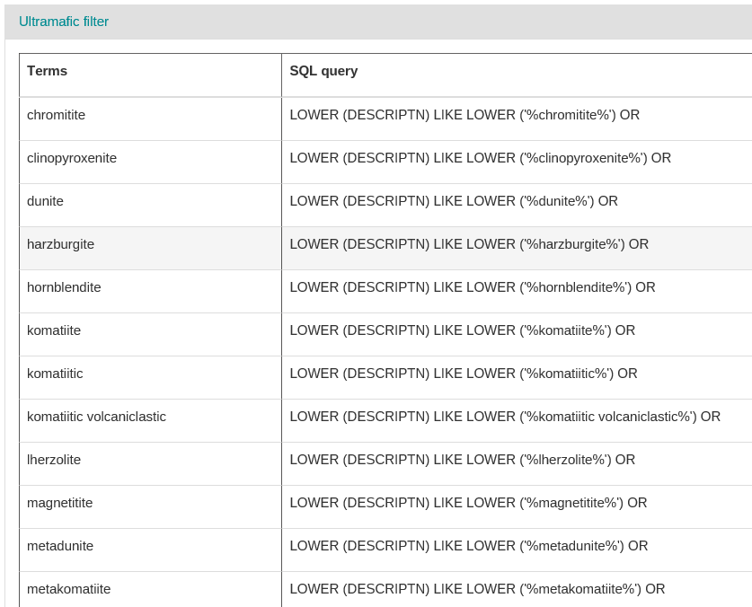
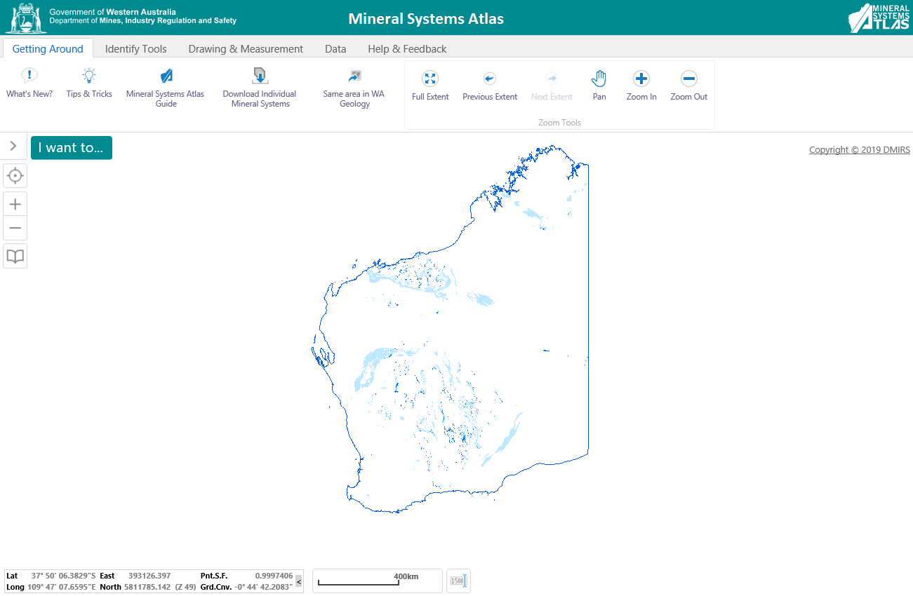
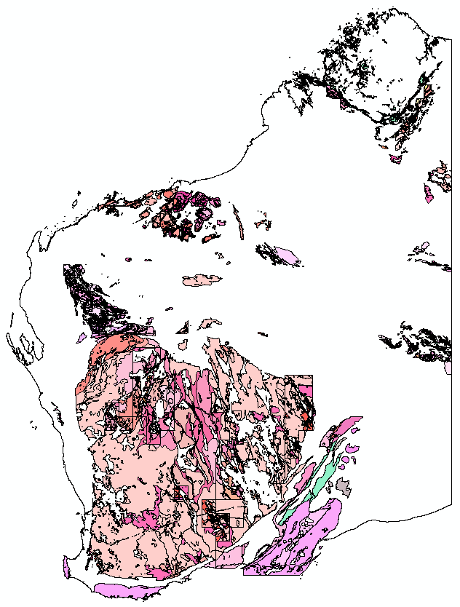
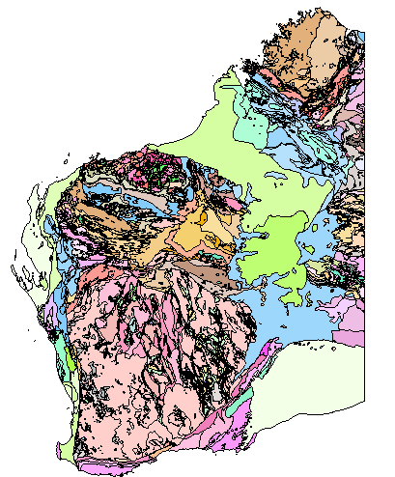
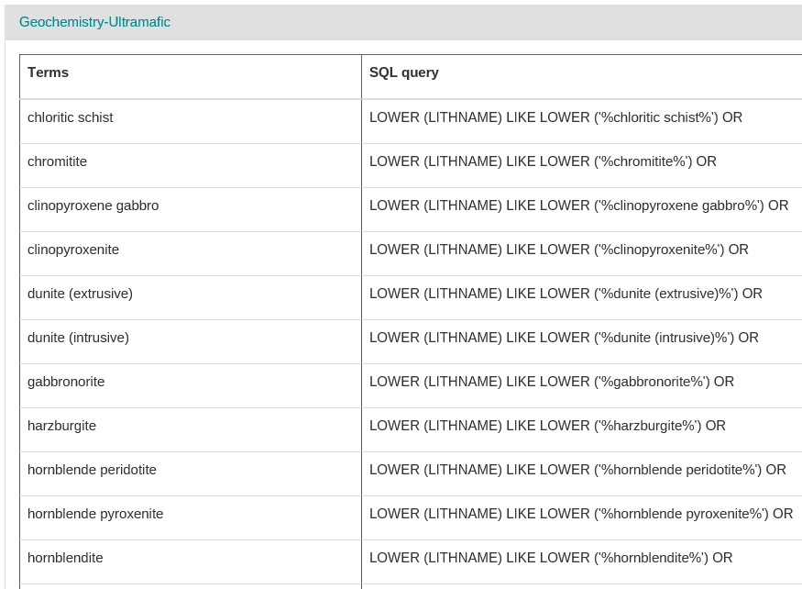
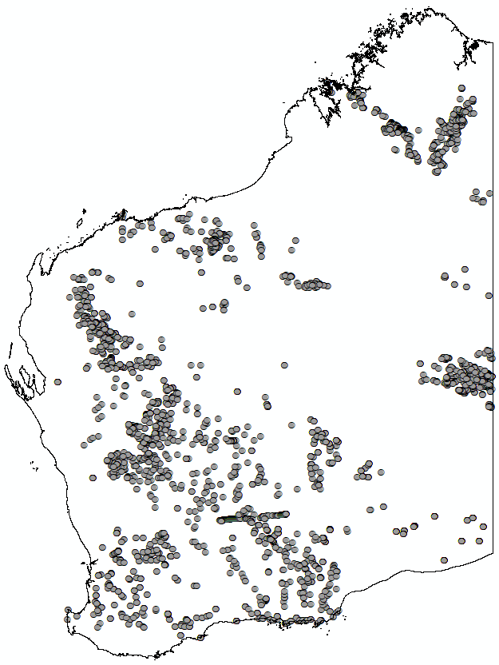
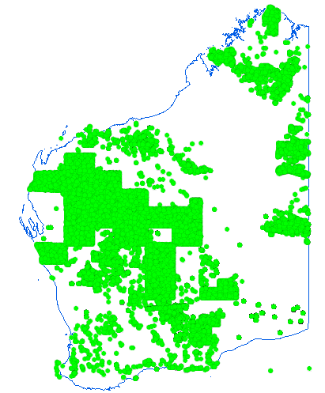
Filtering GSWA datasets
Granitic rocks
Geology
FILTER
Granitic rocks
Geochemistry
FILTER

Slide 6
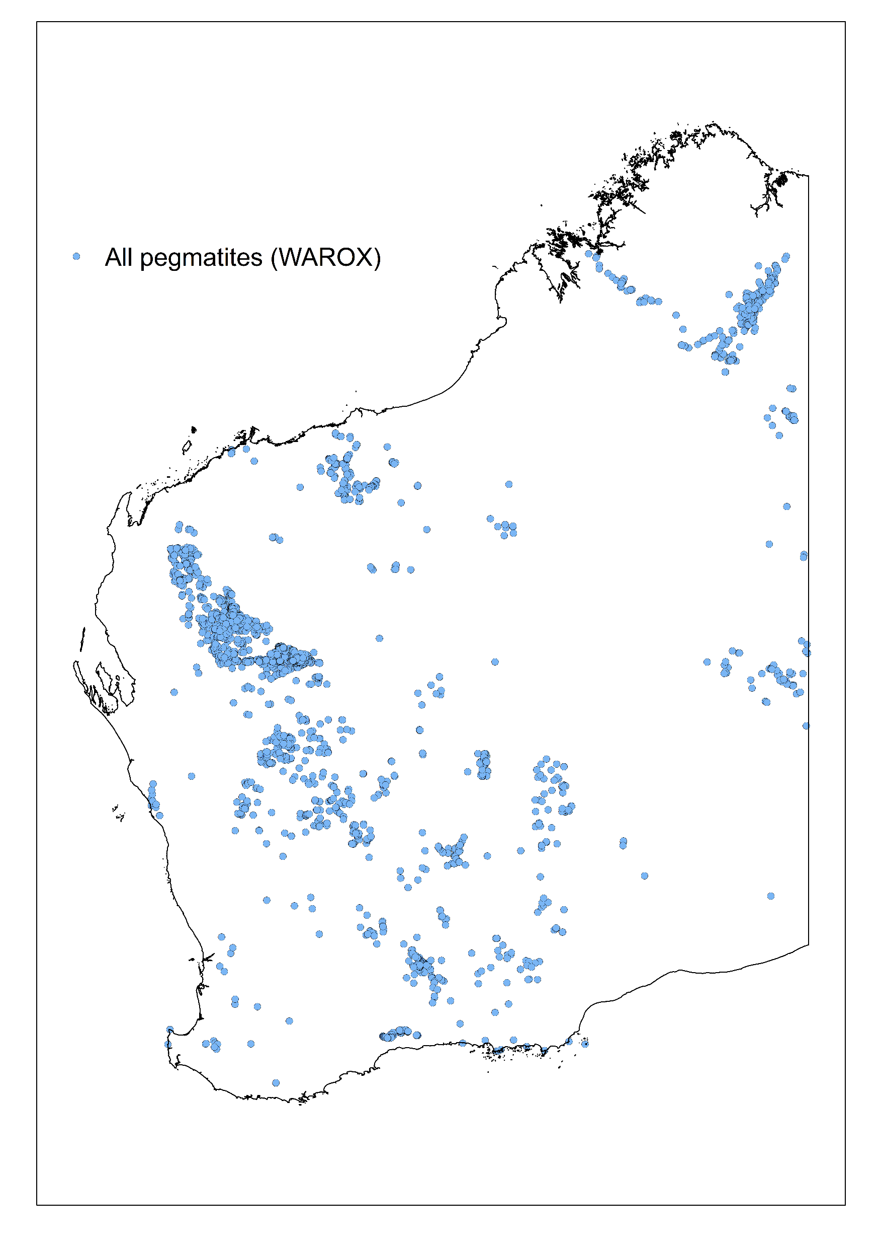
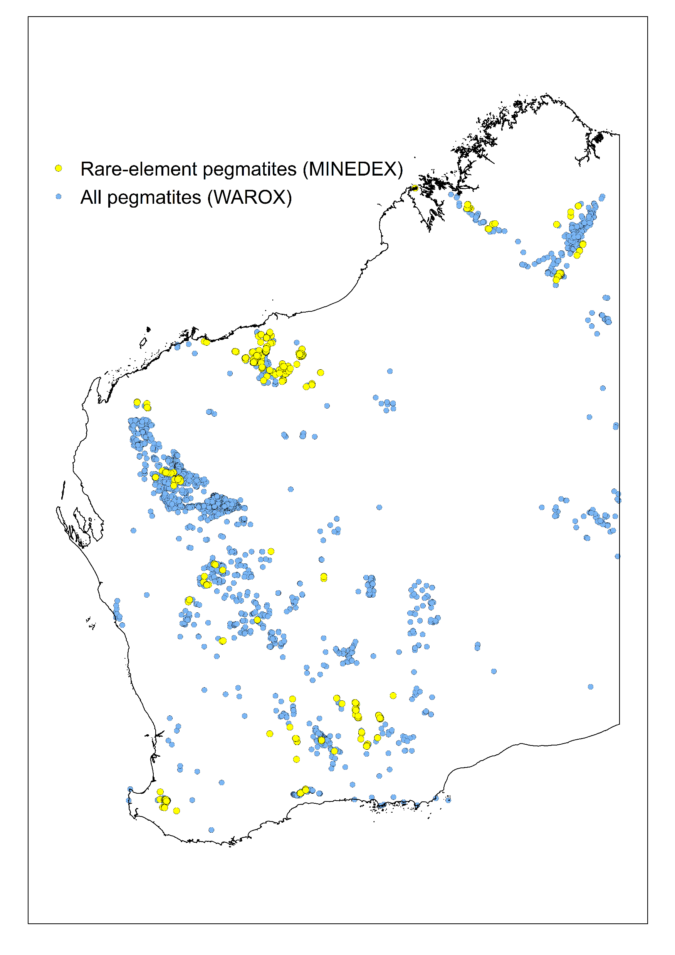
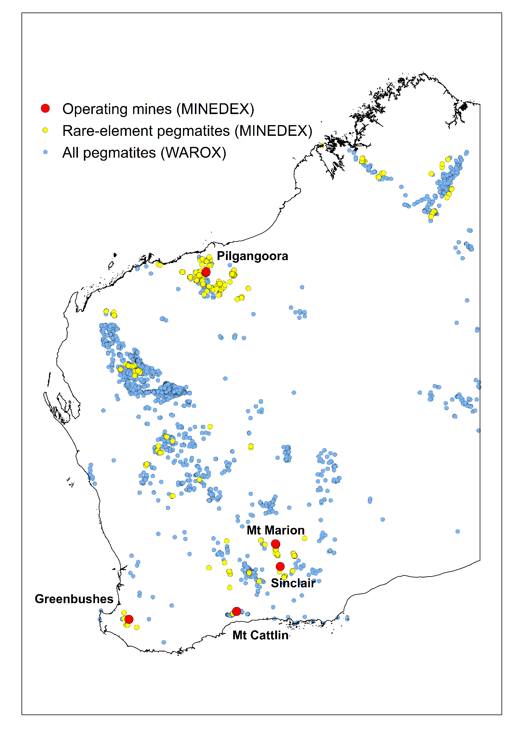
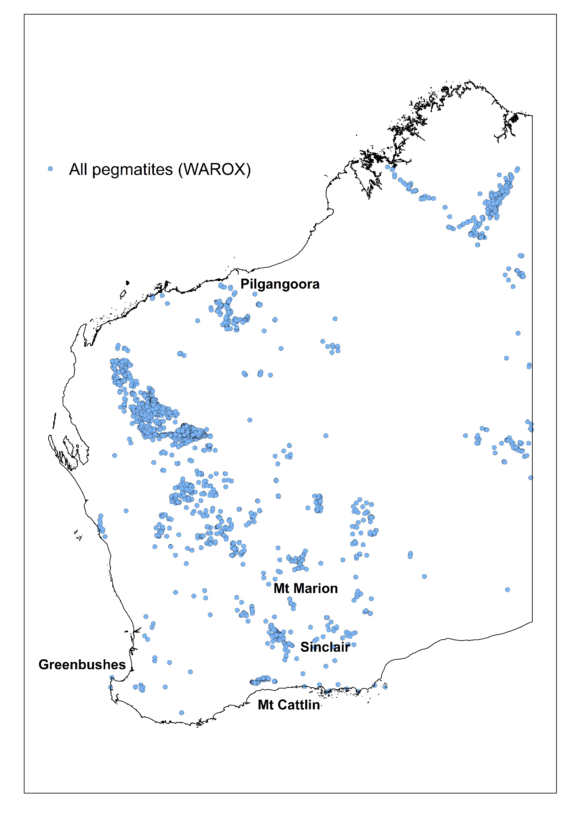
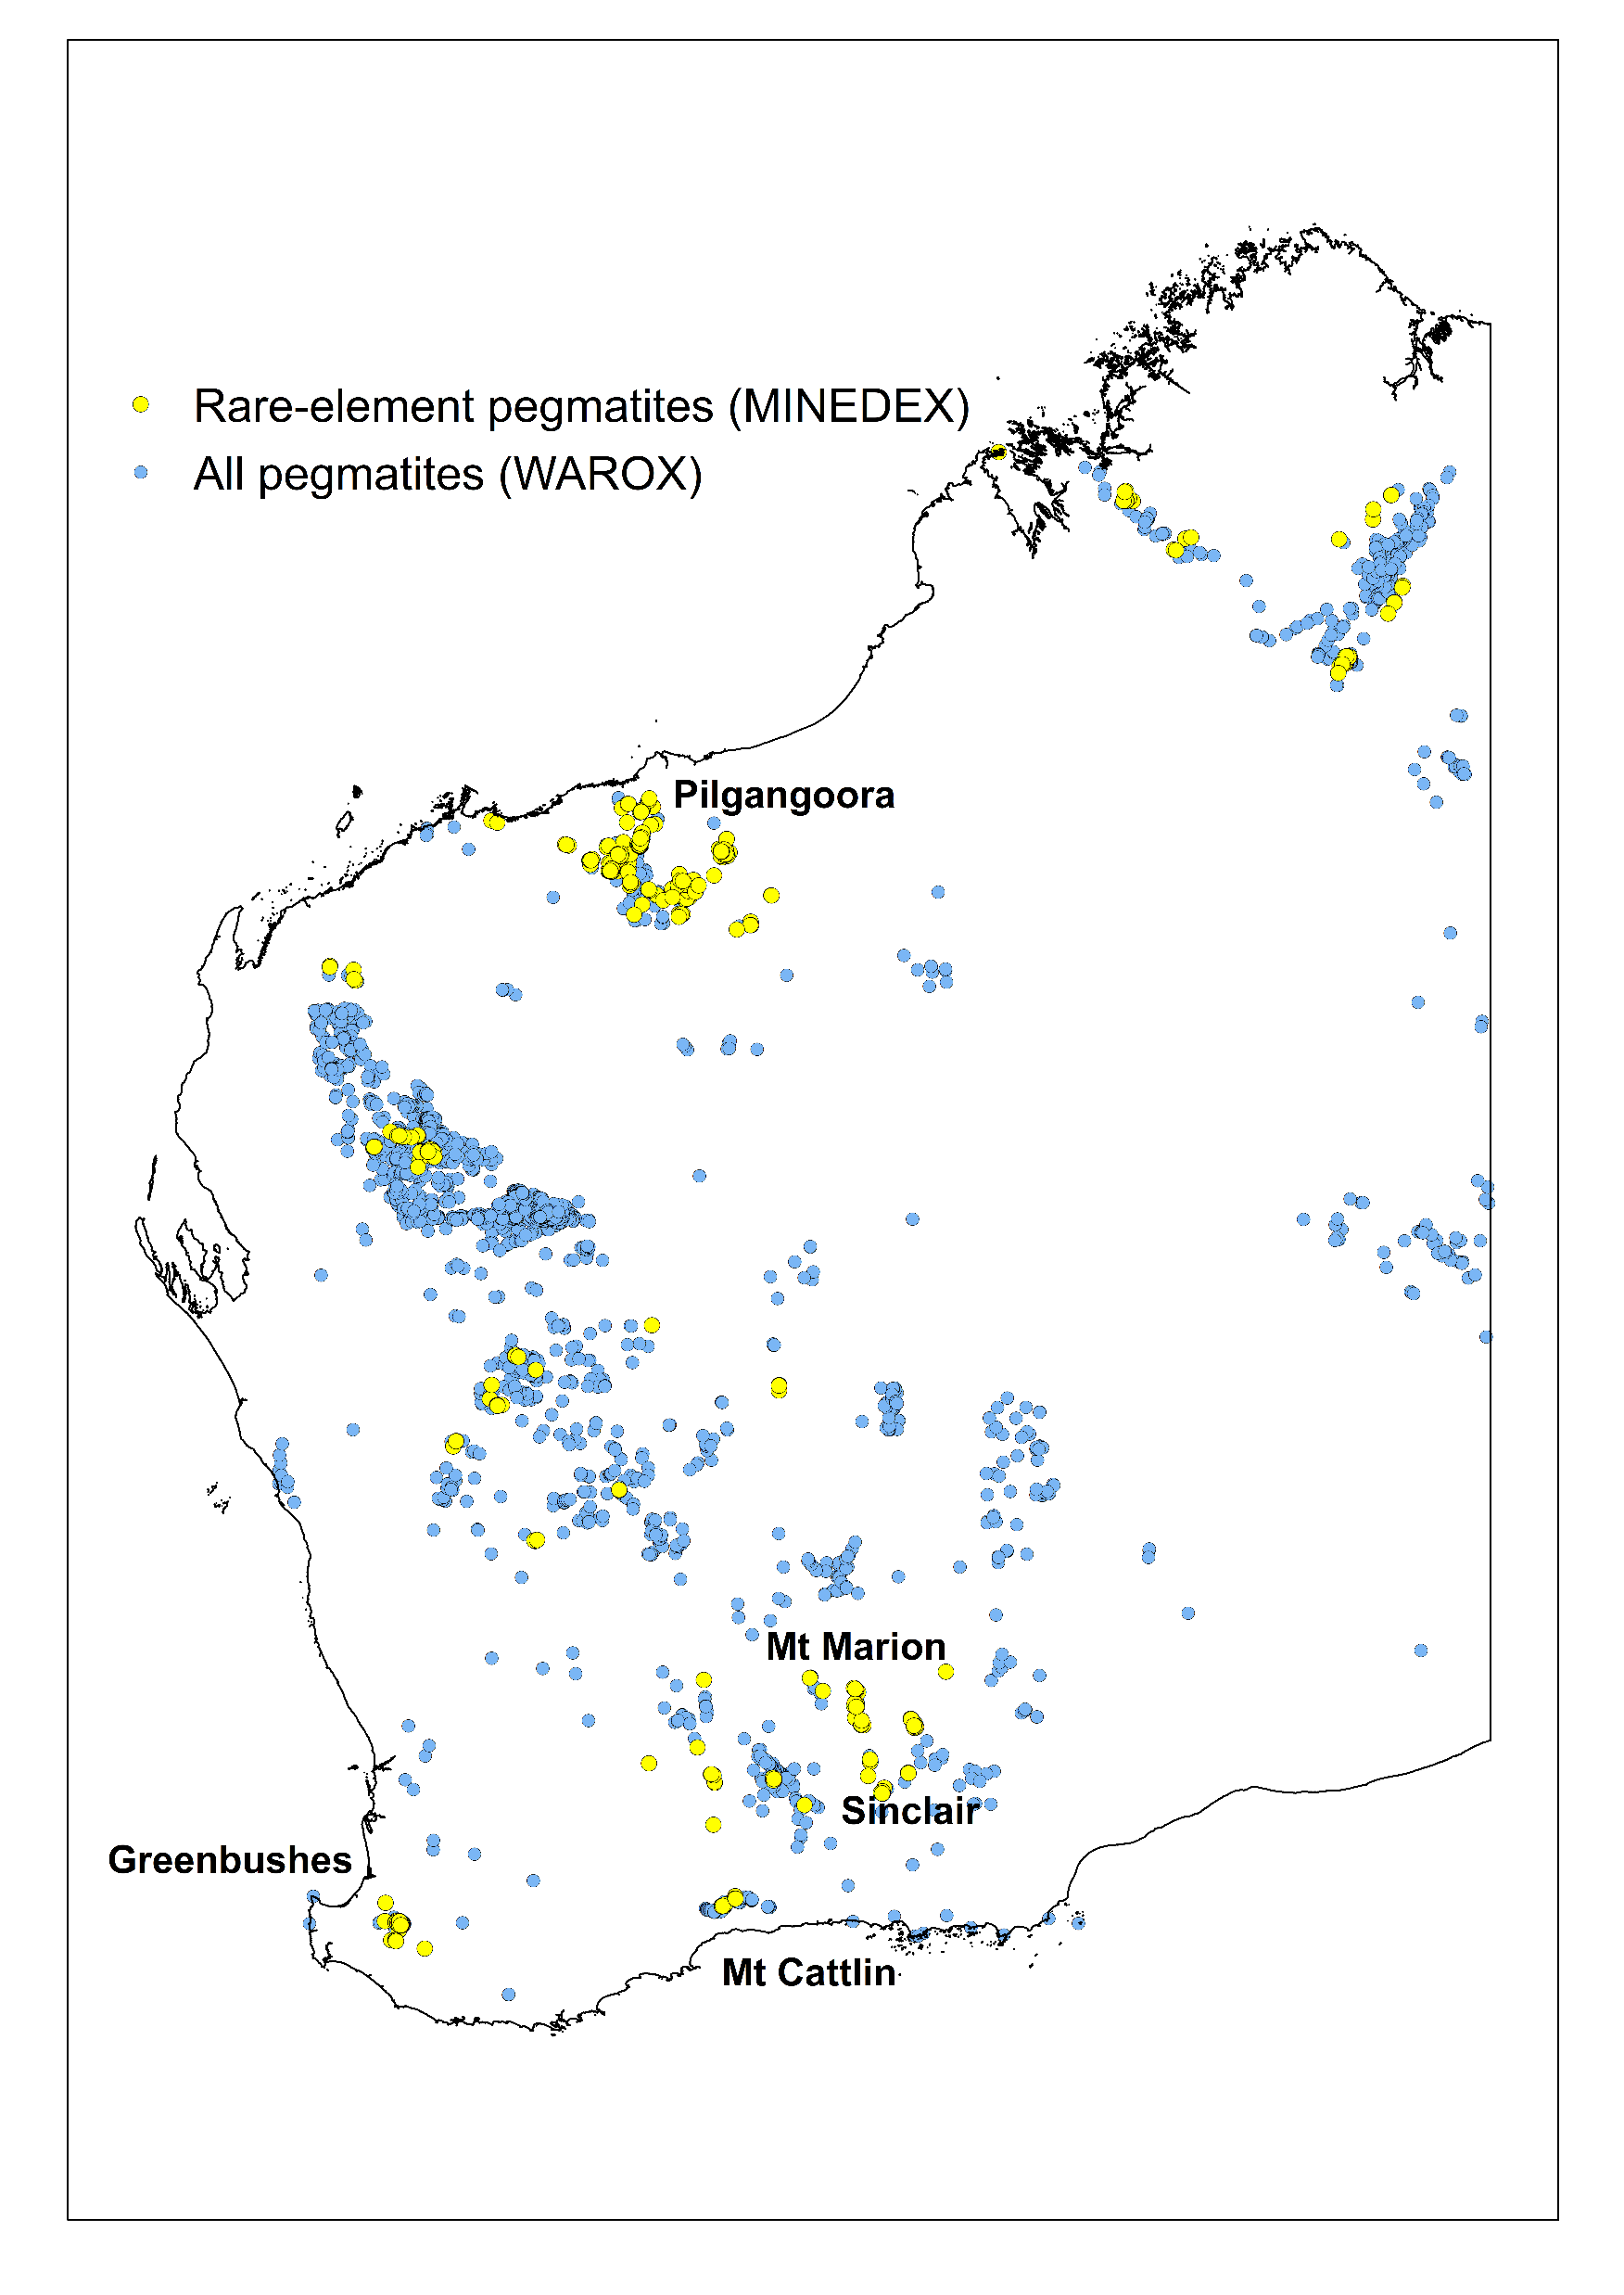




Rare-element pegmatites
Pegmatite mineralization in WA
What are rare-element pegmatites?
Pegmatites
Common pegmatites (99%)
Rare-element pegmatites (<1%)
Lithium–Caesium–Tantalum (LCT) pegmatites
Niobium–Yttrium–Fluorine (NYF) pegmatites
Common pegmatites
(
99
%)
Rare
-
element
Lithium
–
Caesium
–
Tantalum
pegmatites
(
LCT
)
(
<
1
%)
pegmatites
Niobium
–
Yttrium
–
Fluorine
(
NYF
)
pegmatites
Pegmatites
Common pegmatites (99%)
Rare-element pegmatites (<1%)
  Lithium–Caesium–Tantalum (LCT) pegmatites
  Niobium–Yttrium–Fluorine (NYF) pegmatites

Slide 7
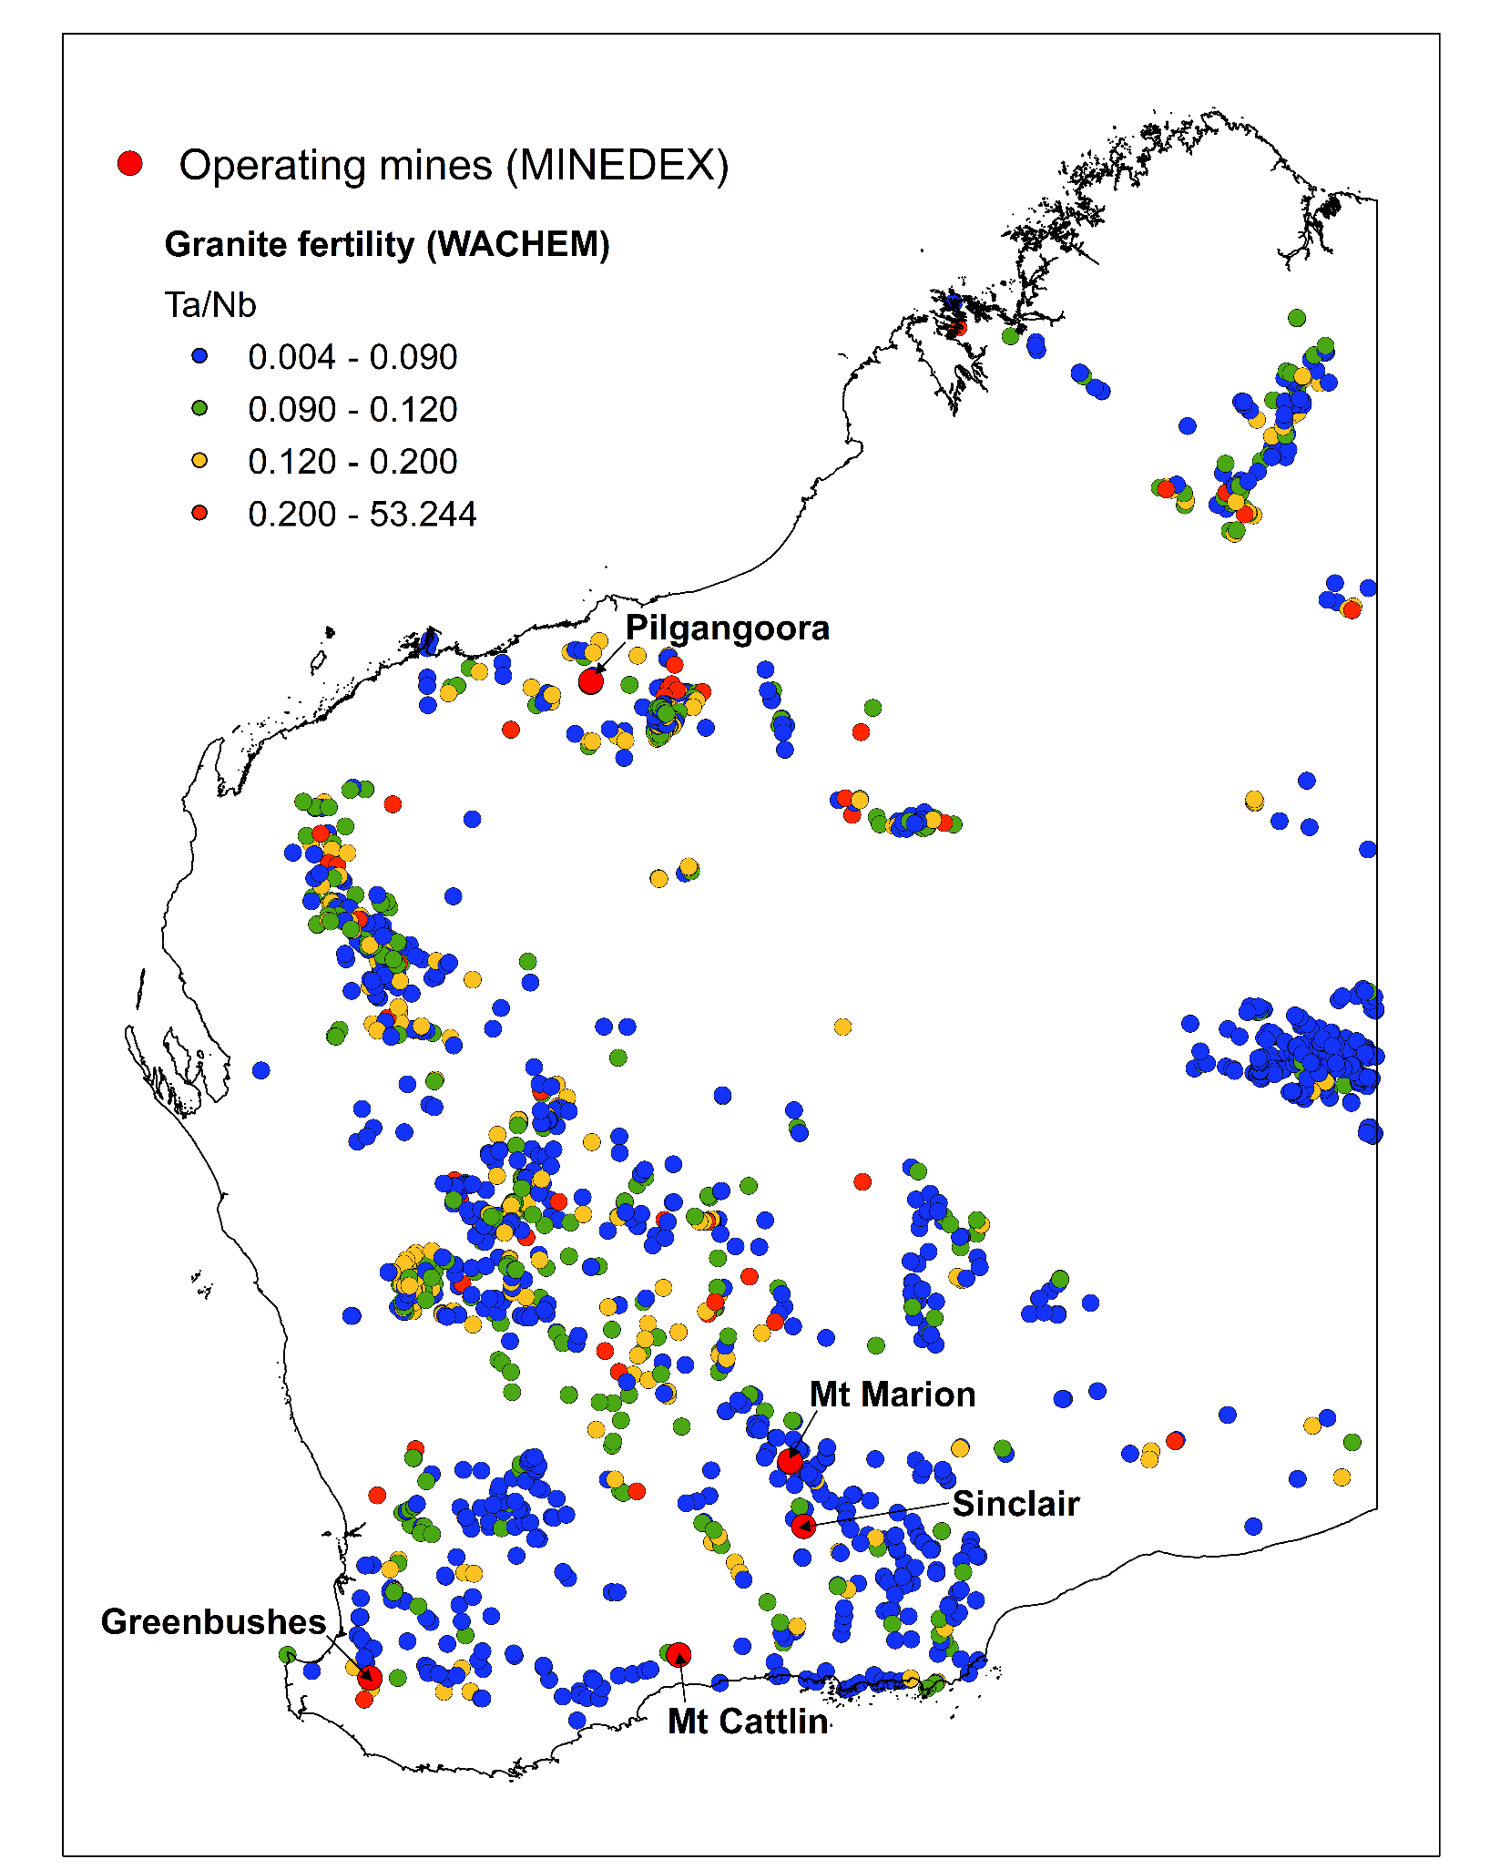
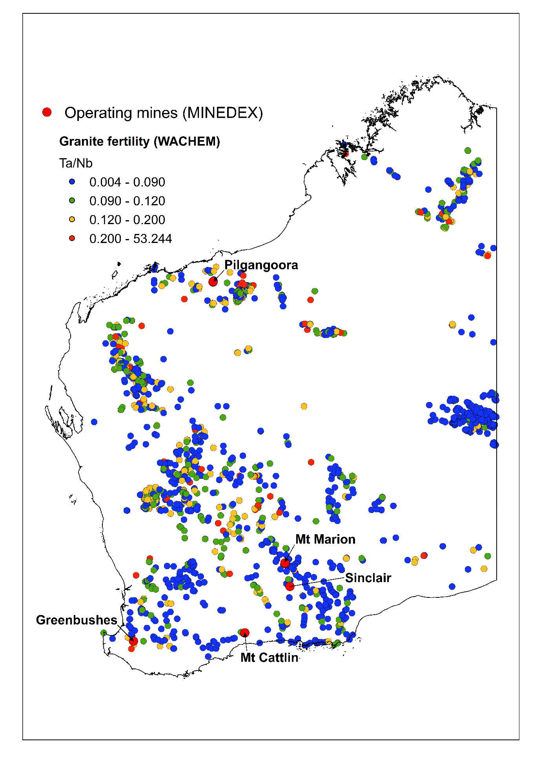
SOURCE
Fertile granitic magmas – a source of fluids and metals for pegmatites
S-type granites with extreme fractionation:
enriched in Li, Cs, Ta, Rb, Sn, F, Be, Nb, Ga, Fe, Ti and REE
high Li/Mg, Cs/K, Rb/K and Ta/Nb
contain fluorite, cordierite, tourmaline, garnet, white potassium feldspar and green muscovite
Example

Slide 8
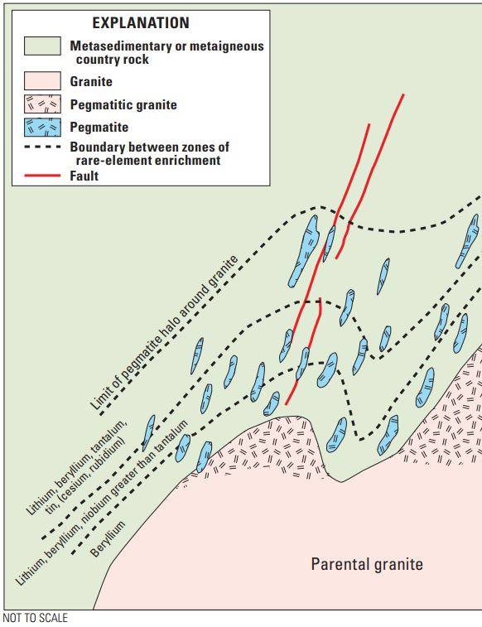
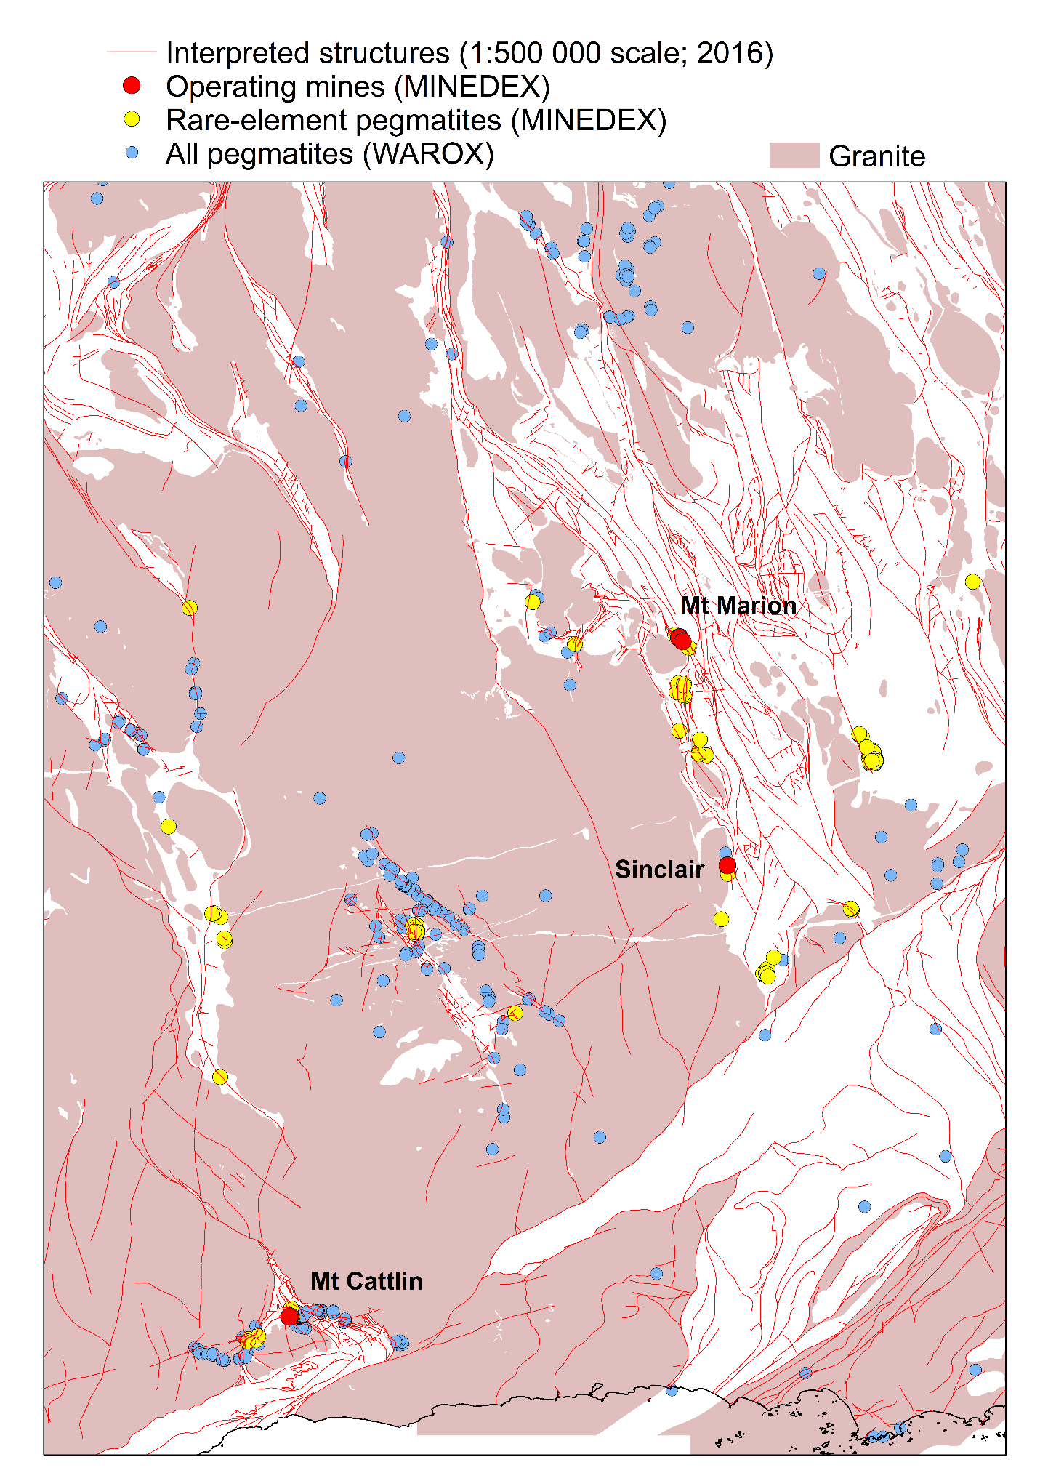
ACTIVE PATHWAY – magma transport through the Crust
Conceptual plan or cross-section
Example from the southern Yilgarn
Pegmatites are opportunistic
Pegmatites are opportunistic – they use a variety of structural pathways including faults, fractures, foliation or bedding planes in country rocks
Bradley et al. (2017)
Notes:
Pegmatites are opportunistic – they use a variety of structural pathways including faults, fractures, foliation or bedding planes in country rocks

Slide 9
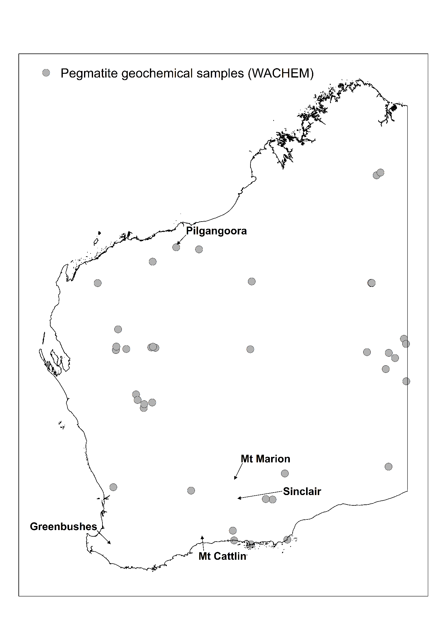
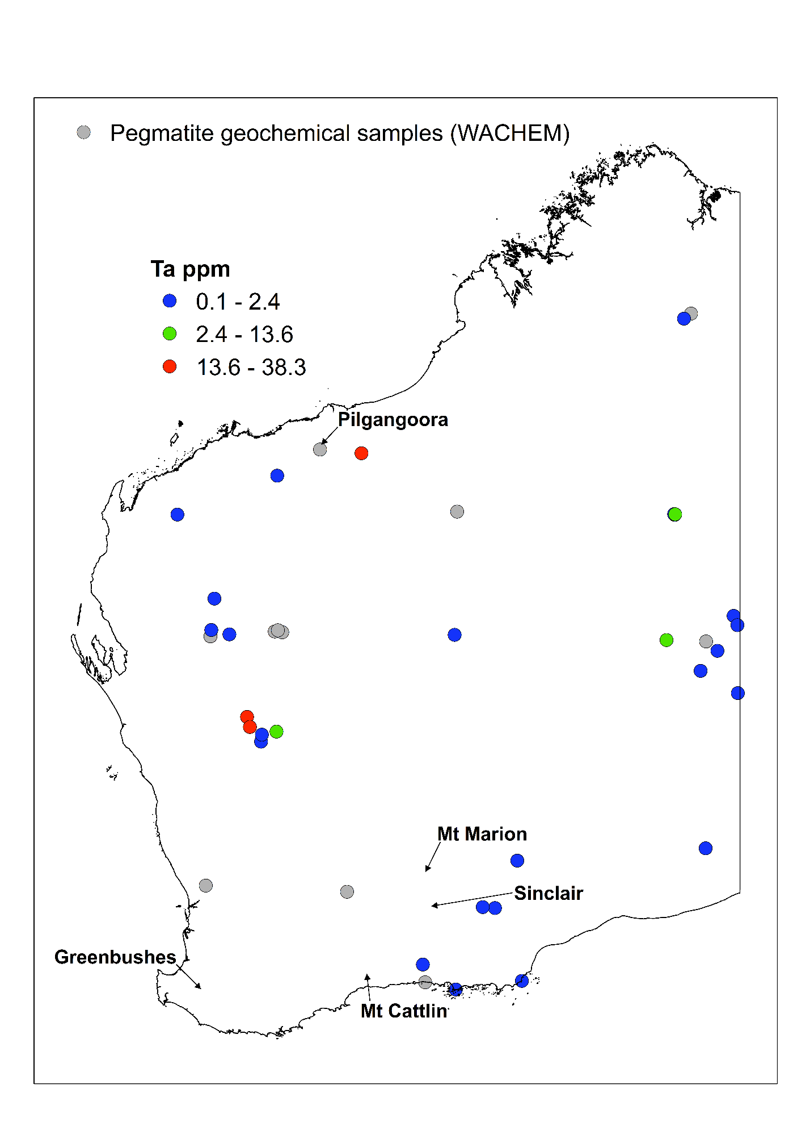
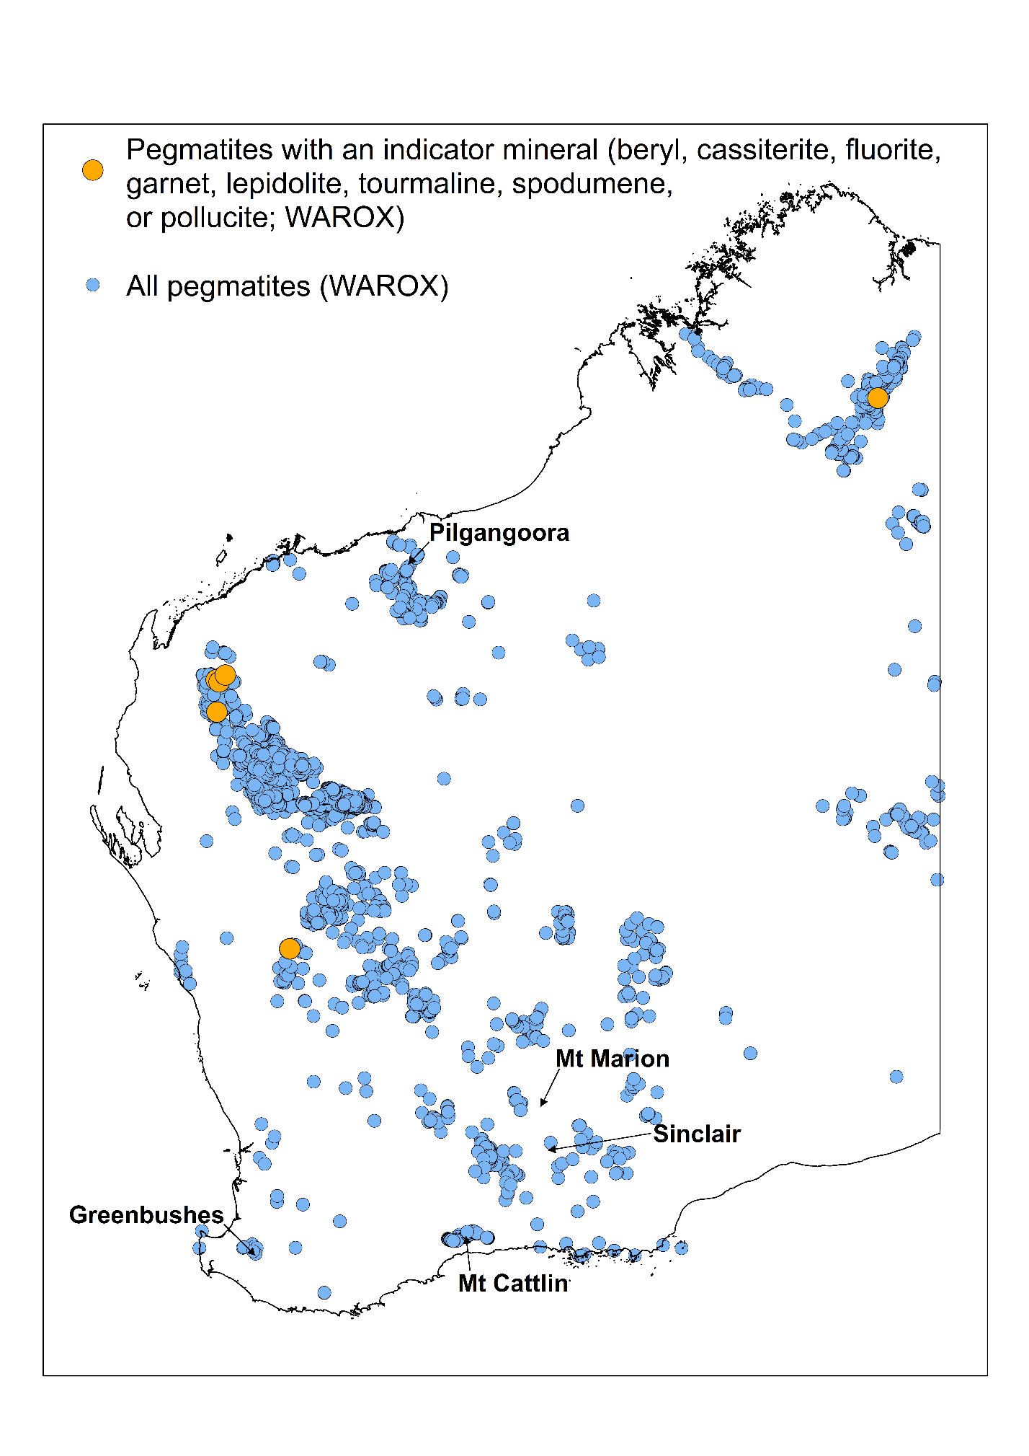
TRAP – magma cooling and crystal growth
Conceptual plan or cross section
Available geochemical data for pegmatites
Tantalum data for pegmatites
Indicator minerals for rare-element pegmatites
Li
Ta
F
Cs
U
Be
Increasing prospectivity
<10 km of a fertile granite
Cooling and fractionation
Bradley et al. (2017)
Notes:
Cooling and chemical diffusion of fractionating granitic melts result in rapid crystallization (over days to years)
Pegmatites located within 10 km of fertile granites, and particularly roof zones, are more favourable sites
Geochemical (Be, Cs, F, Li, Ta, U) and mineralogical zonation in pegmatites

Slide 10
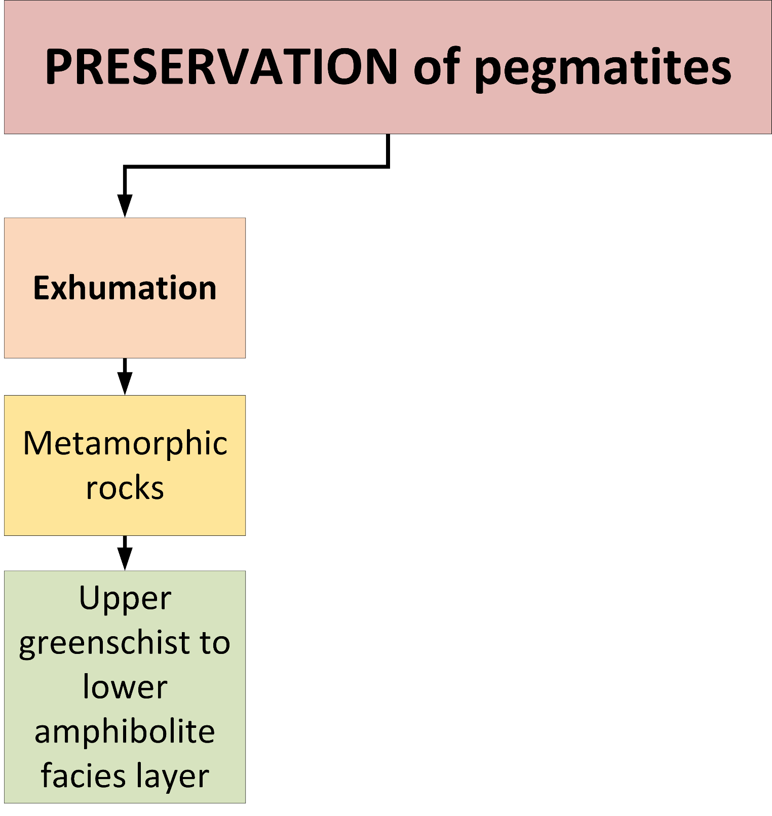
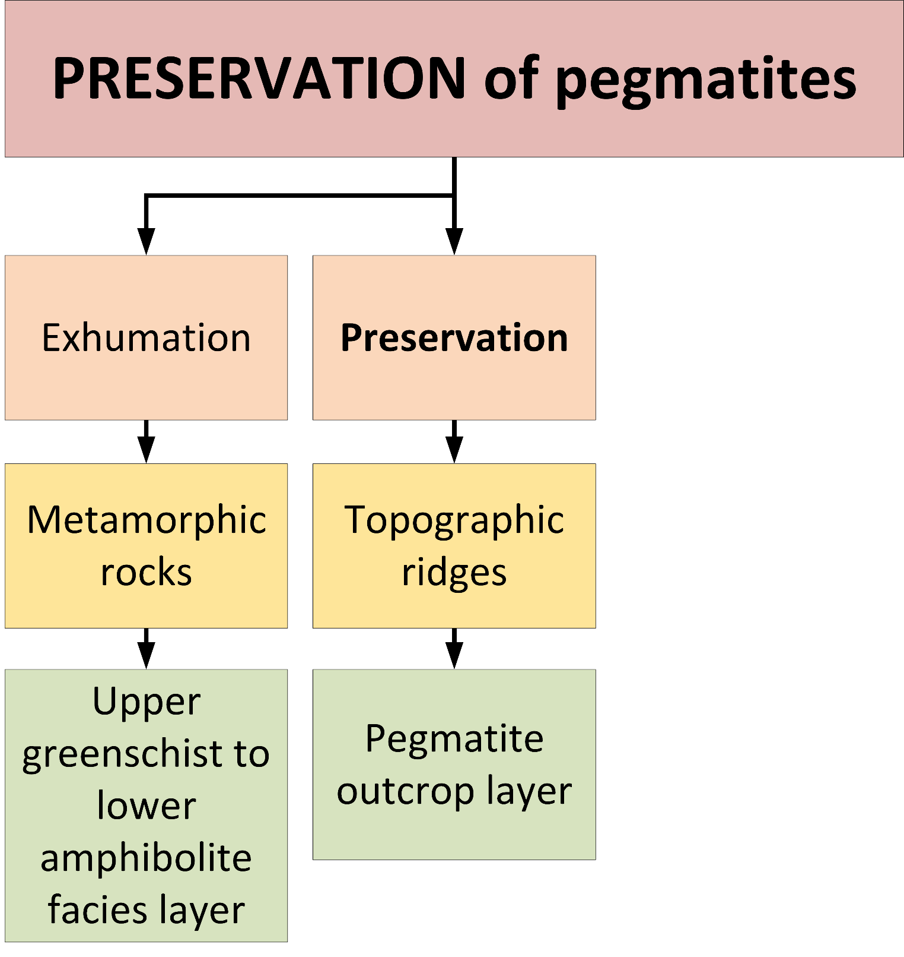
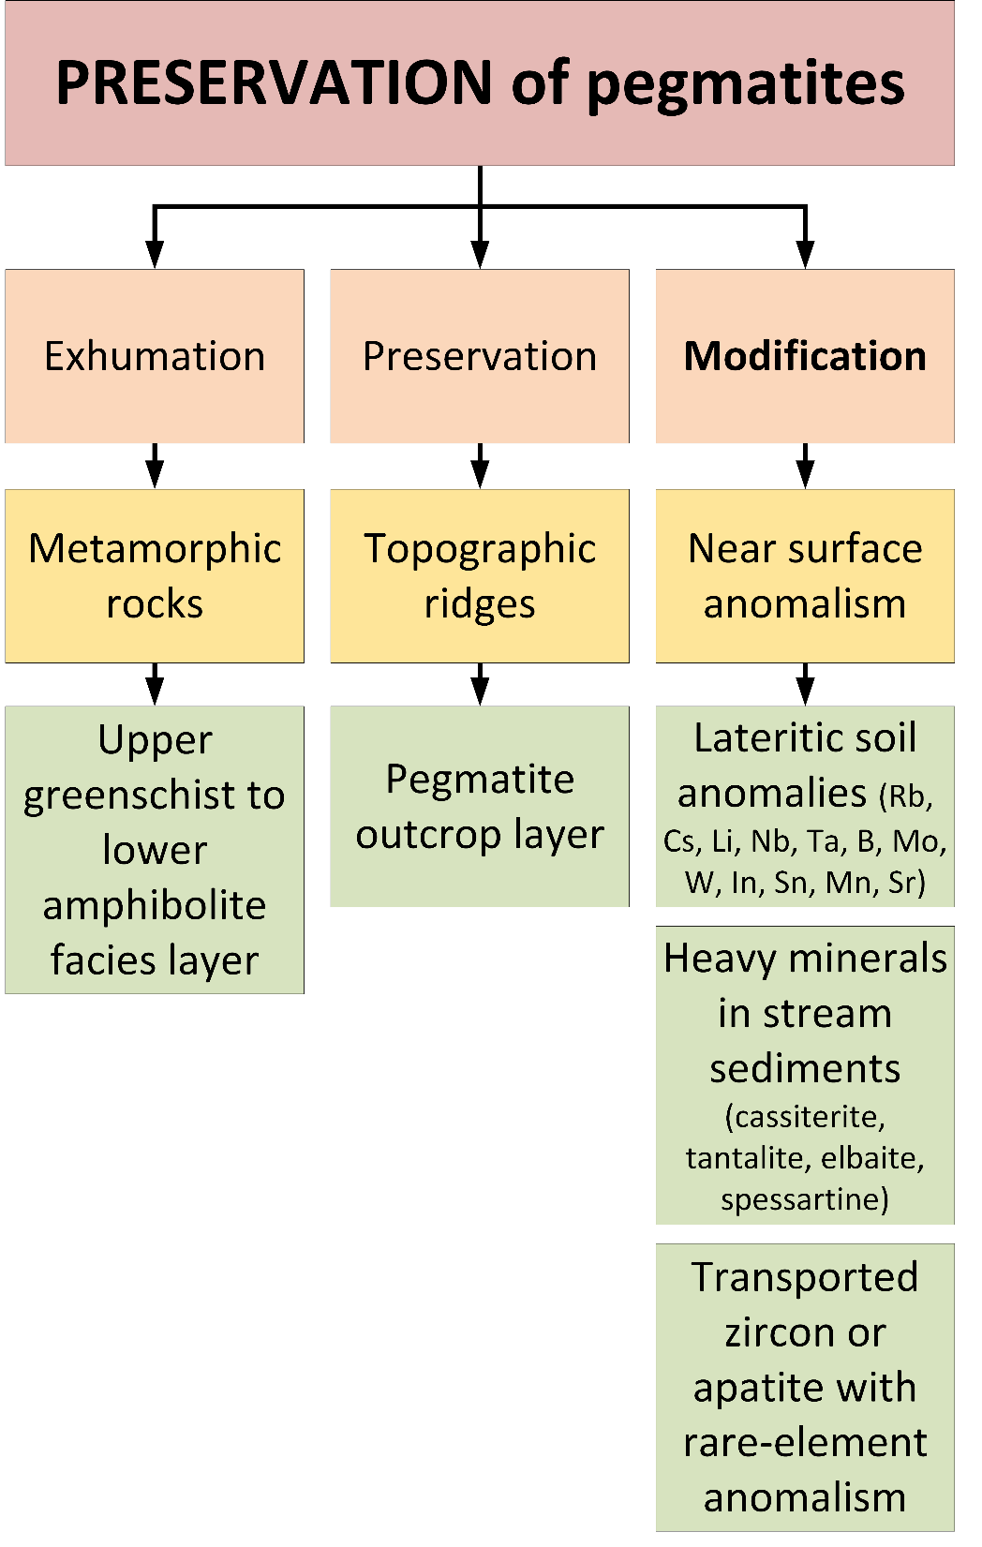
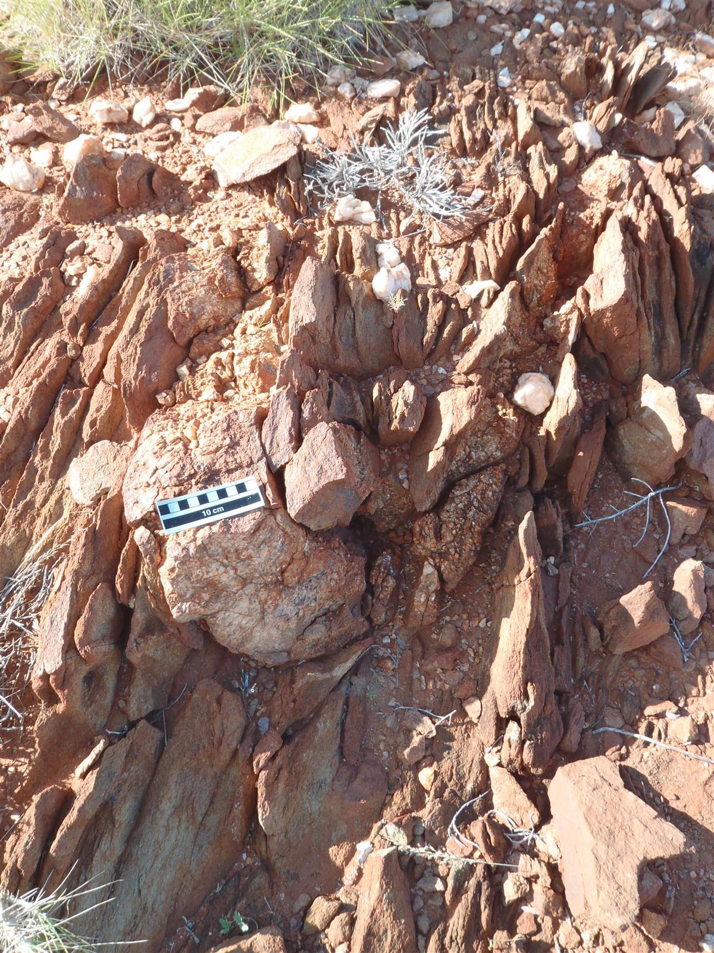
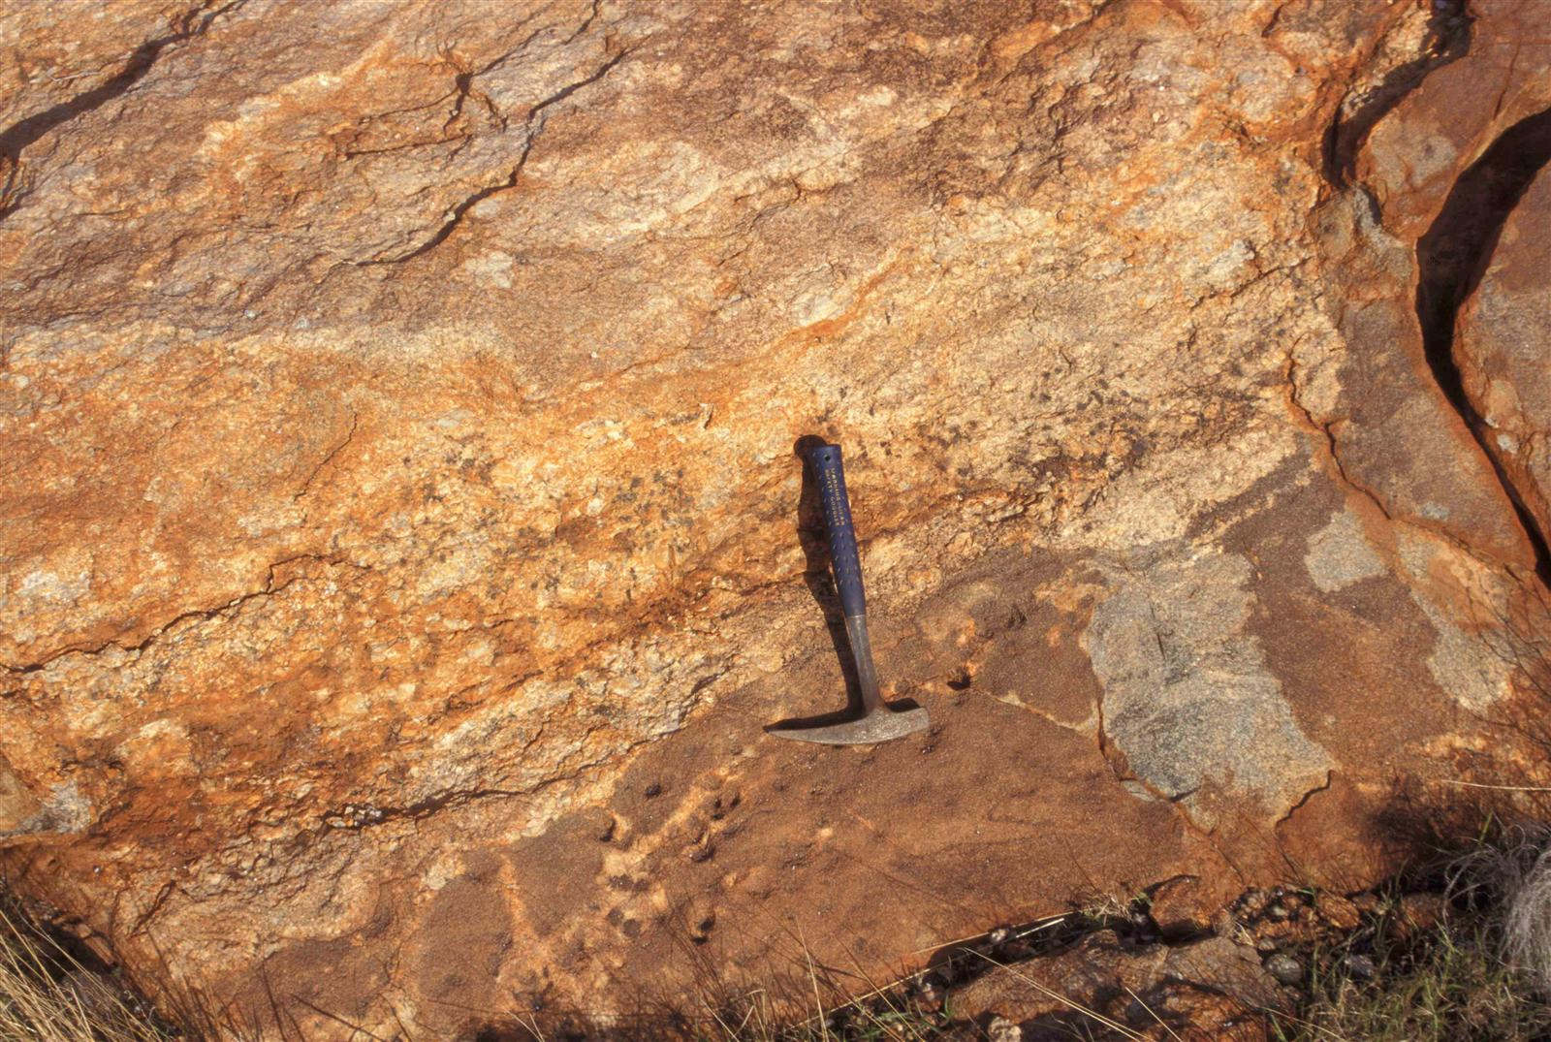
PRESERVATION
Example from the Capricorn Orogen
Constituent Process
Targeting
Mappable Proxies
pegmatite
Pegmatite in outcrop
Pegmatite sheet intrudes monzogranite.
WAROX entry (DRN1093; Nelson D.R.)
quartzite
WAROX point (SPJGAS002053; Johnson S.P.)

Slide 11
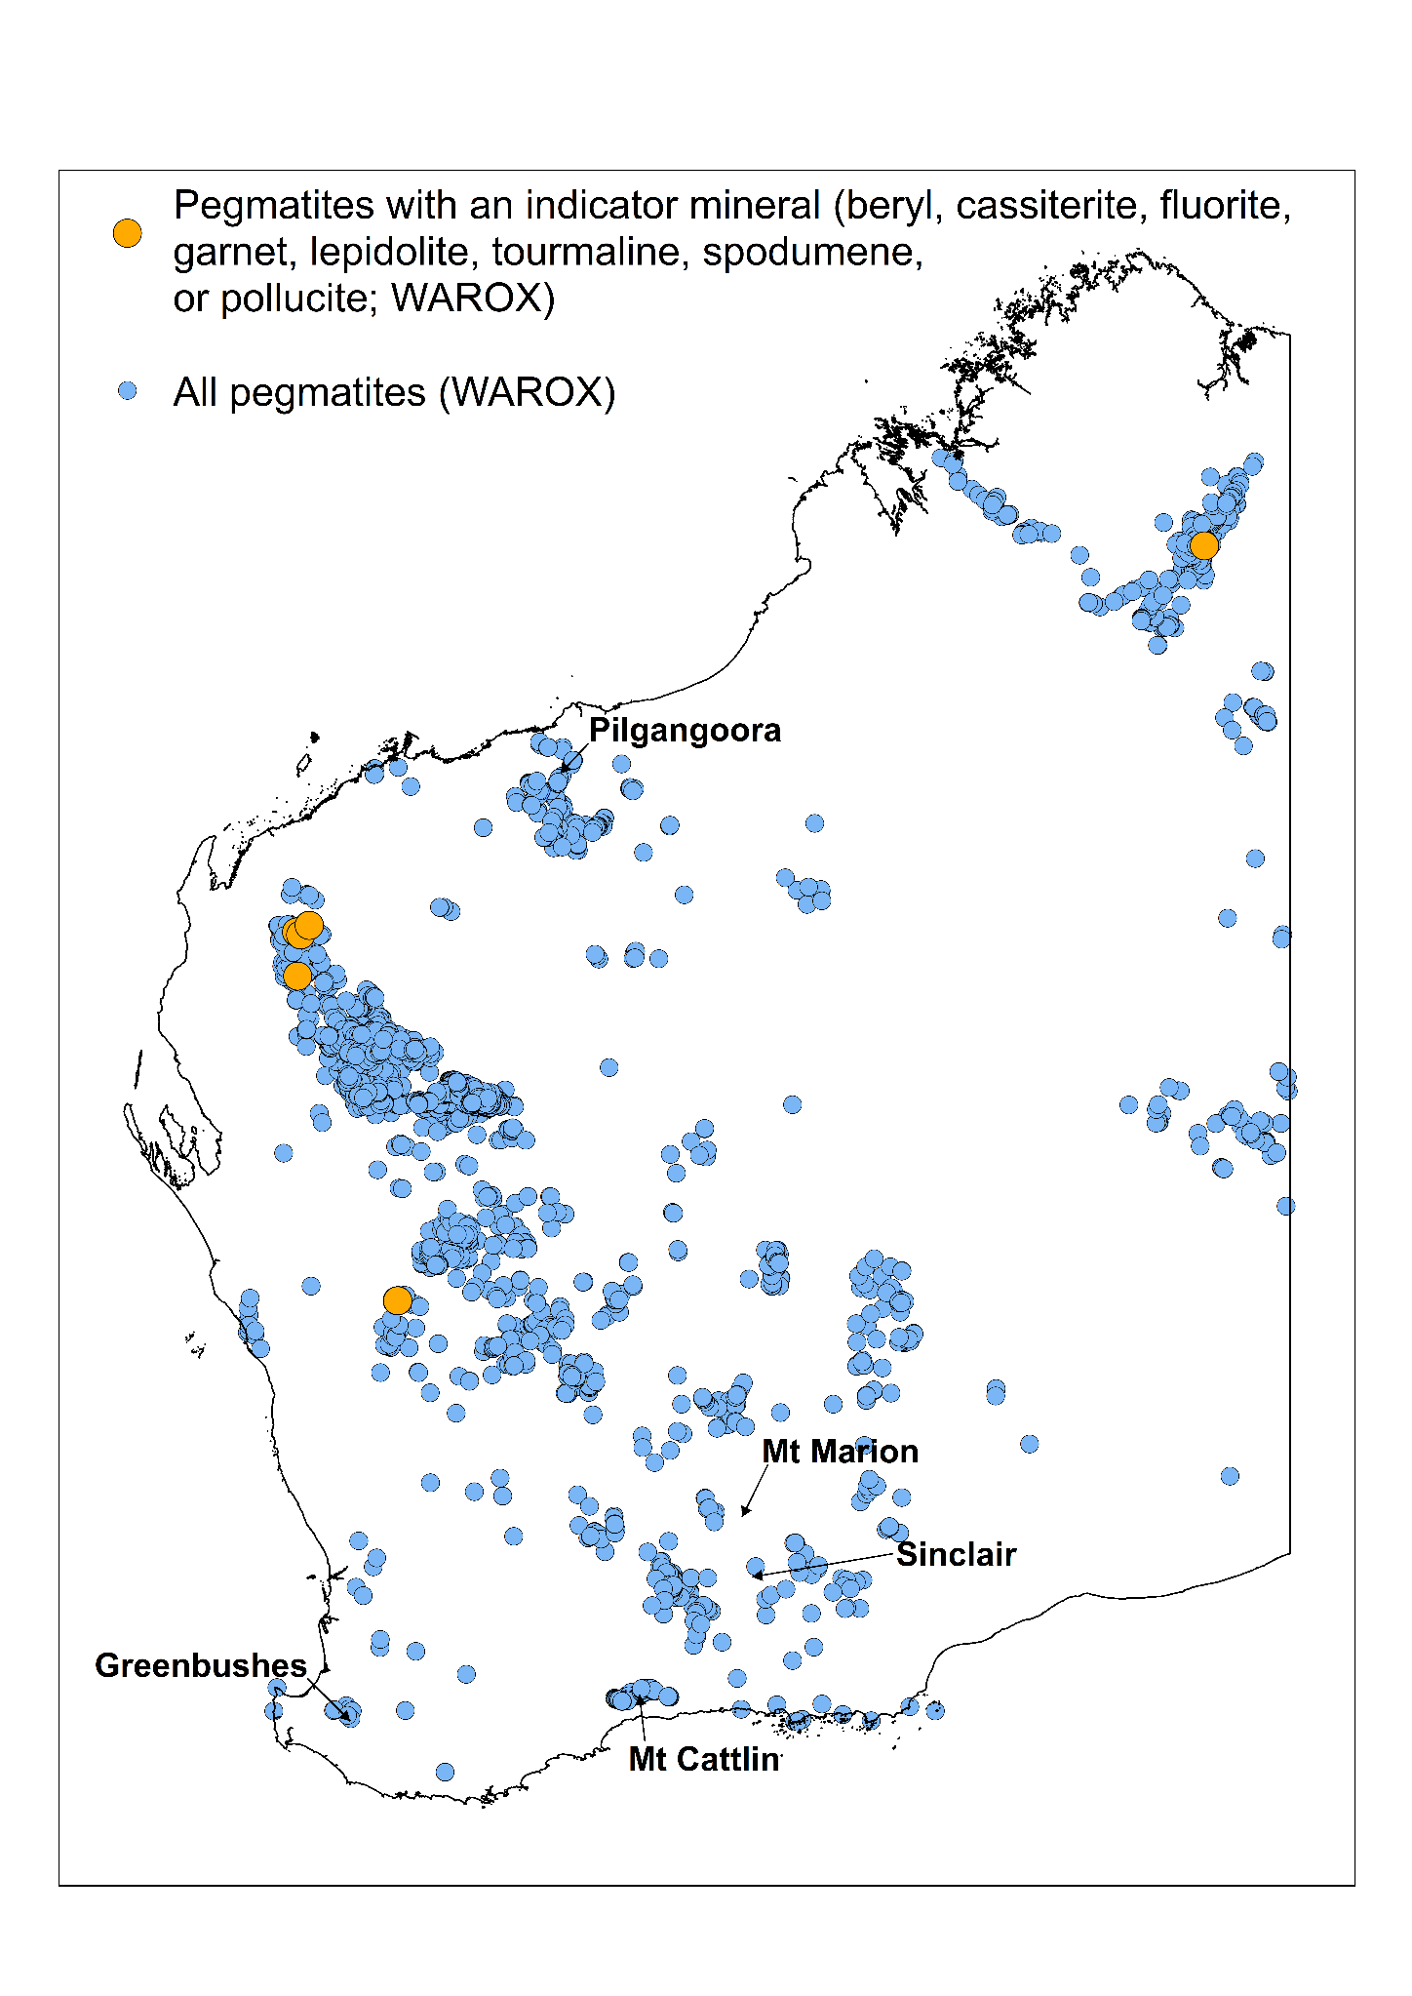
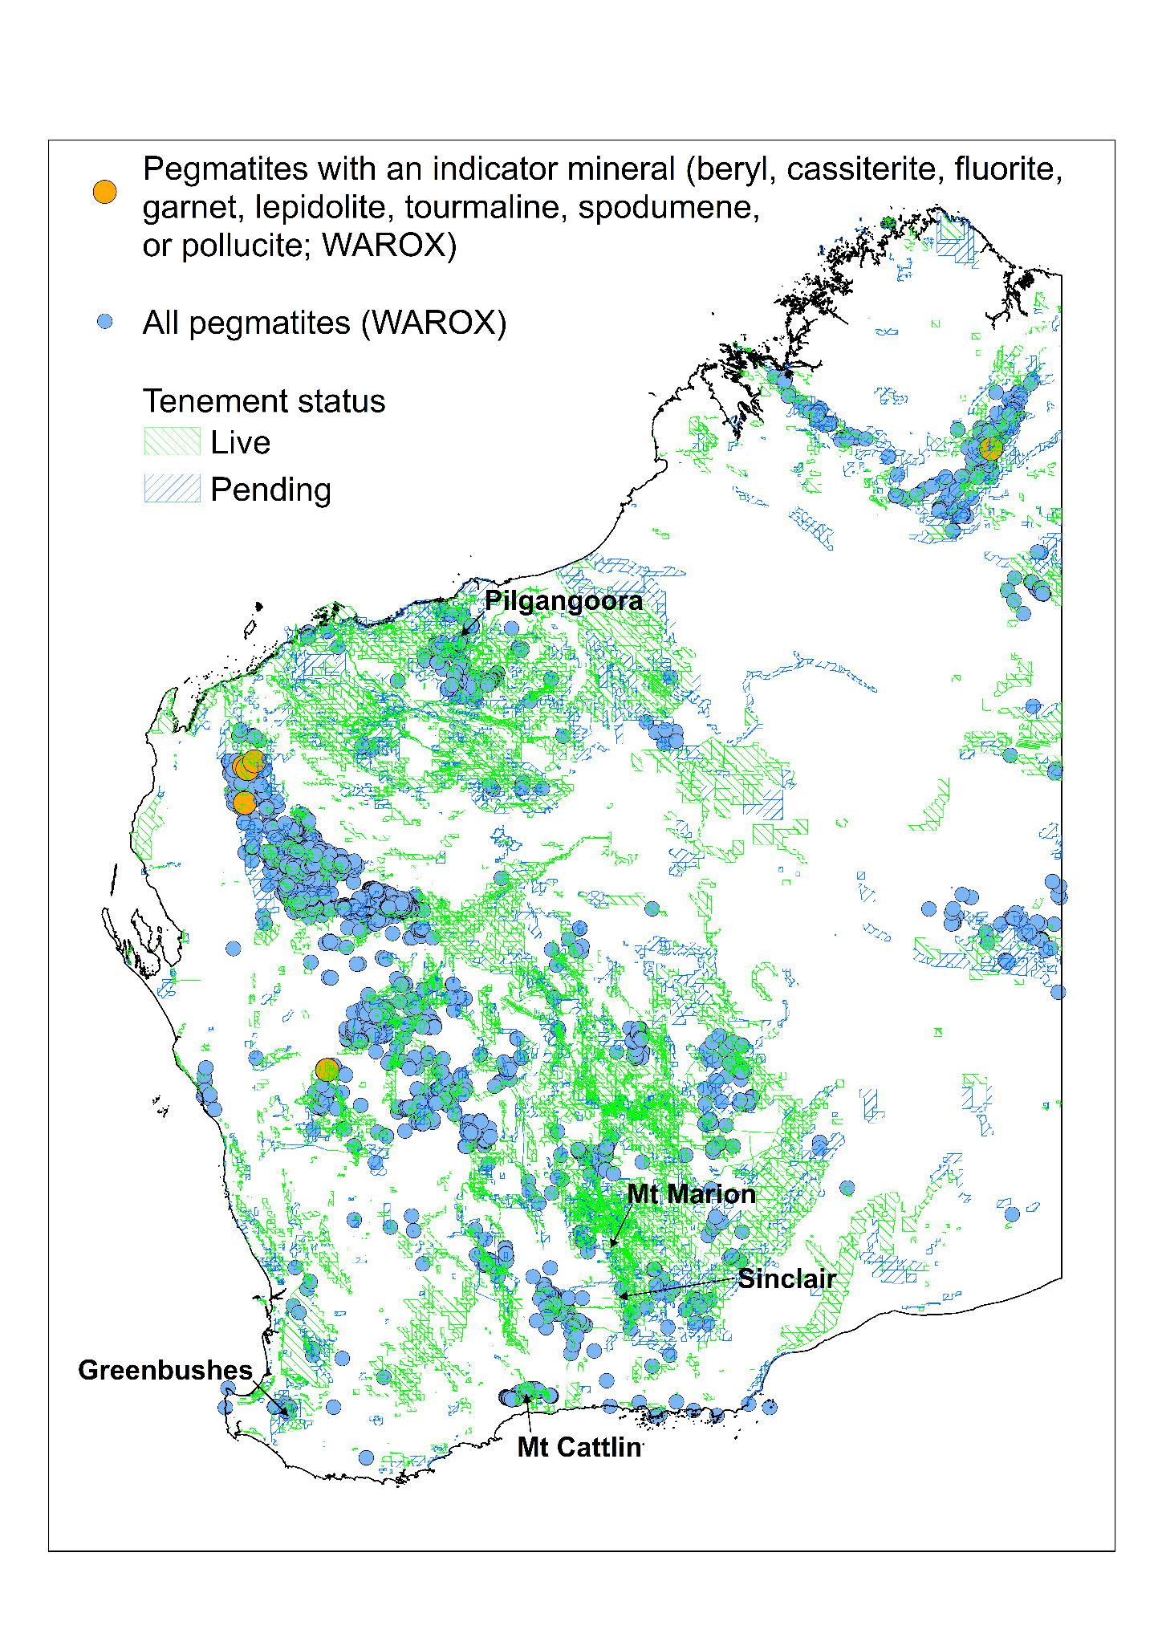
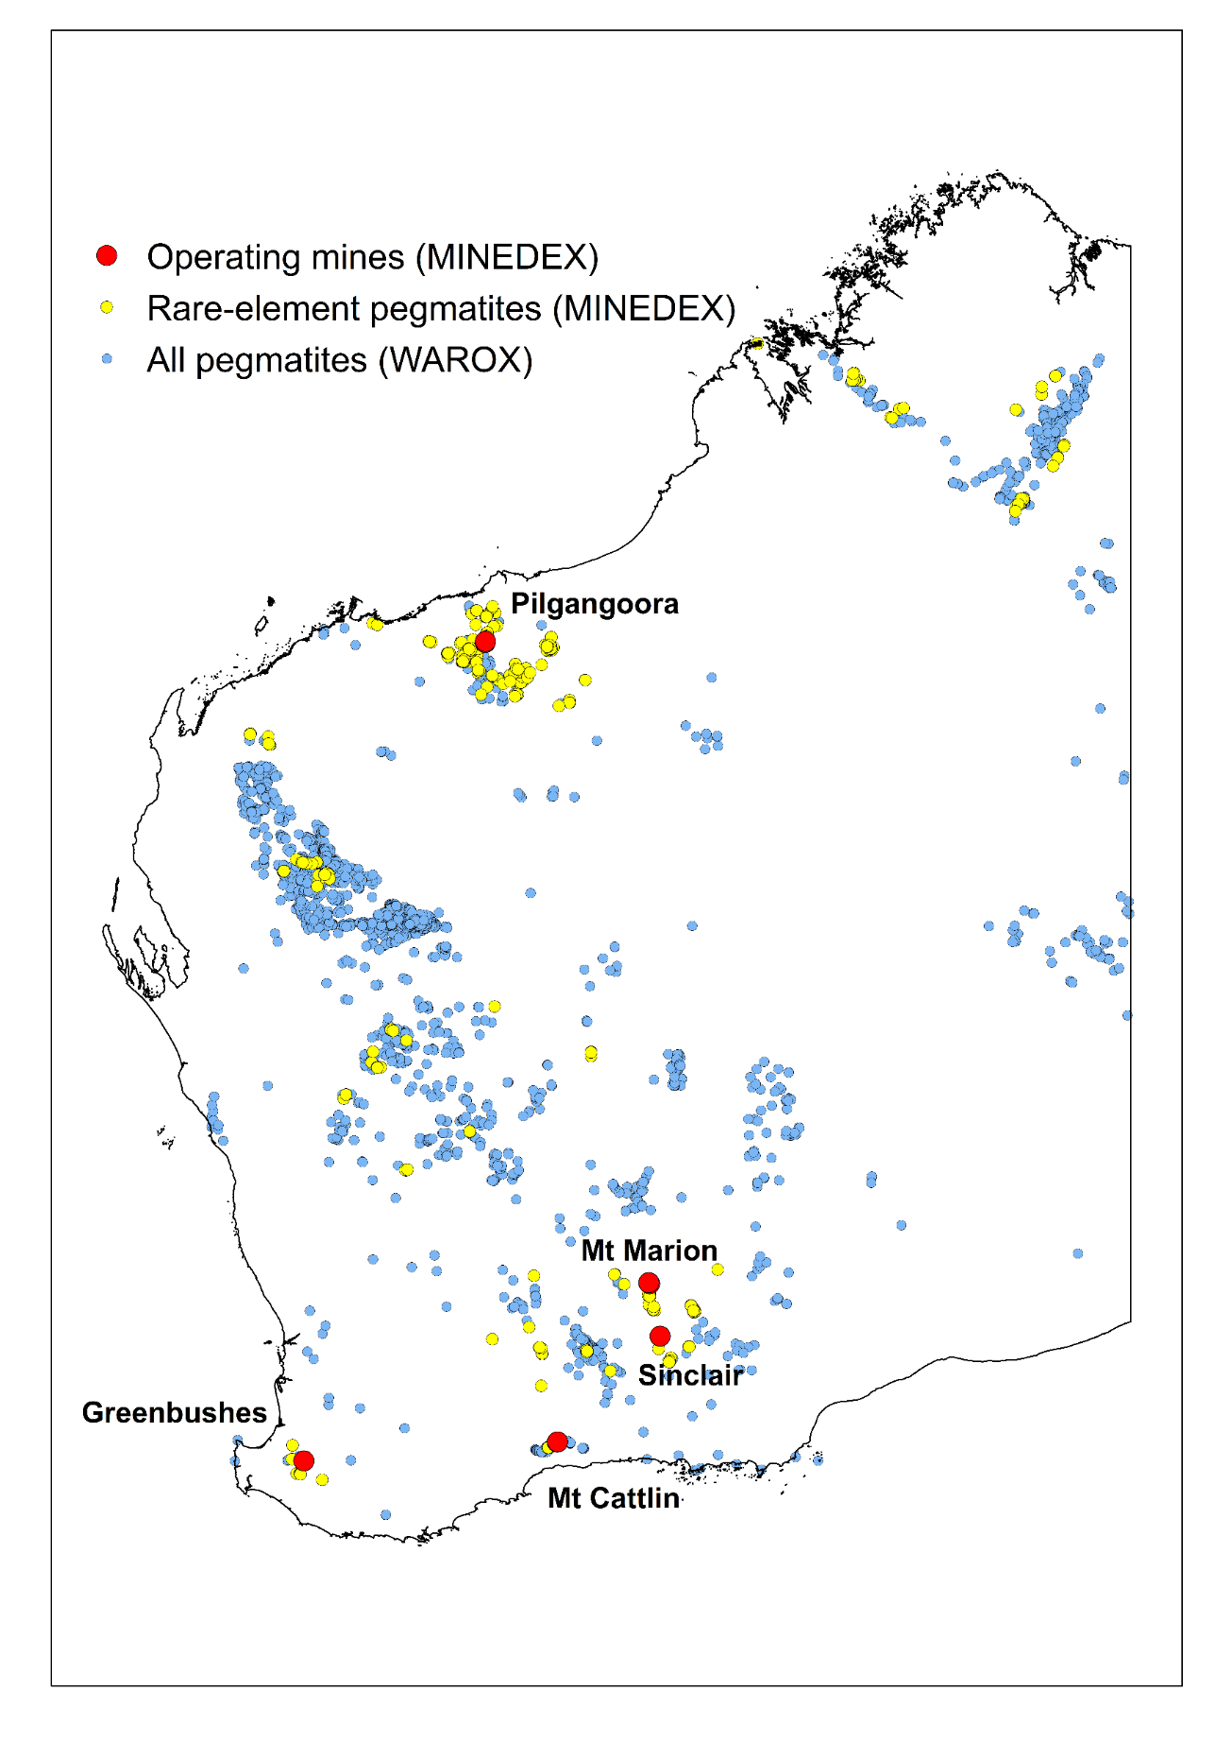
Data inputs for mineral exploration
Pegmatite mineralization in WA
Granite fertility
Pegmatite fertility

Slide 12
Conclusions
Mineral Systems Atlas
Always up to date – no USB packages
External users
For Explorers, Researchers, Students…
The Guide can be an educational tool
GSWA users
A driver for collecting new data and designing projects
Influencing database refinements
Less searching & cleaning data

