Slide 1


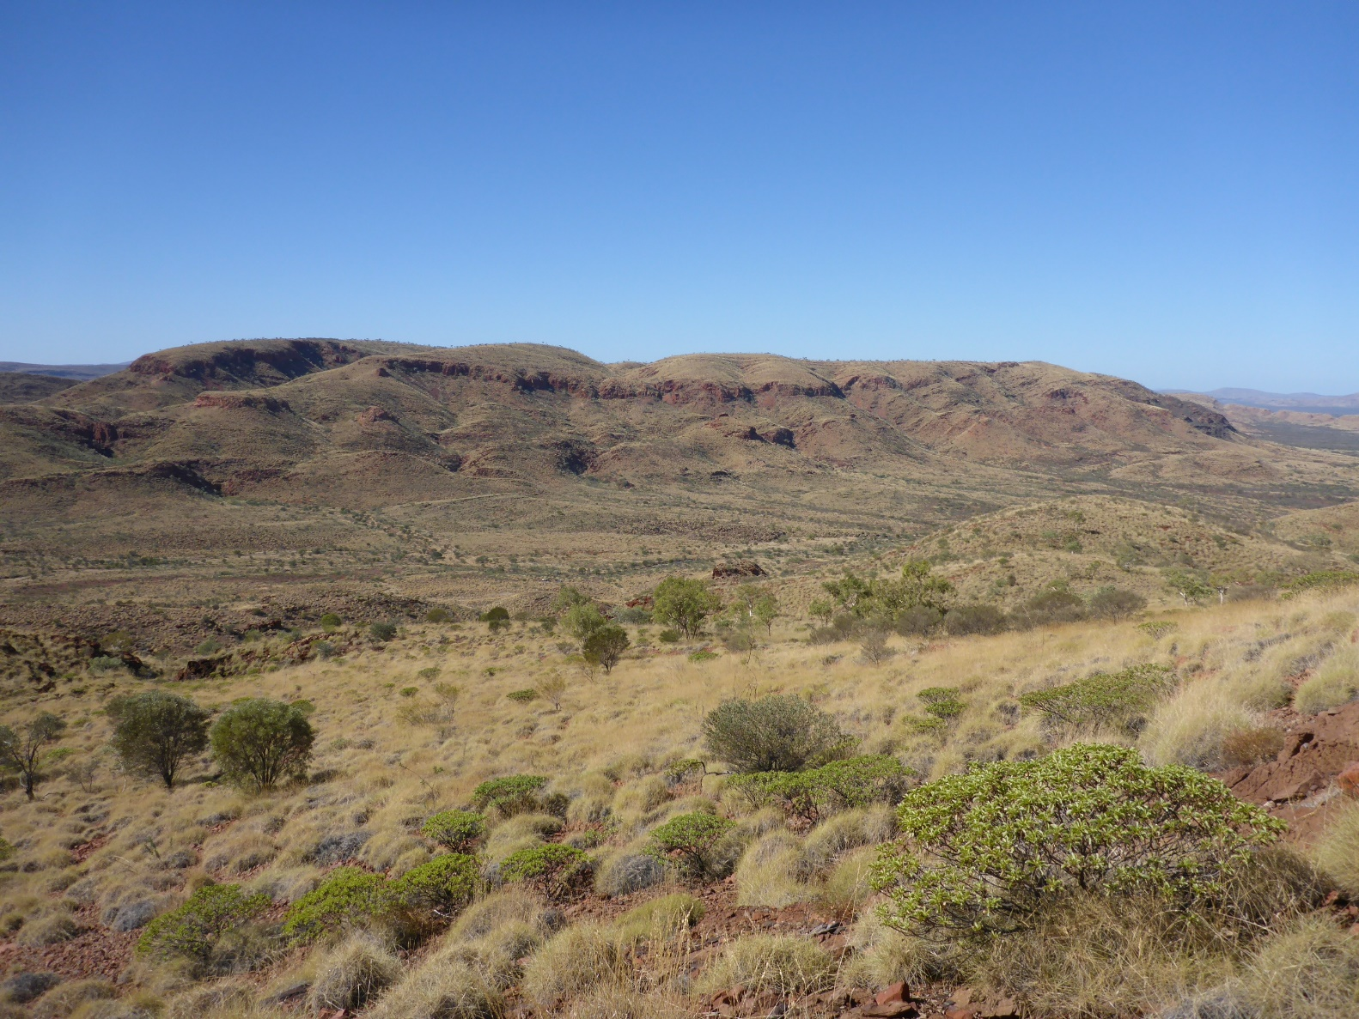
Tectonic setting and exploration potential of the northern Capricorn Orogen
Presented by
David Martin

Slide 2
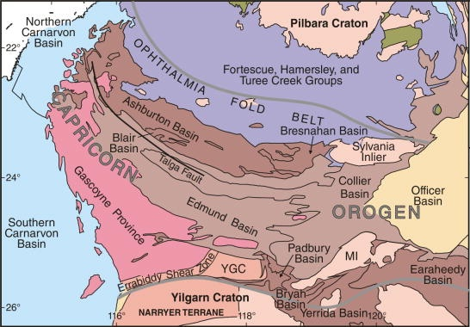
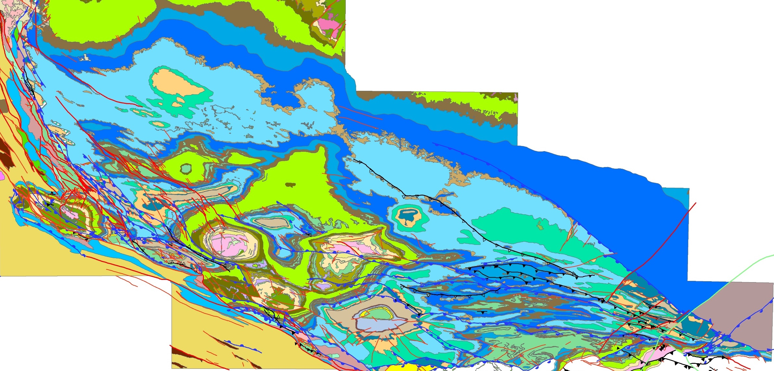
Hypogene iron ore
Red Hill
Supergene iron ore
Gold
Base metals
Merlin
Paulsens
Belvedere
Wellthandalthaluna
Tom Price
Mt McGrath
Mt Wall
Anthiby Well
Paraburdoo
Giles Mini
Lido
Channar
Mt Olympus
Mt Whaleback

Slide 3
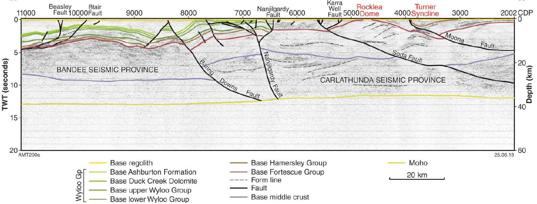
10GA-CP1 seismic line

Slide 4
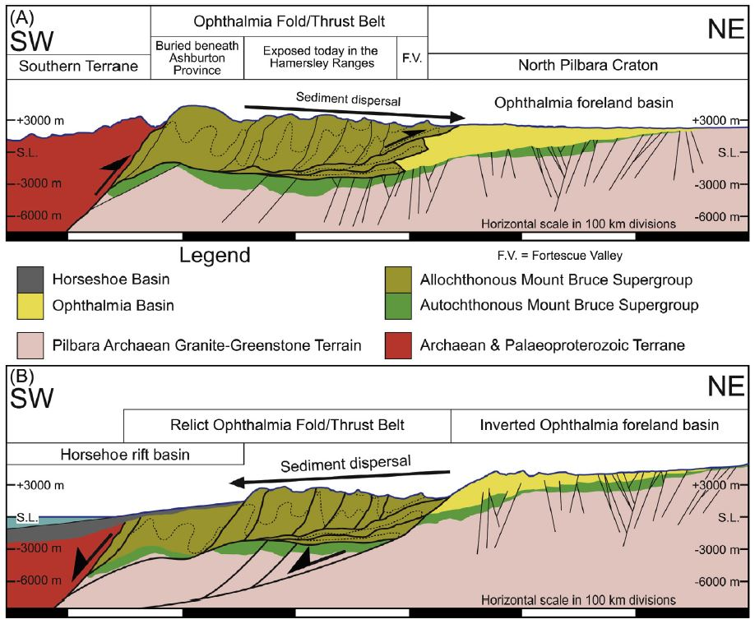
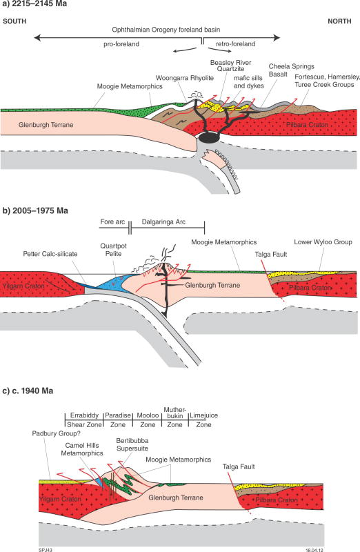
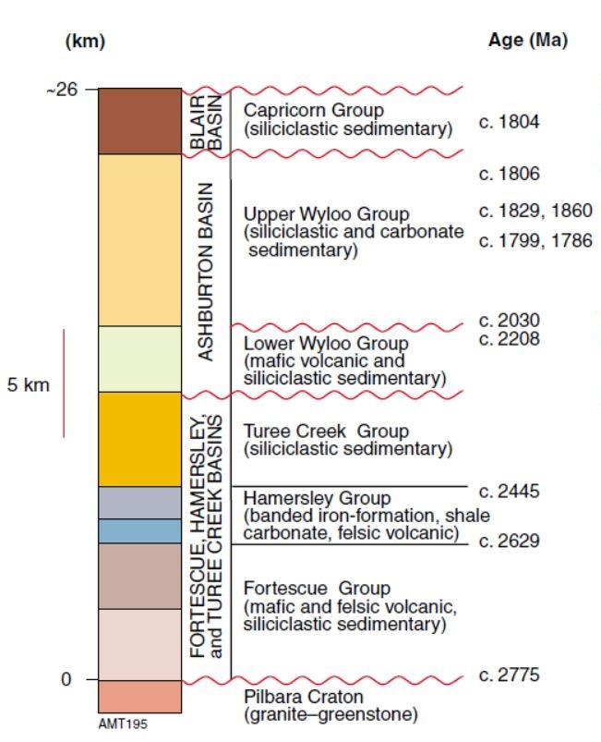
Previous interpretations
Pilbara–Yilgarn Craton convergence, followed by continental collision
Retroarc accretionary foreland basin, followed by continental collision (± intervening rift event)
Intracontinental basin or failed rift followed by collision
Retroarc basin followed by LIP, then foreland basin, rift and collision
2208 Ma
LIP
Horseshoe Basin
(<2050–2008 Ma)
65–370 myr
Turee Creek Basin
(2445–2420 Ma)
(Krapež et al., 2017)

Slide 5
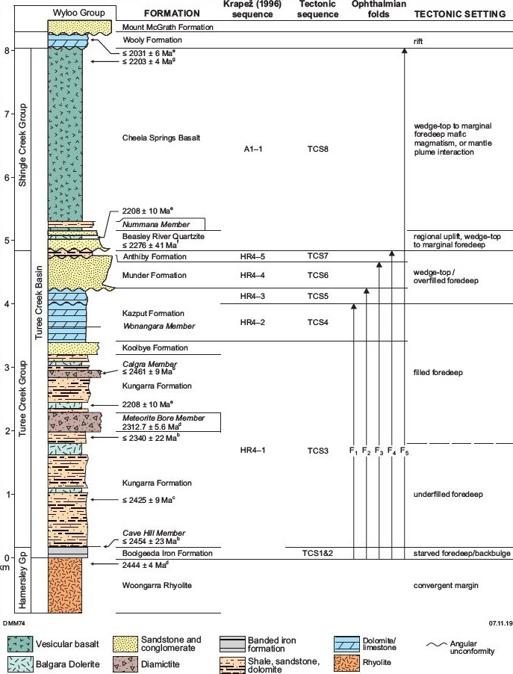
Stratigraphic revisions
2203 Ma
Boolgeeda Iron Formation and Kungarra Formation disconformities
Lithostratigraphy: 6 new units (incl. Balgara Dolerite) & 4 revisions (incl. Wooly Fm)
Improved geochronology
Significance of Balgara Dolerite & unconformities
2325 Ma
119 myr

Slide 6
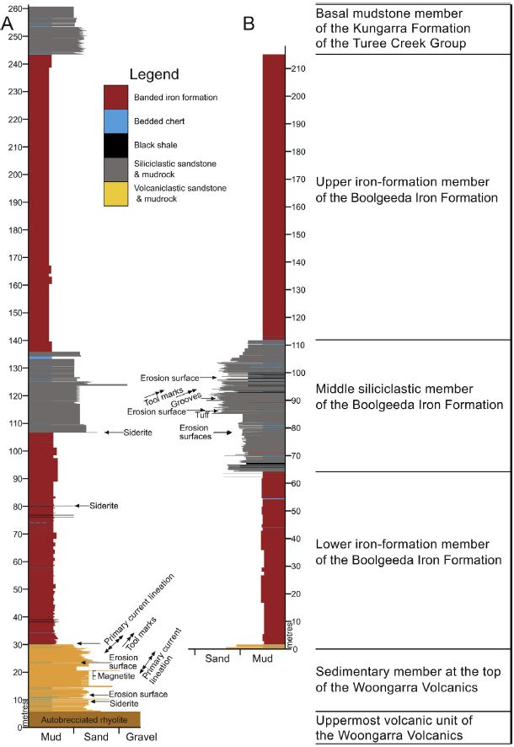
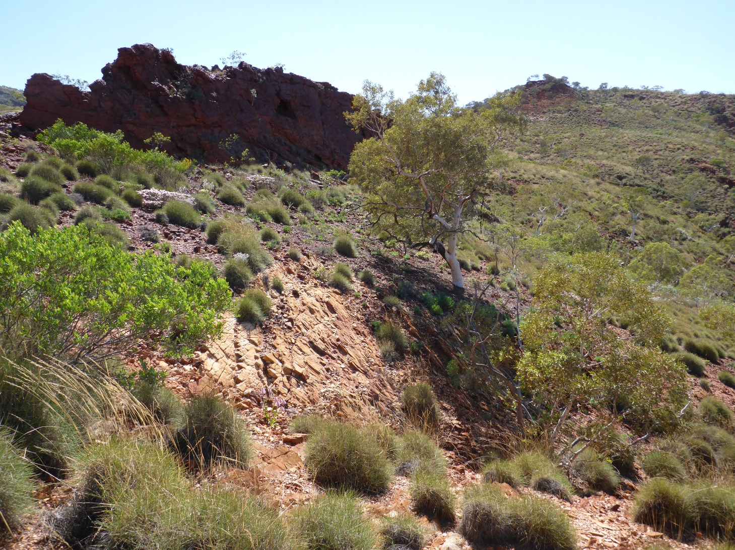
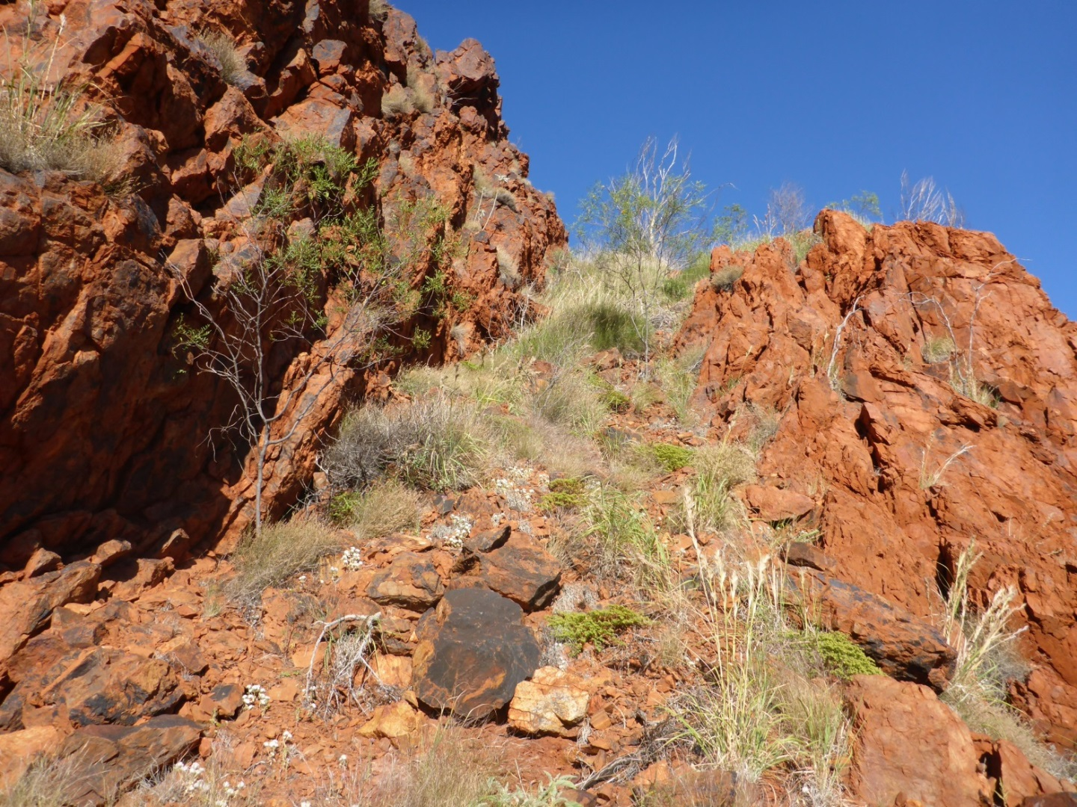
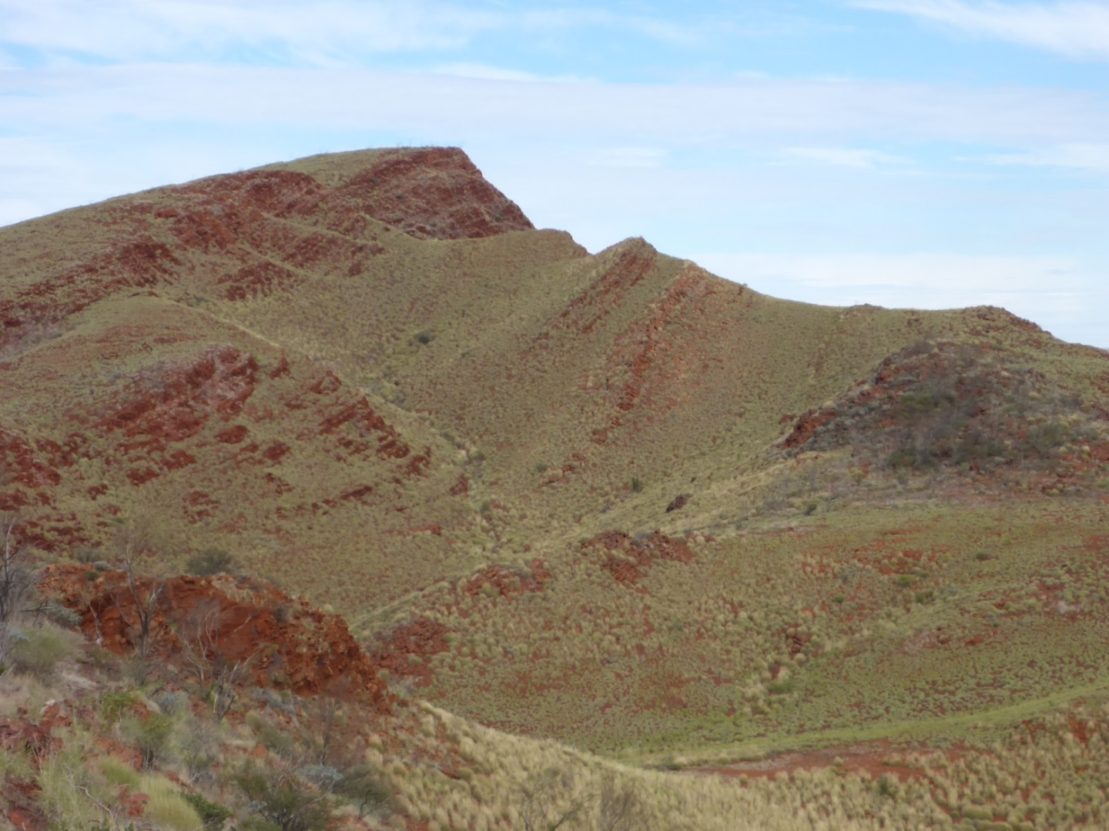
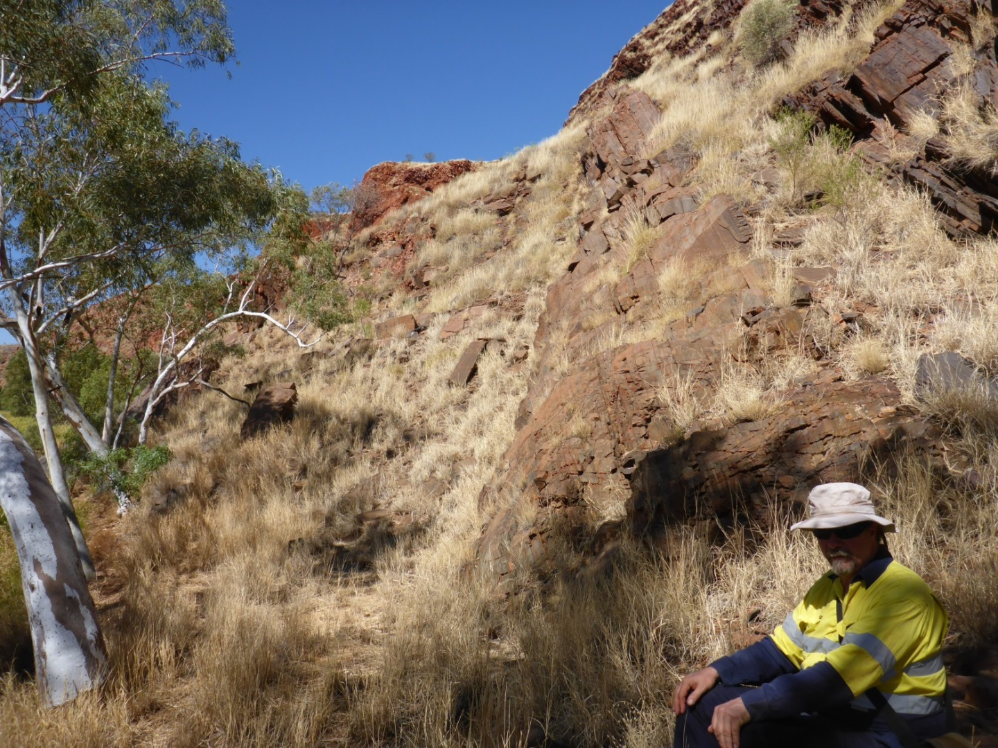
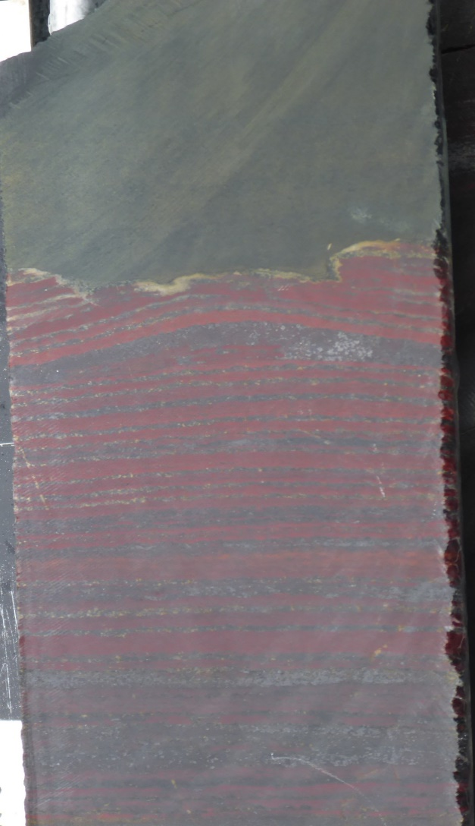
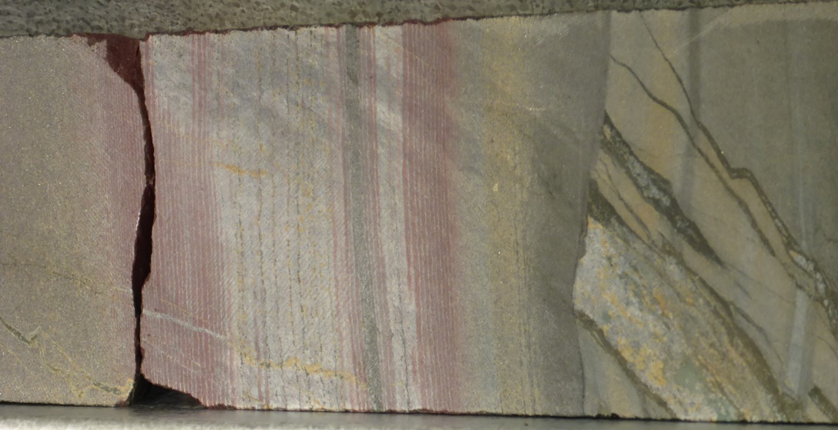
Boolgeeda revision
≤2454 ± 23 Ma
(Caquineau et al., 2018)
≤2446 Ma
(Simonson et al., 2014)
2 cm
2 cm
≤2445 ± 5 Ma
(Trendall et al., 2004)
2444 ± 4 Ma (Wingate et al., 2018)
(Krapez et al., 2017)

Slide 7
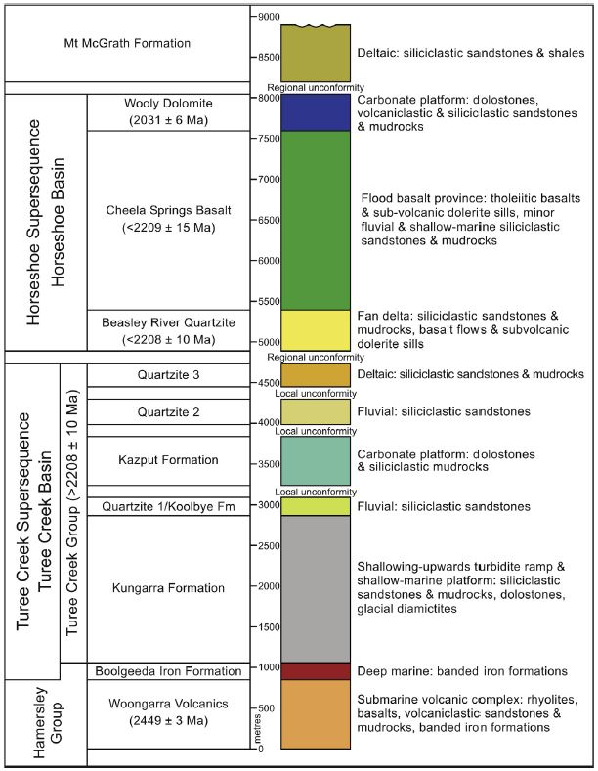
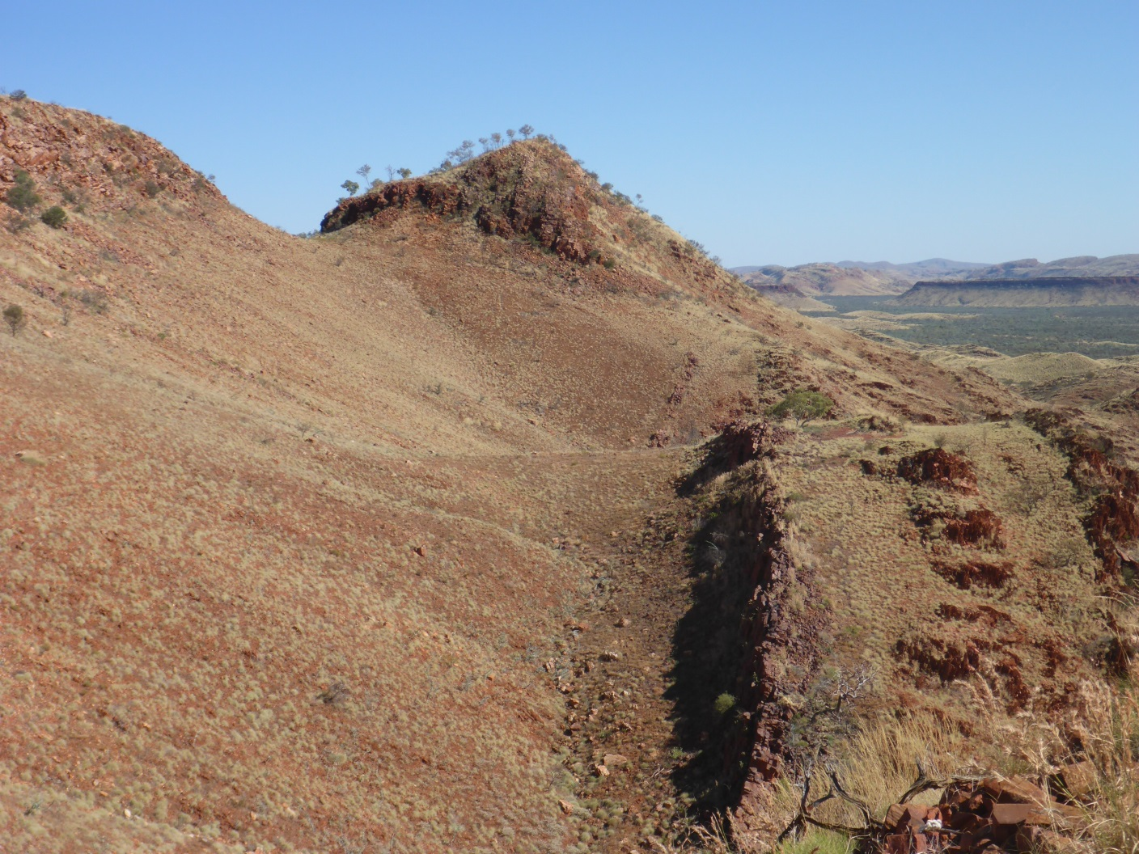
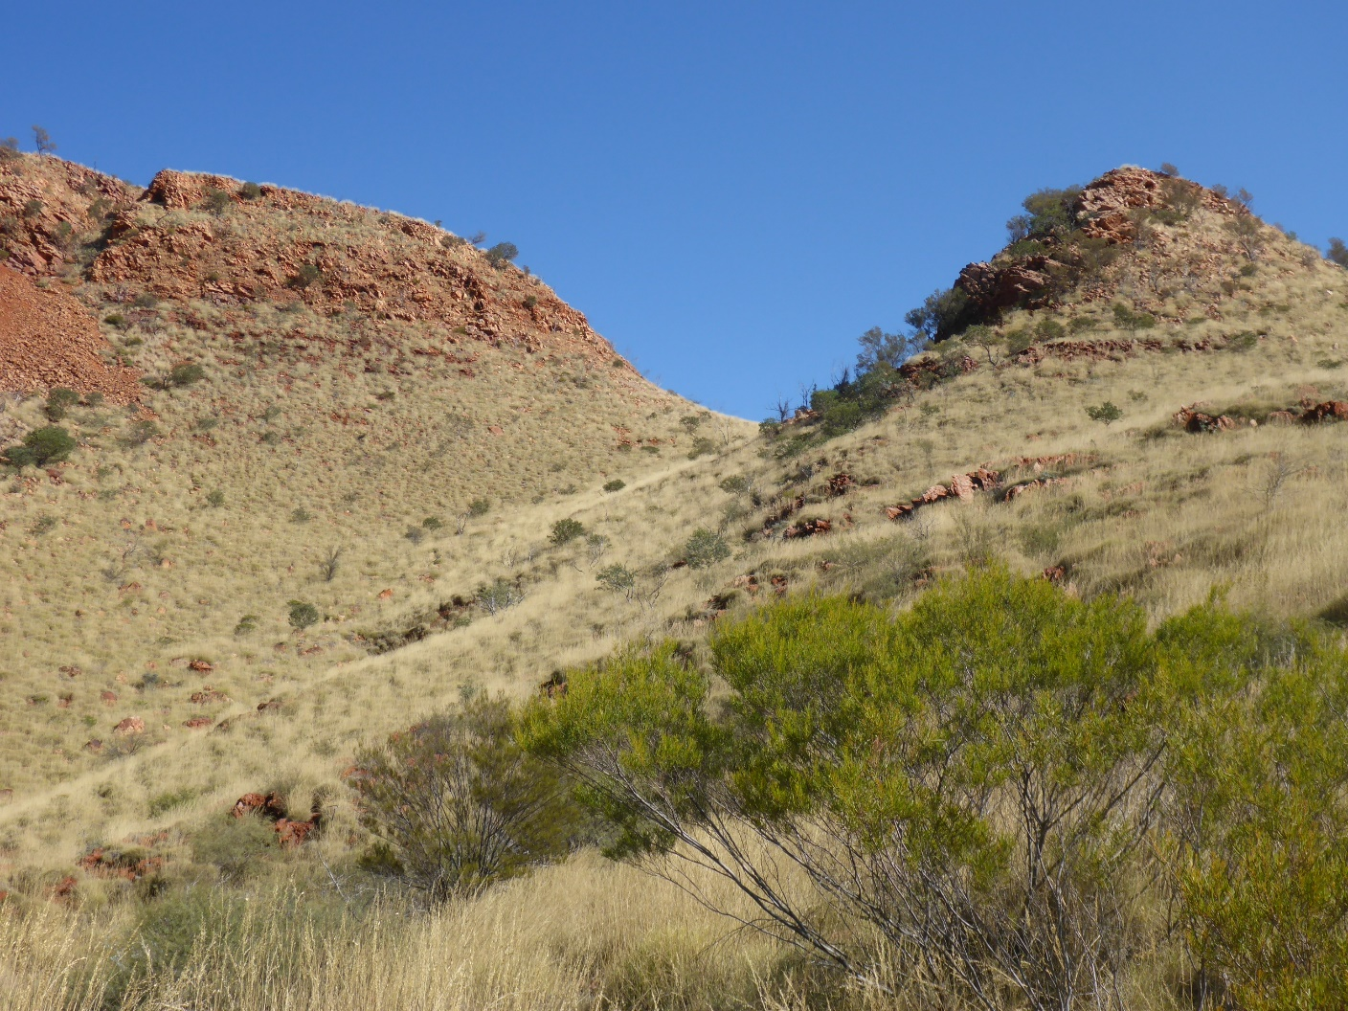
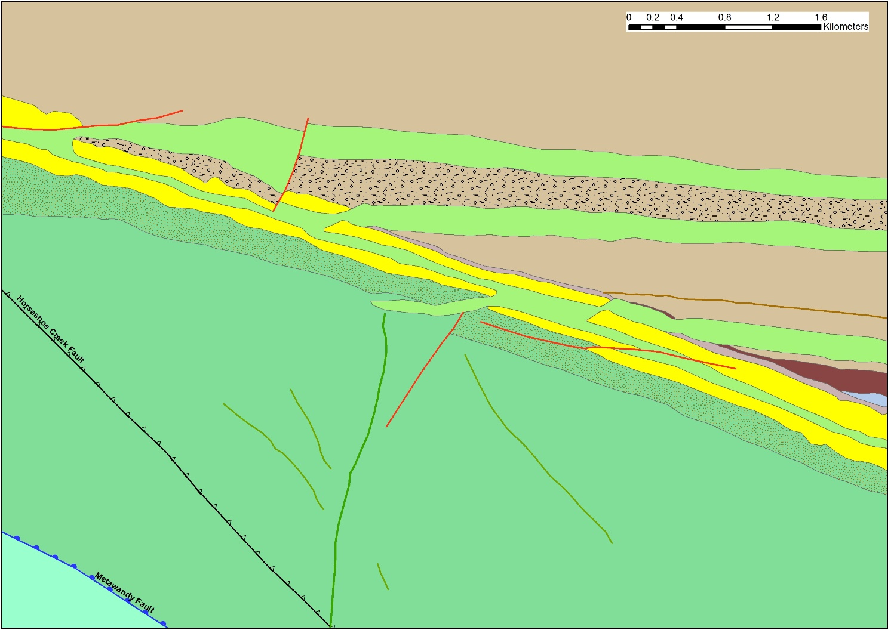
Significance of the Balgara Dolerite
≤ 2203 ± 4 Ma
Shingle Creek
Group
Balgara Dolerite
2208 ± 10 Ma
TCS
Anthiby Fm
Munder Fm
2208 ± 10 Ma
HS
(Krapež et al., 2017)

Slide 8
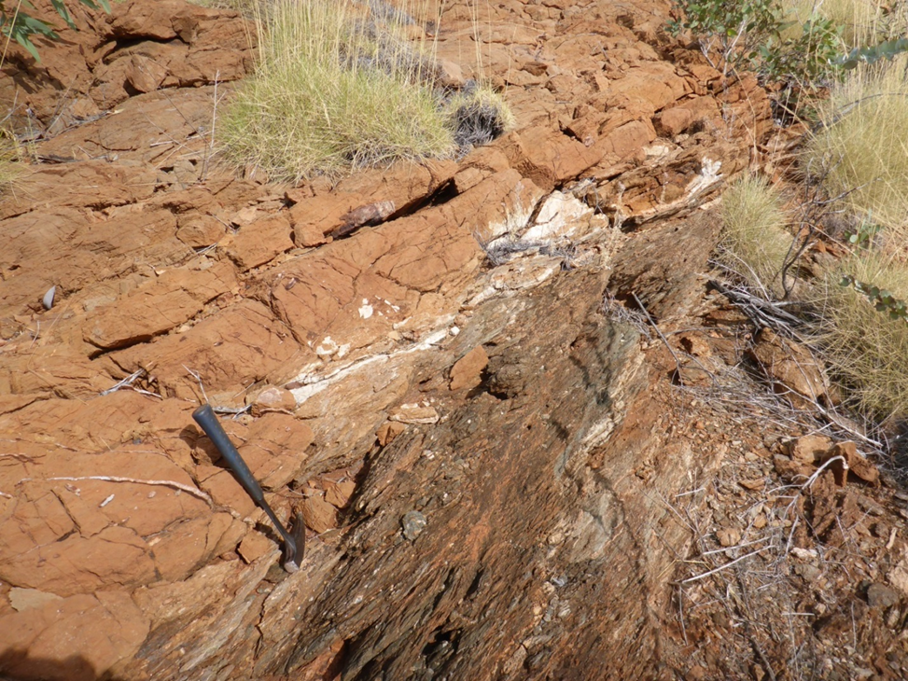
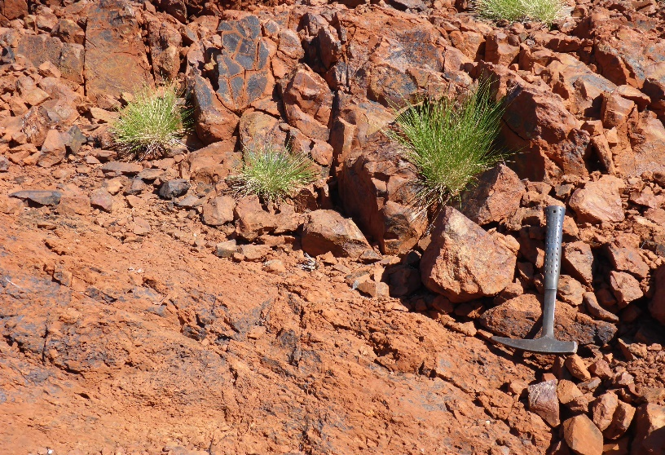
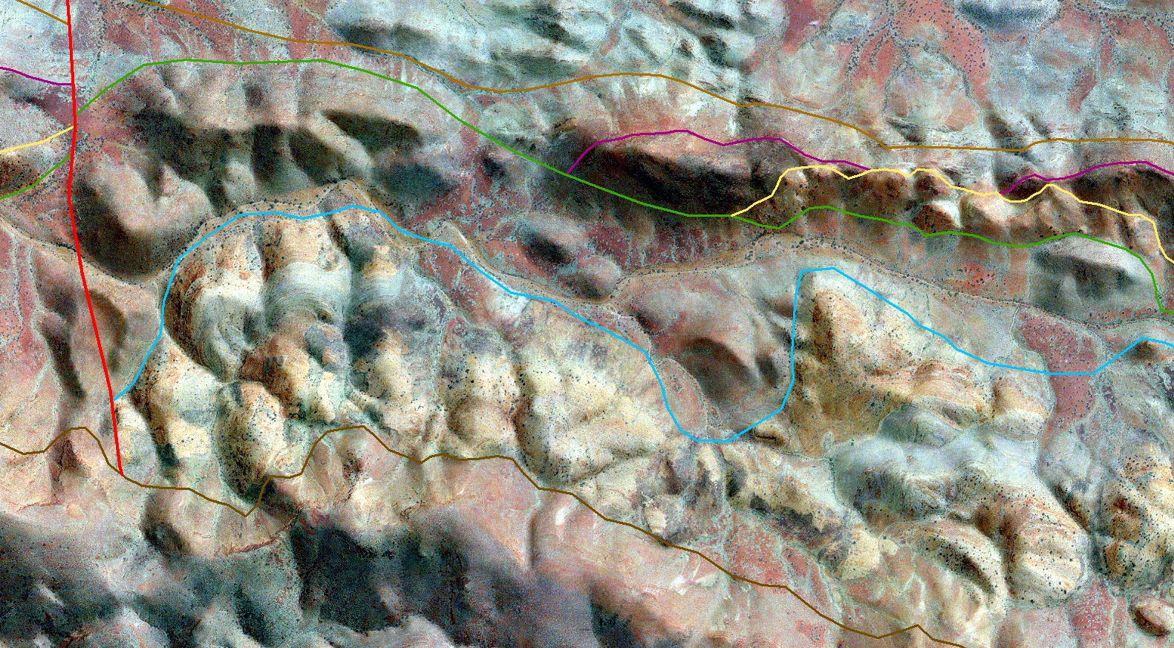
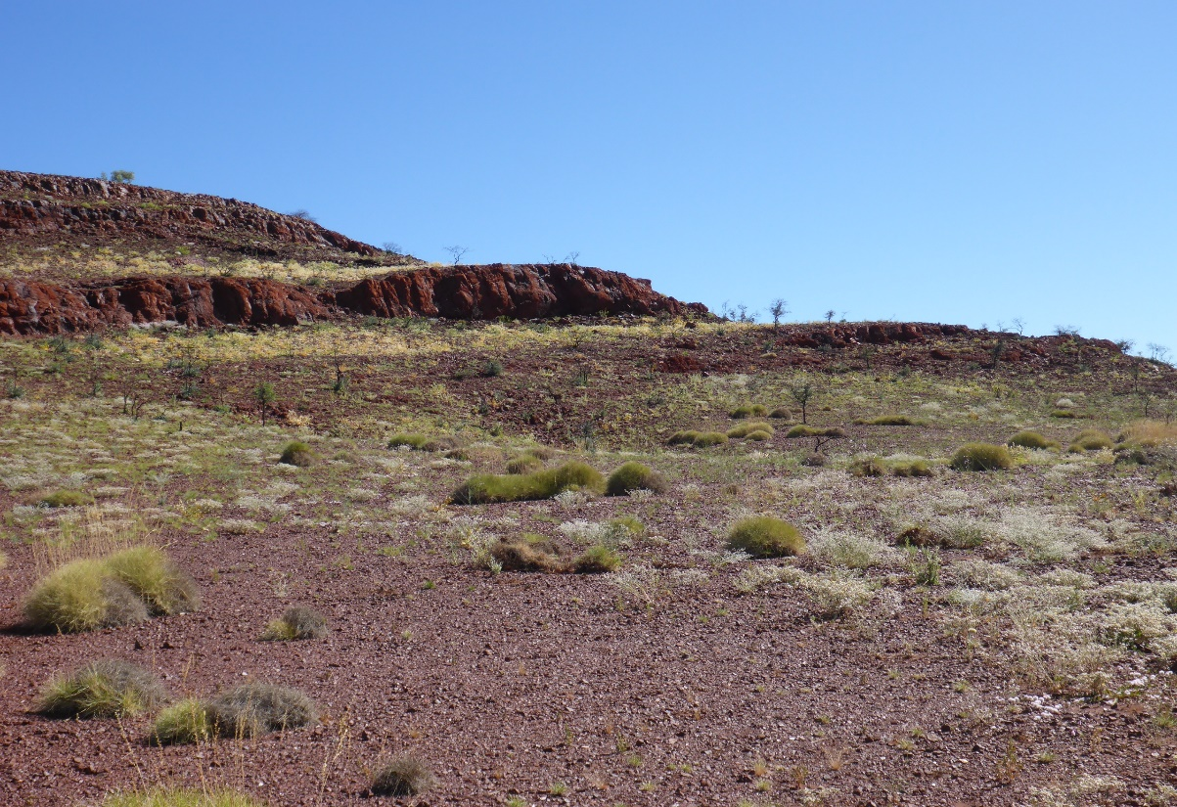
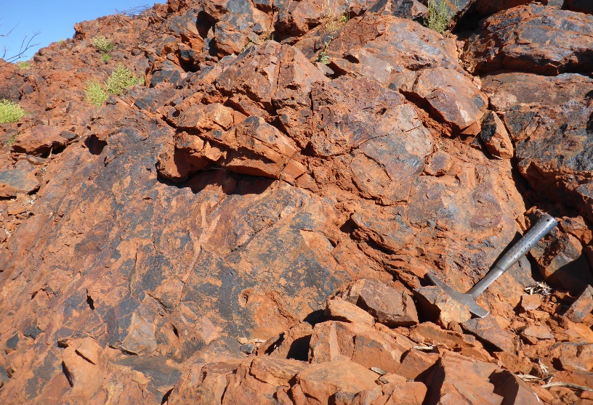
Wooly Formation unconformity
400 m

Slide 9
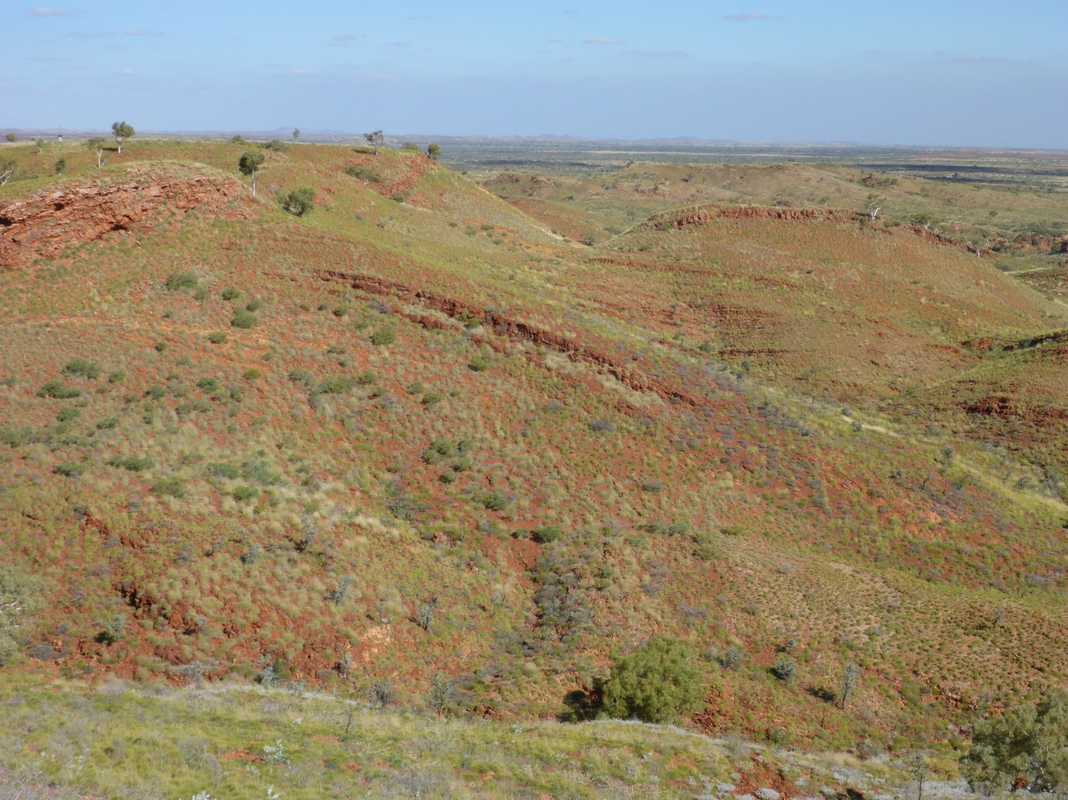
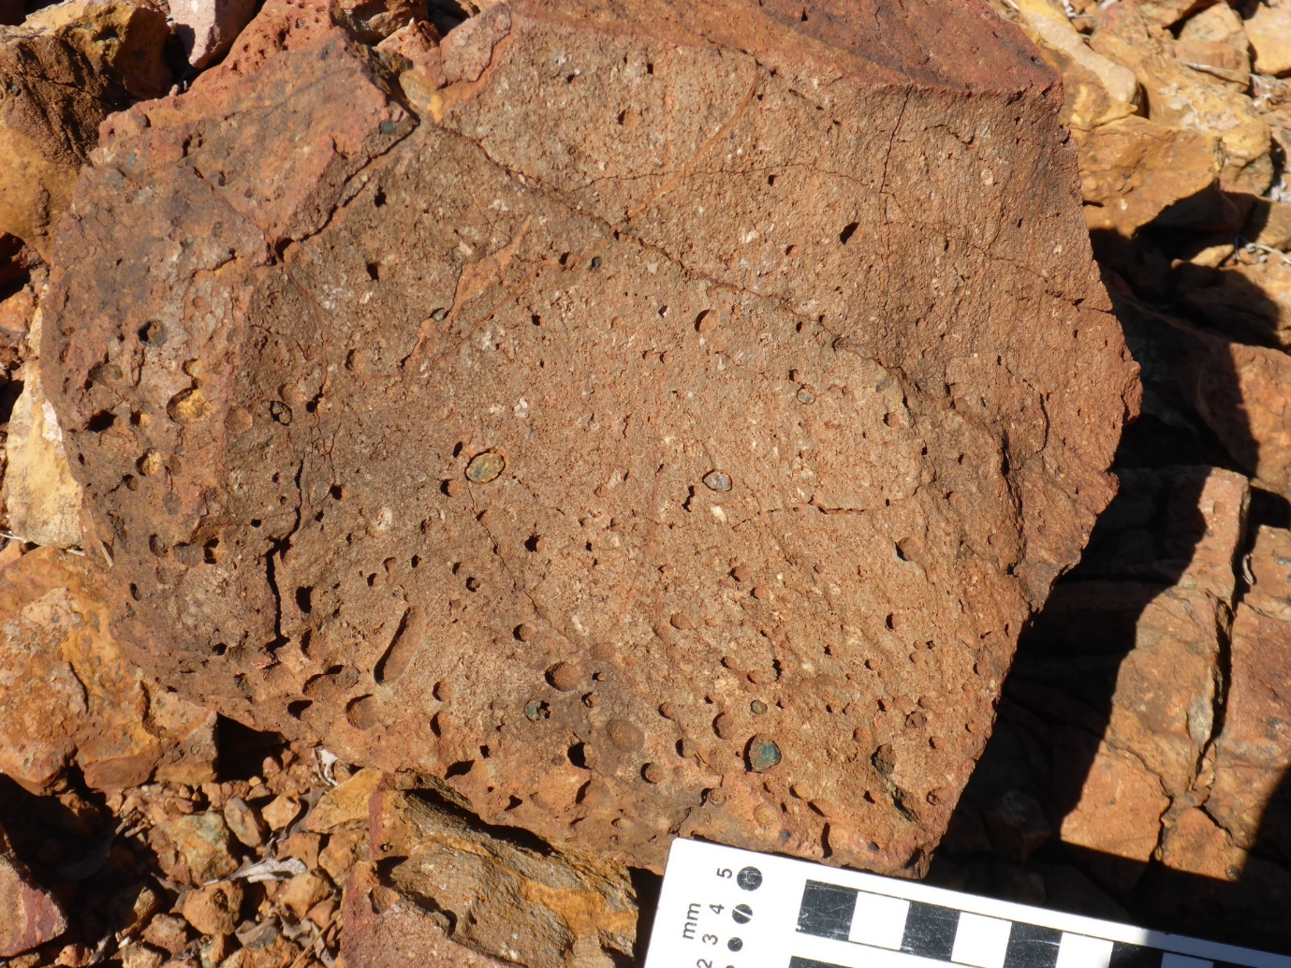
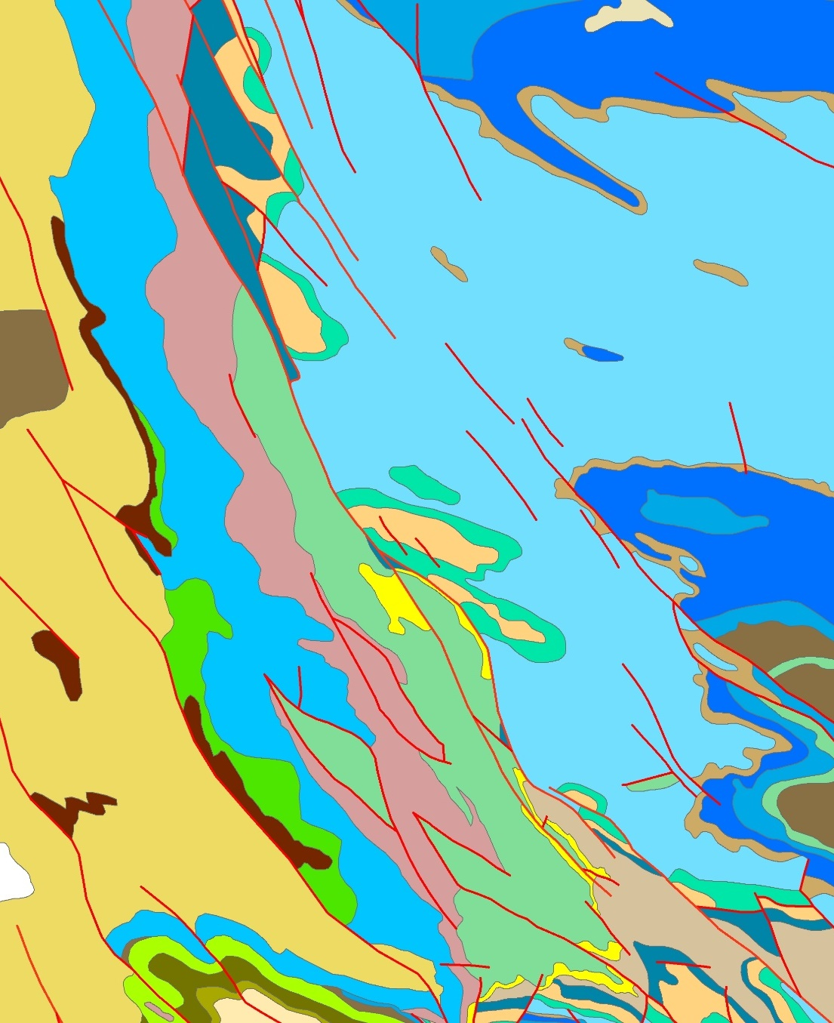
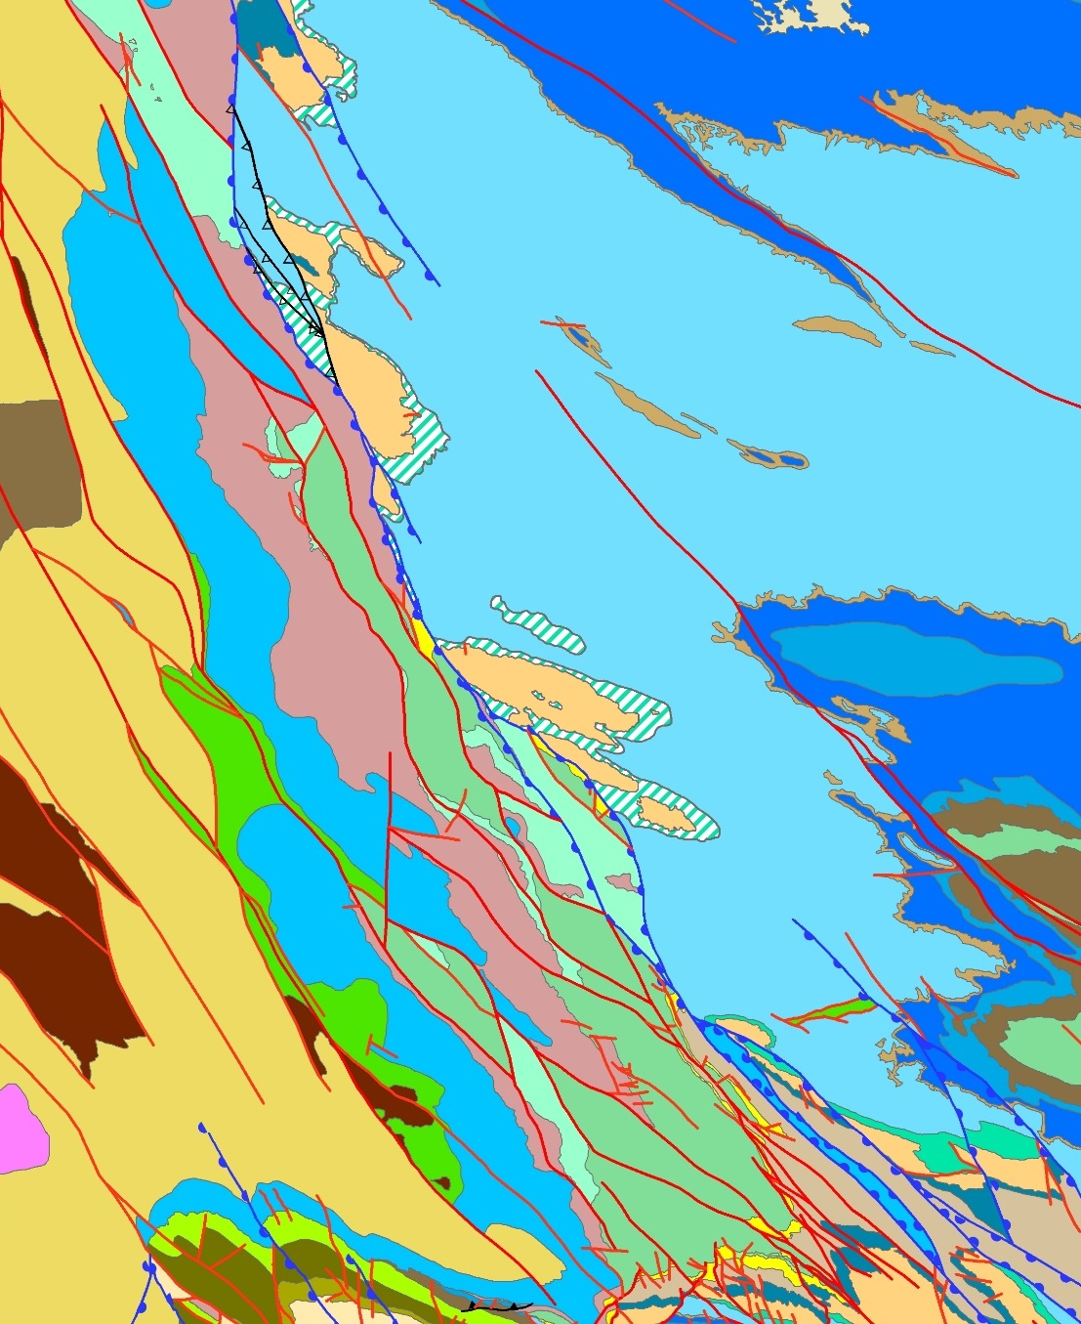
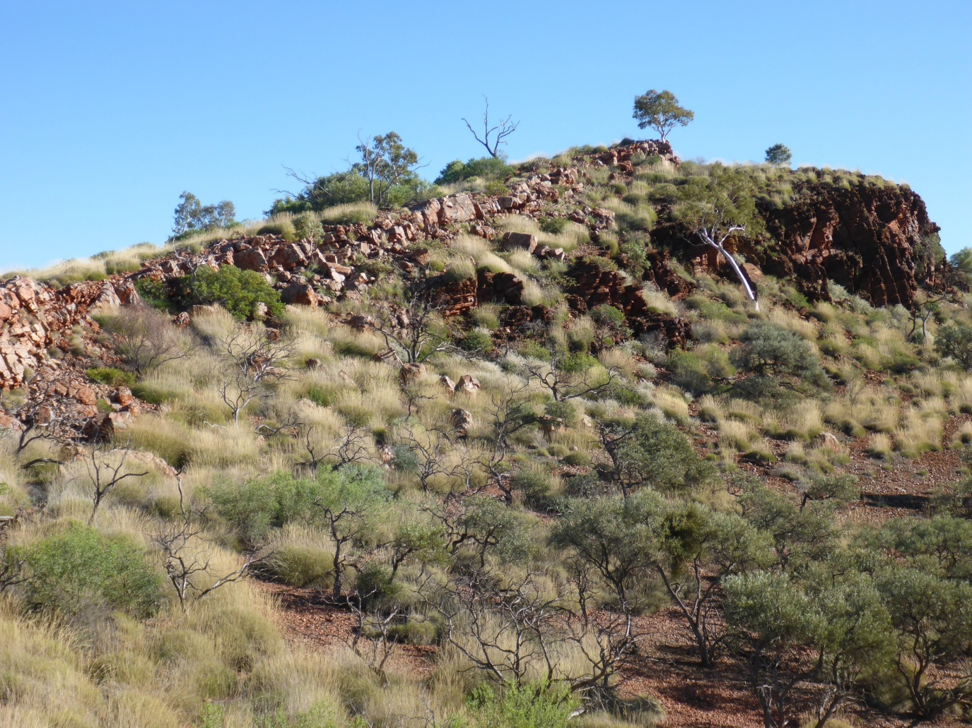
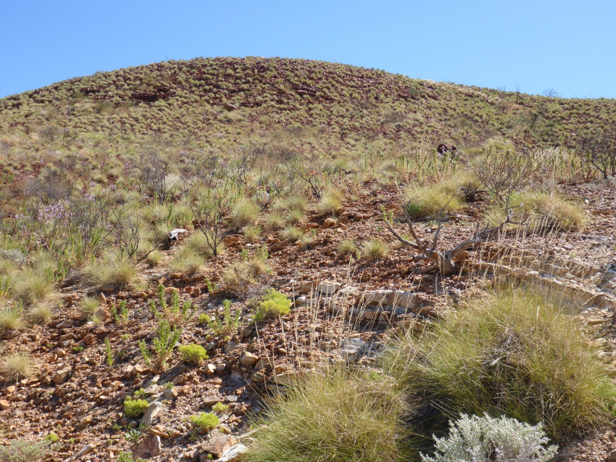
2016
2019
Red Hill copper
Mt McGrath reference section
Urandy Creek
Duck Creek

Slide 10
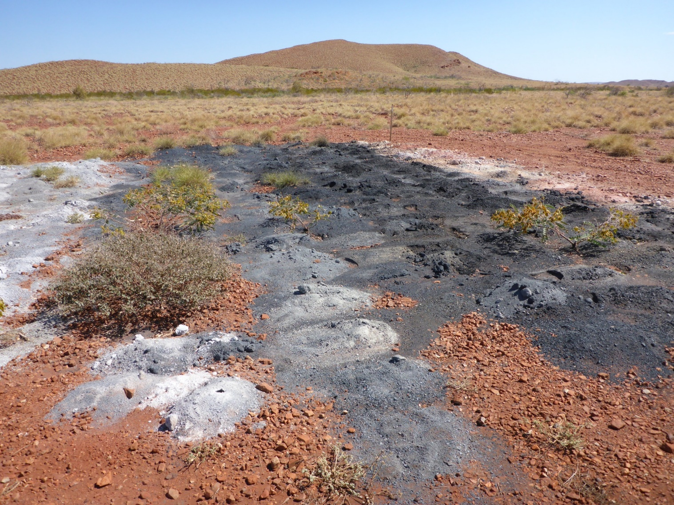
Mount McGrath
Hypogene iron ore
Red Hill
Supergene iron ore
Gold
Base metals
Merlin
Paulsens
Belvedere
Wellthandalthaluna
Tom Price
Mt McGrath
Mt Wall
Anthiby Well
Paraburdoo
Giles Mini
Lido
Channar
Mt Olympus
Mt Whaleback

Slide 11
Conclusions
Shingle Creek and Turee Creek Groups are temporally and genetically linked within the Turee Creek Basin by relationships to the c. 2208 Ma Balgara Dolerite
Folded unconformities, facies distributions, and provenance data suggest a retroarc foreland setting for the c. 2325–2203 Ma Turee Creek Basin
Revised Wooly Formation extends throughout the southwestern Pilbara Craton margin
This margin is delineated by mainly post-Ophthalmian normal faults, potentially related to Wooly Formation rifting c. 2031 Ma

Slide 12
Conclusions
Normal faults exert a strong structural control on the location of iron ore and orogenic gold deposits in the region
Wooly Formation pre-dates the 2002–1947 Ma Glenburgh Orogeny and may be partly coeval with the Bryah Basin
Minor dextral strike-slip reactivation is relatively late, but pre-750 Ma, and primarily localized along the far SW faults
The revised Wooly Formation hosts the > 1 moz Mt Olympus gold deposit and several prospects, as well as a Cu-Pb-Zn prospect at Red Hill, making it an important potential exploration target

