Slide 1

National Principles for
Child Safe Organisations
Notes:
Hello, everyone! I am thrilled to have you all here today to introduce the National Principles.
My name is [insert name] and I can’t wait to dive into this important topic together. Let’s make this a lively and insightful conversation.
This Children’s Week, we want to talk about the National Principles for Child Safe Organisations

Slide 2

Acknowledgment of Country
2
Notes:
I would like to respectfully acknowledge the [insert the appropriate Aboriginal and Torres Strait Islander language group – for example, Whadjuk Noongar people], the Traditional Custodians of the land on which we meet and pay my respects to Elders past and present.
I would also like to acknowledge the victims and survivors of child sexual abuse, particularly those who were brave enough to share their stories with the Royal Commission into Institutional Responses to Child Sexual Abuse and in doing so have ultimately increased safety for children and young people in organisations, as well as ensuring those who are yet to share their stories are listened to, believed and supported on a journey of healing when they choose to share their experiences.

Slide 3
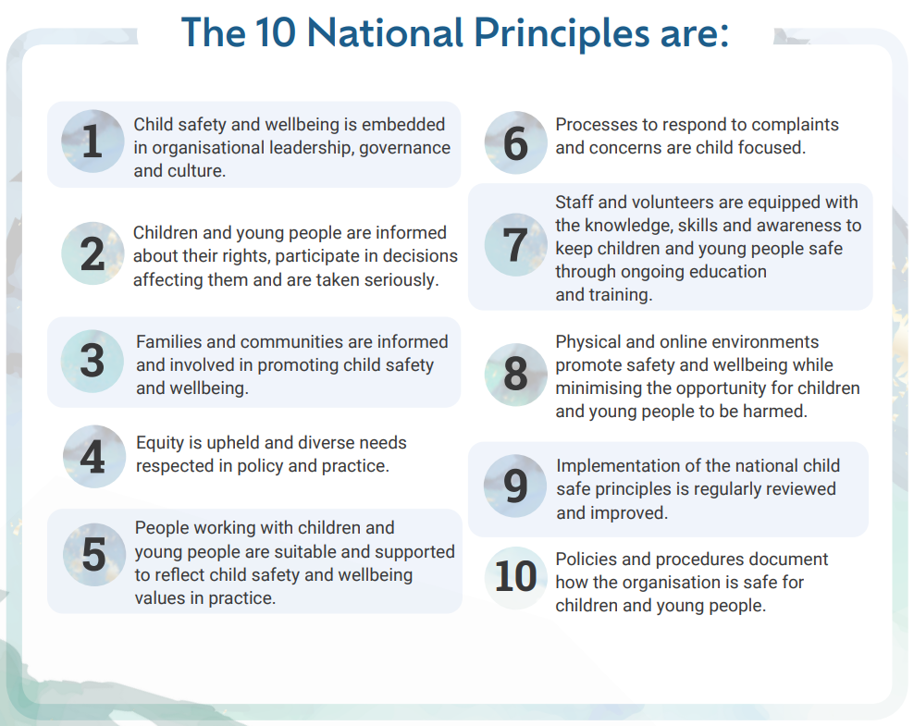
Notes:
The 10 National Principles for Child Safe Organisations, shown on the screen, were created in response to recommendations delivered by the Royal Commission into Institutional Responses to Child Sexual Abuse.
The National Principles were agreed nationally in 2019, based on the original Child Safe Standards identified by the Royal Commission, as ten key elements essential for increasing safety for children and young people in organisations.
Implementing the National Principles is not a tick-box exercise, and each Principle can be implemented in any order. All the Principles inter-relate, and collectively they make organisations safer for children.
By embedding the National Principles into your organisation, you begin to create a culture that adopts strategies and takes action to promote wellbeing for, and prevents harm to, children and young people.

Slide 4
What is a Child Safe Organisation?
Child safe organisations create cultures where the safety and wellbeing of children and young people is prioritised and actions are taken to identify risks and protect children from harm, including from sexual abuse.
Organisations who embed the National Principles provide environments where child sexual abuse is better prevented, identified, reported and responded to.
Notes:
A child safe organisation prioritises creating an environment where children's safety and well-being are paramount. This means the organisation takes steps to promote well-being and prevent harm to children and young people.
Children and young people’s safety and well-being is the centre of thought, values and actions, with emphasis on genuine engagement with and valuing of children.
Child safe organisations can respond appropriately to any concerns, disclosures, allegations or suspicions of harm.

Slide 5
Who needs to implement the National Principles?
The WA Government is encouraging organisations across the state who engage with children and young people to implement the National principles.
In Western Australian (WA), there are approximately 25,000 organisations in scope of implementation of the National Principles where children and young people engage.
Notes:
The Royal Commission recommended organisations involved in specific areas of child-related work to implement the National Principles.
In Western Australia, there is an understanding and expectation that all organisations should consider the safety of children a priority.
If your organisation engages with children and young people then the National Principles should be implemented. This includes as staff, recreation activities and receiving a paid or unpaid service.
Those organisations who interact with families that include children are also encouraged to implement the National Principles.

Slide 6
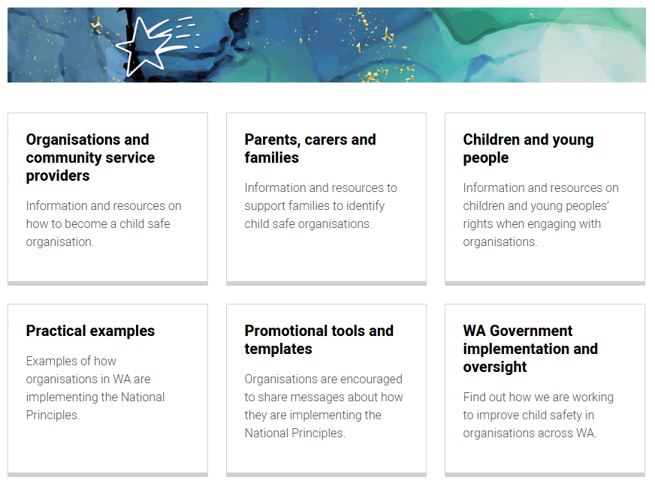
Child Safe Organisations Knowledge Hub
Information and resources
Document templates
Self-assessment tools
Guidelines
Available events, live webinars and previous recordings
Organisation examples
www.communities.wa.gov.au/childsafeorgs
Notes:
With support from the community sector, the Western Australian Government has created the Child Safe Organisations Knowledge Hub to help build organisational capacity and support whole-of-community implementation of the National Principles.
The Knowledge Hub has separate resources targeted to organisations, families, parents and carers and children and young people.
Launched in September 2023, the Knowledge Hub also provides specific information to assist organisations to get started in their journey, including case studies.
A key resource is the National Principles Self-assessment and Review Tool, developed by the Commissioner for Children and Young People.
Utilised with the Guidelines, the self-assessment tool helps organisations to identify any gaps and areas of strength for children and young people’s safety.
To access the Knowledge Hub directly go to www.communities.wa.gov.au/childsafeorgs or google ‘Safer WA’.

Slide 7
Next steps
Organisations – find the Knowledge Hub and check out the Getting Started tab.
Parents, carers and families – ask organisations, where your children are involved, how they are implementing the National Principles
Children and young people – ask how you can have a say in the organisations where you participate.
Every organisation has a responsibility to keep children and young people safe
Notes:
The theme for WA Children Week in 2025 is “Everyone should know about children’s rights!”.
In Western Australia in 2025, there is a focus on the second National Principle, “Children and young people are informed about their rights, participate in decisions affecting them and are taken seriously”.
The WA Government is committed to the implementation of the National Principles and building capacity of our communities to create a safer WA for children.
Every organisation has a responsibility to keep children and young people safe.

Slide 8

csaroyalcommission@communities.wa.gov.au
Notes:
The QR code on this slide will take you directly to the Child Safe Organisations Knowledge Hub where you can join up to the Child Safe Organisations mailing list to be kept up to date with National Principles.
You can also google ‘SAFER WA’ to be directed to the Knowledge Hub, as well as information to how the WA Government are implementing recommendations from the Royal Commission.
Please be encouraged to email the Department of Communities Royal Commission Implementation Team if you have questions, their email address is shown on the screen.
Thank you for your time today.

