Slide 1

CoastWA Training
Coastal Adaptation Options Analysis
Presented by
Trent Hunt - M P Rogers & Associates

Slide 2
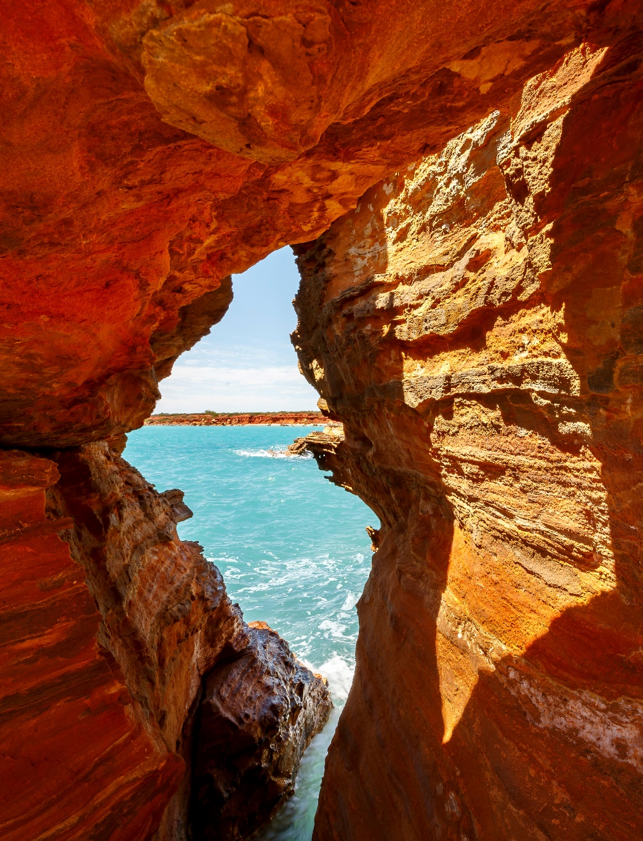
Training Modules
Coastal Processes
Coastal Protection Works
Benefit Distribution Analysis
Coastal Hazard Assessments
Vulnerability Analysis & Risk Evaluation
CHRMAP Implementation
CoastAdapt Refresh
Coastal Adaptation Options Analysis
Red Rocks, Broome

Slide 3
Overview
What is an Adaptation Options Analysis?
When are they needed / how are they used?
How are the options developed?
When and how to involve the community?
What options should be considered and how are they assessed?
How and when are they implemented?
Examples and lessons learnt

Slide 4
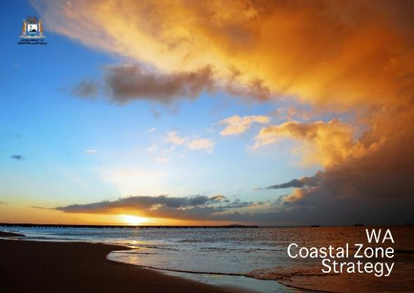
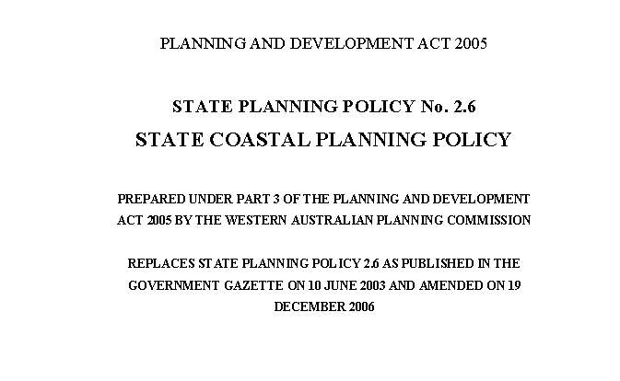
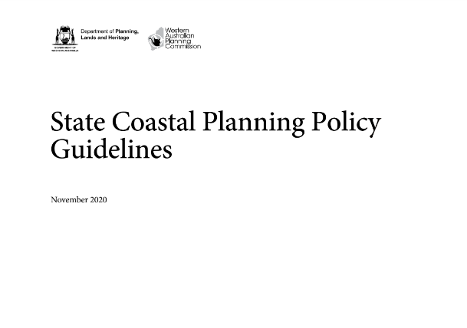
References & Documents
WA Coastal Zone Strategy
SPP2.6 State Coastal Planning Policy
SPP2.6 State Coastal Planning Policy Guidelines

Slide 5
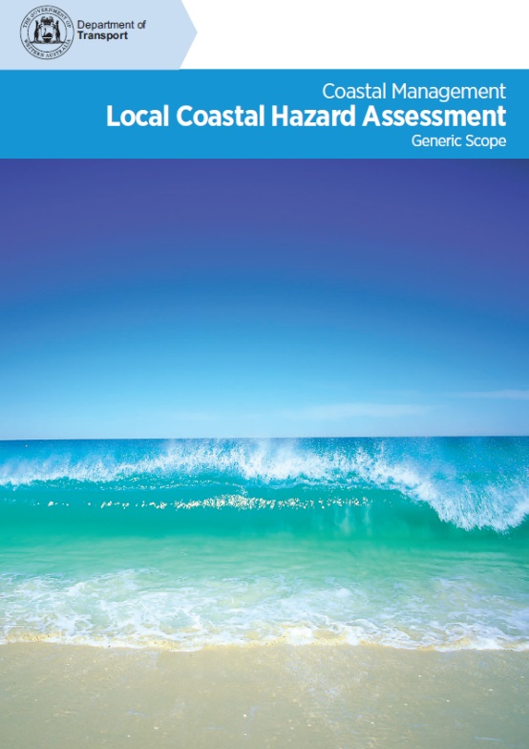
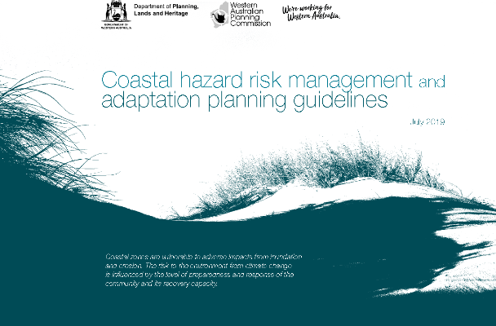
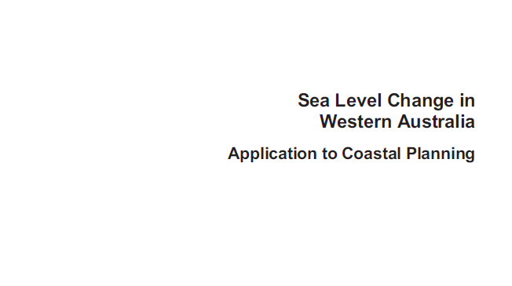
References & Documents
Coastal hazard risk management and adaptation planning guidelines
Local Coastal Hazard Assessment
Sea Level Change in Western Australia

Slide 6
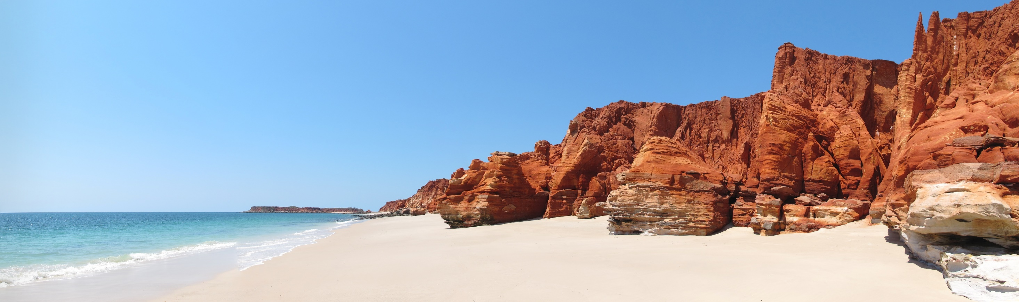
What is Coastal Adaptation?
Kimberley Cliffs near Broome

Slide 7
Coastal Adaptation
An adjustment in natural or human systems in response to actual or expected stimuli or their effects, which moderates harm or exploits beneficial opportunities. Adaptation is the means for maximising the gains and minimising the losses associated with coastal hazards over the planning timeframe.
In context of WA Coastal Planning, the response to the impacts of coastal hazards

Slide 8
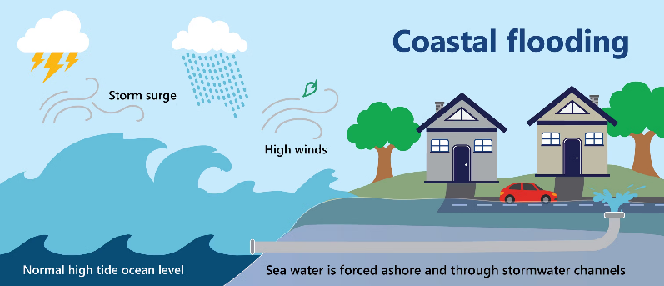
Coastal Hazards
Defined under SPP2.6 as:
  “the consequence of coastal processes that affect the environment and safety of people.”
They are a source of potential harm
Can include:
  Erosion
  Inundation
Assessed through Coastal Hazard Assessments, presented in earlier modules
From Coastadapt

Slide 9
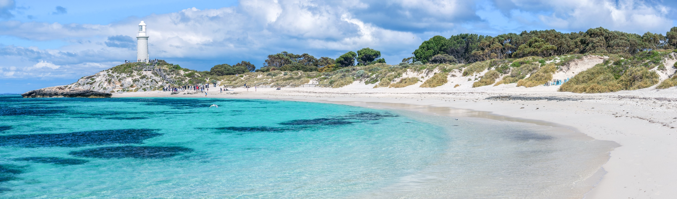
What is an Adaptation Options Analysis?
Rottnest Island

Slide 10
Adaptation Options Analysis
Process of identifying and analysing various strategies or actions to mitigate the impacts of coastal hazards
Aims to develop and ultimately implement an adaptation plan, strategy or action
Example Adaptation Pathways (CoastAdapt)

Slide 11
Adaptation Options Analysis Process
Framing
Identify problem and risks
Identify objectives
Identify values
Stakeholder Engagement & Input
At all stages
Identify Range of Options
Identify all potential options
Consider hierarchy
Filter & Refine Options
Identify any fatal flaws
Develop shortlist of options
Refine appropriate options
Analysis of Options
Multi-Criteria Analysis
Cost Benefit Analysis
Confirm Trade-offs
Consider impacts and trade-offs
Get acceptance from stakeholders
Recommendations
Preferred option
Further investigations
Further design
Implementation Planning
Preferred option
Triggers
Monitoring

Slide 12
Adaptation Options Analysis
Used to develop preferred option (pathway, strategy or action)
Used to develop an implementation plan
Can be completed as part of the Coastal Hazard Risk Management & Adaptation Planning process, or detailed assessment following

Slide 13
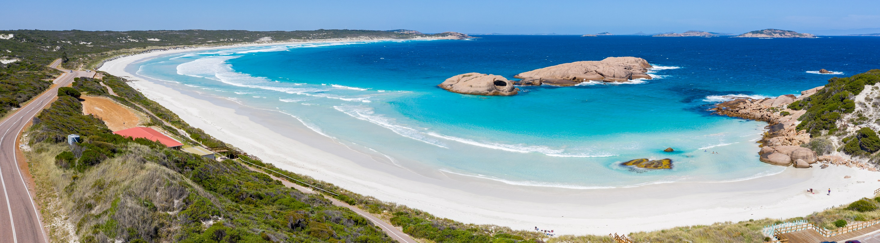
CHRMAP Stages
Twilight Cove, Esperance

Slide 14
Coastal Hazard Risk Management & Adaptation Planning
CHRMAP under SPP2.6 & CHRMAP Guidelines
Stage 1 – Establish the Context
Stage 2 – Risk Identification
Stage 3 – Vulnerability Assessment
Stage 4 – Risk Evaluation
Stage 5 – Risk Treatment
  Coastal Adaptation Options Analysis
Stage 6 – Implementation Plan

Slide 15
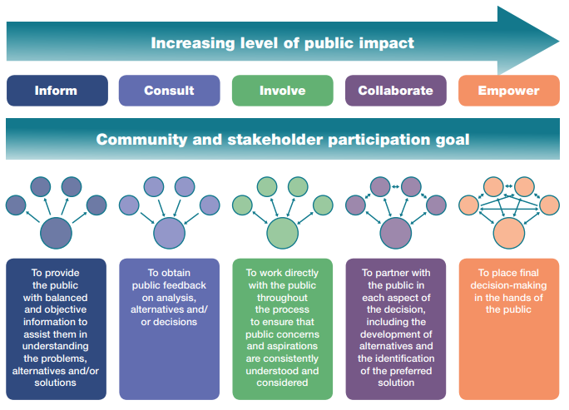
Stage 1 – Establish Context
Determine purpose
Determine objectives
Determine scope
Determine study area
Determine values
Determine existing controls
Determine success criteria
Community consultation important

Slide 16
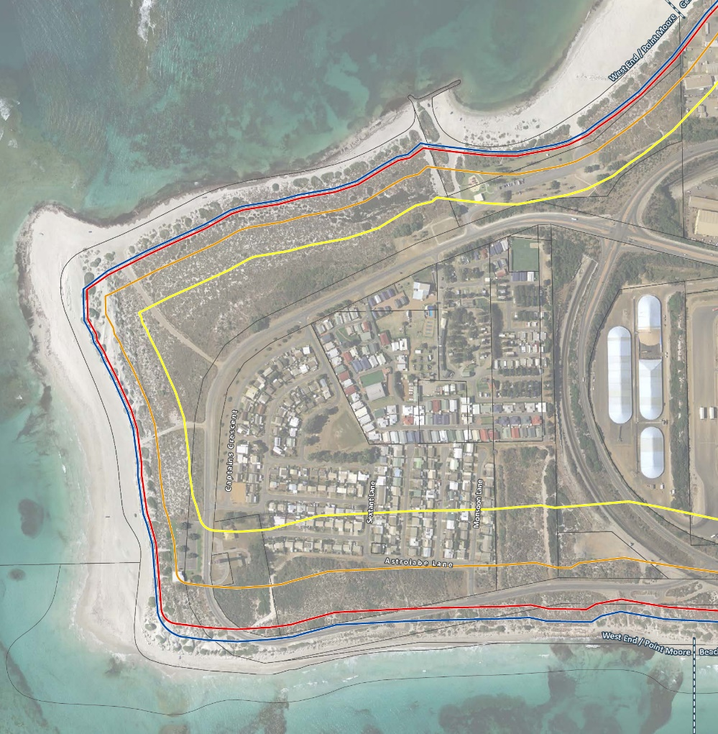
Stage 2 – Risk Identification
Coastal hazard identification
Asset identification
Hazard mapping

Slide 17
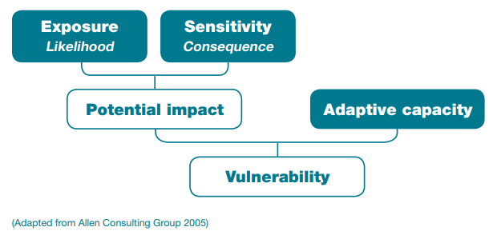
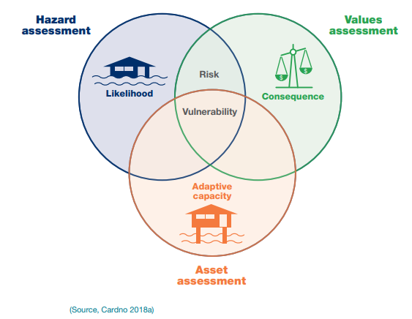
Stage 3 – Vulnerability Assessment

Slide 18
Stage 4 – Risk Evaluation
Aims to prioritise risk management measures
Consider impact of existing controls
Re-evaluate risks once impacts of existing controls have been reviewed
Updated risk assessment can be used to set priorities for risk treatment

Slide 19
Priorities for Risk Treatment
The risk and vulnerability tolerance scales should be used to identify risks that require treatment
Once it is identified that treatment is required, the level of vulnerability should inform the priority for treatment
Risk treatment options should include consideration of both erosion and inundation, noting that different areas may require different treatments

Slide 20
Stage 5 – Risk Treatment
Considers how to respond to the risk and asset vulnerability
Assessed risk treatment options
Often referred to as coastal adaptation options
Identifies risk management pathways and triggers

Slide 21
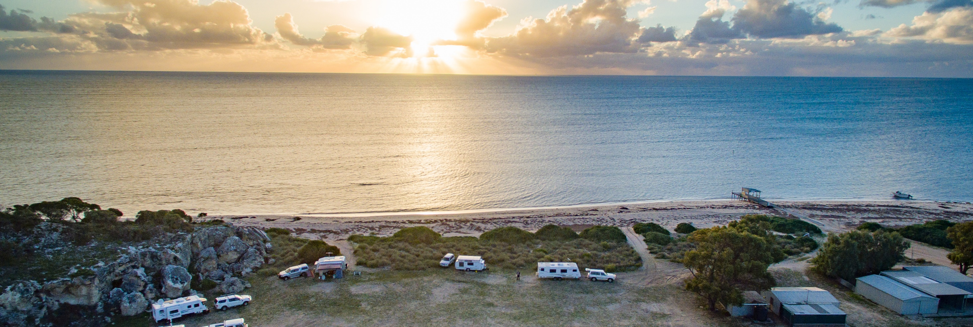
When is an Adaptation Options Analysis needed and how are they used?
Dongara

Slide 22
When are Adaptation Options Required?
When Risk Evaluation has determined risks intolerable
Risk Treatment has been determined to be required
Risk treatment = Adaptation Option
Can be completed as part of CHRMAP process
May be completed following CHRMAP
  More detailed assessment
  Refine options or consider additional data

Slide 23
How is Adaptation Options Analysis Used?
To develop appropriate Adaptation Options
  Meet objectives and values
  Reduce risks
  Enhance benefits
To compare between potential options
To determine appropriate implementation pathways and triggers

Slide 24
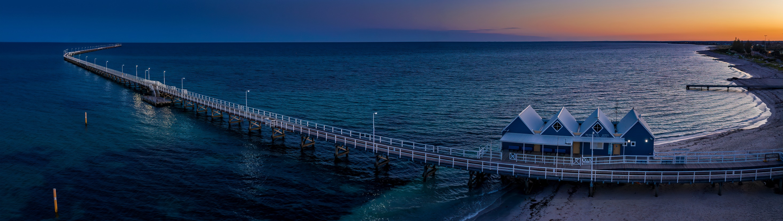
How are they Developed?
Busselton Jetty

Slide 25
Adaptation Option Development
Define specific site objectives and constraints
Understand coastal values of community and stakeholders
Likely completed in earlier stages
  Values can change
  Objectives can change
  Risks can change
Work with stakeholders

Slide 26
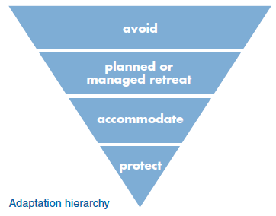
Adaptation Option Development
Important to consider and assess the full range of risk treatments
Consider options across a range of criteria
Consider options on a hierarchy
May determine strategy, then option

Slide 27
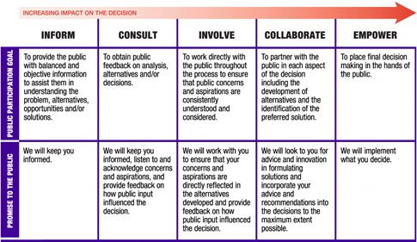
Community & Stakeholder Involvement
Determine community and stakeholder engagement strategy
Input from community through process
Consider Community Engagement Panel or Reference Group
Allows collaborative input to
assessment

Slide 28
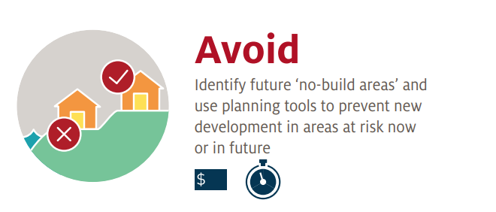
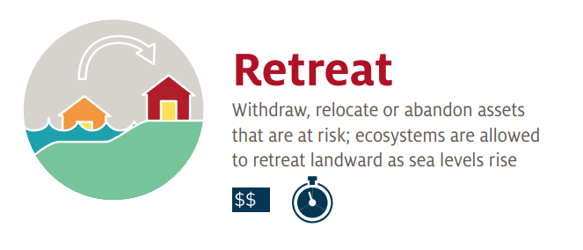
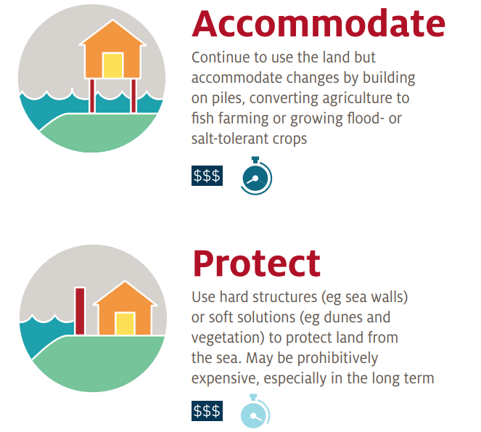
Risk Management & Adaptation Hierarchy
Considers retention of decision-making flexibility
Options which retain flexibility preferred
Four broad categories identified
  Avoid
  Planned or Managed Retreat
  Accommodate
  Protect
Adaptation options assessed down hierarchy

Slide 29
Risk Management & Adaptation Hierarchy
AVOID
Avoid construction of new assets within coastal hazard areas
Preferred risk treatment option where possible
Largely applies to greenfield locations

Slide 30
Risk Management & Adaptation Hierarchy
PLANNED OR MANAGED RETREAT
Aims to preserve coastal assets, public access, recreation, conservation and foreshore management
Involves relocating or sacrificing infrastructure, both public assets and private property, when erosion and recession impacts reach action trigger points
May also be at asset end of life

Slide 31
Risk Management & Adaptation Hierarchy
ACCOMMODATE
Utilise design and management strategies which render the risks as tolerable/acceptable, allowing land to continue to be utilised until risks become intolerable
May include a mix of structural or non-structural approaches
Can switch to retreat options later

Slide 32
Risk Management & Adaptation Hierarchy
PROTECT
Protect assets from impacts of erosion and inundation
Should be primarily in public interest
Should be congruent with coastal processes and assets

Slide 33
No Regrets Options
Aim to retain flexibility and improve resilience
Options which address long term impacts and short term conditions
Often cover the time while the preferred risk treatment option is being determined
Prior to implementing long term adaptation works

Slide 34
Do Nothing
Accept losses
Assumes that current risk levels are tolerable
Can provide a basis for comparison
May result in reactive action to hazards as they occur
Requires careful stakeholder information

Slide 35
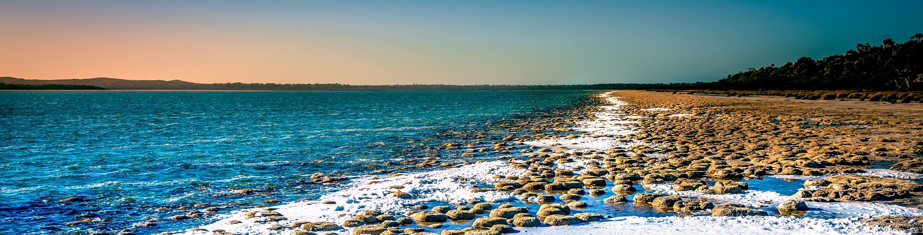
Adaptation Options
Lake Clifton

Slide 36
Range of Adaptation Options
Hierarchy presented categories of options
All potential options considered
Work through hierarchy
Indicative treatments for each category presented

Slide 37
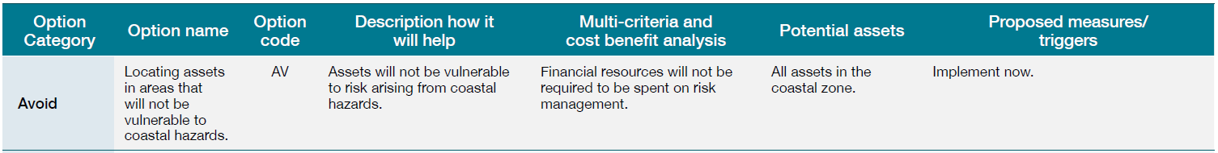
Avoid Options

Slide 38
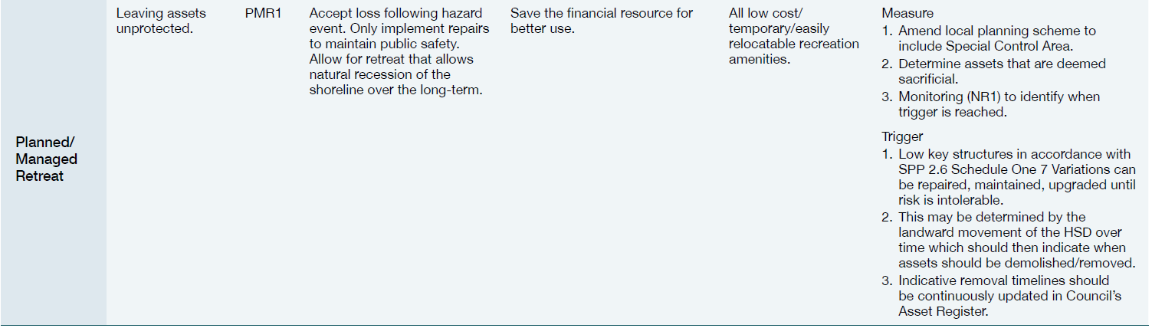
Retreat Options

Slide 39
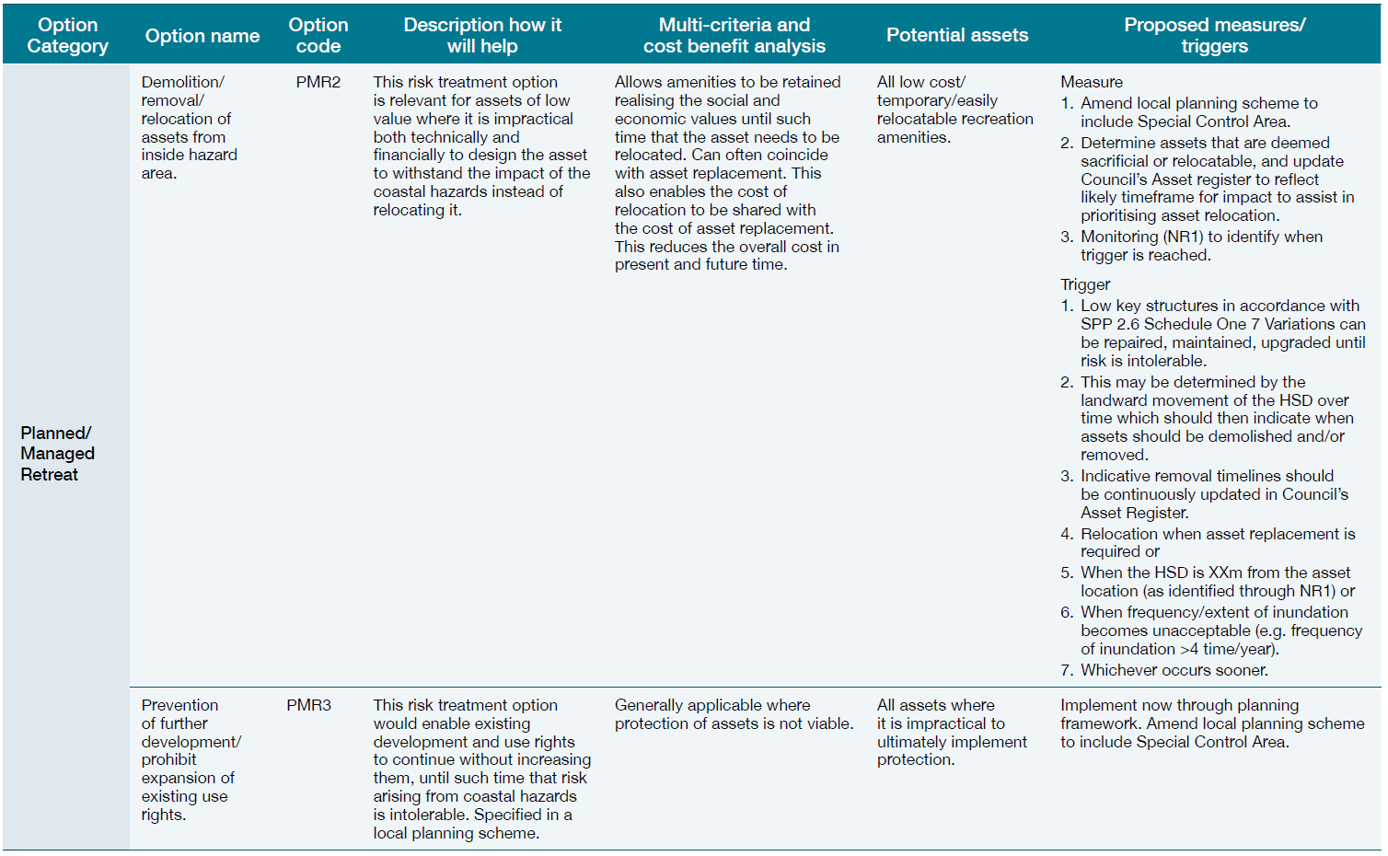
Retreat Options

Slide 40
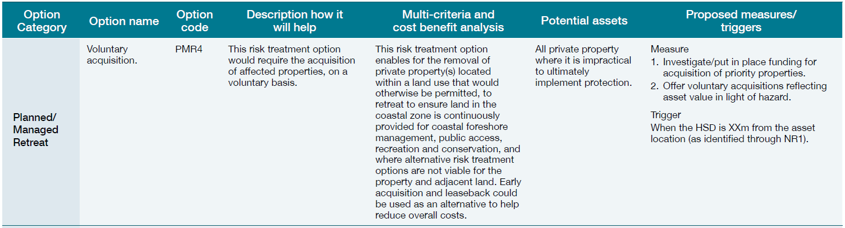
Retreat Options

Slide 41
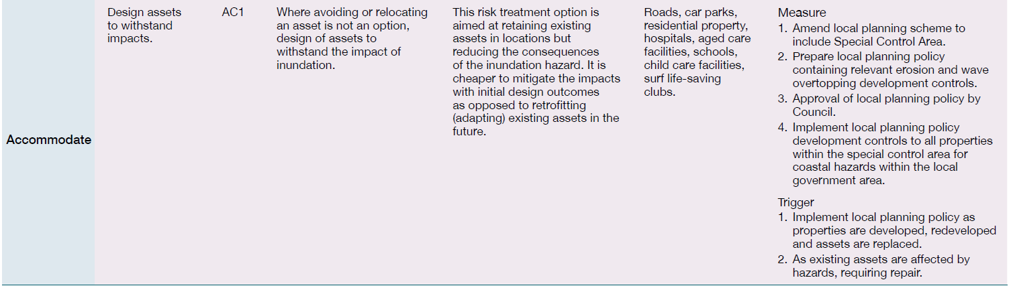
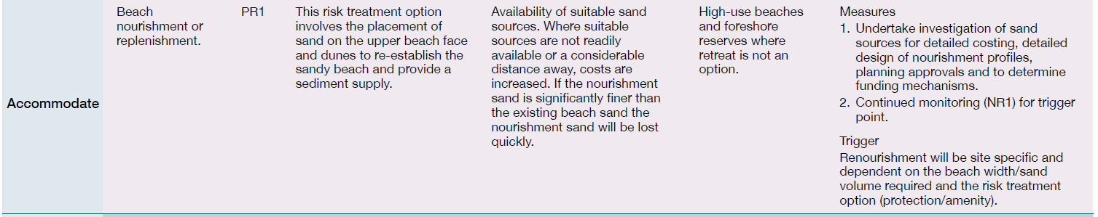
Accommodate Options

Slide 42
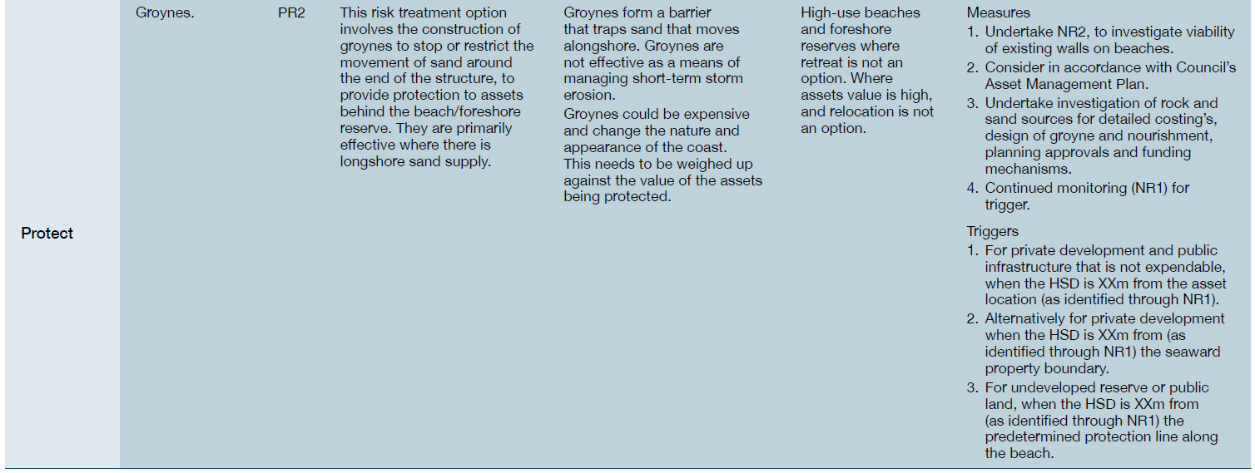
Protect Options

Slide 43
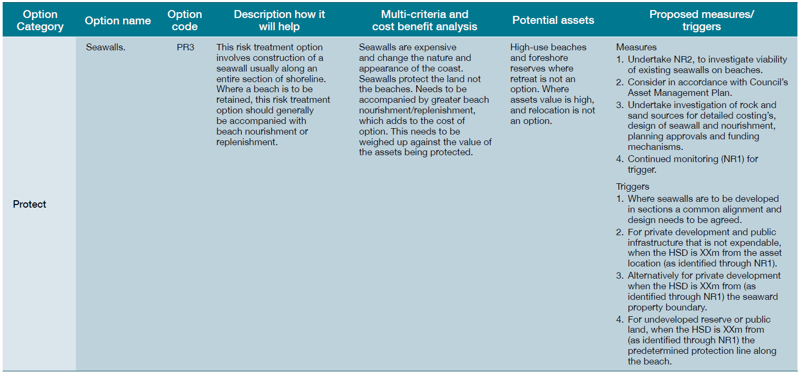
Protect Options

Slide 44
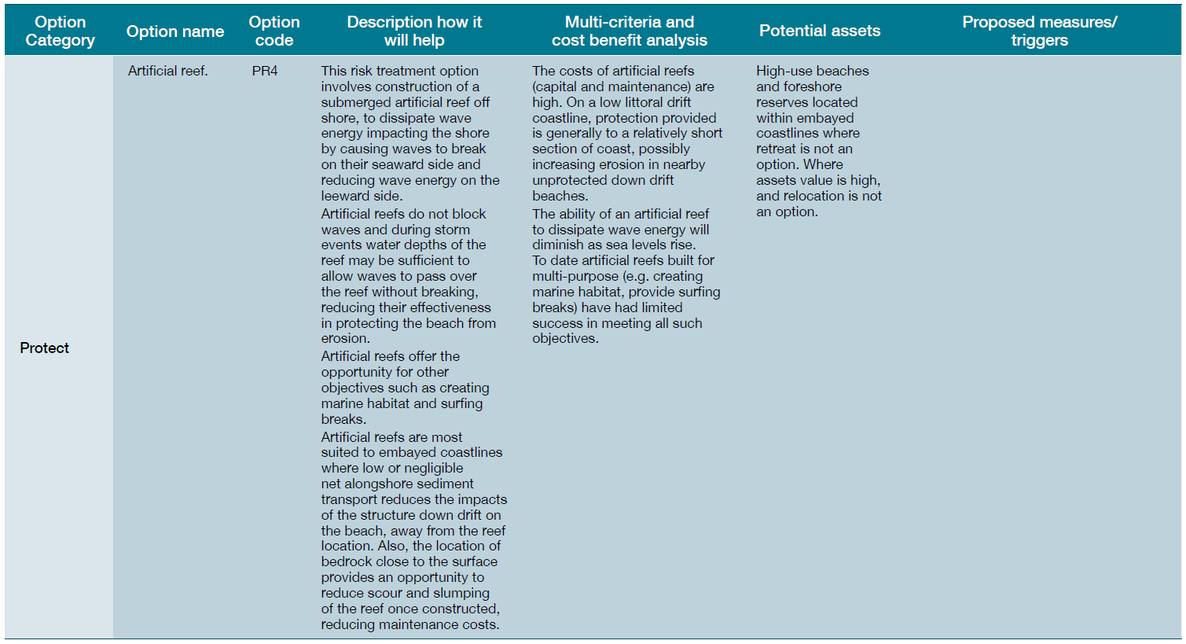
Protect Options

Slide 45
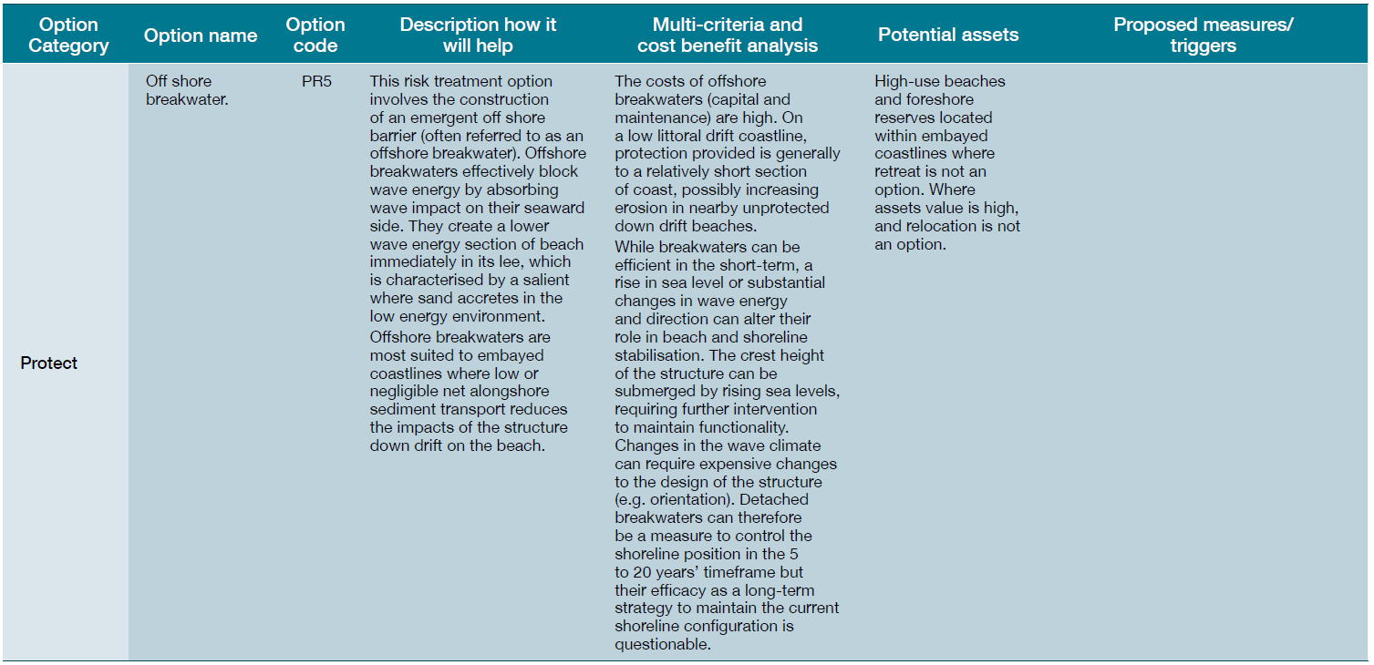
Protect Options

Slide 46
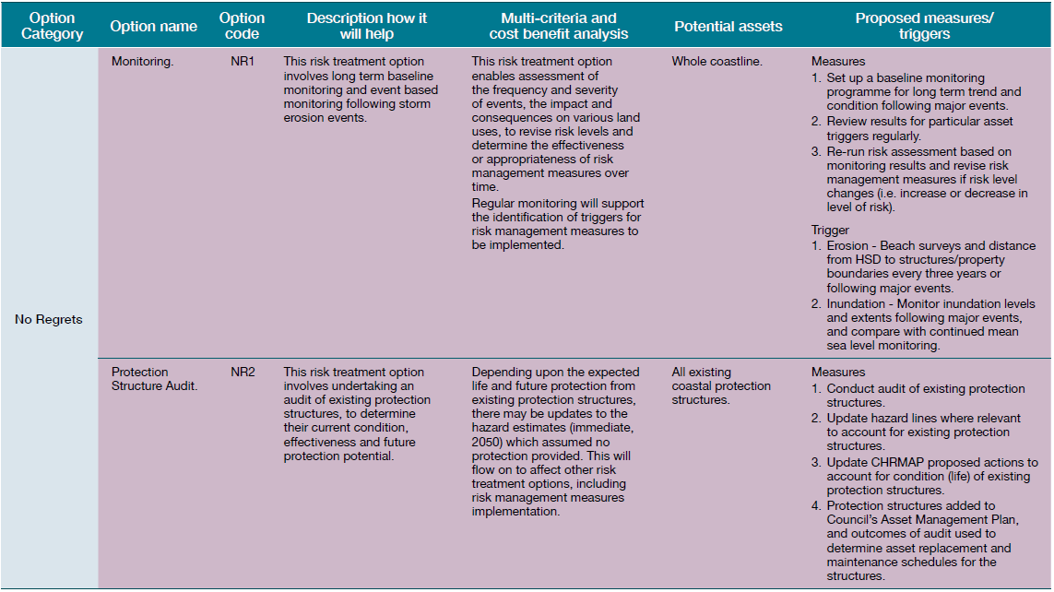
No Regrets

Slide 47
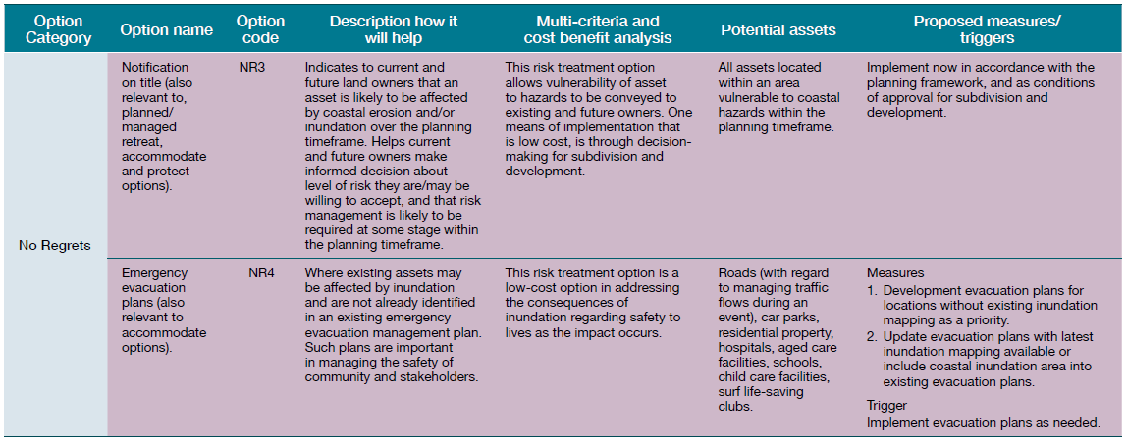
No Regrets

Slide 48
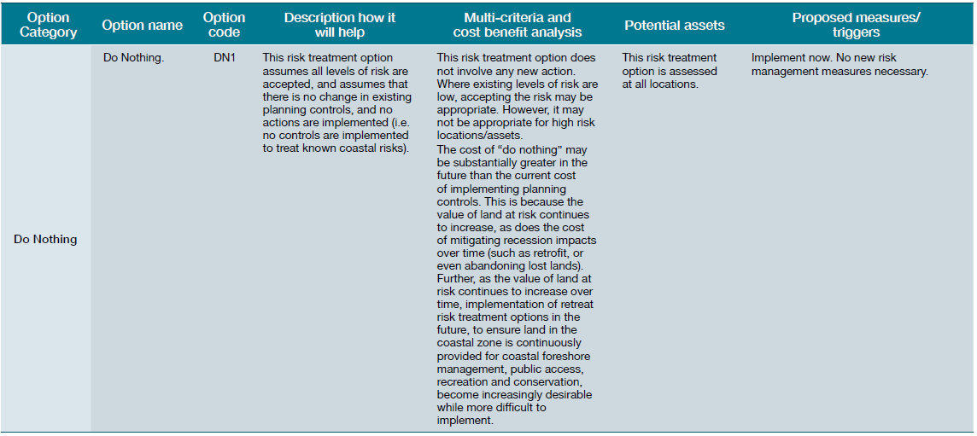
Do Nothing

Slide 49
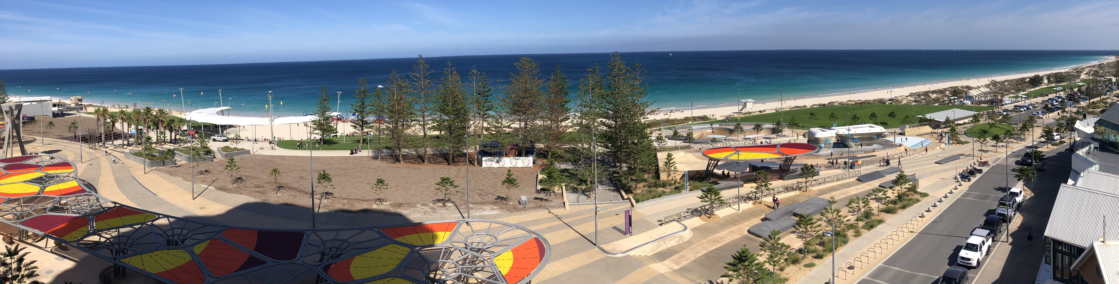
How are they Analysed?
Scarborough

Slide 50
Adaptation Options Analysis Process
Framing
Identify problem and risks
Identify objectives
Identify values
Stakeholder Engagement & Input
At all stages
Identify Range of Options
Identify all potential options
Consider hierarchy
Filter & Refine Options
Identify any fatal flaws
Develop shortlist of options
Refine appropriate options
Analysis of Options
Multi-Criteria Analysis
Cost Benefit Analysis
Confirm Trade-offs
Consider impacts and trade-offs
Get acceptance from stakeholders
Recommendations
Preferred option
Further investigations
Further design
Implementation Planning
Preferred option
Further investigations
Further design

Slide 51
Analysis of Options
Initial filtering of options via fatal flaws, eg
  SLSC can’t avoid all risk as required to be adjacent coast
  Port is required to be located at the coastline
  LGA or MRWA may require a road to remain in current location
  Community values retention of beach
Fatal flaw or first pass filtering completed against project objectives, values or success criteria
Shortlist a range of potentially appropriate treatments
Potential options then assessed via Multi Criteria Analysis (MCA) and Cost Benefit Analysis (CBA)

Slide 52
Analysis of Options
Shortlist a range of potentially appropriate treatments
Options developed or refined
Concepts developed
Impacts, pros, cons and costs assessed
Potential options assessed via Multi Criteria Analysis (MCA) and Cost Benefit Analysis (CBA)

Slide 53
Multi Criteria Analysis
Framework for assessing and selecting appropriate options
Requires consideration of success criteria
  Technical, environmental, social, economic
Selection of criteria, weighting and scoring system is critical
Criteria linked to values or objectives
Tested with stakeholders
Criteria | Technical | Social | Environmental | Economic
Weighting | 25% | 25% | 25% | 25%

Slide 54
Multi Criteria Analysis
1
2
3
4
5
TECHNICAL
Considers the technical effectiveness of the strategy or option, the adaptability of the option and the complexity of any legal or approval requirements.
SOCIAL
Considers provision of beach and recreational opportunities, coastal amenity, accessible coastline and provision of recreational facilities.
ENVIRONMENTAL
Considers the preservation of the beach and dune environment and the marine environment.
ECONOMIC
Considers the capital and maintenance costs of each option.

Slide 55
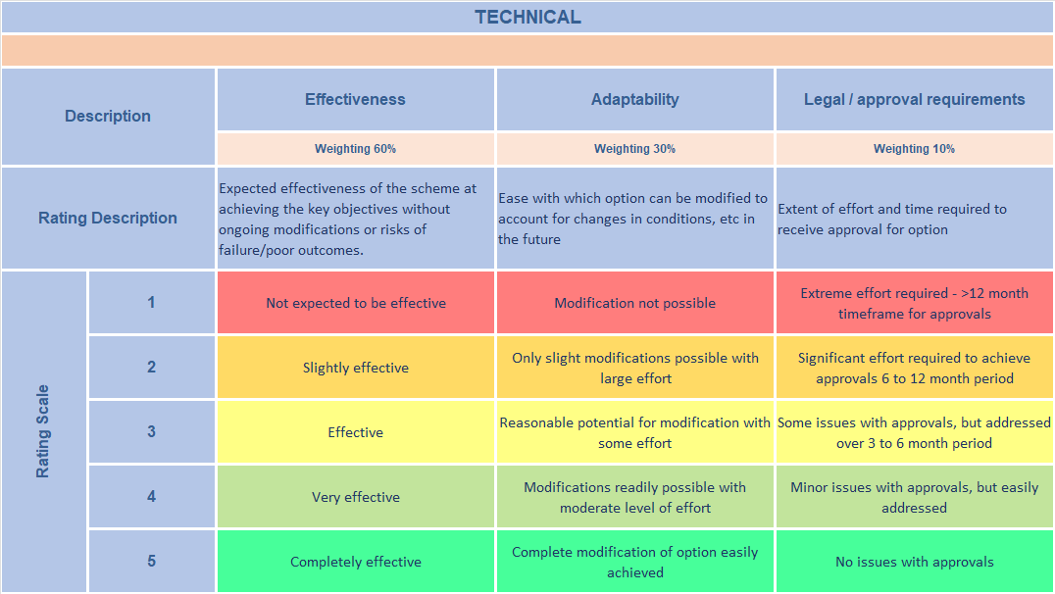
Example Technical Criteria & Scores
Indicative example only

Slide 56
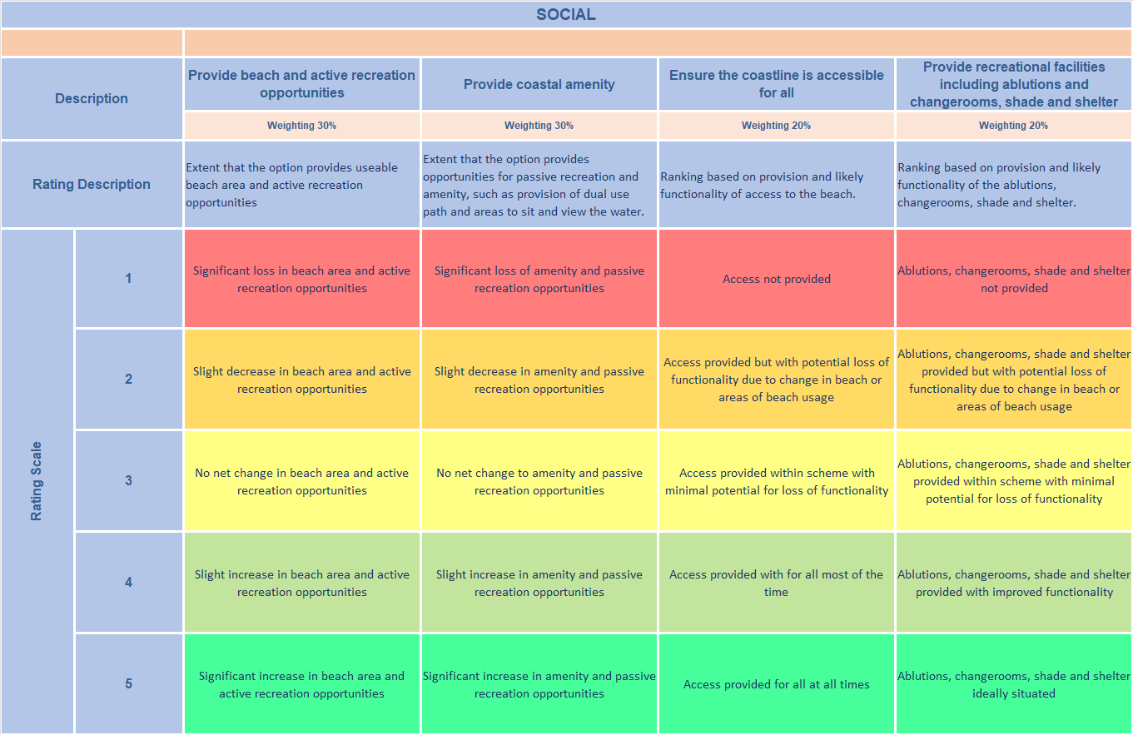
Example Social Criteria & Scores
Indicative example only

Slide 57
Example Environmental Criteria & Scores
Indicative example only

Slide 58
Example Economic Criteria & Scores
Indicative example only

Slide 59
Multi Criteria Analysis (example)
Aims to initially narrow options – identify potential options and those which are inappropriate
Option | Technical (25%) |  |  | Social (25%) |  | Environment (25%) |  | Economic (25%) |  | Score
Option | Effectiveness | Adaptability | Constructability | Provide beach for recreation | Provide foreshore facilities | Preserve beach / dunes | Preserve marine environment | Capital cost | Ongoing / maintenance cost | /100
Sand Nourishment | 3 | 5 | 3 | 5 | 3 | 5 | 5 | 5 | 1 | 78
Seawall | 5 | 3 | 3 | 1 | 3 | 1 | 4 | 3 | 3 | 56
Groynes | 3 | 3 | 3 | 3 | 3 | 3 | 3 | 3 | 3 | 60
Artificial Reef | 1 | 1 | 3 | 5 | 3 | 3 | 3 | 1 | 3 | 53
Indicative example only

Slide 60
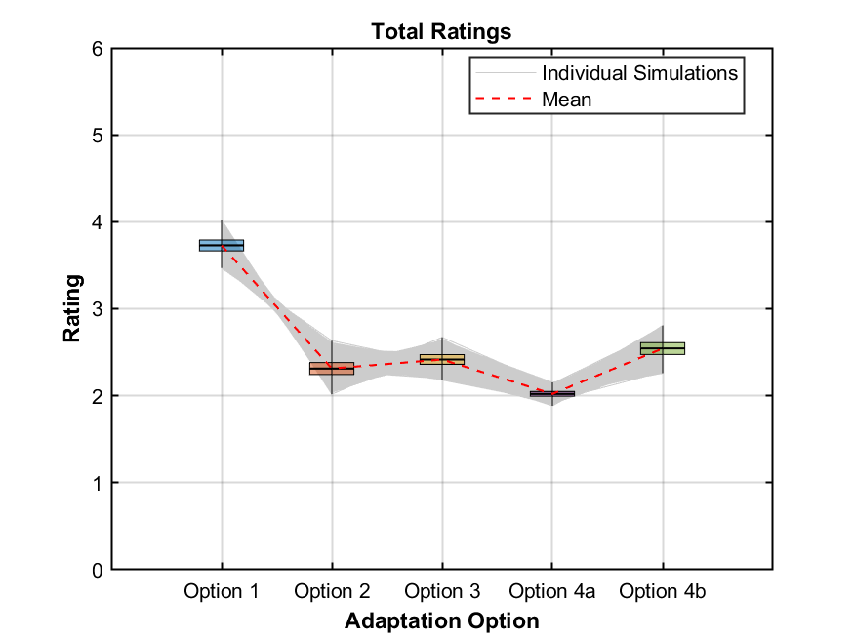
Sensitivity to Criteria
Sensitivity to criteria should be tested
Different criteria will have different rankings, within the same general theme
Sensitivity of both criteria and sub-criteria weighting should be considered
Input sought from stakeholders

Slide 61
Multi Criteria Analysis Output
MCA will further refine list of appropriate options
Can be used to recommend a single preferred option, or several suitable options for detailed assessment
Preferred option or options assessed in CBA

Slide 62
Cost Benefit Analysis
CBA process assists in refining appropriate range of options and prioritising options
Identifies both costs and benefits associated with each option
Include economic (capital or maintenance) along with social and environment (loss of foreshore or provision of beach) costs or benefits
May be direct or indirect
Considered over the planning timeframe or life of the projects

Slide 63
Costs
Whole of life costs need to be considered (capital, maintenance and operation, demolition or removal)
Require accurate estimate of costs – need concepts
Loss of environmental or social value

Slide 64
Benefits
Benefits represent reduction in impact from the implementation of an option
Include avoided costs
Gains in environmental or social value

Slide 65
Cost Benefit Analysis
Accurate assessment of asset value important
CBA uses an appropriate discount rate
Consider sensitivity to account for variability in assumptions
CBA determines:
  Net Present Economic Value (NPEV) – sum of discounted benefits less the sum of the discounted costs
  Benefit Cost Ratio (BCR) – ratio of present value of benefits to present value of costs
Option is typically viable if NPEV is positive and BCR > 1

Slide 66
Cost Benefit Analysis Example
Discount Rate | Costs | Benefits | NPEV | BCR
4% | $1,442,308 | $1,923,077 | $480,769 | 1.3
7% | $1,401,869 | $1,869,159 | $467,290 | 1.3
10% | $1,363,636 | $1,818,182 | $454,546 | 1.3
Indicative example only
In this example, BCR is > 1 and NPEV positive
Option appears viable

Slide 67
Benefit Distribution Analysis
BDA applies beneficiary pays system
Assists in apportioning costs for adaptation works
Often completed on preferred option
Considers a base case
BDA covered in module 3
https://www.wa.gov.au/government/document-collections/coastwa-training-series#module-3-benefit-distribution-analysis

Slide 68
Re-consider Impacts & Trade offs
Particularly for developed sites, unlikely to be single option which meets all objectives and stakeholder desires
Trade-offs required
This may include things such as removal or relocation of assets when threatened, or ongoing placement of sand
Following analysis, impacts should be re-considered in detail for preferred options

Slide 69
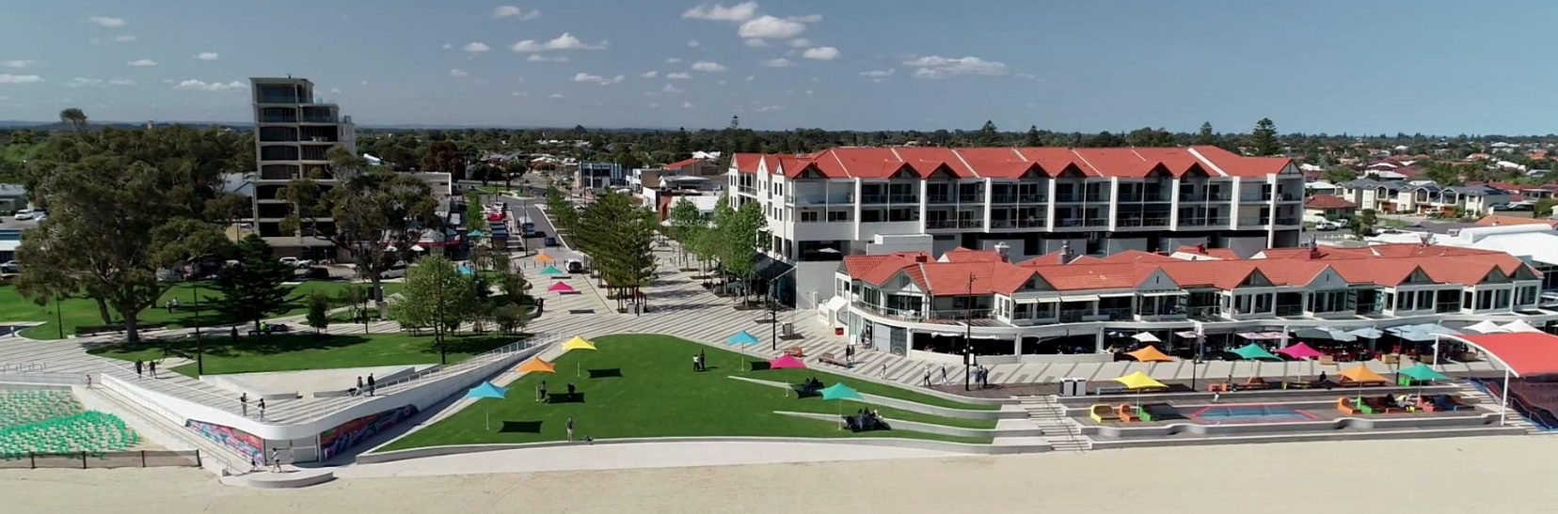
How and when are they implemented?
Rockingham Foreshore

Slide 70
Adaptation Pathways
Implementation of adaptation options linked to risk management pathways
Risk management pathways enables the establishment of a decision-making strategy that is made up of a sequence of decision points over time
The risk management pathway approach combines decision-making at trigger points for risk treatments within an ongoing process that maintains flexibility in risk treatments available over time

Slide 71
Risk Management Pathways
Each decision making point along the pathway is triggered by a change
Each decision making point has associated risk treatment options
Selection of an adaptation option leads to the next risk management pathway and next decision making point
At each decision making point, the wide range of options is retained

Slide 72
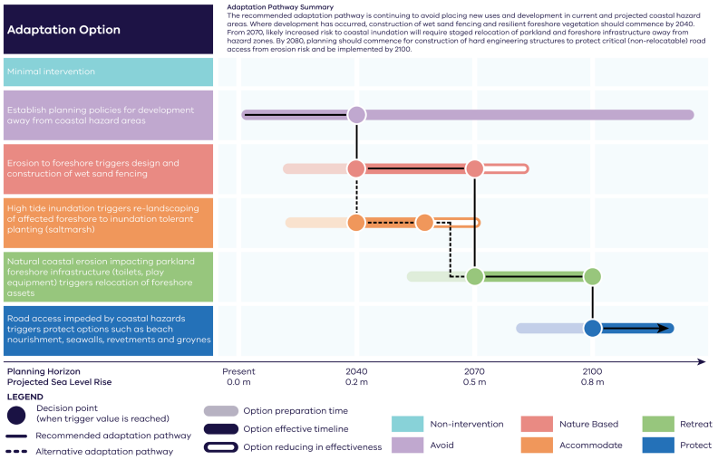
Risk Management Pathway
DEECA 2023

Slide 73
Triggers
Identification of triggers allows planning for when implementation is required
Triggers can be time or event based
For LGAs can be linked to risk management frameworks
Event type triggers linked to coastal monitoring

Slide 74
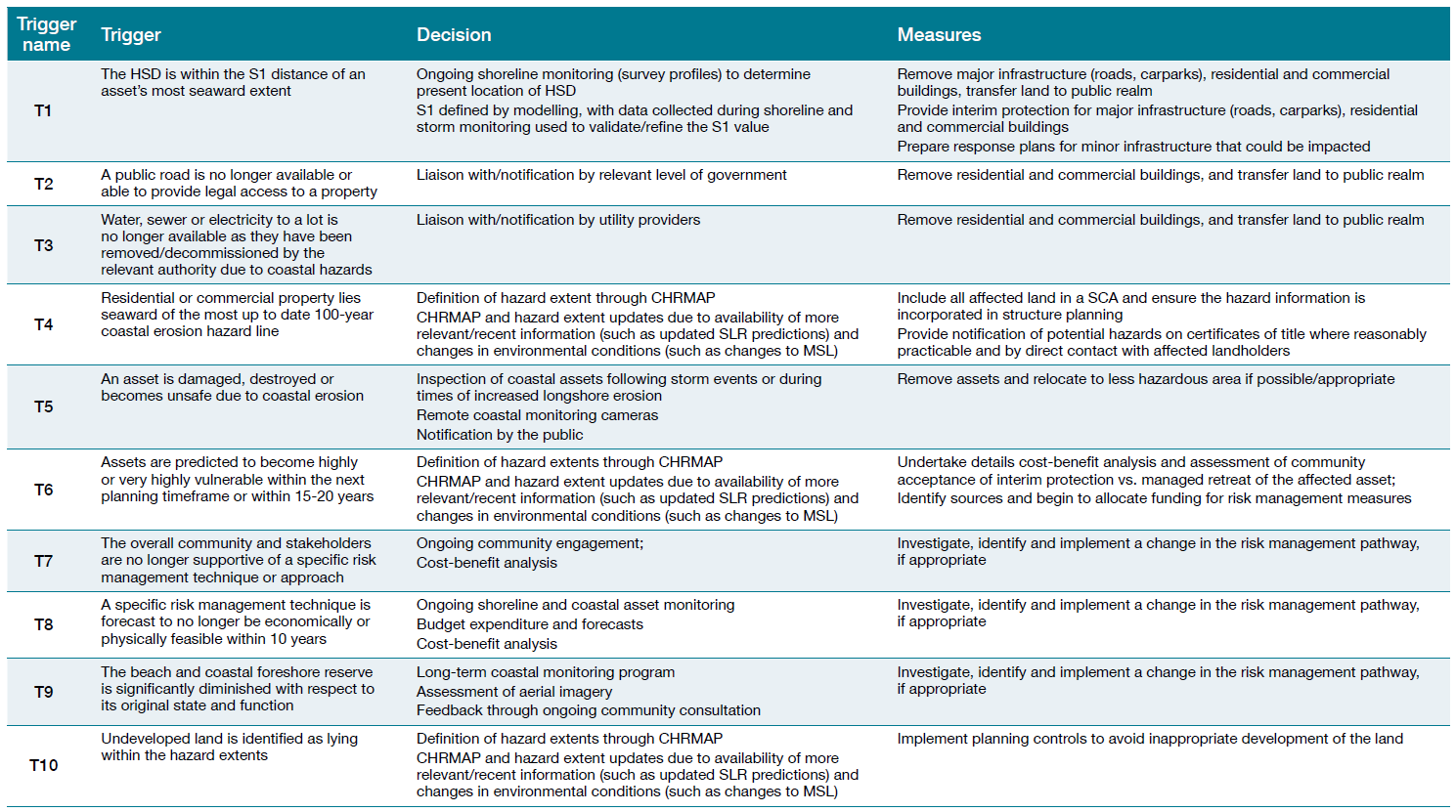
Triggers

Slide 75
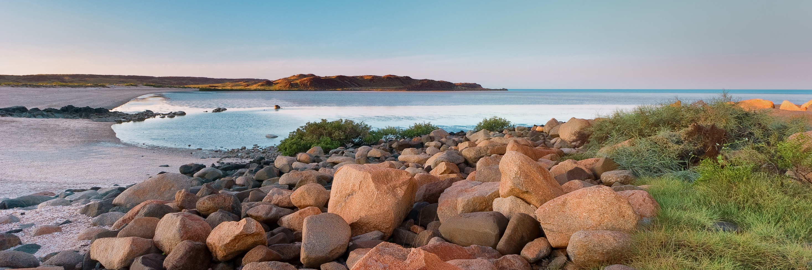
Examples & Case Studies

Slide 76
Greenfield Example

Slide 77
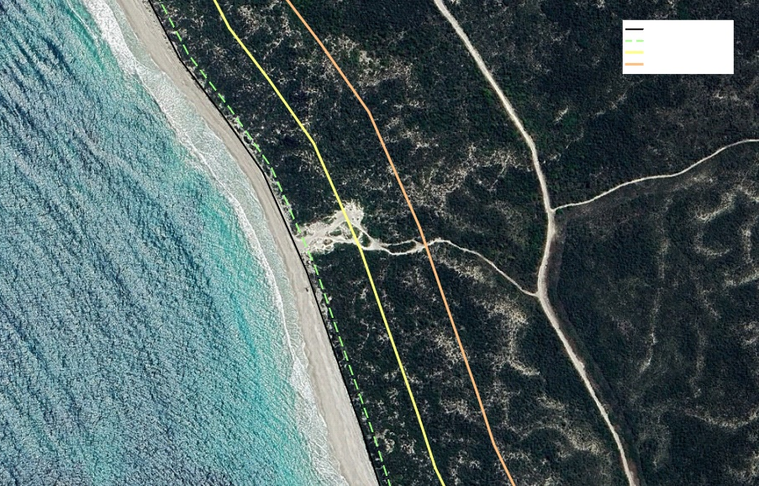
Undeveloped Areas
Options assessment less formal
Pathway clear based on hierarchy
Able to AVOID risk
of coastal hazards
HSD
Present day
50 years
100 years

Slide 78
Developed Example -
Port Beach

Slide 79
Port Beach
Area identified as hotspot of high management importance
CHRMAP completed for the area including Port Beach, Fremantle
High value assets
Large number of stakeholders, including CoF, FP, MRWA, business owners, recreational users and community

Slide 80
Adaptation Options Analysis Process
Framing
Identify problem and risks
Identify objectives
Identify values
Stakeholder Engagement & Input
At all stages
Identify Range of Options
Identify all potential options
Consider hierarchy
Filter & Refine Options
Identify any fatal flaws
Develop shortlist of options
Refine appropriate options
Analysis of Options
Multi-Criteria Analysis
Cost Benefit Analysis
Confirm Trade-offs
Consider impacts and trade-offs
Get acceptance from stakeholders
Recommendations
Preferred option
Further investigations
Further design
Implementation Planning
Preferred option
Further investigations
Further design

Slide 81
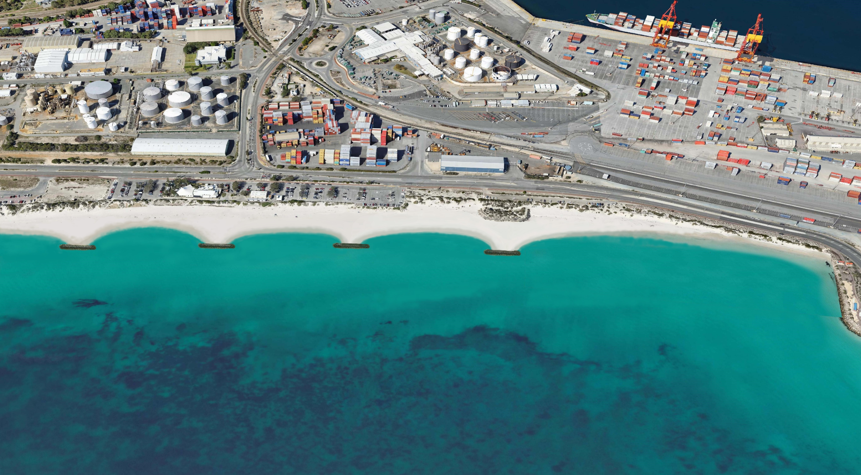
Port Beach – Stakeholder Engagement
Stakeholder Reference Group formed
Feedback and input sought on each stage of assessment
Initial range of options refined and concepts developed
  Sketches
  Costs
  Pros, cons
  Impacts

Slide 82
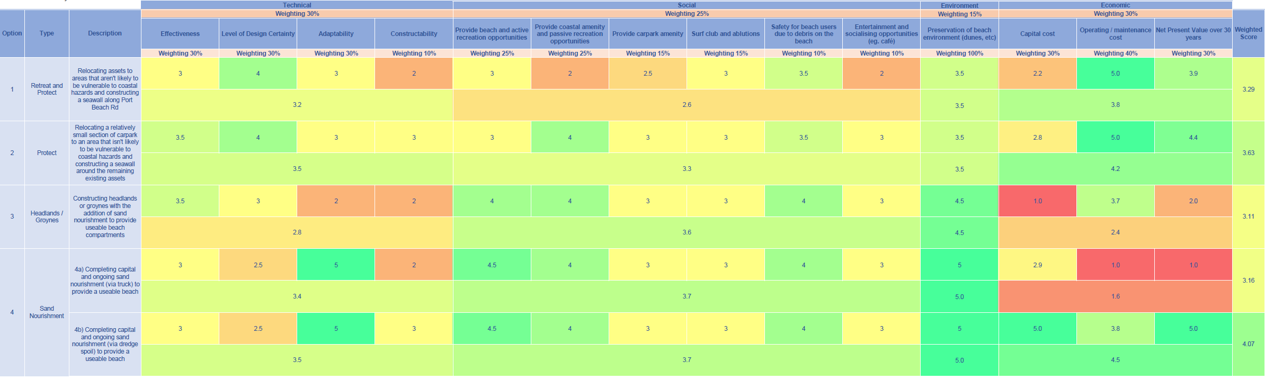
Port Beach
MCA and CBA completed
Criteria based on values and project objectives
Tested with Reference Group

Slide 83
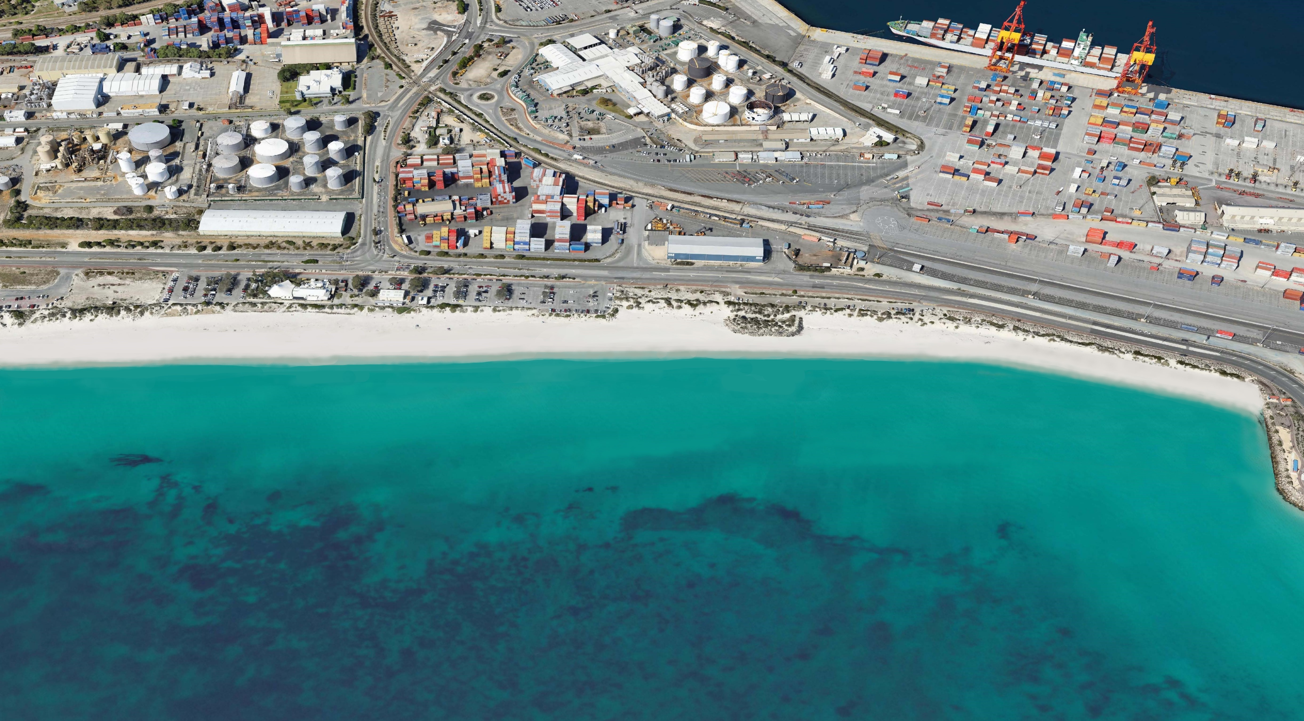
Port Beach
Large scale sand nourishment selected as preferred option
Trade offs outlined and communicated
Impacts reviewed
Detailed design completed
Works implemented

Slide 84
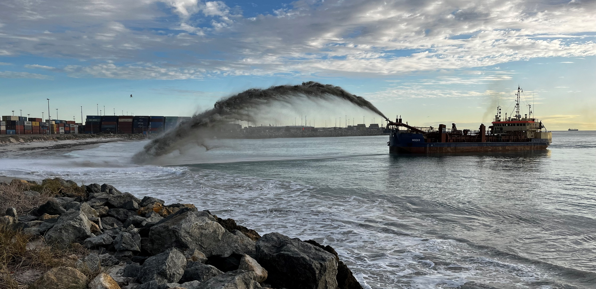
Port Beach

Slide 85
South Thomson Bay, Rottnest Island

Slide 86
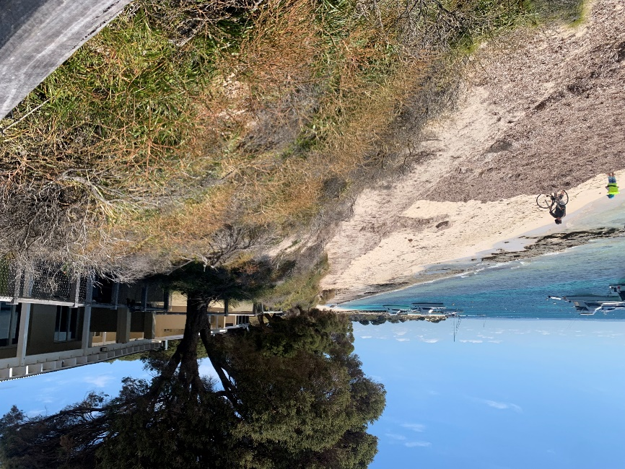

South Thomson, Rottnest
Site identified as a coastal hotspot
Ongoing erosion
Limited buffer to holiday chalets
High value site

Slide 87

Options Assessment
Coastal Erosion Management Plan developed
Adaptation strategies developed and assessed
Seashore Engineering 2020

Slide 88

Adaptation Pathway
Adaptation Pathway developed
Management triggers determined
Assessed through monitoring
Monitoring indicated triggers hit early
Stakeholders reviewed risks and implemented protect pathway
Seashore Engineering 2020

Slide 89

South Thomson Seawall

Slide 90

Lessons Learnt
Watermans Bay

Slide 91
Lessons Learnt
Ensure objectives are well defined and understood
Ensure potential options are wide enough
Ensure community input is gained early and through process
Ensure values are well understood
Ensure constraints are well understood
Ensure the narrative of recommended option is understood
Ensure risks are treated by options
Ensure trade offs and impacts are understood

Slide 92

Thank you
Cottesloe

