Slide 1
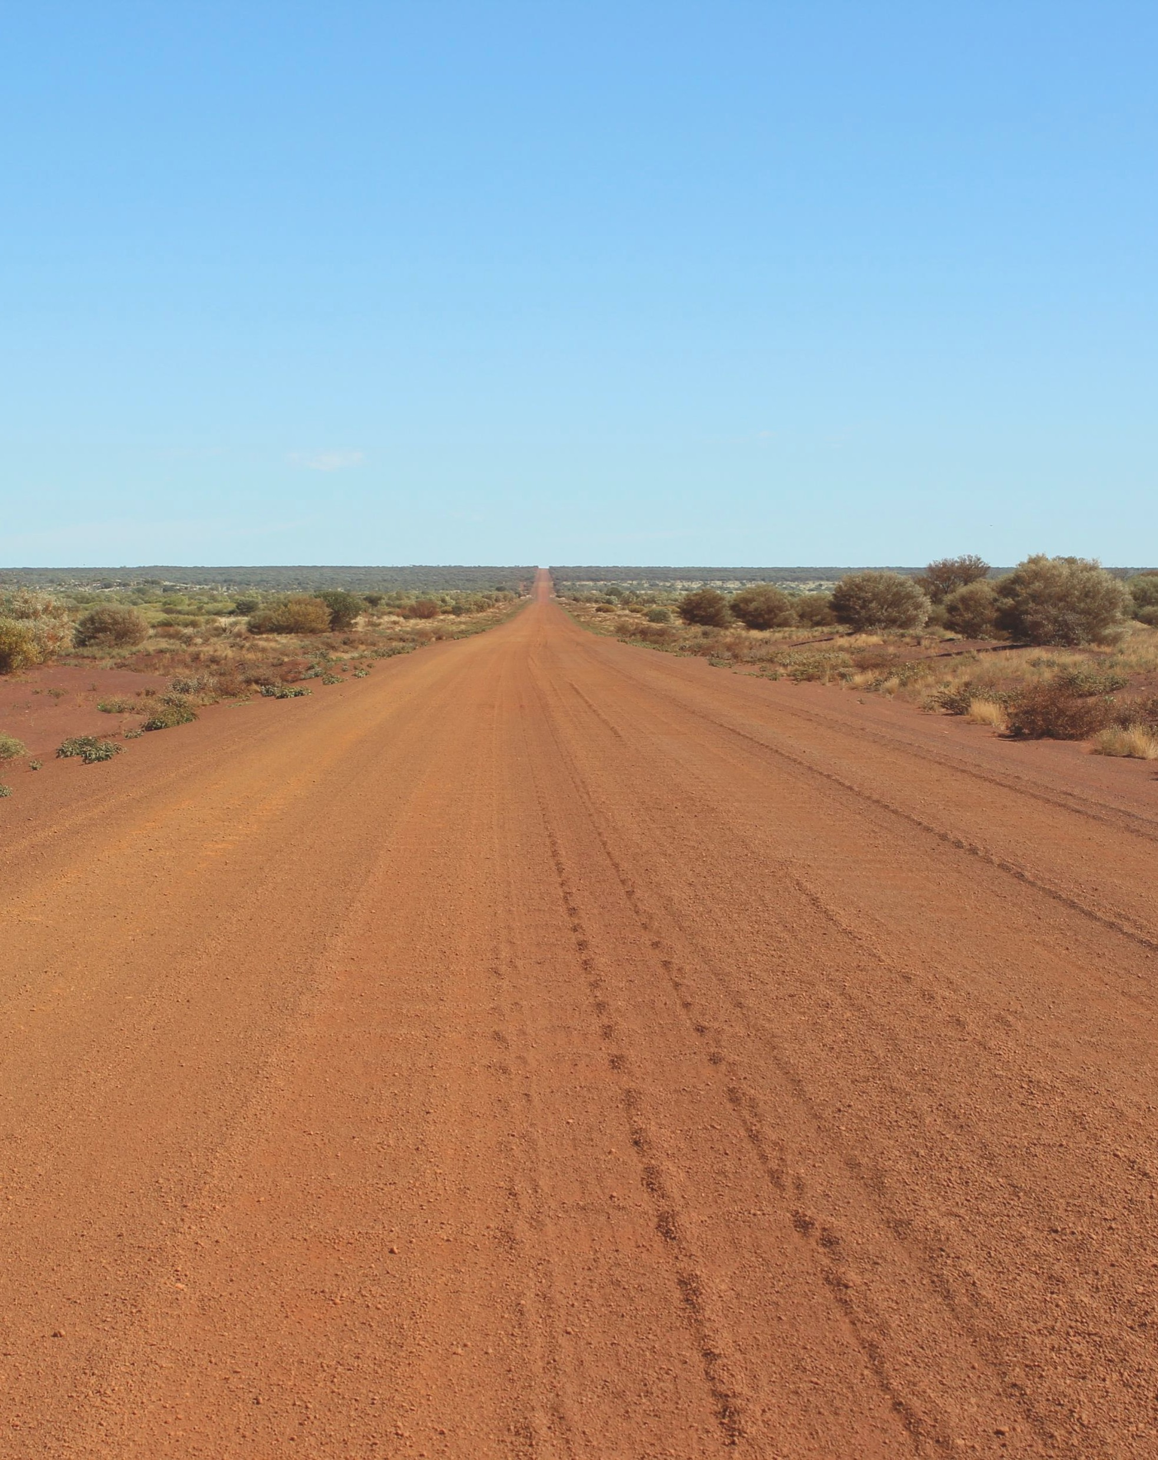
Amendments to the Aboriginal Affairs Planning Authority Act 1972
(Amendment Bill)
2 April 2026

Slide 2
The Department of Planning, Lands and Heritage acknowledges Aboriginal people as the traditional custodians of Western Australia
We pay our respects to the Ancestors and Elders, both past and present, and the ongoing connection between people, land, waters and community
We acknowledge those who continue to share knowledge, their traditions and culture to support our journey for reconciliation
In particular, we recognise land and cultural heritage as places that hold great significance for Aboriginal people

Slide 3
Outline
1. Project background
2. Aboriginal Affairs Planning Authority (AAPA) Act Amendment Bill 2026
    Native Title
    Definition of an Aboriginal person
    Aboriginal Lands Trust (ALT) consultation under 23(c)
    Divestment of Part III reserves
    Removing barriers for divestment
    Power to grant permits
    Strengthening trespass offence
3. Project status and next steps

Slide 4
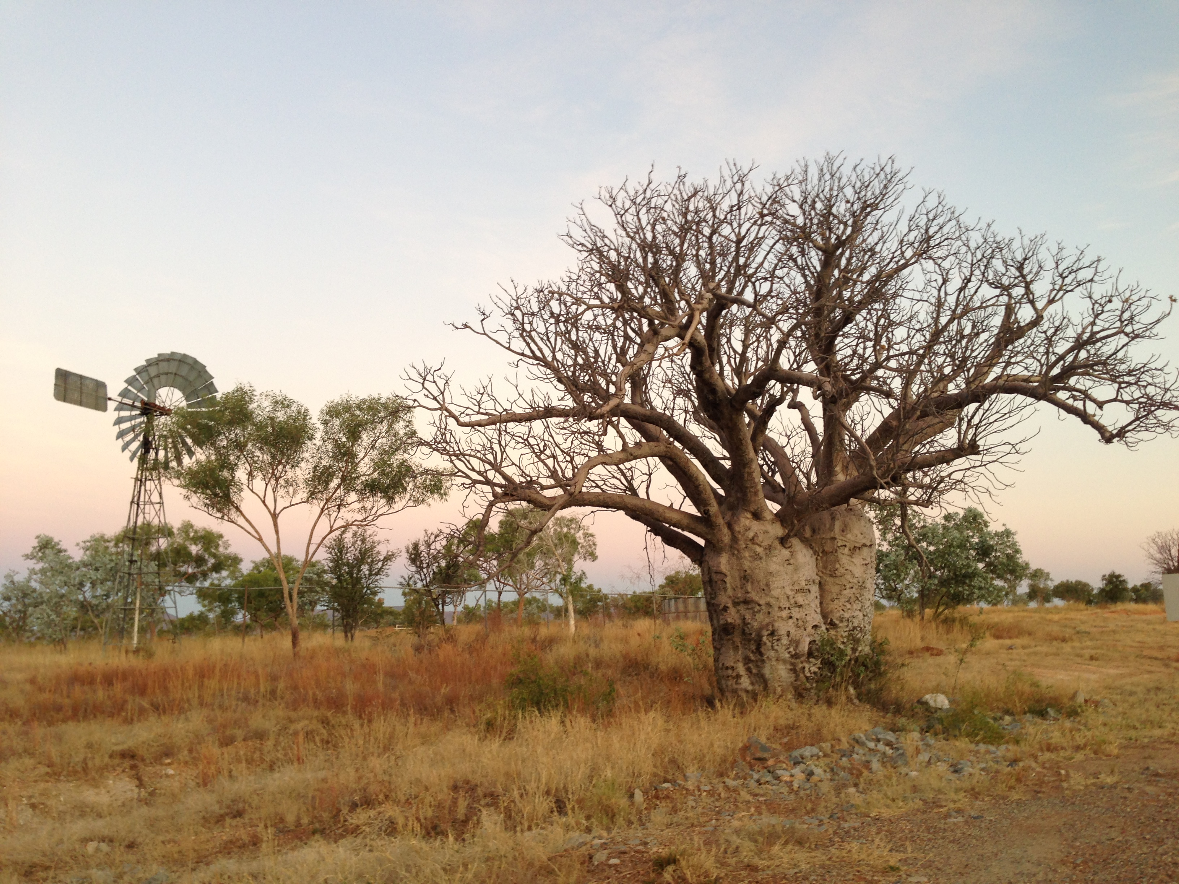
Project
background

Slide 5
Where did the proposal come from?
In 2017 the State Government made a commitment to divest the entire ALT estate
Since 2019, the Department has been working with Aboriginal corporations to progress divestment and divested 27 properties
Aboriginal stakeholders have told Government that changes are required to the AAPA Act to achieve divestment
In 2022, Cabinet approved targeted amendments to the AAPA Act to remove barriers to, and maximise opportunities for, divestment
A fulsome review of the AAPA Act will be undertaken following these targeted amendments

Slide 6
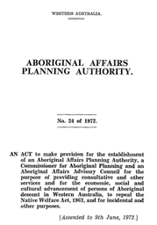
What is the AAPA Act?
Aboriginal Affairs Coordinating Committee
Aboriginal Affairs Planning Authority
Aboriginal Lands Trust
Aboriginal Advisory Council

Slide 7
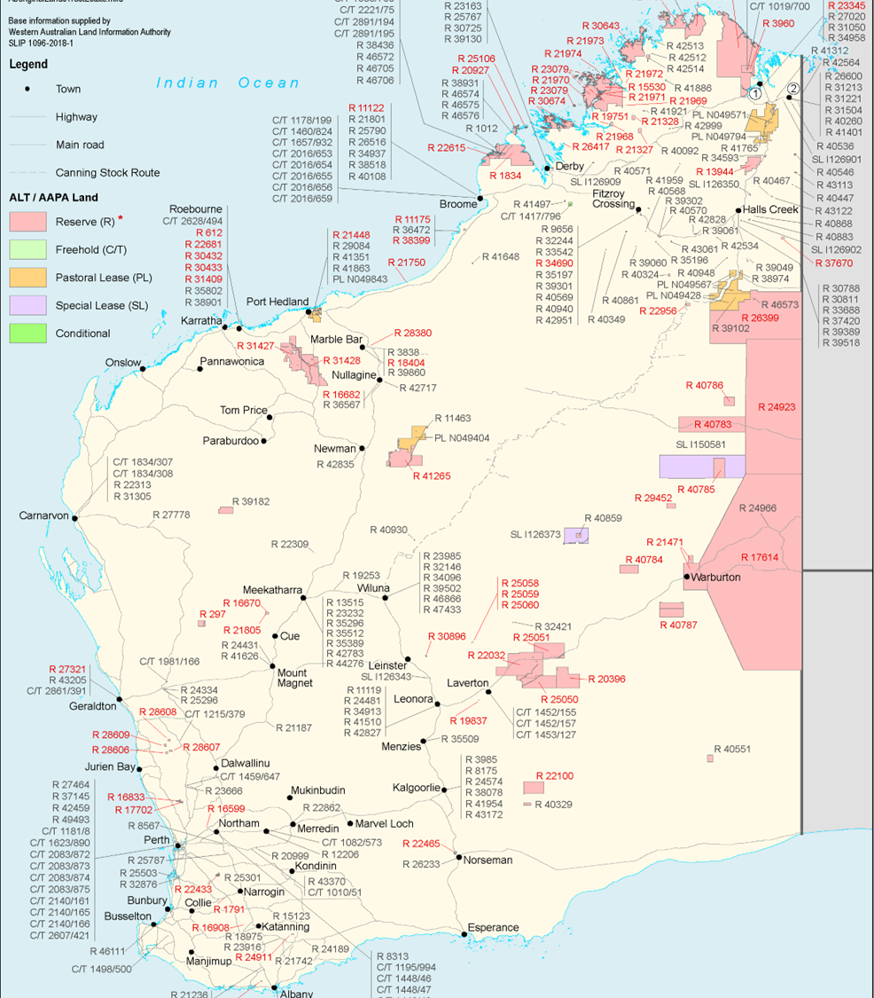
ALT estate
285 properties held by ALT/AAPA
21.8 million ha/8.7% of the WA land mass
400 leases/subleases
81 Part III reserved lands make up 93% of the ALT estate land mass
67 Native Title determinations/claims
142 permanent communities
12,000 people living on the ALT estate

Slide 8
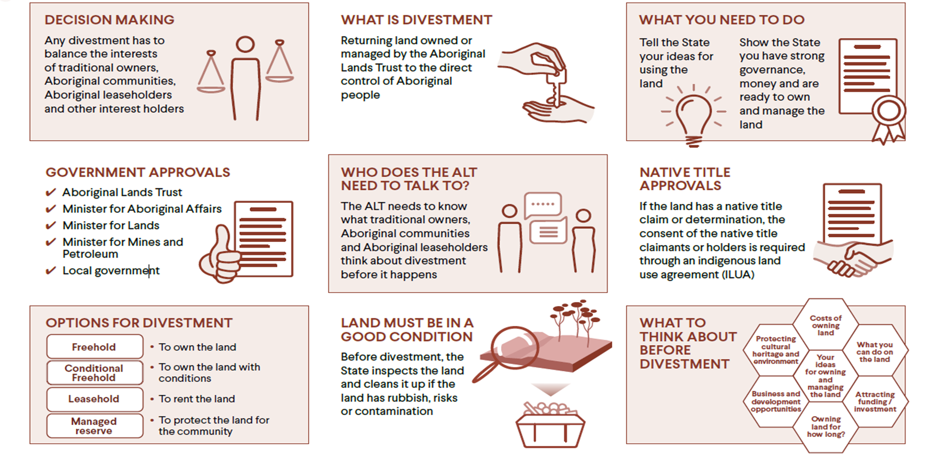
ALT divestment

Slide 9
Funding available
Activity | Description
Participation at divestment meetings | Director fees Travel allowance for Directors Venue hire Catering
Independent legal advice | Considerations of accepting land Inform the preferred tenure option Reviewing legal documents
ILUA authorisation meetings | Costs of ILUA authorisation meetings
Independent professional advice | Land use planning Environmental consultants Development advice
Capability and capacity building activities | Governance reviews to support land management Strategic planning Economic opportunity assessments
Post divestment support | Transitional support to Aboriginal stakeholders’ post divestment

Slide 10
Why does the Act need to change?
The AAPA Act is outdated and does not consider the Native Title Act
Part III reserved lands cannot be managed by an Aboriginal person or entity
Red tape makes divestment of Part III reserved lands difficult
The ALT’s duty to consult is uncertain
Many Aboriginal people have a connection to the ALT estate with different views on how it should be managed or divested

Slide 11
Consultation to date
Date | Activity | Results of consultation
2019 to 2022 | Aboriginal stakeholder feedback on ALT divestment program informed the proposal for amendments to the AAPA Act. | Approximately 250 people consulted in person and through direct engagement with key stakeholders during the consultation period. 23 survey responses and six written submissions received.
April to July 2022 | First round of consultation: sessions held in Albany, Perth, Port Hedland, Roebourne, Newman, Kununurra, Halls Creek, Broome, Derby, Fitzroy Crossing, Carnarvon, Geraldton and Kalgoorlie.
 | Department held broader stakeholder consultation sessions with native title representative bodies and other key Aboriginal stakeholders.

Slide 12
Changes arising from consultation
Original proposal | New intent
Removal of power to proclaim new Part III reserves | The proposal to remove the power to proclaim new Part III reserves has been withdrawn
No changes to enforcement provisions | The Bill now proposes targeted updates to enforcement provisions by increasing penalties and extending the prosecution period for trespass offences
Dissolution of the ALT | The proposal to dissolve the ALT has been withdrawn so that land with ongoing responsibilities can continue to be managed by the ALT, and to support a staged approach to divestment in line with Aboriginal stakeholder priorities

Slide 13
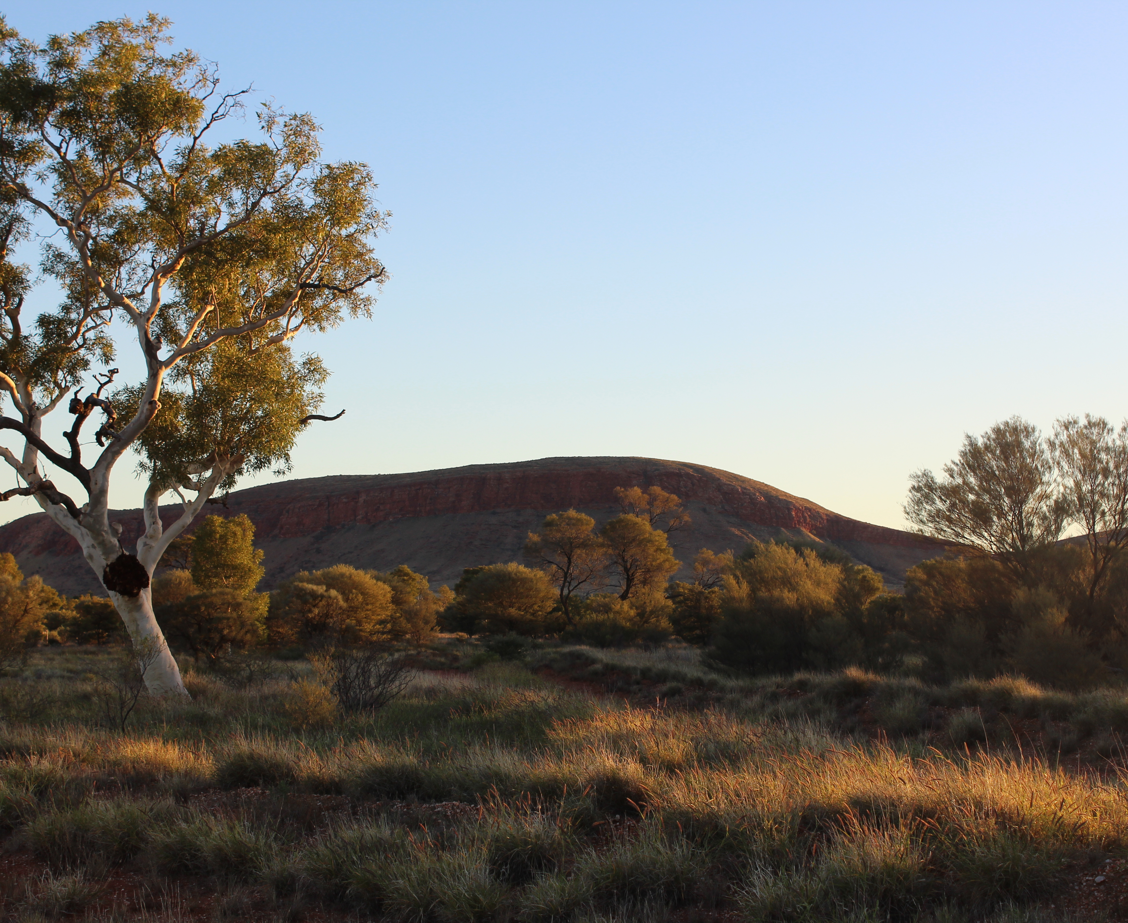
AAPA Act Amendment Bill 2026
*Blue boxes and graphics detail changes proposed in Amendment Bill

Slide 14
Native Title
The AAPA Act predates the Native Title Act 1993 (Cth) (NTA)
All ALT divestment projects are undertaken subject to the NTA
When divesting land, an Indigenous Land Use Agreement (ILUA) with the Registered Native Title Body Corporate (RNTBC) is required
The divestment team provides funding to support RNTBC’s independent legal advice to review the ILUA and cover ILUA authorisation costs
Proposed change:
Feedback from Aboriginal stakeholders about ALT divestment confirmed a need to clarify the interaction between native title and divestment
The Amendment Bill will align the AAPA Act with the Native Title Act 1993

Slide 15
Definition of Aboriginal people
Include new definition of Aboriginal person as a person who:
    is wholly or partly descended from the original inhabitants of Australia;
    identifies as an Aboriginal person; and
    is accepted as an Aboriginal person by an Aboriginal community in which the person lives, or with which the person identifies.

Slide 16



ALT consultation under Section 23(C)
Currently the ALT must use and manage the ALT estate in accordance with the “wish of the Aboriginal inhabitants of the area so far as that can be ascertained and is practicable”
The Amendment Bill will define those Aboriginal stakeholders who must be consulted
Registered native title claimants
Registered native title body corporate
Community Governing Body
Aboriginal stakeholder determined by Trust
Aboriginal leaseholders
Aboriginal residents

Slide 17
Part III reserve special protections
Vested in the Authority
for the benefit of Aboriginal people forever
Non-Aboriginal people must have a permit to enter Part III reserved lands – if they don’t they commit an offence
Parliamentary approval is required to cancel or change the boundaries of Part III reserved lands
Minister for Mines and Petroleum must consult with the Minister for Aboriginal Affairs before giving mining companies permission to explore or mine
Aboriginal Affairs Planning Authority must agree to the grant of any interests (except mining and petroleum)

Slide 18
Part III reserves under current Act
Part III reserves make up 93% of the ALT estate
Part III reserves cannot be managed by an Aboriginal corporation
Divesting requires a parliamentary process and removing their special protections to allow the Minister for Lands to grant tenure
As a result, many Aboriginal corporations with an interest in Part III reserves have advised they would prefer to retain the status quo

Slide 19
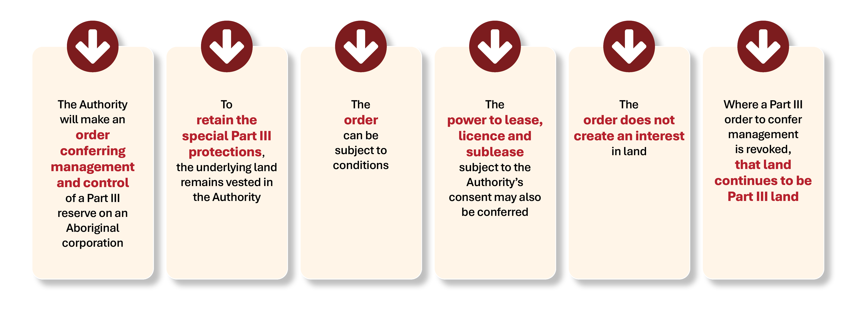
Proposed change - divesting Part III reserves
The Amendment Bill will give Aboriginal corporations the option to manage Part III reserves with the special protections in place
The land will remain vested in the Authority, which is essential to ensuring the Part III protections remain and the land continues to be set aside for the benefit of all Aboriginal people

Slide 20
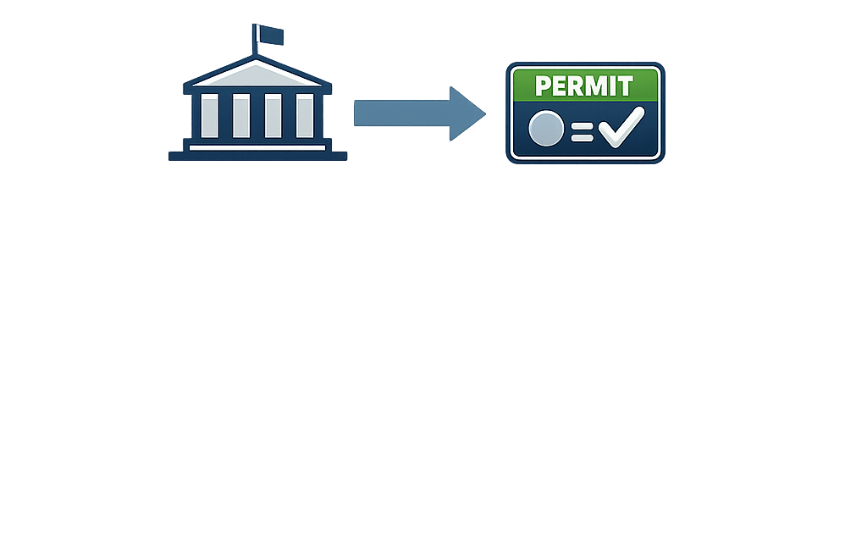
Power to grant permits
Current Act
Amendment Bill
The Amendment Bill will give Aboriginal corporations the option to grant its own permit where it manages a Part III reserve
Minister has power to grant a permit to enter Part III reserves
Minister can give the power to grant a permit
The Minister for Aboriginal Affairs can give the power to grant permits to an Aboriginal corporation
Time to support capacity building of the Aboriginal corporation to administer the power to grant permits
ALT consults with ‘Aboriginal stakeholders’ on the permit
Aboriginal corporation can grant a permit

Slide 21

Removing barriers to divest Part III
Currently, if an Aboriginal corporation requests divestment of a Part III reserve in a different tenure (e.g. freehold or lease), a parliamentary process is required and can take 12 to 24 months
Minister for Aboriginal Affairs makes a recommendation to the Governor
Aboriginal Affairs Planning Authority is referred to and prepares a report
Report presented to both Houses of Parliament for 14 days
Either House may pass a resolution rejecting the recommendation
Remove parliamentary steps for divestment:
  if we want to divest a Part III reserve in another tenure (e.g. freehold or lease)
  if we want to change the boundaries of a Part III reserve so we can divest a portion of it in another tenure
  No change to ALT consultation with Aboriginal stakeholders

Slide 22
Cutting red tape - roads and public utilities
Telephone, power, water and gas services and main roads are located on Part III reserved lands – uncertainty about who is responsible for them
Changing boundaries of Part III reserved lands so they don’t overlap public utility services and main roads requires the same parliamentary steps
Minister for Aboriginal Affairs makes a recommendation to the Governor
Aboriginal Affairs Planning Authority is referred to and prepares a report
Report presented to both Houses of Parliament for 14 days
Either House may pass a resolution rejecting the recommendation
Remove parliamentary steps if we are changing boundaries of Part III reserves so they don’t overlap:
    Telephone, power and gas infrastructure
    Roads
  No change to ALT consultation with Aboriginal stakeholders

Slide 23



Strengthening trespass offence
The Amendment Bill includes measures to strengthen the enforcement of offences and update the penalties, to better deter trespass in remote areas
Limitation period extended to six years
Penalties modernised and increased
Now a continuing offence – daily penalties

Slide 24
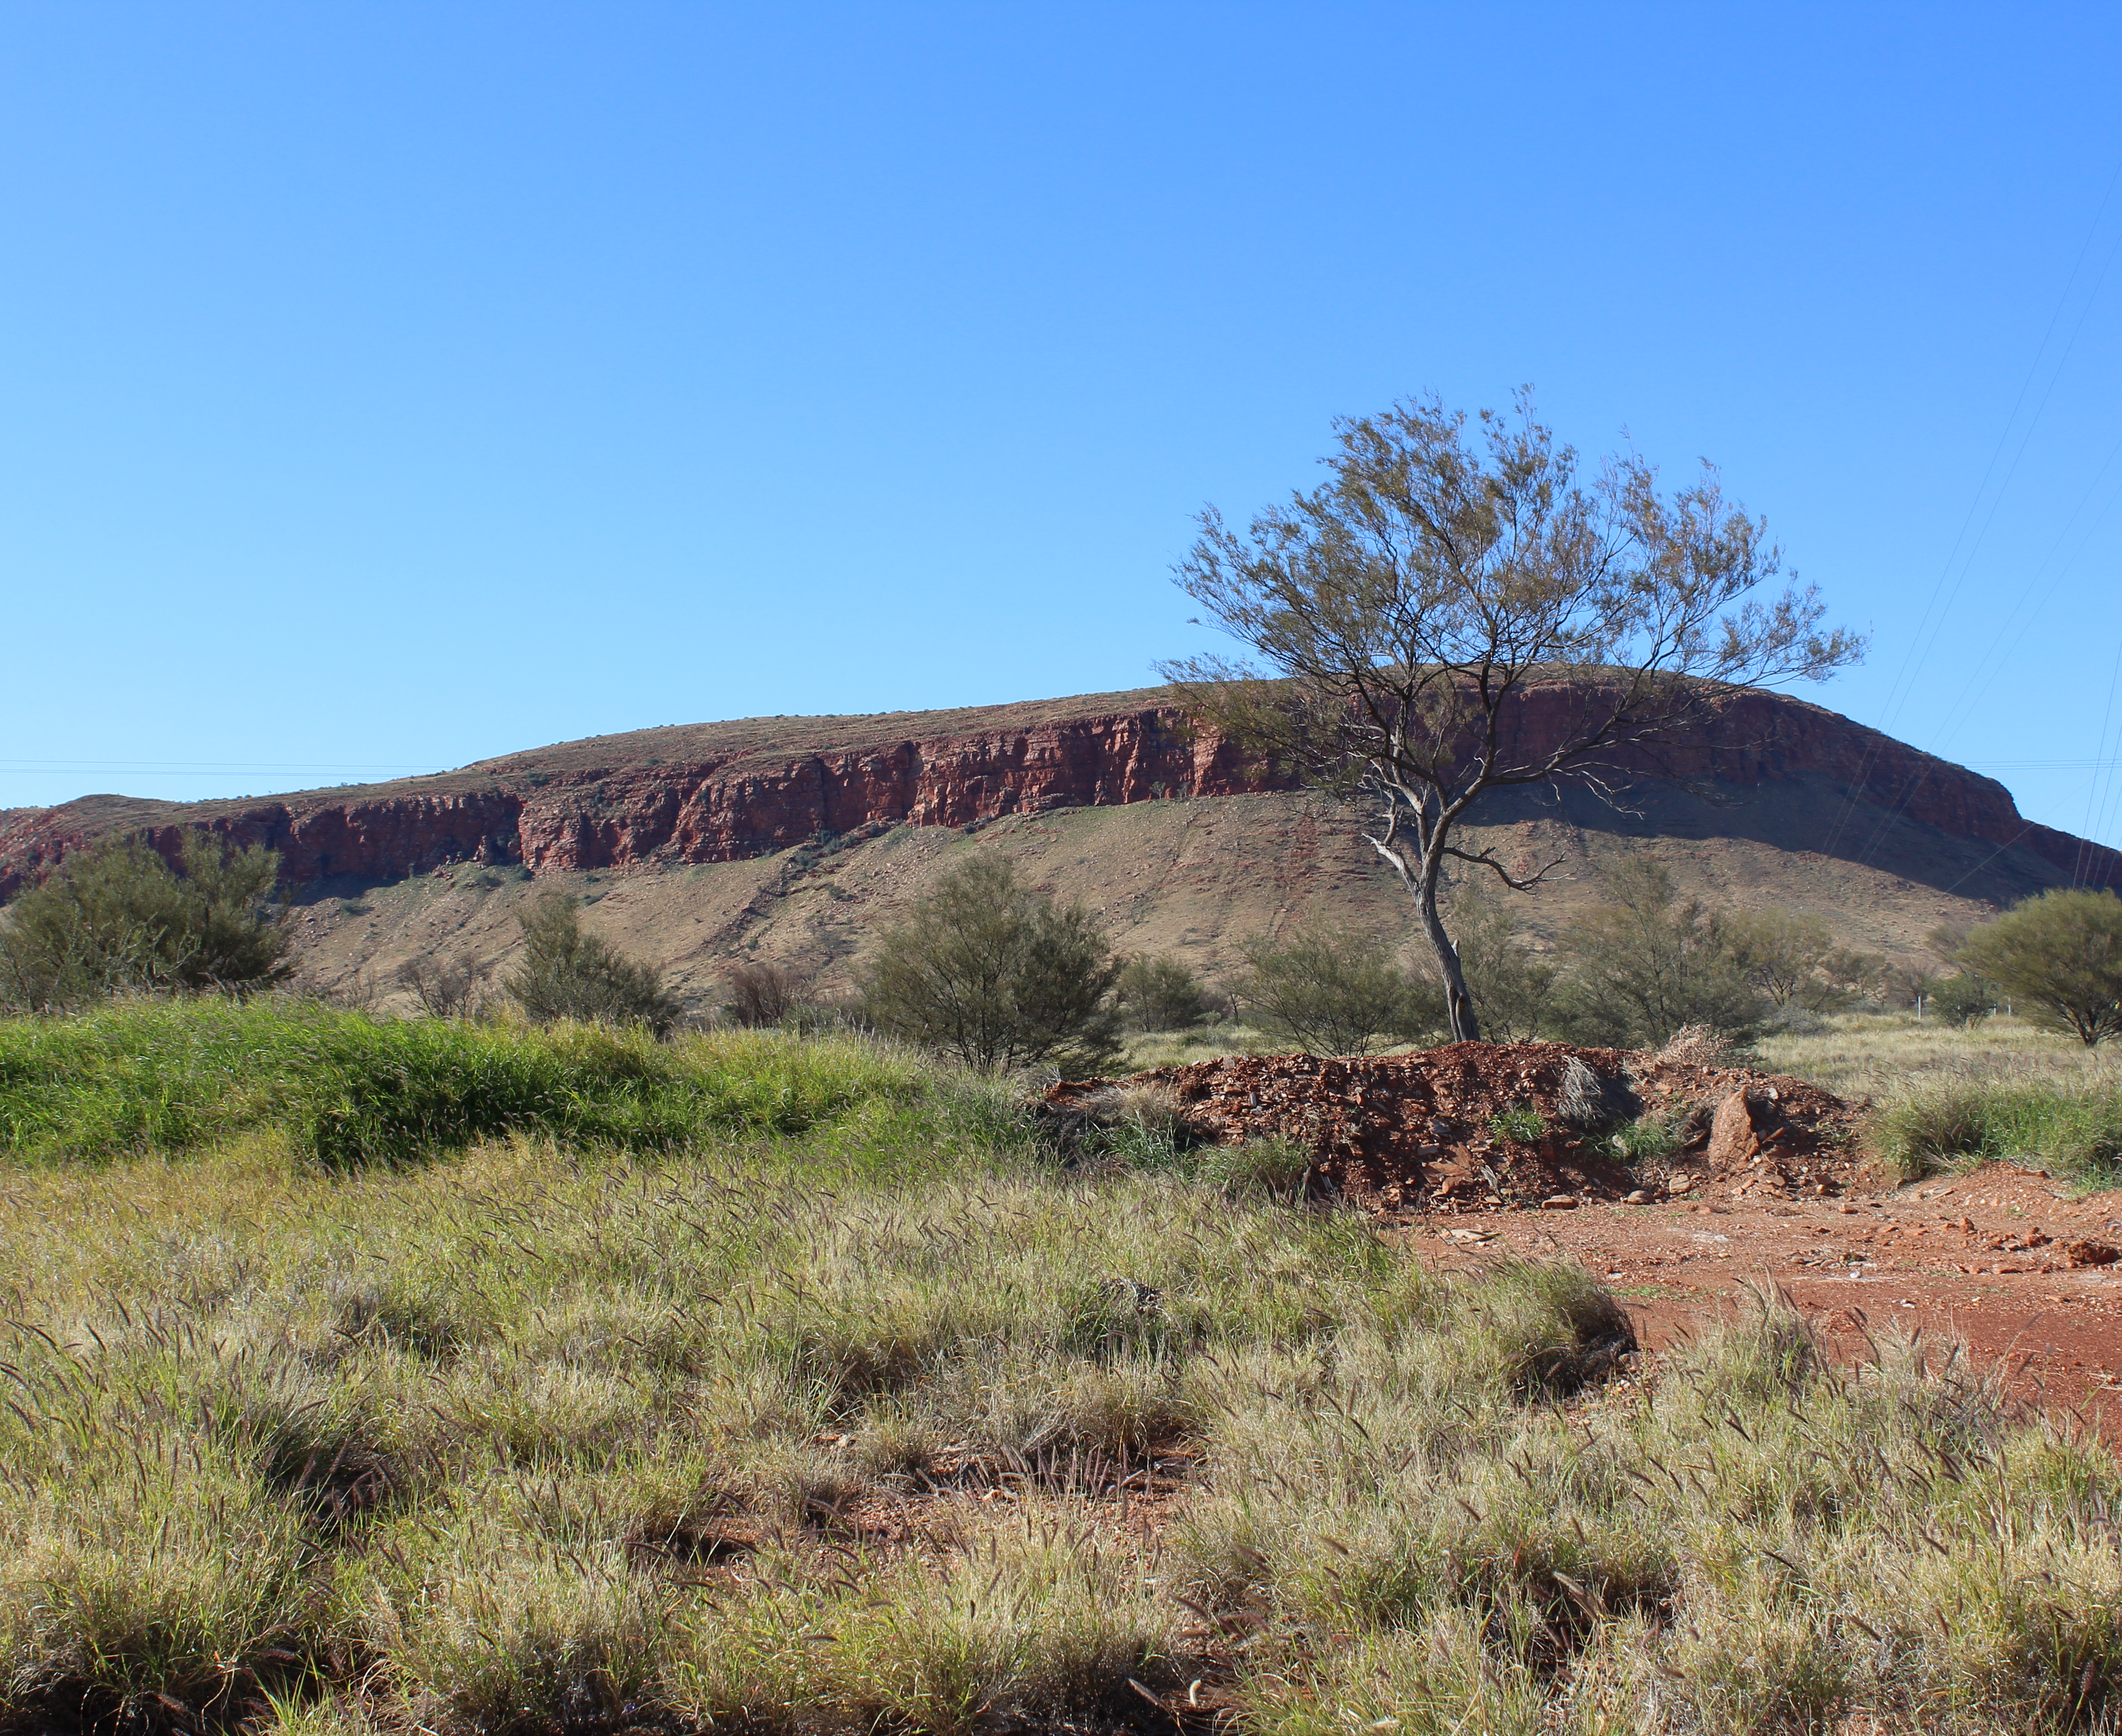
Project status and next steps

Slide 25
Consultation update
Apr–Jun 2022
Public consultation
2023–2024
Feedback and legal issues considered
Late 2024–2025
Deferred until after March 2025 election
Dec 2025
Drafting of Amendment Bill commences
From Apr 2026
Stakeholder engagement and submissions
After May
Amendment Bill made available for Public consultation

Slide 26
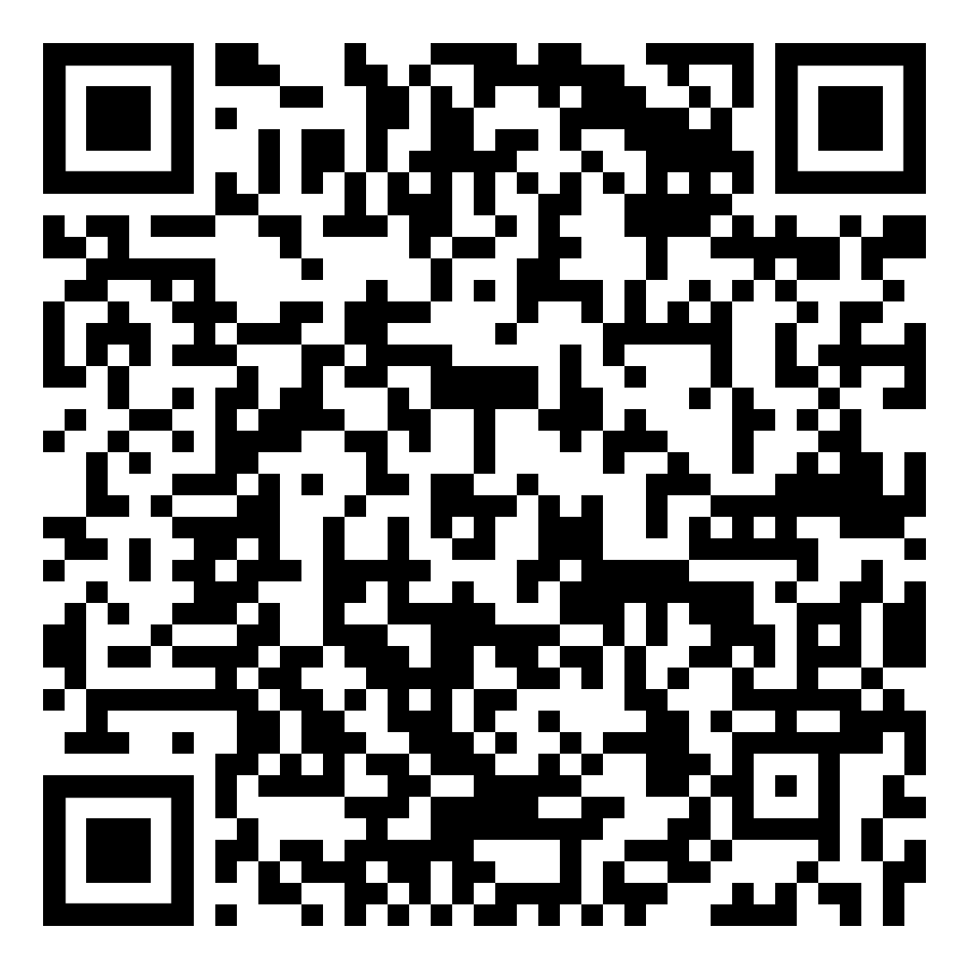
Contact us
Website:
https://www.wa.gov.au/government/document-collections/
aboriginal-affairs-planning-authority-act-1972
Email: aapa-act@dplh.wa.gov.au

