Slide 1

Agency ICT Modernisation Benefits Realisation Framework
January 2025
[Agency Name]

Slide 2
Contents Page
01 | Benefit Realisation Framework Overview | 3
02 | Benefit Realisation Process | 7
03 | Operationalisation | 14
04 | Appendix | 19

Slide 3
Benefits Realisation Overview

Slide 4

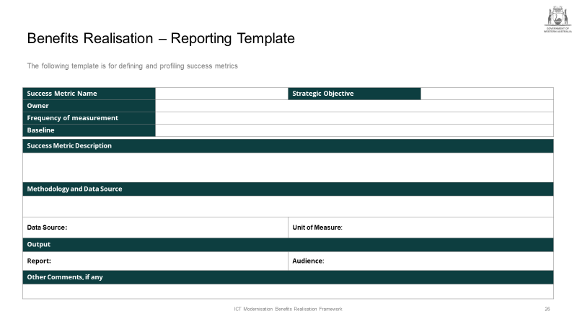
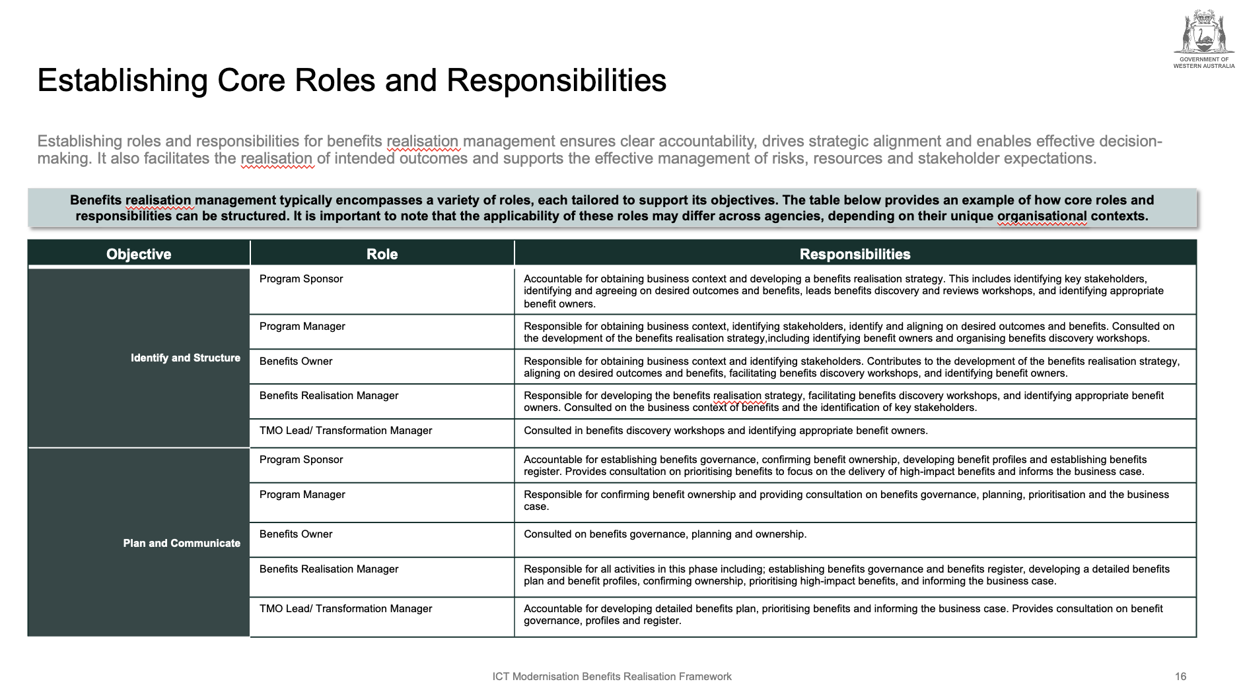

Framework Overview
The framework acts as a comprehensive guide on how to achieve benefits realisation, tracking and benefits reporting in a structured manner across Agencies, to ensure benefits are consistently realised and effectively communicated.
ABOUT THIS DOCUMENT
The framework provides Agencies with a clear, practical guide to understanding and applying the Benefits Realisation Framework, tracking mechanisms, and reporting processes. It outlines the tools, processes and metrics essential for monitoring, measuring and reporting on the value and benefits achieved from transformation initiatives. Acting as a single source of truth, the Benefits Realisation Framework ensures clarity, consistency, and enables Agencies to effectively track value, allowing stakeholders to assess progress throughout the transformation journey.
The framework is not intended to replace existing frameworks or established practices, however, provides guidance on how to realise, track and report the value of Modernisation initiatives.
TEMPLATE
Agency ICT Modernisation
Benefits Realisation Framework
Benefits Realisation Report / Benefit Profile Template
Enabling Core Roles and Responsibilities
A detailed framework outlining a structured approach to identifying, planning, managing and tracking benefits. Ensuring consistency in benefit management across Agencies. While aiding in measuring the true impact of modernisation initiatives and demonstrate value to stakeholders.
A systematic template to establish clear reporting mechanisms for communicating progress to stakeholders. It helps to define the benefits reporting requirements, identifies key forums and stakeholders, and facilitates effective communication channels.
A structured guide, outlining the processes, tools and metrics required to monitor, measure and report on the value and benefits achieved from modernisation initiatives. Ensuring clear expectations of who is responsible, accountable, who should be consulted and informed.
INTENT
Notes:
Definition of the playbook
Templates:
Benefits realisation framework –
Benefits realisation report
Benefits realisation RACI (Tracking Mechanisms)

Slide 5


Benefits Realisation Framework
Below outlines what you can expect from implementing the benefits realisation framework and when it should be used to maximise value and realise potential.
When to use it
The four-step approach outlined in this framework can be used in entirety or as needed for:
Planning Phase – Informing, planning, staffing, and execution of future engagements, ensuring benefits are well defined from the outset
Execution Phase – To track and manage benefits of initiatives throughout the modernisation journey
Post- Implementation– Provide benefits realisation reports to evaluate and report on the benefits realised by the Agency
Executive Conversations – Framing and articulating the value of modernisation, while managing stakeholder expectations and providing transparency
The framework can also serve as a check to confirm that all major considerations for benefits realisation have been accounted for in the execution of various phases of a modernisation initiative.
What it is
What it is Not
The Benefits Realisation Framework is a guide for Agencies to manage, track and realise the value of their modernisation initiatives throughout the lifecycle of the project or program.
The tools, activities, deliverables, and templates in the Benefits Realisation Framework represent a framework for guiding an agency through a large-scale modernisation transformation, defining how to realise expected value from a transformation and ensure that benefits are sustained overtime in alignment with the Organisational/ Business Strategy and business goals.
The Benefits Realisation Framework is not intended to be one size fits all, nor is it intended to be prescriptive. The framework has been developed to provide guidance on how benefits realisation can be defined, monitored and expected benefits can be achieved, it should be adapted to fit each unique situation and the approach or deliverables leveraged accordingly.

Slide 6
Benefits Realisation – Why?
Benefits realisation aligns strategy and goals, identified during the Strategy and Business Case stage, and tracks progress to demonstrate return on investment and sustained value to meet stakeholder expectations.
Why do we need to track the benefits?
Encourage stakeholder buy-in
Provide a mechanism for enhancing success
Ensures broader strategic goals and objectives
Value Delivery and Strategic Alignment
Tracking benefits ensures that the initiative is aligned to the Modernisation Strategic Goals and maximises its value.
Monitoring progress can ensure that the expected benefits are delivered and directly contribute to long-term success.
Supports Continuous Improvement
Monitoring benefits throughout the project lifecycle allows agencies to capture insights and lessons learned. This data can be used to improve future initiatives, refine management processes and optimise approaches for future initiatives.
Sustainability and Long-Term Value
In complex transformations, benefits often take time to fully materialise. Tracking is essential to make sure that the benefits are sustained and continue well beyond the project’s completion, driving long-term value.
Benefits Realisation Framework
Benefits realisation tracks actual value against planned outcomes, ensuring that anticipated benefits are achieved. By making benefits measurable, Agencies are able to demonstrate success and justify future investments. The framework also helps identify risks early, drive continuous improvement, and ensure long-term sustainability, while validating that the initiative delivers its intended outcomes.
Clarity of Outcomes
Direct measurement of benefits enhances transparency and accountability, creating a clear line of sight into the progress of the initiative, what value is being delivered and who is responsible.
Regularly monitored benefits enable data-driven decisions, keeping the project on track and maximising value.
Risk Management
Monitoring benefits helps Agencies stay ahead of potential risks by identifying underperforming benefits or benefits that are not being realised early on. This allows for proactive risk management and corrective measures to ensure success.
Justifies Future Investments
Effective tracking and benefits realised, provides evidence to support future investments for similar projects or programs, increasing the likelihood of securing funding for future initiatives, as it provides a track record of success and value delivery.

Slide 7
Benefits Realisation Process

Slide 8
Benefits Realisation Process
The Benefits Realisation Process follows a 4-phase approach, as aligned to the DPC ICT Benefits Realisation Framework.
Benefit Realisation Process
The Benefit Realisation Process involves multiple steps, spanning the identification of benefits through to the establishment of a baseline, and capturing the benefits realisation.
Phases
1| Identify and Structure
Identify key stakeholders and expected benefits realisation.
2| Plan and Communicate
Define Benefits Management Plan, including metric identification, process definition and role / responsibility designation.
3| Monitor and Modify
Monitor and reporting of benefits.
4| Evaluate, Realise and Learn
Maintain on-going Benefits Realisation practices post-delivery / modernisation execution.
Identify Expected Benefits
Stakeholder Identification
Strategic Alignment
Develop benefits profile
Approach for tracking
Establish Practices
Capture Progress
Compile Reporting
Reporting and Forums
Benefits Review
Expected Outcomes
Expected benefits agreed and metrics for monitoring identified (e.g. cost reduction, emissions reduction, effort / time saved, etc.)
Process established for monitoring and reporting on Benefits Realisation, including the designation of responsible parties
Benefits realisation captured during and post-modernisation
Benefits reviewed and revised for relevance

Slide 9
1| Identify and Structure
Identify Expected Benefits
Stakeholder Identification
Strategic Alignment
This phase focuses on identifying the expected benefits from the initiative and structuring them to align with organisational goals. It involves stakeholder engagement, defining clear outcomes, and setting measurable objectives.
1 | Identity and Structure
The initial identification of benefits should commence as early as possible in the initiative. It sets the foundation for the entire initiative by clearly defining what the organisation aims to achieve. Majority of the benefits are identified during the initial phases of the transformation journey like strategy development or business case development. This step involves articulating both business and technical benefits, aligning to the Agency’s and the WoG’s strategic objectives and gaining consensus from all relevant stakeholders.
Key Activities
Identify and articulate the benefits expected from modernisation initiatives. Update the benefits register with the identified details.
Identify and engage relevant stakeholders in the form of workshops, surveys, or interviews with business leaders, IT teams, and end-users to capture a broad spectrum of expectations.
Categorise benefits into business (e.g., increased agility, reduced time-to-market, improved customer satisfaction) and technical (e.g., improved system performance, scalability, enhanced security) or financial/ non-financial based on agreed approach
Validate that the identified benefits align with the Agency’s broader strategic goals, such as improving operational efficiency or accelerating digital transformation.
Ensure that the identified benefits are aligned to WA government objectives.
Key Stakeholders [refer to DPC ICT Benefits Realisation Framework for detailed RACI]
Program/ Project Manager
Program Sponsor
Benefits Owner
Supporting Documents
Benefits register
Benefits distribution matrix
Key Outcomes
Benefits expected are clearly understood, categorised and prioritised.
The identified benefits are validated by all relevant stakeholders and strategic alignment is considered.

Slide 10



How Do We Identify Modernisation Benefits?
A three-tiered approach should be adopted to identify the benefits of the ICT Modernisation and establish a clear causal link between each benefit and the initiatives implemented. These include benefits that have a direct impact to an agency’s budget (Tier 1), efficiency improvements that do not result in an improved budget position (Tier 2) and wider economic, social and environmental benefits (Tier 3).
Qualitative and Quantitative Benefits Measured
TIER 1 Examples
Benefits that could lead to a reduction of spending on an activity, project, programme or policy that has direct impact on the agency’s budget (e.g. reduced hosting costs)
TIER 1: CASH RELEASING
(Quantitative)
TIER 2 Examples
There is a benefit (which could be either quantifiable or non-quantifiable) but does not lead to a direct reduction in spending (e.g. improved quality)
TIER 2: NON-CASH RELEASING
(Quantitative and Qualitative)
TIER 3 Examples
Broader economic, social and environmental benefits that are a result of the outcomes of the initiative (e.g. improved health outcomes)
TIER 3: WIDER ECONOMIC,
SOCIAL AND ENVIRONMENTAL
(Quantitative and Qualitative)

Slide 11
2| Plan and Communicate
Develop benefits profile
Approach for tracking
Establish
Practices
This phase includes definition of a detailed plan to track benefits and ensure alignment with business strategies. Communication with stakeholders is key to set expectations, establish ownership, and define tracking processes.
2 | Plan and Communicate
Once the benefits are identified and agreed, a detailed plan for tracking is created. A benefits profile outlining the critical information for each agreed benefits is documented prior to planning the tracking methodology and establishing the associated governance practices
Key Activities
Create benefits profiles with summarised description of benefits including details on success metrics, ownership, responsibilities, dependencies, etc.
Set target values and realisation timeline in consultation with the stakeholders.
Establish baseline values for each benefit to compare performance before and after transformation initiative completion or throughout the journey.
Seek agreement of baseline data and benefits targets from relevant stakeholders to ensure consensus. This will act as the foundation for tracking the benefits throughout the transformation journey.
Define how the identified benefits will be measured over time.
Outline the required roles and responsibilities and set processes and tools (e.g., reports, data sources) required for benefits realisation.
Decide the frequency of review of the target values.
Plan for potential issues (e.g., data accessibility, management change) that could impact benefits realisation.
Designated communication methods and forums to keep all stakeholders informed about progress, challenges, and adjustments are established.
Key Stakeholders [refer to DPC ICT Benefits Realisation Framework for detailed RACI]
Program/ Project Manager
Benefits Owner/ Realisation Manager
Supporting Documents
Benefits register
Benefits profiles
Benefits management plan/ approach
Benefits realisation roadmap
Key Outcomes
Benefit profiles are clearly defined and documented.
Tracking methodology is clearly defined and agreed among stakeholders.
Communication channels and forums are established with roles and responsibilities well-understood.

Slide 12
3| Monitor and Modify
Capture Progress
Compile Reporting
Reporting and Forums
Benefits Review
This phase involves actively monitoring the progress of benefits realisation using defined KPIs and metrics. Adjustments are made as needed to address any gaps or challenges and to optimise performance.
3 | Monitor and Modify
During the execution of the initiative, the benefits identified needs to be tracked, comparing actual results with expected benefits. This phase will also involve making adjustments as needed to ensure the benefits are fully realised.
Key Activities
Establish performance reporting and benefits tracking processes. Create dashboards, reporting structure, and set cadence for their review.
Monitor the establish KPIs and metrics to evaluate whether benefits are being achieved. This can be done through the identified channels and tooling like regular reports, dashboard reviews, or team meetings.
Ensure that there is a ‘single version of the truth’ for benefits reporting. Ensure that decisions are data-driven. Leverage analytics to assess performance and predict future outcomes.
Periodically assess the status of the benefits realisation process to identify any gaps or underperformance.
If progress is not meeting expectations, adjust the approach, tools, or strategies to address issues and get back on track. When adjusting the approach, it is recommended to review the benefits to determine whether the benefits expected (identified) are still feasible and revise as required.
Recognise and communicate progress, no matter how small, to maintain momentum and stakeholder buy-in.
Key Stakeholders [refer to DPC ICT Benefits Realisation Framework for detailed RACI]
Program/ Project Manager
Benefits Owner
Benefits Realisation Manager
Transformation Management Office
Program Sponsor
Supporting Documents
Benefits Management Plan
Benefits register
Tracking Reports
Key Outcomes
Track progress against KPIs and metrics.
Effective modification of the approach or plan to ensure benefit realisation stays on track.
Continuous engagement with stakeholders to ensure alignment and support for modifications.

Slide 13
4| Evaluate, Realise and Learn
Capture Progress
Compile Reporting
Reporting and Forums
Benefits Review
After the initiative, the benefits are evaluated against the original objectives to assess success. Lessons learned are captured to improve future initiatives and refine the benefits realisation process for continuous improvement.
4 | Evaluate, Realise and Learn
This phase evaluates the overall success of the initiative by comparing the realised benefits with the expected benefits. It also focuses on learning from the process to improve future initiatives.
Key Activities
Ensure benefits are continuously aligned to the strategic objectives. Compare actual results with the expected benefits. Identify which benefits were realised, partially realised, or not achieved at all.
Identify new potential benefits and sunset benefits that have been achieved or become obsolete after the program is over. Consider not only immediate outcomes but also the longer-term impact of the benefits realised, such as sustained cost savings or improved customer satisfaction.
Conduct a thorough retrospective analysis with all relevant stakeholders to assess the overall effectiveness of the benefits realisation process.
Document key insights and lessons learned from the benefits realisation process to refine strategies and methodologies for future projects.
Incorporate the lessons into future initiatives to continuously improve how benefits are realised, tracked, and adjusted. Knowledge transfer to ensure lessons and insights are shared across the Agency, strengthening its future capabilities is conducted.
Key Stakeholders [refer to DPC ICT Benefits Realisation Framework for detailed RACI]
Benefits Owner
Benefits Realisation Manager
Program Sponsor
Supporting Documents
Finalised Tracking Reports
Benefits register
Lessons learnt
Key Outcomes
Benefits are evaluated and accessed for realisation achievement based on expectation.
Success and shortcomings are identified.
Lessons learned and continuous improvement recommendations are documented for future initiatives.

Slide 14
Operationalisation

Slide 15
Operationalising Benefits Realisation
Operationalising benefits realisation tracking involves embedding systematic processes, clear ownership, and continuous monitoring of integration into the Agency.
Tracking Benefits Realisation
Operationalising the tracking of benefits realisation involves multiple steps, to ensure that the planned benefits are systematically achieved and sustained throughout the lifecycle of an initiative.
.
Activities
Choose Tools
Select the appropriate tools to track benefits
Implement modern systems, dashboards and monitoring tools that can automatically pull data and update KPIs in real time.
Automate data collection where possible to minimise manual errors and efforts.
Ensure all data sources are integrated for centralised access, allowing teams to view real-time data where available.
Develop Templates and Dashboards
Create standard templates for data entry to ensure consistency
Dashboards should provide real-time updates and allow different stakeholders to view relevant data according to their needs.
Use clear and intuitive visualisations like charts, graphs, and traffic lights to show progress toward each benefit.
Different departments may be responsible for different benefits, so dashboards should be customisable based on the user’s role.
Assign Responsibility
Designate team members responsible for data collection, analysis, and reporting
Assign individuals or teams who are accountable for ensuring the benefit is realised.
Separate the responsibility of tracking from ownership if necessary. For example, TMO might be responsible for gathering data, analysing it, and reporting it to benefit owners.
Use a RACI matrix to clearly define the roles and responsibilities around tracking each benefit.
Integrate Systems
Ensure that the tracking system integrates smoothly with existing processes and tools
Regular meetings and reports like project meetings and exec reports, should focus on the current state of benefit realisation.
Benefits tracking reports should inform adjustments to project activities, whether it’s a shift in approach or additional resources needed to ensure benefits are realised.
Where targets are not being met, perform variance analysis to identify why benefits are falling short and take corrective actions.
Notes:
to ensure that the planned benefits are systematically achieved and sustained throughout the lifecycle of an initiative.

Slide 16
Establishing Core Roles and Responsibilities (1 of 2)
Establishing roles and responsibilities for Benefits Realisation Management ensures clear accountability, drives strategic alignment and enables effective decision-making. It also facilitates the realisation of intended outcomes and supports the effective management of risks, resources and stakeholder expectations.
Benefits Realisation Management typically encompasses a variety of roles, each tailored to support its objectives. The table below provides an example of how core roles and responsibilities can be structured. It is important to note that the applicability of these roles may differ across Agencies, depending on their unique organisational contexts.
Objective | Role | Responsibilities
Identify and Structure | Program Sponsor | Accountable for obtaining business context and driving the development of a Benefits Realisation Plan. This includes identifying key stakeholders, identifying and agreeing on desired outcomes and benefits, leading benefits discovery and review workshops, and identifying appropriate Benefits Owners.
 | Program Manager | Responsible for obtaining business context, identifying stakeholders, identify and aligning on desired outcomes and benefits. Consulted on the development of the Benefits Realisation Plan, including identifying benefit owners and organising benefits discovery workshops.
 | Benefits Owner | Responsible for obtaining business context and identifying stakeholders. Contributes to the development of the Benefits Realisation Plan, aligning on desired outcomes and benefits, facilitating benefits discovery workshops, and identifying Benefits Owners.
 | Benefits Realisation Manager | Responsible for developing the Benefits Realisation Plan, facilitating benefits discovery workshops, and identifying appropriate benefit owners. Consulted on the business context of benefits and the identification of key stakeholders.
 | TMO Lead/ Transformation Manager | Consulted in benefits discovery workshops and identifying appropriate benefit owners.
Plan and Communicate | Program Sponsor | Accountable for establishing benefits governance, confirming benefit ownership, developing benefit profiles and establishing benefits register. Provides consultation on prioritising benefits to focus on the delivery of high-impact benefits.
 | Program Manager | Responsible for confirming benefit ownership and providing consultation on benefits governance, planning, prioritisation and the business case.
 | Benefits Owner | Consulted on benefits governance, planning and ownership.
 | Benefits Realisation Manager | Responsible for all activities in this phase including; establishing benefits governance and a benefits register, developing a detailed Benefits Realisation Plan and benefit profiles, confirming ownership, and prioritising high-impact benefits.
 | TMO Lead/ Transformation Manager | Accountable for developing a detailed Benefits Realisation Plan and prioritising benefits. Provides consultation on benefit governance, profiles and register.

Slide 17
Establishing Core Roles and Responsibilities (2 of 2)
Establishing roles and responsibilities for Benefits Realisation Management ensures clear accountability, drives strategic alignment and enables effective decision-making. It also facilitates the realisation of intended outcomes and supports the effective management of risks, resources and stakeholder expectations.
Benefits Realisation Management typically encompasses a variety of roles, each tailored to support its objectives. The table below provides an example of how core roles and responsibilities can be structured. It is important to note that the applicability of these roles may differ across Agencies, depending on their unique organisational contexts.
Objective | Role | Responsibilities
Monitor and Modify | Program Sponsor | Accountable for phase activities including, updating the benefits register, finalising targets with Benefits Owners, reviewing progress against Business Case/ Benefits Realisation Register, establishing benefits tracking mechanisms (outlined in the Benefits Realisation Plan) and transitioning of benefits reporting to BAU teams. Owns the Benefits Management Plan.
 | Program Manager | Delivers initiatives which enable the realisation of benefits realisation. Responsible for agreeing on final targets with Benefits Owners and providing consultation on updates to the benefits register and hand over of benefits reporting to BAU teams.
 | Benefits Owner | Measures and monitors progress of realising benefits and ensures the Benefit Register is kept to update. Also, responsible for the handing over of benefits reporting to BAU teams and consulting on final target agreements and updates to the Benefit Register.
 | Benefits Realisation Manager | Responsible for phase activities, including updating the Benefit Register and deliverables, finalising targets with Benefits Owners, reviewing progress against Business Case/ Benefits Realisation Register, establishing benefits tracking mechanisms (outlined in the Benefits Realisation Plan) and provides consultation on the hand over of benefits reporting to BAU teams. Owns the Benefit Register and benefits profiles.
 | TMO Lead/ Transformation Manager | Accountable for updating benefit deliverables and consulted on reviewing progress against the Business Case/ Benefits Realisation Register, as well as establishing a benefits tracking mechanisms (outlined in the Benefits Realisation Plan).
Evaluate, Realise and Learn | Program Sponsor | Accountable for phase activities including, analysing benefits, conducting benefits evaluation meetings with key stakeholders and post-implementation reviews and capturing lessons learned.
 | Program Manager | Consults on benefits analysis, stakeholder evaluations and the capture of lessons learned.
 | Benefits Owner | Responsible for benefits analysis and consulting on stakeholder evaluations and the capture of lessons learned.
 | Benefits Realisation Manager | Responsible for all activities in this phase including, analysing benefits, conducting benefits evaluation meetings with key stakeholders and post-implementation reviews, capturing lessons learned and reporting on results.
 | TMO Lead/ Transformation Manager | Accountable for reporting on results and consulting in benefits evaluation meetings with key stakeholders as well as post-implementation reviews.

Slide 18
Forums and Reporting
The forums listed below are aligned to the DPC ICT Benefits Realisation Framework and provide guidance on the responsibilities and reporting mechanisms for each.
Governance Bodies
WA Government
Decision-making body on ICT Modernisation proposals in line with Government priorities and the State Budget process
Reviews progress on initiative delivery, including delivery of benefits
Office of Digital Government (DPC)
Owns the Benefits Realisation Management Framework
Supports Agencies with the adaption and implementation of the Framework
Agency Project/ Program Board
(Sponsoring Group)
Oversees the distribution of investment across the Agency in order to create and maintain a strategically balanced high- value portfolio
Shows visible commitment to the realisation of the end benefits
Approves the Benefit Management Plan
Receives periodic reports to monitor the status of ICT Modernisation benefits realisation across the Department
Program/ Project Control Groups
Ensures Gateway Reviews are organised when required, including Benefits Realisation Gateway Reviews
Receive periodic reports to monitor the status of ICT Modernisation benefits realisation within the program
Forum
Reporting
Reporting: Benefit Realisation Gateway Review, Benefit Dashboard / Tooling*
Frequency: Quarterly / Monthly
Reporting: Benefit Dashboard / Tooling*
Frequency: Bi-Monthly / Monthly
Reporting: Benefit Management Plan, Benefits Profile Template, Benefit Dashboard / Tooling*
Frequency: Monthly / Fortnightly
Reporting: Benefit Realisation Gateway Review, Benefit Profile Template
Frequency: Fortnightly / Weekly
*Please see appendix for a benefit dashboard/tooling example on slide 23.

Slide 19
Appendix

Slide 20
Key considerations
Some key considerations for benefits realisation and the successful management and tracking of value are outlined below:
The benefits outlined within the framework and model will not materialise without active management and tracking. Without appropriate systems in place to accurately measure the appropriate metrics in a timely manner, there will be no defensible way to tracing metrics back to the Modernisation initiatives.
Data quality and availability may be limited across a number of benefits areas. Assumptions may be used to fill the gaps and provide a forecast view of benefits that could be expected.
Ineffective Traceability of Benefits Post-Modernisation
Data Quality Limits Tracking Effectiveness
To simplify the management and upkeep of the Benefits Realisation Model, data may be sourced and maintained in external sources (where the source of truth resides). These links can be sensitive to the structure of the documents from which they are pulling, as well as the naming conventions of the columns.
Source Data is Improperly Controlled
The use of assumptions throughout the Benefits Modelling (forecasting) may be necessary to fill gaps in available data as, as well as quantify variables that will ultimately affect the forecasting. As the current state changes and new information becomes available, these assumptions become outdated and introduce increasing uncertainty into forecasts.
Assumption Validity Degrades Over Time
Benefits may be influenced by a number of factors, including operating model, service model design, processes, and culture. As such, the ability for an Agency to fully realise these benefits is highly variable and dependent on the ability to identify inefficiencies and rectify them.
Unable to Realise and Track Efficiency Focused Benefits

Slide 21
Benefits Register Template
The Benefits Register is a living document that must be regularly updated to track progress of realised benefits throughout the modernisation journey. It is essential for ensuring transformation initiatives deliver value and that benefits are systematically monitored and managed across Agencies.
Benefit Tier | Benefit | Description | Benefit Category | Measure | Benefit Owner | Last Updated | Benefit Profile | Notes
Tier 2 | Change Efficiency | Reduction in lead time for changes achieved through modernisation and automation. | Technology | Lead time for changes Development cycle times (working days) Feature cycle time (working days) | John Smith | 10/01/2025 | [Link to profile] | NA

Slide 22
Benefits Realisation Report/ Benefit Profile Template
A Benefits Profile/ Benefits Realisation Report outlines the key attribute details of a benefit identified. It provides a deep-dive of the benefit including data source and success measures for realisation tracking.
Success Metric Name |  | Strategic Objective
Owner
Frequency of measurement
Baseline
Success Metric Description
Methodology and Data Source
Data Source: | Unit of Measure:
Output
Report: | Audience:
Other Comments, if any

Slide 23
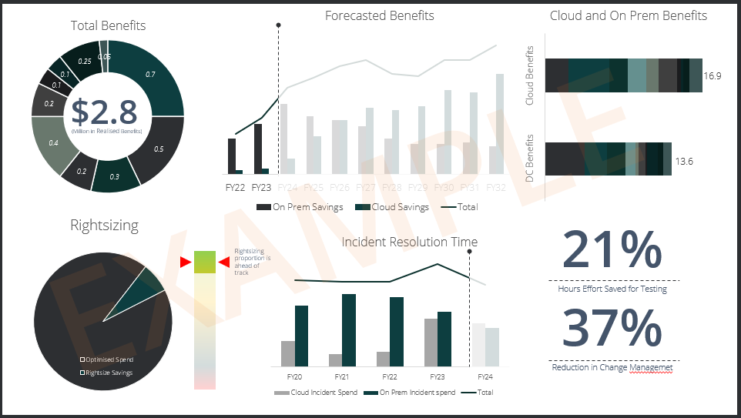
Benefits Dashboard
The dashboard will display an overview of the key benefits identified and their current progress towards realisation. The views may vary based on the audience of the dashboard. The below is an example dashboard. The dashboard may depict several snapshot views, including overarching benefits total, total benefits over time (forecast vs actual), deep dive into each benefit, benefits per portfolio etc.
Forecasted benefits split into cloud and on-premise benefits ($)
Total current benefits tracked across benefits realisation framework split by benefits category ($)
Total tracked benefits for different hosting options split by business portfolio
Sliding Red/Amber/Green indicator tracking optimised spend
EXAMPLE
Reduction in overall change management or testing efforts by FTEs across organisation
Optimised spend vs potential unrealised right size savings
Reduction in FTE spent resolving incidents

Slide 24
END

